Slide 1
Version 2.5
Upgrades, Enhancements, and Changes

Slide 2
Cycler Module Rework
iTest can control both the A and B sides of the cycler from 1 test stand
Each stand makes a reservation for which side(s) it needs
Once the reservation is made, it goes into the proper mode
Most scripts won’t have any changes
Cycle Runner can now be configured to run synchronized profiles on both A and B simultaneously.
Issue 1297 and Merge Request 907

Slide 3
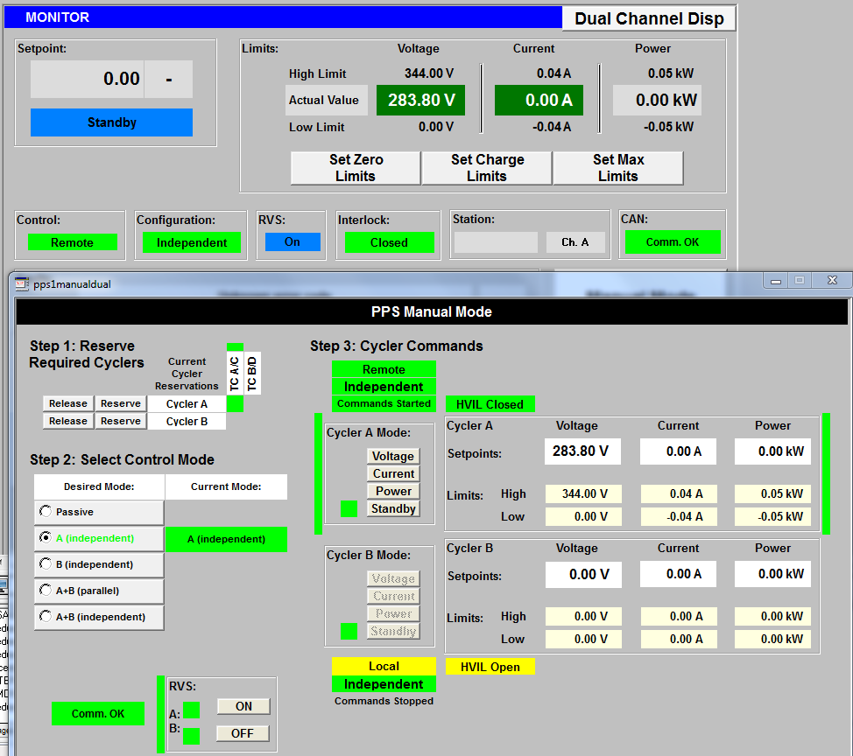
Cycler Module Rework Standby Mode

Slide 4
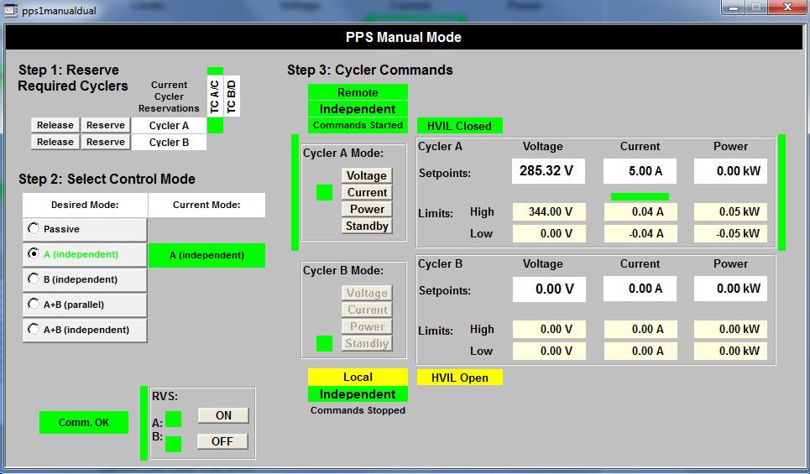
Cycler Module Rework Current Mode

Slide 5
BEV 3 Enhancements
BLINC module has been enhanced for better BEV 3 support
The BEV3 wired CMA code has been merged (Issue 1917)
Added BEV3 ROW BDSB communication (Issue 2118)
Add additional diagnostic wireless packets (Issue 2185)
Fixed errors while closing wireless communication script (Issue 2367)
Make wireless communications more robust (Issue 2234)
Some code is still in unmerged branches (feature/PTC_DCFC_Integration)

Slide 6
New Tests and Programs
Add BEV2 Modified (Issue 1776)
Humid Heat Cyclic pre-conditioning corrected (Issue 2209)
Improve PTC cycle counting (Issue 1987)
Ensure that RVibe and PTC wait for the proper humidity (Issue 1882)

Slide 7
Misc Changes
Allow 60 seconds for voltage to return after a fault before calling out (Issue 511)
Added branch information to the main panel (Issue 1840)
Update links to Grafana, Gitlab, etc in iCentral (Issue 1851)
Split test parameters into separate files (Issue 1203)
Use iCentral Part Tracker to remember barcodes (Issue 1850)
Added MT-30 calibration limits (Issue 2333)
Improve faults for NeoVI problems (Issue 366)
Make more python scripts silent (Issue 2250)

Slide 8
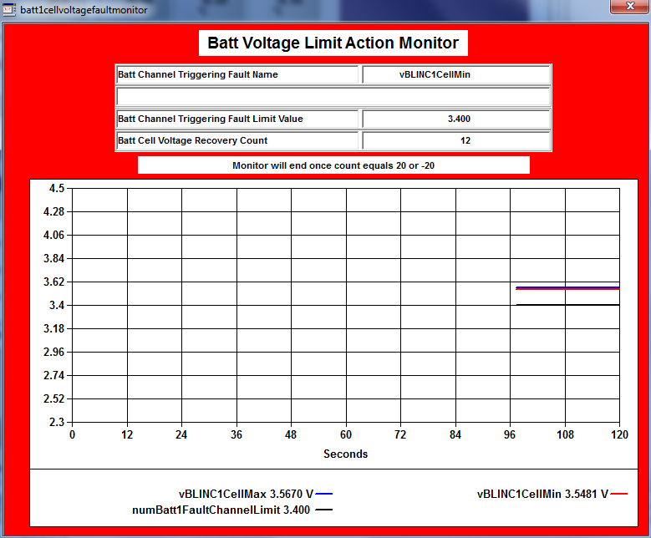
Allow 60 seconds for voltage to return after a fault before calling out

Slide 9
Misc Changes (2)
Add calibration pre-check procedures (Issue 822)
Removed unused channels (Issue 1971)
Improve Shaker Driver during sine sweeps (Issue 1852)
Add a snap log when vibration profiles starts (Issue 1852)
Add an option to skip battery diagnostics and isolation testing (Issue 1900)
Add the ability to skip/abort pyvalid (Issue 984)
Fix pyvalid for negative responses (Issue 2164)
Add a parameter for configuring if contractors need an economizer (Issue 2251)
Add more limits channels to the data files for use in reports (Issue 2181)

Slide 10
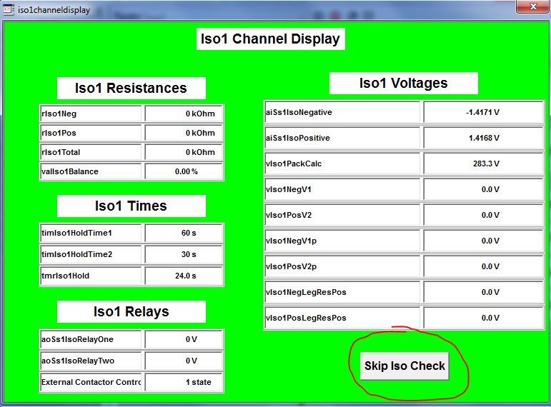
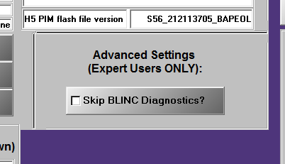
Add an option to skip battery diagnostics and isolation testing

Slide 11
Misc Changes (3)
Make stopping a BSM pack faster (Issue 986)
Add parameters for modules without contactors (Issue 2096)
Replace A&D provided serial driver with a custom one (Issue 1722)
Fix bug in the chiller driver for stands with a 3 digit name (Issue 352)

