Slide 1
Version 3.1
Upgrades, Enhancements, and Changes

Slide 2
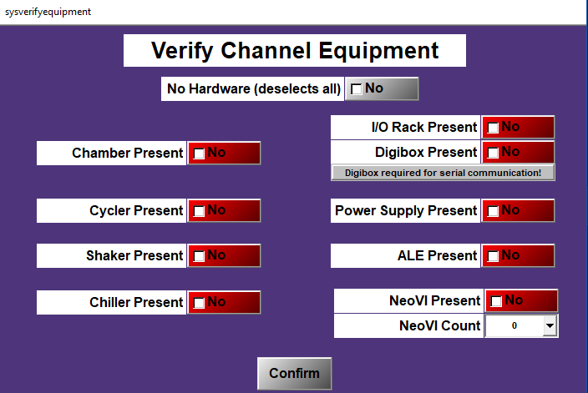
New Equipment Selection Screen
Allows operator to pick what hardware is attached before initialization
Issue 1919 and Merge Request 916

Slide 3
BEV 3 Enhancements
BLINC module has been enhanced for better BEV 3 support
BEV3 wireless auto port connect (Issue 2381)
APIExplorer serial communication crash fixed (Issue 2691)
Log BEV3 wireless path stability and packet error rate (Issue 2424)
Ensure that charging contactors are open with stopping (Issue 2476)
Fix 2-meter isolation test for BEV3 RoW Alpha (Issue 2490)

Slide 4
New Tests and Programs
Add BEV3 China Beta1 (Hotfix 3.0.2)
Universal Mech Fatigue shell script (Issue 285)
Fixed R-Vibe balancing at cold (Issue 2633)
H5 and H4 temperature and cell voltage validity bits handled correctly (Issue 2600)
Use CAN Frames instead of UDS messaging for faster voltage data (Issue 1966
Created a sanitize script for sending solution to non-GM employees (Issue 2021)
Still not fully tested

Slide 5
Misc Changes
Improve startup time for Part Tracker (Issue 2642)
Resetting a fault will now also close the issue in Pager Duty (Issue 2435)
Other improvements for Pager Duty (Issue 2137, 2122, 1954)
Add fault time to callout message (Issue 2635)
E-stop status display text no longer cut off (Issue 2608)
Rearrange SysSpecInfo to match green sheet (Issue 2604)
BLINC1BkBalance doesn’t always skip on Button C (Issue 2545)
Merged Ecc1DryAirPurge and Ecc1BkChamberControl (Issue 1804)

Slide 6
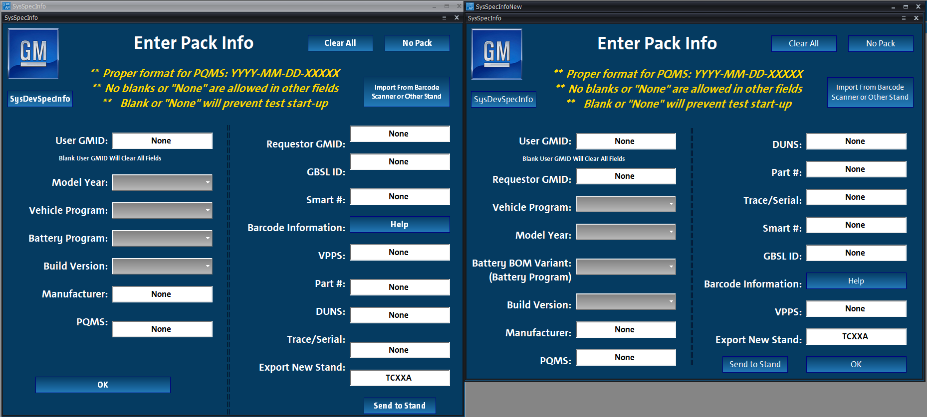
Old vs New SysSpecInfo

Slide 7
Misc Changes (2)
Allow Seal1 to run with No Pack selected (Issue 2415)
Fix case-sensitivity issue in Pps1VoltagePIDStart (Issue 2696)
Fix file copy comments (Issue 2694)
Remove general stability from GoToNominal (Issue 2692)
Fixed an issue monitoring cell voltages for H4 packs (Issue 2670)
Fixed Batt1 limit monitor exiting early (Issue 2669)
Reduced Fault Queue CPU usage (Issue 2663)
Remove all unused channels (Issue 1884)
Add weather station info to log header (Issue 291)

