Slide 1
Version 3.2
Upgrades, Enhancements, and Changes

Slide 2
Background
Currently, iTest infrastructure generates a lot of lost time due to:
Abundance of faults
Very conservative methods of handling faults
Equipment downtime
Restarting of iTest
Frequent/small code changes
Critical callouts that aren’t “safety critical”

Slide 3
Scope
Reduce critical callouts to on-call personnel
Improve usability of iTest and reduce downtime through:
Reducing the amount of annoying/unnecessary faults
Giving users/software a chance to resolve/recover from issues as they arise
Reducing need for software changes for non-functional equipment
Provide more software control around stopping the system
Improve scope and monitoring of critical faults

Slide 4
Implementation
Improvements to iTest software include
Selecting Equipment that is present before initializing
New software module actions to support stopping the system
Ability to De-initialize and Re-Initialize the system without restarting
Focus on a select few critical fault categories
Improve Fault Info Display and Logic
Reducing common faults
Reducing neighbor-stand faults

Slide 5
Improvements

Slide 6
Verify Equipment
Allow a user to confirm or change equipment that is expected to be present on start-up of iTest console
This allows a user to select what is “initialized” and available for use before the system “assumes” everything in the solution is there
Benefits:
Allows system to be started without code changes for “turning-off” software for equipment that isn’t actually there or down for maintenance
Reduce faults/downtime by not having faults on initialization/test start
More user control exposed to configuration solution as needed

Slide 7
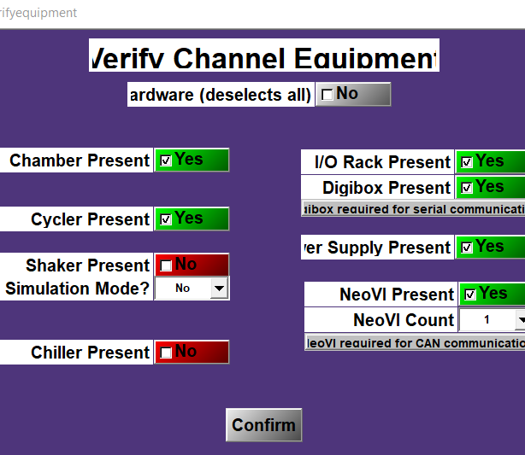
Verify Equipment Display
New display on iTest Console start-up to determine what equipment is present

Slide 8
System Actions
New System actions added to solution
Stop Test Controls
Safe
Fault Response
These actions are called as part of the system stop after a test or in the event of a fault

Slide 9
Stop Test Controls
When the system is stopping due to a fault or a successful test completion, we need to stop actively running code
Old implementation:
Stop all running code below a certain specified “level”
Caused issues with procedures being stopped due to “level” not being set in procedure properties
New Logic:
Stop active test sequence (e.g. NPt1)
Stop all background code running to prevent unexpected behavior when stopping
Implementation will explicitly stop specific procedures for each software module in solution

Slide 10
Safe Action
Will stop electrical/mechanical inputs to DUT when system is stopping due to a fault or a successful test completion
Old Implementation:
Code was spread out through various procedures and haphazardly implemented
Other actions could prevent logic from being executed (code hang-ups)
New Implementation:
Follows a specific order of operations to get system in electrically/mechanically “safe” state
Reduces code complexity by using a system action to handle necessary operations

Slide 11
Fault Response
Will handle all driving all required modules to nominal state when system is stopping due to a fault condition
Old implementation:
Used GoToNominal procedure to handle both successful test completion and fault conditions
Modules that had faults present would skip nominal actions to prevent “snow-ball” effect of faults
New implementation:
Split successful and non-successful tests situations into separate actions
Nominal will run the same way every time a test completes successfully
New, Fault Response action will handle commands to drive the system back to nominal state
Flexibility to add special-cases when needed to address specific modules or faults
Reduces nominal code complexity to ensure system stays safe
A “fault” log will be active while the system is responding to a fault, stored on the data drive

Slide 12
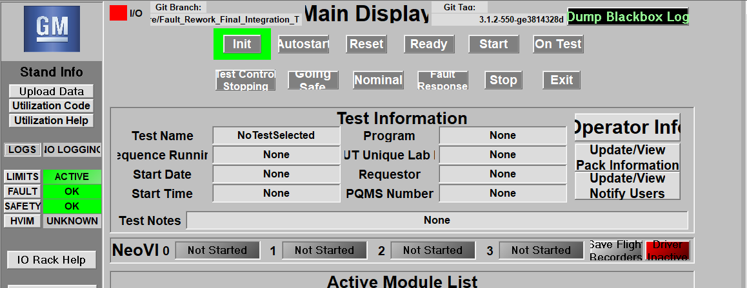
Main Display Updates
Updated “Main” display with new test actions and module de-init/re-init buttons

Slide 13
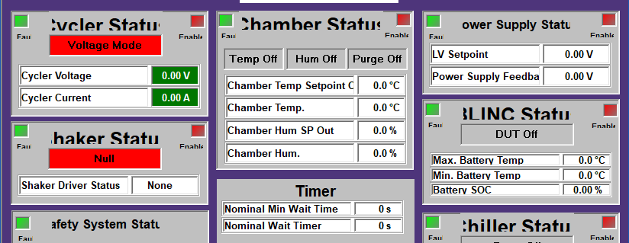
New Nominal Status Display
New display for “GoToNominal” and “Fault Response”

Slide 14
De-Initialize/Re-Initialize Capability
In addition to configuring the system prior to system start-up, a new De-initialize and Re-initialize capability has been added
Allows for a software module to be fully deactivated while iTest Console is open and successfully re-activated without the need to restart the system
Old Implementation:
Exposed an “enabled” flag to the user to toggle enabled/disable state
Enable buttons didn’t actually disable a module, rather prevented procedures and calculations from running
New Implementation:
Created logic to ensure a module was truly disabled (no code running/no device communication/not exposed to the rest of the solution)
Reduced the amount of modules that are able to be enabled/disabled from the “Main” display and from the specific Module display
*Note* Applies only to device modules (e.g. cycler/chamber/chiller/power supply/shaker)

Slide 15
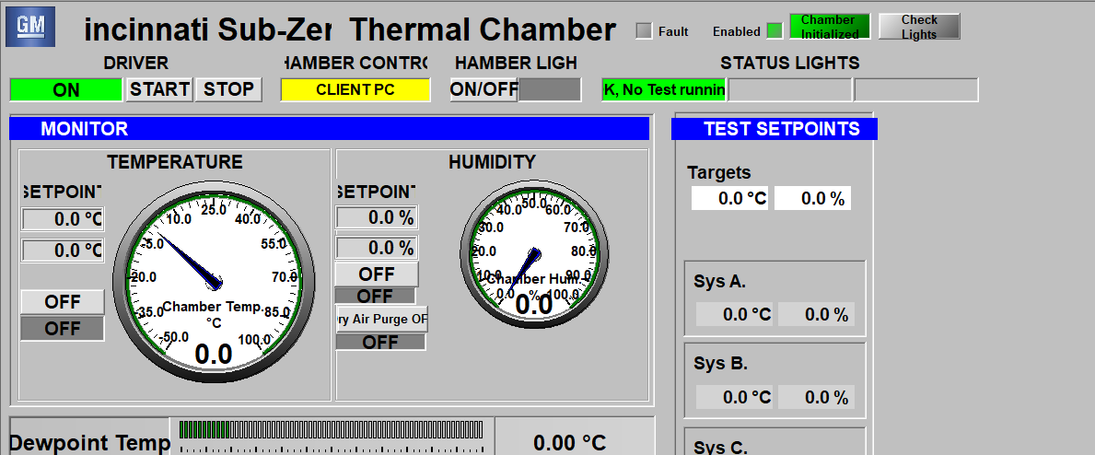
De-Initialize/Re-Initialize Display Example
Main Display
Chamber Display

Slide 16
Critical Fault Improvement
Simplified the criteria for Critical faults that called out
Old Implementation:
Large number of critical callouts for a number of “non-ideal” situations
No solid criteria for what a “critical” fault is
New Implementation:
Reduction in the number of potential critical callouts
Specific “safety-minded” critical fault criteria
Consistent logic and definitions throughout the solution

Slide 17
Critical Fault Categories
Critically High/Critically Low Sensed Cell Voltage
System will detect if monitored cell voltages have gone above/below their respective safety (not-operational) limits
Critically High Temperature/Critically High Rate of Temperature Change
System will detect if external thermocouple/internal thermistor has exceeded critically high temperature level
System will detect if the monitored temperature has a high rate of change that would indicate a thermal runaway
Critical Loss of Communication/Control
System will detect if we have lost communication with/control of equipment or DUT while on test

Slide 18
Critical Fault Thresholds
Voltage Safety Limits
High Cell Voltage: 4.5V
Low Cell Voltage: 1.5V
Temperature Safety Limits:
High Temperature: 90 Deg. C
High Rate of Temperature Change: 1 Degree C per Second
Communication/Control Loss:
Communication – attempt to reconnect to device driver (if applicable) once and raise a critical fault if we were unsuccessful or if it happened more than once
Control – If we detect that the equipment isn’t respond to a request and the system is at a non-ideal temperature/humidity/electrical condition

Slide 19
New Fault Types
Expanded Non-Critical/Critical Faults to include:
Loss of Comm for Equipment
Loss of Control for Equipment
Loss of Comm for DUT
New Non-Critical Callouts
Equipment
DUT
Software
*NOTE* - These show up in Low Priority Callout channel in Slack

Slide 20
Fault Info Action Changes
Split the action for resetting the system and resolving Pager Duty callout
Old Implementation:
System Reset and Pager Duty Resolve function share a button on Fault Info Display
System Reset can be clicked at any time but will only work when system is idle
New Implementation:
New separate buttons that are able to be pressed when they user is allowed to take action
Pager Duty resolve button will become inactive if there is no callout or the user has already resolved it via the button
System reset will remain inactive until system is idle, then become active to allow user to reset system and fault

Slide 21
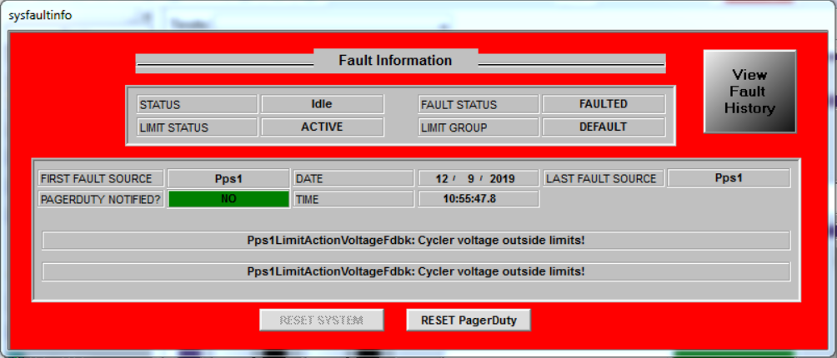
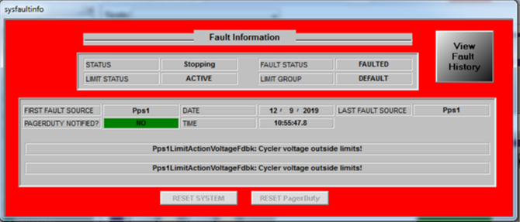
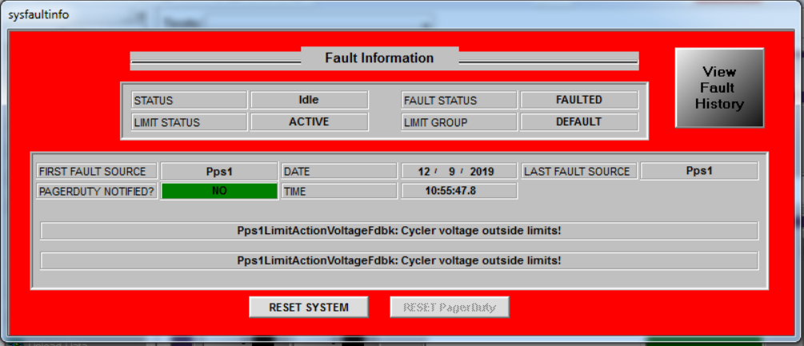
Fault Status Display
Split Buttons to reset system and reset pager duty callout (if it called out)
Initial Fault with Callout
Present
Initial Fault with Callout
Cleared
System can be Reset

Slide 22
Reduce Annoying Faults
Add the ability to prevent the system from faulting when the user is at the stand and can resolve an issue rather than shutting everything down
Improvements:
Incorrect battery program in SysSpecInfo
Pack did not turn on during AutoStart
E-Stop causes cycler comm dropout
Unsuccessful E-Gate communication retry
Send notifications for isolation issues instead of faults
Prevent isolation test from running if there is a cycler issue/no HVIM

Slide 23
Neighbor Stand Fault Improvement
Change the behavior of neighbor stand faults to only fault when its necessary
Old Implementation:
One stands fault flag gets propagated to other stands “remote fault” flag
There is a 30 second delay before the neighbor stand will fault
Any fault can trigger the neighbor stand and will continue to happen until the faults are cleared
New Implementation:
The stand that initially faults will determine if there is a reason to fault the neighbor stand
Shared equipment fault (chamber/chiller/e-stop/shaker/cycler)
Non-ideal stopping conditions (high temp/humidity)
User specified synced stands should fault together
Triggers only one time via a mail slot message to the neighbor stand(s)
Ability for the user to specify if they want the stands to fault together

Slide 24
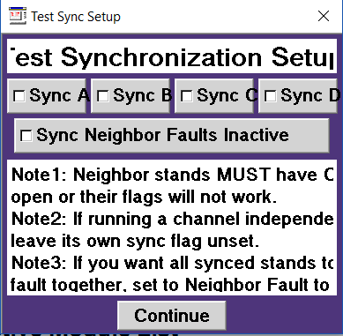
Neighbor Stand Fault Setup
Adds in a new “sync neighbor faults” button that allows an override to always have synced stands fault with their neighbors

Slide 25
Special thanks
John Thornton was instrumental in making all these changes happen. He setup many meetings to get feedback from the DE’s, VE’s, and LSIE’s to gather feedback on improvements to

Slide 26
Misc Improvements
Remove Sys Go Offline
Remove labminder watchdog in place of pager duty
Fix polarity check issue (multiple copies running)
Add notification to stand owner if stand is not on-test
Fixing reset PD and fault info PD AP button disable state fix
Fix idle state mapping
Remove timeout for verify equipment
Safety system close safety relay timeout implementation
Merge Api for PD for GM China and Warren
Fix broken develop with missing #endif
Lower Pps1BkCharge timeouts
Add test notes to pagerduty dictionary
China Beta 1 VRFM issues

Slide 27
Misc Improvements (2)
Added power-off timer to BLINC1BkPowerOff
Added updated C++ shaker driver and related changes
Fix BEV2 ship test c-rate multiplier
Fix for correcting cycler current feedback to 0A in Batt1Limits python script if below noise floor OR in standby
Run sanitizer
Fixed pagerduty bug with location enums not being defined/additional checks/debugging
Set/Reset soc in BLINC1BkGoToSOC in cell manufacturer mode
Add missing end quotes on mailslot messages/quoted text
Merge master into develop for AEC cycler module changes
Removed Elect1 test from solution
Correct B3_1_0 current limits to 50% SOC values
Update actual capacity when resuming life cycle test
Removed active iso call from blinc1start

Slide 28
Misc Improvements (3)
Resolve cell clamp limit crossed bug
Enable selection of GSCT charging temperature
Updated K226 P2.7 limits from PrePV testing
Update BLINC ignore isolation flag to ignore active isolation flag to reduce confusion
Refactor chamber internal variables to reduce confusion
Add interlock button to Pps1 displays/layouts
Fix broken custom blocks in sequences
Add checking for VITM cell balancing disabled value in balancing scripts
Remove HPPC python charge power calculation scrip
Add isolation values to grafana
Remove ALE module from solution
Add timer and limit action in iTest for pack being left on while off-test
Update batt1 limits getter to use python executable instead of command prompt

