Slide 1
Co-op Presentation
Sean Morse
Studying Electrical Engineering at Kettering University
GPG Engineering Co-op Freshman Student
Notes:
Introduce yourself, say who are what your major is, etc.

Slide 2
Centralized Event Log (CEL)
Main project for the rotation
Learned various skills
LSIE Team function and role
Professional Software publication and review process
iTest Test Automation Software
Python

Slide 3
Problem: Improve the communication about test status and faulting
The main method of seeing issues on tests was through Jira tickets for LSIE team
Slow to get valuable information, and not as easy to access
Hard to trace repeating issues
Where can the information be stored?
Must be easy to access
Allow for past message references to be stored

Slide 4
Approach
Where to store the information?
Three options: Database, Z drive, iCentral
What information to store?
Should store iTest starting and closing, tests starting, faulting, and completing
Make it easy to add more information to store in future modifications

Slide 5
Implementation
Created a Python script to work in iTest
iTest will run the script only when it’s needed
Easier to integrate into iTest
It will update the logs on the Z drive and send a message
Read an .ini file to grab the webhook URL
It will update or create a new file for the DUT/test stand
The message contains the argument and rdb strings
Trying to avoid the issue with too many characters for iTest
Tested on multiple test stands
Works great on test stands
Records all information

Slide 6
Adding Microsoft Teams Messages
Originally separate project
The logs and Teams Messages could use the exact same information gathering infrastructure
Attached work from Nguyen Phan and modified it to allow for status messages to be sent to Microsoft Teams channels
This will only have Test Stand messages and no channels for DUT
DUT channels would require a lot of work to keep up to date
Too many channels to manage
Allows for people to directly comment on each chamber’s status

Slide 7
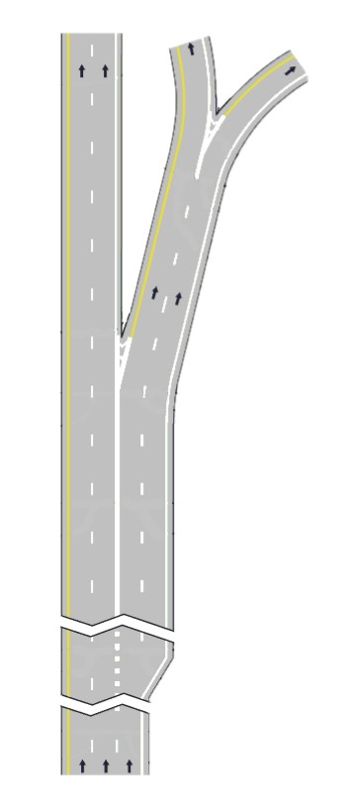
PagerDuty
iCentral
Etc.
iTest
CEL
Teams
Status
Message
Z drive files

Slide 8
Results
Channels have been made for the MS teams and webhooks added
All messages and logs work perfectly and record all the intended information
Have been able to change and add more information to the status message
Microsoft Teams message is under review
Pull Request #273

Slide 9
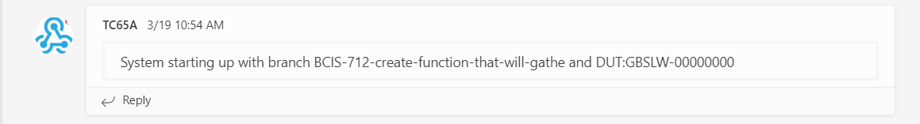
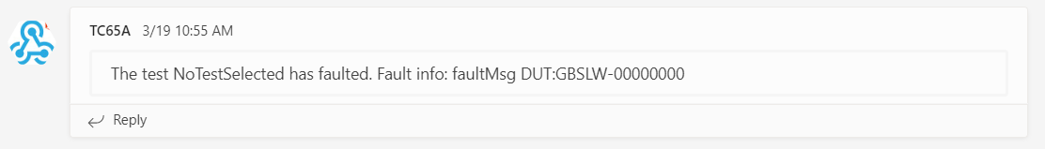
Example Outcomes
Above is an example of some logs of a test done last Tuesday on TC65A
Below is the DUT log information that ran in concurrent with the test chamber above
Microsoft Teams messages below

Slide 10
Thank you for your help and time!
Questions/Comments?
Notes:
Mention work in Alg group next term

