Slide 1

Andre’ Brown
Battery Test System Integration
Planning Team
EGM: -Justin Hermann
7/13/2020 - 1/8/2021

Slide 2



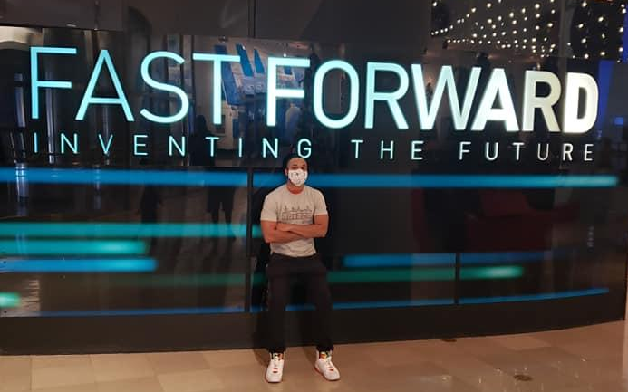


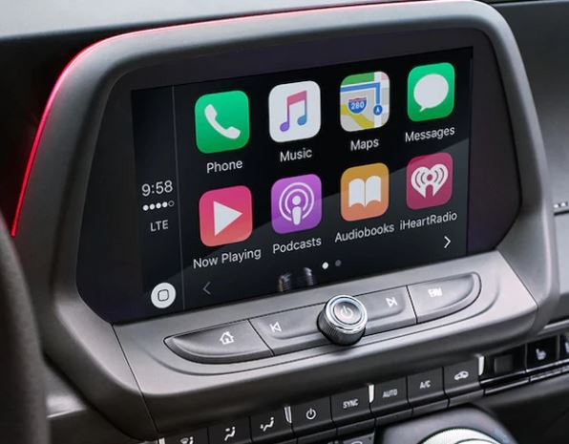
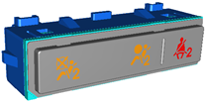
ABOUT ME
University: -Prairie View A & M University
Major: Electrical Engineer Houston, Texas
GM Start Date: 7/13/2020
Rotation #3: Battery Test System Integration / Battery Lab Planner
Hobbies/Interests:
I have a YouTube channel about barbering
I really enjoy traveling
Past Rotations:
Infotainment Hardware Engineer
Infotainment Software Robustness Engineer
Switch Design Release Engineer

Slide 3
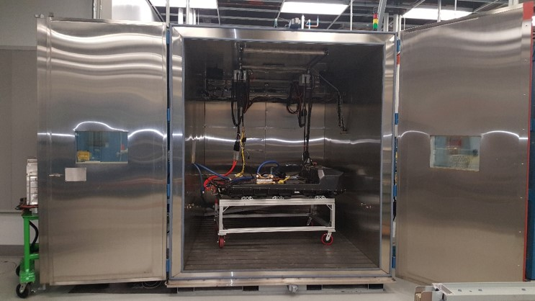
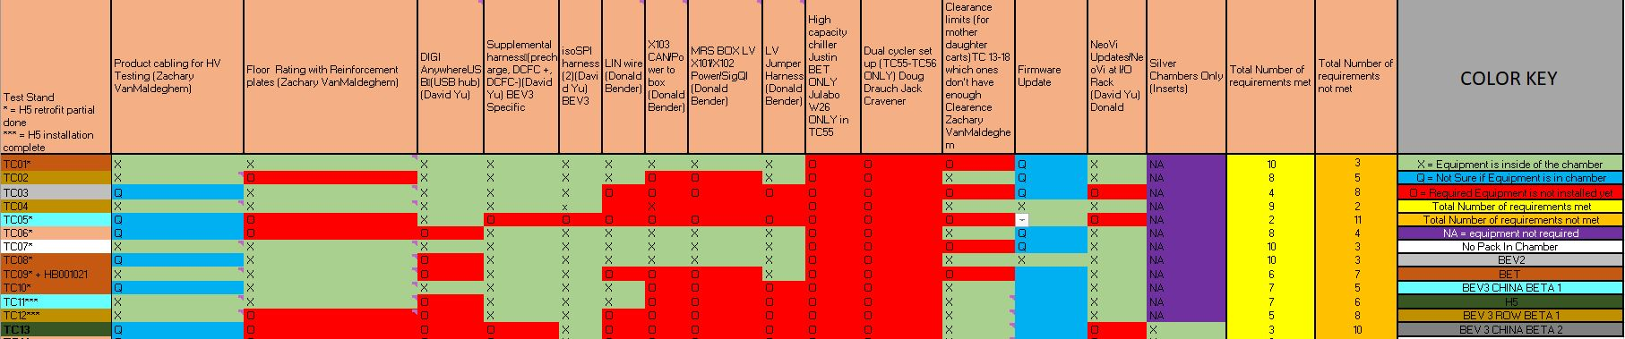
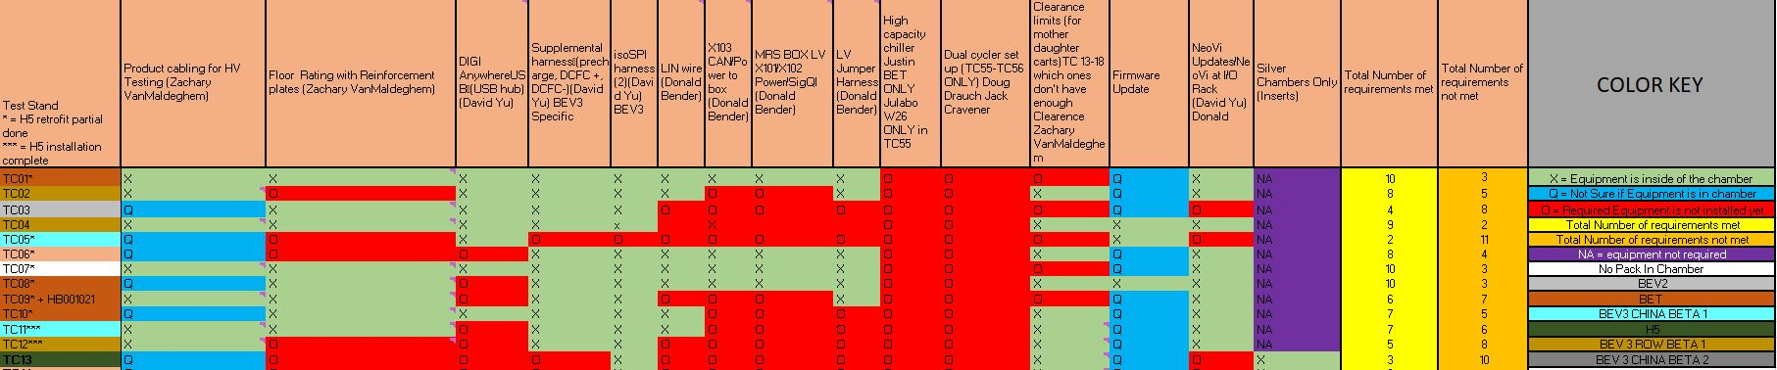
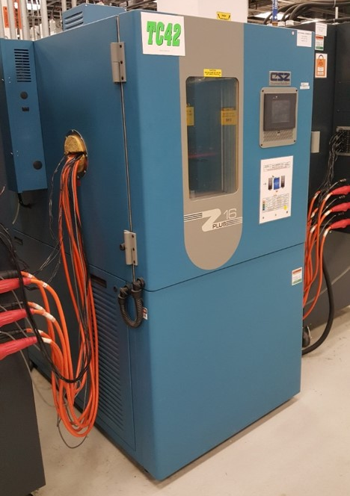
Assignment #1 Battery Lab Equipment Tracker
Documented each chamber in all the battery labs and labeled the type of battery pack by color
Created a check list for the designated engineer for specific test equipment
Added a color key to help the user understand exactly what each cell means for both the chambers and the equipment
EXAMPLE PICTURE BOX

Slide 4
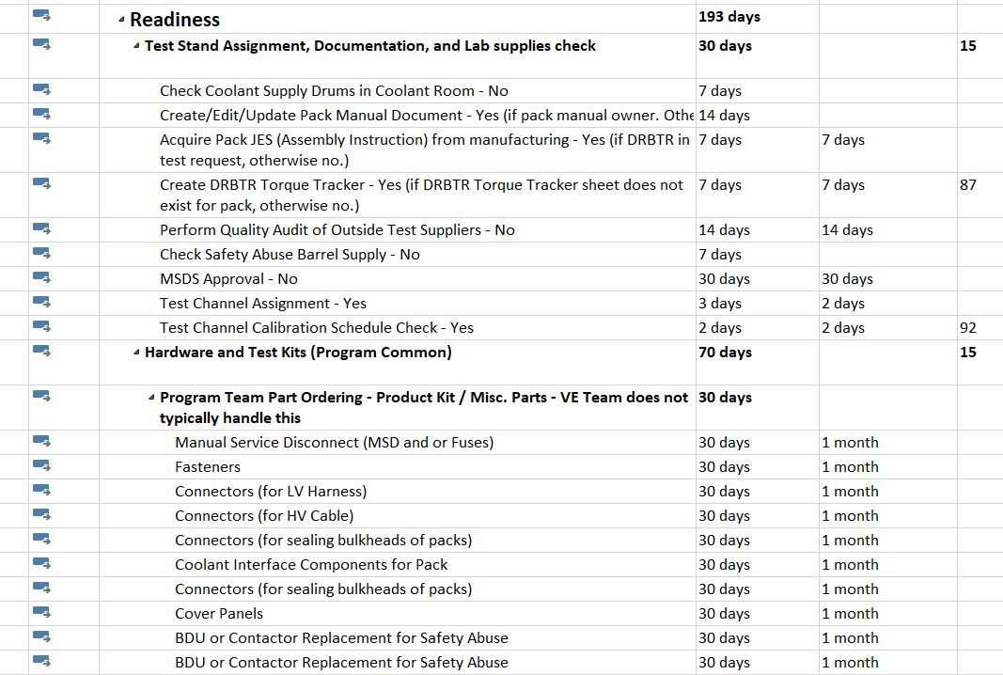

Assignment #2 Readiness
I interviewed a lot validation engineers and analyzed what was considered new, old, or need to be removed from the readiness document for the time frame for current tests
I updated the readiness document based on all of the different interview that I gathered and created a updated version with the latest days and timeframes
The goal is to transfer this to a readiness check list

Slide 5
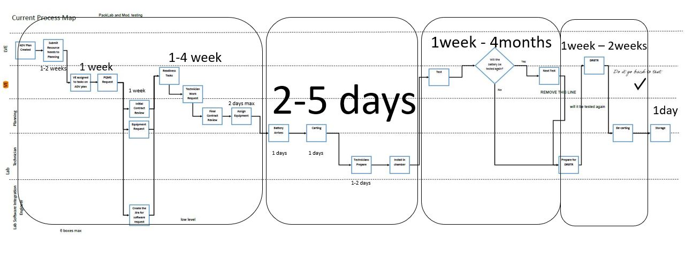
Assignment #3 Battery Storage Life Cycle and Check List
I created a process map that documents the battery lab processes from receiving the pack before test to disposition after test
I listed out each step with the designated days of each process
I created a check list for all of the battery packs in the labs and used this list to help assist in the disposition process to avoid taking up disposition storage space
This assignment will ensure that device dispositioning is part of the process and minimizes the storage issue

Slide 6
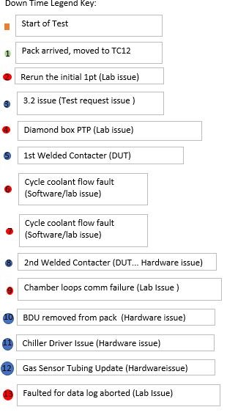
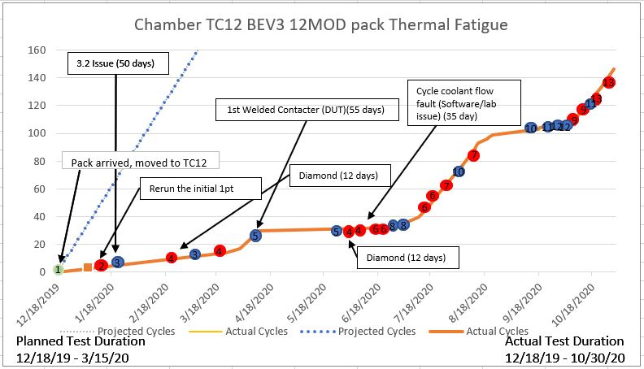

Assignment #4 Battery Chambers Runtime
I monitoring multiple test to understand the bottlenecks in the process within test execution
The graph will helped the lab understand the down time issues that occurred during testing
The red and blue points are key issues that occurred during the test process that effects the original test duration

Slide 7
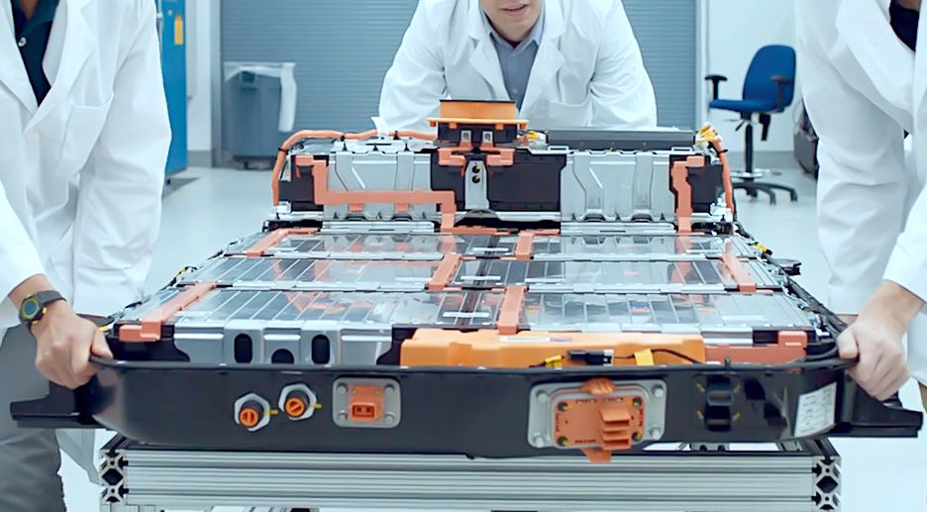
Feedback
I loved the aspect of being able to see different roles in the battery lab as a planner. It feel like I was in a lot of different roles because of how easy it was to access to different people and see what they did in their particular role
I enjoyed having multiple valuable tasks that related back to everyone across the battery lab
I feel like I learned more out of this TRACK rotation out of all of my other rotations
EXAMPLE PICTURE BOX
Next Rotation
Validation Engineers - Battery
Function: Validation
Manager: Robert Main
Rotation Length: 1/11/2021-7/16/2021

Slide 8

See you in January !

