Slide 1


The Visual Causality Analyst: An Interactive Interface for Causal Reasoning
Jun Wang, Stony Brook University
Klaus Mueller, Stony Brook University, SUNY Korea

Slide 2
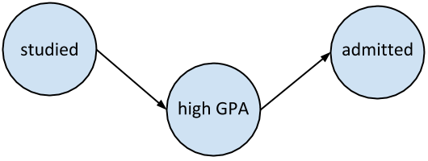
Causality
“Any relationship that cannot be defined from the distribution alone” [Pearl, 2010]
Counterfactuals
  A causes B means: If A didn’t happen (change), B would not happen (change)
All relations between variables in a system form a Causal Network

Slide 3
Causal Networks
Causal networks can be represented as Bayesian belief networks
  Directed Acyclic Graphs (DAGs)
  Augmented with conditional probability distributions
  CPT, CPD, Linear Regression, Logistic Regression, etc.
  Probabilistic Dependency and Causal Dependency
Thus causal networks can be learned as Bayesian networks
  But with added constraints and assumptions

Slide 4
Structure Learning
Score-based algorithms
Constraint-based algorithms
Search through the space of possible structures (models) with some scoring function.
  K2 [Cooper & Herskowitz, 1992]
  GBPS [Spirtes & Meek, 1995]
  BDe metric [Heckerman et al. 1995]
  Sparse Candidate [Friedman et al. 1999]
  Exact [Koivisto & Sood, 2004][Silander & Myllymaki, 2006]
  GES [Chickering, 2002]
  GIES [Hauser & Bühlmann, 2012]
  …
Find a graph that satisfies all the constraints implied by the data distribution.
  SGS [Spirtes et al. 2000]
  PC [Spirtes et al. 2000][Meek, 1995]
  TPDA [Cheng et al. 1997]
  Heuristic two-phase [Wang & Chan, 2010]
  TC [Pellet & Elisseeff, 2008]
  …

Slide 5
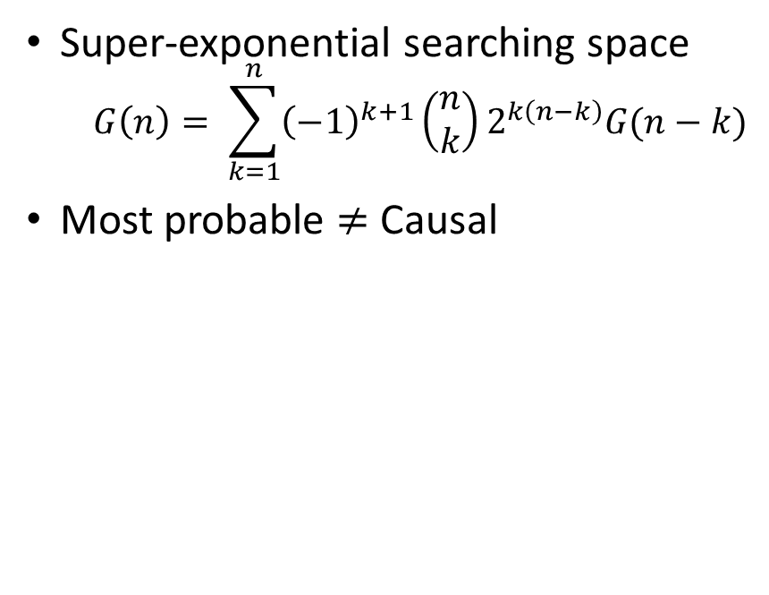
Structure Learning
Score-based algorithms
Constraint-based algorithms
Super-exponential searching space
  $$G\left(n\right)= \sum_{k=1}^{n}{{\left(−1\right)}^{k+1}\left(\begin{matrix}n \\ k\end{matrix}\right)}2^{k\left(n−k\right)}G(n−k)$$
Most probable $≠$ Causal
Build structure constrained by conditional independence/dependence calculated from data distributions
Such conditional dependencies imply causal dependence and counterfactuals

Slide 6
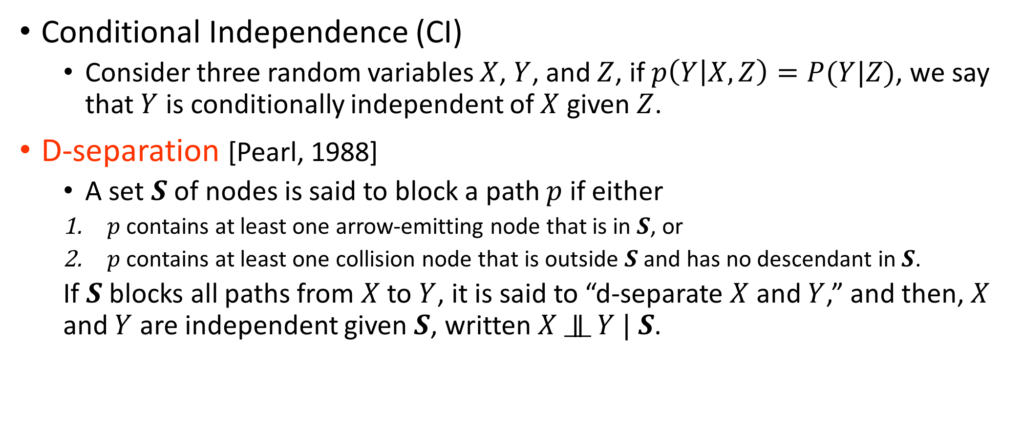
Conditional Independence and D-separation
Conditional Independence (CI)
  Consider three random variables $X$, $Y$, and $Z$, if $p\left(Y | X,Z\right)=P(Y|Z)$, we say that $Y$ is conditionally independent of $X$ given $Z$.
D-separation [Pearl, 1988]
  A set $S$ of nodes is said to block a path $p$ if either
  $p$ contains at least one arrow-emitting node that is in $S$, or
  $p$ contains at least one collision node that is outside $S$ and has no descendant in $S$.
  If $S$ blocks all paths from $X$ to $Y$, it is said to “d-separate $X$ and $Y$,” and then, $X$ and $Y$ are independent given $S$, written $X$ $∥$ $Y | S$.

Slide 7
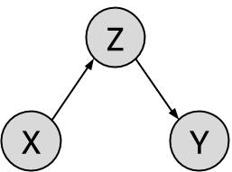
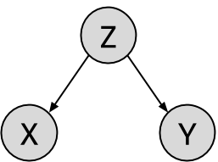
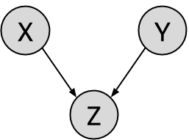



D-separation
Chain of Causation
Confounding
Collision (V-structure)
Collider
$X$ $∥$ $Y | Z$
$X$ $∥$ $Y | Z$
$X$ $∥$ $Y$
Faithfulness Assumption
  There is a graph capable to express all CI relations in data.
Causal Sufficiency
  No hidden confounder or selection bias.

Slide 8
TC Algorithm [Pellet & Elisseeff, 2008]
Start from an empty graph,
For each pair of variables in dataset, test for CI conditioning on all other variables. Connect the pair if they are dependent.
Output: Moral Graph
For each pair of connected variables, search for colliders in variables forming triangles with them.
Require a number of CI test exponential to the number of potential colliders
Orient V-structures and propagate.
Output: Partial DAG

Slide 9
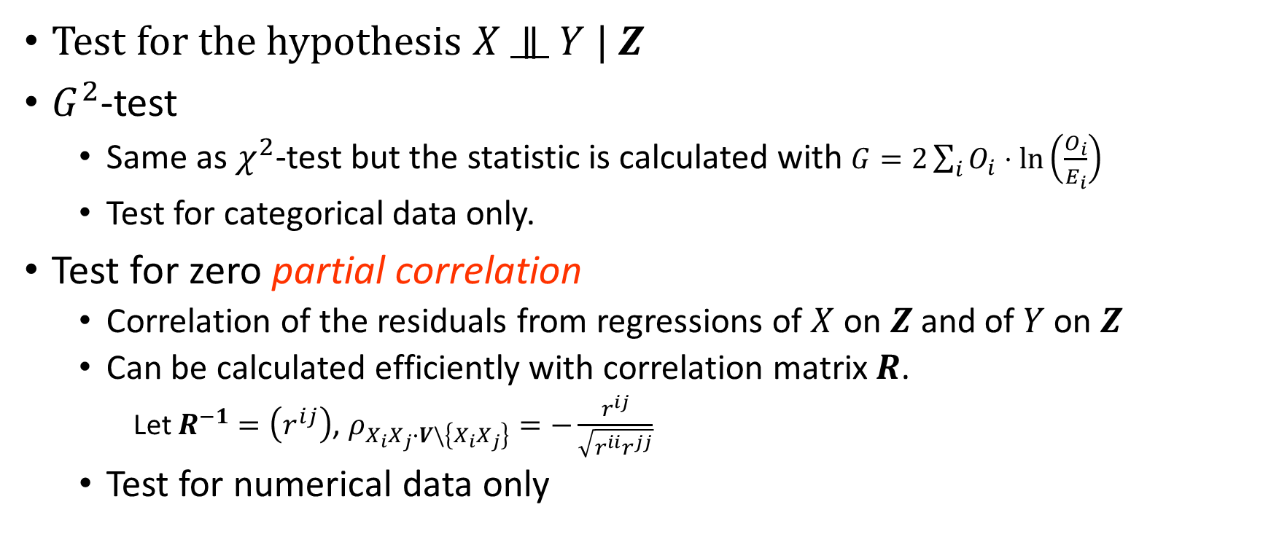
CI Test
Test for the hypothesis $X$ $∥$ $Y | Z$
$G^{2}$-test
  Same as $χ^{2}$-test but the statistic is calculated with $G=2\sum_{i}{O_{i}}⋅\ln\left(\frac{O_{i}}{E_{i}}\right)$
  Test for categorical data only.
Test for zero partial correlation
  Correlation of the residuals from regressions of $X$ on $Z$and of $Y$ on $Z$
  Can be calculated efficiently with correlation matrix $R$.
    Let $R^{−1}=\left(r^{ij}\right)$, $ρ_{X_{i}X_{j}∙V\backslash \left\{X_{i}X_{j}\right\}}=−\frac{r^{ij}}{\sqrt{r^{ii}r^{jj}}}$
  Test for numerical data only

Slide 10
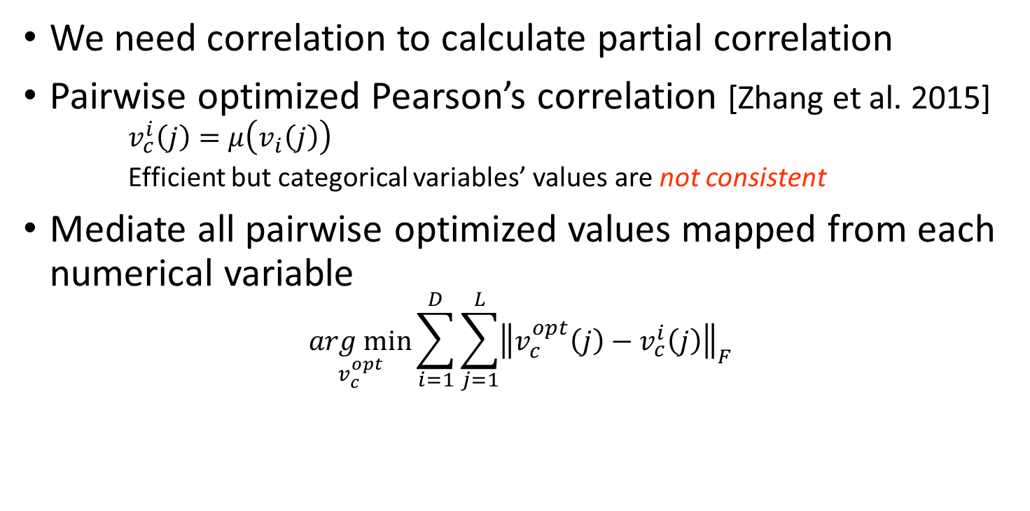
Correlations of Categorical & Numerical Variables
We need correlation to calculate partial correlation
Pairwise optimized Pearson’s correlation [Zhang et al. 2015]
    $$v_{c}^{i}\left(j\right)=μ\left(v_{i}\left(j\right)\right)$$
    Efficient but categorical variables’ values are not consistent
Mediate all pairwise optimized values mapped from each numerical variable
$$\underset{v_{c}^{opt}}{arg min}{\sum_{i=1}^{D}{\sum_{j=1}^{L}{{\left\|v_{c}^{opt}\left(j\right)−v_{c}^{i}\left(j\right)\right\|}_{F}}}}$$
X | Y | Z | XY | Xz
A | 1 | 5 | 2 | 6
A | 3 | 7 | 2 | 6
B | 7 | 1 | 8 | 2
B | 8 | 2 | 8 | 2
B | 9 | 3 | 8 | 2

Slide 11
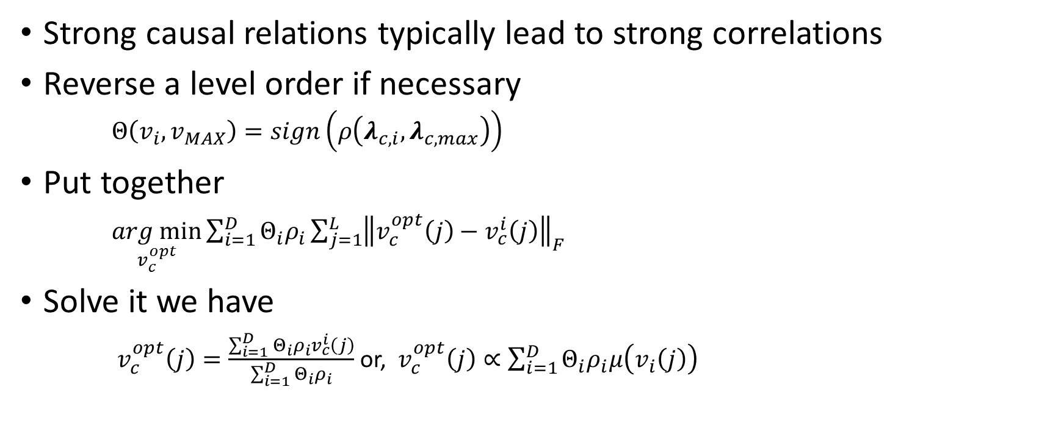
Level Value Mapping of Categorical Variables
Strong causal relations typically lead to strong correlations
Reverse a level order if necessary
  $Θ\left(v_{i}, v_{MAX}\right)=sign\left(ρ\left(λ_{c,i}, λ_{c,max}\right)\right)$
Put together
$\underset{v_{c}^{opt}}{arg min}{\sum_{i=1}^{D}{Θ_{i}ρ_{i}\sum_{j=1}^{L}{{\left\|v_{c}^{opt}\left(j\right)−v_{c}^{i}\left(j\right)\right\|}_{F}}}}$
Solve it we have
$v_{c}^{opt}\left(j\right)=\frac{\sum_{i=1}^{D}{Θ_{i}ρ_{i}v_{c}^{i}\left(j\right)}}{\sum_{i=1}^{D}{Θ_{i}ρ_{i}}}$ or, $v_{c}^{opt}\left(j\right)∝\sum_{i=1}^{D}{Θ_{i}ρ_{i}μ\left(v_{i}\left(j\right)\right)}$
Variable pair categorical/numerical | Pairwise | Global
origin/horsepower | 0.488 | 0.476
origin/weight | 0.595 | 0.561
origin/displacement | 0.656 | 0.637
origin/mpg | 0.576 | -0.530
origin/timeTo60mph | 0.272 | -0.272

Slide 12
Causality in Practical Application
CI tests require good data quality to make correct judgements.
Satisfaction of causal assumptions cannot be guaranteed.
Hard to manage all causal relations when variable number is large.
Cannot alter the learned structure and test hypotheses.
Solution
  A Visual Analytical System!

Slide 13
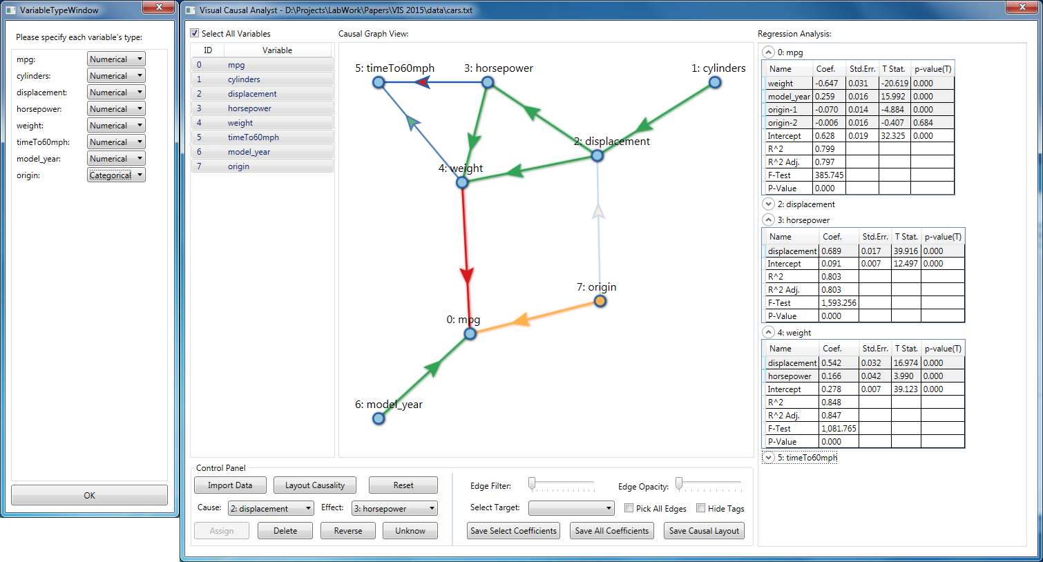
The Visual Causality Analyst
Running on auto mpg dataset [UCI Machine Learning Repository, 2013]

Slide 14
The Causality Analyst
Analytical Stages
  Data preparation
    Mapping levels of categorical variables
  Structure Learning
    Learn causal structures with the TC algorithm
  Regression Analysis
    Quantify causal relations with linear and logistic regression analyses
    Make dummy variables out of categorical variables
  Visual Analytics with the Causal Graph
    Interactive analysis with visual feedback

Slide 15
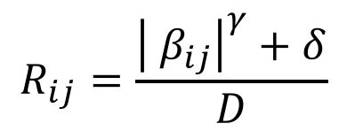
Visualization Patterns
Vertices: variables
  Color: type of the variable ( numerical categorical)
Edges: causal relations
  Direction Marks: direction and qualities of causal relation
  positive negative multiple
  Opacity: (maximum) causal strength measured by regression coefficients, scaled and enhanced by
  Dashed line: relation with unknown direction
$$R_{ij}=\frac{{\left| β_{ij}\right|}^{γ}+δ}{D}$$

Slide 16
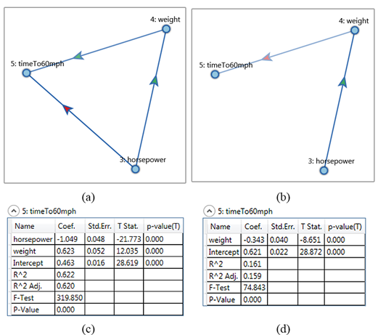
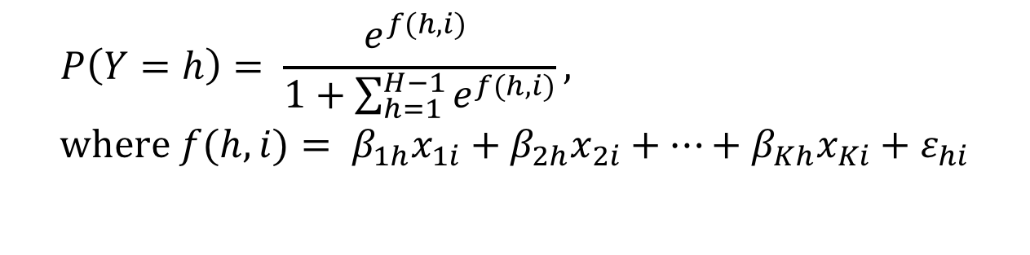

Regression Analysis
Linear regression analysis
  Numerical dependent variable
  p-value, F-statistics, R-squared, etc.
Logistic regression analysis
  Categorical dependent variable
  p-value, Deviance, Likelihood, etc.
$$y_{i}= β_{1}x_{1i}+β_{2}x_{2i}+…+β_{K}x_{Ki}+ε$$
$$P\left(Y=h\right)= \frac{e^{f(h,i)} }{1+\sum_{h=1}^{H−1}{e^{f(h,i)}}}, \\ where f(h,i)= β_{1h}x_{1i}+β_{2h}x_{2i}+…+β_{Kh}x_{Ki}+ε_{hi}$$

Slide 17
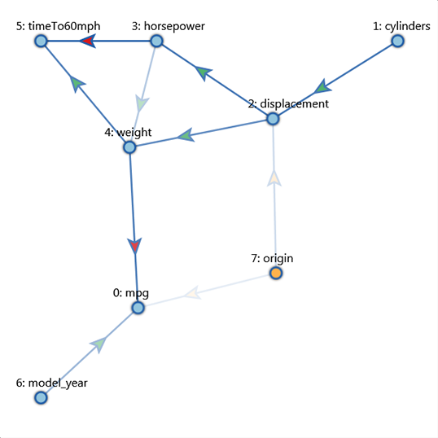
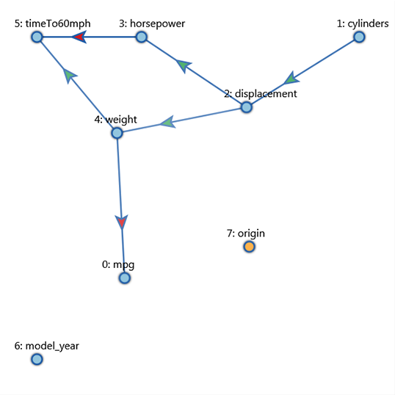
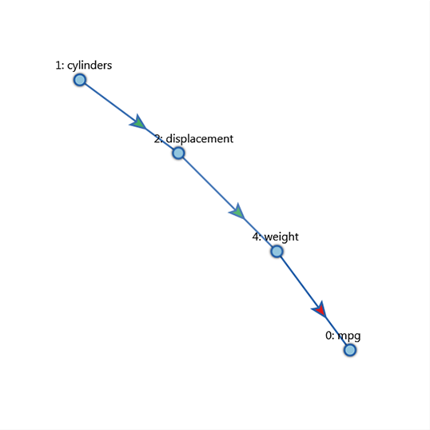
Case 1: Auto MPG dataset [UCI Machine Learning Repository, 2013]
8 variables, 392 observations
The complete causal graph
Filter edges with 0.4 coefficient threshold
The causal chain related to mpg

Slide 18
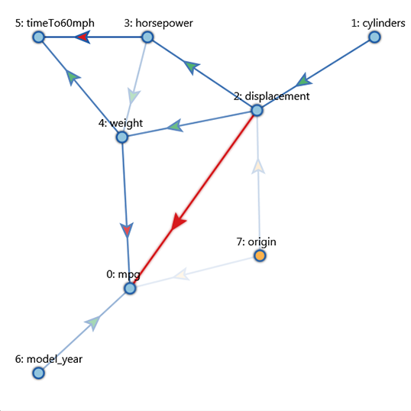
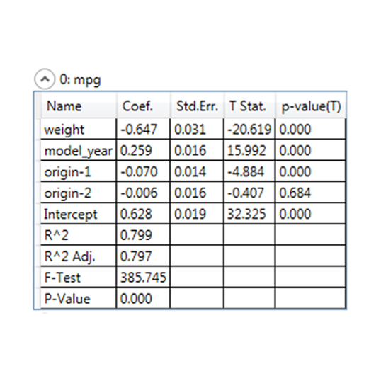
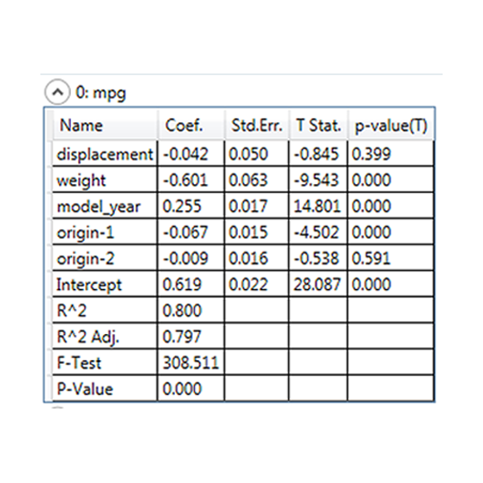
Case 1: Auto MPG dataset [UCI Machine Learning Repository, 2013]
The added causal relation
Regression view of mpg before adding the edge
Regression view of mpg after adding the edge

Slide 19
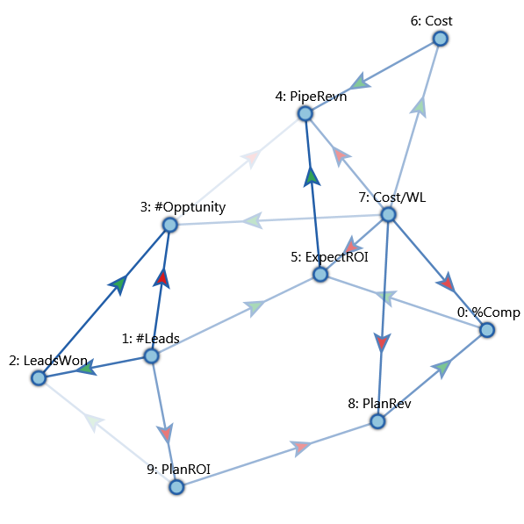
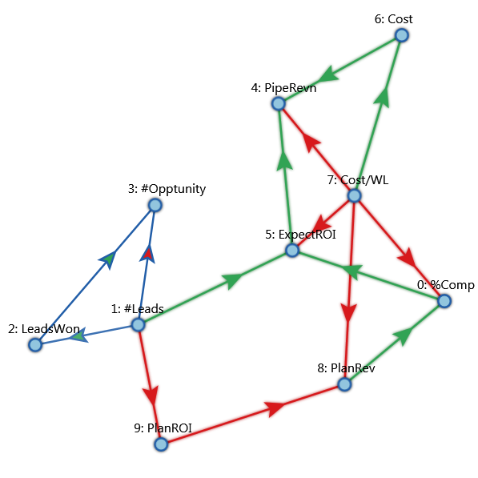
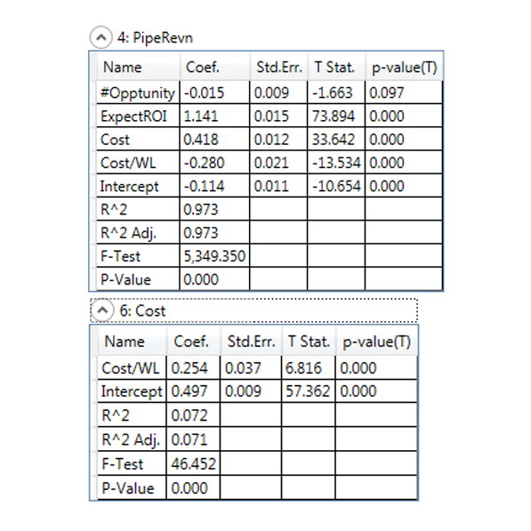
Case 2: Sales Campaign Dataset
10 variables, 600 observations
The causal graph
All relations related to PipeRevn
Regression view of PipeRevn and Cost

Slide 20
Future Work
Analytical visualization
  Visualize goodness of fitting for regression models of each node as node stroke thickness
  e.g. F-test score or Deviance, Automatic predictor analysis
  Automatic predictor analysis
  Fit data on existed structure
  Scoring the graph structure according to the dataset
Causal inference within data clusters
  Integrate tools like Illustrative Parallel Coordinates [McDonnell and Klaus, 2008]
Causality from time series data
  Time series chain graph and Granger causality graphs [Eichler, 2008]

Slide 21
Other Potential Future Work
More sophisticated CI test equivalence
Data cleaning, e.g. outlier detection and removal
Handling big data, e.g. incremental visualization
Causal analysis involving interventional data
…

Slide 22
Summary
Causality and Causal Network
Constraint-based Structural Learning
Value Mapping of Categorical Variables
The Visual Causal Analyst
  Analytical Stages
  Visualization of Causal Graph with Statistical Assessment
  Interactive Analysis with Visual Feedback
  Prototype with Many Potential Future Work

Slide 23
Thanks for attending my talk!

