Slide 1
Progressive Clustering of Big Data with GPU Acceleration and Visualization
Jun Wang¹, Eric Papenhausen¹, Bing Wang¹, Sungsoo Ha¹,
Alla Zelenyuk², and Klaus Muller¹
¹Computer Science Department, Stony Brook University
²Pacific Northwest National Laboratory
2017 New York Scientific Data Summit (NYSDS) Jun Wang

Slide 2
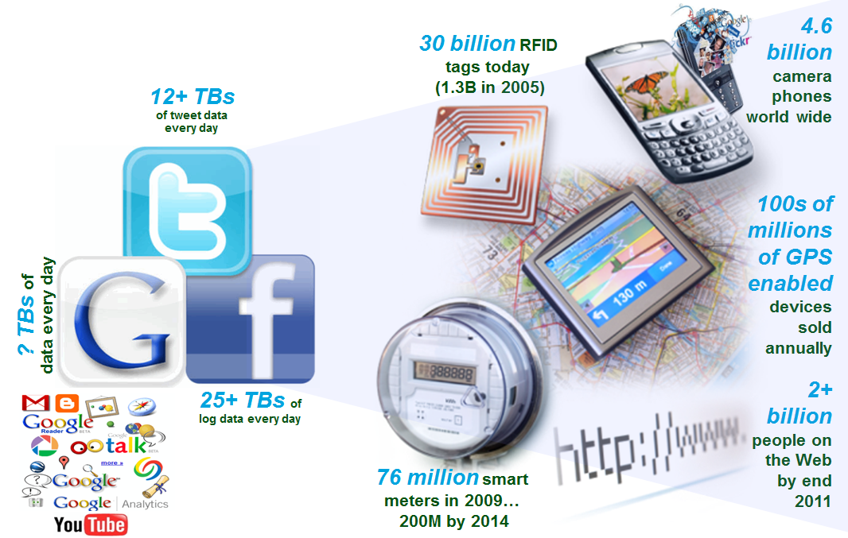
The Internet of Things and People

Slide 3


Big Data for Scientific Research
Nature - Big Data
Sept. 3, 2008, Vol. 455, Issue 7209
Science - Dealing with Data
Feb. 11, 2011, Vol. 331, Issue 6018

Slide 4
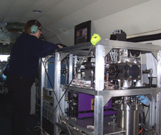
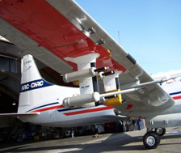
Our Data – Aerosol Science
Understand the processes that control formation, physicochemical properties and transformations of particles
Acquired by a state-of-the-art single particle mass spectrometer (SPLAT II) often deployed in an aircraft

Slide 5
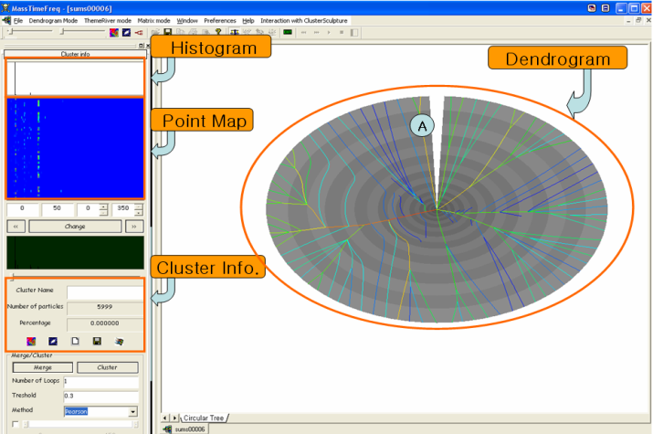
Our Data – Aerosol Science
SPLAT II can acquire up to 100 particles per second at sizes between 50-3,000 nm at a precision of 1 nm
  Creates a 450-D mass spectrum for each particle
Overall Goal:
Build the hierarchical structure of particles that can be used in automated classification of new particle acquisitions
SpectraMiner

Slide 6
Our Data – Aerosol Science
Data Scale:
450 dimensions
Typically, several millions of points
Goal:
Overall: hierarchical (tree) structure
In this talk: parallel clustering algorithms for
  Redundancy elimination
  Learning the leaf level of the tree

Slide 7
Incremental k-Means – Sequential
The old CPU-based solution
Input: data points P, distance threshold t
Output: clusters C
C = empty set
for each unclustered point p in P
if C is empty then
Make p a new cluster center and add it into C
else
p = next unclustered point
Find the cluster center c in C closest to p
let d = distance(c, p)
if d < t then Cluster p into c
else Make p a new cluster center added to C
end if
end if
end for
return C

Slide 8
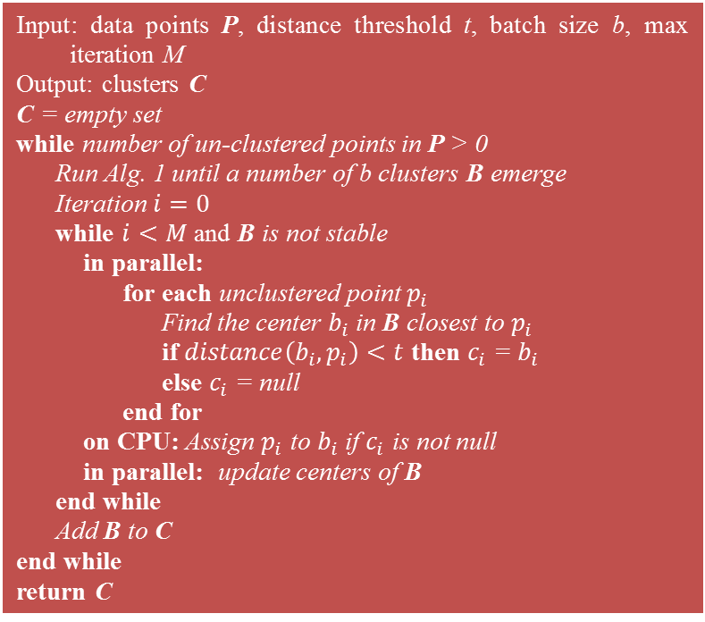
Incremental k-Means – Parallel
NEW GPU-based solution
Input: data points P, distance threshold t, batch size b, max iteration M
Output: clusters C
C = empty set
while number of un-clustered points in P > 0
Run Alg. 1 until a number of b clusters B emerge
Iteration $i=0$
while $i<M$ and B is not stable
in parallel:
for each unclustered point $p_{i}$
Find the center $b_{i}$ in B closest to $p_{i}$
if $distance\left(b_{i}, p_{i}\right)<t$ then $c_{i}$ = $b_{i}$
else $c_{i}$ = null
end for
on CPU: Assign $p_{i}$ to $b_{i}$ if $c_{i}$ is not null
in parallel: update centers of B
end while
Add B to C
end while
return C

Slide 9
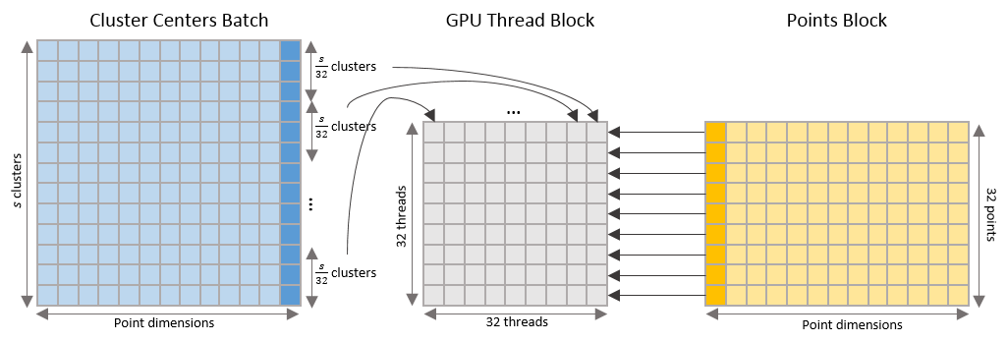
Incremental k-Means – Parallel
GPU Thread Block: 32 × 32 threads
If we set the batch size b = 96:
A group of 96/32 = 3 cluster centers is mapped to a column of the block
Number of thread block launched: N/32

Slide 10
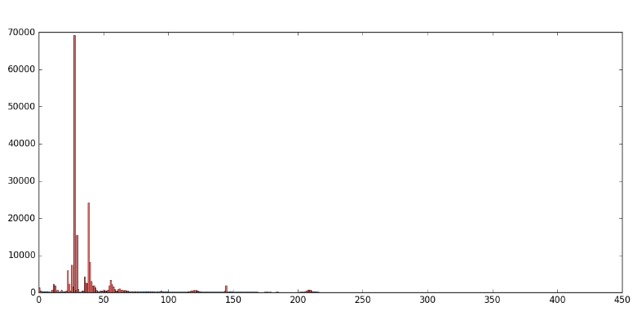
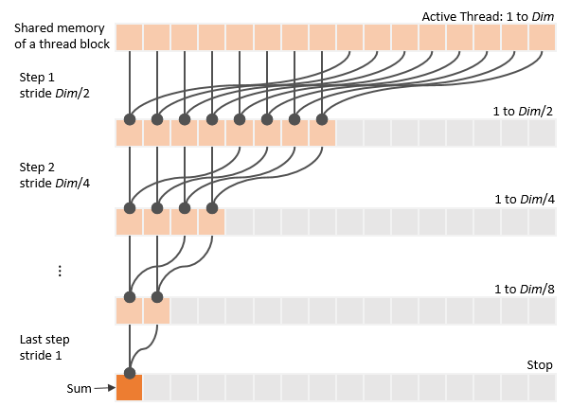
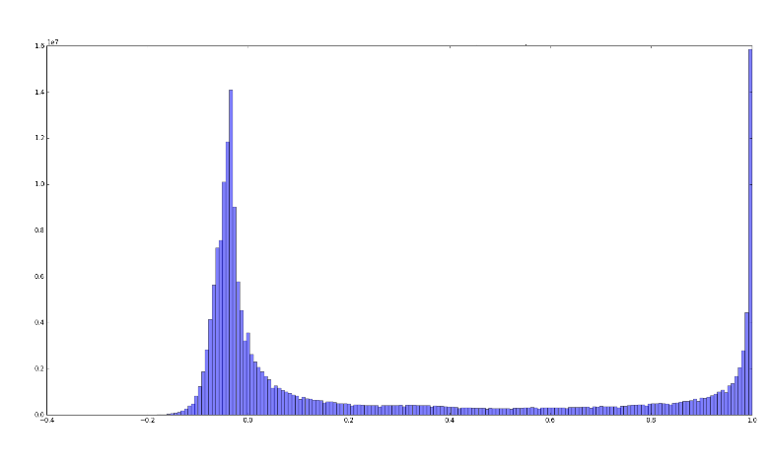
Dimension Reduction and the Threshold t
Dimension standard deviations by parallel reduction

Slide 11
Comments and Observations
Algorithm merges the incremental k-means algorithm with a parallel implementation (k=C)
Design choices:
  C=96 good balance between CPU and GPU utilization
  With C>96 algorithm becomes CPU-bound
  With C<96 the GPU would be underutilized
  A multiple of 32 avoids divergent warps on the GPU
  Max iterations = 5 worked best
Advantages of the new scheme:
  Second pass of previous scheme no longer needed

Slide 12
GPU Implementation
Platform
  1-4 Tesla K20 GPUs
  Installed in a remote ‘cloud’ server
Parallelism
  Launch N/32 thread blocks of size 32 x 32 each
  Each thread compares a point with 3 cluster centers
  Make use of shared memory to avoid non-coalesced memory accesses

Slide 13
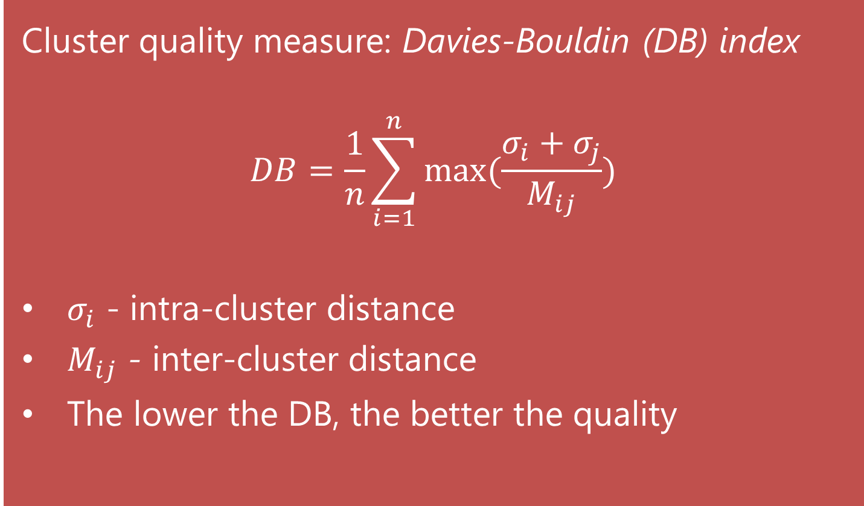
Quality Measures
Cluster quality measure: Davies-Bouldin (DB) index
$$DB=\frac{1}{n}\sum_{i=1}^{n}{max⁡(\frac{σ_{i}+σ_{j}}{M_{ij}})}$$
$σ_{i}$ - intra-cluster distance
$M_{ij}$ - inter-cluster distance
The lower the DB, the better the quality

Slide 14
Acceleration by Sub-Thresholding
Sub-thresholding:
  Points with small distance to the center are settled and will not be re-visited in inner iterations
This also somehow improves the DB index
Data Size | Sequential | Parallel | ST: 0.3 | ST: 0.2 | ST: 0.15
10k | 0.527 | 0.539 | 0.540 | 0.537 | 0.529
50k | 0.546 | 0.590 | 0.548 | 0.554 | 0.539
100k | 0.550 | 0.584 | 0.600 | 0.570 | 0.544
200k | 0.564 | 0.587 | 0.640 | 0.593 | 0.564

Slide 15
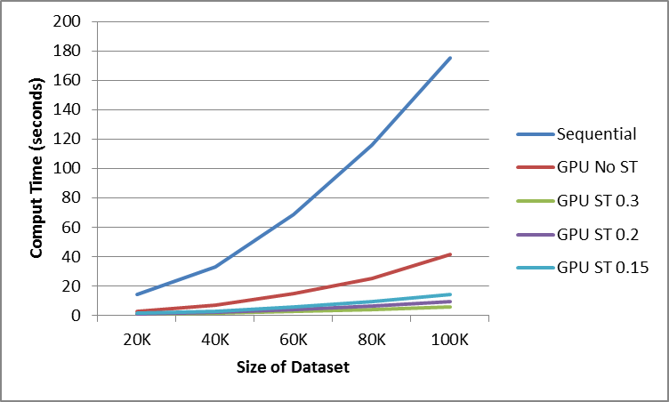
Results – Different Settings
About 33x speedup

Slide 16
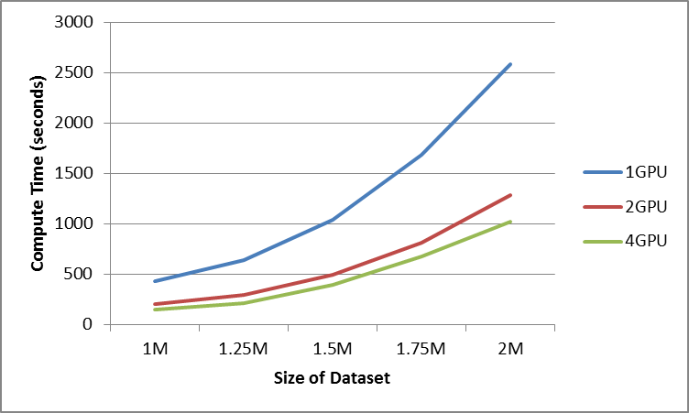
Results – Multi-GPU
4-GPU has about 100x speedup over sequential

Slide 17
In-Situ Visual Feedback (1)
Visualize cluster centers as summary snapshots
  Glimmer MDS algorithm
  Intuitive 2D layout
Color map:
  Small clusters map to mostly white
  Large clusters map to saturated blue
We find that early visualizations are already quite revealing
  This is shown by cluster size histogram
  Cluster size of M>10 is considered significant

Slide 18
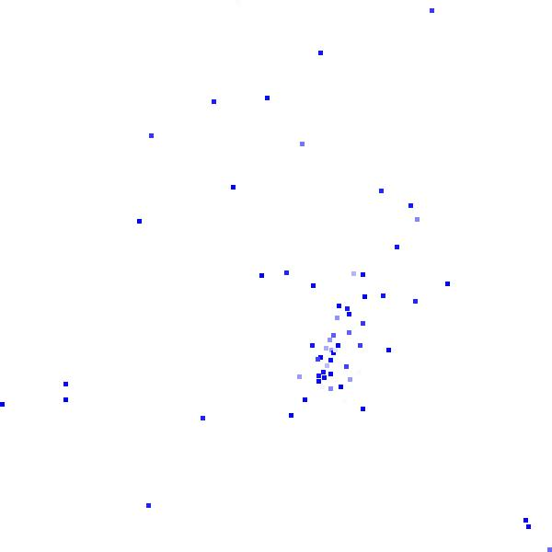
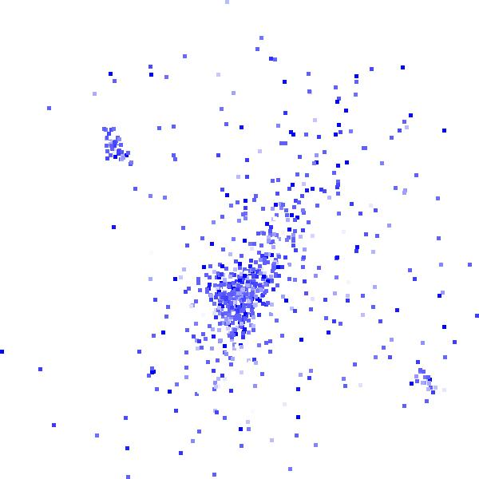
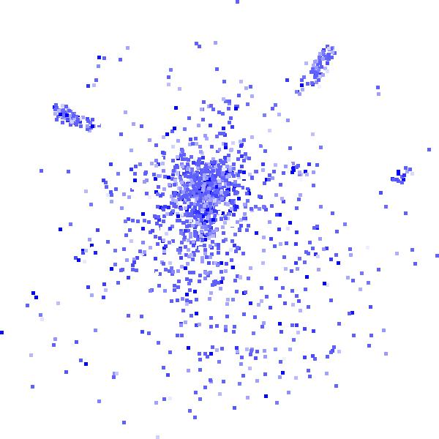
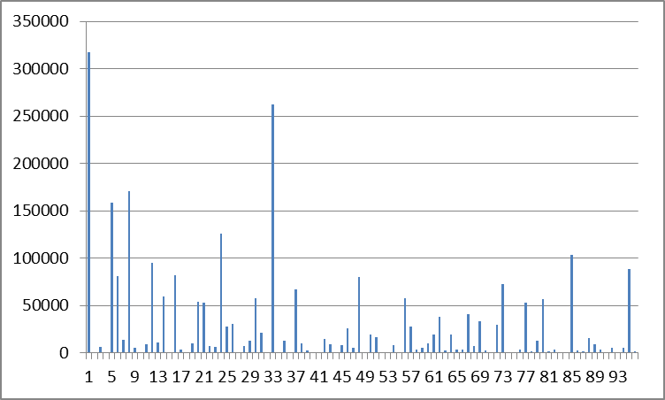
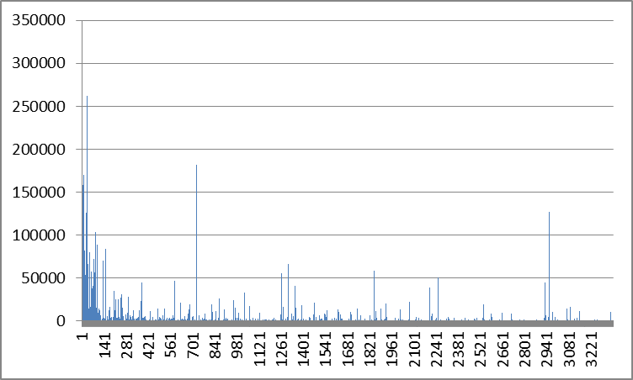
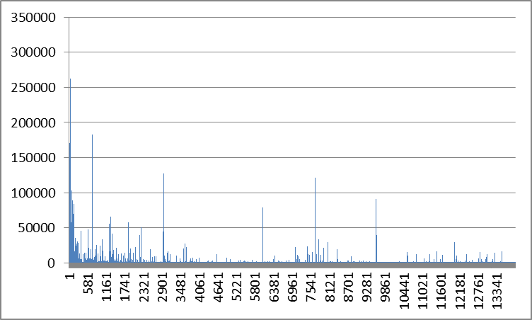
In-Situ Visual Feedback (2)
79/96
998/3360
2004/13920

Slide 19
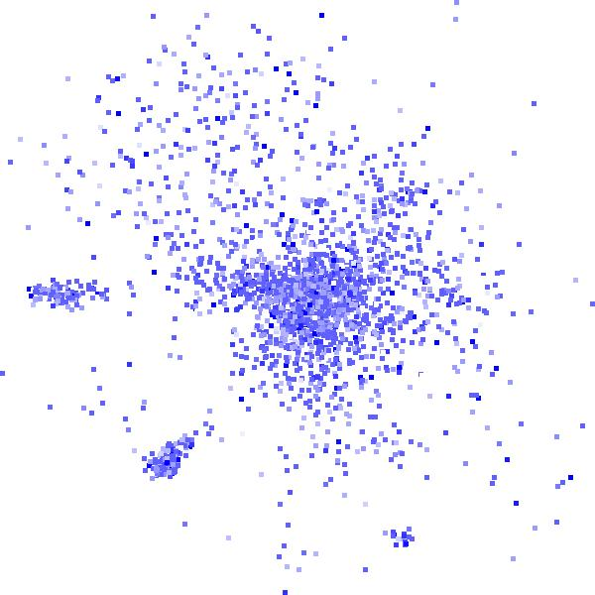
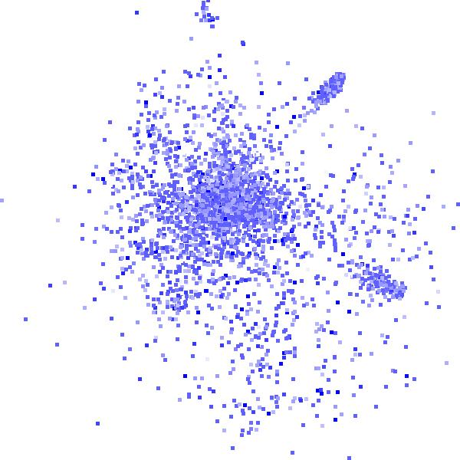
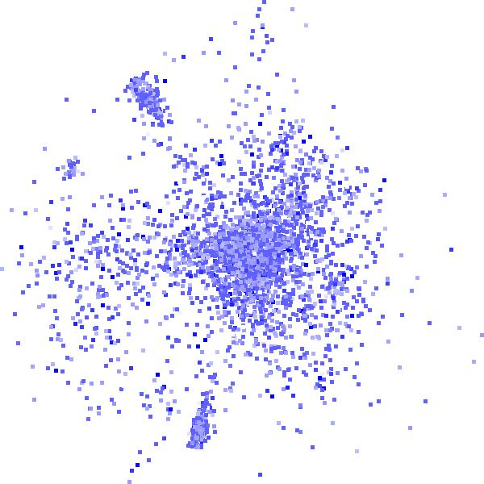
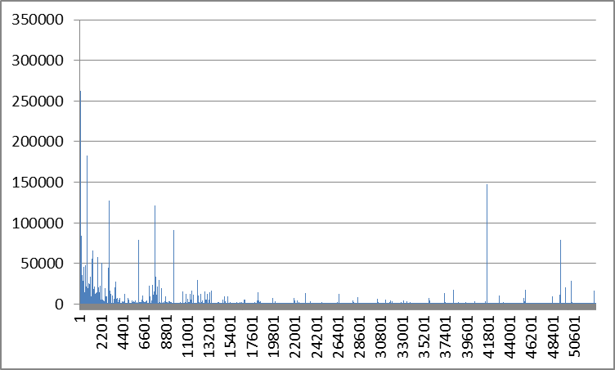
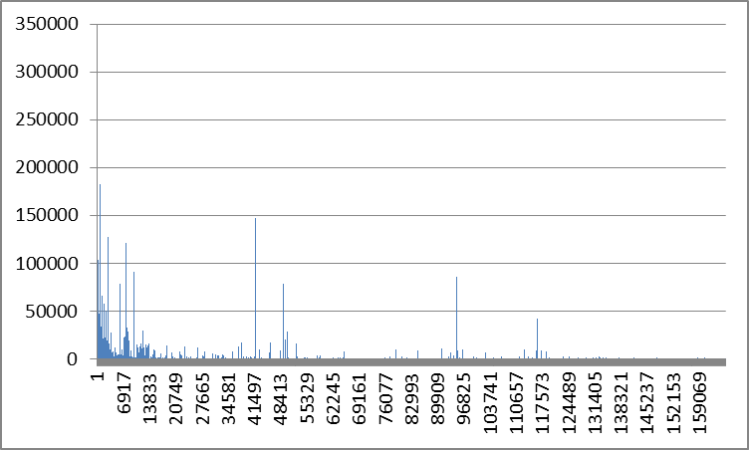
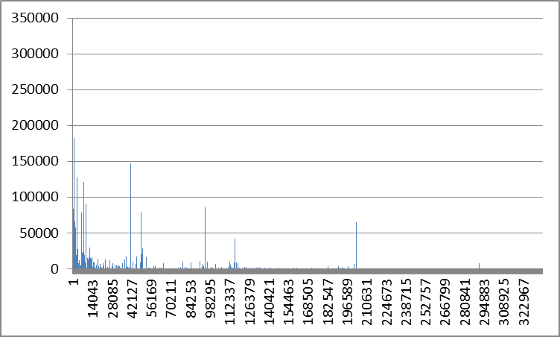
In-Situ Visual Feedback (3)
3001/52800
4002/165984
4207/336994

Slide 20
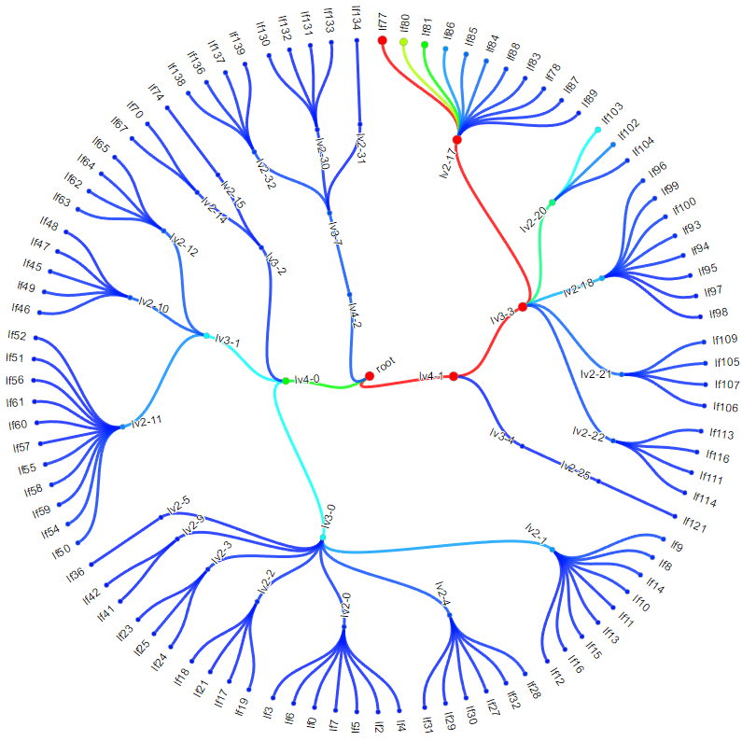
Conclusions and Future Work
Current approach quite promising
  Good speedup and results
  In-situ visualization of data reduction process with early valuable feedback
Future work
  More efficient data storage facilities
  Load-balancing point for multi-GPU
  Accelerate the hierarchy building
  A comprehensive VA system

Slide 21
Final Slide
Thanks for attending!
And thanks to NSF and DOE for funding
Any questions?

