Slide 1


4μ Network of Excellence
Delivering the Knowledge Community in Multi-Material Micro Manufacture
Rob Bell
Natalie Withenshaw
www.ctechinnovation.com
Notes:
1

Slide 2
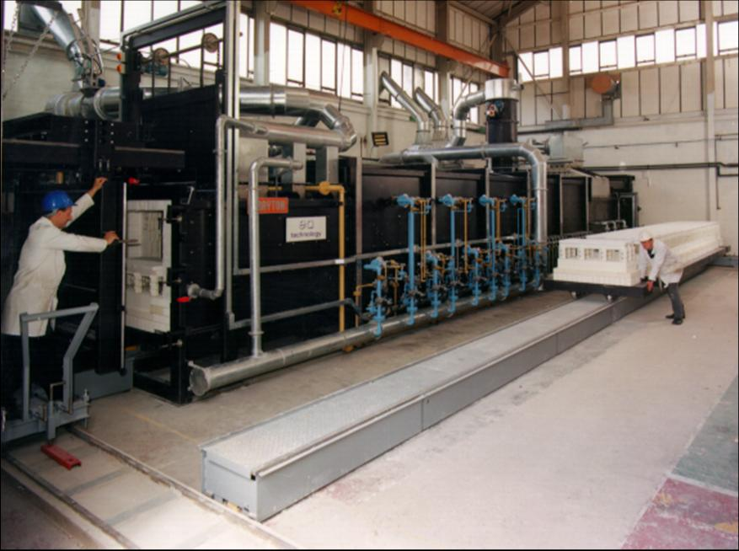
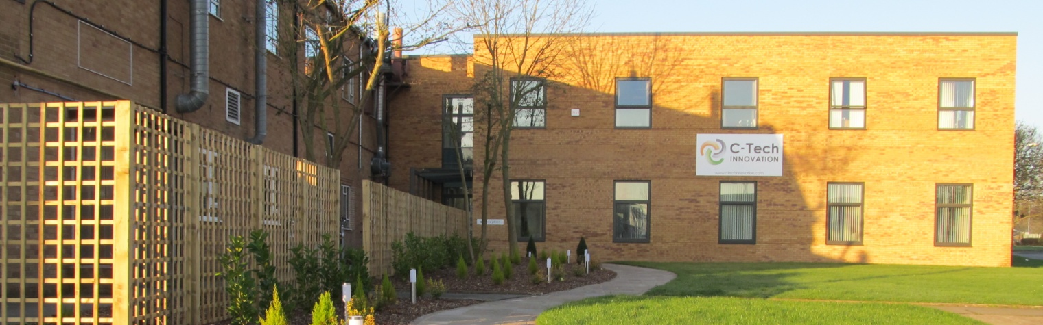
C-Tech Innovation
Electricity Council Research Centre founded in 1961
C-Tech Innovation formed in 2001 after management buyout of the Materials and Process Development Centre
Staff of 60 with around 75% technical bias (Physicists, Chemists, Biochemists, Material and chemical engineers)
Over 1500 patents so far

Slide 3
The C-Tech Organisation
Ventures and Investments
Industrial
Products
Research and
Development
Knowledge and
Management
Services
C-Tech Innovation

Slide 4
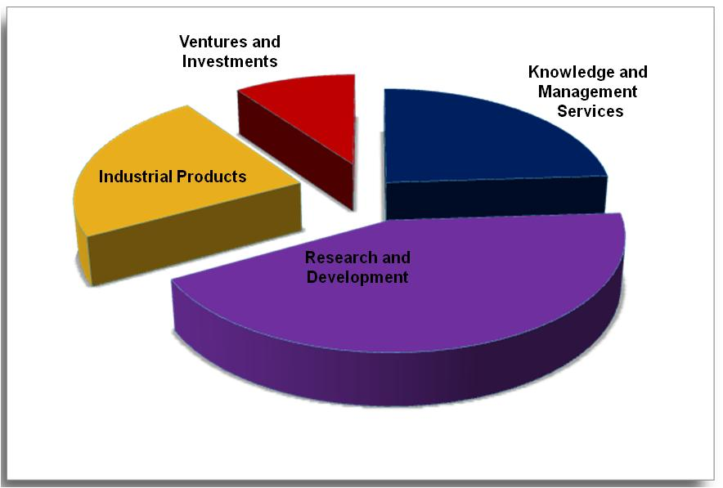
Business Activity Split

Slide 5
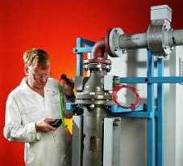
Research & Development
Working in collaboration with clients and partners we work hard to develop practical and commercially successful solutions or products.
Leader in international collaborative research, currently leading or partnering in 24 research programmes with a value of around €40M
Facilities include
Research Laboratories
Prototype build and test facilities
Modelling software (Comsol & Ansys Multi-physics)
Characterisation and analysis equipment
We operate in key technology areas
Energy
Environment
Nanoscience
Security and Safety
Food

Slide 6
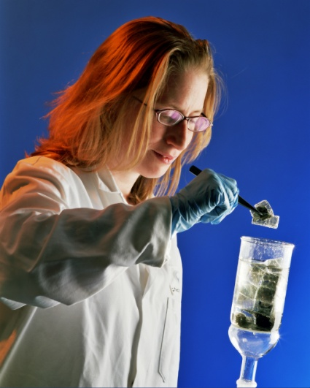
Current Funded Research Activity
Portfolio 24 ongoing research projects
8 UK funded, 16 EU funded
14 FP7 projects running
5 as coordinator
5 more in negotiation
NMP, ENV, KBBE, SEC, ICT
Example projects include:
Nano Materials for Air Quality Monitoring (INTASENSE),
Novel High Temperature Processing (EDEFU),
Zinc air Battery development (POWAIR)
Bio chemical Production of Chiral compounds (KYROBIO)
Metal recovery from industrial effluents (ECOMETRE)

Slide 7

Knowledge & Management Services
To deliver real lasting benefit, innovation must embrace all facets of the organisation: its leadership, its structure, its culture and its strategy
We do this by providing a complete Innovation Management Service - developing operational procedures to deliver sustainability and growth
Programme Management
Designing and delivering complex regional and national,
public sector funded programmes
Business Innovation
More effective leadership and strategy: managing and developing
people, knowledge and processes to deliver innovation and growth
Environmental Leadership
Developing Environmental Leadership to help in reducing
environmental impact whilst developing clear competitive advantage

Slide 8
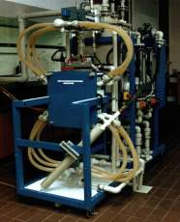
Industrial Products
Business growth is fuelled by successful application of new scientific discovery
We develop and commercialise processes and build equipment for the food, chemical and advanced material industries
Specialisms include
Thermal processing
microwave, radio frequency, ohmic, plasma
Electro-chemistry
waste treatment, metals processing, fuel cells, flow batteries
Engineering Design Service
Commercially available design, analysis, manufacturing and life cycle assessment capability

Slide 9
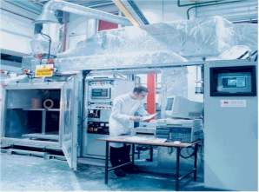
Ventures & Investments
Successful innovation requires successful commercialisation. We work with 3rd parties to exploit ideas, technologies and intellectual property
Commercialisation of Intellectual Property
Creating value from IP
License agreements (licensing in/out)
External partners to enhance commercialisation
Creation of spin-outs
Transfer of IP and knowledge, external funding
C-Tech Innovation Venture Fund
Accelerating growth of in-house and 3rd party technology
Investment Readiness Forums
Advice and feedback from independent investment advisors

Slide 10
The Innovation Journey
Ideation, Strategy,
Opportunity
spotting
Innovation,
Creativity
Commercialisation:
Product, Process
&
Service launch
Concept design
&
scoping
Markets:
Assessments,
Access,
Planning, IP
Research
&
Development
Prototyping

Slide 11

Support of The 4M Network
C-Tech Innovation will provide the Secretariat support for the 4M Network

Slide 12

ESKTN Current Project
Natalie Withenshaw,
Project Marketing Manager, C-Tech Innovation
Environmental Sustainability KTN
Monthly newsletter, weekly e-bulletins
Maintain the website _connect, updating news articles and events listings
Organise events and exhibitions
Produce reports and literature
Promotion of the network, collaborations, PR

Slide 13
Working with 4M members
How will we continue to support members?
Newsletter
Monthly communication with members
Website
News updates, project dissemination
Support for the Annual Conference
Organisation and support
Formatting the review of papers, and liaising with the publisher to produce the transactions for the conference
Membership payments

Slide 14
www.ctechinnovation.com
Notes:
14

