Slide 1
People and the Planet
KS3 Curriculum Project

Slide 2
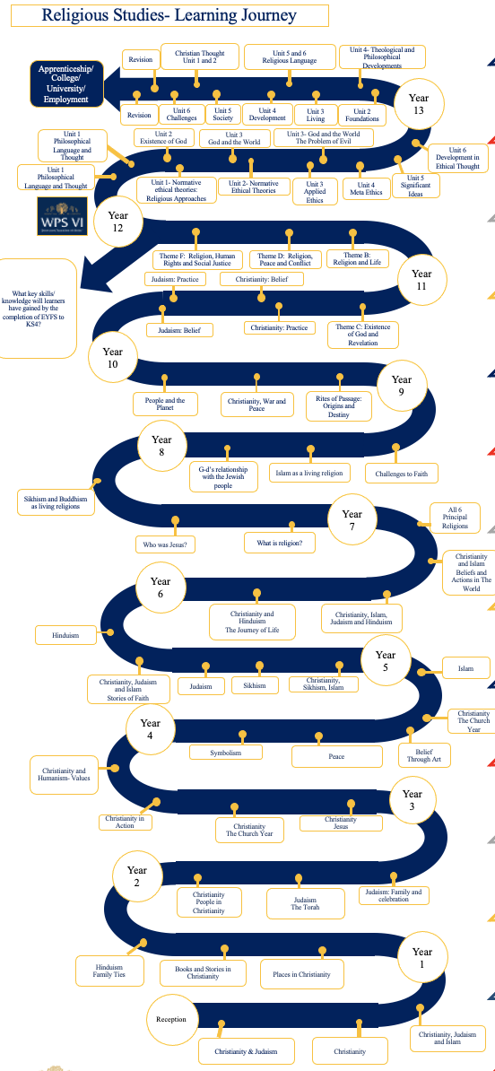


Slide 3



Slide 4
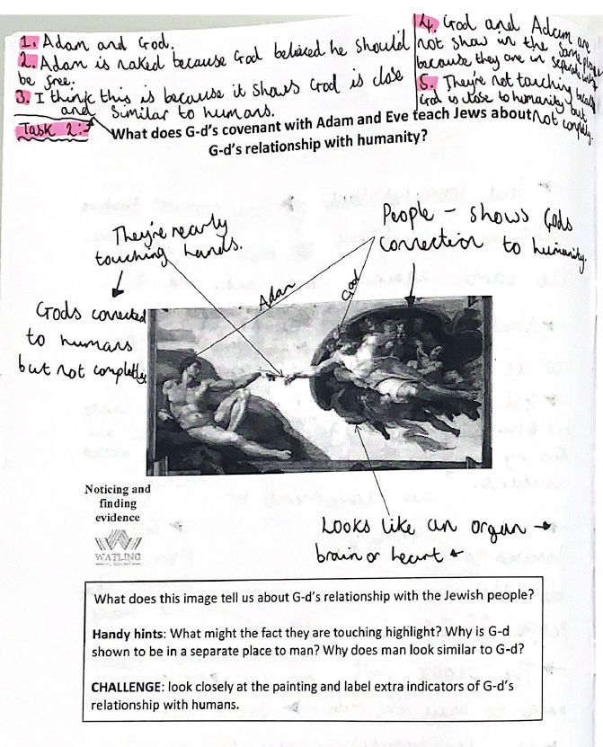
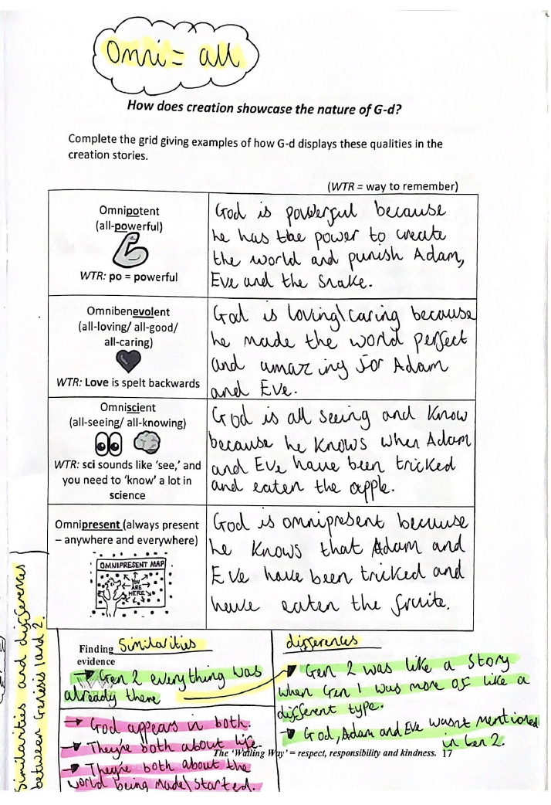
Clarity
Consistency
Centralised
Resource, but not a lesson
Routine
Clear instructions
Revision resource

Slide 5
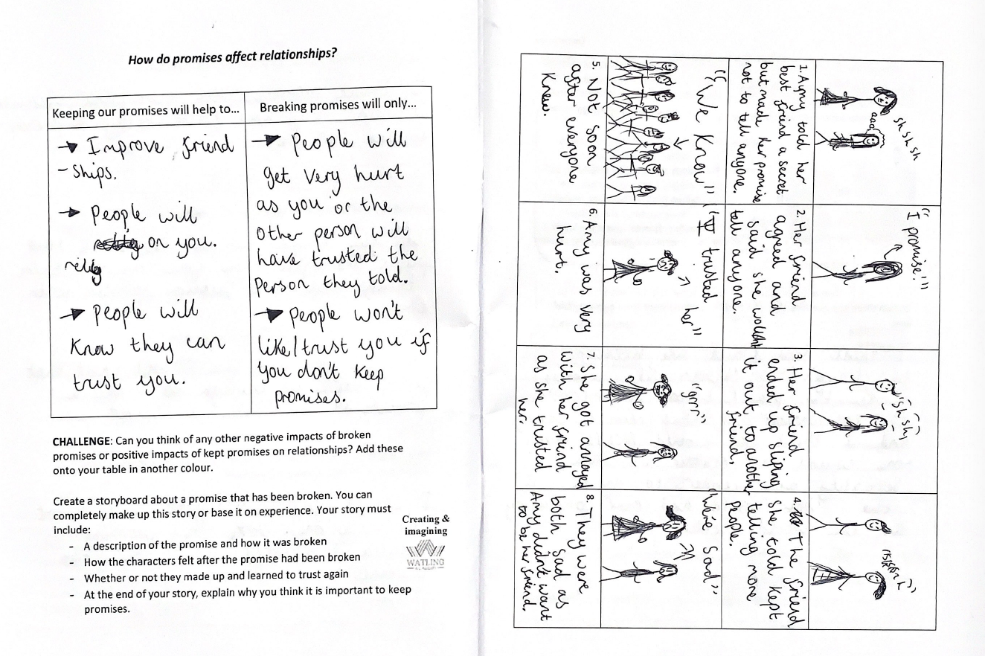

Slide 6

“They should…”
“They need to…”

Slide 7
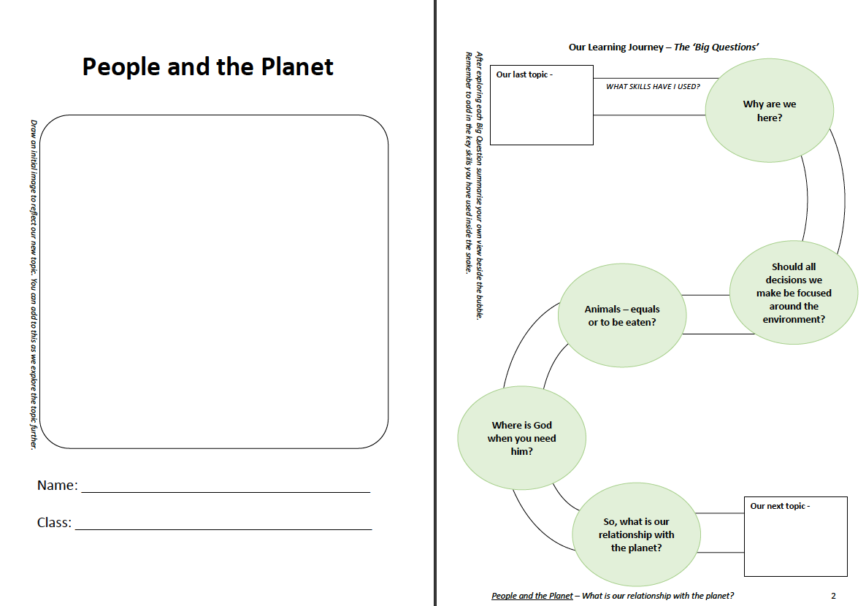

Slide 8
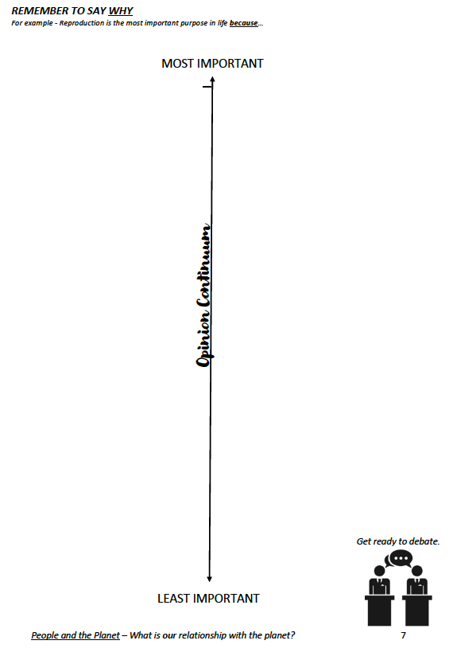

Partner talk
Evaluation

Slide 9
You now have 10 minutes to make a poster displaying ways that we can help stop climate change. Include practical advice and why it is our responsibility to care for the environment.

Slide 10
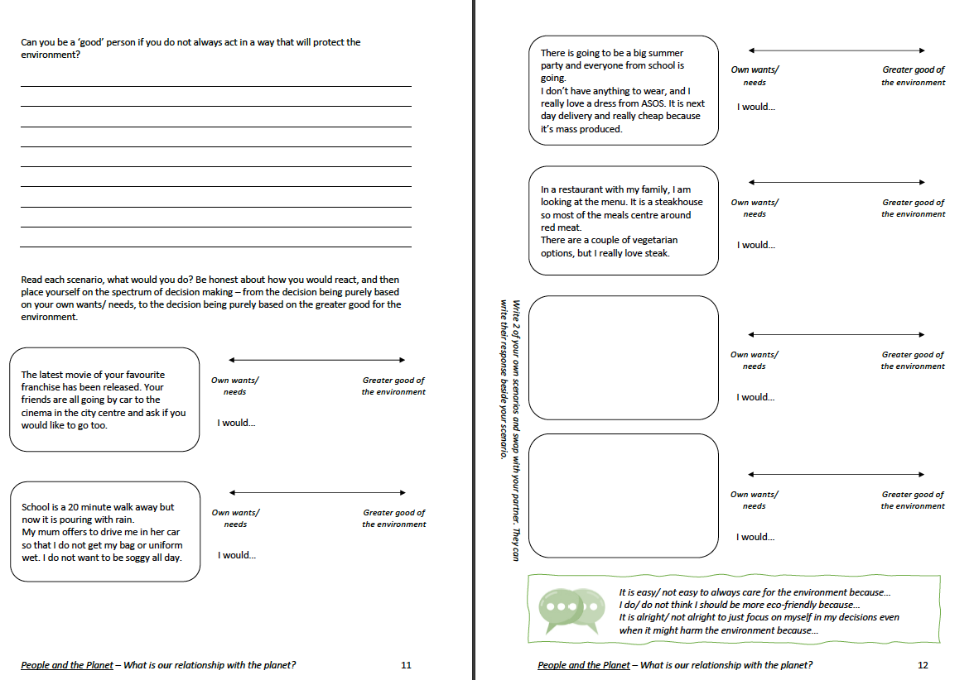

Slide 11
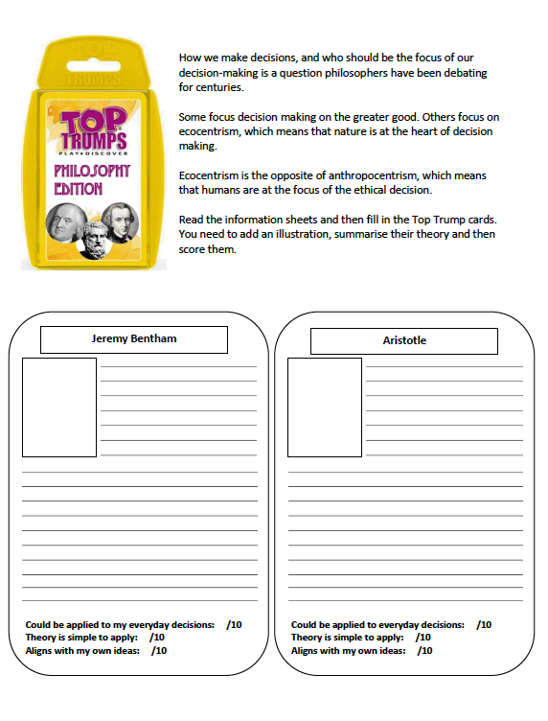
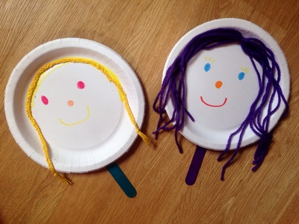

Slide 12
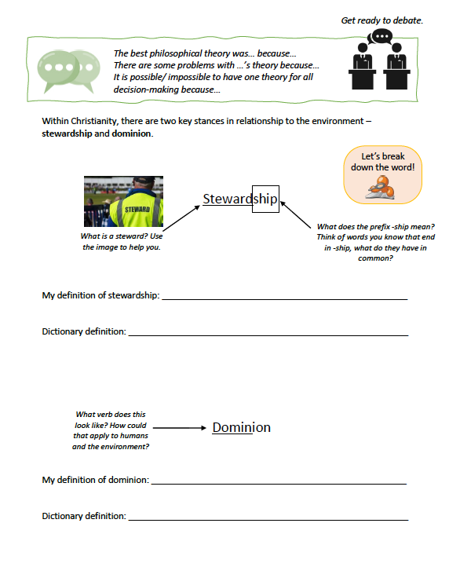

Slide 13
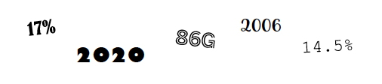

Slide 14
76g = average meat consumed in UK
17% cut in meat consumption in UK in 2021
Livestock are responsible for 14.5% of global greenhouse gases.
2006 = Animal Welfare Act
2020 = ethical veganism is protected belief

Slide 15
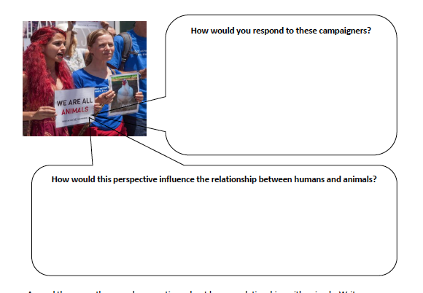

Slide 16
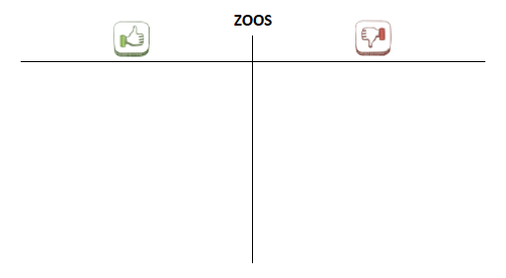
Silent debate

Slide 17
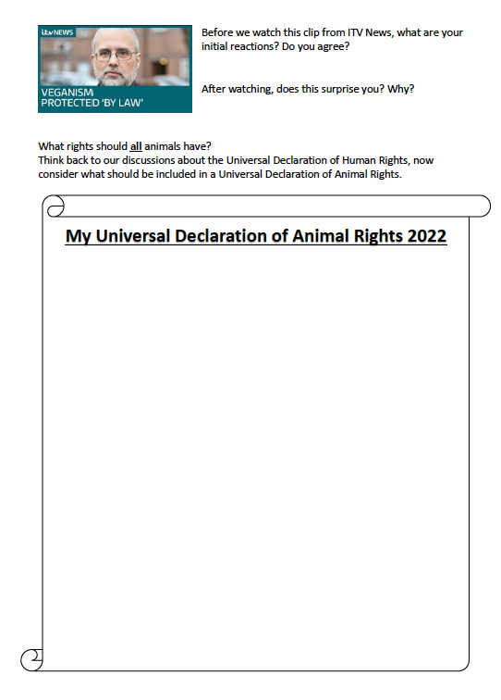

Slide 18
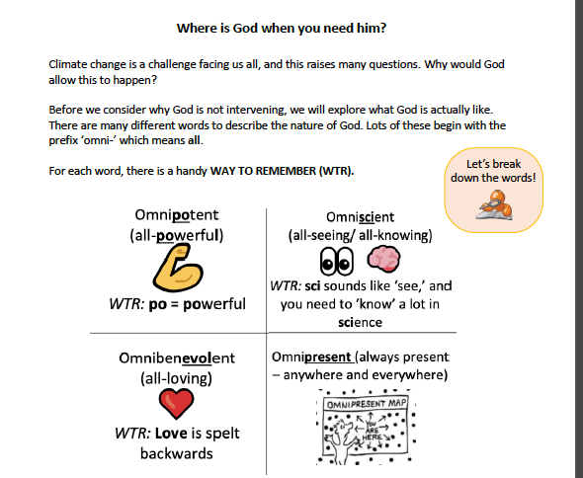

Slide 19
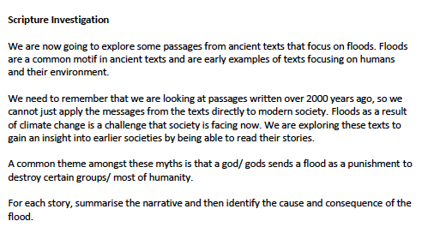
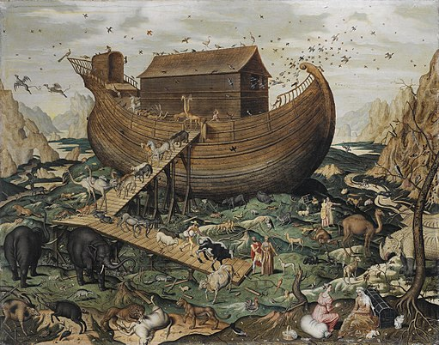

Slide 20
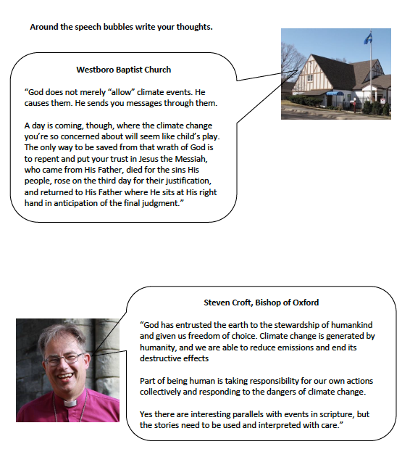

Slide 21
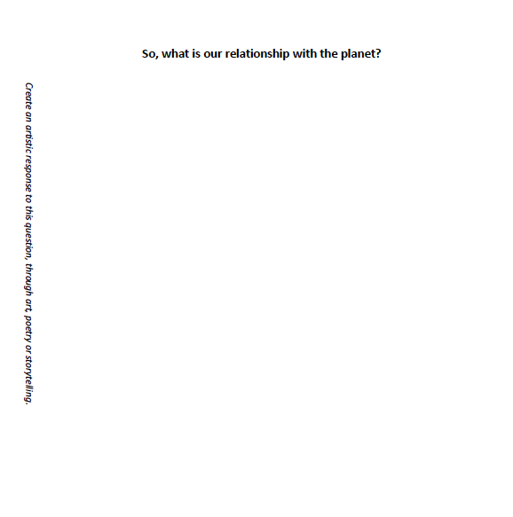
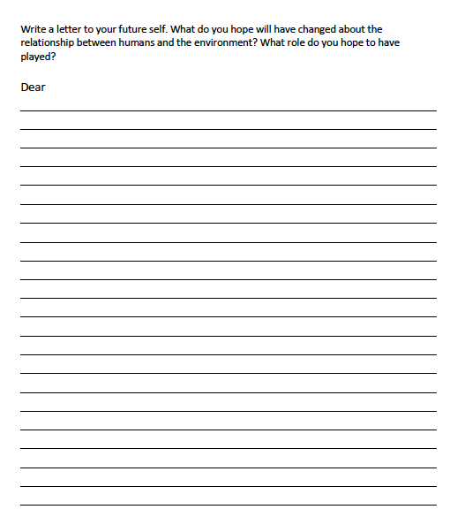

Slide 22
People and the Planet
By the end of the topics, students should…

