Slide 1
TranAD: Deep Transformer Networks for Anomaly Detection in Multivariate Time Series Data
Shreshth Tuli, Giuliao Casale, Nicholas R. Jennings
2022
임동주

Slide 2
목차
Introduction
Related Work
Method
Data Preprocessing
Model Architecture
Loss Function
Experiments
Q&A

Slide 3
Introduction
- Challenges
Data Modality의 증가
IoT 장비 증가로 인한 센서 데이터 급증
데이터의
➔ 데이터의 이상을 “탐지” 하는 것 외에도 그 “원인”을 찾아내는 것도 중요
- Existing Solutions
SAND(Statistical Anomaly Detection)
openGauss / LSTM-NDT
MTAD-GAT / GDN
Etc.

Slide 4
Related Work
- Classical Methods
k-means
SVM
PCA
ARIMA
MERLIN
- DL-based Methods
LSTM-NDT
DAGMM → Autoencoding
LSTM-VAE
ConvLSTM
MAD-GAN
MTAD-GAN
CAEM
GDN 등등

Slide 5

Method
- Data Preprocessing

Slide 6
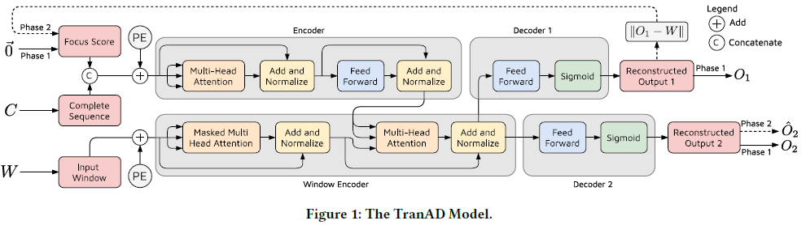
Method
- Model Architecture
Notes:
LN: Layer Norm
MLP : Multi Layer Perceptron

Slide 7

Method
- Loss Function(Adversarial Training)
Notes:
-Input -> Q,K,V : (Npatch​×C)∗(C×C)→(Npatch​×C) -Q∗KT∗V : (Npatch​×C)∗(C×Npatch​)∗(Npatch​×C)→(Npatch​×C) -Attention -> Output : (Npatch​×C)∗(C×C)→(Npatch​×C)
-Input -> Q,K,V : Npatch​C2 -Q∗KT∗V : 2Npatch2​C -Attention -> Output : Npatch​C2

Slide 8
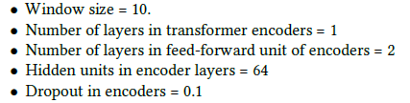
Experiments
- Hyperparameters
Notes:
[1K]
ViT Baseline보다 파라미터는 적으나 성능은 높음
Convnet 모델 기반모델들과 비교해서 약간 나은 speed-accuracy trade-off
Efficientnet과 비등한 성능
[22K]
Swin 모델들이 전반적으로 높은 정확도.

Slide 9
Experiments
- Datasets
- Metrics
Numenta Anomaly Benchmark(NAB)
HexagonML(UCR)
MIT-BIH supraventricular Arrhythmia Database(MBA)
Soil Moisture Active Passive(SMAP)
Mars Science Laboratory(MSL)
Secure Water Treatment(SWaT)
Water Distribution(WADI)
Server Machine Dataset(SMD)
Multi-Source Distributed System(MSDS)
Anomaly Detection
> precision, recall, ROC/AUC
Anomaly Diagnosis
> HitRate@P%
Notes:
Backbone 모델로서도 준수한 성능.

Slide 10
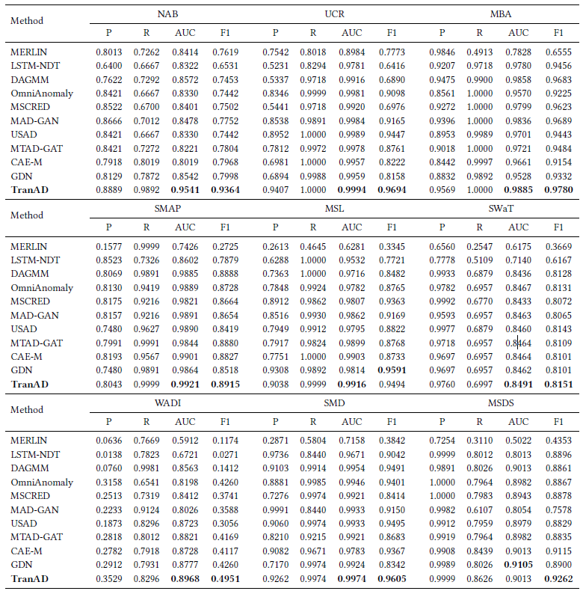
Experiments
- Result(Detection)

Slide 11
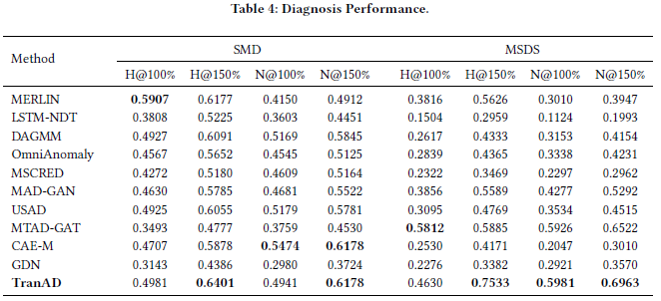
Experiments
- Result(Diagnosis)

Slide 12
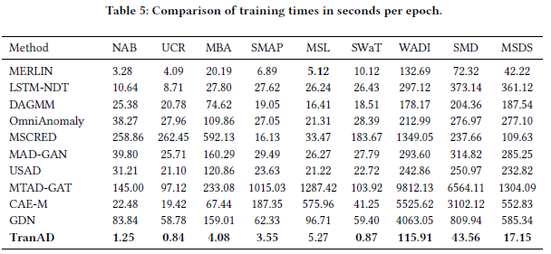
Experiments
- Result(Training Time)

Slide 13
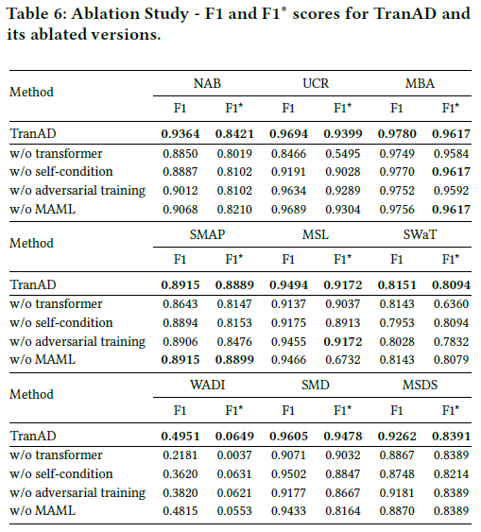
Experiments
- Ablation Studies
Notes:
F1* score : 학습 데이터 중 20%만 사용하여 학습(이것도 8:2로 나누어 학습/valid 수행)

Slide 14
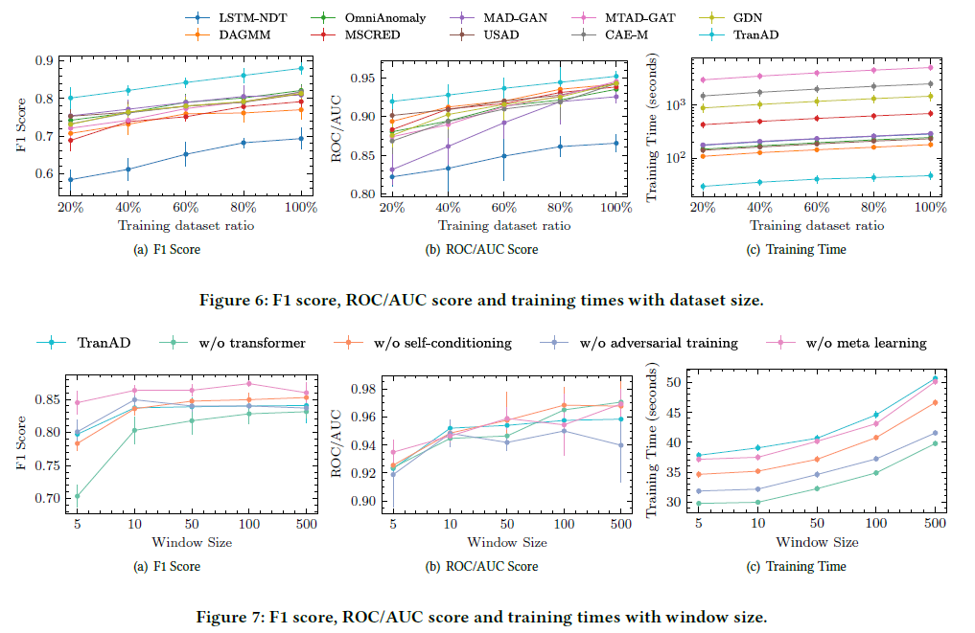
Experiments
- Ablation Studies

Slide 15
Q&A
[Github]
https://github.com/microsoft/Swin-Transformer

