Slide 1
Project Concept Audit
Tianming zhao u5961519

Slide 2
Company
Centre for Internet Safety(CIS)
CIS was created to foster a safer, more trusted Internet by providing thought leadership and policy advice on the social, legal, political and economic impacts of cybercrime and threats to cybersecurity.[1]

Slide 3
Project Content
Combine AI/machine learning concept with open source penetration testing tools to build a tool that can conduct automated penetration testing web application and give better result.

Slide 4
What is penetration testing?
A penetration test, colloquially known as a pen test, is an authorized simulated attack on a computer system that looks for security weaknesses, potentially gaining access to the system's features and data.[2]

Slide 5
The process of penetration testing
Information collection
Vulnerability scanning
Exploit
Payload

Slide 6
Why this project is valuable?
For penetration testers
This project will simplify their job.
For web developers
This project will give them the ability to detect vulnerability earlier.

Slide 7
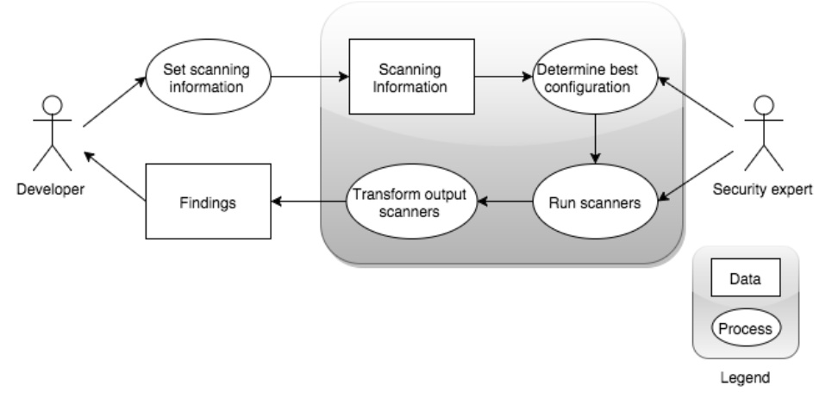
Initial idea about the project
[3]

Slide 8
Timetable
Week | Content
Week 1 - 4 | Learn pen-testing
Week 5 | Design
Week 6 - 8 | Build & Test the 1st function
Week 9 - 11 | Build & Test the 2nd function
Week 12 - 14 | Build & Test the 3rd function

Slide 9
Thank you

Slide 10
References
[1] http://www.canberra.edu.au/cis/aboutcis/
[2] https://en.wikipedia.org/wiki/Penetration_test
[3] Y.R. Smeets, BSc , 2015, Improving the Adoption of Dynamic Web Security Vulnerability Scanners

