Slide 1
旅行推銷員問題
Traveling Salesman Problem, TSP

Slide 2
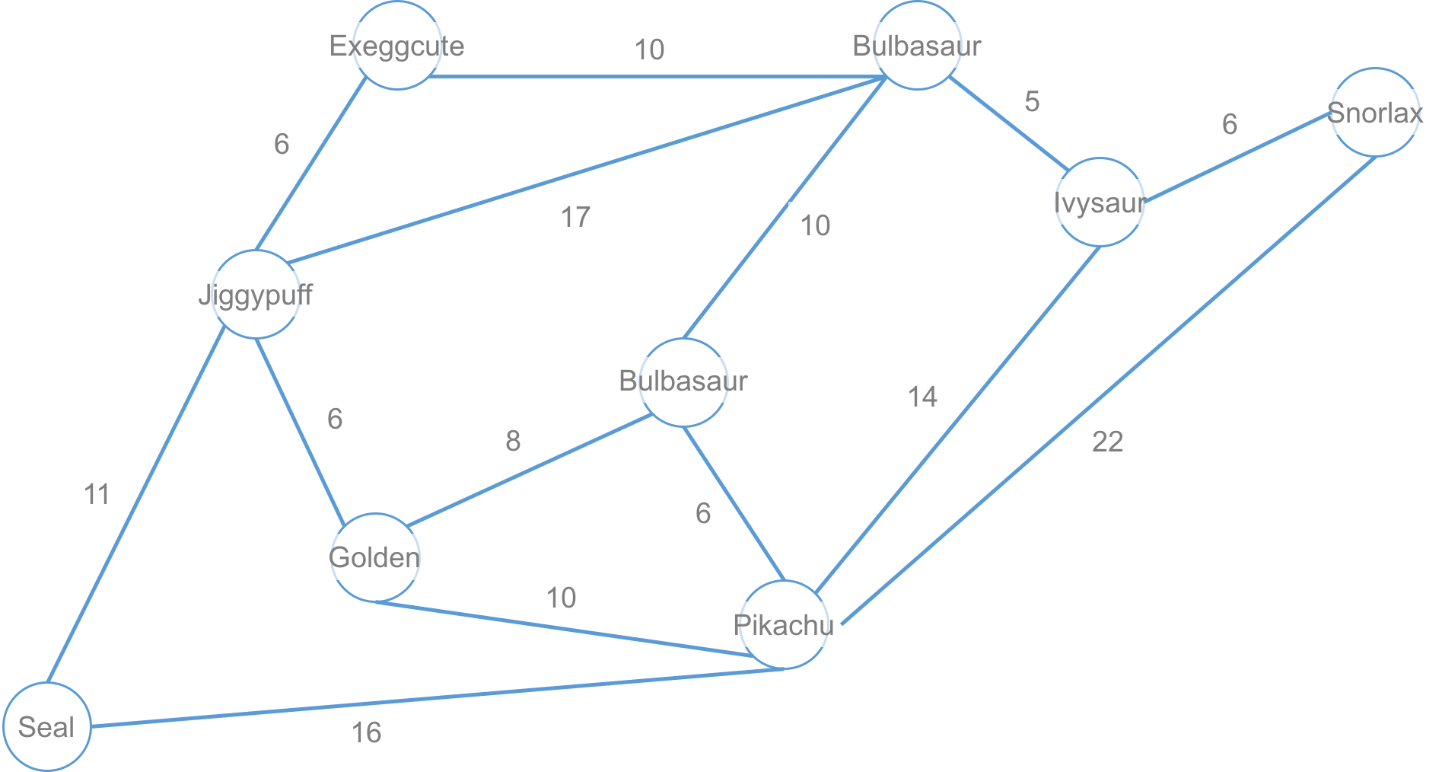
如何將圖Graph儲存下來？
6
2
7
8
1
5
3
4
0

Slide 3
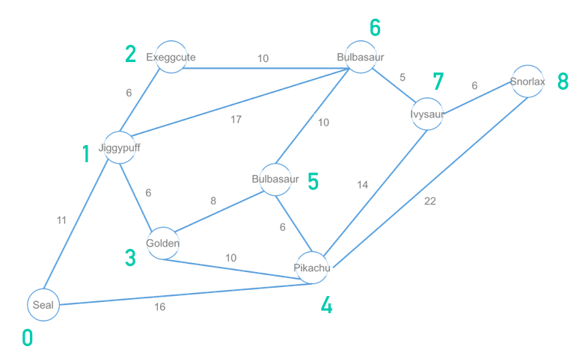
如何將圖Graph儲存下來？
 | [0] | [1] | [2] | [3] | [4] | [5] | [6] | [7] | [8]
[0] |  | 11 |  |  | 16
[1] | 11 |  | 6 | 6 |  |  | 17
[2] |  | 6 |  |  |  |  | 10
[3] |  | 6 |  |  | 10 | 8
[4] | 16 |  |  | 10 |  | 6 |  | 14 | 22
[5] |  |  |  | 8 | 6 |  | 10
[6] |  | 17 | 10 |  |  | 10 |  | 5
[7] |  |  |  |  | 14 |  | 5 |  | 6
[8] |  |  |  |  | 22 |  |  | 6

Slide 4
如何將圖Graph儲存下來？
 | [0] | [1] | [2] | [3] | [4] | [5] | [6] | [7] | [8]
[0] | 0 | 11 |  |  | 16
[1] | 11 | 0 | 6 | 6 |  |  | 17
[2] |  | 6 | 0 |  |  |  | 10
[3] |  | 6 |  | 0 | 10 | 8
[4] | 16 |  |  | 10 | 0 | 6 |  | 14 | 22
[5] |  |  |  | 8 | 6 | 0 | 10
[6] |  | 17 | 10 |  |  | 10 | 0 | 5
[7] |  |  |  |  | 14 |  | 5 | 0 | 6
[8] |  |  |  |  | 22 |  |  | 6 | 0

Slide 5
點到點之間最短路徑
 | [0] | [1] | [2] | [3] | [4] | [5] | [6] | [7] | [8]
[0] | 0 | 11 | 17 |  | 16
[1] | 11 | 0 | 6 | 6 |  |  | 17
[2] |  | 6 | 0 |  |  |  | 10
[3] |  | 6 |  | 0 | 10 | 8
[4] | 16 |  |  | 10 | 0 | 6 |  | 14 | 22
[5] |  |  |  | 8 | 6 | 0 | 10
[6] |  | 17 | 10 |  |  | 10 | 0 | 5
[7] |  |  |  |  | 14 |  | 5 | 0 | 6
[8] |  |  |  |  | 22 |  |  | 6 | 0

Slide 6
點到點之間最短路徑
 | [0] | [1] | [2] | [3] | [4] | [5] | [6] | [7] | [8]
[0] | 0 | 11 | 17 | 17 | 16
[1] | 11 | 0 | 6 | 6 |  |  | 17
[2] |  | 6 | 0 |  |  |  | 10
[3] |  | 6 |  | 0 | 10 | 8
[4] | 16 |  |  | 10 | 0 | 6 |  | 14 | 22
[5] |  |  |  | 8 | 6 | 0 | 10
[6] |  | 17 | 10 |  |  | 10 | 0 | 5
[7] |  |  |  |  | 14 |  | 5 | 0 | 6
[8] |  |  |  |  | 22 |  |  | 6 | 0

