Slide 1
Project
MovieLens data sets (100k dataset)
Collected by the GroupLens Research Project at the University of Minnesota
This data set consists of:
100,000 ratings (1-5) from 943 users on 1682 movies. (Each user has rated at least 20 movies.)
Simple demographic info for the users (age, gender, occupation, zip)
README (data formats)

Slide 2
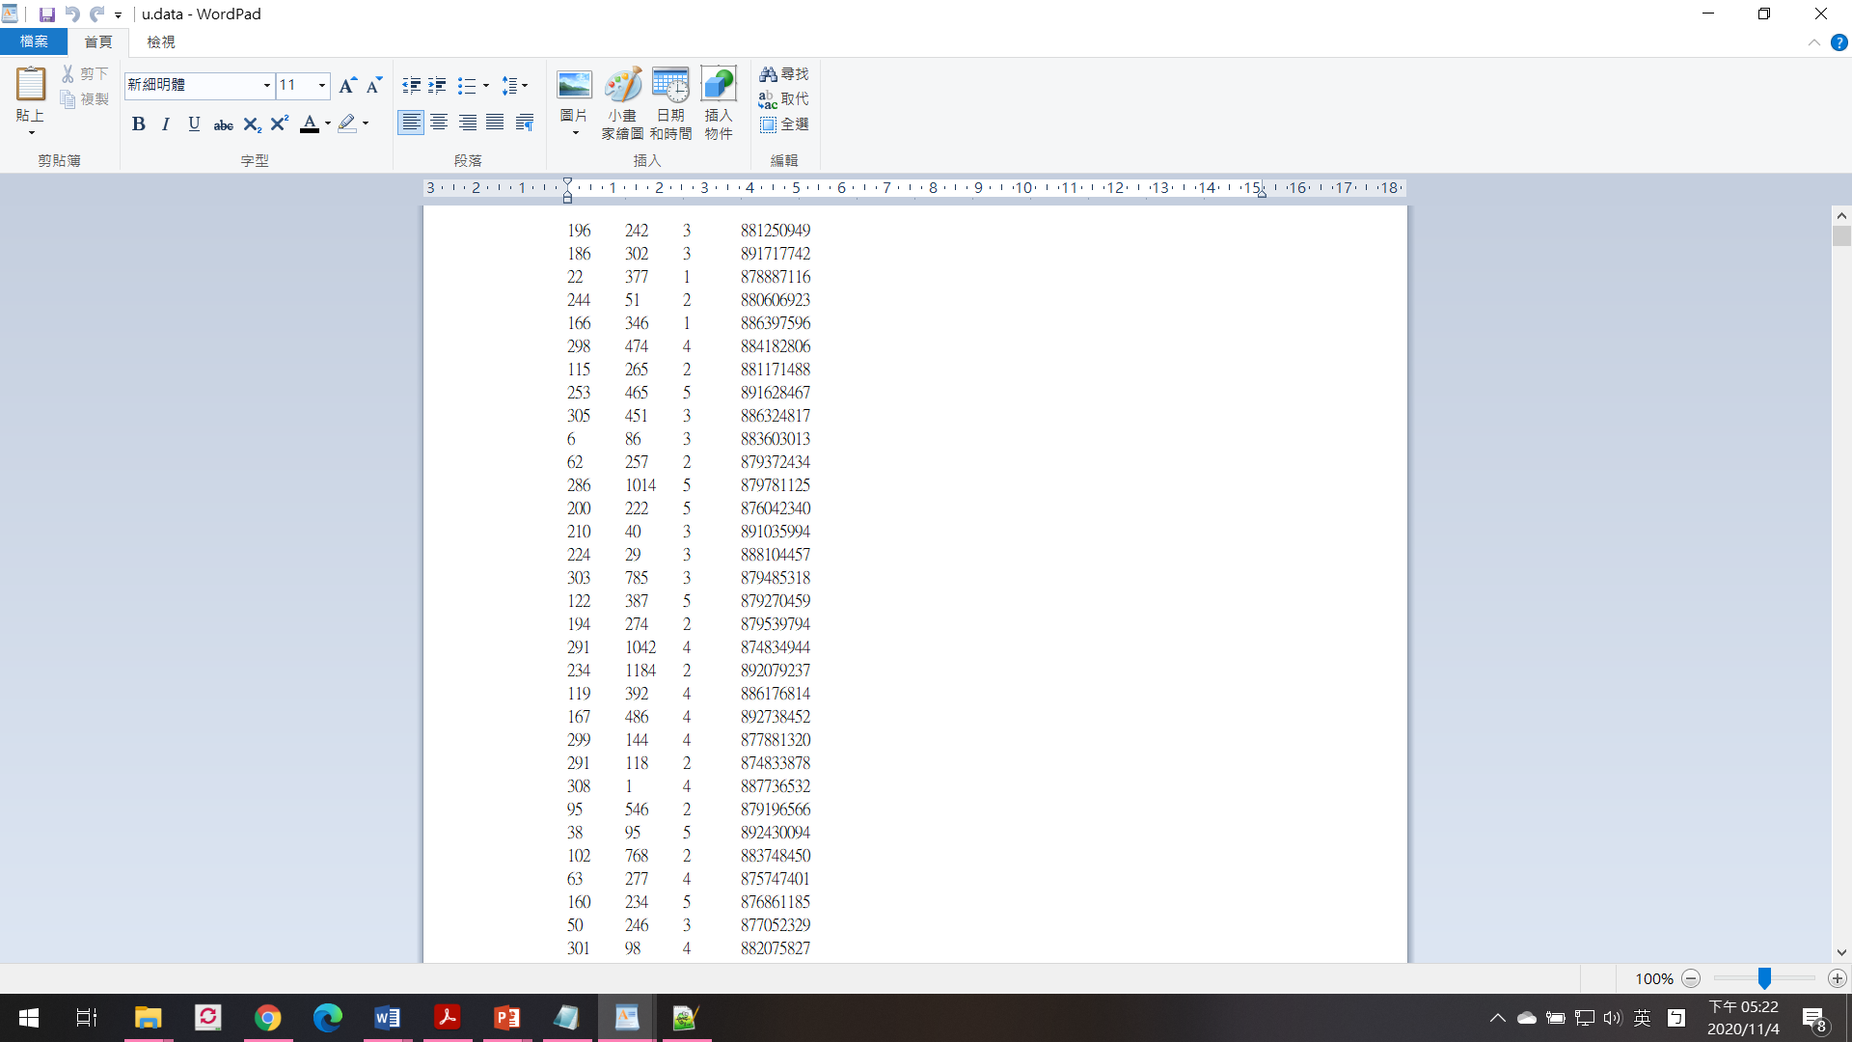
Rating Data
u.data
100000 ratings by 943 users on 1682 items
user id|item id|rating|timestamp

Slide 3

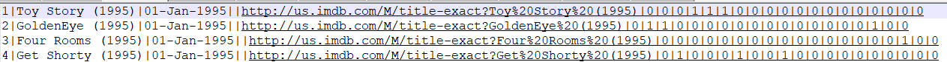
Movie Items
u.item
Information about the items (movies)
movie id | movie title | release date | video release date | IMDb URL | unknown | Action | Adventure | Animation | Children's | Comedy | Crime | Documentary | Drama | Fantasy | Film-Noir | Horror | Musical | Mystery | Romance | Sci-Fi | Thriller | War | Western |
The last 19 fields are the genres, a 1 indicates the movie is of that genre, a 0 indicates it is not; movies can be in several genres at once.
The movie ids are the same as item ids in u.data
All URLs are unreachable now

Slide 4
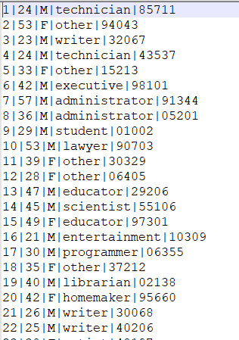
User Data
u.user
Demographic information about the users
user id | age | gender | occupation | zip code
The user ids are the ones used in u.data
The list of the occupations(21) u.occupation

Slide 5
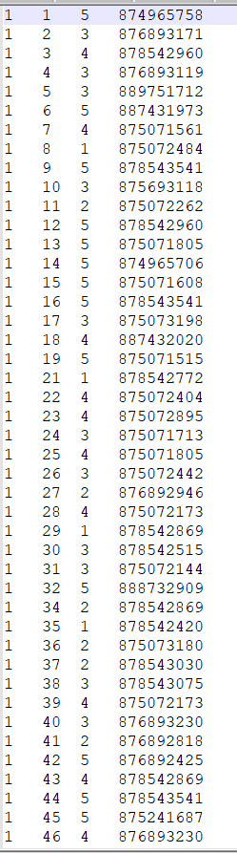
Training and Testing
Training and test data set
ua.base, ua.test
ub.base,ub.test
The data sets split the u.data into a training set and a test set with exactly 10 ratings per user in the test set
ua.test and ub.test are disjoint
Five-fold cross validation
u1~u5

Slide 6
Project Team
2~3 persons per team
Oral presentation
Show the work on data analysis
Beginning example
Show the work on recommendation
Compared with at least the item based neighborhood CF
Upload the report in ipynb format with codes and text descriptions (explain your observations, solutions, results, etc.)

