Slide 1
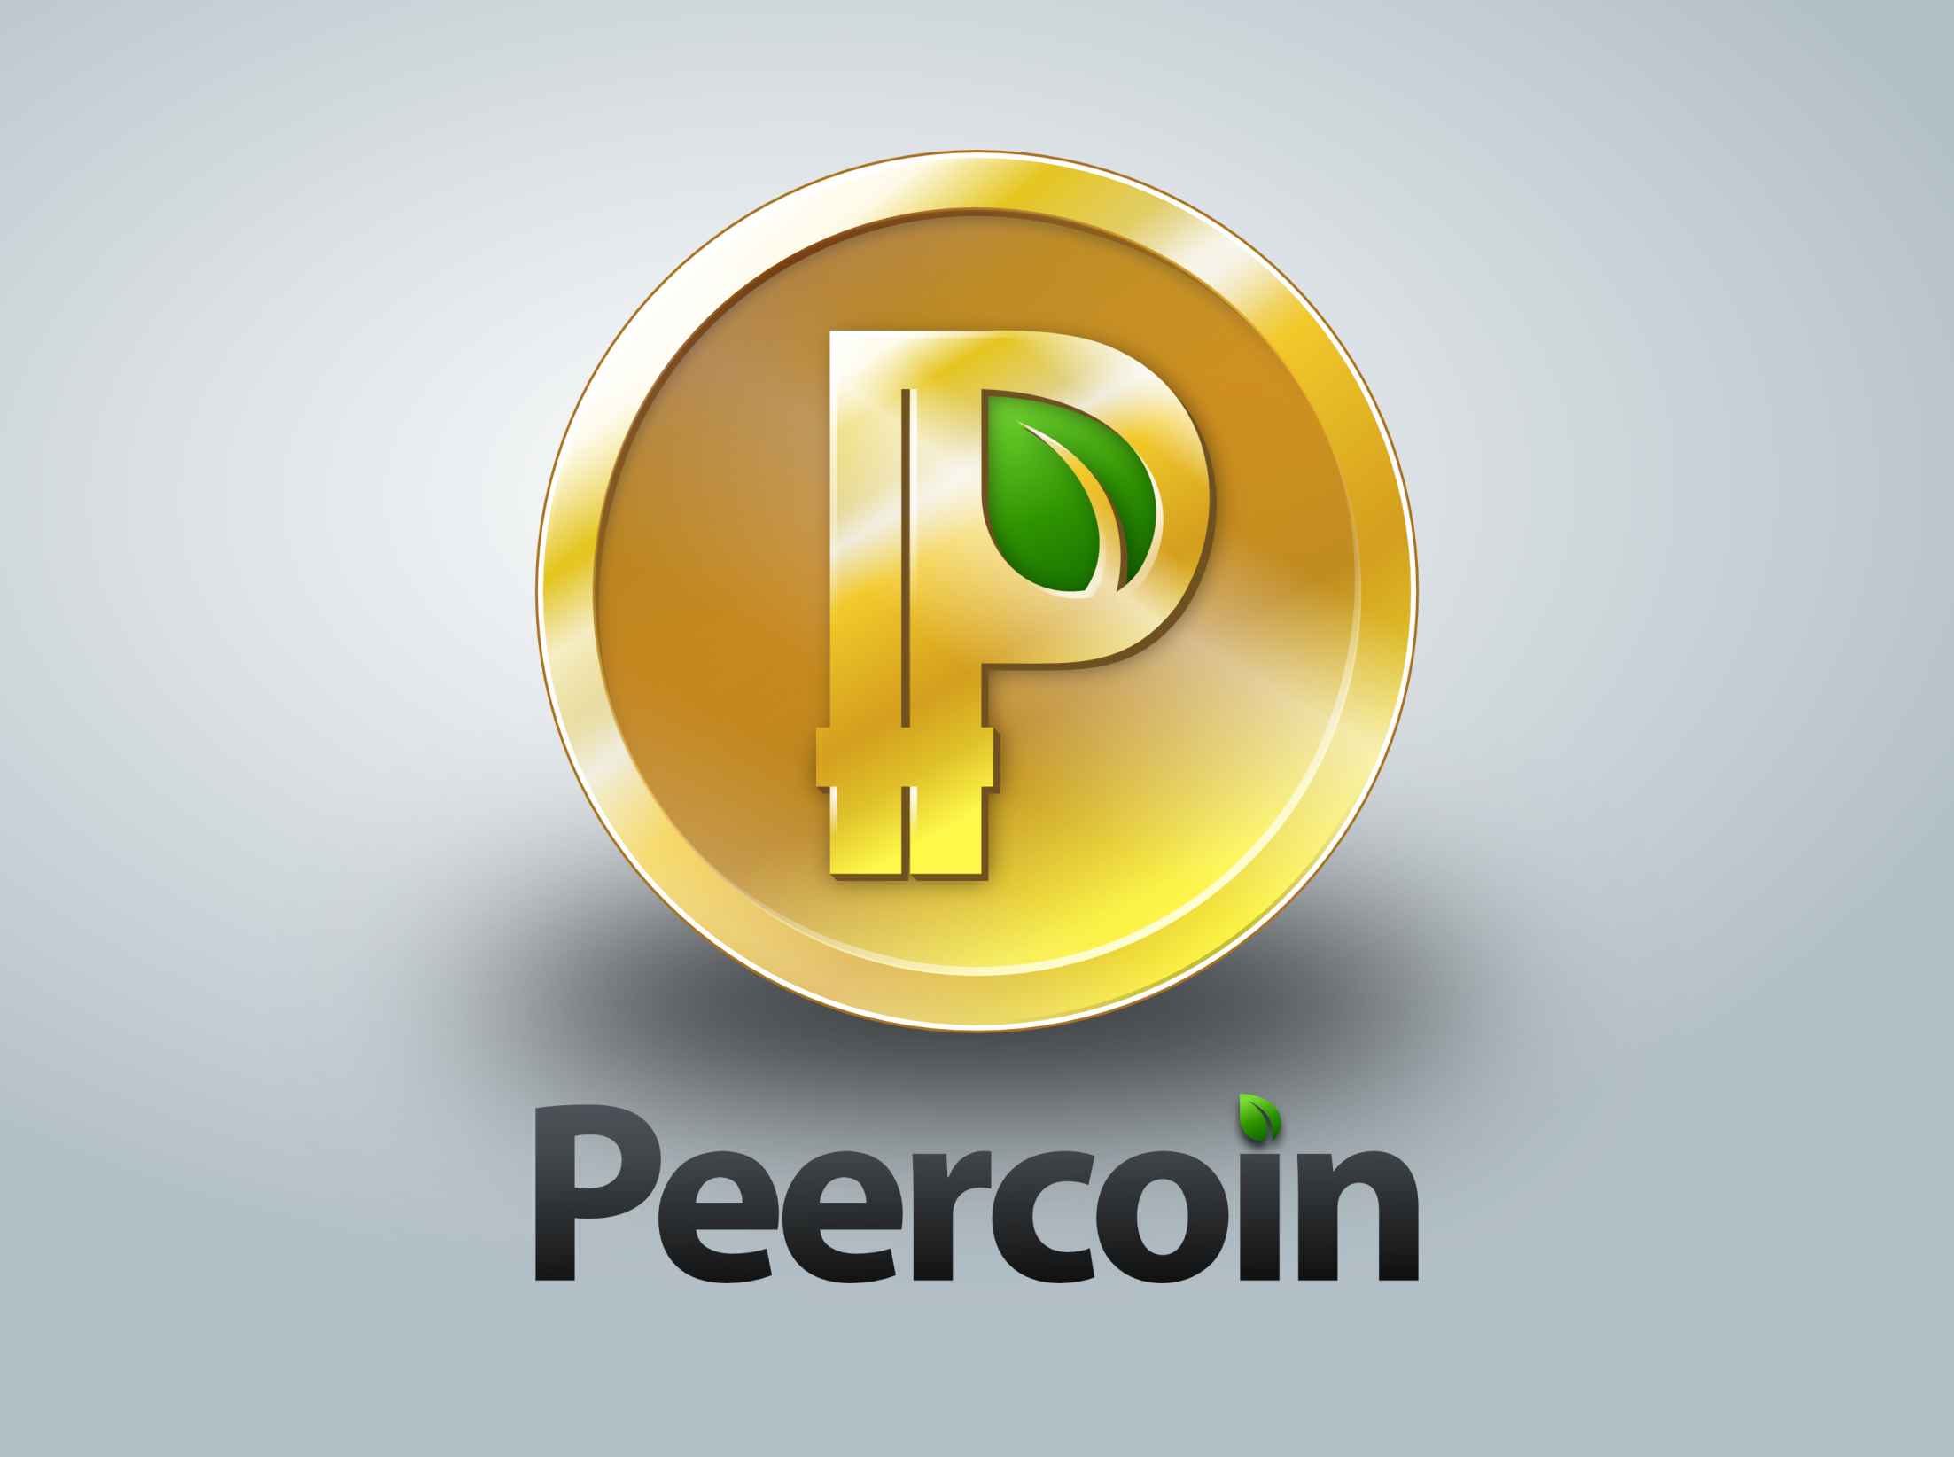

Slide 2
“The Secure & Sustainable Cryptocoin”
Created in 2012 and Inspired by Bitcoin
First Proof-of-Stake/Proof-of-Work Hybrid
Increased Protection from “51% Attack”
An Energy-Efficient Approach to Decentralized Currency

Slide 3
What is Proof-of-Stake?
“Minting” instead of Mining Used to Secure the Network. Coin Age Helps Validate Transactions
1% Block Reward Per Annum. Equal for Everyone who Mints
Hybrid = “Best of Both Worlds”
PoW: Fair Initial Distribution
PoS: Long-term Security

Slide 4
Significance of Proof-of-Stake
PoS Solves the “Tragedy of the Commons”
Minting Helps Keep Block Generation More Decentralized and Fair
Backbone Currency:
Small Blockchain
Fixed 0.01 PPC Transaction Fee
Transaction Fee is Destroyed
Inflation vs Deflation Leads to Equilibrium
Long-term Stable Store of Value

Slide 5
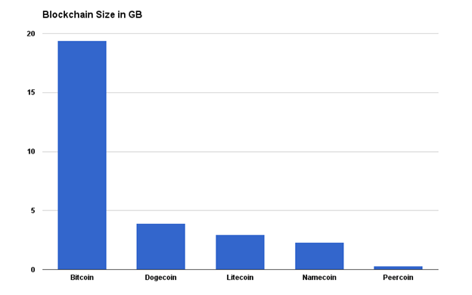
Blockchain Size Comparison

Slide 6
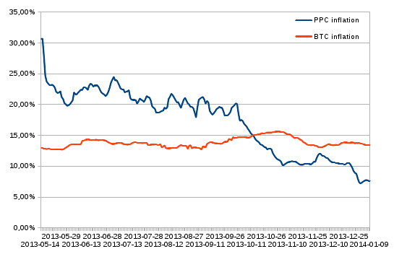
Money Supply Comparison
Market Cap:
~ $70 Million
Price Per Coin:
~ $3.30
Total Supply:
~ 21,200,000
Source: cointrader.org

Slide 7
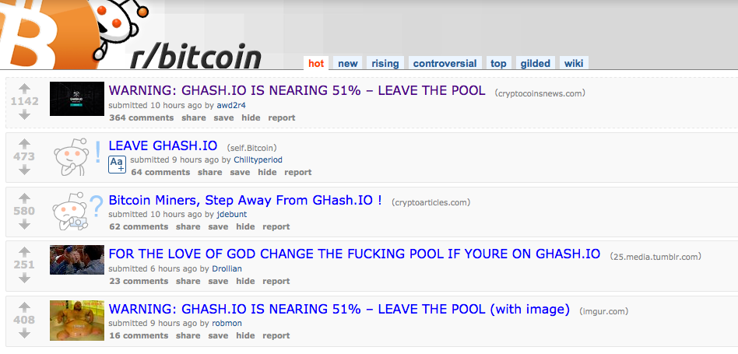
How is Peercoin More Secure?
Peercoin is More Resistant to 51% Attack
Bitcoin Mining Leads to Centralization

Slide 8
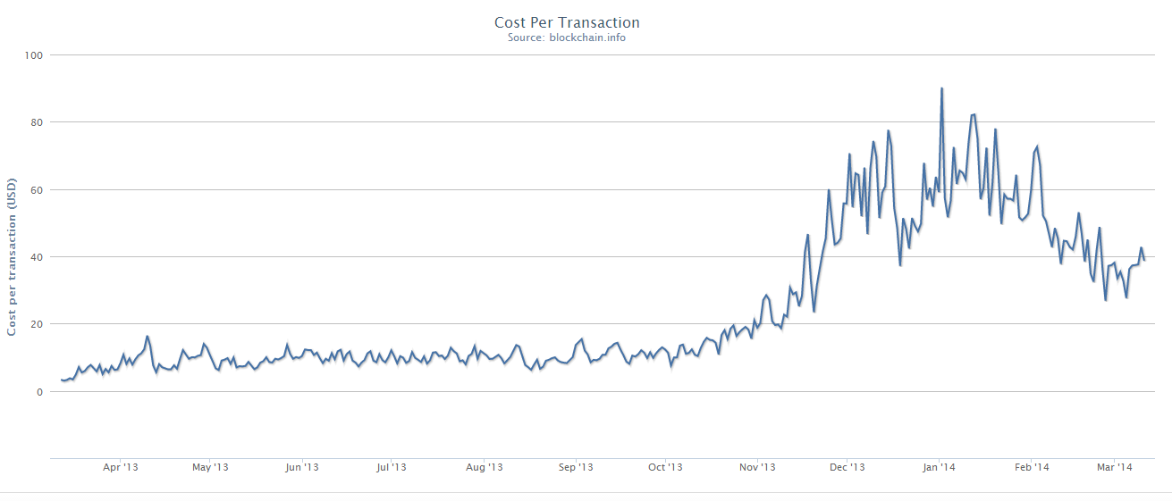
Does Energy-Efficiency Matter?
Bitcoin Network Costs Over $15 Million Per Day – Forbes (http://www.forbes.com/sites/timworstall/2013/12/03/fascinating-number-bitcoin-mining-uses-15-millions-worth-of-electricity-every-day/)

Slide 9


Slide 10
What are Peershares?
Decentralized Distribution of Shares and Dividends
Inexpensive IPO for Businesses Without the Need for a Third-Party
$500,000 Raised in Funding
Utilizes Peercoin Network as a Backbone
Future Indirect Funding of Peercoin Development

Slide 11
Ongoing Progress
Version 0.4 Release
peer4commit.com
Easy-to-Understand Video User Guides
Active Enthusiastic Community

Slide 12


Want to Learn More?
Official Website Forum
Peercoin.net Peercointalk.org
@PeercoinPPC facebook.com/Peercoin

