Slide 1

PREDICTION OF MARKET TRENDS
MENTOR:
PROF. G. WALUNJKAR

Slide 2
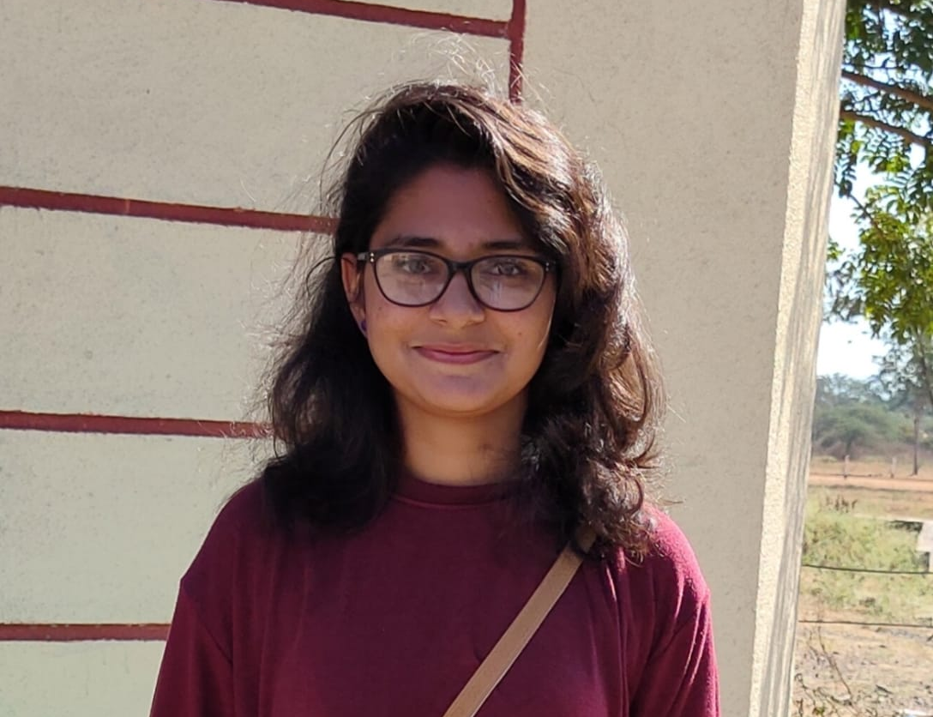

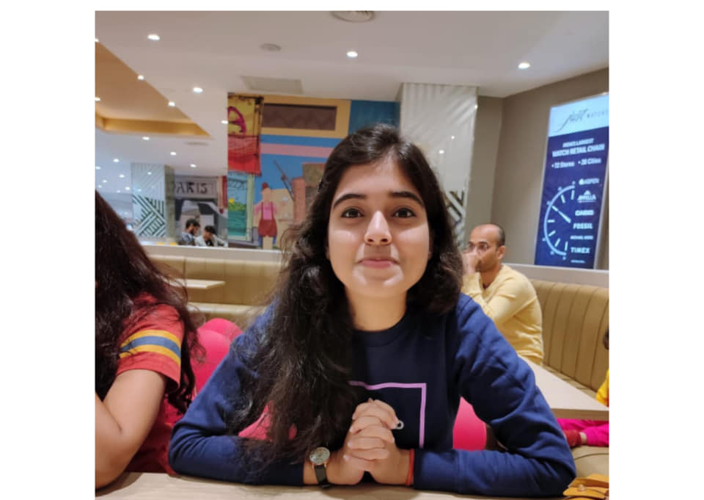
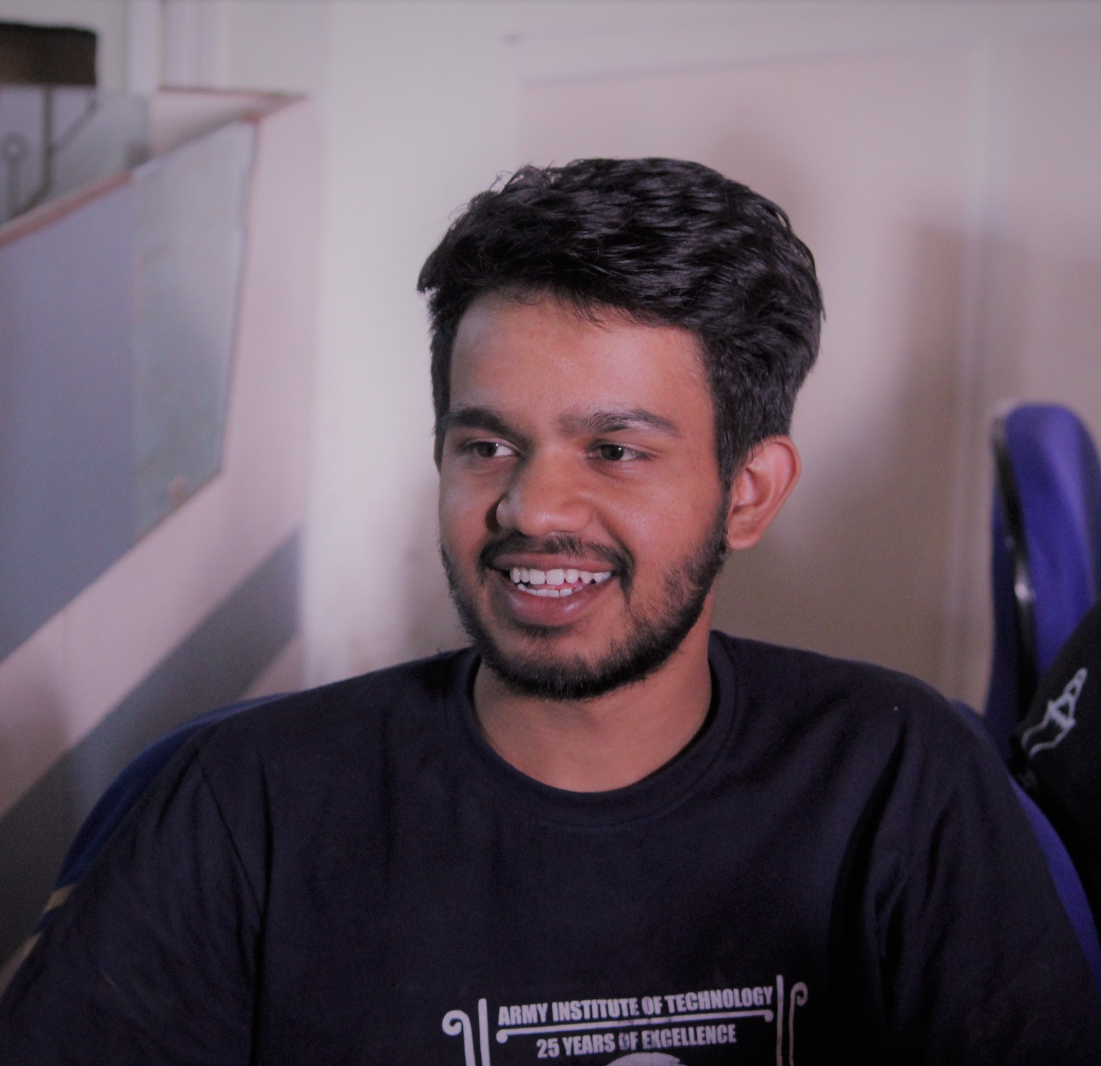

TEAM INTRODUCTION
MAYANK KUMAR 4435
PAYAL 4442
R SANKALP 4446
SHIKHA JHA 4457

Slide 3


Prediction of Market trends
Introduction to Indian markets and factors affecting .
Sentimental Analysis and its Influence
Module Development process
Algorithm Comparisons
DIVISONS OF PROJECT

Slide 4

Basic Software Project Plan
Prediction of Market Trend – (Link to Research Paper)

Slide 5
Basic Software Project Plan
Problem Statement :
The proportion of individual investors in India has been in a high level, especially after the start of the bull market in 2020. The number of the new account openings India is increasing in recent years and individual investors have become an important part to the development of Indian markets.
With the popularity of Internet, Internet forum is the main channel for individual investors to vent their emotions and pick-up information. Therefore, we use the digital data and news feeds to construct the investor attention or sentiment index of any major index like NIFTY50, SENSEX, etc and test the corelation between media attention(sentiments) and trading volume in predicting their trends.

Slide 6
Basic Software Project Plan
GOALS AND OBJECTIVES. :
Sentiment analysis or opinion mining makes use of text mining, natural language processing (NLP), in order to identify and extract the subjective content by analysing user’s opinion, evaluation, sentiments, attitudes and emotions.
The prediction of mood/trend of stock markets is a vital problem, where a trader wants to make a position with predefined amount of shares over a fixed time horizon in the predicted trend.

Slide 7
Basic Software Project Plan
Project Scope. :
Use of recently introduced machine learning techniques in the prediction of stocks have yielded promising results and thereby marked the use of them in profitable exchange schemes. It has led to the conclusion that it is possible to predict stock market with more accuracy and efficiency using machine learning techniques.
In the future, the stock market prediction system can be further improved by utilizing a much bigger dataset than the one being utilized currently. This would help to increase the accuracy of our prediction models.

Slide 8
Basic Software Project Plan
General Requirements. :
Data collection
Software:
Python - Jupyter Notebook
Web Development – React, Node.js
Hardware:
Process Intel10 core processor, 2.2 GHz with Turboboost upto 3.1 GHz.
25 MB Cache
Motherboard – ASRock EPC612D8A
RAM – 128 GB DDR4 2133 MHz or more
2 TB Hard Disk (7200 RPM) + 512 GB SSD

Slide 9
System Architecture diagram. :
SENTIMENT ANALYSIS DAILY
STOCK MARKET DAILY
LSTM
FORUM TEXT
POSITIVE
NEGATIVE
NEUTRAL
NAÏVE BASE
PROCESSING
PREDCITION
ARCHITECTURE SUGGESTED

Slide 10
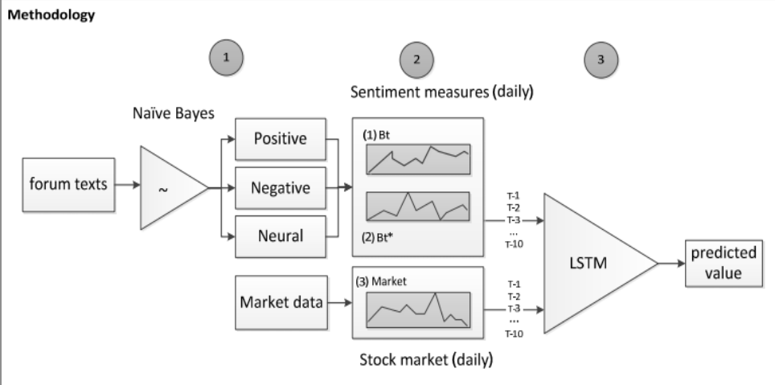
Methodology

Slide 11
Basic Software Project Plan
1.3 Major Functionalities delivered by the project. :
User Authentication.
Interactive UI for end-user.
Personalized trend analysis based on user’s interest.
One-click trade based on our recommendation.
Freedom to trade on their own choice.

Slide 12

Basic Software Project Plan
1.3 Major Constraints. :
Data collection
Data Cleaning
Hardware Requirement
Model Accuracy
Model Integration

Slide 13

Basic Software Project Plan
Project Resources. :
Data: Social media websites, Moneycontrol portal, etc.
Hardware: Will use college’s Resources for model testing.
This Photo by Unknown author is licensed under CC BY-SA.

Slide 14

Basic Software Project Plan
PROJECT SCHEDULE : Will be completing the project in 3 phases.
Phase 1: (Sept. – Dec.)
Get ML model working.
Testing of model for static data.
Phase 2: (Jan. – Feb.)
Creating automatic data collecting functionality.
Creating front-end for the user.
Phase 3: (Feb. – Mar.)
Creating Backend & Integrating of all modules and final testing.
Deploy to cloud.

Slide 15
Basic Software Project Plan
PROJECT TEAM ORGANIZATION:
ML model creation: Sankalp
Model Primary Testing: Payal & Sankalp
Frontend Creation: Shikha & Mayank
Backend Creation: Mayank & Shikha.
Automatic Data Collection module: Mayank & Shikha
Integration of all modules: All members
Model Secondary Testing: Sankalp & Mayank
Deploy: Payal & Shikha.

Slide 16
THANK YOU…

