Slide 1
Cardiac muscle’s titin follows calcium-dependent power-law relaxation
Filip Jezek¹, Anthony Baker³, David Nordsletten², Daniel A Beard¹
¹Department of Molecular and Integrative Physiology, University of Michigan, Ann Arbor, MI, USA;
²Departments of Biomedical Engineering and Cardiac Surgery, University of Michigan, Ann Arbor, MI, USA;
³Veterans Affairs Medical Center, San Francisco, CA, and Department of Medicine, University of California, San Francisco, CA, USA
fjezek@umich.edu
Notes:
About titin passive viscoelastic properties
We are more interested in the active part
Came across fitting of intriquate dataset – how much is passive involved?

Slide 2
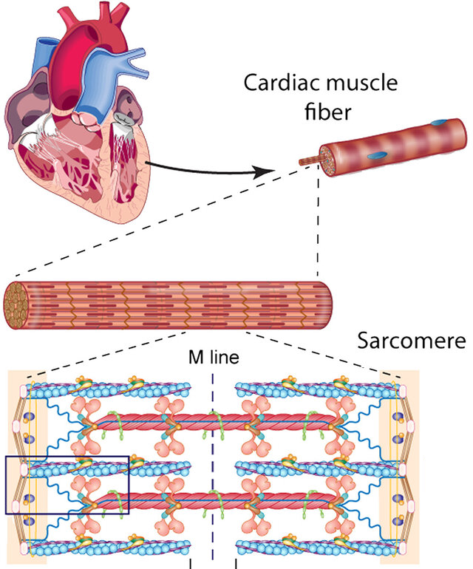
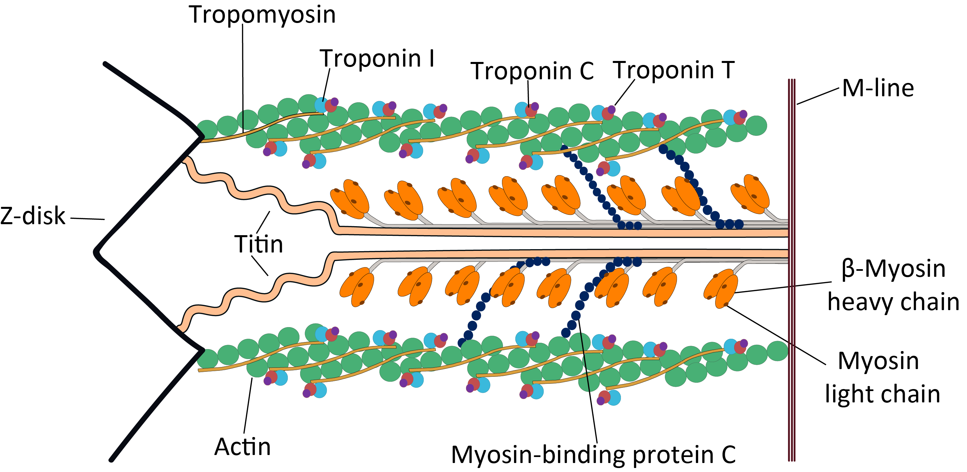
Titin
Major sarcomeric structural contributor to passive tension
Molecular spring, contributing to the passive mechanical properties of striated muscle
Contributor to diastolic dysfunction¹
¹ L. van Heerebeek et al. "Molecular and Cellular Basis for Diastolic Dysfunction." Current Heart Failure Reports, 9 (2012): 293-302. https://doi.org/10.1007/s11897-012-0109-5.
Images credit: Peng 2014 http://dx.doi.org/10.1074/mcp.M114.040675
https://commons.wikimedia.org/wiki/File:Cardiac_sarcomere_structure.png

Slide 3
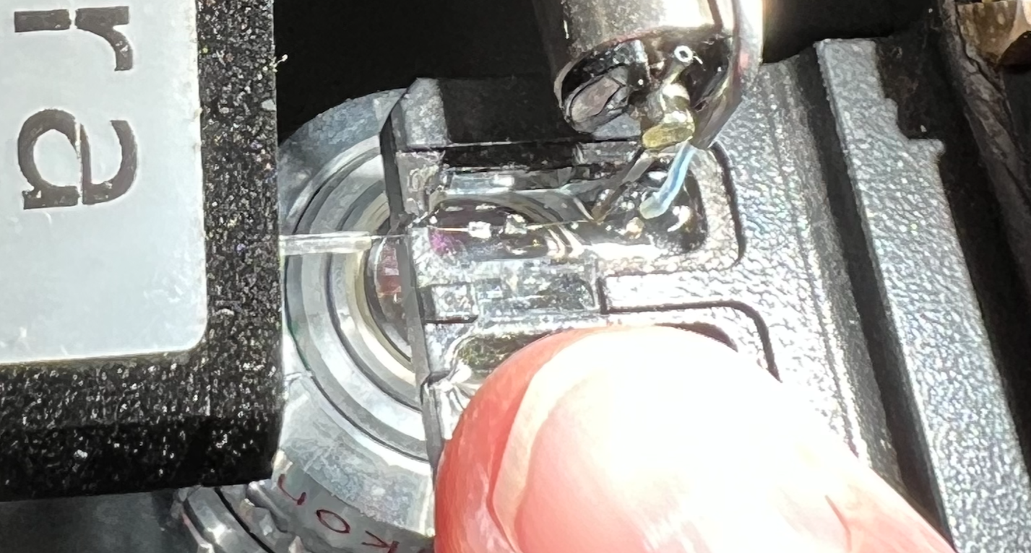
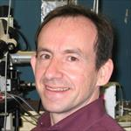
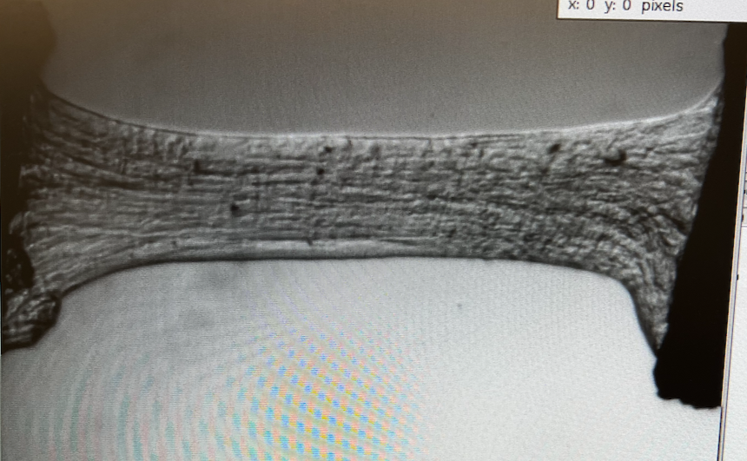
Probing passive mechanical properties of cardiac muscle fibers
muscle
Force
gauge
motor
Skinned murine cardiac trabecular muscle
Anthony Baker UCSF
100 μm

Slide 4
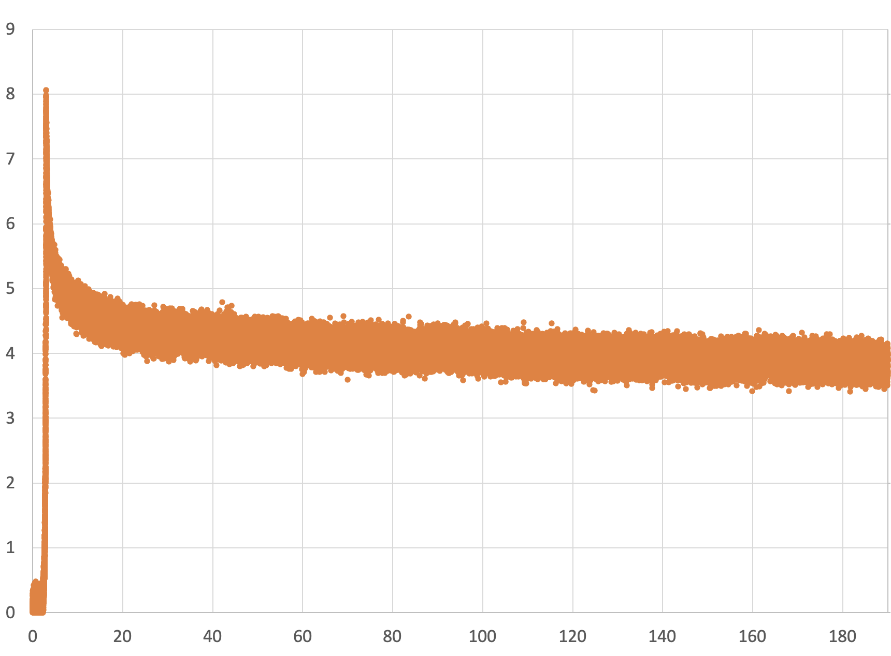
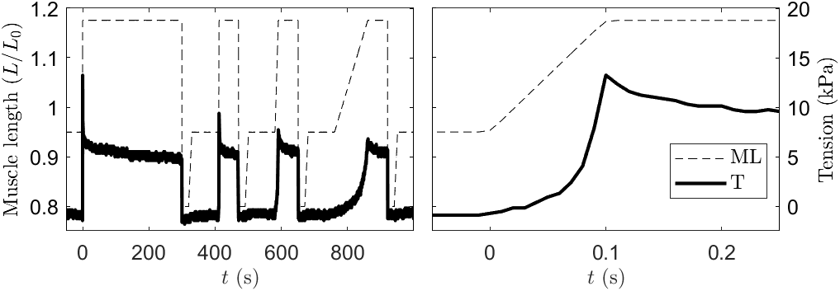
Stress relaxation after rapid muscle stretch
peak
Viscoelastic
force
“steady state”
Stress (kPa)
Time (s)
(demembranated mouse trabecula, initial sarcomere length of 2.0 um, the stretch from 1.9 to 2.3 um sarcomere length)

Slide 5
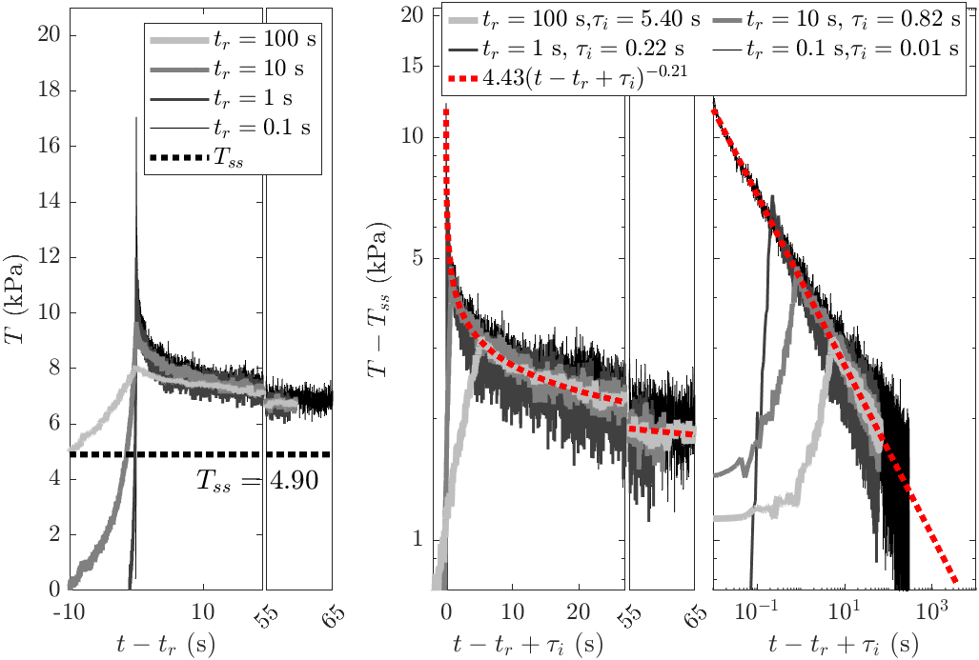
Tension decay follows power law ~ t ^{-­0.2}
All ramps overlayed and shifted
Steady-state force estimated and removed in semilog and log-log axes
Decay to 1 kPa in
18 minutes
Decay to 0.1 kPa in
800 years!

Slide 6
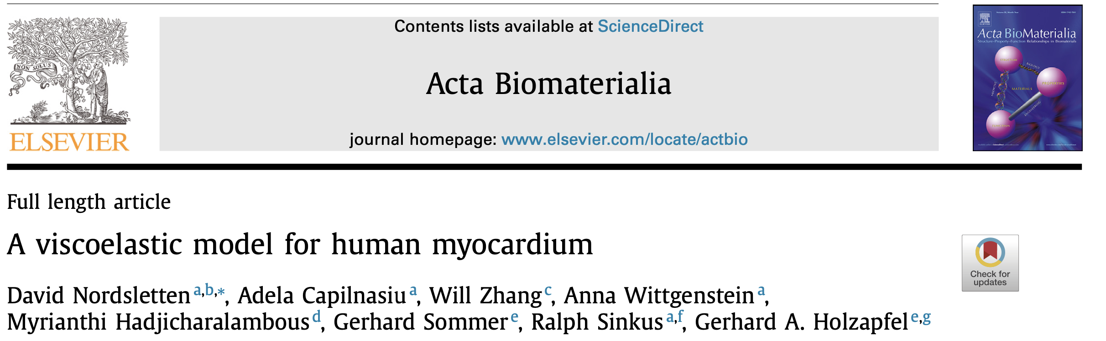
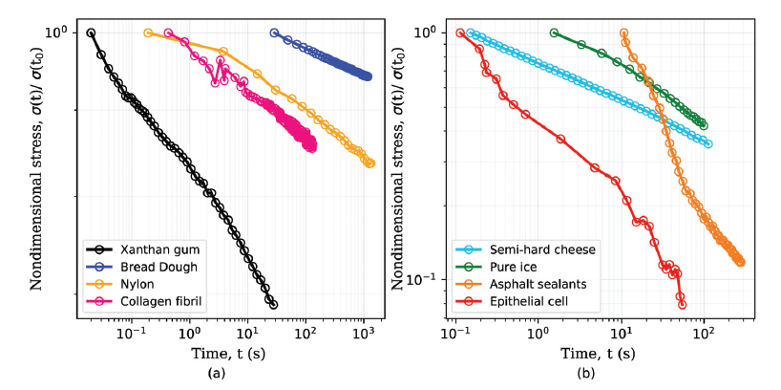
Notes:
This is not really surprising – lots of materials follow a power-law decay – straight line on log log plot, including cheese and collagen
Our collaborator David Nordsletten made a behavioral viscoelastic model that captures

Slide 7
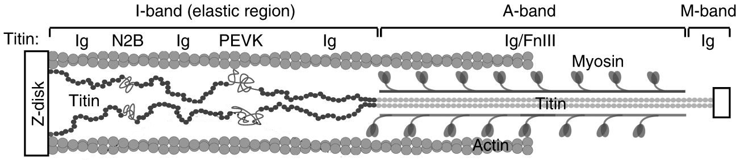
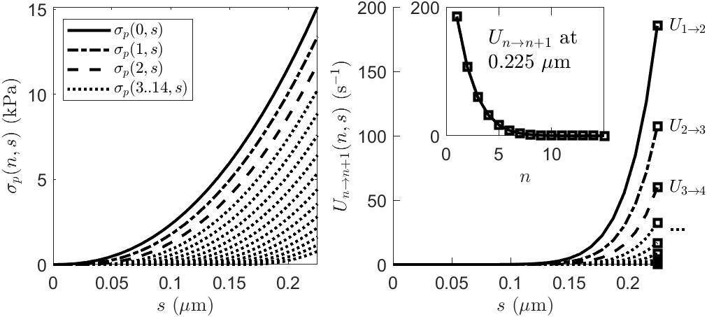
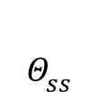
The mechanistic Model
A
Serial immunoglobulin-like (Ig) domains in the titin chain can unfold reversibly
$$Θ_{ss}$$
B
actin
Slack associated
with 1 unfolded domain
Z disk
Ca²⁺-dependent
association
Stress in an individual proximal titin chain
folded Ig states
unfolded state
strain
proximal Ig domain
PEVK
segment
distal Ig
domain
probability of a chain having n unfolded domains and strain (stretch) s
L_{p}
L_{d}
stretching of chains
C
D
Unfolding rates
Image from https://www.nature.com/articles/s41467-017-02528-7 under CC by 4 international licence https://creativecommons.org/licenses/by/4.0/
Notes:
We like to understand that. Or I like to understand.
We made a model of a single sarcomere,
The main assumption is serial IG like domains that can unfold under stress
We count how many have unfolded – it is most stiff if none, it adds some slack if one and so on;

Slide 8
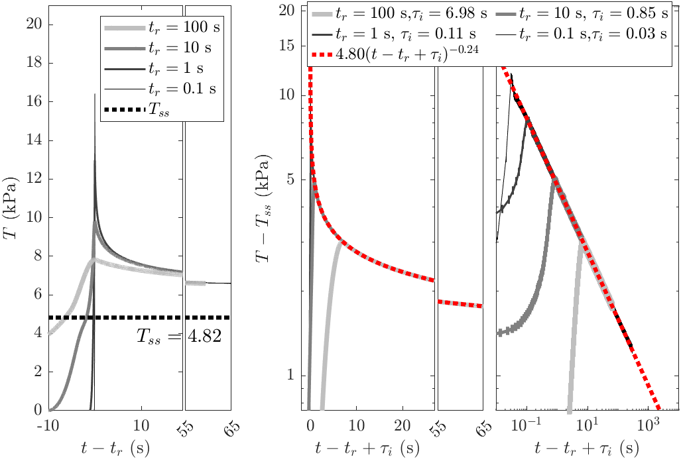
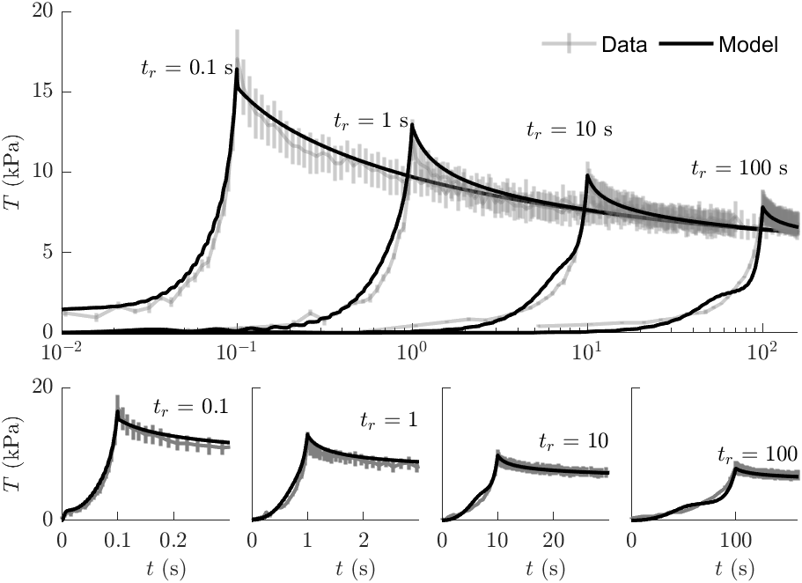
Fit to data captures observed power-law decay
With 10 adjustable parameters
Notes:
And voila, with 10 params..
The model naturally simulates the power law
Is able to simulate the measured data with ramp speeds over 3 orders of magnitude

Slide 9
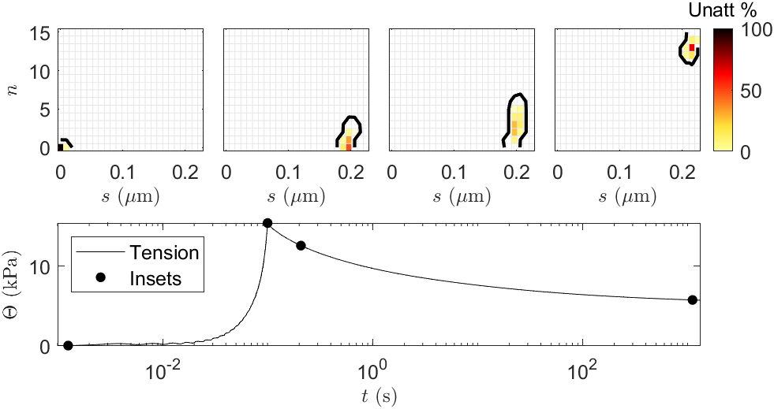
Simulation of stretch and relaxation

Slide 10
What if we add calcium?
How does titin act during systole?
Simulate diastolic dysfunctions
Notes:
Several papers already suggested a role of Ca on titin. We were motivated by the paper of Squarci et al.

Slide 11

Contraction!
Notes:
Well, of course..

Slide 12
What if we add calcium and suppress myosin activation?
Para-nitro-blebbistatin + mavacamten (50 μM PNB + 50 μM Mava)
Notes:
After PNB there was a little of residual force – at most 5%. To make sure there is none we added mavacamten.
Now we are confident that the Ca-mediated effects are NOT caused by active contraction

Slide 13
Calcium increases the viscoelastic stiffness
A
Increases the viscoelastic peak
Up to 6-fold increase in viscoelastic force!
Over a range of pCa
( pCa = -log(Ca²⁺⁾) )
Is it real though?
Muscle
Ca²⁺
PNB + Mava
Viscoelastic
Relax
Elastic
Ca²⁺
PNB + Mava
****
Relax
Notes:
With the fastest ramp-up there is up to 6-fold increase in viscoelastic force!
Is this real? What can we attribute that to?

Slide 14
PNB and MAVA alone does not affect the viscoelasticity
Only a slight preconditioning effect present
Viscoelastic
Elastic
Notes:
First check – PNB mava does not affect the rig

Slide 15
Active contraction is completely suppressed
Micro-displacements do not induce force
(no attached myosin)
Lower temperature gives same results
Notes:
Second check – active contraction will also increase the peak force

Slide 16
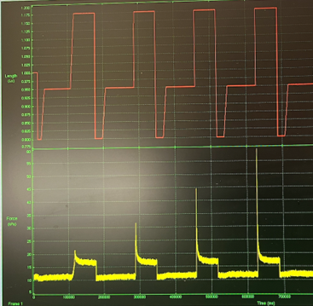
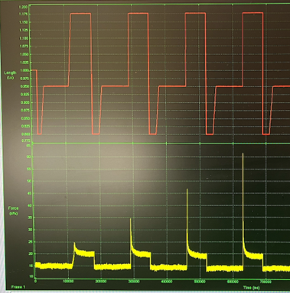
Active contraction is completely suppressed
Preliminary data on ATP dependency (n=1), unpublished
pCa = 4.5
ATP = 8 mM
pCa = 4.5
ATP = 0.2 mM
No ATP dependency observed, either with or without Ca
No active contribution to the viscoelastic difference
Notes:
So recent I do not have the raw data yet – just a screenshots, literary
Its different picture – see the reflection!
If you can see a slight difference, then correct for a zero drift

Slide 17
Ca sensitivity can be attributed to titin
high-salt extraction protocol removes >95% of myosin and actin
  Titin unanchored from the sarcomere
non-myofilament structures left
  collagen
no Ca effect on viscoelastic force
Some resting viscoelastic force remains
The Ca effect does not apply outside of sarcomere

Slide 18
Passive viscoelastic properties are calcium-dependent
Can we quantify that in model and find the mechanism?
Decouple from active mechanisms to investigate diastolic dysfunctions
Notes:
The model can help is point the mechanism
If we knew, we can correctly attribute that

Slide 19
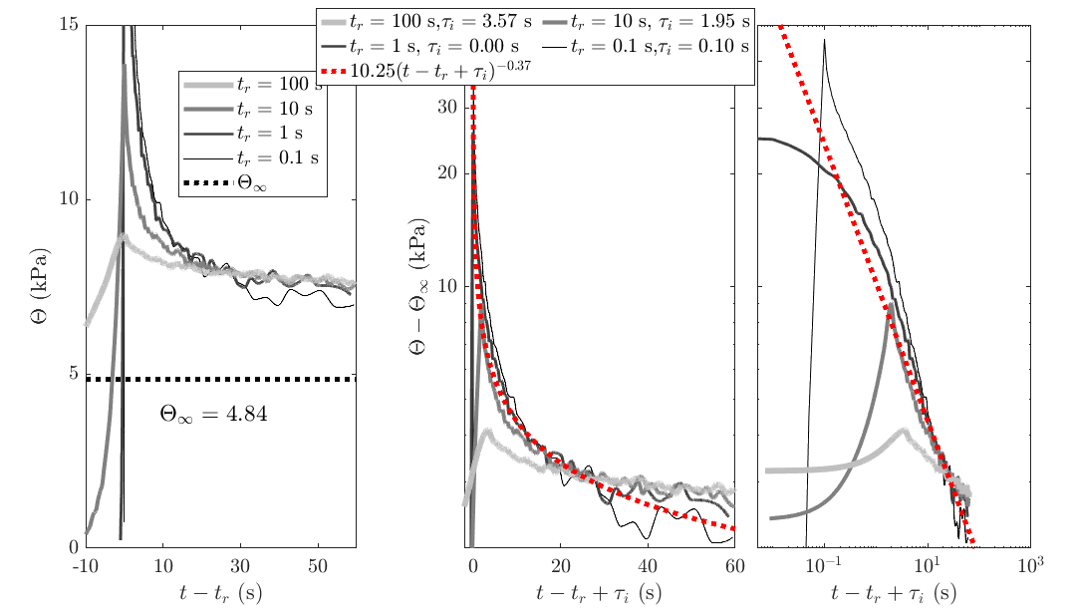

The response does not follow a power law
Not a power law ANYMORE
  Some other (exponential?) process
  PEVK attachment^{a)}
$$Θ_{ss}$$
B
actin
Z disk
folded Ig states
unfolded state
Ca²⁺-dependent
association
proximal Ig domain
PEVK
segment
distal Ig
domain
L_{p}
L_{d}
Squarci C, et al. Titin activates myosin filaments in skeletal muscle by switching from an extensible spring to a mechanical rectifier. PNAS 2023
Notes:
TODO generate an actual image from the data

Slide 20
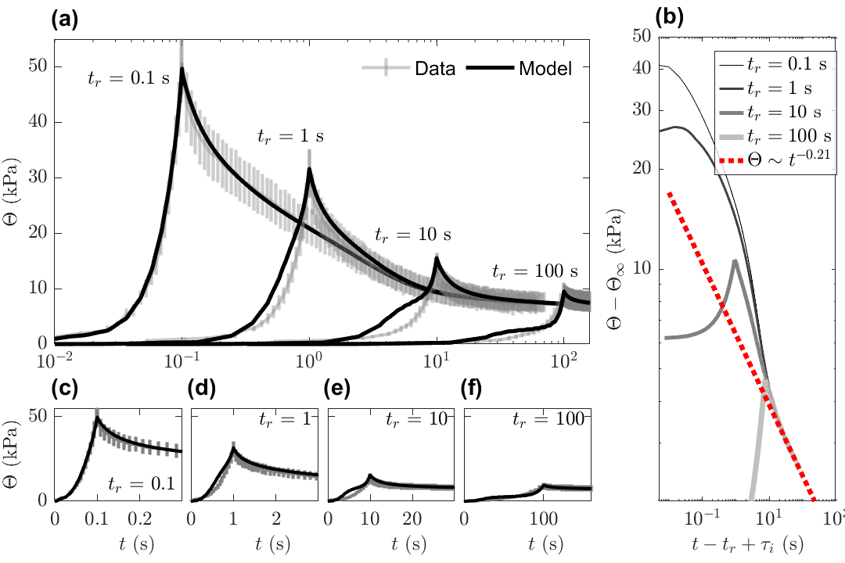
Calcium dependent viscoelasticity – model fit
Fitting 10 + 2 parameters
  PEVK attachment and detachment rates

Slide 21
Ca dependency parameter reduction: from 12 to 4
Start with the best high-Ca fit. For each parameter:
Fix it to its baseline (relaxed) value, optimize the remaining free parameters.
  Acceptable fit →
    Record this combination as a feasible solution.
    Recurse deeper: try fixing another parameter.
  Poor fit →
    Backtrack: relax (unfix) previously fixed parameters as needed.
    Continue search along alternative branches.
Continue until all feasible subsets have been tested
Sort by the number of parameters and error
Outcome: 5 plausible combinations of 4 parameters:
  proximal segment stiffness kp,
  PEVK attachment or detachment rates (kA or kD) and
  unfolding rate (either αU or nU) or proximal chain length–stress exponent np.
The lowest-cost combination: kp^{a)}, kA^{b)}, αU and nU
a) Labeit D, et al. Calcium-dependent molecular spring elements in the giant protein titin. PNAS 2003
b) Kulke et al. Interaction between pevk-titin and actin filaments: (…). Circ Res 2001, Squarci C, et al. Titin activates myosin filaments in skeletal muscle by switching from an extensible spring to a mechanical rectifier. PNAS 2023
Notes:
What drives the Ca dependency?

Slide 22
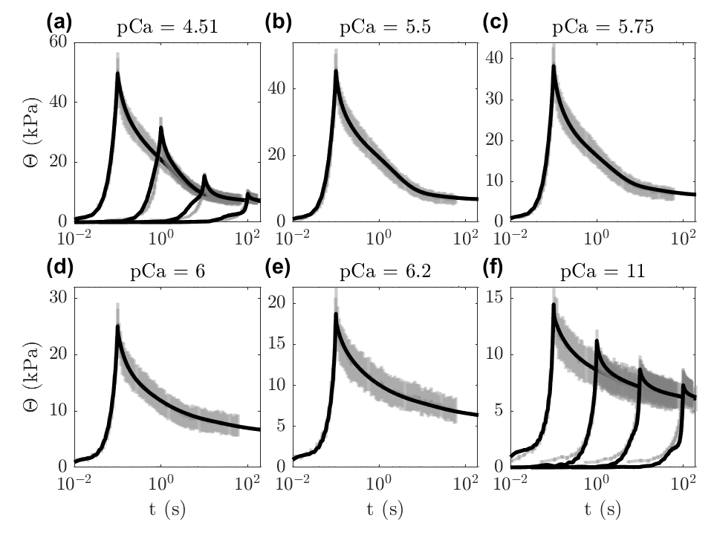
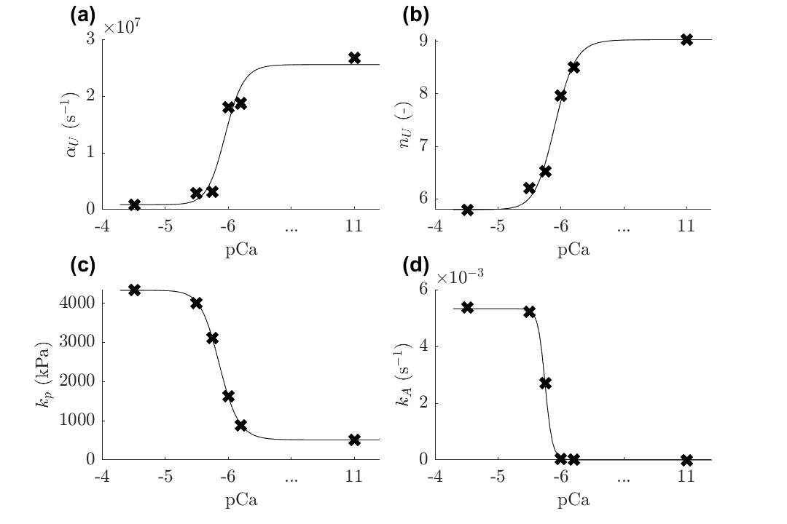
Fitting the pCa – force dependency
Fitting intermediate pCa levels, using the selected subset
  Ensuring monotonicity between relaxed and high-Ca (pCa = 4)
Ca-dependent parameters can be fitted with the Hill-curve
Notes:
The unfolding rate is mathematically based on strain. With increased stiffness there is an increased force, requiring the alpha and unfolding exponent smaller. In result though, the unfolding is more “stabilized” with higher Ca

Slide 23
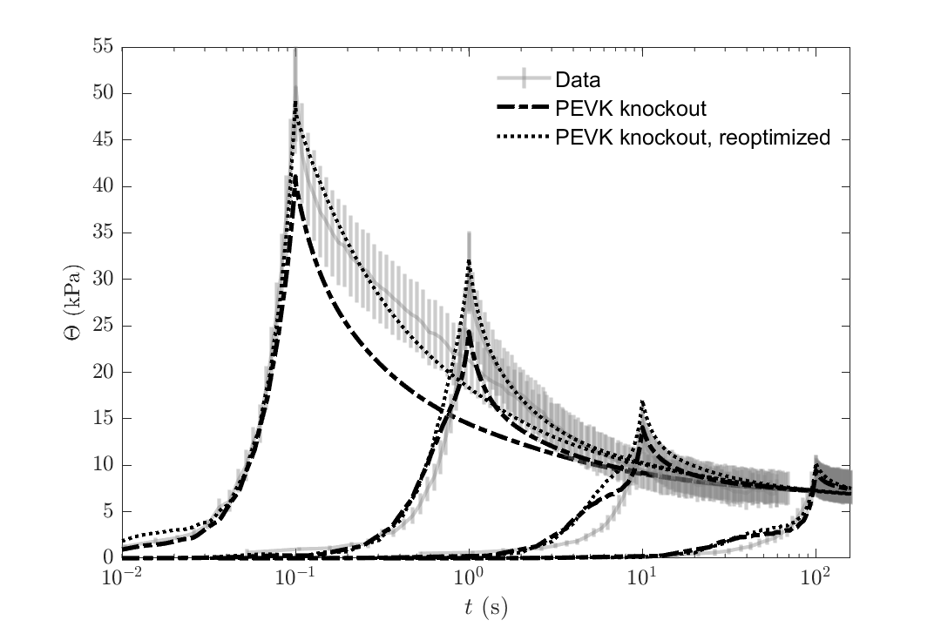
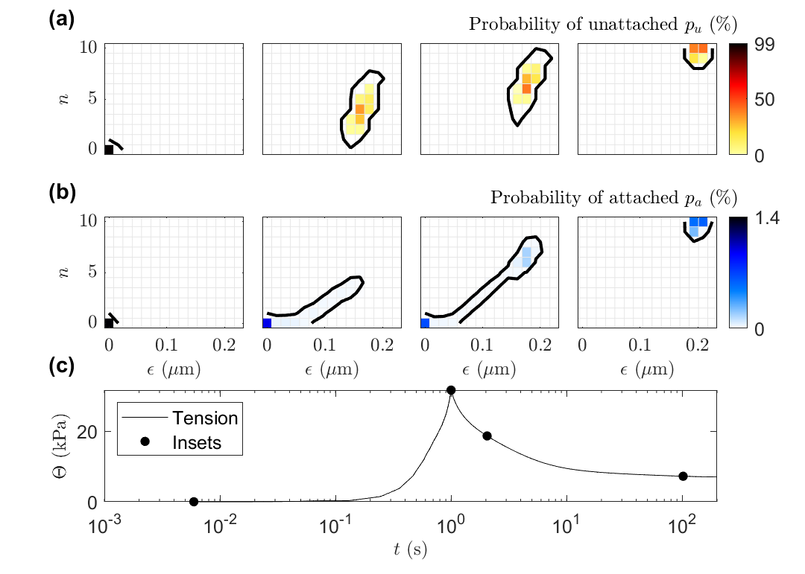
How important is the PEVK attachment?
PEVK attachment mechanism is required to fit a Ca-induced non-power law decay
Notes:
Is low in population – no more than 2% - but visible effect
Wihtout that the model cant reproduce the linear part of the decrease

Slide 24
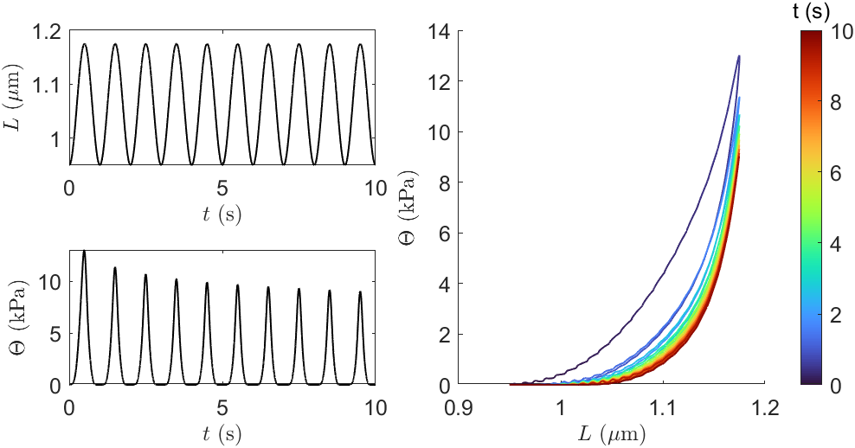
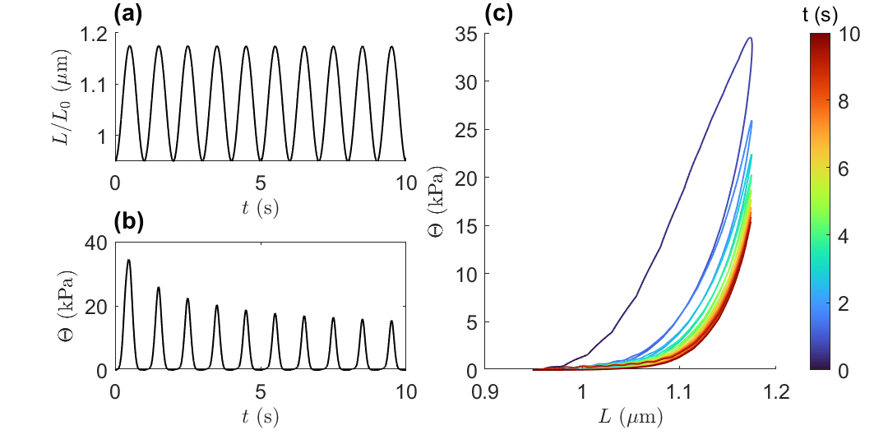
Prediction of hysteresis and Ca²⁺-mediated effects
no Ca²⁺
high Ca²⁺
The model does not quantify refolding yet
Notes:
With that model we tried to predict a cyclic loading (beating heart)
Without refolding it collapses to red

Slide 25
Limitations
Refolding
  Constant refolding rate will affect unfolding
  Stress or strain dependent refolding required
Distal chain can not unfold
  Implementation issues
  Tested swapping for proximal – unable to fit data
Time-scale of Ca effect
  Is it >> or << than the cardiac cycle?
Attribution to titin
  Influence of myBP-C can not be rejected
Identified parameters are not necessarily unique global solution

Slide 26
Summary
Passive viscoelastic properties follow a power-law relaxation
Unfolding “beads-on-a-chain” model can represent this power-law decay over a range of ramp-speeds
The titin stiffens with Ca²⁺, Ca²⁺ activates titin-actin binding
  probably at PEVK domain
Model, extended with PEVK binding, can capture the relaxation
  whole range of [Ca²⁺]
  Wide range of ramp-speed
We attribute these behaviors to titin.
  Other structural elements may contribute.

Slide 27
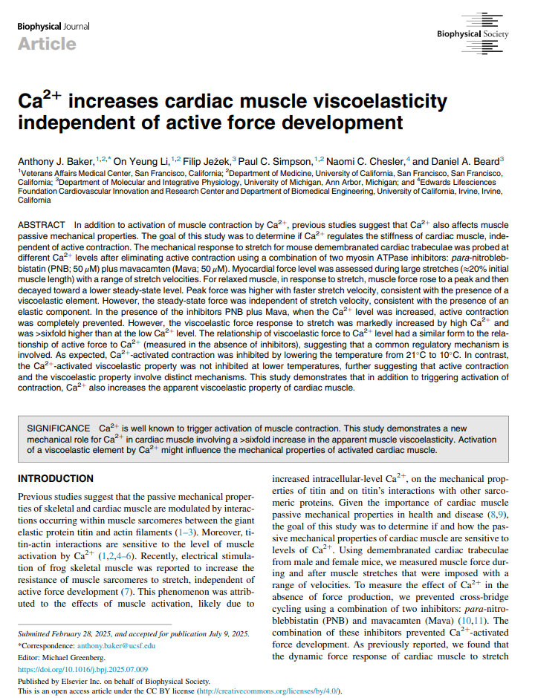
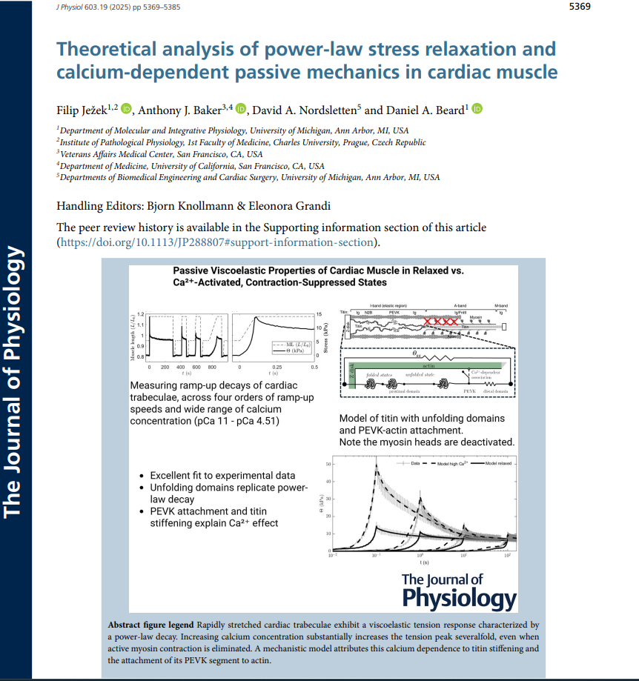
Published papers
Baker et al. – experimental report
Biophys J. 2025 PMID: 40652326
Jezek et al. – modeling and attribution
J. Physiol 2025 PMID: 40846493

Slide 28
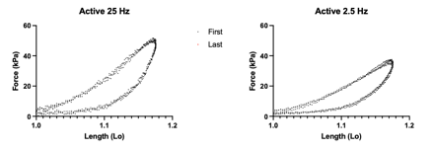
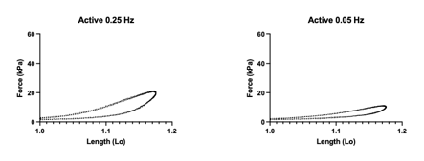
A follow-up: Refolding properties
Coming up next: Identify the refolding rates and preconditioning
Preliminary findings
  associated with force, rapid refolding at zero force
Notes:
Analyzing data

Slide 29

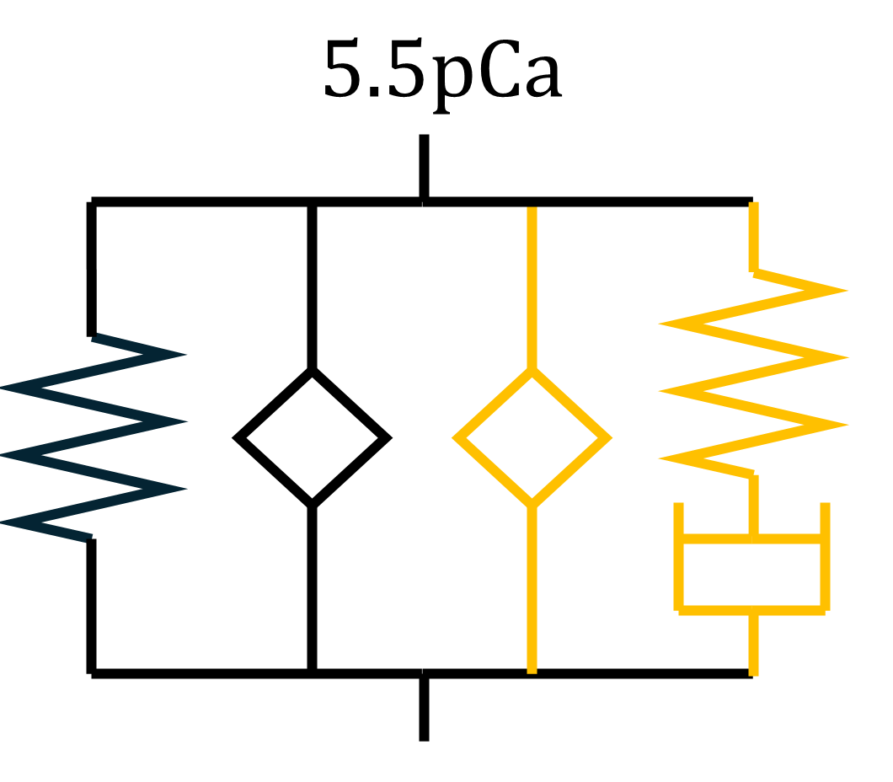
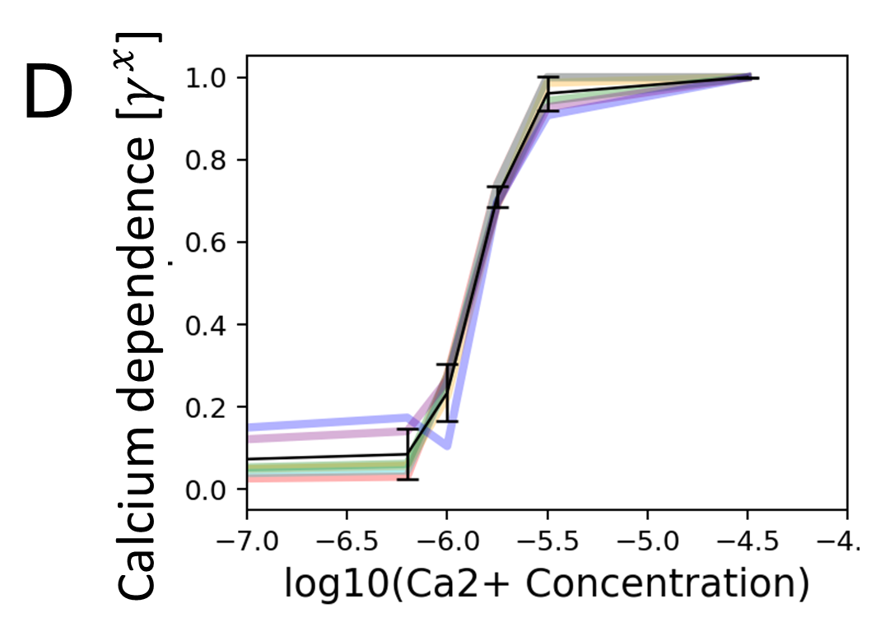
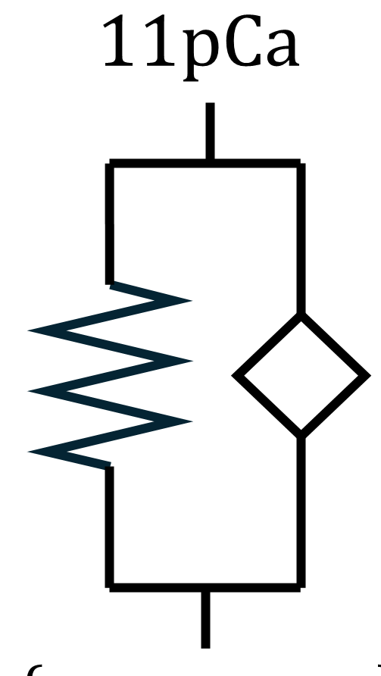
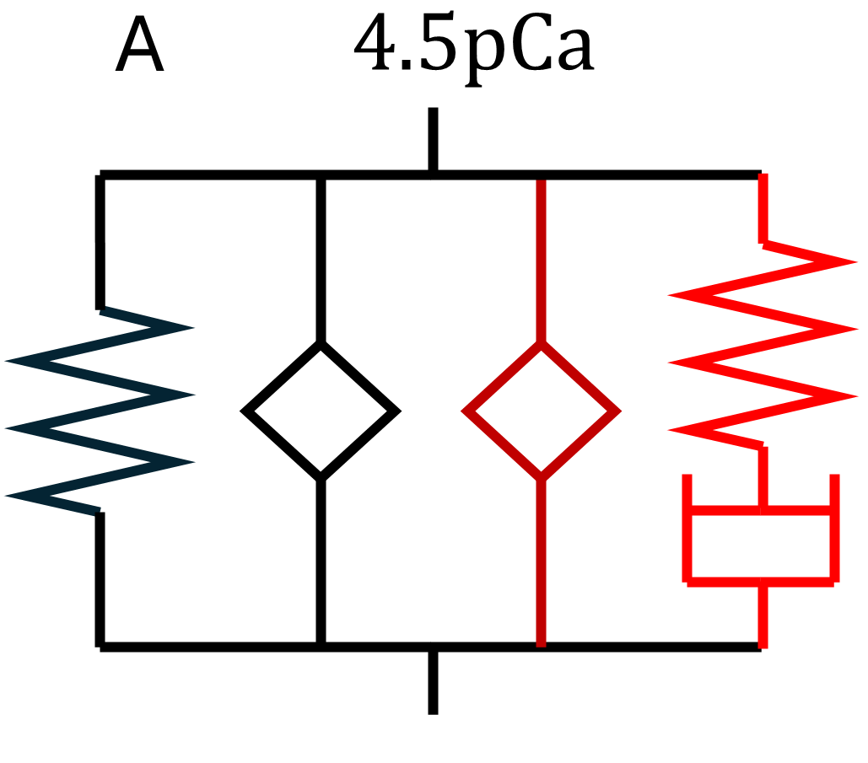
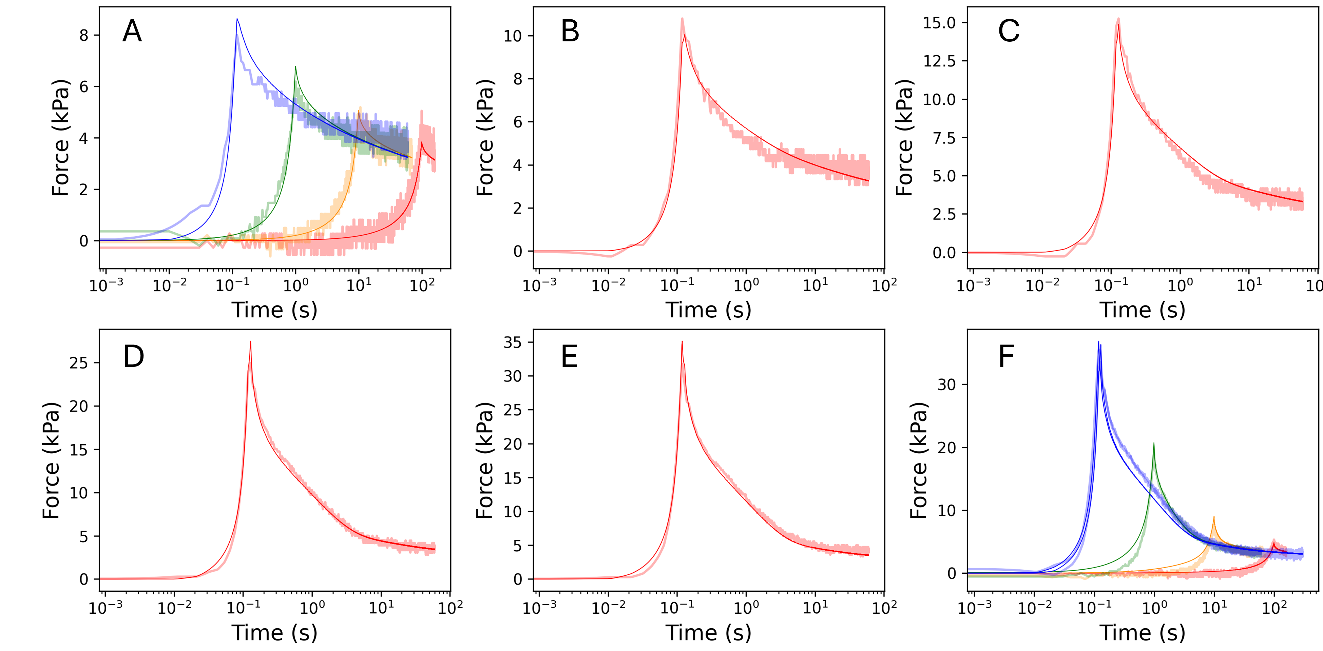
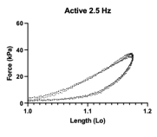
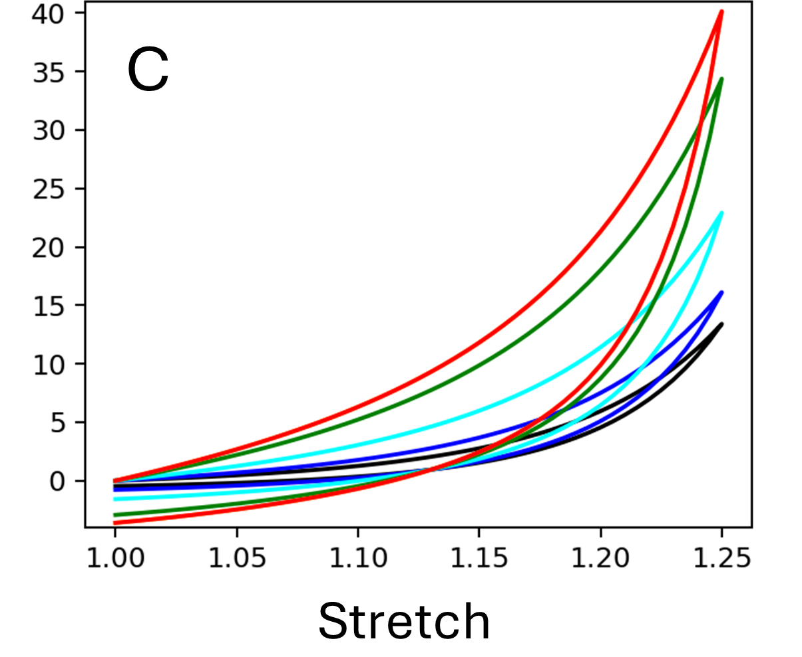
A follow-up: effective implementation to employ in 3D heart models
Will Zhang, UMICH
Power-law representation using fractional derivatives + PEVK effects
Representative fit of a single specimen
Cyclic loading at pCa = 4.5:
data 2.5 Hz, simulation 1Hz (red)
Notes:
MS in preparation

Slide 30
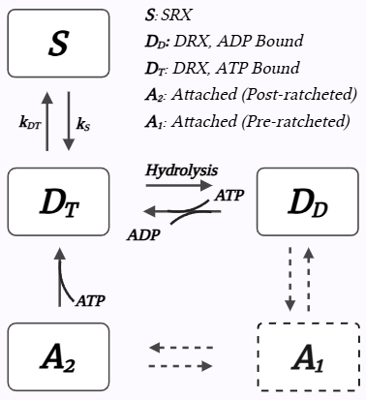
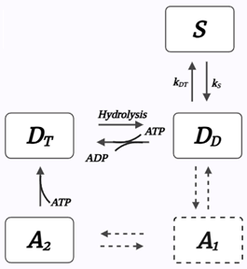
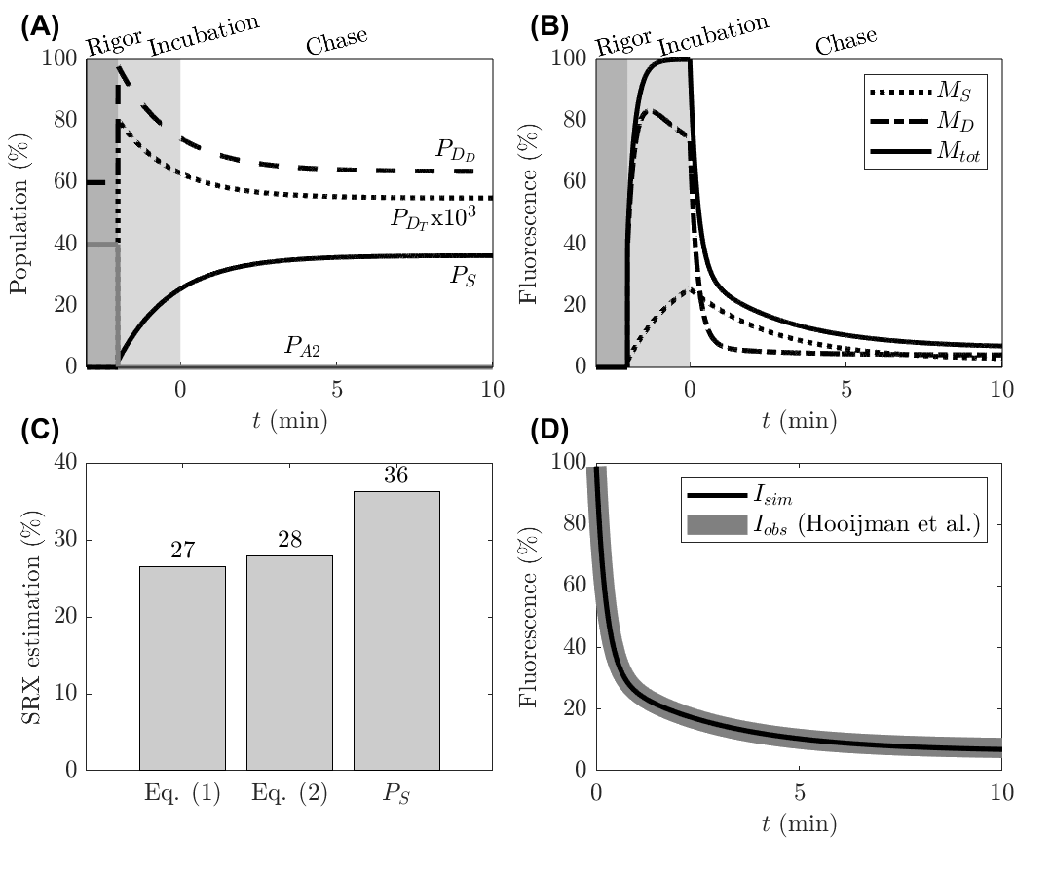
From our other work…
or
Kinetic Modeling of mant-ATP Turnover to Interpret the Biochemically Defined Myosin SRX State
  Incubation with fluorescent ATP analogue, chase with dark ATP – the fluorescence decay shows double-exponential
  Modeling of SRX quantification assay using a cross-bridge model
  Results:
    Discrepancies in calculated and model-predicted SRX
    Demonstrating effects of incubation duration, photobleaching, rigor state fraction etc
In revision in Biophys J.
Notes:
And related to last talk given at this seminar
We deal with active XB modelin, where the SRX plays a vital role. SRX is biochemically defined state that shows several folds lower ATP turnover to save energy.
There is an assay to quantify that. BY using fluorescent mantATP we can see the decay – fast rate is associated with non-SRX, slow rate is SRX.
We have modelled proceses and found a discrepancy between fitting a double-exponential and model-predicted SRX fraction.

Slide 31
Thank you!
Beard Lab
University of Michigan
github.com/beards-lab/TitinViscoelasticity

