Slide 1

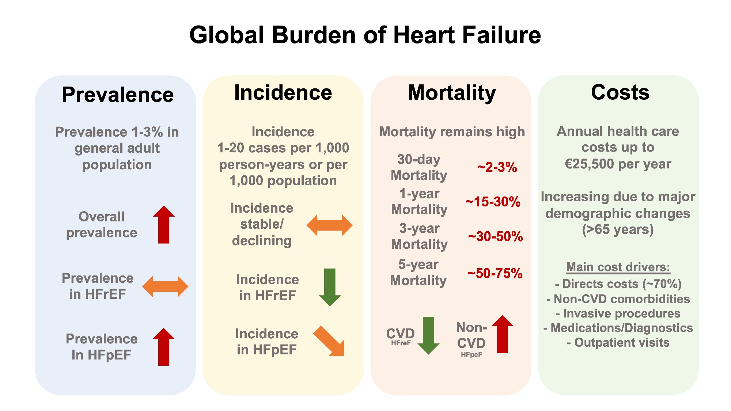

Graphical Abstract
Notes:
Graphical Abstract
Unless provided in the caption above, the following copyright applies to the content of this slide: Published on behalf of the European Society of Cardiology. All rights reserved. © The Author(s) 2022. For permissions, please email: journals.permissions@oup.com.This article is published and distributed under the terms of the Oxford University Press, Standard Journals Publication Model (https://academic.oup.com/journals/pages/open_access/funder_policies/chorus/standard_publication_model)

