Slide 2
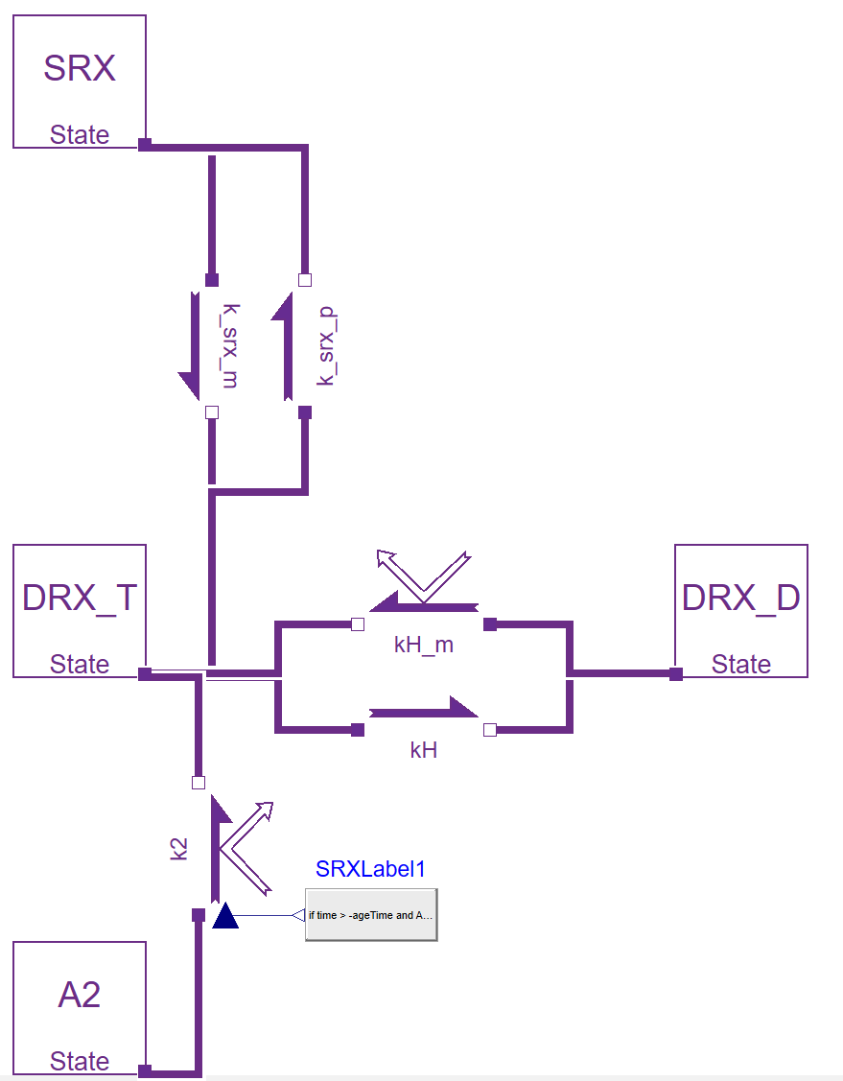
Figure 1: model diagram
(a)
(b)
SRX
SRX ATP bound
KMSR
DRX_{T}
KSR0
DRX_{D}
DRX ATP bound
ATP -> ADP + Pi
DRX ADP bound
RTD
RTD
ATP cycling at rest
RD1
R2T
R1D
A2
Attached post-ratcheted
R12
Attached pre-ratcheted
R21

Slide 3
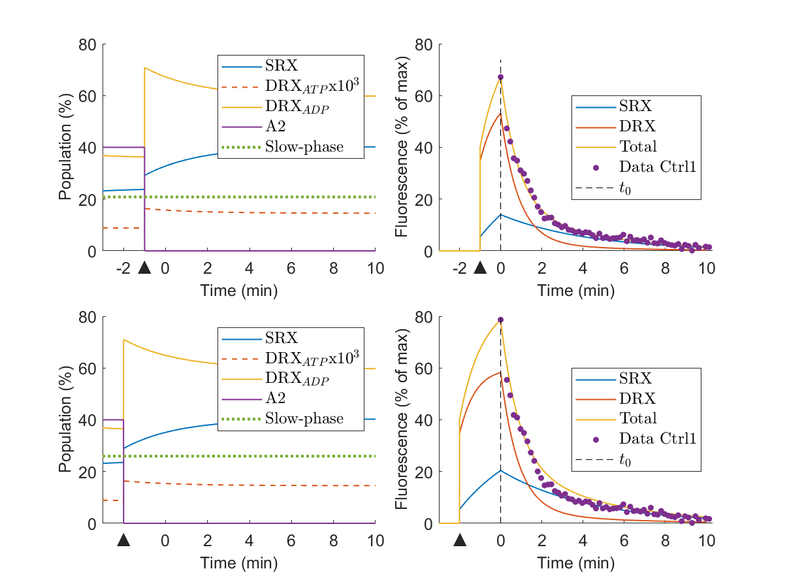
(a)
(b)
(c)
(d)

Slide 4
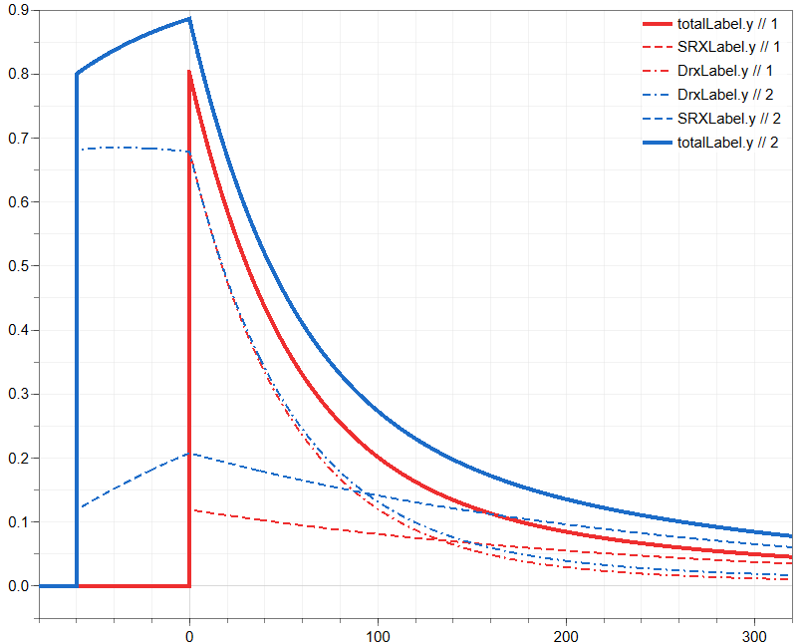
Comparison of 0.2 and 60s incubation time at 80 % of A2 rigor state

Slide 5
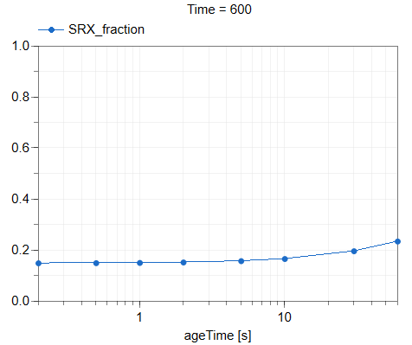
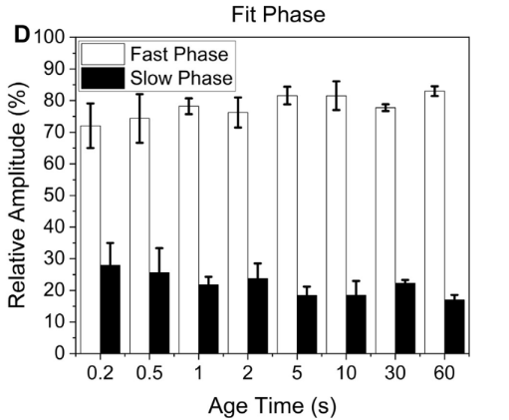

Slide 6
Testing afinity

