Slide 1



THEIA: NAVIGATION FOR THE BLIND
BY LEWAYNE NAIDOO AND ANAN THONGLAM

Slide 2

What does “Theia: Navigation for the Blind” do?

Slide 3
THE PROBLEM
Big population of sensory impaired New Zealanders (11%)
Many of whom are not confident while carrying out day-to-day tasks
No Android application as popular as BlindSquare on the iPhone
Lack of precision for position tracking in many existing applications

Slide 4
PROJECT OBJECTIVE
Our objective is to create an Android application to help the vision impaired navigate and carry out day-to-day activities with confidence. We aim to execute the application well enough to provide it’s user with current location accuracy up to 2 meters, with a return to destination accuracy of at least 4 meters.

Slide 5
SIMILAR APPS ON THE MARKET
LodeStone
GetThere GPS nav for blind
We have tested these applications ourselves as well as having a vision impaired volunteer try them out and give us feedback.
Not much actually out in terms of navigation for the blind.

Slide 6
PROJECT SCOPE
Save a user’s location and orientation on command as a “tag” and return them back to that location on command as well
Save the path of the user and return them safely on that path back to their tagged location
Voice command input and output with haptic feedback
Indoor and Outdoor mode for best use of accuracy
Return to destination accuracy of 80% on average

Slide 7
What makes up our application?

Slide 8
HARDWARE
Sensors used:
Accelerometer and - used to derive step counter
Google API for GPS from device - used to get geolocation of user
Magnetometer (Azimuth) - used to determine user’s current direction relative to north

Slide 9
SOFTWARE
Kalman Filter algorithm - used to predict trustworthiness of next location given
Indoor mode
Outdoor mode
Service
Debugger

Slide 10
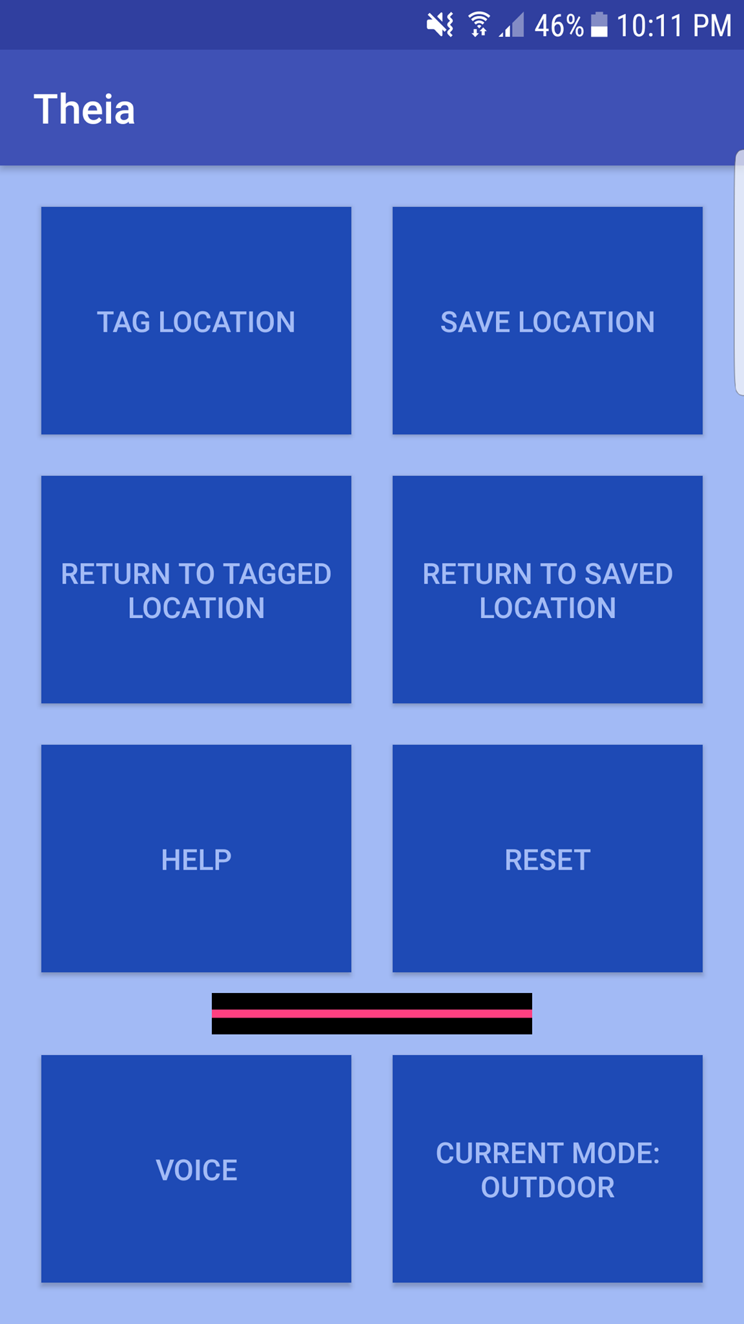
APPLICATION LAYOUT

Slide 11
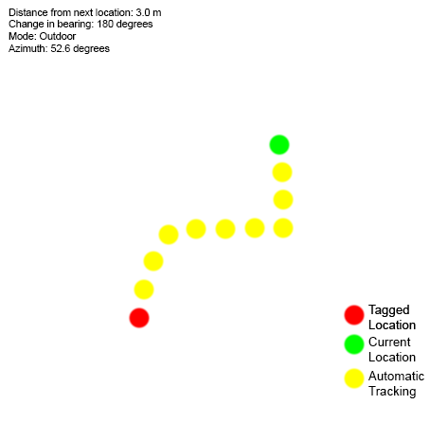
DEBUGGER

Slide 12
MODES
Indoor mode - using step detector to estimate short distances such as navigating from front of elevator to the front of the room at a hotel, based on the size of the user’s foot step.
Outdoor mode - using GPS services at high accuracy and high frequency to obtain the user’s position

Slide 13
KALMAN FILTERING
Accuracy of location is affected by change in time.
The location obtained is likely to be less accurate as time slowly increases.
A Kalman Filter was used in our implementation to predict and correct the current location with changes in time, the user’s orientation and their acceleration as inputs.

Slide 14
KALMAN FILTERING (cont.)
Step 1 : Predict the new location based on the changes in time.
Step 2 : Compute the user’s current orientation and the changes in acceleration
Step 3 : Update the predicted location with the observations (i.e. compute the estimate change in distance based on the acceleration at that orientation).

Slide 15
TESTING PROCEDURES
User current location accuracy
Return to tagged location accuracy and distance away from target accuracy
Battery usage test
We carried out the above tests for the Unwired Labs location API (paid API), the Google API and the Step detector. We then compared them across these three fields and analysed our data to see which options we should use.

Slide 16
RESULTS
This table shows the % of high accuracy (locations with 1 - 5 meters radius accuracy) locations obtained from each API as well as the battery usage per hour on those settings.
All locations are provided at 100ms intervals.
Accuracy setting | Low | Medium | High
Google API | 51% | 70% | 88%
Unwired Labs API | 56% | 74% | 91%
Battery Usage (Google API) | 5% per hour | 9% per hour | 15% per hour
Battery Usage (Unwired Labs API) | 4% per hour | 7% per hour | 13% per hour

Slide 17
RESULTS (cont.)
Measurements of distance to target location versus actual physical measurement (averaged over 20 tests)
Real distance | Google API | Google API + KF | Step detector (indoor) | Step detector + KF
10 metres | 8.2 metres | 9.4 metres | 7.5 metres | 9.1 metres
20 metres | 17.5 metres | 19.1 metres | 16 metres | 17.7 metres
30 metres | 26.3 metres | 28.6 metres | 25 metres | 26.9 metres

Slide 18
IMPORTANT DECISIONS AFTER RESULTS
After analysing the results and comparing them to each other, it can be seen that the Google API is the best choice for outdoor use and the step detector is the best option for indoor use. It was decided that the paid API would not be used and is not worth paying for.

Slide 19
CONCLUSION
We have achieved an Android mobile application which tracks a user’s movements and has the ability to return them to a tagged location within 4 meters of the point, 100% of the time.
What the system succeeds in:
tracking the path of the user, accurate to 2m radius
indoor and outdoor capability
voice control and voice feedback
can be successfully used in parks, beaches, malls, hotels, etc.
System Limitations:
only designed to be used in open areas like parks and beaches or inside buildings and hotels
not designed to be used for navigating on the street and crossing roads

Slide 20
FUTURE WORK
A partnered smartwatch application was always in our plan, however upon researching, we realised that it would be very complicated to make a general smartwatch application as the sensors and compatibilities are very different from device to device. We would like to complete this in the future by designing a smartwatch that would be used explicitly as a partner for this application. The smartwatch will enhance the accuracy of the step detection algorithm and will allow the user to conveniently interact with the application without using a smartphone.

Slide 21
ACKNOWLEDGEMENTS
Supervisor 1: Bruce MacDonald
Supervisor 2: Rashina Hoda
Phil Turner and all volunteers from the Blind Foundation
Henry Williams and Kit Rollings who the project was inspired by

Slide 22
Thank you for your time!
Any questions?

