Slide 1
Timelapse with R-Pi
By: JESSE
@beardyjesse

Slide 2

Overview
Why / objective
Home timelapse
Remote timelapse
Headless issues (and solutions)
FOSStalk & OggCamp 2017
Future improvements

Slide 3
Show me some videos!
Wallpapering
Wedding

Slide 4
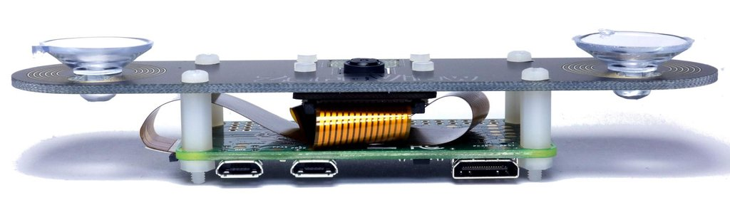
Home Timelapse
Zeroview hardware

Slide 5
Home Timelapse
Photo every 5 or 1 minutes
Nightly cron rsync (and delete) to NAS
Folderise script
Videoise script
Oneoise script

Slide 6
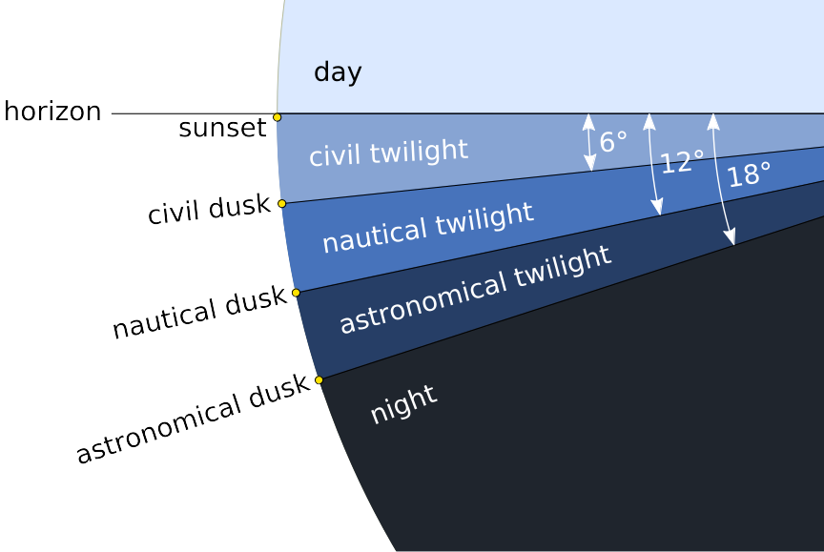
Home Timelapse (sunwait)

Slide 7
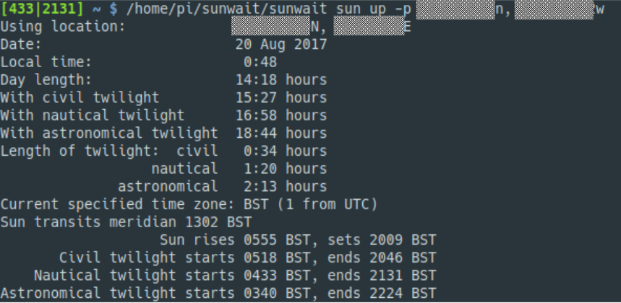
Home Timelapse (sunwait)
https://github.com/klada/sunwait (or as a snap)

Slide 8
Home Timelapse
One day
10 months

Slide 9
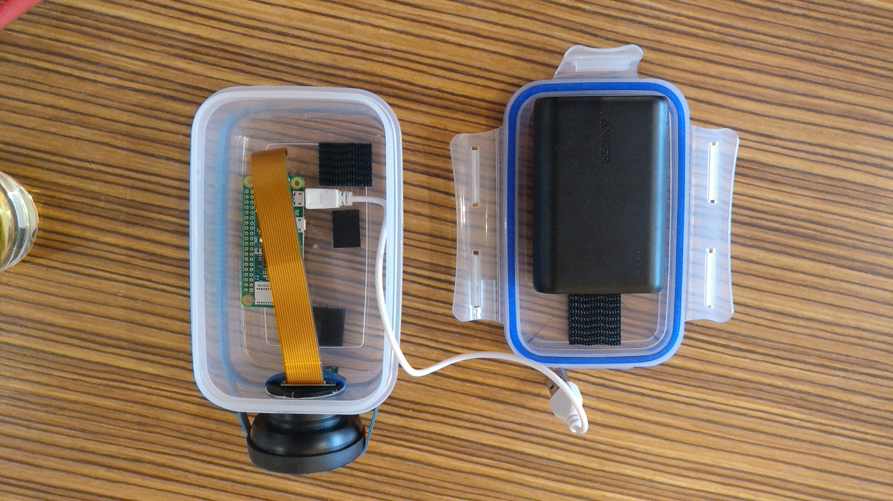
Headless Pi Camera

Slide 10
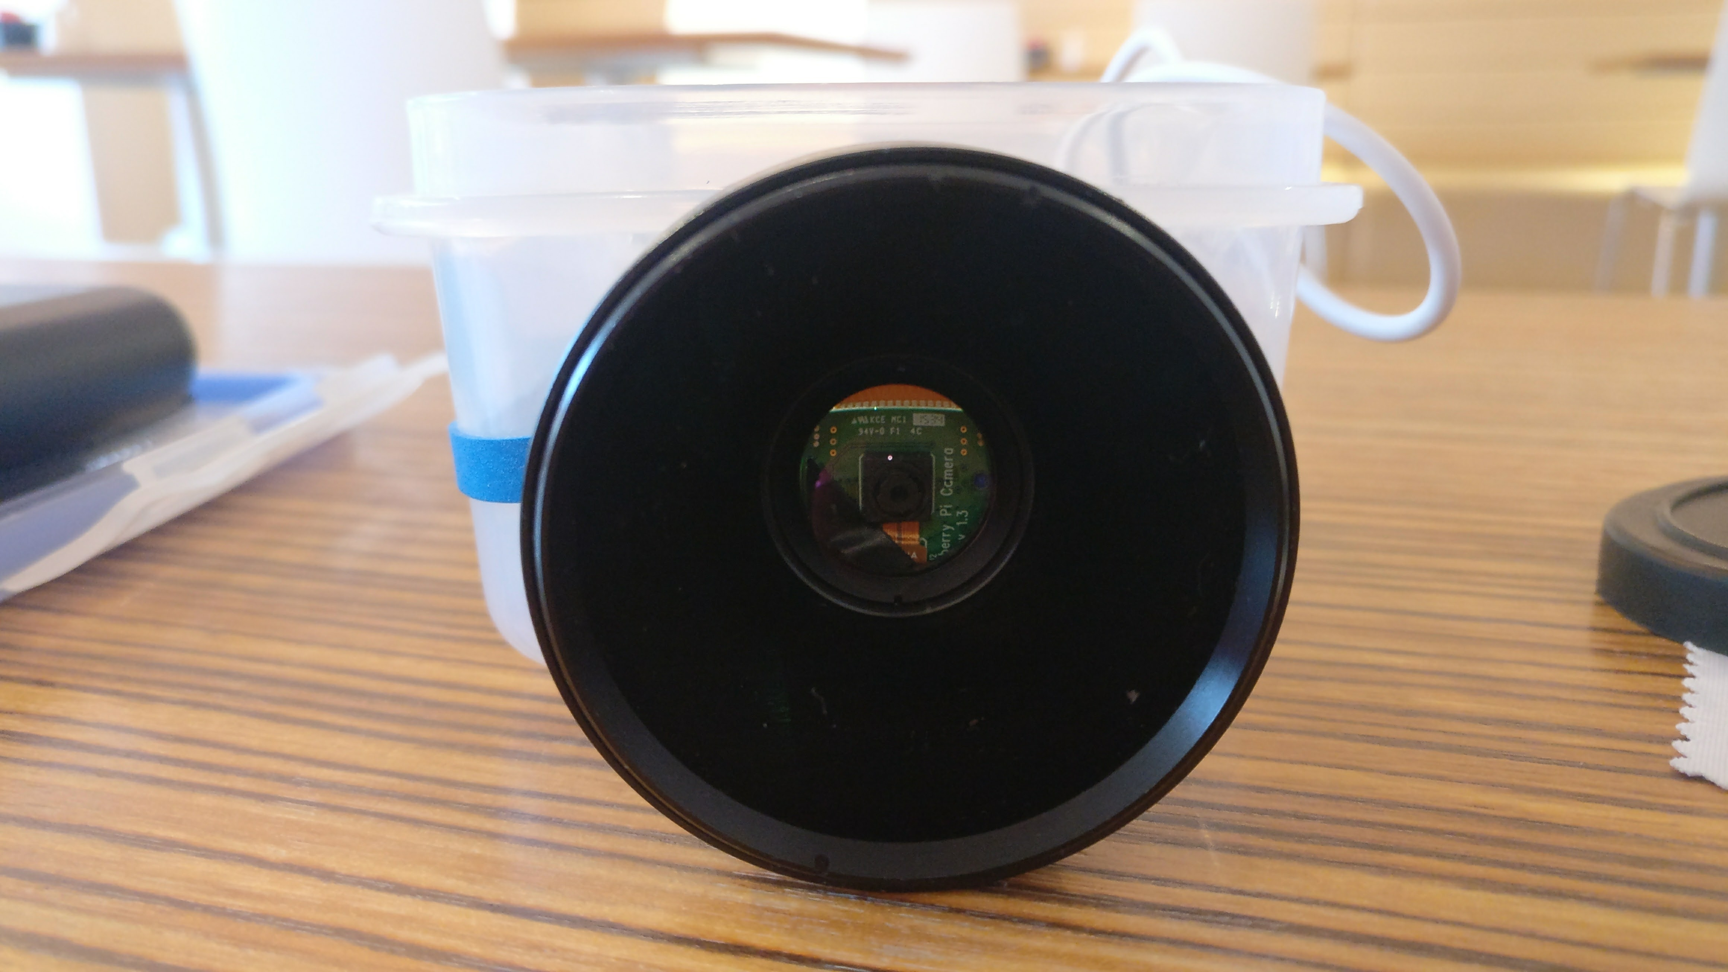
Headless Pi Camera

Slide 11
Headless Code
#! /bin/bash
read -r FOLDER</home/pi/number
mkdir -p /home/pi/$FOLDER
echo $[$FOLDER+1]>/home/pi/number
NUM=0
while true
do
BER="$(printf "%05d" $NUM)"
raspistill -w 2592 -h 1458 -vf -hf --nopreview -o /home/pi/$FOLDER/"$FOLDER"_oggcamp2017_$BER.jpg
NUM=$[$NUM+1]
sleep 10
done

Slide 12
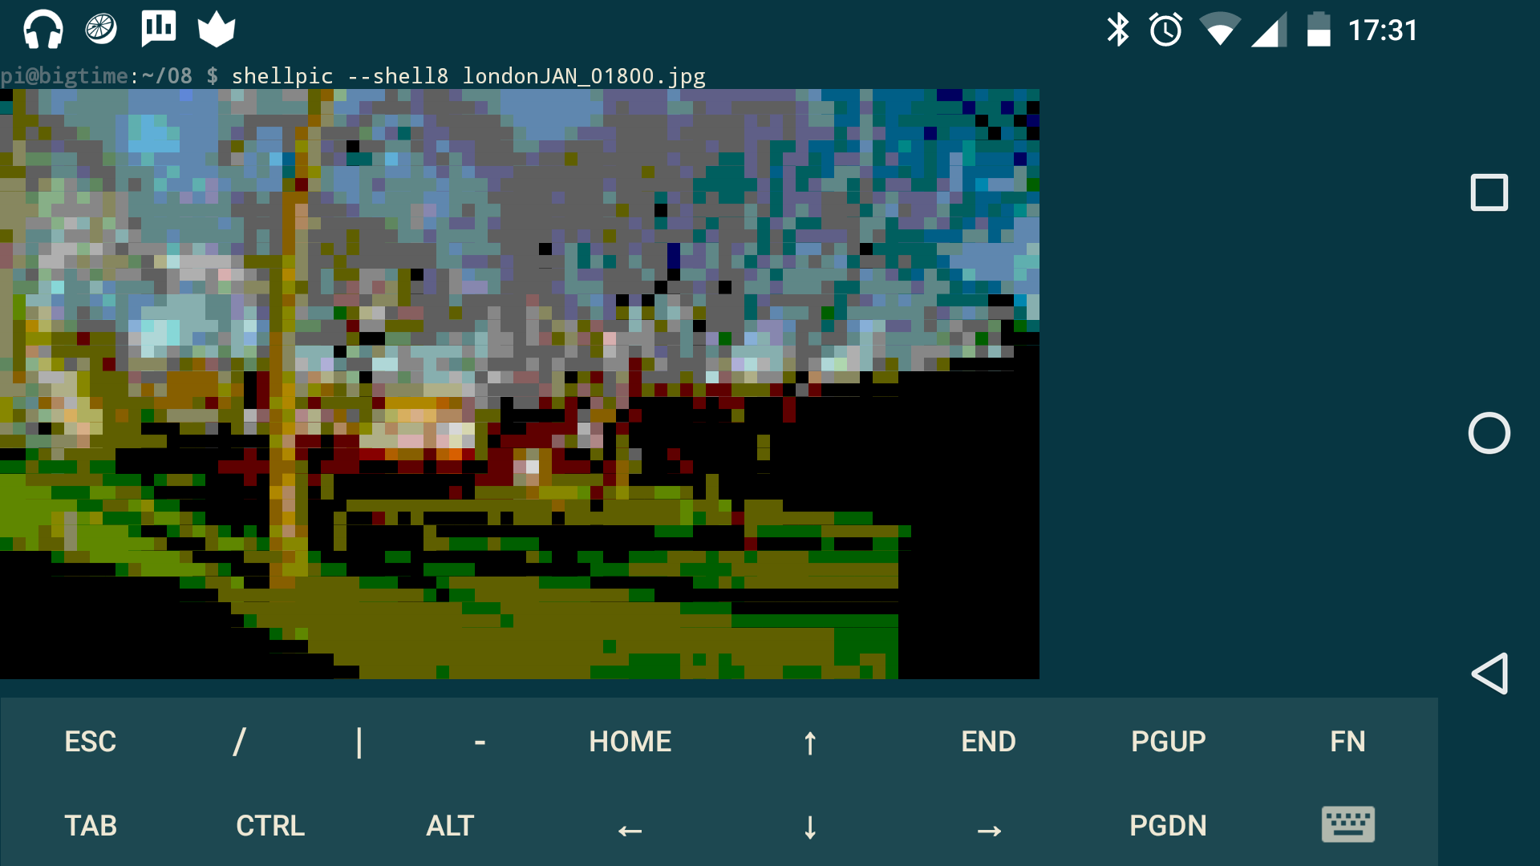
Android View #1 (shellpic)

Slide 13
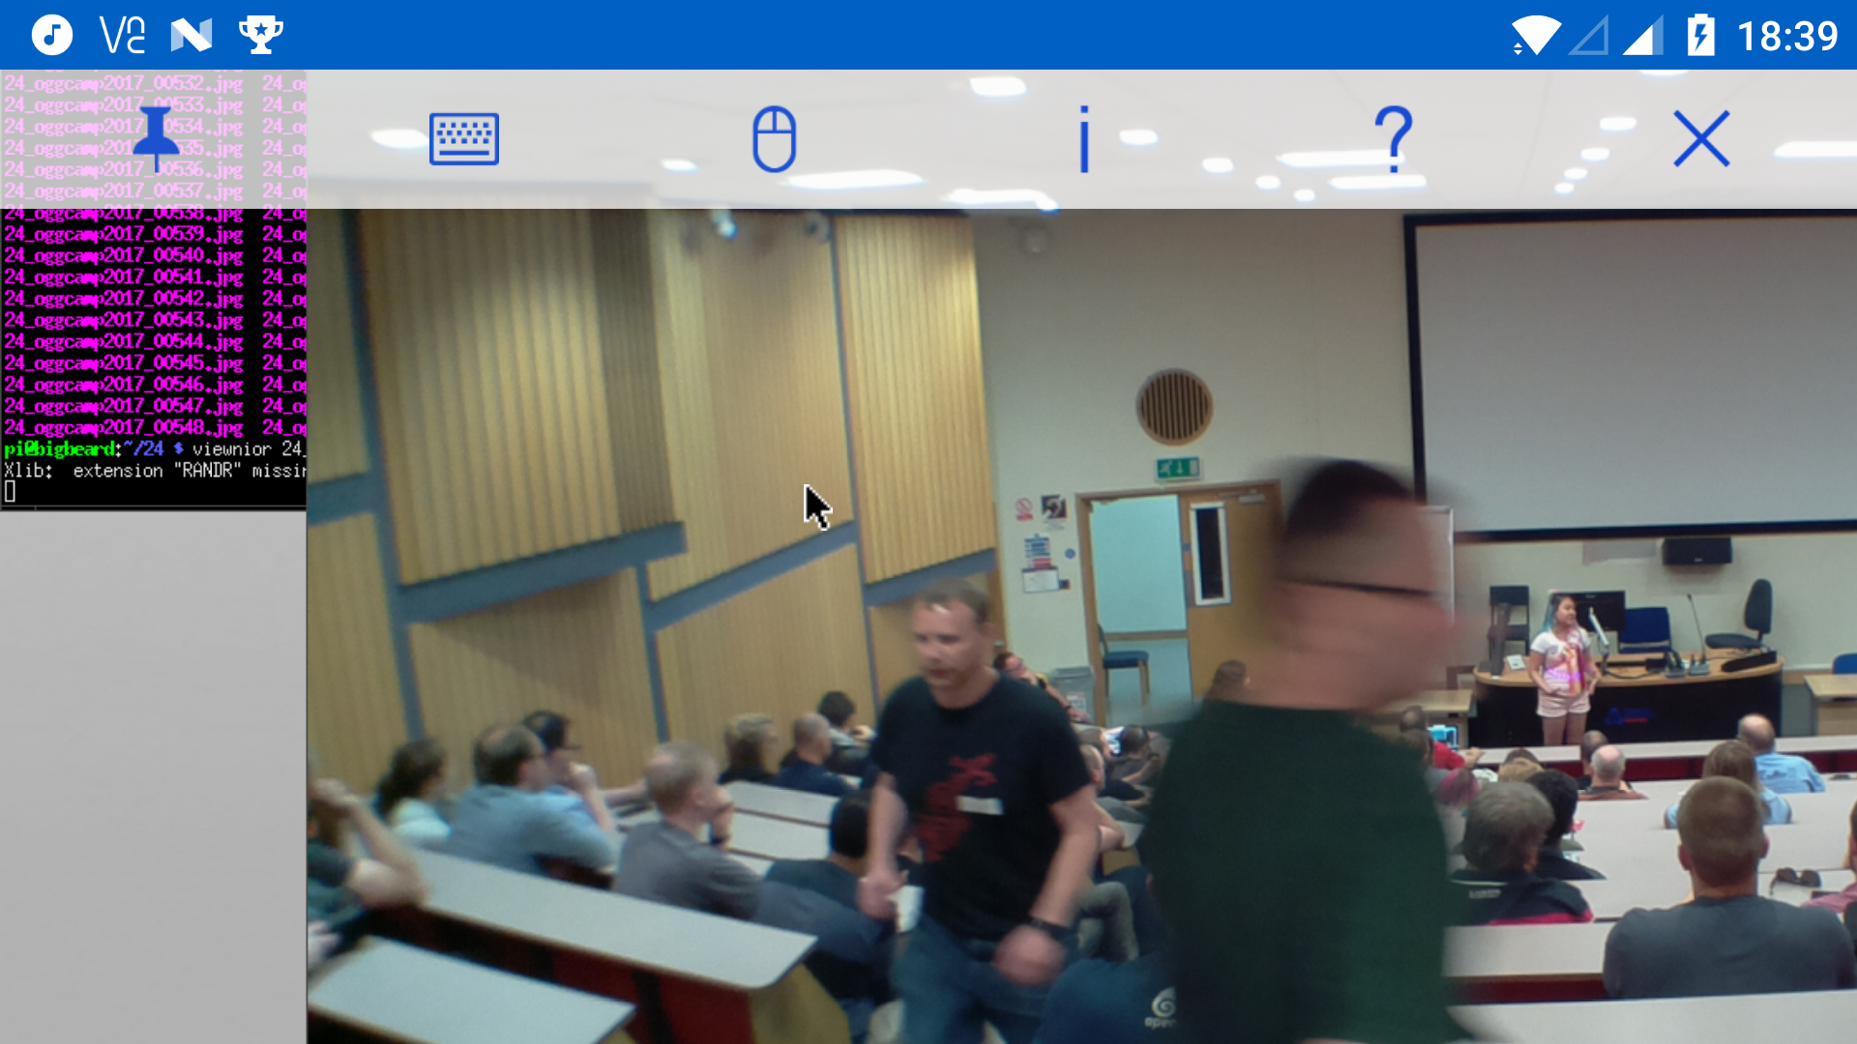
Android View #2 (VNC Viewer)

Slide 14
Ogg/FOSS 2017
OggCamp 2017 Video
FOSStalk 2017

Slide 15
Future Improvements
Movement – Physical & Software
Eliminate vignetting
Button control & LED feedback

