Slide 1
Wildfire Detection from PM Sensor Network
Lizhao Wang

Slide 2
Background
Fire combustion produces very fine smoke particles (PM1) that rise sharply, while PM4 rises more moderately.
The PM1 / PM4 ratio distinguishes fire smoke (fine, fresh particles) from dust (coarse particles).
Short-term bursts are physically linked to ignition or flame activity, not gradual pollution buildup.

Slide 3
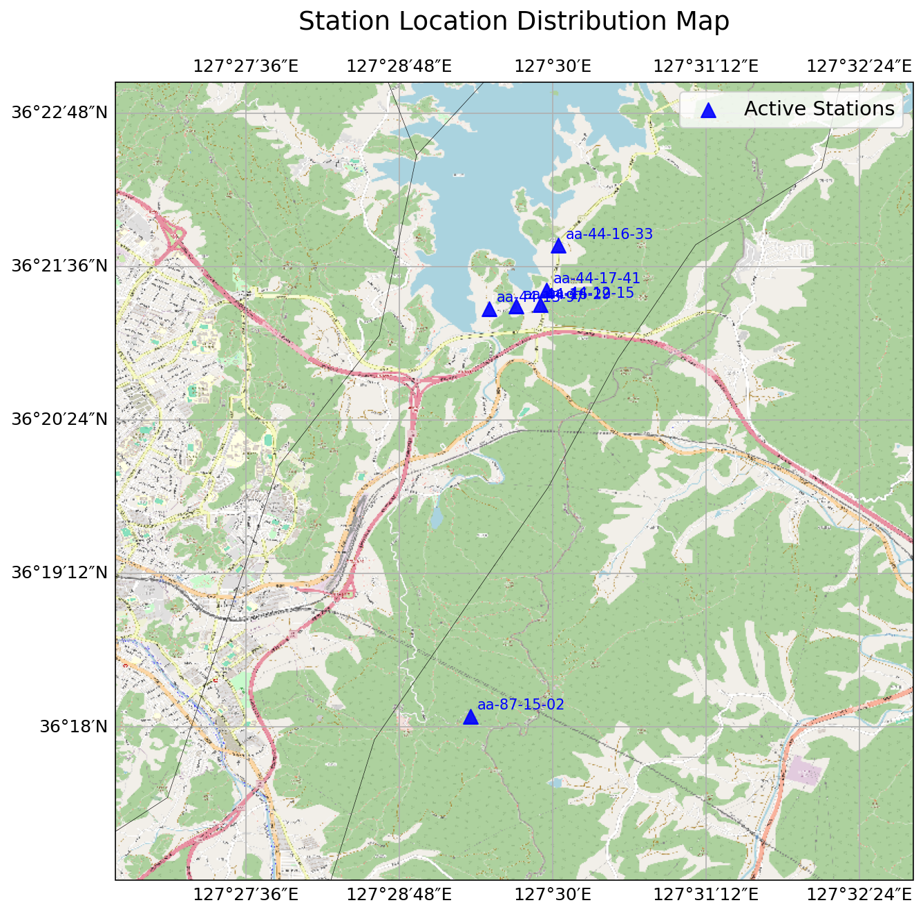
These sites are in Daejeon, South Korea. Five of them cluster around a lake, and one is away from them in the south.

Slide 4
Data Preprocessing
Resample raw sensor data to 30 s intervals using median aggregation.
Apply 1-minute rolling median to suppress outliers.
Apply exponential moving average (~3 min span) for smooth trends.
Derive baseline using diurnal median and compute Z-scores for normalized comparison.

Slide 5
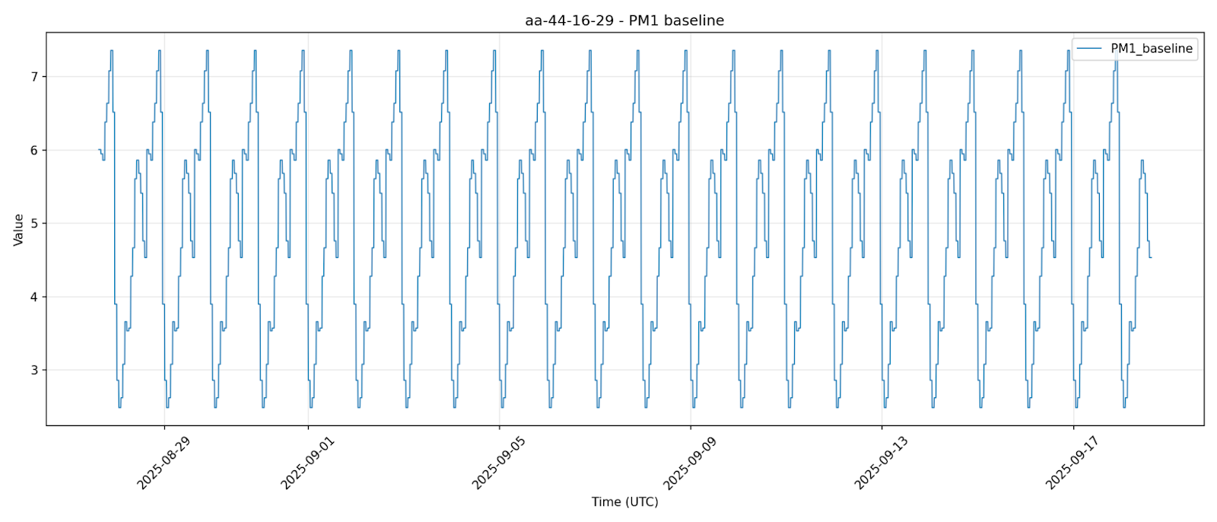
No-fire baseline

Slide 6
Single-Station-Method Assumptions
Each station can detect local fire behavior independently.
Sensor baselines are relatively stable within short windows (few hours).
Environmental noise (humidity, dust) can be filtered by PM ratio and duration checks.

Slide 7
Single-Station-Method Rules
Intensity : zPM1>2.5 (large anomaly in fine particles)
Temporal: rate of change (dPM1 / dt)
Composition: z(PM1/PM4) >1 (fine particles are dominant, to remove air pollution )

Slide 8
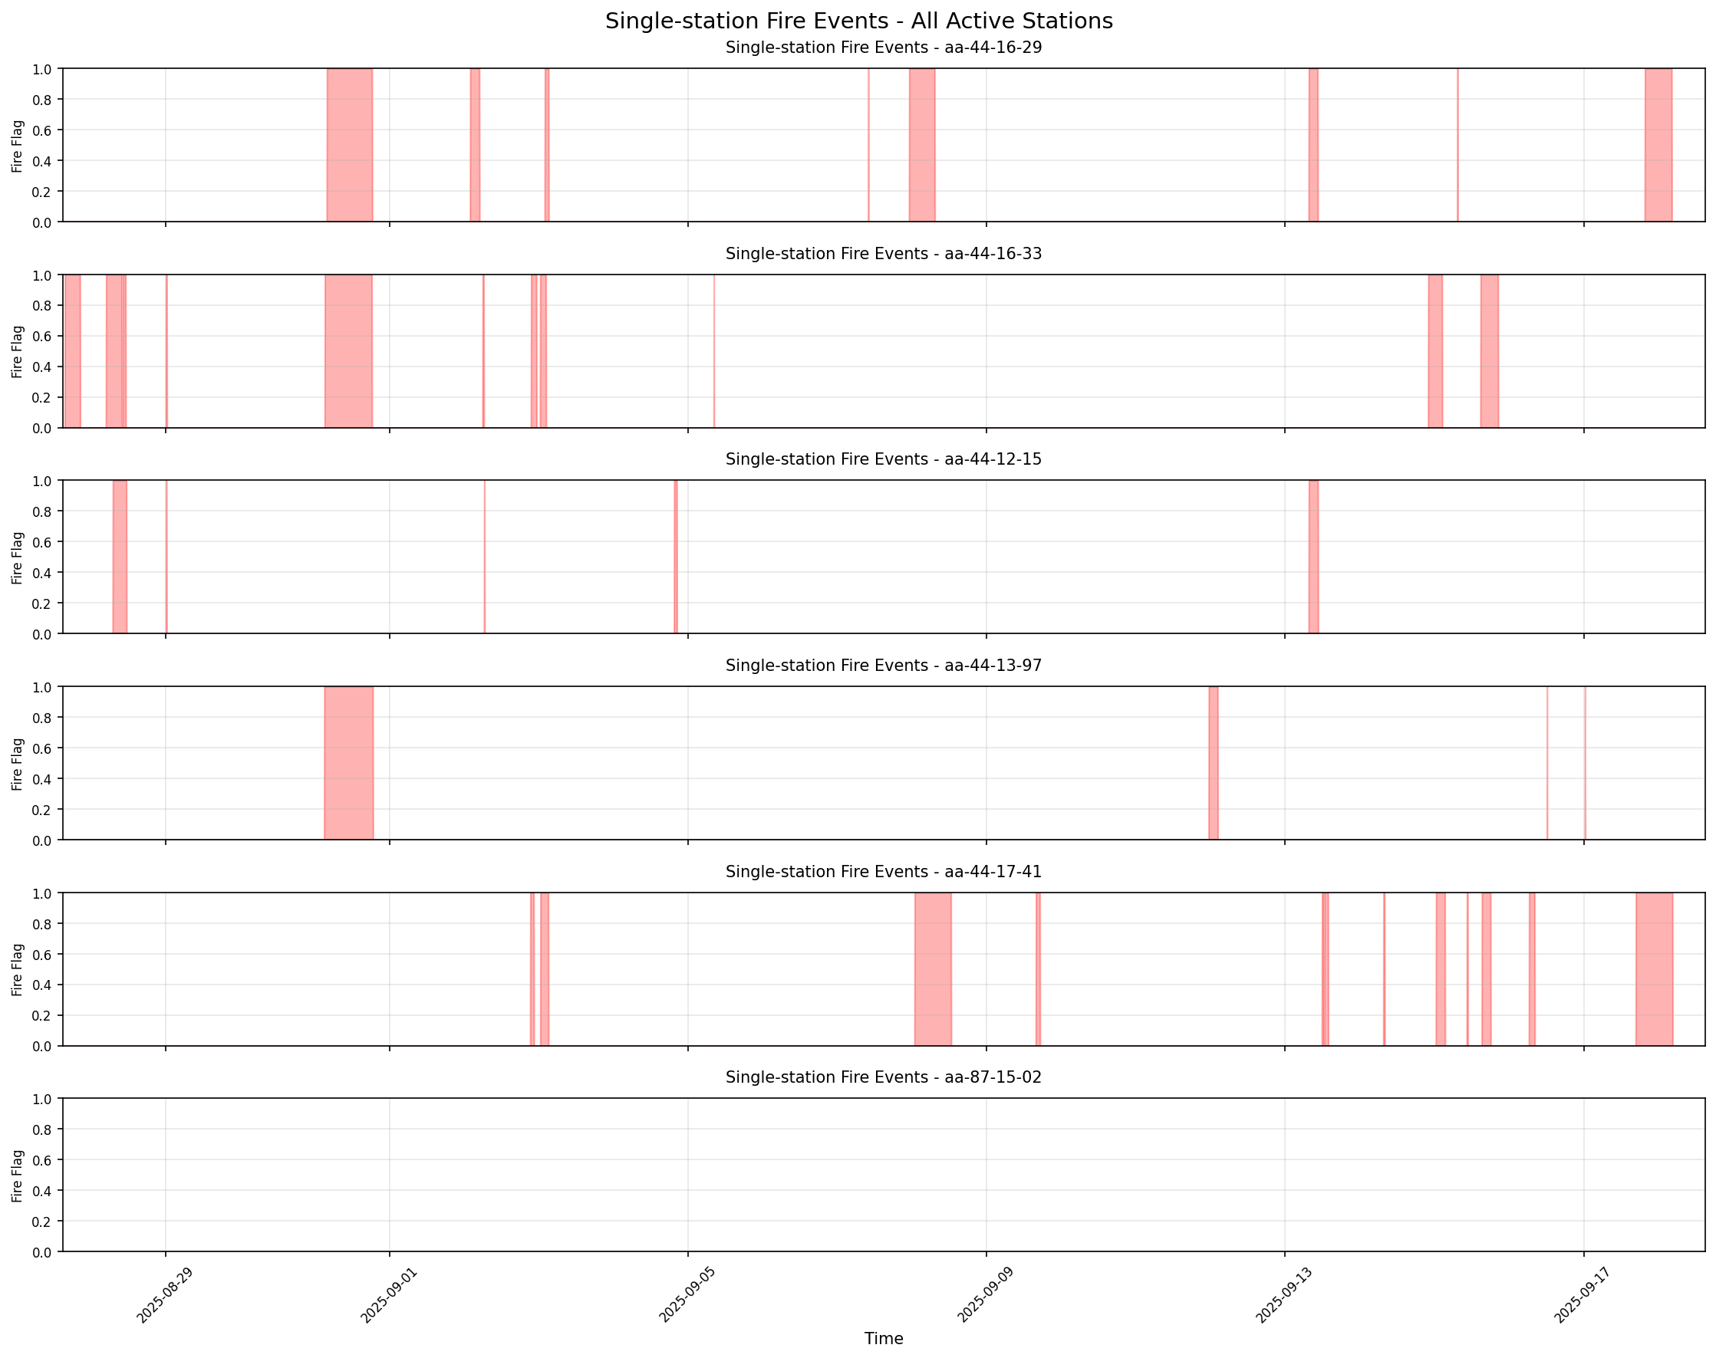
Station-wise Time Series Results
Single-Station Method
X axis is date and time. The position of the red bar indicates when the fire occurred, and its width represents the duration of the fire.
Y axis marks the Fire/ No-fire (binary flag)

Slide 9
Multi-Station Method Assumptions
Real fires generate plumes that spread spatially, influencing nearby stations sequentially.
Signal magnitude decays with distance due to dispersion; arrival timing reflects plume movement.
Dust or pollution, in contrast, shows weak spatial gradients and slow co-occurrence.

Slide 10
Multi-Station- Rules
Same rules of Single-Station-Method
Temporal: adjacent stations respond within 15 minutes if the same event occurs.
Spatial: correlation, distance decay, cross-correlation lag (< 15 min)
Veto:
  RH >85%
  more than ~50% of all stations show a spike

Slide 11
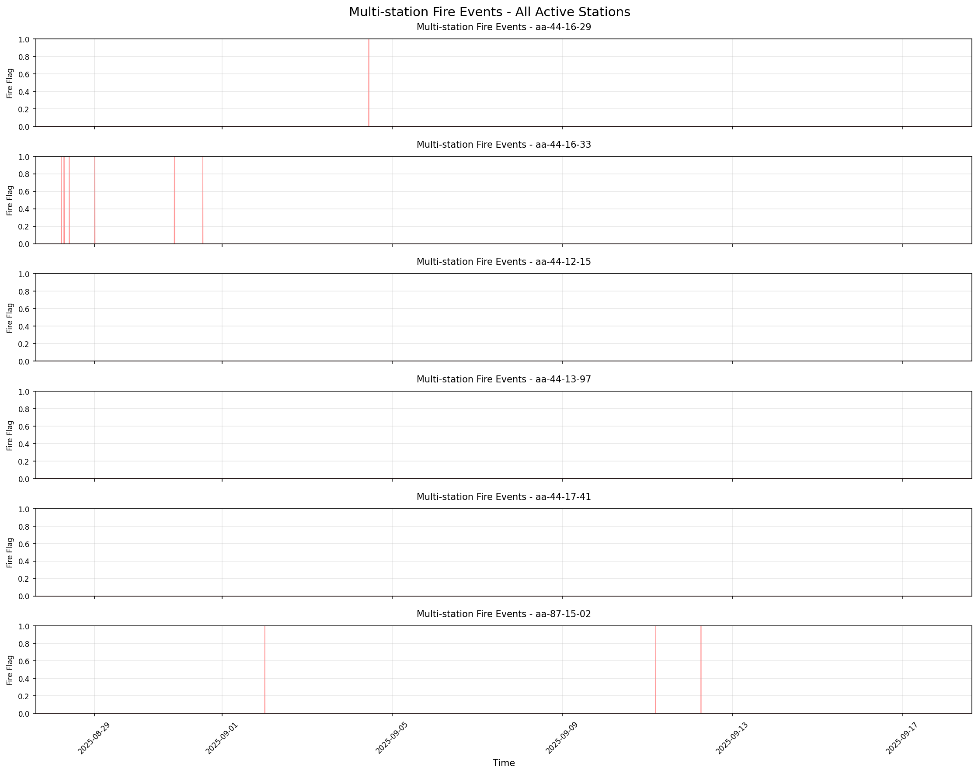
Station-wise Time Series Results
Multi-Station Method
The number of detected fire events has decreased, and the specific parameters still need some adjustment.

Slide 12
TSPulse-Method Theory
TSPulse can model normal temporal dynamics without explicit labels.
High reconstruction error corresponds to abnormal physical conditions (e.g., smoke spike).
Sensor noise is random and short-lived; consistent deviation reflects real events.

Slide 13
TSPulse-Method Assumptions
Under normal (no-fire) conditions, PM1 and PM4 follow predictable daily cycles with slow variation.
A fire introduces sudden deviations that cannot be reconstructed by a model trained on “normal” data.
The reconstruction error thus represents the degree of anomaly.

Slide 14
TSPulse-Method Rules
Fire candidates: reconstruction score > enter threshold (≈ 0.99 quantile).
Event ends when score < exit threshold (≈ 0.95 quantile) for sustained minutes.
Rolling persistence (≥ 10 samples) ensures temporal stability.

Slide 15
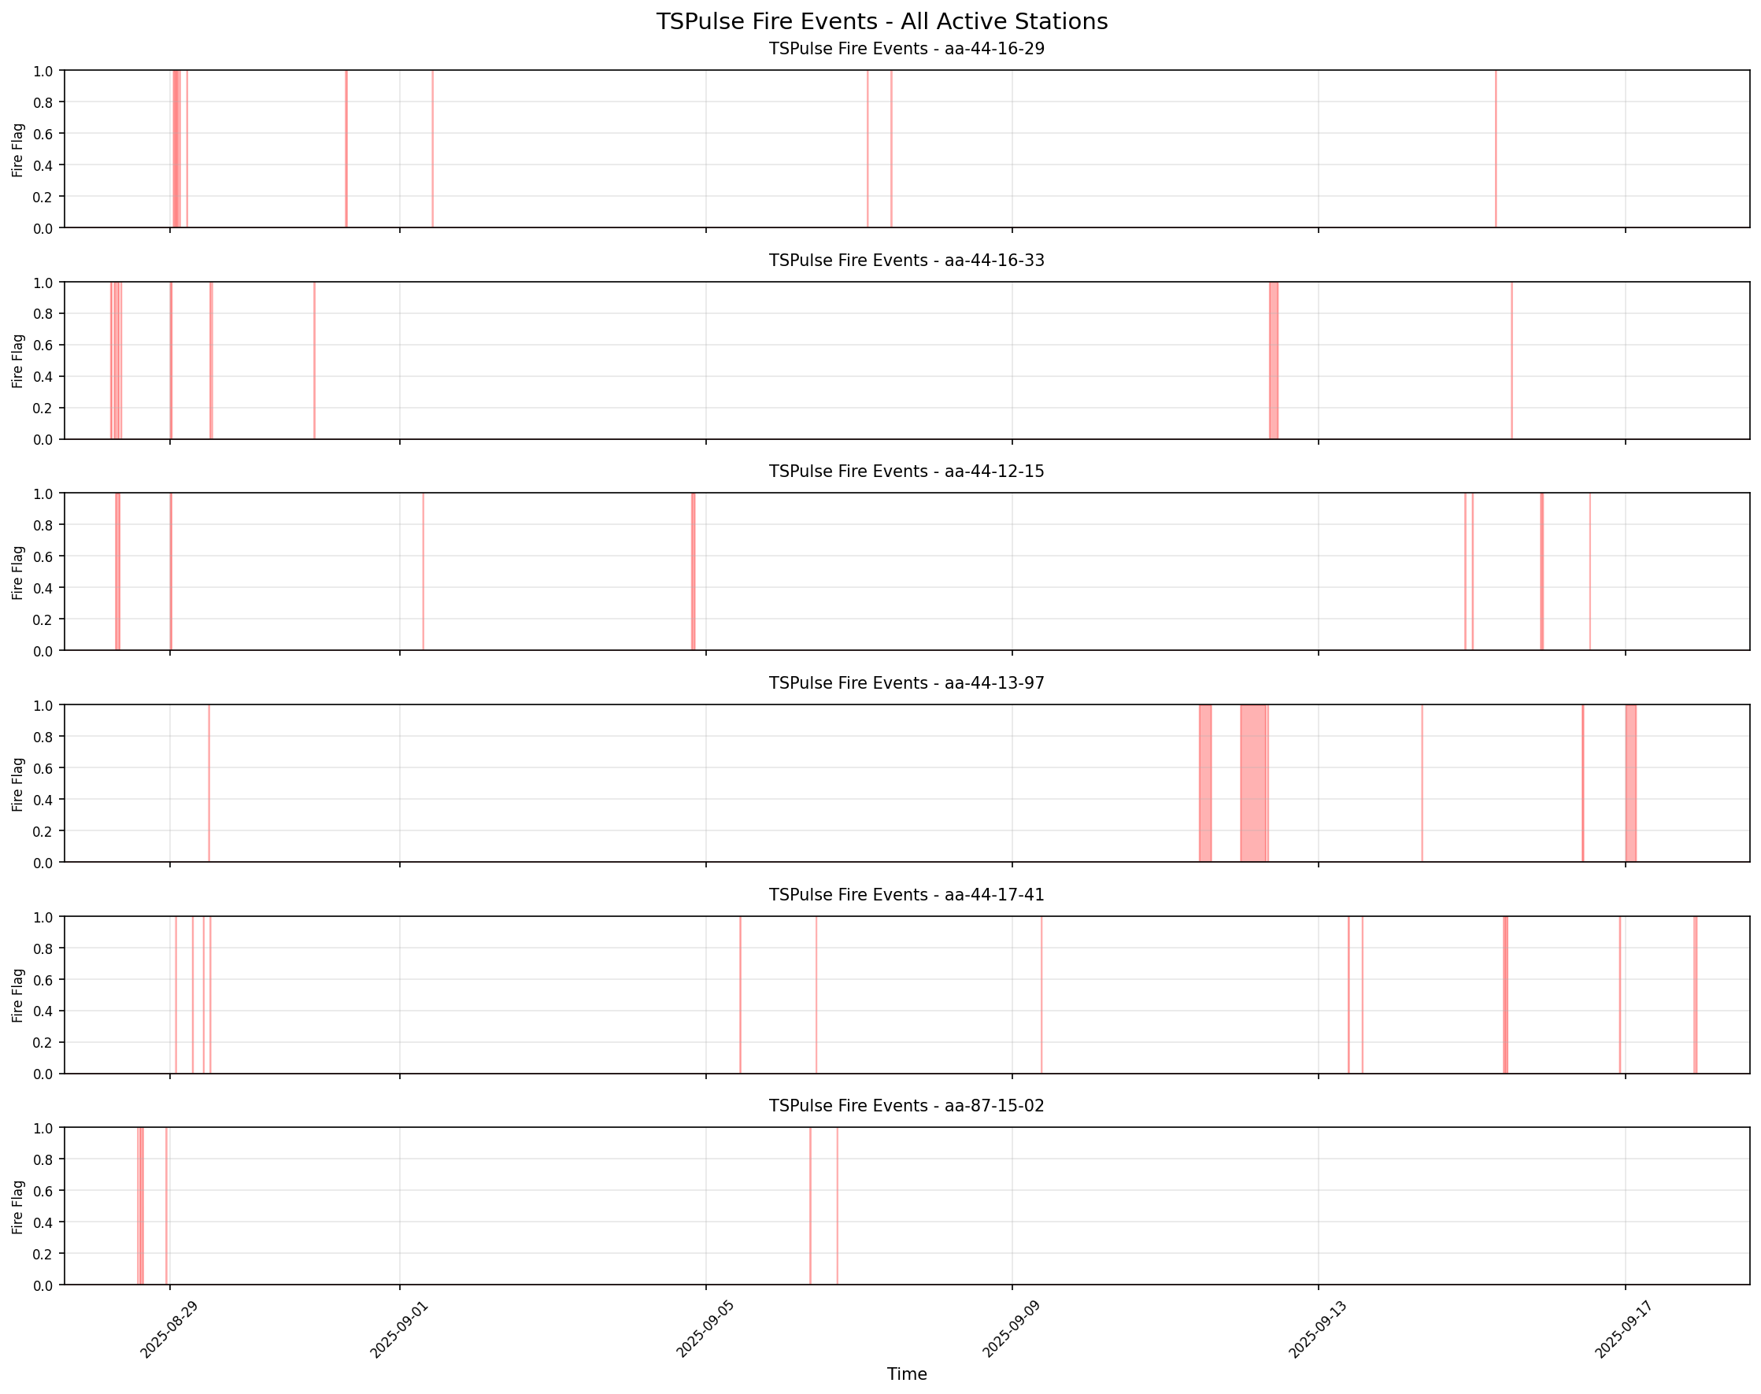
Station-wise Time Series Results
TSPulse Method

Slide 16
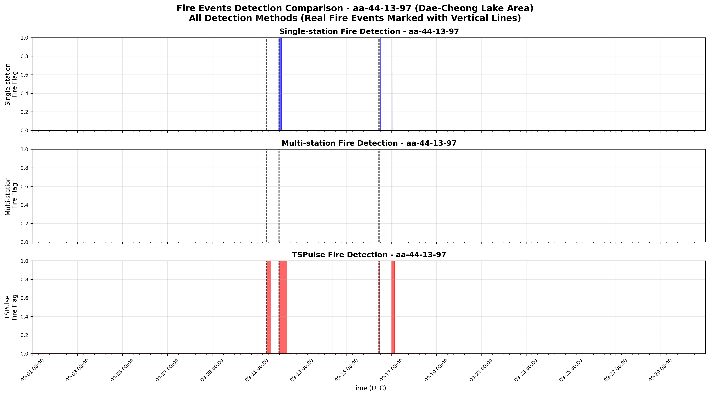

Slide 17
Evaluation at aa_44_13_97
Method Precision Recall F1-Score
--------------------------------------------------
Single-station 0.400 0.500 0.444
TSPulse 0.571 1.000 0.727

Slide 18
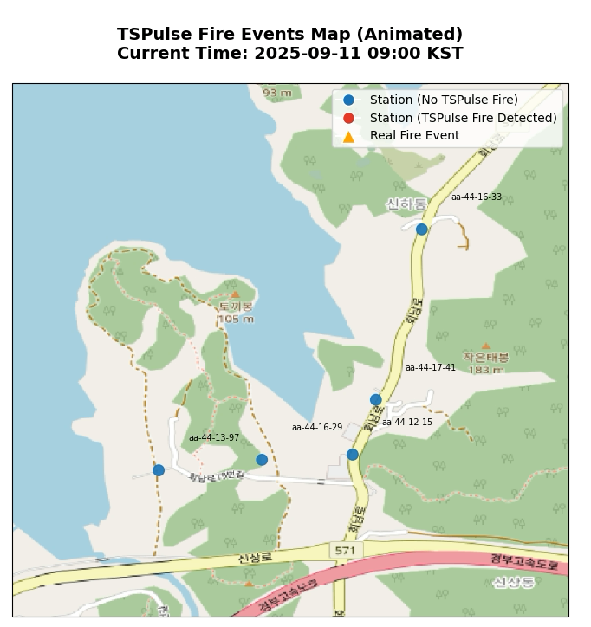
Fire Event Dynamics
TSPulse Method

Slide 19
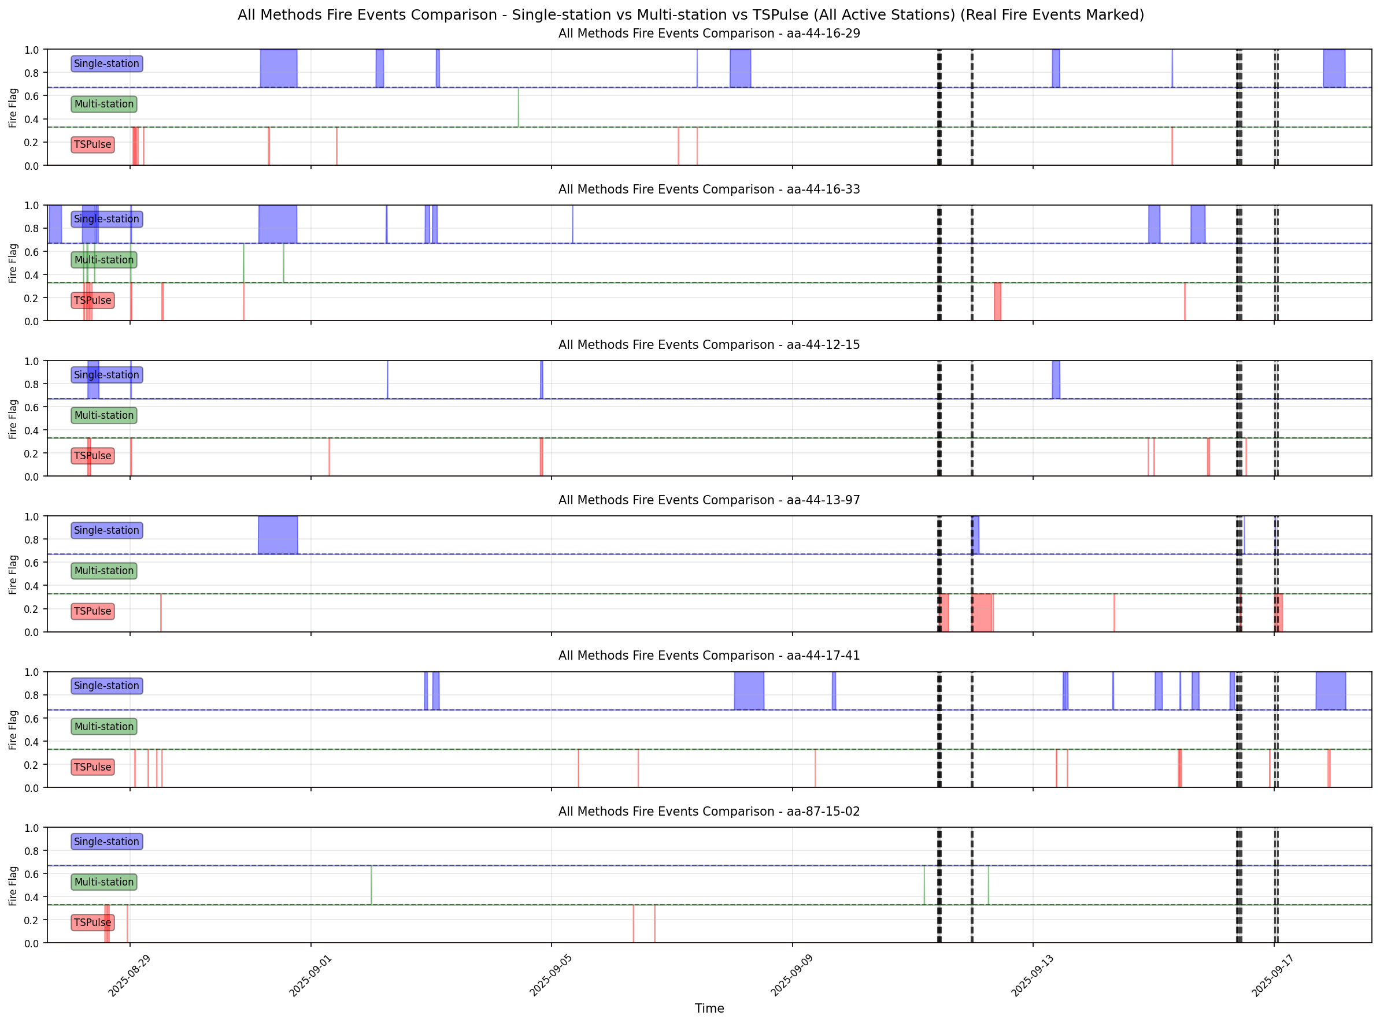

Slide 20
Future work
Model Fine-Tuning
  Use labeled fire events to fine-tune the TSPulse model and recalibrate detection thresholds.
  Optimize blending weights between rule-based and ML scores for better balance of recall and precision.
Improved Veto Logic
  Refine humidity and synchronization vetos to reduce false alarms from fog, rain, or calibration drift.
  Develop adaptive veto thresholds that consider diurnal and seasonal changes.
Environmental Variables Integration
  Incorporate relative humidity, temperature, and wind data to adjust PM and SPH signal interpretation.
  Use wind direction and speed to model how smoke spreads across stations.
SPH Gas Sensor Utilization
  Analyze SPH channel patterns (CO/VOC signatures) as an early fire indicator.
  Build joint PM–SPH anomaly features to better distinguish combustion smoke from dust or pollution.

