Slide 1
Wildfire Detection from N2 Sensor Network – Initial Results
Lizhao Wang

Slide 2
Introduction
In this experiment, I applied three methods to identify fire events from PM sensor data:
1) a single-station anomaly detection method
2) a multi-station joint detection method
3) a deep learning–based anomaly detection method
For each method, two types of visualizations are provided
1) time-series plots for each station with fire periods marked
2) dynamic regional maps showing the detected fire periods

Slide 3
Single-Station Method
This study explores the use of PM sensor data for detecting small fire events by analyzing fine and coarse particulate matter (PM1, PM4). The dataset comes from six stations in Daejeon, South Korea, where several controlled fire events were conducted. The objective is to distinguish true fire ignitions from normal air pollution or background fluctuations.
PM1 represents very fine particles (≤1 µm) mainly from smoke, while PM4 (≤4 µm) includes both PM1 and coarser particles like dust or ash. The PM1/PM4 ratio helps differentiate smoke (high ratio) from dust (low ratio).
The main challenges are data gaps, unaligned timestamps, and the absence of ground-truth fire labels. Therefore, the approach focuses on building a no-fire baseline, smoothing noisy data, and detecting anomalies based on rapid PM rise, fine-particle dominance, and short-term persistence—key signatures that indicate true fire events.

Slide 4
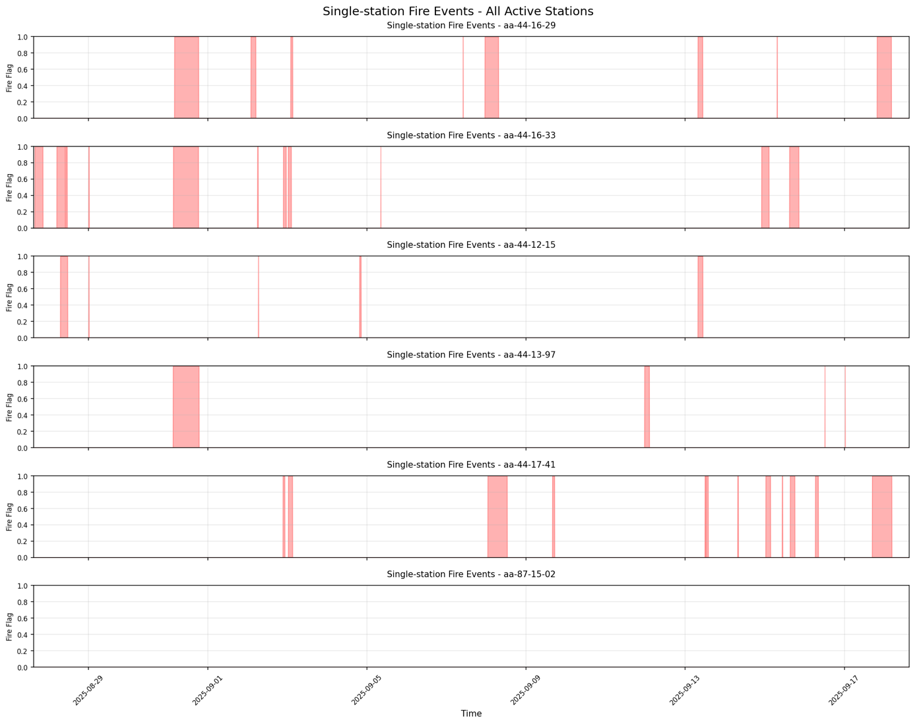
Station-wise Time Series Results
Single-Station Method
X axis is date and time
Y axis marks the Fire/ No-fire

Slide 5
Multi-Station Method
Compared to the single-station method, this approach refines local anomalies into true fire events by enforcing spatial–temporal consistency across multiple sensors.
Nearby stations are required to respond within 15 minutes, with signal peaks decreasing as the distance from ignition increases.
False alarms are further reduced using veto rules, such as removing cases dominated by humidity or network-wide noise.
Future improvement needs incorporate wind direction and speed to better model how particles spread spatially.

Slide 6
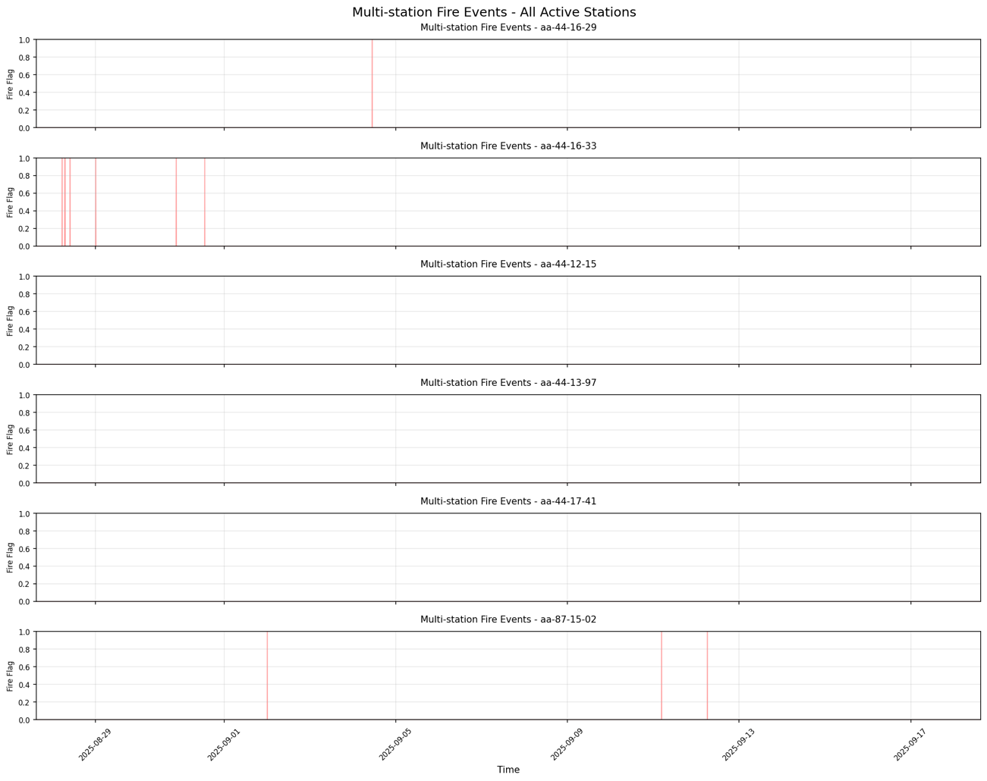
Station-wise Time Series Results
Multi-Station Method

Slide 7
TSPulse Method
This is a machine learning–based automatic anomaly detection method. It uses the TSPulse model to reconstruct the normal (no-fire) behavior of PM1 and PM4 signals.
When the actual sensor readings deviate from the reconstructed baseline, the difference is converted into a fire anomaly score.
Periods where the score exceeds a defined threshold are flagged as potential fire events.
This method automatically learns temporal patterns, adapts to local sensor behavior, and highlights unusual changes without requiring predefined rules or labeled data.

Slide 8
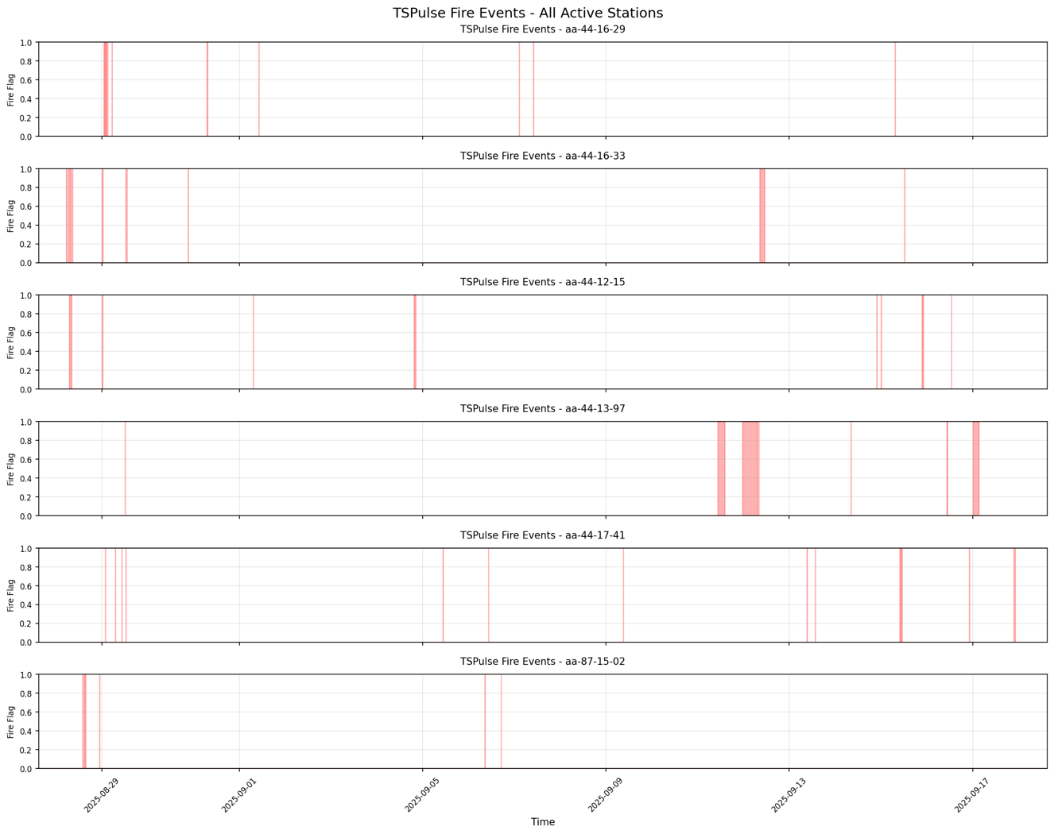
Station-wise Time Series Results
TSPulse Method

Slide 9
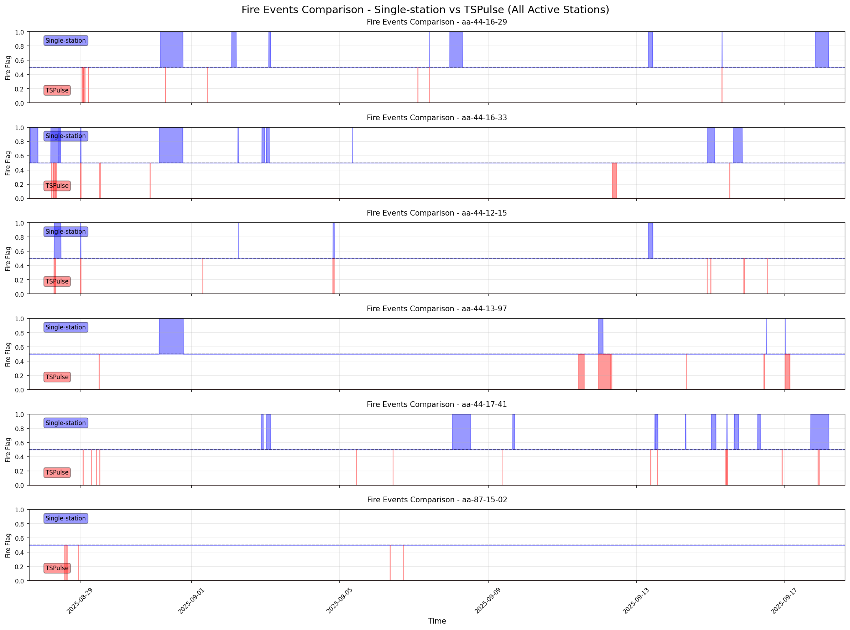
Results
Comparison between single-station and TSPulse

Slide 10
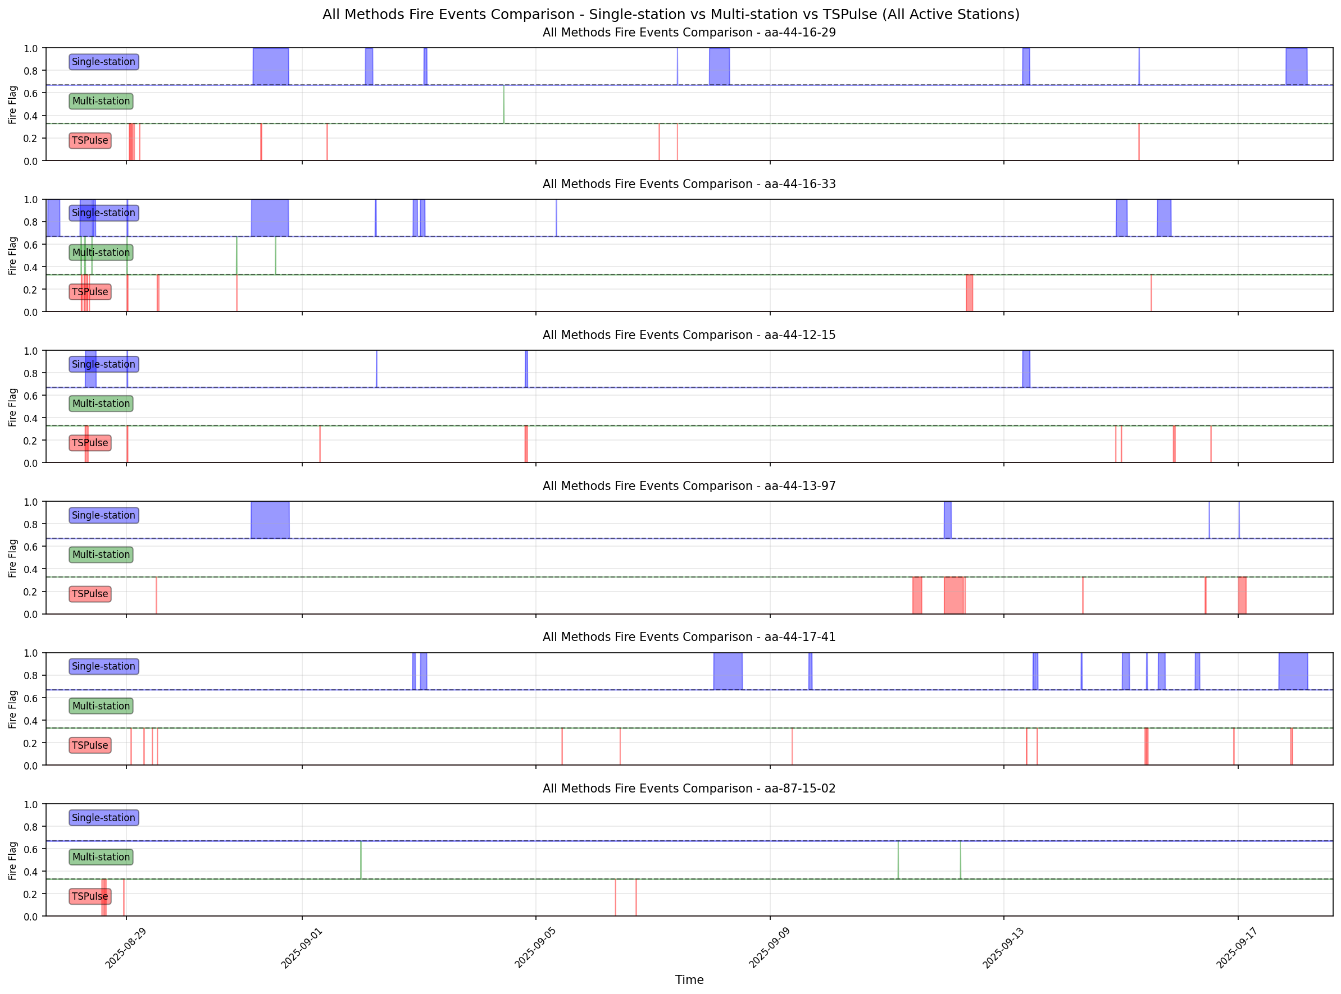
Results
Comparison among three methods

Slide 11
Summary
Overall, the three methods each have their own strengths and characteristics.
All of them require adjustment of parameters and fine-tuning based on real labeled data,
so that the detection results can better match the actual fire events and application needs.

