Slide 1
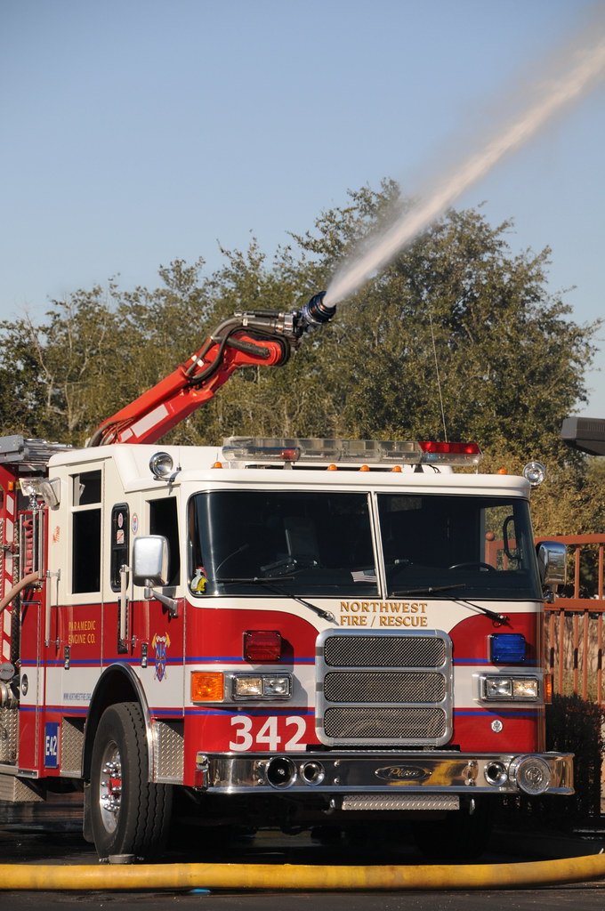
Blaze Bot
EECE 5554
Jonathan Bear

Slide 2
Power
EECE 5554
Peripheral | Example | Power Draw
Robotic Arm | FANUC M-1000iA | 8kW
GPS | BU-353N | 0.21W
Thermal Imager | Bullard QXT Pro | 0W – internal battery (6h of charge)
Camera | NVIDIA Jetson Nano | 5W
CPU | Intel i9 13900K | 199W
Flow Sensor | AkroFlow Portable Flow Meter | 0W – internal battery (years of charge)
Total Power Consumption | 6 hours of use | ~50kWh maximum

Slide 3
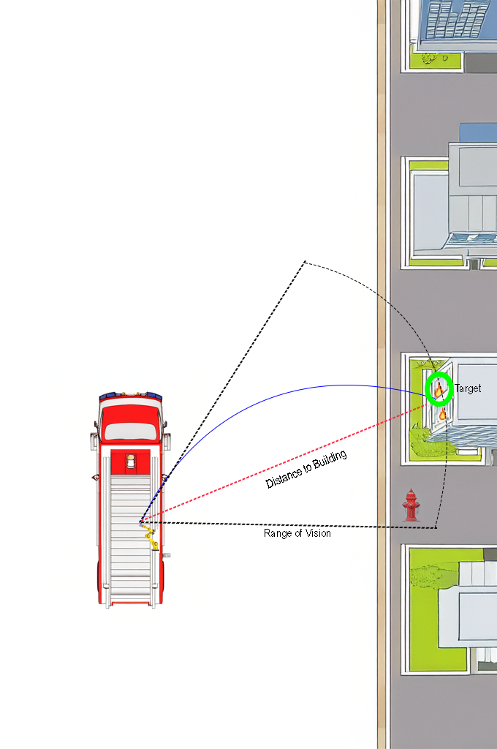
Navigation
EECE 5554
Thermal Imager determines target
GPS and IMU in Arm determine location and orientation, distance to building extracted from these measurables
CPU determines arm angle by extrapolating physics from situation
Camera determines height of target and any obstacles

Slide 4
Sensors
EECE 5554
Thermal Imager
GPS
Robotic Arm
IMU (internal to robotic arm)
Camera
Flow Sensor

Slide 5
Software
EECE 5554
2D Convolution applied to thermal imager to determine most intense flame
Adjust arm until most intense flame is centered
GPS and IMU used to determine distance to building
Camera and distance to building determine height of target flame, and uses pre-existing computer vision libraries to search for any significant obstacles (i.e. Trees, Debris, Humans)
CPU uses flowrate and situational physics to calculate optimal arm angle to extinguish flame

