Slide 1
Mobile Application for Intelligent Transportation Systems with Vehicular Communications Integration
Gil Teixeira – gilteixeira@ua.pt
José Fonseca – jaf@ua.pt, João Almeida – jmpa@ua.pt
Joaquim Ferreira – jjcf@ua.pt
A multi-platform mobile application designed to interface with either vehicles or a central information broker, facilitating monitoring and interaction within the ITS environment. The application integrates sensor data collection and sharing, enabling users to create and visualize events that warn of potential hazards such as accidents, traffic jams, road works, and adverse weather conditions in real-time, thereby helping to prevent accidents and reduce congestion.

Slide 2
Motivation

Slide 3
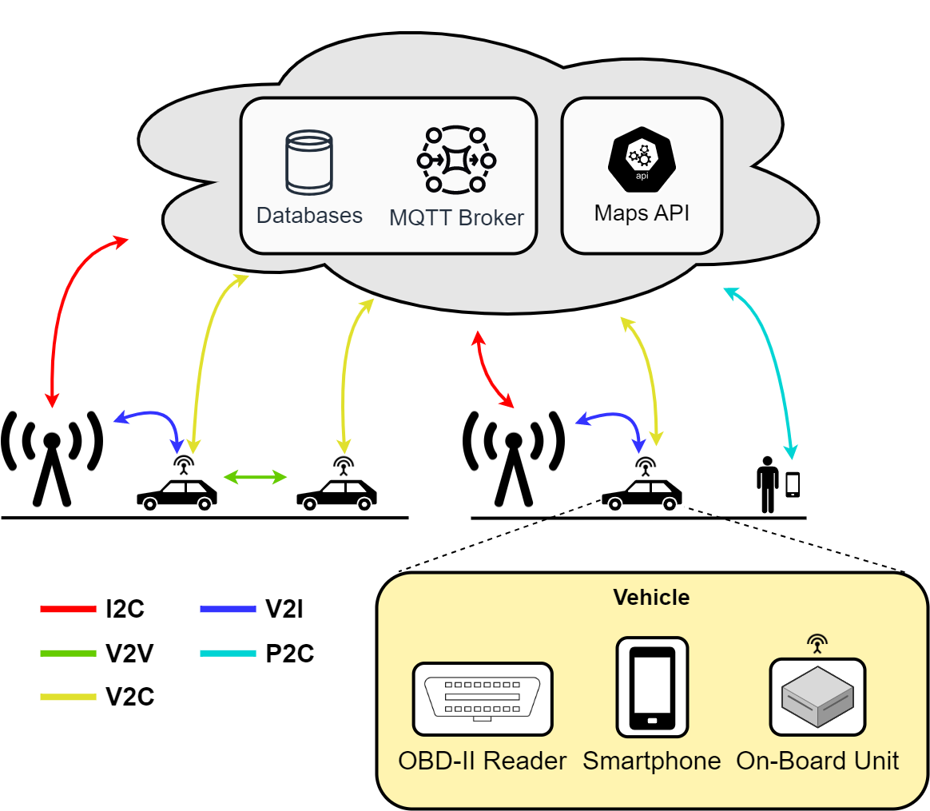
C-ITS (Cooperative Intelligent Trabsoirtation Systems)
A subset of ITS focused on vehicular communications
Direct communications
Contextually relevant informations
Significantly reduced delay
Vechile-To-Everything (V2X) services
Tolling
Electric Vehicle (EV) charging
C-ITS architecture

Slide 4
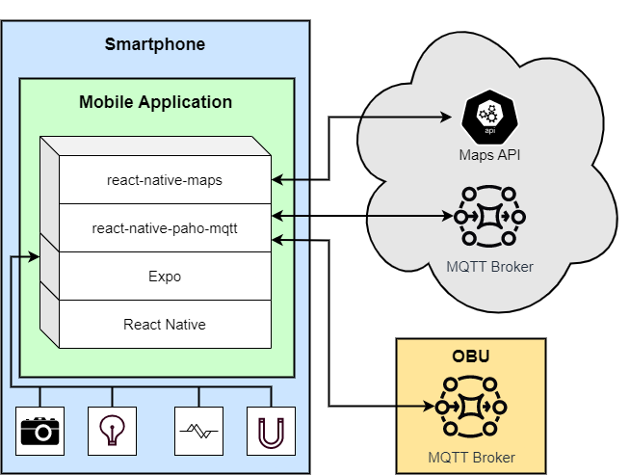
Application Architecture
React Native (RN)
Javascript / Typescript
Expo
Sensor Data Collection
Message Queuing Telemetry Transport (MQTT)
Mobile application architecture and external connections

Slide 5

User Modes
Vulnerable Road User (VRU)
Quadtrees - Geographicly relevant information filter
VRU Awareness Messages (VAMs)
Traffic Control Center (TCC)
Monitoring
On-Board Unit (OBU)
Contextually relevant information
Vehicle-To-Everything (V2X) Services
User mode toggle switch

Slide 6
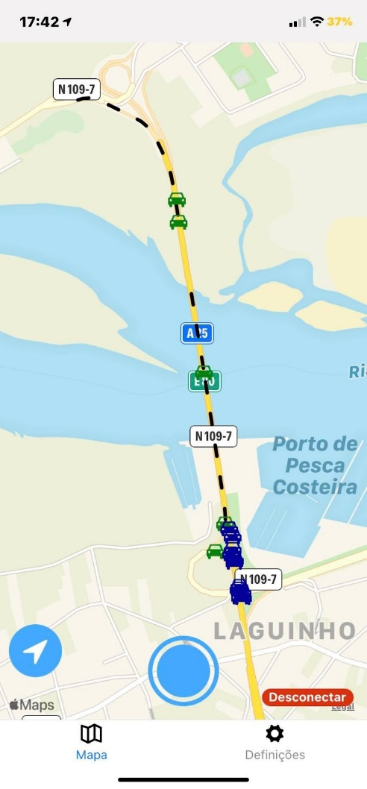
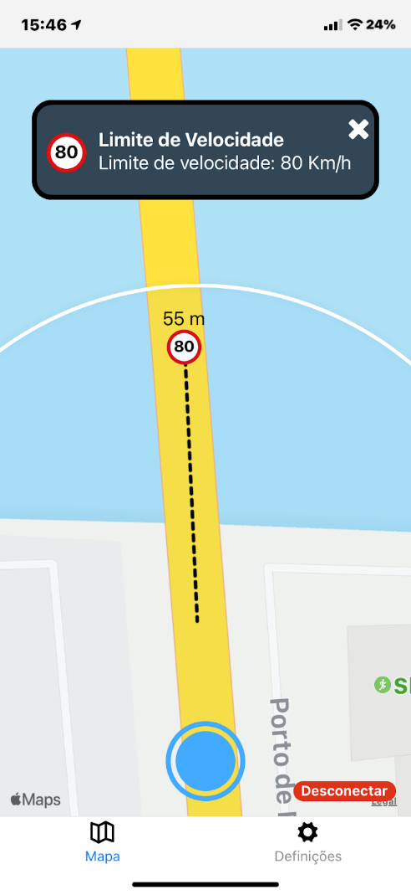
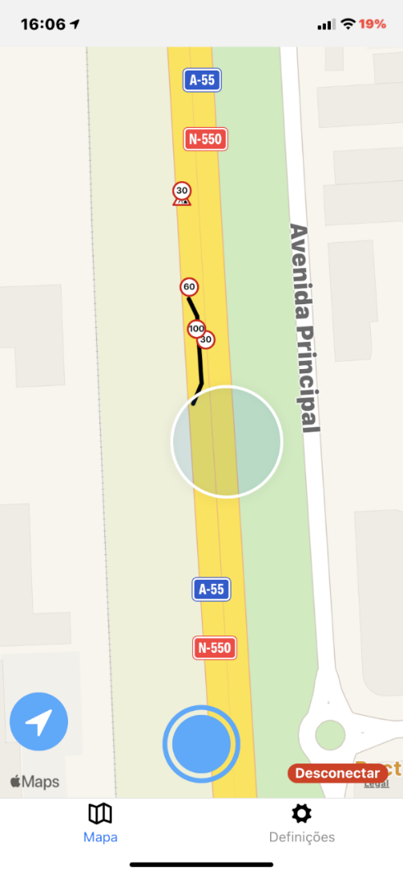
European Telecommunications Standards Institute (ESTI) Messages
CPM - Collective Perception Message​
CAM - Cooperative Awareness Message​
IVIM - Infrastructure to Vehicle Information Message​
HDMAP - ​High-Definition Maps
CPM and CAMs
IVIM
HDMAP

Slide 7
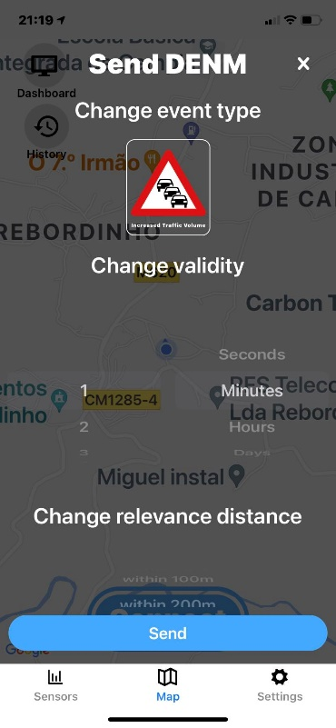
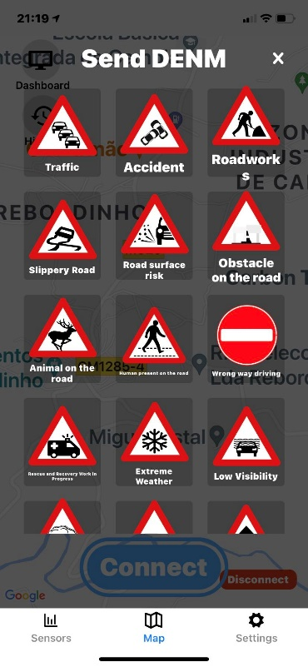
ESTI Messages
DENM - Decentralized Environmental Notification Message
VAM - VRU Awareness Message
DENM creation

Slide 8
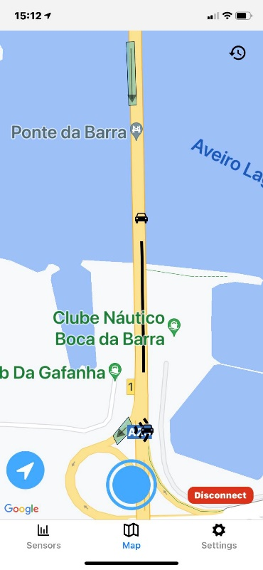
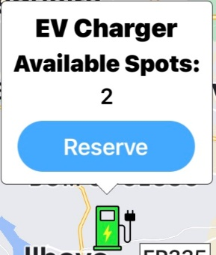
ESTI Messages
SAEM – Services Announcement Essential Message
EVCSNM – Electric Vehicle Charging Spot Notification Message
EVRSRM – Electric Vehicle Recharging Spot Reservation Message
DENM creation

Slide 9
Proprietary Messages
CPM - Collective Perception Message​

Slide 10
Proprietary Messages
CPM - Collective Perception Message​

