Slide 1
Gil Teixeira – gilteixeira@ua.pt
João Almeida – jmpa@ua.pt
José Fonseca – jaf@ua.pt, Joaquim Ferreira – jjcf@ua.pt
A Mobile App for Intelligent Transport Systems with Vehicle Communications Integration. A monitoring system for the road infrastructure equipped with ITS technology, capable of identifying risky driving conditions.

Slide 2
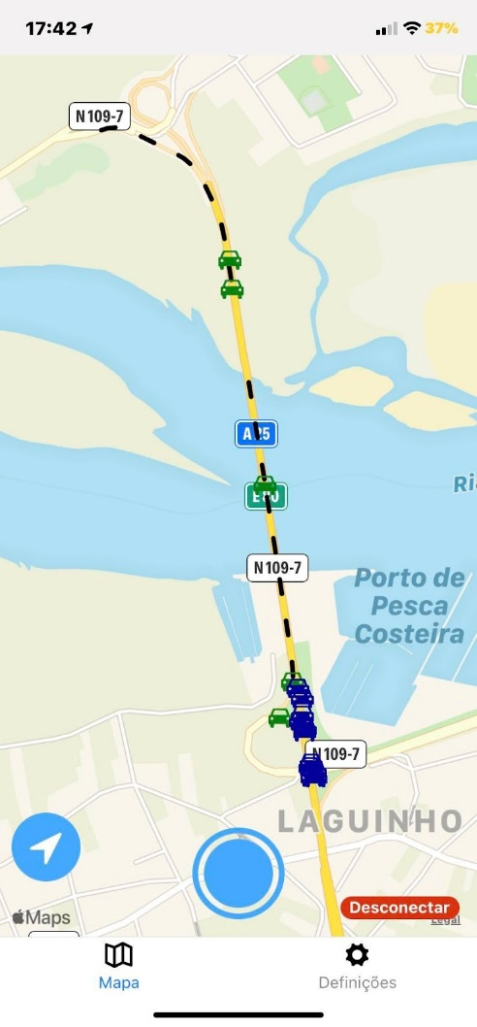
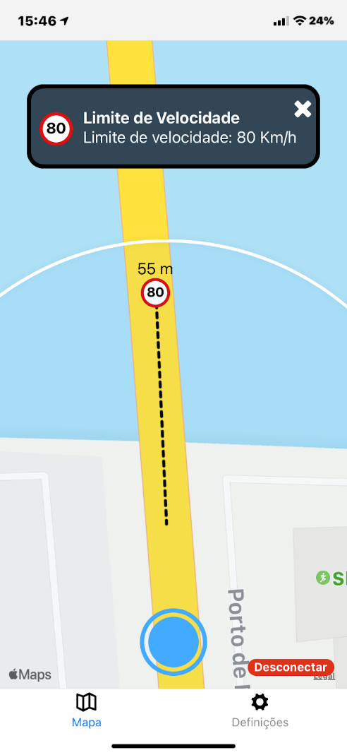
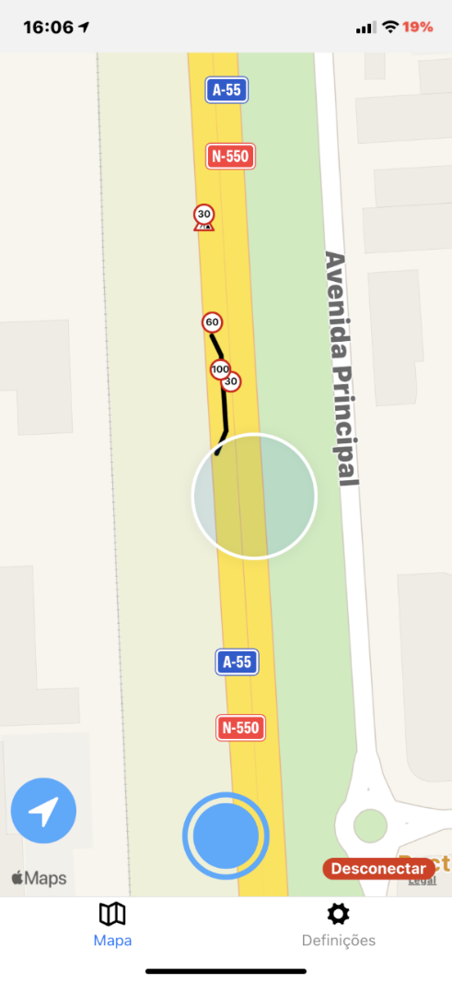
Work done / results
Cooperative, Connected and Automated Mobility
CCAM messages:
CPM
CAM
DENM
VAM
IVIM
HDMAP
SVSM, a new message
Light Sensor Expo contribution
CPM and CAM
IVIM
HDMAP

Slide 3
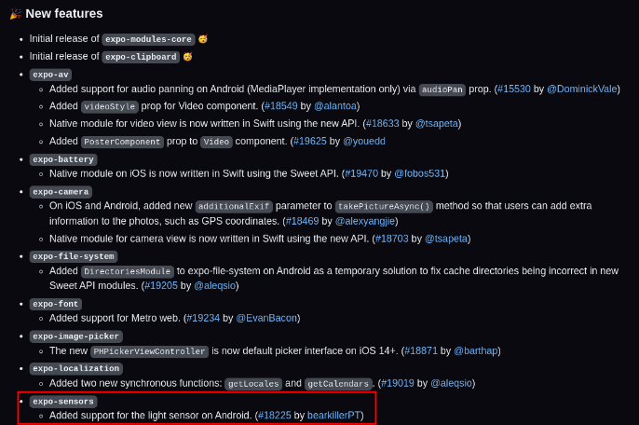
Work done / results
Expo SDK 47 beta 1 released!

Slide 4
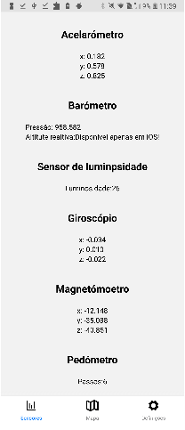
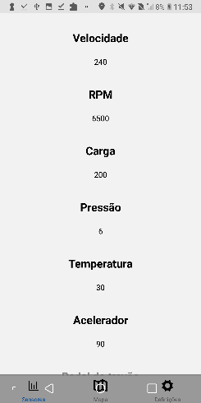
Work done / results
Sensor dedicated screen!
When connected to a car’s
On Board Unit (OBU) the App sends a message called SVSM containing this sensor’s information
When connected to a car’s
OBU a new message named
OVSM transmits the car’s
sensor data

Slide 5
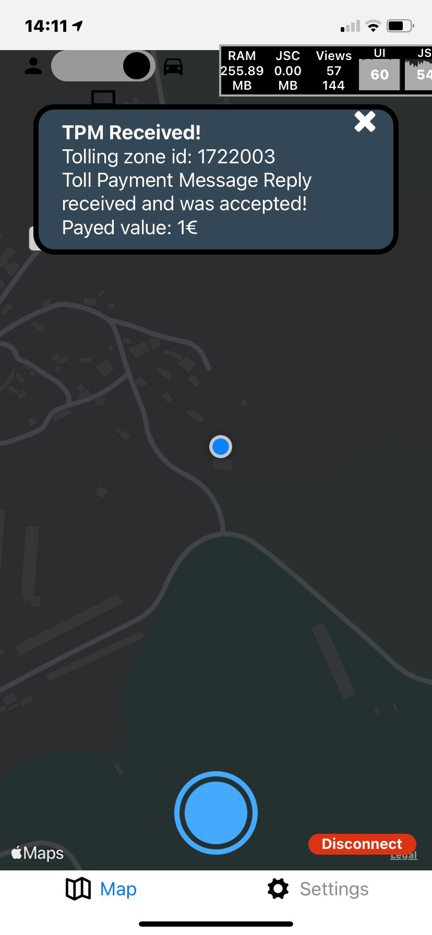
Future work / challenges
V2X tolling
SAEM and TPM messages almost done
EV Charging
(ETSI standard + MagnumCap Connetor)
TPM

