Slide 1
Gil Teixeira – gilteixeira@ua.pt
João Almeida – jmpa@ua.pt
José Fonseca – jaf@ua.pt, Joaquim Ferreira – jjcf@ua.pt
A Mobile App for Intelligent Transport Systems with Vehicle Communications Integration. A monitoring system for the road infrastructure equipped with ITS technology, capable of identifying risky driving conditions.

Slide 2
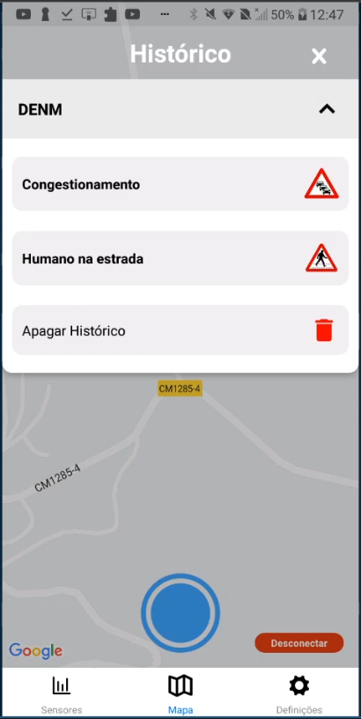
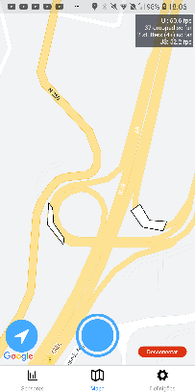
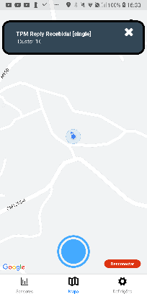
Work done / results
Message Persistent History
Only implemented for DENMs yet
Decentralized Environmental Notification Message
Tolling Zones
Advertised using SAEMs
Services Announcement Essential Message
Tolling Payment Messages

Slide 3
Future work / challenges
EV Charging
(ETSI standard + MagnumCap Connetor)
Message persistent history
Implementation for SAEM, TPM, IVIM and HDMaps

