Slide 1
Gil Teixeira – gilteixeira@ua.pt
José Fonseca – jaf@ua.pt
João Almeida – jmpa@ua.pt, Joaquim Ferreira – jjcf@ua.pt
Portfolio containing professional and academic interests

Slide 2
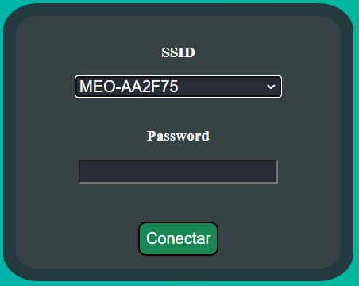
Portfolio
RTOS Project (developed with Heaboo, lda) chosen to complement SOTR which I attended this semester.
Date: 10/2022 - 12/2022
Code for an espressif esp32 featuring:
Wi-Fi management
Creates an AP with a webserver where the user can introduce his Wi-Fi credentials
OTA updates
Web server to monitor and configure
Login component

Slide 3
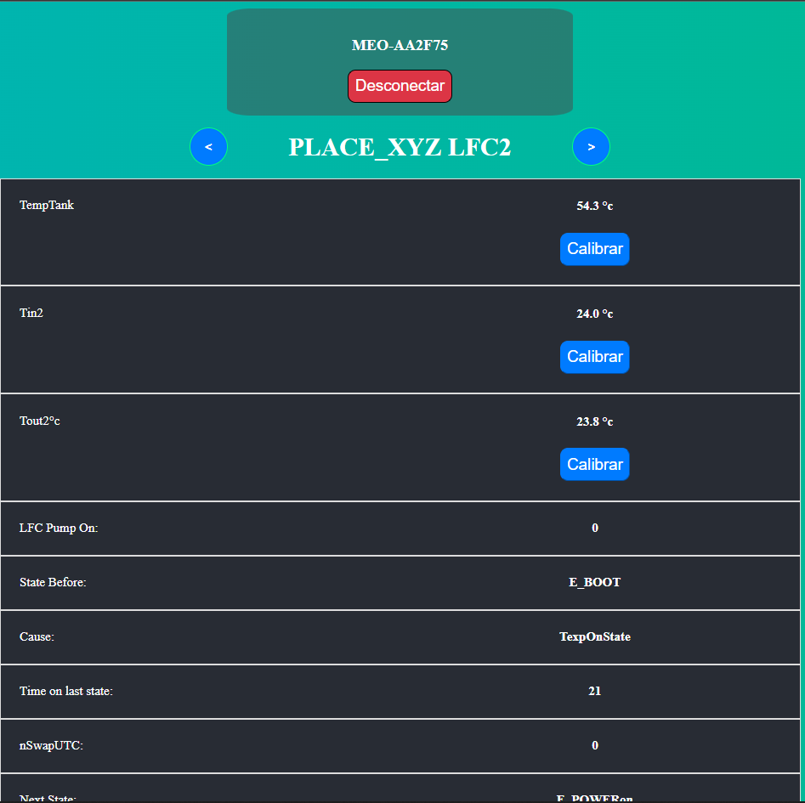
Portfolio
The microcontroller sends 2 types of messages to a server hosted by myself:
Sensor messages
Sent every 15 seconds
Status messages
Sent every state change / 2 minutes passed and also serves as an heartbeat

Slide 4
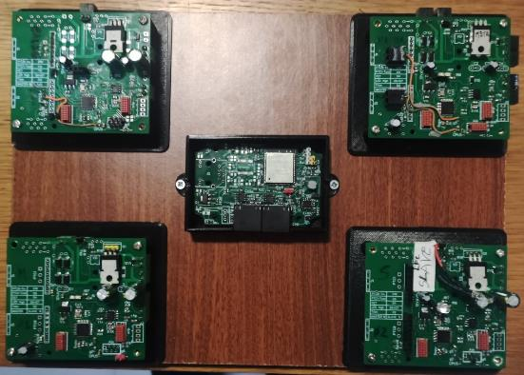
Portfolio
Project developed in collaboration with an engineer of the company who created the current 1 master and up to 3 slaves, all Atmega328, architecture to control and monitor the company’s product which consists of thermic batteries to compensate for the initial cold water when requesting hot water.
This project contributed greatly to my knowledge about RTOS specifically freeRTOS.

