Slide 1
Gil Teixeira – gilteixeira@ua.pt
José Fonseca – jaf@ua.pt
João Almeida – jmpa@ua.pt, Joaquim Ferreira – jjcf@ua.pt
A Mobile App for Intelligent Transport Systems with Vehicle Communications Integration. A monitoring system for the road infrastructure equipped with ITS technology, capable of identifying risky driving conditions.

Slide 2
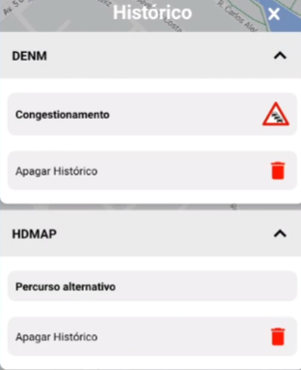
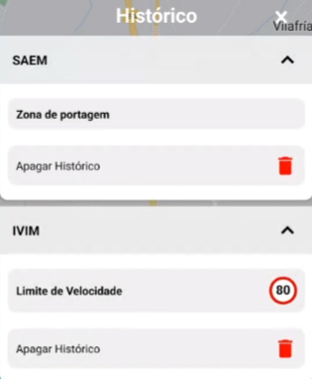
Work done / results
Message Persistent History
Implemented for all required message types
DENMs
HDMAPs
IVIMs
SAEMs
TPMs
Minor bug fixes
Literature on VRU

Slide 3
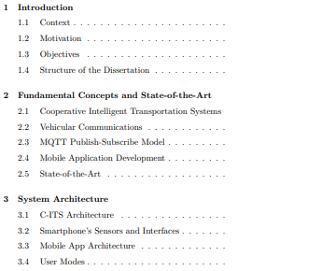
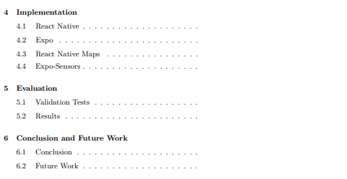
Pre-Dissertation Structure Proposal

