Slide 1
Gil Teixeira – gilteixeira@ua.pt
José Fonseca – jaf@ua.pt
João Almeida – jmpa@ua.pt, Joaquim Ferreira – jjcf@ua.pt
A Mobile App for Intelligent Transport Systems with Vehicle Communications Integration. A monitoring system for the road infrastructure equipped with ITS technology, capable of identifying risky driving conditions.

Slide 2
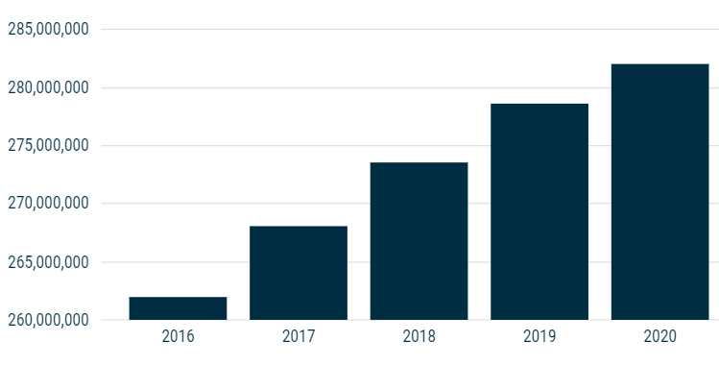
Motivation
Increasingly high number of vehicles
Road degradation
Congestion
Accidents
Climate change
Dangerous weather events
VRUs are the most endangered!
C-ITS and V2X
Cooperative Awareness
Vehicles in use in Europe

Slide 3
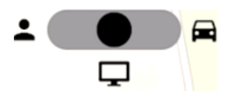
Objectives / User Modes
Objectives:
Warn road users
Weather events
Road events
Directly involve VRUs
Location sharing
Report of events
Traffic Control Centre monitoring
Vehicular communications
Sensors sharing
Tolling
EV charging
User mode switch
User Modes:
VRU mode (left)
TCC mode (centre)
OBU mode (right)

Slide 4
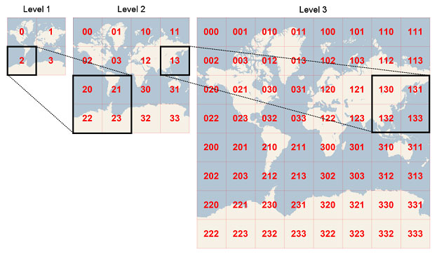
Message Queuing Telemetry Transport
All information is exchanged using an MQTT broker.
Lightweight protocol with a publish/subscribe model.
Topic structure and quadtree allows for a user to subscribe only to it’s nearby messages!

Slide 5
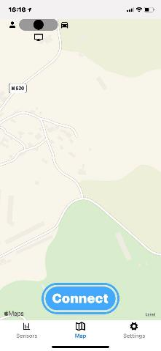
Mobile App Development
Multi-platform:
Android (72.37%)
iOS (26.98%)
Single code base (Typescript and Javascript only!):
React Native
Expo
Stateless message storage with periodic refresh for stable performance.

Slide 6
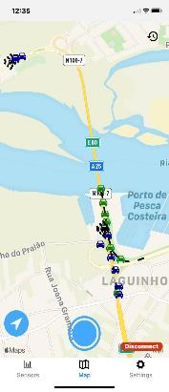
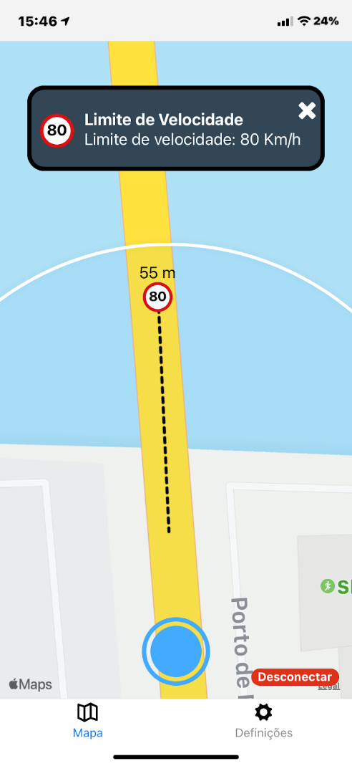
Cooperative, Connected and Automated Mobility Messages
CPM
Cooperative Perception Message
CAM
Cooperative Awareness Message
IVIM
I2V Information Message
CPMs and CAMs
IVIM

Slide 7
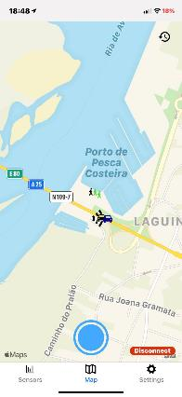
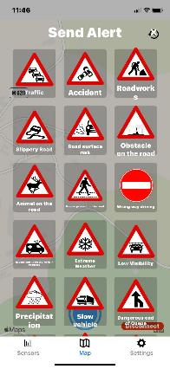
CCAM Messages
VAM
VRU Awareness Message
DENM
Decentralized Environmental Notification Message
DENMs
Menu
VAMs

Slide 8
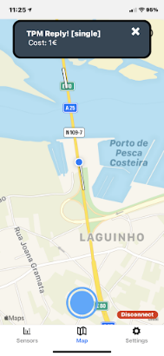
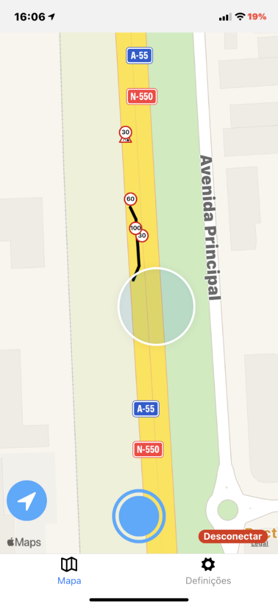

A-To-Be Messages
HEARTBEAT
SAEM
Service Announcement Essential Message
TPM
Tolling Payment Message
HDMAP
High Definition Map
HEARTBEAT
SAEM and TPM
HDMAP

Slide 9
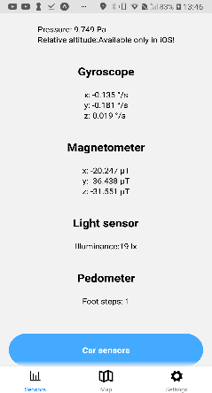
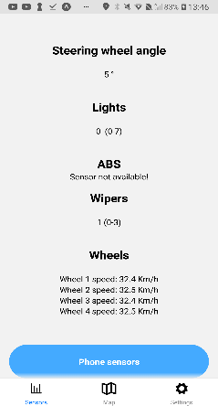
Sensor Messages
VSM
Vehicular Sensor Message
SPVSM
SmartPhone VSM
Expo-Sensors
OVSM
OBD-II VSM
SNVSM
SoNar VSM
Phone
Sensors
Vehicle
Sensors

Slide 10
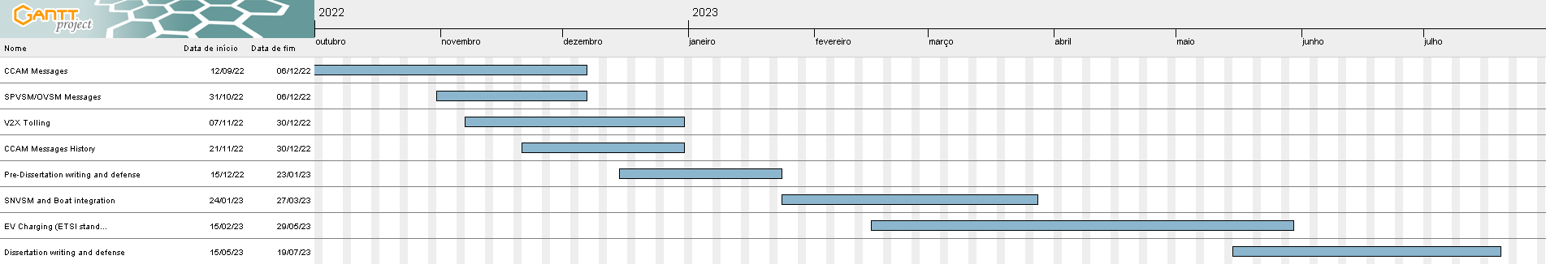
Future Work

