Slide 1


MOSAIC
A multi-agent system for hyper-personalised email marketing
Team 13 · Ong Qing Quan · Agustinus Benyamin Prasetyo
NUS-ISS Graduate Certificate in Architecting AI Systems · SWE5008 Practice Module · October 2026
Notes:
[~30s · finish by 0:30]
Hi everyone, good morning. We're Team 13. I'm Qing Quan, and this is Benyamin.
Our project is called MOSAIC. It's a multi-agent system for personalised email marketing.
The idea is simple. You give it your customer list. Four AI agents find the different groups of customers in there, write a different email for each group, and check every email before it goes out. And then they stop — because a human always presses send.
TIMING (don't read): slide 5 by 2:10 · slide 8 by 3:55 · slide 11 by 5:25 · hand over by 8:00

Slide 2

Campaigns stall at four variants
The limit is cost, not preference — every extra variant costs about what the first one did.
3–4
creative variants per campaign
Each needs a brief, design pass, copy pass, render test and QA sign-off — the fifth costs what the first did.
200k
contacts in four coarse buckets
A durability buyer and a discount hunter both land in “high value”. The email speaks to neither.
1
merge tag counted as personalisation
Dropping a first name into a fixed sentence is usually as far as it goes.
Notes:
[~45s · finish by 1:15]
So let's start with the problem.
A typical company might have two hundred thousand customers. But they still send maybe three or four versions of an email — new customers, old customers, big spenders, and everyone else.
Why only four? It's not that they want to. It's cost. Every version needs its own design, copy, testing and sign-off. So the fifth version costs as much as the first.
The result is what you see here — almost everyone gets the same grey email. Someone who buys for quality and someone who waits for discounts get exactly the same message. And "personalisation" usually just means "Hi, first name".

Slide 3



Why four agents, not one prompt
Generating and checking are two jobs — they should never grade each other.
One large prompt
Rules-based platform
MOSAIC: four agents
Reasonable output, nothing auditable
Fully auditable, but no new content
Generation and assurance, separated
Can’t retry one step
Grades its own work
A model call per customer
Only routes human-written copy
Variants still tied to headcount
AI work once per segment
Independent Guardian with a veto
Re-run one stage, not all
n contacts ≫ k segments — so a creative per segment is affordable.
Notes:
[~50s · finish by 2:05]
So how do you fix this? We looked at two simple options first.
Option one: just use one big AI prompt. It kind of works. But you can't check it step by step, and it ends up marking its own homework.
Option two: a rules-based tool. Very safe, easy to audit. But it doesn't create anything new — a human still writes every email, which is the whole problem.
So we went with four agents. And the key is the line at the bottom. You have thousands of customers, but only a handful of segments. So we do the expensive AI work once per segment, not once per person. That's what makes it affordable.

Slide 4

The solution
01
Five steps, four agents and one human gate — each agent owns exactly one decision.
Notes:
[~5s · finish by 2:10]
Okay — so what does MOSAIC actually do?

Slide 5





Five steps, four agents, one human gate
A tab unlocks only when a person can review the stage before it.
01 · COMPANY INFO
02 · SEGMENTS
03 · CREATIVE REVIEW
04 · EMAIL REVIEW
05 · APPROVAL QUEUE
Intake
Segmentation & Insight
Creative Direction
Email Composer
Guardian + human gate
Company profile, offers and customer CSV
Find, name and bias-test segments
A creative brief per segment
Model writes, code builds
10 checks, then a person sends
Check column flags
Review · regenerate
Edit direction
Edit in the builder
Confirm · press Send
Decision Ledger every agent step, with prompt and model version
Activity log every operator action
Notes:
[~50s · finish by 3:00]
This is the whole system on one slide. And these five steps are exactly the five tabs in our app.
Step one, the marketer enters the company info and uploads the customer list.
Then three agents do the work. The first finds the segments. The second decides the creative direction for each one — the tone, the style, the colours. And the third writes the actual email.
Step five, the Guardian checks every email, and then a person decides whether to send it.
And look at the small boxes underneath. At every step, a person can review, edit or regenerate before moving on — you can't skip ahead. And everything is recorded, so you can always trace what happened.

Slide 6
Each agent owns one decision
The Orchestrator stays simple: fixed stage order, owns state and the gate.
Segmentation & Insight
Creative Direction
seg-v3
OQQ
direction-v2
ABP
Find and explain micro-segments
A written direction per segment
Model HDBSCAN; LLM names clusters
Autonomy features, cluster count, noise
Model gpt-5.6-luna · strict JSON
Autonomy tone, CTA, design, accent
Email Composer & Assembly
Compliance & Brand Guardian
email-v2
OQQ
guardian-v4
ABP
Write and assemble each email
Check every email before send
Model gpt-5.6-luna · word caps
Autonomy copy and which offers to cite
Model rule engine — no LLM
Autonomy veto over every generator
Notes:
[~50s · finish by 3:50]
The main design rule is this: each agent owns one decision, and only one.
Segmentation decides how to group the customers. Creative Direction decides the look and feel. The Composer decides what to say, and which real offers to mention.
The Guardian is the interesting one — it's not AI at all. It's just rules, and that's on purpose. We didn't want an AI checking another AI's work. Rules are cheap, predictable, and we can test them every time we change the code.
And if you look at the initials on the cards — I built the Composer, and Benyamin built the Guardian that checks it. So nobody marks their own work.

Slide 7

Architecture
02
Five logical layers, two deployed services, and a typed blackboard instead of agent-to-agent calls.
Notes:
[~5s · finish by 3:55]
Now, quickly — how is it built?

Slide 8
Logical architecture: five layers
Dependencies point down only — the console never touches the database for pipeline state, and agents never call each other.
Presentation
React 18 · Vite · TS
Five pipeline tabs
Route guard · pipeline.ts
Email builder · 20 block types
Settings · Logs
Orchestration
FastAPI · Python 3.12
REST routers
Job runner + progress
Gatekeeping · 409 on BLOCK
LangGraph StateGraph
Agents
one decision each
Segmentation · seg-v3
Creative · direction-v2
Composer · email-v2
Guardian · guardian-v4
Evaluator · eval-v1
Common services
shared by every agent
OpenRouter client
Decision Ledger
Activity log + cost
CSV profiler
Brand context
Storage + Mailer
Data & external
managed services
Supabase Postgres
Supabase Storage
OpenRouter models
Resend dispatch
Notes:
[~40s · finish by 4:35]
Five layers, top to bottom. The web app on top. The Python backend that runs the pipeline. The agents. Some shared services. And the database and outside services at the bottom.
One thing I want to point out: every AI call goes through one single client. So cost tracking, version tagging and output checking all happen in one place, not all over the code.
And deployment is simple — the frontend and backend run as two services on Railway, and all the API keys stay on the server.

Slide 9
Agents never call each other
They share a typed blackboard, and every step is logged.
Orchestrator
LangGraph · owns state + gate
One stage, end to end
1
Console starts a stage, gets a job id.
1
2
Shared blackboard
Segmentation
WorkspaceState, saved in Supabase
Creative
2
A worker runs the agent on blackboard inputs.
SegmentBrief
CreativeDirection
4
SegmentEmail
GuardianVerdict
3
3
Typed output saved; ledger appended.
Guardian
Composer
4
Console polls progress; next tab unlocks.
Decision Ledger
prompt + model version · lineage
Notes:
[~45s · finish by 5:20]
So how do the agents talk to each other? Short answer — they don't.
They share what we call a blackboard. Each agent reads what the one before it wrote, does its job, and writes its result back. A bit like passing a document down the line.
Why does that matter? Because if you don't like the emails, you just re-run the email step. You don't start again from the beginning.
And on the right is what happens when you click a button: the app starts a job, the agent runs in the background, the result is saved, and the next tab unlocks.

Slide 10

Agent design
03
How each agent reasons, what it is allowed to decide, and what code decides instead.
Notes:
[~5s · finish by 5:25]
Let's look inside a few of the agents.

Slide 11
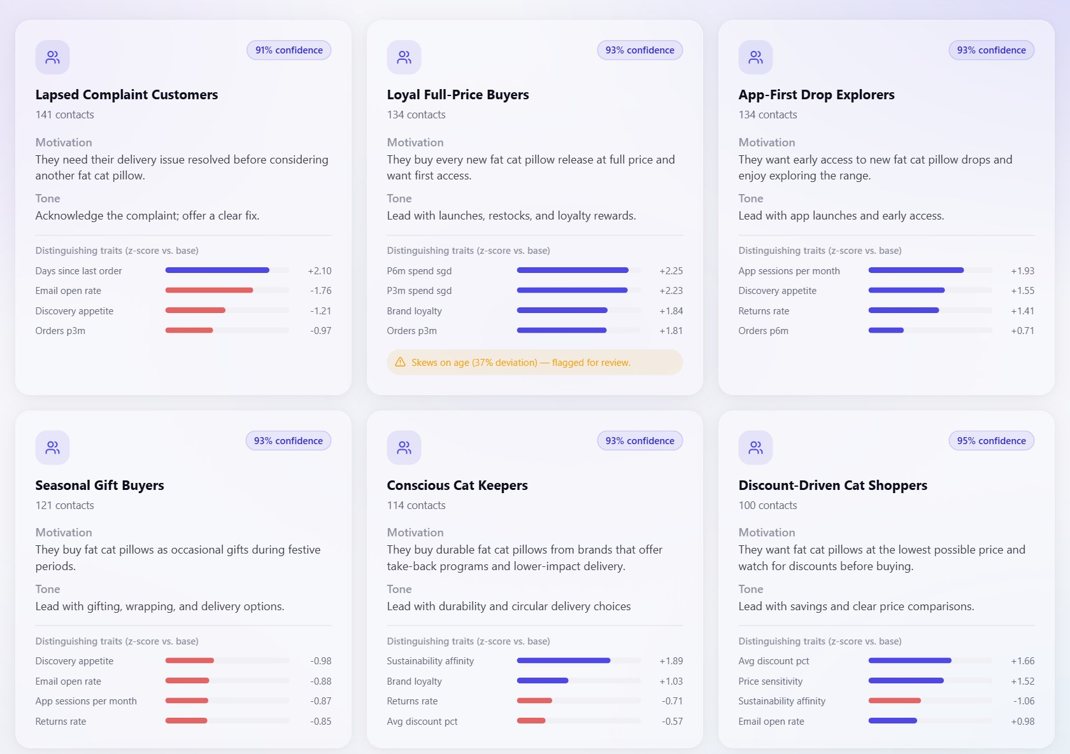
Segments that explain themselves
The numbers find the segments; the model only names them.
Segmentation & Insight · seg-v3
1
Profile any CSV
schema inferred on every run
2
Hold out protected columns
age and gender never used to cluster
3
Cluster with HDBSCAN
misfits stay as noise
4
Explain, then name
top traits → short name
5
Proxy-test every segment
flag hidden age or gender skew
6 segments
0.382 silhouette
25.6% noise
Segments tab in the console
Notes:
[~50s · finish by 6:15]
First, segmentation — this is the part I built.
The key idea: the numbers find the groups, and the AI only names them. We cluster the customers on the real data first. Then we show the AI the top traits of each group, and it gives the group a name. So the AI can't make up a segment that isn't really there.
We also keep age and gender out of the clustering completely. But we still check afterwards — if a segment ends up being mostly one age group anyway, we flag it.
On our demo list of a thousand customers, we got six segments. About a quarter didn't fit any group — and that's fine, we don't force them in.

Slide 12
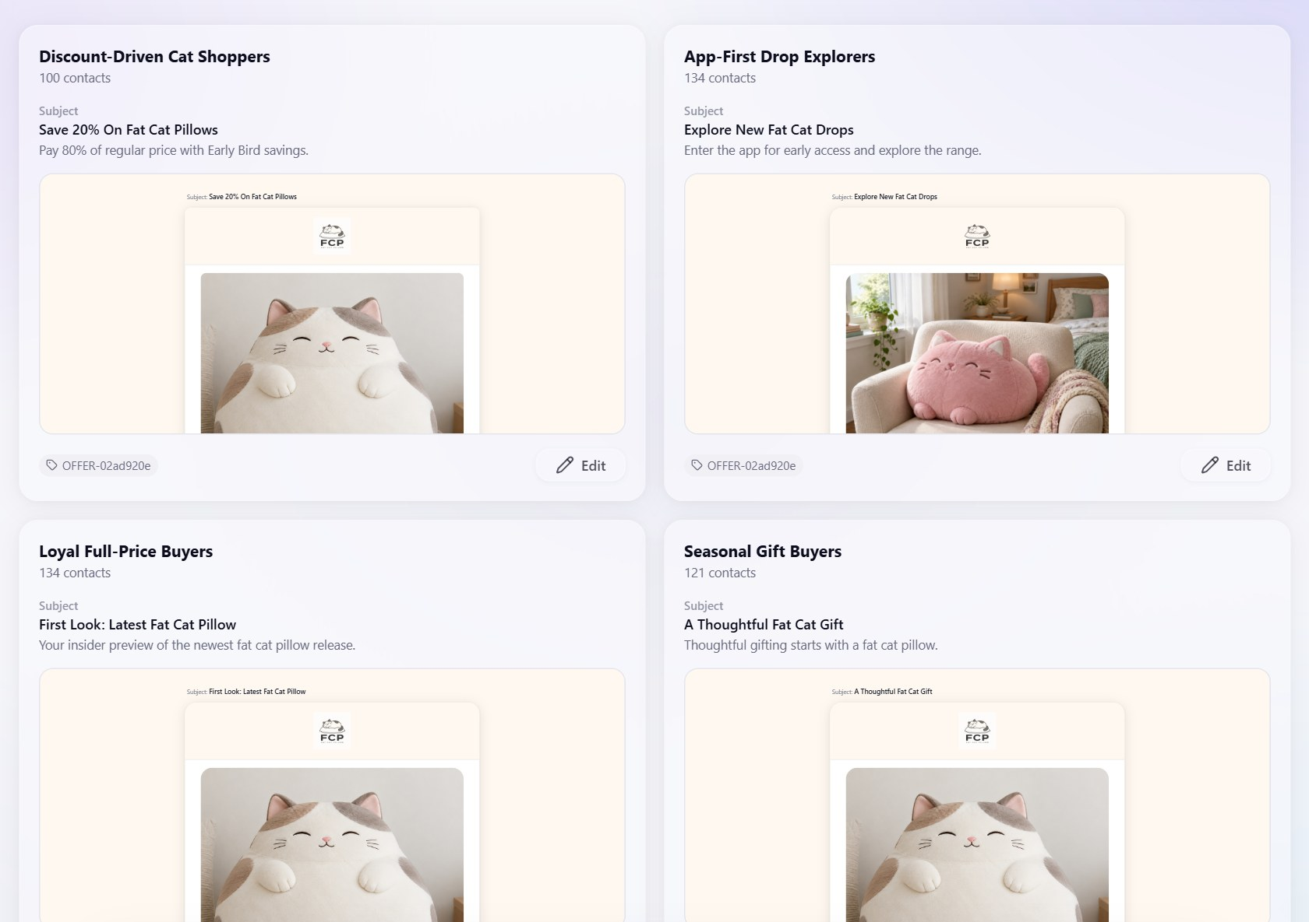
The model writes words; code builds the email
A bad response can shorten the copy — never break the template.
Creative Direction · direction-v2
Six short fields
Accent colour checked in code
No urgency or scarcity tricks
Email Composer · email-v2
Model writes the words only
Code builds the layout
Made-up offers dropped
Email Review — one email per segment
Notes:
[~40s · finish by 6:55]
Next, one rule we use everywhere: the AI writes the words, but code builds the email.
The creative agent gives a short written direction — tone, style, an accent colour. And we check that colour in code, so it's always valid.
The Composer only writes the text. The layout is built by code. And if the AI mentions an offer that doesn't exist, we just drop it.
So the worst a bad AI answer can do is make the copy shorter. It can't break the email, and it can't invent a discount.

Slide 13
Ten checks between a draft and an inbox
Rule-based, and re-run after every edit.
COMPLIANCE
CONTENT
DELIVERABILITY
Demo workspace
may we lawfully send this?
does the copy hold up?
will it land and render?
re-checked 14 Oct 2026
Consent
Prompt injection
Subject line
block
block
revise
Unsubscribe link
Real offers only
Links
6
emails
block
revise
revise
PII leak
Merge tags
Images
block
block
revise
Bias proxy
revise
5 PASS
PASS
REVISE
BLOCK
1 REVISE · age proxy
a person sends
fix, or send knowingly
cannot be sent
0 BLOCK
Notes:
[~50s · finish by 7:45]
And finally — before anything goes out, every email goes through ten checks, in three groups.
Compliance: are we even allowed to send this? Is there consent, an unsubscribe link, no personal data leaking? Content: are the offers real, and has anyone tried to sneak instructions in? And deliverability: will it land, and will it look right?
Then there are three results. Pass — good to go. Revise — something to fix. And Block — the system simply won't send it. Not just a greyed-out button; the backend refuses.
On our demo, five emails passed and one got Revise. And that one is actually a fairness issue — which Benyamin will walk you through now.
→ Hand over to Benyamin

Slide 14

Assurance
04
Responsible AI enforced in code, the security risk register, and the MLSecOps pipeline that guards every change.
Notes:
[0:10 | ends 10:30 | ABP]
Assurance — how we keep it responsible and secure.

Slide 15


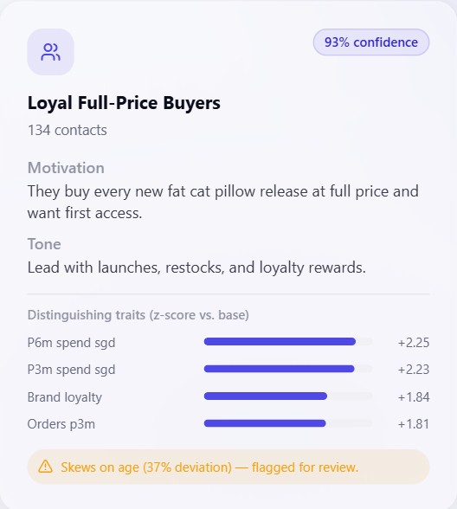



Responsible AI, enforced in code
A limit nobody enforces is not a control — every principle maps to something the code checks.
Fairness
REAL FINDING ON THE DEMO DATA
Protected attributes never enter clustering; a proxy test catches segments that correlate with them anyway.
37%
age deviation in “Loyal Full-Price Buyers” — flagged, then carried into the Guardian as REVISE.
Explainability
Z-scored traits per segment, a rationale per direction, cited offers and per-check results per email.
Accountability
Only a person can send; BLOCK is refused server-side; every decision lands in the append-only ledger.
Manipulation guardrail
No urgency or scarcity in prompts; the judge scores “no dark patterns”; spam phrasing is flagged.
Governance
IMDA Model AI Governance Framework mapping; PDPA consent re-checked whenever the Guardian runs.
Notes:
[0:55 | ends 11:25 | ABP]
Our rule: a limit nobody enforces is not a control, so every principle maps to something in the code.
Fairness: protected attributes are excluded from clustering, and a proxy test catches segments that correlate with them anyway. On our data it found one — "Loyal Full-Price Buyers" deviates 37% on age from the base rate. We don't silently delete that segment; that isn't the system's call. We flag it on the Segments tab and carry it into the Guardian as a REVISE, so a person owns the decision.
Explainability comes from the traits per segment, a rationale per direction and per-check results per email; accountability from the human gate and the append-only ledger. The mapping to IMDA's Model AI Governance Framework and PDPA is in section 5 of the report.

Slide 16
AI security risk register
14 risks mapped to the OWASP Top 10 for LLM Applications (2025). Full register with evidence: report §6.
Inherent likelihood × impact
Residual risk after controls
LIKELIHOOD ↑
High
R13
Unauthenticated API, no rate limits
High
R1
Indirect prompt injection (LLM01)
Medium
Med
R4
Personal data to model provider (LLM02)
Medium
R4
R5
R8
R1
R12
R13
R9
R11
R8
Unbounded consumption (LLM10)
Medium
R12
Secrets + supply chain (LLM03)
Medium
Low
R14
R2
R6
R3
R7
R10
R11
Segments as protected-attribute proxies
Medium
R5
Hallucinated offers (LLM09)
Low–Med
Low
Med
High
IMPACT →
Low residual: R2, R3, R6, R7, R9, R10, R14
Notes:
[0:45 | ends 12:10 | ABP]
We registered fourteen risks against the OWASP Top 10 for LLM applications. Left is inherent risk before controls; right is what remains after them.
We want to be upfront: the highest residual risk is that the API has no authentication or rate limiting — fine for a demonstrator, not for production.
Prompt injection is mitigated structurally — customer free text only reaches the model as a small data sample under a strict schema, and the Guardian scans the output — but an input sanitiser is still on our list. The full register, with evidence for every control, is section 6 of the report.

Slide 17




MLSecOps / LLMSecOps pipeline
Every push runs a deterministic, free gate — no CI job calls OpenRouter or Supabase.
Change
code · prompt · schema
Push / PR
GitHub
CI · 3 jobs
ci.yml
Deploy
Railway, health-gated
Job 1 · LLMSecOps
Job 2 · Guardian corpus + contracts
Job 3 · Console
No committed secrets: any tracked .env or .env.local fails the build.
6 adversarial fixtures through the real run_checks(); 8 pins on rubric weights, schemas, prompt versions, protected columns, live keys.
npm ci · lint (reported) · production build (blocking) — the command Railway runs.
Decision Ledger
Activity log + cost
eval-v1 sidecar
Negative test
prompt + model version per artifact
operator actions; spend per stage
code metrics + LLM judge; delta per run
planted PII → job 2 red
Not yet automated: external alerting, a metrics dashboard and LLM tracing — the Logs tab and ledger are read by a person today.
Notes:
[0:45 | ends 12:55 | ABP]
All of this is locked in by CI. Every push runs three jobs: a secrets check; the Guardian's adversarial corpus plus contract tests; and a production build of the console.
The corpus pushes emails with leaked PII, injection phrasing, a missing unsubscribe and a broken merge tag through the real Guardian code — each must BLOCK. Contract tests pin prompt versions and schemas, so a silent prompt change fails the build. And we proved the gate works: plant a phone number in the "clean" email and the pipeline goes red.
Automated alerting is still to come.
HANDOVER: "Qing Quan will show the results and the demo."

Slide 18

Results
05
What the tests and the evaluator say, the demo, how it scales — and what we would do next.
Notes:
[0:10 | ends 13:05 | OQQ]
So — does it work?

Slide 19
Testing and evaluation results
Deterministic tests gate every push; the sidecar evaluator scores the agents on what they actually produced.
14 / 14
automated tests pass — pytest, locally and in CI
eval-v1 agent scores overall 88.2
6
Guardian corpus — PII, injection, unsubscribe and merge tag must BLOCK; ungrounded offer fails; clean PASSes
8
Contract pins — rubric sums, agent schemas, prompt versions, protected columns, no live keys
1
CI negative test — planted PII turns the build red
E2E
1,000 contacts → 6 segments → 6 emails → 3 live sends via Resend
Lowest criterion: segment-name faithfulness, 6.9 / 15. Judge: openai/gpt-5.6-luna, conservative rubric.
Notes:
[0:45 | ends 13:50 | OQQ]
All fourteen automated tests pass, locally and in CI. End to end, we ran a thousand contacts through to six emails and three real sends through Resend.
Our evaluator scores each agent on what it actually produced, mixing code metrics with an LLM judge: 88.2 overall. Creative and Composer score in the mid-nineties.
Segmentation is lowest at 70.8 — partly the honest clustering scores, and partly because the judge found some segment names claim more than the traits show. That's our clearest improvement target.

Slide 20
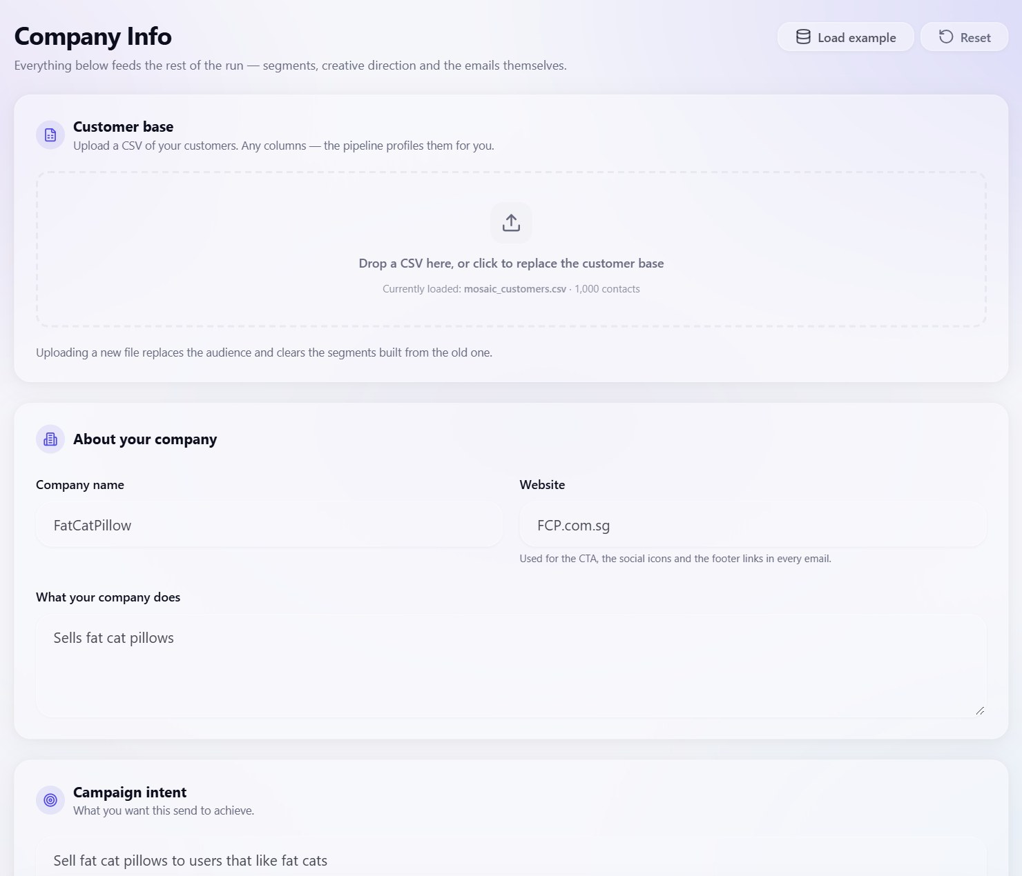
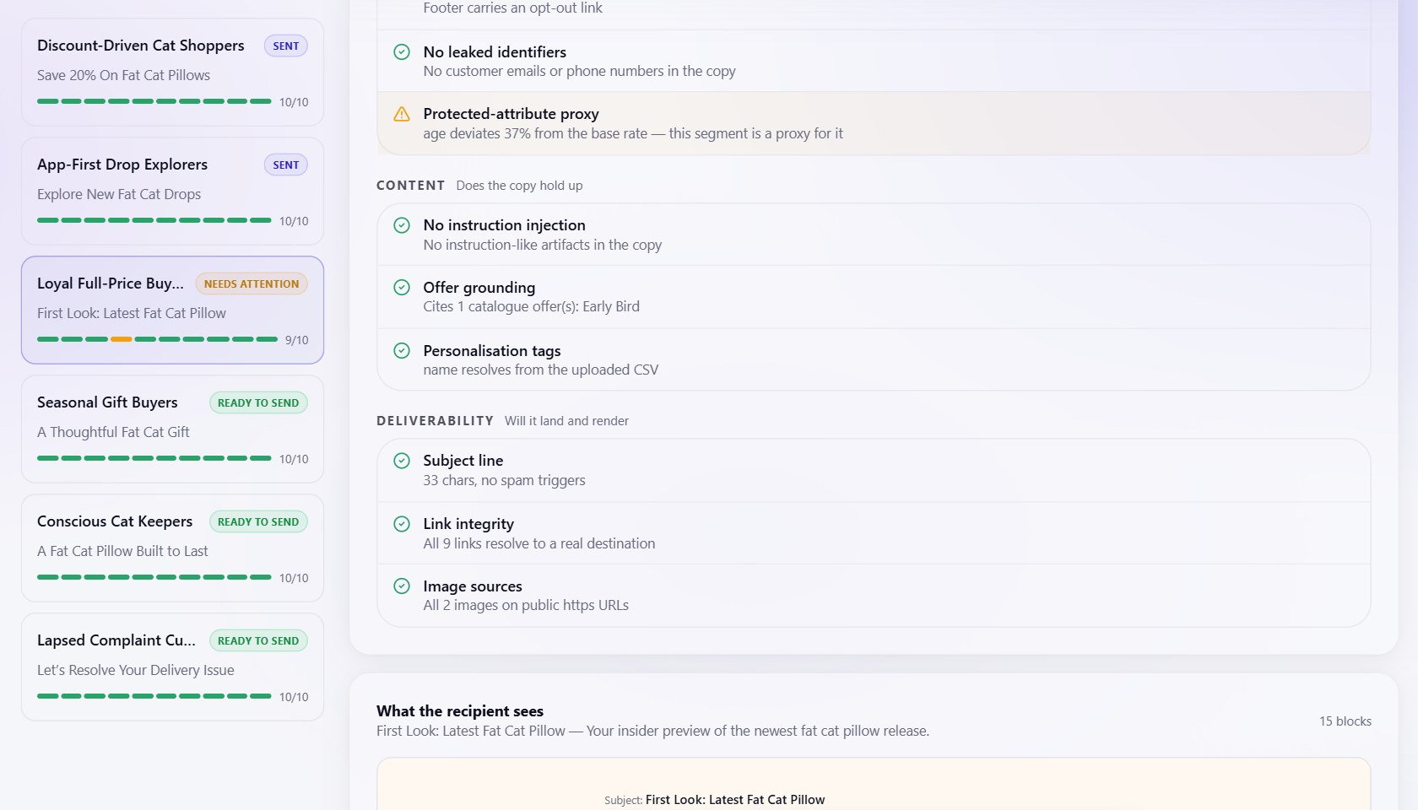
Demo walkthrough
From an uploaded CSV to a checked, sent email — in the order the console works.
1
2
Company Info
Segments
Upload any CSV; columns profiled, protected and consent columns flagged
Clusters named from z-scored traits; proxy flag on the card
3
4
Email Review
Approval Queue
One email per segment, editable in the builder
Checks re-run after edits; a person sends
Notes:
[2:00 | ends 15:50 | OQQ]
LIVE DEMO — 2 minutes. Before the session: run start.ps1, confirm the Supabase project is not paused, open the console on Company Info with the demo workspace loaded. Do NOT press Regenerate during the demo — generation takes minutes.
1. Company Info (15 s): scroll to the contacts table. "Here's the uploaded list — 1,000 contacts. Age and gender are marked 'held out' — they never enter clustering — and each contact's consent shows as active or withdrawn."
2. Segments (30 s): "Six segments. Each card shows the z-scored traits that define it — that's the explanation. And here's the age-proxy flag on Loyal Full-Price Buyers."
3. Email Review (30 s): open one PASS email in the builder, type "Call 9123 4567" into the intro text and save. "Let's plant a phone number."
4. Approval Queue (35 s): "The checks re-ran on the edited email: No leaked identifiers fails, the verdict is BLOCK, and Send is disabled — the API would refuse it anyway." Remove the phone number, save: "Back to PASS — and only now can a person confirm the address and send." Send to our own inbox only.
5. Logs (10 s): "Every step is recorded — what I did, and what the agents did, with prompt and model versions."
FALLBACK: if the live demo fails, stay on this slide and narrate the four screenshots in the same order.

Slide 21
Cost scales with segments, not contacts
Expensive model work runs once per segment (k); per-recipient work is a deterministic merge-tag fill.
Stage | LLM calls | Embedding calls | Per recipient
Segmentation & Insight | k | ⌈n / 200⌉ | —
Creative Direction | k | — | —
Email Composer | k | — | —
Guardian | 0 · rule engine | — | —
Dispatch | 0 | — | merge-tag fill
18
LLM calls per full run (k = 6) — at 1,000 contacts or 200,000.
Embedding calls grow with n: 5 at 1,000 contacts, 1,000 at 200,000 — batched and cheap.
Honest limits
Not load-tested; the demonstrator runs 1,000 contacts end to end
One replica (in-memory job registry) · 20,000-row upload cap · HDBSCAN on one machine
Path to scale: shared job store → multiple workers; cluster a sample and assign the rest
Notes:
[0:35 | ends 16:25 | OQQ]
On scale: counting calls from the code, cost grows with the number of segments, not the number of contacts. With six segments, a full run is eighteen LLM calls whether the list has a thousand contacts or two hundred thousand; only the cheap, batched embedding calls grow.
We haven't load-tested, and the limits are on the slide — one replica, a 20,000-row upload cap, and clustering on one machine.
IF SHORT ON TIME: skip — "Cost scales with segments, not contacts: eighteen LLM calls per run."

Slide 22



Reflection and next steps
Four deliberate changes from the proposal, three lessons, and what we would build next.
Changed from the proposal
What we learned
Next
Written creative direction replaced generated imagery
Strictly sequential graph — each tab reviews the last
Per-recipient resolution became a merge-tag layer
Real dispatch via Resend, not a sandbox stub
Schemas and code-owned layout beat prompt wording
Keep the LLM out of the veto: deterministic checks are cheap, testable, explainable
Honest metrics beat flattering ones
Bounded Guardian → Composer revise loop
Retry + fallback model in the OpenRouter client
Auth, rate limits, shared job store
Alerts on BLOCK-rate shifts; LLM tracing
Notes:
[0:40 | ends 17:05 | OQQ]
Looking back: we changed four things from the proposal — most visibly, a written creative direction instead of generated images, and real dispatch instead of a sandbox.
Our biggest lesson: schemas and code-owned structure control models far better than prompt wording, and keeping the LLM out of the veto made the Guardian cheap, testable and explainable.
Next, we'd add a bounded Guardian-to-Composer revise loop, retries with a fallback model, authentication and rate limits, and proper alerting.

Slide 23

Thank you
Questions?
Team 13 · Ong Qing Quan · Agustinus Benyamin Prasetyo
github.com/bearly-profitable/MOSAIC
Notes:
[0:15 | ends 17:20 | OQQ + ABP]
Thank you. MOSAIC: four agents that do the work — and then stop, because a person presses send. We're happy to take questions.
BUFFER: 2:40 left in a 20-minute slot for overruns or Q&A.
LIKELY QUESTIONS
Why no LLM in the Guardian? — Determinism: testable in CI, explainable check by check, and free to run on every edit. The LLM judge is used offline, in evaluation only.
How do you handle prompt injection? — Structurally today: free text reaches the model only as a small data sample under a strict, length-capped schema, and the Guardian blocks instruction-like output. An input sanitiser is next.
Why only one replica? — Job progress is held in memory; a shared job store is the fix.
Isn't a 0.38 silhouette low? — The synthetic archetypes overlap by design; we report it honestly, and noise is allowed rather than forced into a segment.
What actually gets sent? — One rendered email per send to an operator-confirmed address, with merge tags filled from a real contact in that segment.
Who decides on the flagged segment? — The operator. The system makes the correlation visible; it doesn't make the ethical call.

