Slide 1

Predicting Power Plant Full Load Electrical Output
Amin Fesharaki, Benjamin Earnest, and Jeffrey Joyner

Slide 2
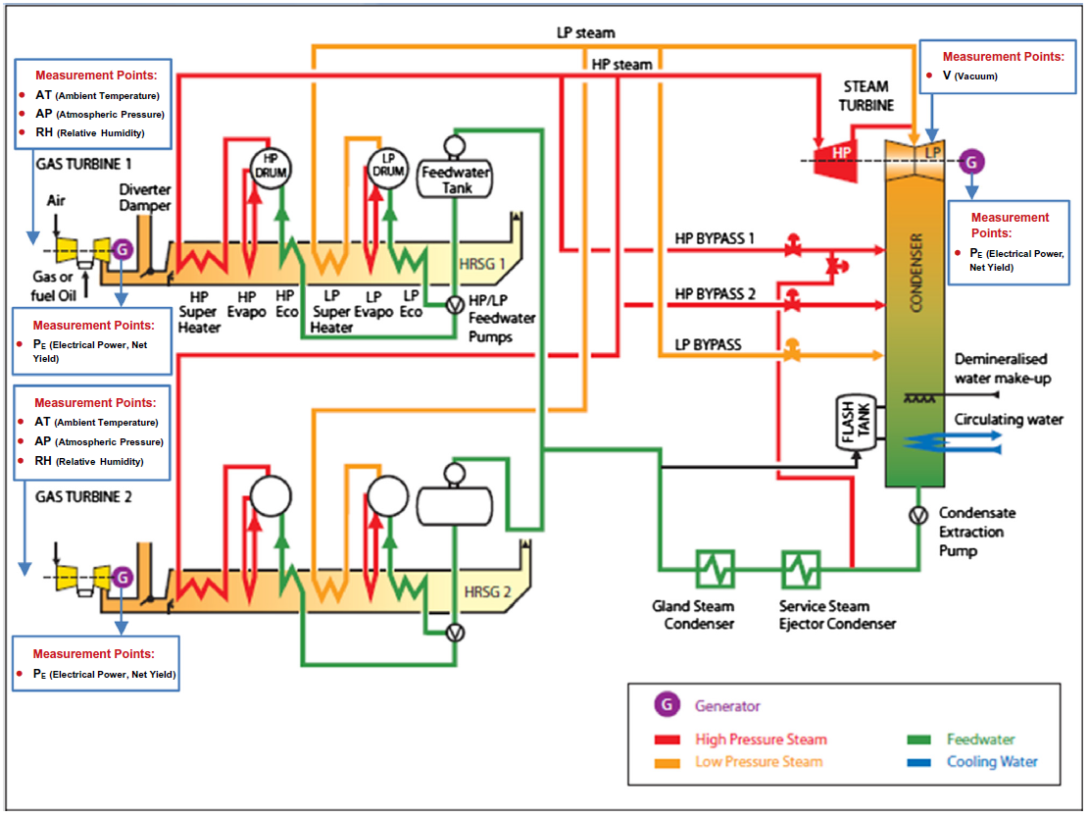
Combined Cycle Power Plants (CCPP)
2x Gas Turbine Generators (160 MW)
2x Waste Heat Steam Generators
1x Steam Turbine Generator (160 MW)

Slide 3
Problem Statement
Objective: Predict full power output capability of CCPP.
Thermodynamic analysis to do the same would require thousands of non-linear equations (Tufekci, 2014).
Data is from UCI machine Learning repository.
Results will be compared to 2014 study.
Optimal model will be evaluated on Root Mean Square Error (RMSE), Mean Absolute Error (MAE), and the correlation coefficient (R^2)

Slide 4
Data Description
Data is imported into the R environment from an excel spreadsheet.
4 predictor variables, 1 target, 9568 observations.
All variables are continuous.
Predictors: ambient temperature (AT), atmospheric pressure (AP), relative humidity (RH), steam exhaust vacuum (V).
Target: Full load electrical power output (PE)
No missing values

Slide 5
Exploratory Data Analysis (EDA)
Descriptive Statistics:
 | Mean | Standard Deviation | Range | Median
Ambient Temperature (C) | 19.65 | 7.45 | 35.3 | 20.34
Atmospheric Pressure (mbar) | 1013.3 | 5.93 | 40.4 | 1012.9
Relative Humidity (%) | 73.31 | 14.60 | 74.6 | 74.97
Exhaust Pressure (cm Hg) | 54.31 | 12.71 | 56.2 | 52.08
Elec Power Output (MW) | 454.4 | 17.07 | 75.5 | 451.6

Slide 6
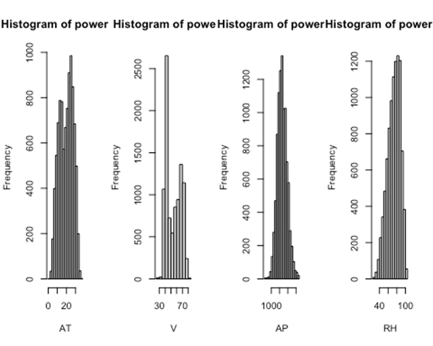
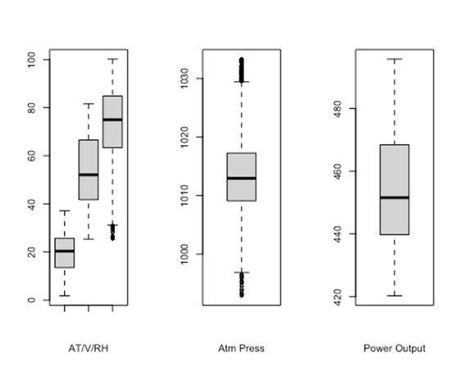
EDA
Distributions:
Relatively normal distributions.
Boxplot shows scaling issues.
Few outliers.

Slide 7
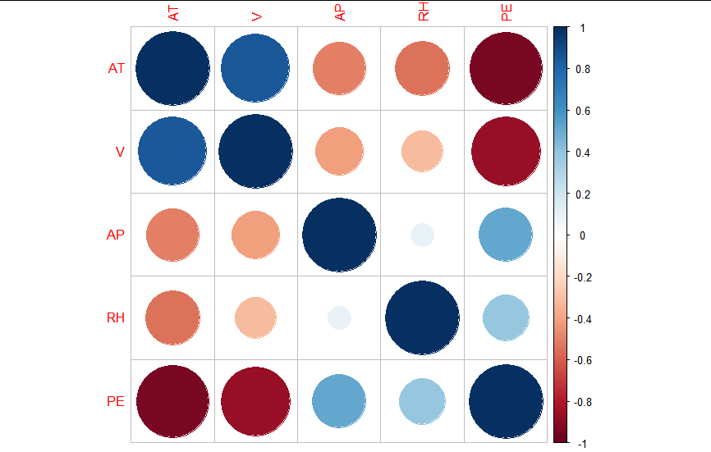
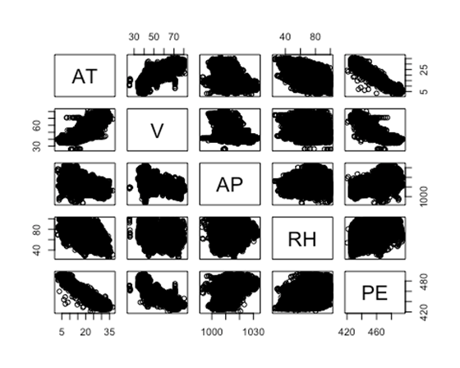
EDA
Relationships between variables:
Shows relationships between PE/AT and PE/V
Confirmed by correlation plot

Slide 8
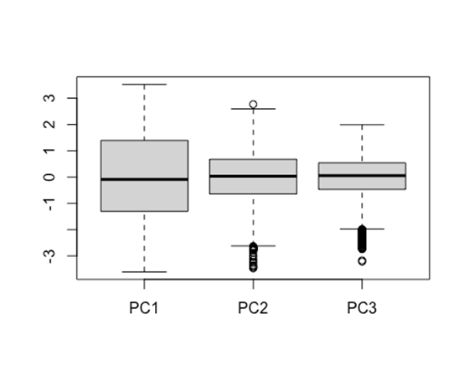
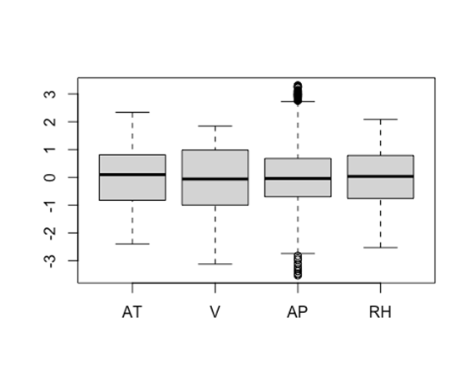
Splitting and Preprocessing
Data was partitioned using an 80/20 train/test split.
Data was centered, scaled, and transformed after test test/train split.
Principle components were identified for a PC model, which explain 95% of the variance in PE.

Slide 9
Model Building Strategies
Goal: PREDICT total power output of power plant
GIVEN four known variables (ambient temperature (AT), atmospheric pressure (AP), relative humidity (RH), steam exhaust vacuum (V).
Which variable is most important?
Tool: PREDICTIVE MODELING - find the best model for situation

Slide 10
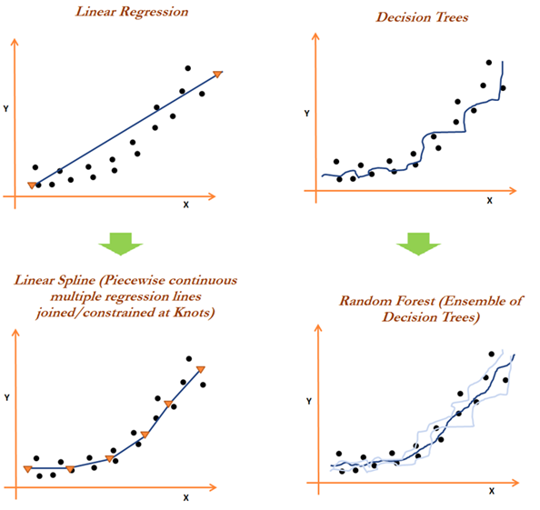
Model Building Strategies
Linear data vs Non-Linear data
If-then Logic for Trees
Linear models: OLS, Ridge, Lasso, ElasticNet, PLS, PCR, OLS PCA
Non-Linear models: SVM Radial, KNN, Neural Network, MARS, SVM Poly
Tree Regression: Random Forest, Boosting, Cubist, CART, and Bagged

Slide 11
Model Performance and Hyperparameter Tuning
Resampling standard: 10-fold cross validation
Reproducibility: Random number seed of 100
Train model: Training set (partitioned 80% of data)
Tune: Tweak hyper-parameters to optimize performance

Slide 12
Model Performance and Hyperparameter Tuning
Linear
Tune length (PLS, PCR),
tune grid (Ridge, Lasso, ElasticNet)
Non-Linear
Tune length (SVM),
tune grid (KNN, MARS, Neural Network)
Trees
Tune grid (Boost)
Number of bags/trees (Bagged, Random Forest)

Slide 13
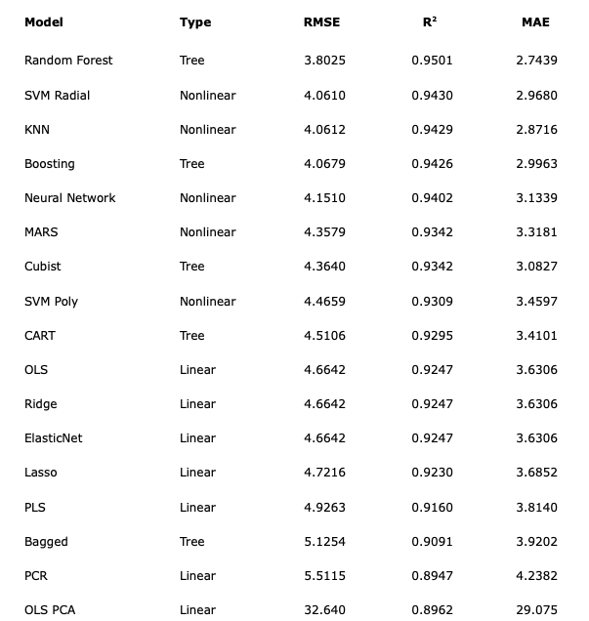

Results
Notes:
For each model used in the study, the RMSE, RSquard and MAE were calculated based on the test set predictions. However, Prediction accuracy using root mean-squared error will indicate the best performance models. From this slide, we can see the performance metrics for every model in ascending order of RMSE scores. In other words, the most successful models start at the top with Random Forest and work its way down to the worst model, which was the Ordinary least squares model using Principle component analysis.
As mentioned previously, 3 different types of models are used: linear, nonlinear, and tree regression models. The best models for each type are as follows: Ordinary least squares was the best linear regression model, Support vector machine with radial basis function had the best nonlinear model, and the best tree regression model is Random forest. In addition, the table also shows that nonlinear models outperform linear models, which indicates that the data should be considered nonlinear. If the data were linear, then linear models would outperform the other models.
Furthermore, as shown in the table, Random forest had the lowest RMSE value among all other models. Therefore, variations of the random forest model were made to see if we can improve its RMSE score.

Slide 14
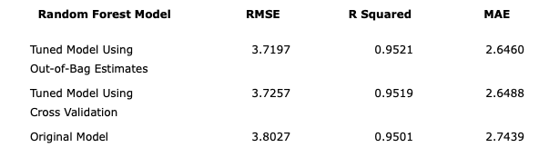
Model Selection
Relative Humidity has the highest weight, or variable importance, used by the model
Best Model: Random Forest Tuned by Out-of-Bag estimates
Final Model Parameters:
# of trees: 500
# of variables tried at each split: 2
Variance explained: 95.2%
Variable Importance for Optimal Model - Random Forest (OOB)
Predictor | Overall Importance
Relative Humidity | 105.554
Ambient Temperature | 70.8531
Ambient Pressure | 52.3890
Turbine Exhaust Pressure | 40.1479
Notes:
2 additional random forest models were created. One is a random forest model tuned using cross validation while the other model is tuned using Out-of-Bag estimates. Among the random forest models, the one tuned by out of bag estimates yielded the lowest RMSE score of 3.7187. The parameters used by the final model are shown on the left hand side of the screen.
On The right hand side shows the variable importance of the out-of-bag random forest model. Among the 4 predictors, Relative humidity had the highest importance, followed by ambient temperature, ambient pressure, and turbine exhaust pressure. Therefore, we can conclude that relative humidity was the most influential predictor used in the model. With this insight, plant operators can potentially focus on manipulating the relative humidity and ambient temperature to reach a desired electrical output level.

Slide 15
Discussion and Conclusion
Problem: Predicting electrical power output in power plants using predictive modeling
Objective: Recreate and improve Tufekci’s 2014 study regarding the same problem.
How: Create various regression models to see which model perform performs the best.
Result: The most successful model was Random Forest tuned by Out-of-Bag estimates.
Tufekci’s best model was the Bagging algorithm with REPTree, with a RMSE of 3.787
Our Random Forest model had an RMSE of 3.719
Solution: Modeling proves to be sufficient instead of modeling a system using thermodynamic approaches.
Future Works: Gather more data from different power plants with similar unit design, and to further improve predictive performance with different tuned models.
Notes:
To reiterate, our main problem of this study was to predict electrical power output in power plants. This could be achieved by modeling the system using thermodynamic approaches. However, using such approaches can involve assumptions and complex nonlinear equations. To avoid this scenario, predictive modeling can be used to predict the electrical output. Therefore, 19 regression models were made to determine the most successful model, and hopefully, improve the research done by Tufekci and his team.
In conclusion, predictive modeling is shown to be a sufficient alternate solution than modeling a system using thermodynamic approaches. Our study has not only determined that the random forest model tuned by out-of-bag estimates was sufficient in predicting electrical power output in power plants, but has also slightly outperform Tufkeci’s most successful model. However, future works should still be continued to perfect the prediction and increase the accuracy by testing more models and gathering more data from different power plants with similar unit design.

Slide 16
Thank you!
https://github.com/bearnest21/ADS-503-Team-6-Final-Project

Slide 17
References
Tufekci, P. (2014). Prediction of full load electrical power output of a base load operated combined cycle power plant using machine learning methods. Electrical Power and Energy Systems, 60, 126-140.

