Slide 1
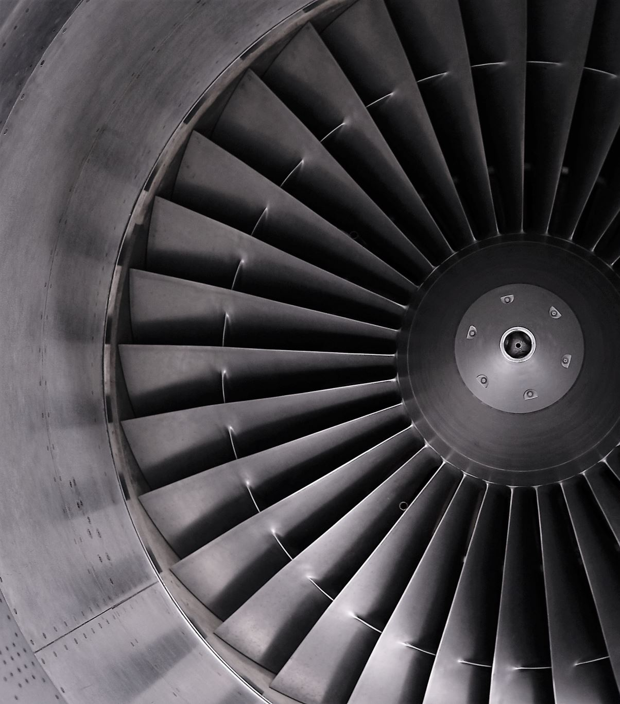
Predicting Power Plant Full Load Electrical Output
Amin Fesharaki, Benjamin Earnest, and Jeffrey Joyner

Slide 2
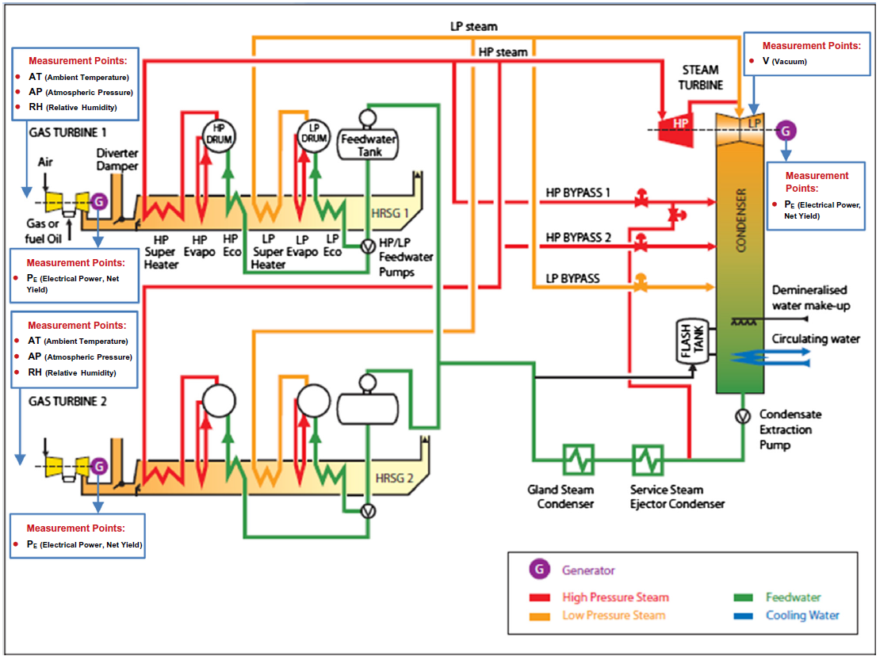
Combined Cycle Power Plants (CCPP)
2x Gas Turbine Generators (160 MW)
2x Waste Heat Steam Generators
1x Steam Turbine Generator (160 MW)

Slide 3
Problem Statement
Objective: Predict full power output capability of CCPP.
Thermodynamic analysis to do the same would require thousands of non-linear equations (Tufekci, 2014).
Data is from UCI machine Learning repository.
Results will be compared to 2014 study.
Optimal model will be evaluated on Root Mean Square Error (RMSE), Mean Absolute Error (MAE), and the correlation coefficient (R^2)

Slide 4
Solutions Explored
We used predictive modeling on 6 years of past data.
Random Forest model was superior fit for power prediction
It beat out 15 other prediction models.
An impressive 95% of variance in power output explained by temperature, pressure, humidity and exhaust vacuum pressure, using the top model.
Relative humidity was the most important factor.

Slide 5
Discussion and Conclusion
Problem: Predicting electrical power output in power plants using predictive modeling
Objective: Recreate and improve Tufekci’s 2014 study regarding the same problem.
How: Create various regression models to see which model perform performs the best.
Result: Machine learning proves to be sufficient instead of modeling a system using thermodynamic approaches.
Insight: Due to variable importance, plant operators can focus more on controlling relative humidity to reach a desired electrical output
Future Works: Gather more data from different power plants with similar unit design, and to further improve predictive performance with different tuned models.
Notes:
Therefore, we can conclude that relative humidity was the most influential predictor used in the model. With this insight, plant operators can potentially focus on manipulating the relative humidity and ambient temperature to reach a desired electrical output level.
In conclusion, predictive modeling is shown to be a sufficient alternate solution than modeling a system using thermodynamic approaches. Our study has not only determined that the random forest model tuned by out-of-bag estimates was sufficient in predicting electrical power output in power plants, but has also slightly outperform Tufkeci’s most successful model. However, future works should still be continued to perfect the prediction and increase the accuracy by testing more models and gathering more data from different power plants with similar unit design.

