Slide 1
Finding Abnormalities
in Capsule Endoscopy
Andrew Forrester
2019 Jan 18

Slide 2

Problem
Colorectal Cancer
3rd most common (worldwide)
2nd leading cause of cancer death (US)
Up to 90% of colorectal cancers are preventable with good quality colonoscopies.
-- Using AI to improve the quality of patient care
Capsule Endoscopy
Humans aren’t well suited for examining images of entire gastrointestinal tract.
Computer Vision -- Docbot’s preliminary model can reduce read times by 80%.
Notes:
~ 100k images per capsule endoscopy, doctors have to view every single frame

Slide 3
Deliverable
Production-ready algorithms that contain:
A model that assesses whether an image contains an abnormality.
A model that assesses the location of each identified abnormality.
Goals:
Achieve higher accuracy than existing model (0.96 AUC).
Optimize for high sensitivity (no false negatives).
Achieve high specificity as well (few false positives).
Notes:
AUC -- Appropriate Use Criteria (AUC) specify when it is appropriate to perform a medical procedure or service.

Slide 4
Data Pipeline
Image Classifier
Object Detector
Object Detection / Segmentation / Recognition

Slide 5
Data
swallowed capsule:
takes images of the entire gastrointestinal tract
at a rate of 2-3 FPS
for 8-16 hours
120,000 annotated images
200,000 more images

Slide 6
Model
CNN -- Convolutional Neural Network
MobileNet

Slide 7
Results

Slide 8
Challenges and Next Steps
Get the data
Build the infrastructure / pipeline
Select specifics of a simple starting model / architecture

Slide 9
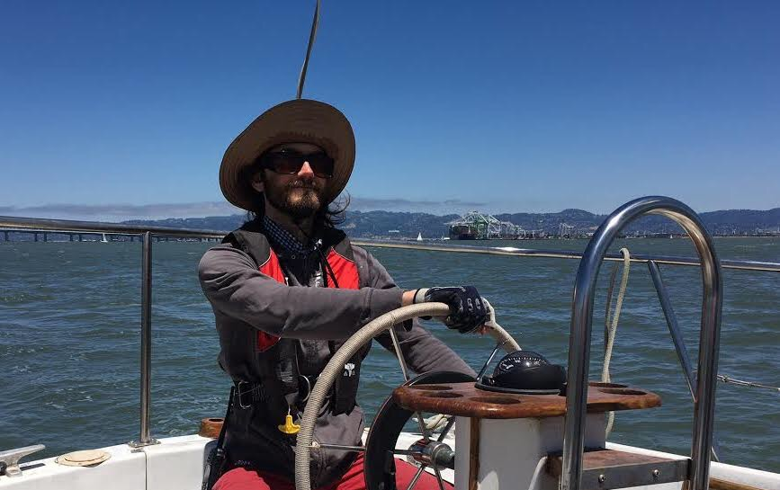
Thank you!
Andrew Forrester
Background: Physics PhD, AI: NLP & AGI
Interests: Philosophy and Praxeology
Society and its organization
Alternative education

