Slide 1
CS101 Algorithms and Data Structures
Graph traversal
Textbook Ch 22.2/3/5
Notes:
Adapted from the slides by Douglas Wilhelm Harder of U Waterloo (https://ece.uwaterloo.ca/~dwharder/aads/Lecture_materials/)
May also contain material from the slides at https://courses.cs.washington.edu/courses/cse326/03wi/326lecturesb.shtml (by Dan Suciu of U Washington)

Slide 2
Outline
Graph traversal
  Breadth-first
  Depth-first
Applications
  Connectedness
  Unweighted path length
  Identifying bipartite graphs
  Image segmentation via graph cut

Slide 3
Outline
We will look at traversals of graphs
  Breadth-first or depth-first traversals
  Must avoid cycles
  Depth-first traversals can be recursive or iterative
  Problems that can be solved using traversals

Slide 4
Graph Traversal
Traversals of a graph
  A means of visiting all the vertices in a graph
  Also called searches
Similar to tree traversal, we have breadth-first and depth-first traversals on graphs
  Breadth-first requires a queue
  Depth-first requires a stack

Slide 5
Graph Traversal
Different from tree traversal: there may be multiple paths between two vertices.
To avoid visiting a vertex for multiple times, we have to track which vertices have already been visited
  We may have an indicator variable in each vertex
  We may use a hash table or a bit array
  Requiring Θ(|V|) memory
The time complexity of graph traversal cannot be better than and should not be worse than Θ(|V| + |E|)
  Connected graphs simplify this to Θ(|E|)
  Worst case: Θ(|V| ²)

Slide 6
Breadth-first traversal
Breadth-first traversal on a graph:
  Choose any vertex, mark it as visited and push it onto queue
  While the queue is not empty:
    Pop the top vertex v from the queue
    For each vertex adjacent to v that has not been visited:
      Mark it visited, and
      Push it onto the queue
This continues until the queue is empty
  If there are no unvisited vertices, the graph is connected
The size of the queue is O(|V|)

Slide 7
Breadth-first traversal
The size of the queue is O(|V|)
  The actual size depends both on:
    The number of edges, and
    The out-degree of the vertices

Slide 8
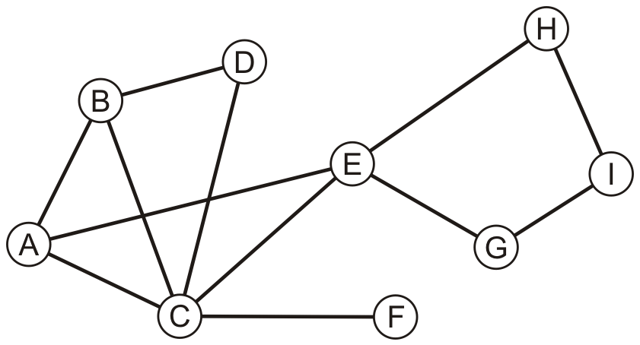
Example
Consider this graph

Slide 9
Example
Performing a breadth-first traversal
  Push the first vertex onto the queue
A

Slide 10
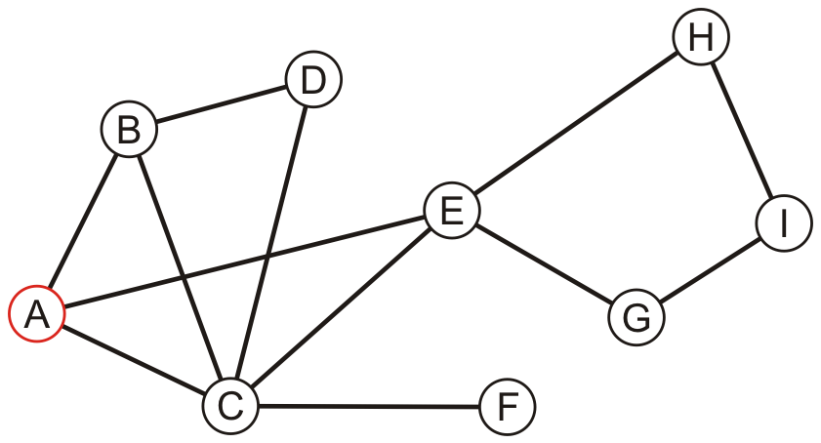
Example
Performing a breadth-first traversal
  Pop A and push B, C and E
  A
B | C | E

Slide 11
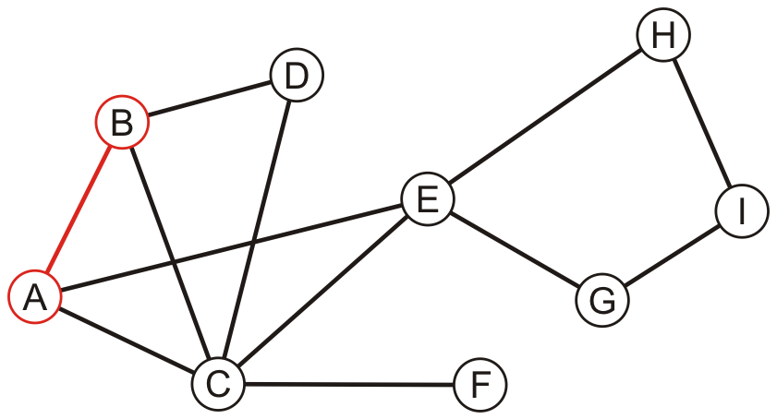
Example
Performing a breadth-first traversal:
  Pop B and push D
  A, B
C | E | D

Slide 12
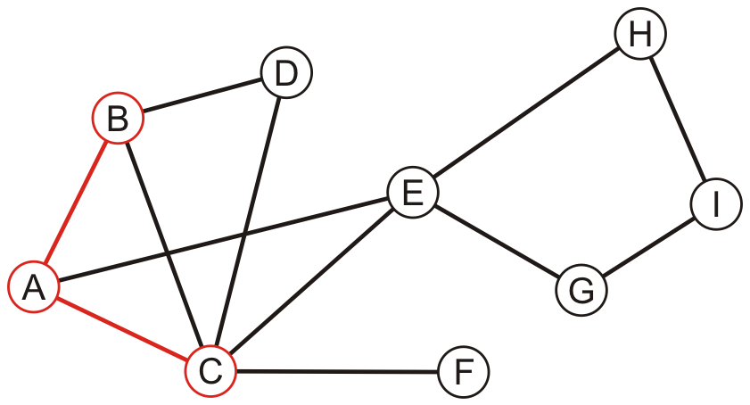
Example
Performing a breadth-first traversal:
  Pop C and push F
  A, B, C
E | D | F

Slide 13
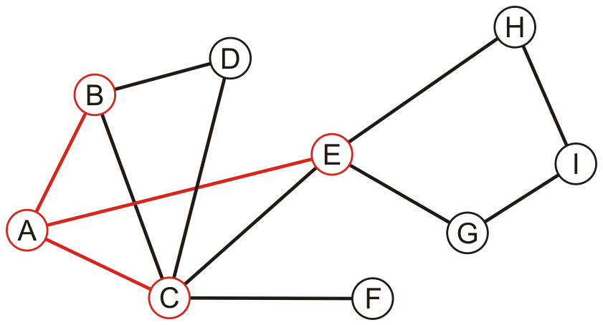
Example
Performing a breadth-first traversal:
  Pop E and push G and H
  A, B, C, E
D | F | G | H

Slide 14
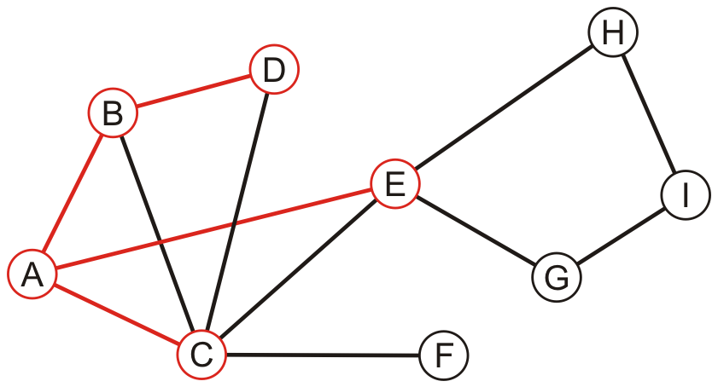
Example
Performing a breadth-first traversal:
  Pop D
  A, B, C, E, D
F | G | H

Slide 15
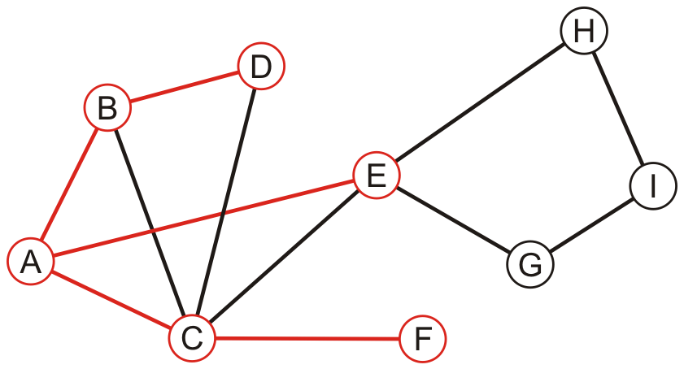
Example
Performing a breadth-first traversal:
  Pop F
  A, B, C, E, D, F
G | H

Slide 16
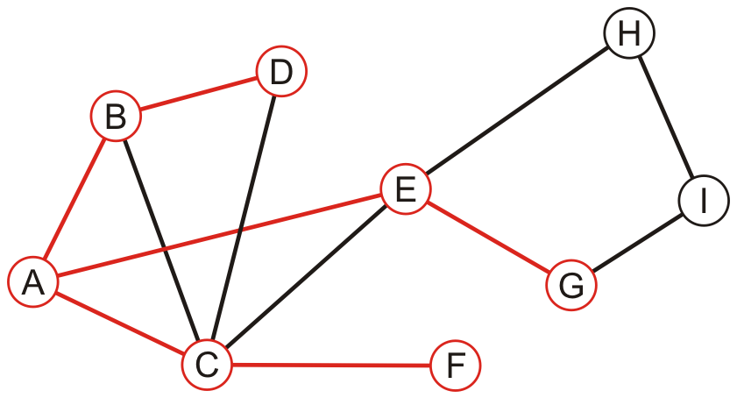
Example
Performing a breadth-first traversal:
  Pop G and push I
  A, B, C, E, D, F, G
H | I

Slide 17
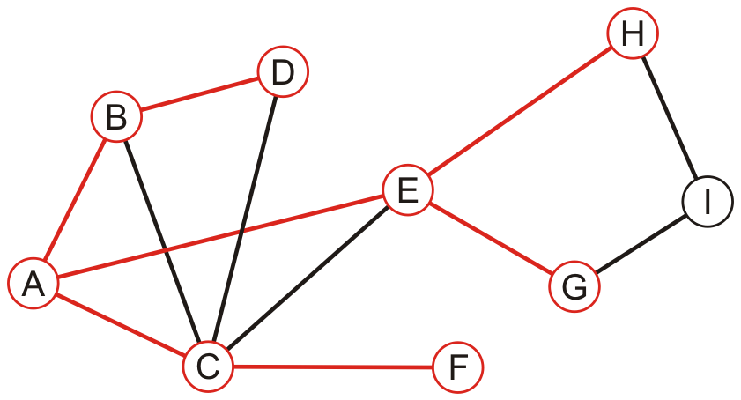
Example
Performing a breadth-first traversal:
  Pop H
  A, B, C, E, D, F, G, H
I

Slide 18
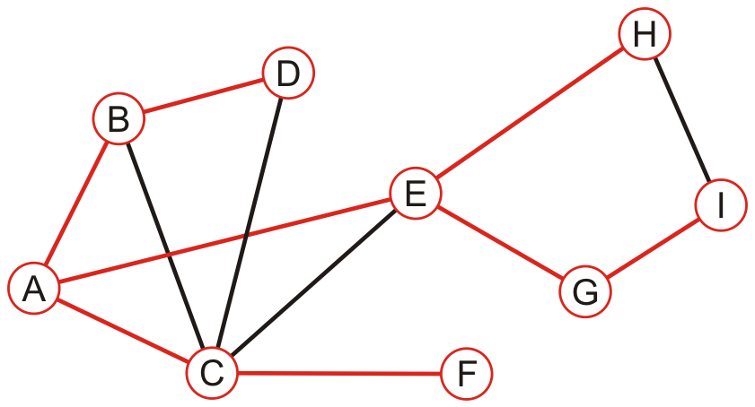
Example
Performing a breadth-first traversal:
  Pop I
  A, B, C, E, D, F, G, H, I

Slide 19
Example
Performing a breadth-first traversal:
  The queue is empty: we are finished
  A, B, C, E, D, F, G, H, I

Slide 20
Implementation of breadth-first traversal
An implementation can use a queue
  void Graph::breadth_first_traversal( Vertex *first ) const {
  unordered_map<Vertex *, int> hash;
  hash.insert( first );
  std::queue<Vertex *> queue;
  queue.push( first );
  while ( !queue.empty() ) {
  Vertex *v = queue.front();
  queue.pop();
  // Perform an operation on v
  for ( Vertex *w : v->adjacent_vertices() ) {
  if ( !hash.member( w ) ) {
  hash.insert( w );
  queue.push( w );
  }
  }
  }
  }

Slide 21
Depth-first traversal
Depth-first traversal on a graph:
  Choose any vertex, mark it as visited
  From that vertex:
    If there is another adjacent vertex not yet visited, go to it
    Otherwise, go back to the previous vertex
  Continue until no visited vertices have unvisited adjacent vertices
Two implementations:
  Recursive
  Use a stack

Slide 22
Recursive depth-first traversal
A recursive implementation uses the call stack for memory:
  void Graph::depth_first_traversal( Vertex *first ) const {
  std::unordered_map<Vertex *, int> hash;
  hash.insert( first );
  first->depth_first_traversal( hash );
  }
  void Vertex::depth_first_traversal( unordered_map<Vertex *, int> &hash ) const {
  // Perform an operation on this
  for ( Vertex *v : adjacent_vertices() ) {
  if ( !hash.member( v ) ) {
  hash.insert( v );
  v->depth_first_traversal( hash );
  }
  }
  }

Slide 23
Depth-first traversal
A recursive implementation:
  void Vertex::depth_first_traversal() const {
  for ( Vertex *v : adjacent_vertices() ) {
  if ( !v->visited() ) {
  v->mark_visited();
  v->depth_first_traversal();
  }
  }
  }

Slide 24
Iterative depth-first traversal
An iterative implementation can use a stack
  void Graph::depth_first_traversal( Vertex *first ) const {
  unordered_map<Vertex *, int> hash;
  hash.insert( first );
  std::stack<Vertex *> stack;
  stack.push( first );
  while ( !stack.empty() ) {
  Vertex *v = stack.top();
  stack.pop();
  // Perform an operation on v
  for ( Vertex *w : v->adjacent_vertices() ) {
  if ( !hash.member( w ) ) {
  hash.insert( w );
  stack.push( w );
  }
  }
  }
  }

Slide 25
Depth-first traversal
Use a stack:
  Choose any vertex
    Mark it as visited
    Place it onto an empty stack
  While the stack is not empty:
    If the vertex on the top of the stack has an unvisited adjacent vertex v,
      Mark v as visited
      Place v onto the top of the stack
    Otherwise, pop the top of the stack

Slide 26
Example
Perform a recursive depth-first traversal on this same graph

Slide 27
Example
Performing a recursive depth-first traversal:
  Visit the first node
  A

Slide 28
Example
Performing a recursive depth-first traversal:
  A has an unvisited neighbor
  A, B

Slide 29
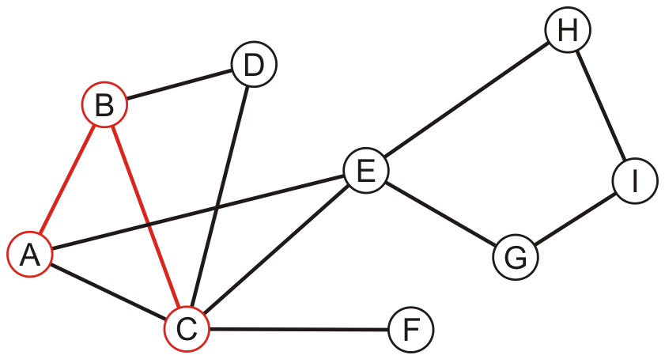
Example
Performing a recursive depth-first traversal:
  B has an unvisited neighbor
  A, B, C

Slide 30
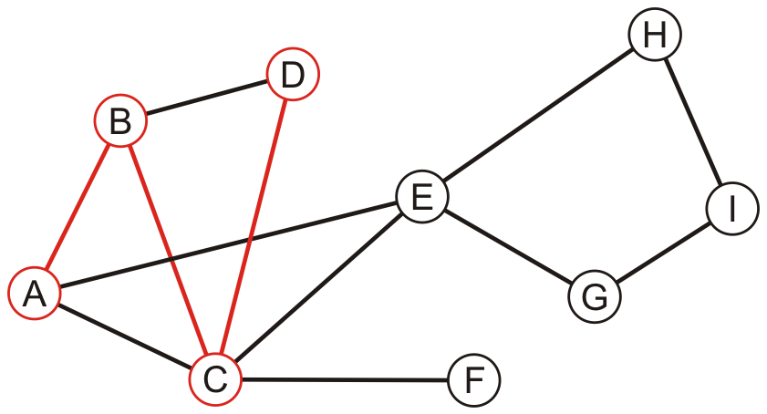
Example
Performing a recursive depth-first traversal:
  C has an unvisited neighbor
  A, B, C, D

Slide 31
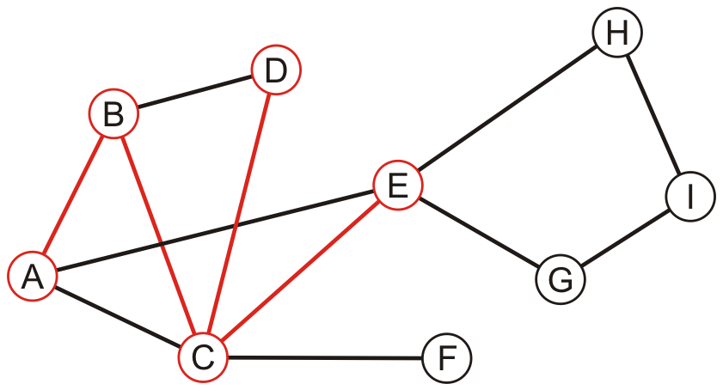
Example
Performing a recursive depth-first traversal:
  D has no unvisited neighbors, so we return to C
  A, B, C, D, E

Slide 32
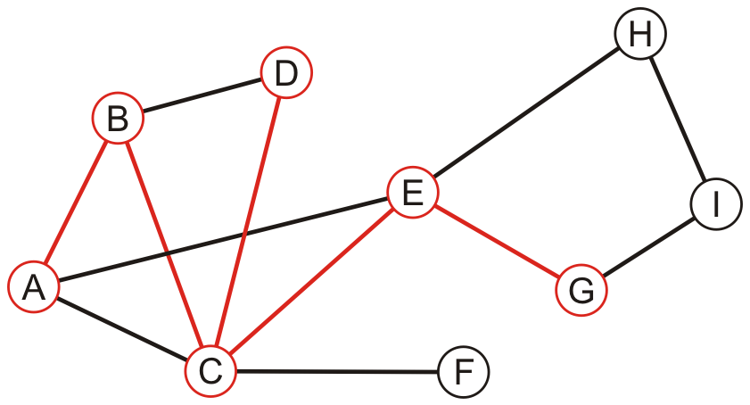
Example
Performing a recursive depth-first traversal:
  E has an unvisited neighbor
  A, B, C, D, E, G

Slide 33
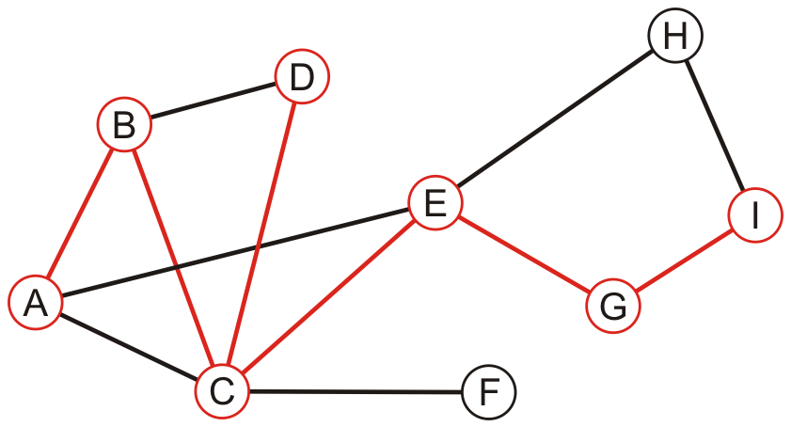
Example
Performing a recursive depth-first traversal:
  F has an unvisited neighbor
  A, B, C, D, E, G, I

Slide 34
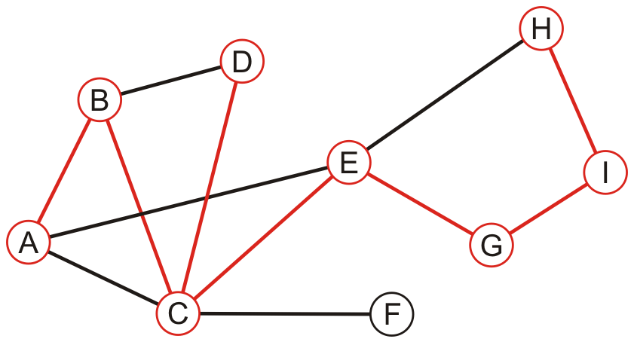
Example
Performing a recursive depth-first traversal:
  H has an unvisited neighbor
  A, B, C, D, E, G, I, H

Slide 35
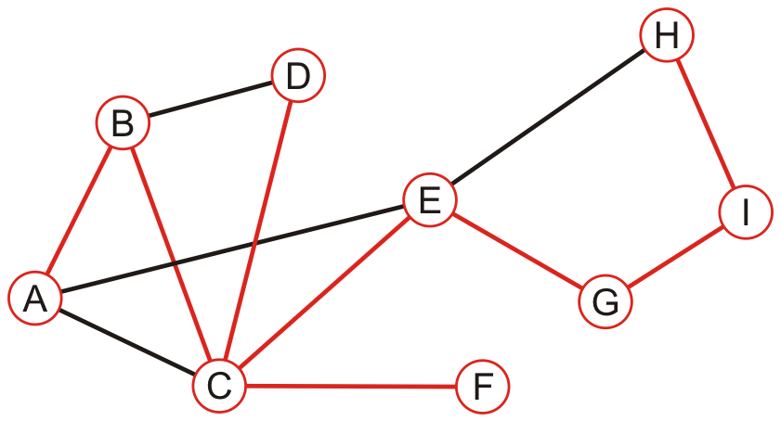
Example
Performing a recursive depth-first traversal:
  We recurse back to C which has an unvisited neighbour
  A, B, C, D, E, G, I, H, F

Slide 36
Example
Performing a recursive depth-first traversal:
  We recurse finding that no other nodes have unvisited neighbours
  A, B, C, D, E, G, I, H, F

Slide 37
Comparison
The order in which vertices can differ greatly
  An iterative depth-first traversal may also be different again
A, B, C, E, D, F, G, H, I
A, B, C, D, E, G, I, H, F

Slide 38
Applications
Applications of tree traversals include:
  Determining connectiveness and finding connected sub-graphs
  Determining the path length from one vertex to all others
  Testing if a graph is bipartite
  Determining maximum flow
  Cheney’s algorithm for garbage collection

Slide 39
Summary
This topic covered graph traversals
  Considered breadth-first and depth-first traversals
  Depth-first traversals can recursive or iterative
  More overhead than traversals of rooted trees
  Considered a STL approach to the design
  Considered an example with both implementations
  They are also called searches

Slide 40
References
Wikipedia, http://en.wikipedia.org/wiki/Graph_traversal
http://en.wikipedia.org/wiki/Depth-first_search
http://en.wikipedia.org/wiki/Breadth-first_search
These slides are provided for the ECE 250 Algorithms and Data Structures course. The material in it reflects Douglas W. Harder’s best judgment in light of the information available to him at the time of preparation. Any reliance on these course slides by any party for any other purpose are the responsibility of such parties. Douglas W. Harder accepts no responsibility for damages, if any, suffered by any party as a result of decisions made or actions based on these course slides for any other purpose than that for which it was intended.

Slide 41
Outline
Graph traversal
  Breadth-first
  Depth-first
Applications
  Connectedness
  Unweighted path length
  Identifying bipartite graphs
  Image segmentation via graph cut

Slide 42
Outline
We will use graph traversals to determine:
  Whether one vertex is connected to another
  The connected sub-graphs of a graph

Slide 43
Connected
First, let us determine whether one vertex is connected to another
  v_{j} is connected to v_{k} if there is a path from the first to the second
Strategy:
  Perform a breadth-first traversal starting at v_{j}
  If the vertex v_{k} is ever found during the traversal, return true
  Otherwise, return false

Slide 44
Connected
Consider implementing a breadth-first traversal on an undirected graph:
  Choose any vertex, mark it as visited and push it onto queue
  While the queue is not empty:
    Pop to top vertex v from the queue
    For each vertex adjacent to v that has not been visited:
      Mark it visited, and
      Push it onto the queue
This continues until the queue is empty
  Note: if there are no unvisited vertices, the graph is connected,

Slide 45
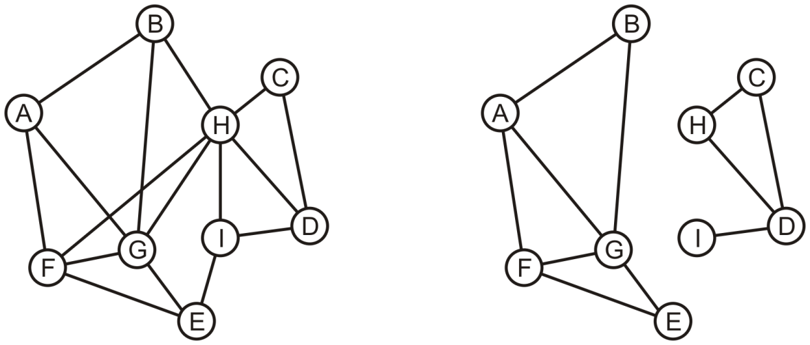
Determining Connections
Is A connected to D?

Slide 46
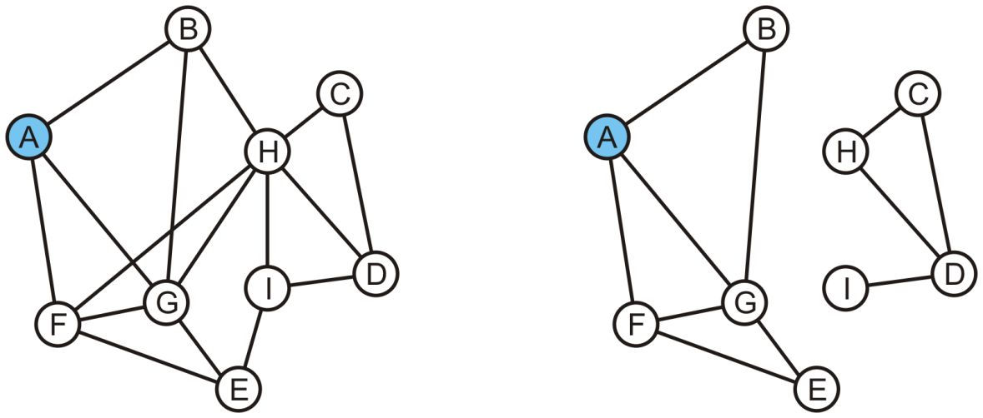
Determining Connections
Vertex A is marked as visited and pushed onto the queue
A
A

Slide 47
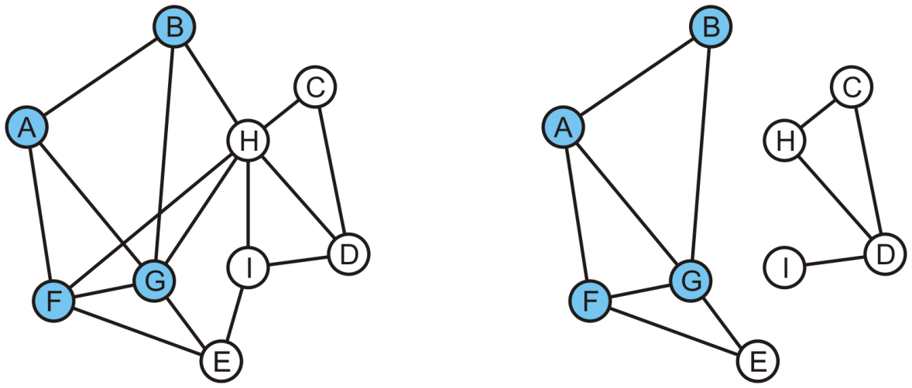
Determining Connections
Pop the head, A, and mark and push B, F and G
B | F | G
B | F | G

Slide 48
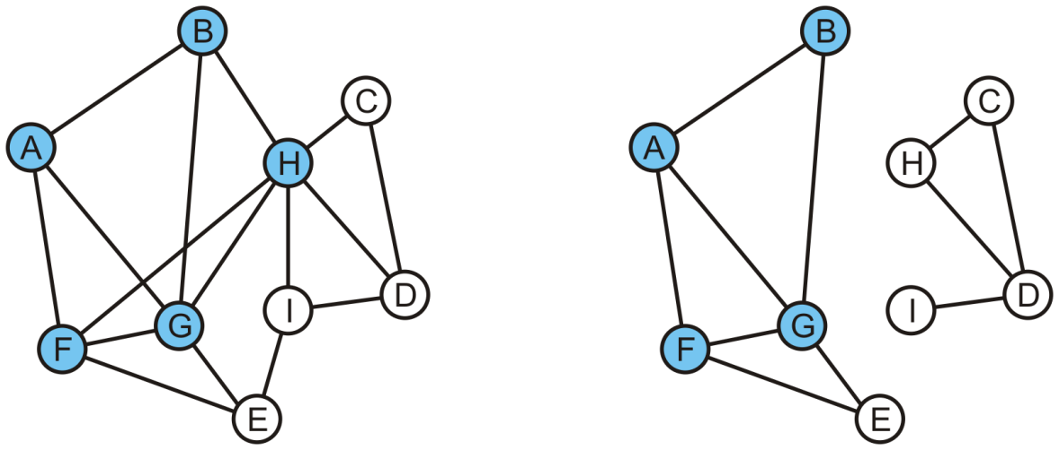
Determining Connections
Pop B and mark and, in the left graph, mark and push H
  On the right graph, B has no unvisited adjacent vertices
F | G | H
F | G

Slide 49
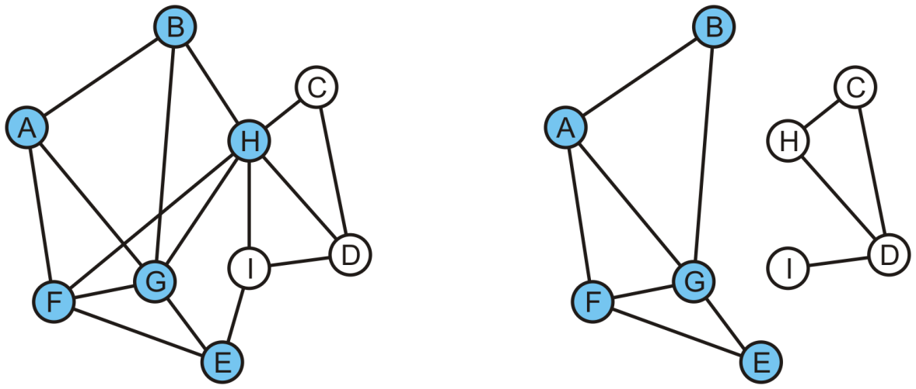
Determining Connections
Popping F results in the pushing of E
G | H | E
G | E

Slide 50
Determining Connections
In either graph, G has no adjacent vertices that are unvisited
H | E
E

Slide 51
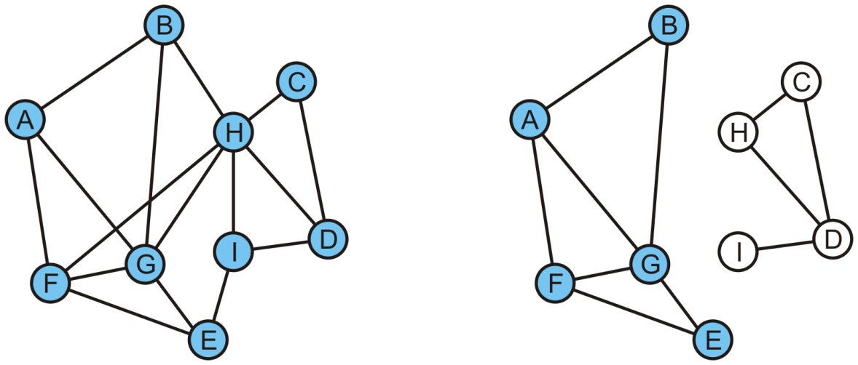
Determining Connections
Popping H on the left graph results in C, I, D being pushed
E | C | I | D

Slide 52
Determining Connections
On the left, D is now visited
  We determine A is connected to D
E | C | I | D

Slide 53
Determining Connections
On the right, the queue is empty and D is not visited
  We determine A is not connected to D
C | I | D

Slide 54
Connected Components
Suppose we want to partition the vertices into connected sub-graphs
  While there are unvisited vertices in the tree:
    Select an unvisited vertex and perform a traversal on that vertex
    Each vertex that is visited in that traversal is added to the set initially containing the initial unvisited vertex
  Continue until all vertices are visited
We would use a disjoint set data structure for maximum efficiency

Slide 55
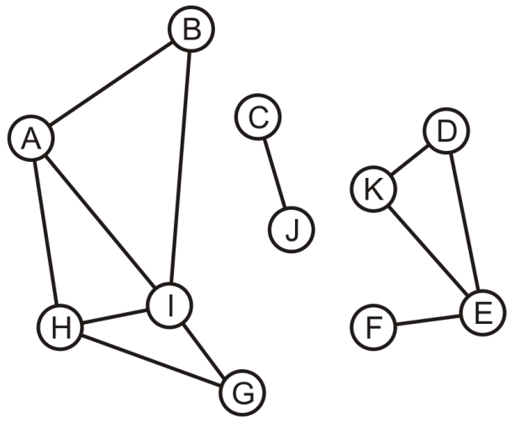
Connected Components
Here we start with a set of singletons
A | B | C | D | E | F | G | H | I | J | K
A | B | C | D | E | F | G | H | I | J | K

Slide 56
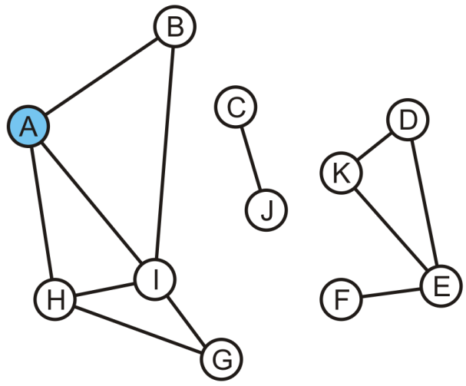
Connected Components
The vertex A is unvisited, so we start with it
A | B | C | D | E | F | G | H | I | J | K
A | B | C | D | E | F | G | H | I | J | K

Slide 57
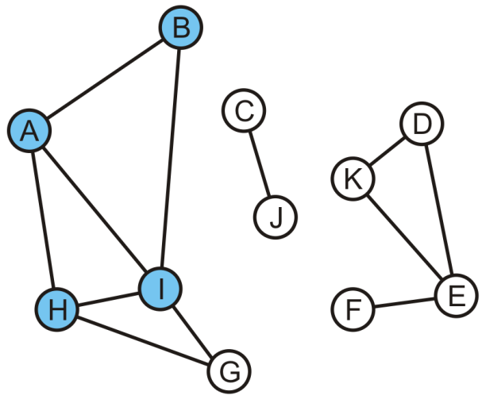
Connected Components
Take the union of with its adjacent vertices: {A, B, H, I}
A | B | C | D | E | F | G | H | I | J | K
A | A | C | D | E | F | G | A | A | J | K

Slide 58
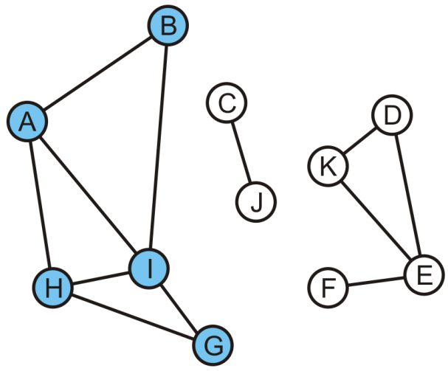
Connected Components
As the traversal continues, we take the union of the set {G} with the set containing H: {A, B, G, H, I}
  The traversal is finished
A | B | C | D | E | F | G | H | I | J | K
A | A | C | D | E | F | A | A | A | J | K

Slide 59
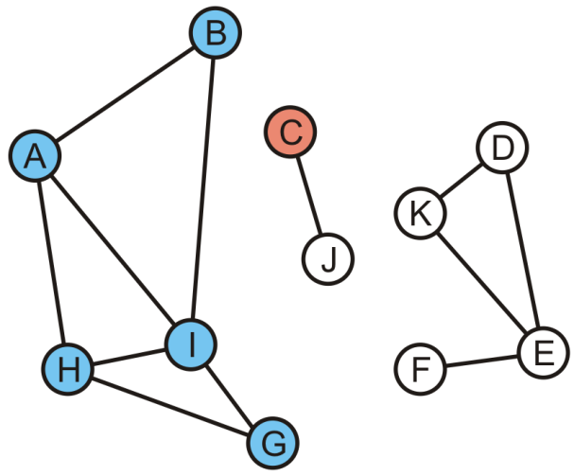
Connected Components
Start another traversal with C: this defines a new set {C}
A | B | C | D | E | F | G | H | I | J | K
A | A | C | D | E | F | A | A | A | J | K

Slide 60
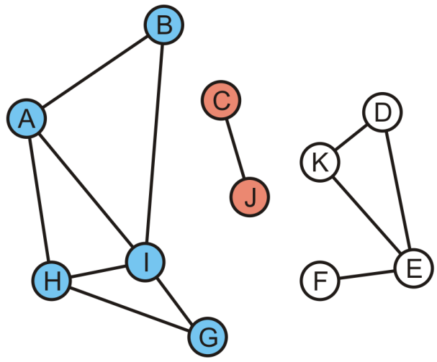
Connected Components
We take the union of {C} and its adjacent vertex J: {C, J}
  This traversal is finished
A | B | C | D | E | F | G | H | I | J | K
A | A | C | D | E | F | A | A | A | C | K

Slide 61
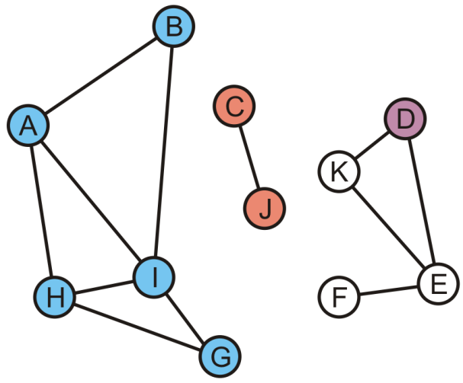
Connected Components
We start again with the set {D}
A | B | C | D | E | F | G | H | I | J | K
A | A | C | D | E | F | A | A | A | C | K

Slide 62
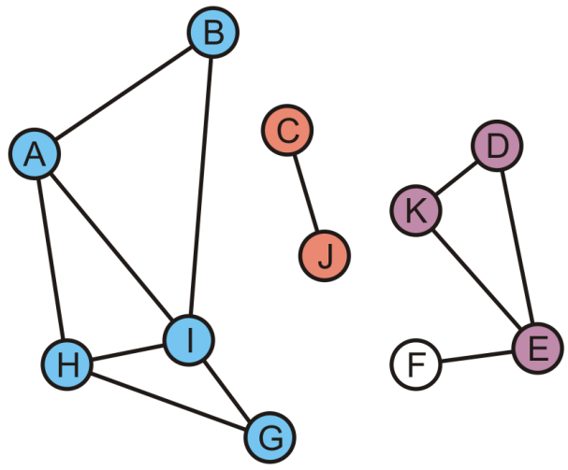
Connected Components
K and E are adjacent to D, so take the unions creating {D, E, K}
A | B | C | D | E | F | G | H | I | J | K
A | A | C | D | D | F | A | A | A | C | D

Slide 63
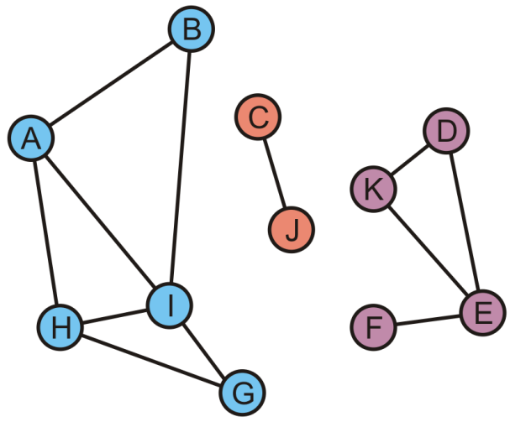
Connected Components
Finally, during this last traversal we find that F is adjacent to E
  Take the union of {F} with the set containing E: {D, E, F, K}
A | B | C | D | E | F | G | H | I | J | K
A | A | C | D | D | D | A | A | A | C | D

Slide 64
Connected Components
All vertices are visited, so we are done
  There are three connected sub-graphs {A, B, G, H, I}, {C, J}, {D, E, F, K}
A | B | C | D | E | F | G | H | I | J | K
A | A | C | D | D | D | A | A | A | C | D

Slide 65
Tracking Unvisited Vertices
How do you implement a set of unvisited vertices so as to:
  Find an unvisited vertex in Θ(1) time?
  Remove a vertex that has been visited from this list in Θ(1) time?
Bad solution
  We can simply flag vertices as visited, but this would require O(|V|) time to find an unvisited vertex
Good solutions
  A hash table of unvisited vertices
  Or, an array of unvisited vertices, and we store for each vertex its position in the array
Notes:
The solution will have to use Θ(|V|) additional memory…

Slide 66
Tracking Unvisited Vertices
Create two arrays:
  One array, unvisited, will contain the unvisited vertices
  The other, loc_in_unvisited, will contain the location of vertex v_{i} in the first array
  Or, instead of a second array, we may add a member variable in the vertex class
0 | 1 | 2 | 3 | 4 | 5 | 6 | 7 | 8 | 9 | 10
A | B | C | D | E | F | G | H | I | J | K
A | B | C | D | E | F | G | H | I | J | K
0 | 1 | 2 | 3 | 4 | 5 | 6 | 7 | 8 | 9 | 10

Slide 67
Tracking Unvisited Vertices
Suppose we visit D
  D is in entry 3
  How shall we delete D in the first array?
0 | 1 | 2 | 3 | 4 | 5 | 6 | 7 | 8 | 9 | 10
A | B | C | D | E | F | G | H | I | J | K
A | B | C | D | E | F | G | H | I | J | K
0 | 1 | 2 | 3 | 4 | 5 | 6 | 7 | 8 | 9 | 10

Slide 68
Tracking Unvisited Vertices
Suppose we visit D
  D is in entry 3
  Copy the last unvisited vertex into this location and update the location array for this value
0 | 1 | 2 | 3 | 4 | 5 | 6 | 7 | 8 | 9 | 10
A | B | C | K | E | F | G | H | I | J
A | B | C | D | E | F | G | H | I | J | K
0 | 1 | 2 | 3 | 4 | 5 | 6 | 7 | 8 | 9 | 3

Slide 69
Tracking Unvisited Vertices
Suppose we visit G
  G is in entry 6
0 | 1 | 2 | 3 | 4 | 5 | 6 | 7 | 8 | 9 | 10
A | B | C | K | E | F | G | H | I | J
A | B | C | D | E | F | G | H | I | J | K
0 | 1 | 2 | 3 | 4 | 5 | 6 | 7 | 8 | 9 | 3

Slide 70
Tracking Unvisited Vertices
Suppose we visit G
  G is in entry 6
  Copy the last unvisited vertex into this location and update the location array for this value
0 | 1 | 2 | 3 | 4 | 5 | 6 | 7 | 8 | 9 | 10
A | B | C | K | E | F | J | H | I
A | B | C | D | E | F | G | H | I | J | K
0 | 1 | 2 | 3 | 4 | 5 | 6 | 7 | 8 | 6 | 3

Slide 71
Tracking Unvisited Vertices
Suppose we now visit K
  K is in entry 3
0 | 1 | 2 | 3 | 4 | 5 | 6 | 7 | 8 | 9 | 10
A | B | C | K | E | F | J | H | I
A | B | C | D | E | F | G | H | I | J | K
0 | 1 | 2 | 3 | 4 | 5 | 6 | 7 | 8 | 6 | 3

Slide 72
Tracking Unvisited Vertices
Suppose we now visit K
  K is in entry 3
  Copy the last unvisited vertex into this location and update the location array for this value
0 | 1 | 2 | 3 | 4 | 5 | 6 | 7 | 8 | 9 | 10
A | B | C | I | E | F | J | H
A | B | C | D | E | F | G | H | I | J | K
0 | 1 | 2 | 3 | 4 | 5 | 6 | 7 | 3 | 6 | 3

Slide 73
Tracking Unvisited Vertices
If we want to find an unvisited vertex, we simply return the last entry of the first array and return it
0 | 1 | 2 | 3 | 4 | 5 | 6 | 7 | 8 | 9 | 10
A | B | C | I | E | F | J | H
A | B | C | D | E | F | G | H | I | J | K
0 | 1 | 2 | 3 | 4 | 5 | 6 | 7 | 3 | 6 | 3

Slide 74
Tracking Unvisited Vertices
In this case, an unvisited vertex is H
  Removing it is trivial: just decrement the count of unvisited vertices
0 | 1 | 2 | 3 | 4 | 5 | 6 | 7 | 8 | 9 | 10
A | B | C | I | E | F | J
A | B | C | D | E | F | G | H | I | J | K
0 | 1 | 2 | 3 | 4 | 5 | 6 | 7 | 3 | 6 | 3

Slide 75
Tracking Unvisited Vertices
The actual algorithm is exceptionally fast:
  The initialization is Θ(|V|)
  int unvisited[nV];
  int loc_in_unvisited[nV];
  for ( int i = 0; i < nV; ++i ) {
  unvisited[i] = i;
  loc_in_unvisited[i] = i;
  }

Slide 76
Tracking Unvisited Vertices
The actual algorithm is exceptionally fast:
  Determining if the vertex v_{k} is visited is fast: Θ(1)
  bool is_unvisited( int k ) const {
  return loc_in_unvisited[k] < count &&
  unvisited[ loc_in_unvisited[k] ] == k;
  }

Slide 77
Tracking Unvisited Vertices
The actual algorithm is exceptionally fast:
  Marking vertex v_{k} as having been visited is also fast: Θ(1)
  void erase( int k ) {
  if ( !is_unvisited() ) {
  return; // It has already been marked as visited
  }
  --count;
  int posn = loc_in_unvisited[k];
  unvisited[posn] = unvisited[count];
  loc_in_unvisited[unvisited[count]] = posn;
  }

Slide 78
Tracking Unvisited Vertices
The actual algorithm is exceptionally fast:
  Returning a vertex that is unvisited is also fast: Θ(1)
  int return unvisited() {
  if ( count == 0 ) {
  throw underflow();
  }
  --count;
  return unvisited[count];
  }

Slide 79
Summary
This topic covered connectedness
  Determining if two vertices are connected
  Determining the connected sub-graphs of a graph
  Tracking unvisited vertices

Slide 80
References
Wikipedia, http://en.wikipedia.org/wiki/Connectivity_(graph_theory)
These slides are provided for the ECE 250 Algorithms and Data Structures course. The material in it reflects Douglas W. Harder’s best judgment in light of the information available to him at the time of preparation. Any reliance on these course slides by any party for any other purpose are the responsibility of such parties. Douglas W. Harder accepts no responsibility for damages, if any, suffered by any party as a result of decisions made or actions based on these course slides for any other purpose than that for which it was intended.

Slide 81
Outline
Graph traversal
  Breadth-first
  Depth-first
Applications
  Connectedness
  Unweighted path length
  Identifying bipartite graphs
  Image segmentation via graph cut

Slide 82
Determining Distances
Problem: in an unweighted graph, find the distances from one vertex v to all the other vertices
  Distance: the length of the shortest path between two vertices
Method:
  Use a breadth-first traversal
  Vertices are added in layers
  The starting vertex v is defined to be in the zeroth layer, L₀
  While the k^{th} layer is not empty, all unvisited vertices adjacent to vertices in L_{k} are added to the (k + 1)^{st} layer
The distance from v to vertices in L_{k} is k
Any unvisited vertices are said to have an infinite distance from v
Notes:
Reference: Kleinberg and Tardos

Slide 83
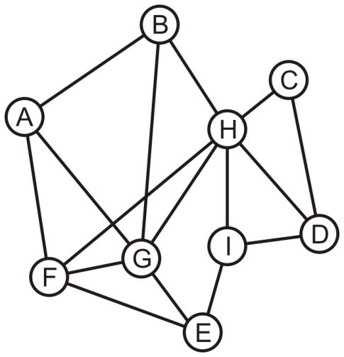
Determining Distances
Consider this graph: find the distance from A to each other vertex

Slide 84
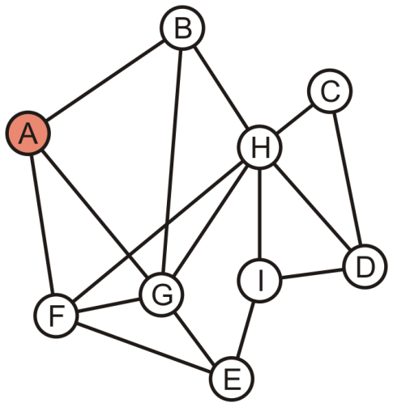
Determining Distances
A forms the zeroeth layer, L₀
A

Slide 85
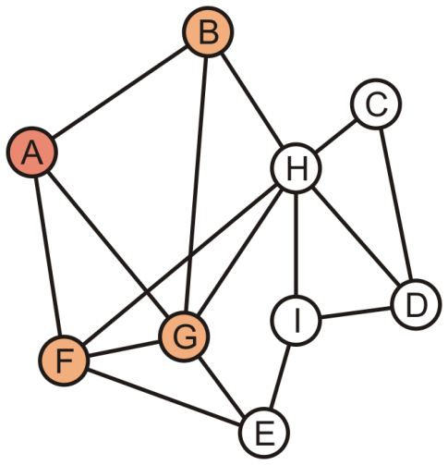
Determining Distances
The unvisited vertices B, F and G are adjacent to A
  These form the first layer, L₁
B | F | G

Slide 86
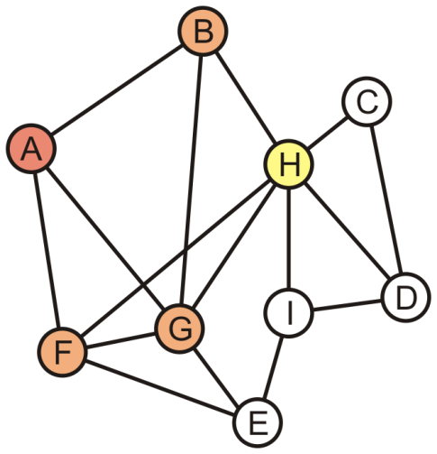
Determining Distances
We now begin popping L₁ vertices: pop B
  H is adjacent to B
  It is tagged L₂
F | G | H

Slide 87
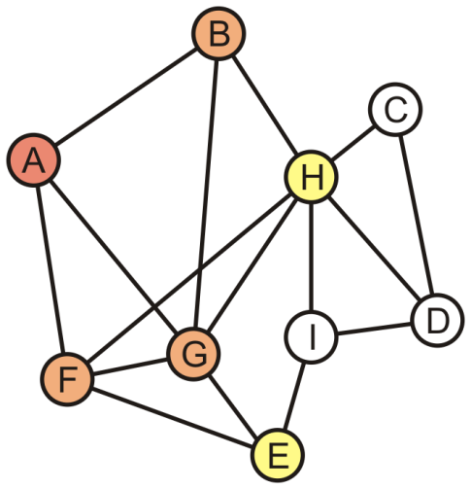
Determining Distances
Popping F pushes E onto the queue
  It is also tagged L₂
G | H | E

Slide 88
Determining Distances
We pop G which has no other unvisited neighbours
  G is the last L₁ vertex; thus H and E form the second layer, L₂
H | E

Slide 89
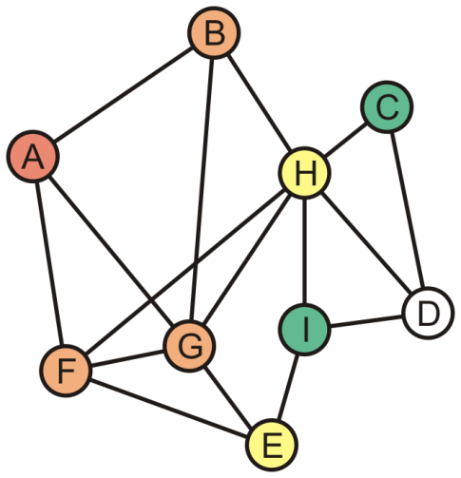
Determining Distances
Popping H in L₂ adds C and I to the third layer L₃
E | C | I

Slide 90
Determining Distances
E has no more adjacent unvisited vertices
  Thus C and I form the third layer, L₃
C | I

Slide 91
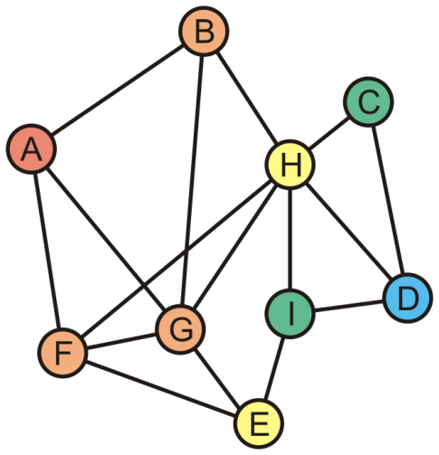
Determining Distances
The unvisited vertex D is adjacent to vertices in L₃
  This vertex forms the fourth layer, L₄
  Distance 1: B, F, G
  Distance 2: H, E
  Distance 3: C, I
  Distance 4: D

Slide 92
Determining Distances
Theorem:
  If, in a breadth-first traversal of a graph, two vertices v and w appear in layers L_{i} and L_{j}, respectively and {v, w} is an edge in the graph,
  then i and j differ by at most one
Proof:
  If i = j, we are done
  If i ≠ j, without loss of generality, assume i < j
    Because v ∈ L_{i}, w does not appear in any previous layer, and {v, w} is an edge in the graph, it follows that w ∈ L_{i + 1}
    Thus, j = i + 1
  Therefore, i and j differ by at most one

Slide 93
Sumary
This topic found the unweighted path length from a single vertex to all other vertices
  A breadth-first traversal was used
  The first vertex is marked as layer 0
  Vertices added to the queue by one in layer k are marked as layer k + 1
  Later, we will see different algorithms for finding the shortest path length in weighted graphs

Slide 94
References
Wikipedia, http://en.wikipedia.org/wiki/Shortest_path
http://en.wikipedia.org/wiki/Breadth-first_search
[1] Jon Kleinberg and Éva Tardos, Algorithm Design, Addison Wesley, 2006, §§3.2-5, pp.78-99.
These slides are provided for the ECE 250 Algorithms and Data Structures course. The material in it reflects Douglas W. Harder’s best judgment in light of the information available to him at the time of preparation. Any reliance on these course slides by any party for any other purpose are the responsibility of such parties. Douglas W. Harder accepts no responsibility for damages, if any, suffered by any party as a result of decisions made or actions based on these course slides for any other purpose than that for which it was intended.

Slide 95
Outline
This topic looks at another problem solved by breadth-first traversals
  Determining if a graph is bipartite
  Definition of a bipartite graph
  The algorithm
  An example

Slide 96
Outline
Graph traversal
  Breadth-first
  Depth-first
Applications
  Connectedness
  Unweighted path length
  Identifying bipartite graphs
  Image segmentation via graph cut

Slide 97
Definition
Definition
  A bipartite graph is a graph where the vertices V can be divided into two disjoint sets V₁ and V₂ such that every edge has one vertex in V₁ and the other in V₂

Slide 98
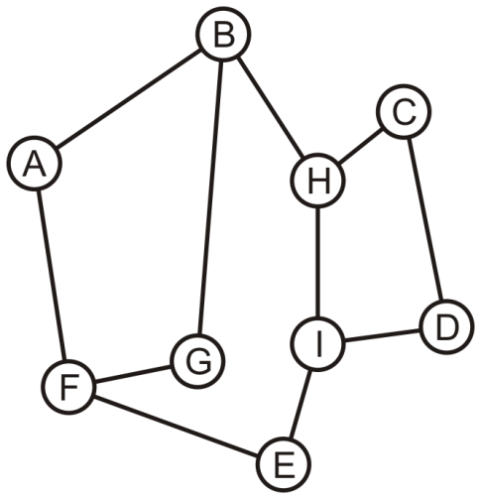
Bipartite Graphs
Consider this graph: is it bipartite?

Slide 99
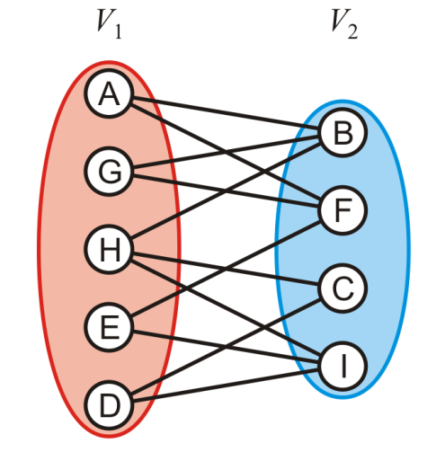
Bipartite Graphs
Yes: With a little work, it is possible to determine that we can decompose the vertices into two disjoint sets

Slide 100
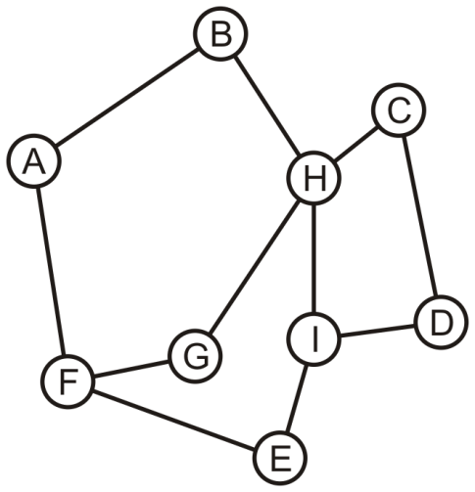
Bipartite Graphs
Is this graph bipartite?

Slide 101
Bipartite Graphs
In this case, it is not a bipartite graph
How can we determine if a graph is bipartite?

Slide 102
Bipartite Graphs
Use a breadth-first traversal for a connected graph:
  Choose a vertex, mark it belonging to V₁ and push it onto a queue
  While the queue is not empty, pop the front vertex v and
    Any adjacent vertices that are already marked must belong to the set not containing v, otherwise, the graph is not bipartite (we are done);
    Any unmarked adjacent vertices are marked as belonging to the other set and they are pushed onto the queue
  If the queue is empty, the graph is bipartite

Slide 103
Bipartite Graphs
With the first graph, we can start with any vertex
  We will use colours to distinguish the two sets

Slide 104
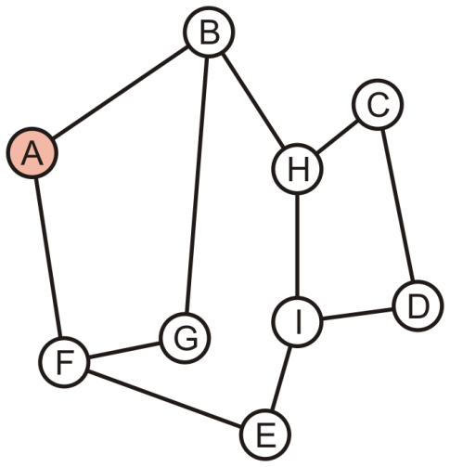
Bipartite Graphs
Push A onto the queue and colour it red
A

Slide 105
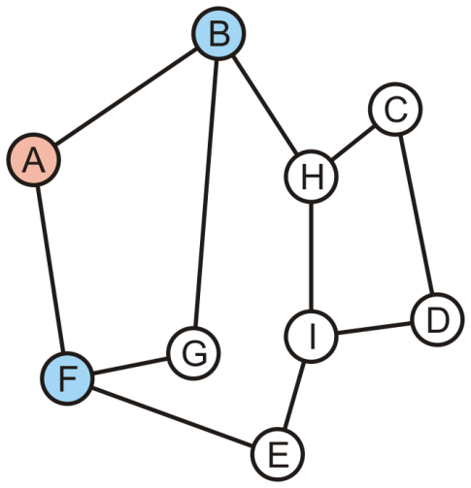
Bipartite Graphs
Pop A and its two neighbours are not marked:
  Mark them as blue and push them onto the queue
B | F

Slide 106
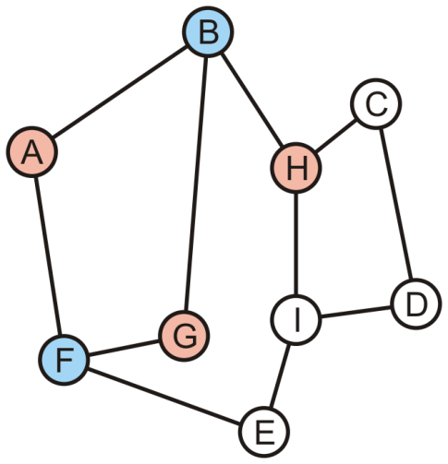
Bipartite Graphs
Pop B—it is blue:
  Its one marked neighbour, A, is red
  Its other neighbours G and H are not marked: mark them red and push them onto the queue
F | G | H

Slide 107
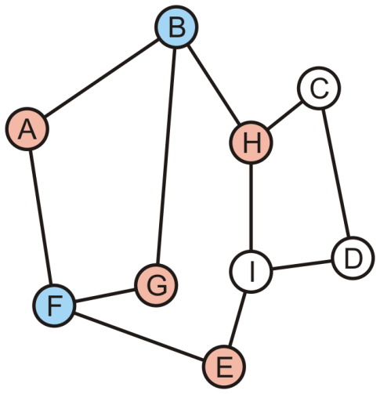
Bipartite Graphs
Pop F—it is blue:
  Its two marked neighbours, A and G, are red
  Its neighbour E is not marked: mark it red and pus it onto the queue
G | H | E

Slide 108
Bipartite Graphs
Pop G—it is red:
  Its two marked neighbours, B and F, are blue
H | E

Slide 109
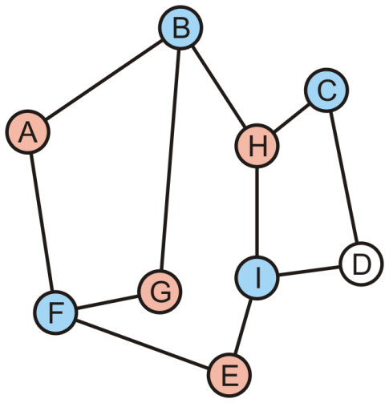
Bipartite Graphs
Pop H—it is red:
  Its marked neighbours, B, is blue
  It has two unmarked neighbours, C and I; mark them blue and push them onto the queue
E | C | I

Slide 110
Bipartite Graphs
Pop E—it is red:
  Its marked neighbours, F and I, are blue
C | I

Slide 111
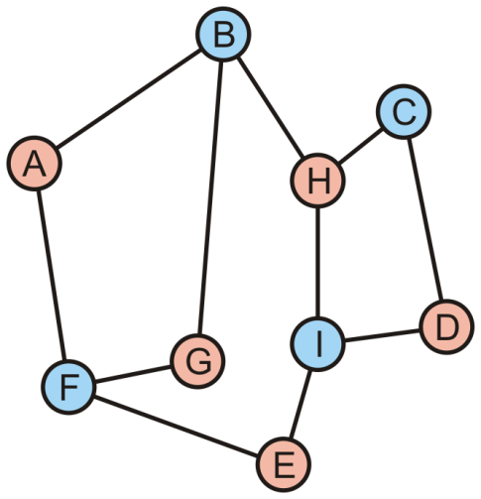
Bipartite Graphs
Pop C—it is blue:
  Its marked neighbour, H, is red
  Mark D as red and push it onto the queue
I | D

Slide 112
Bipartite Graphs
Pop I—it is blue:
  Its marked neighbours, H, D and E, are all red
D

Slide 113
Bipartite Graphs
Pop D—it is red:
  Its marked neighbours, C and I, are both blue

Slide 114
Bipartite Graphs
The queue is empty, the graph is bipartite

Slide 115
Bipartite Graphs
Consider the other graph which was claimed to be not bipartite

Slide 116
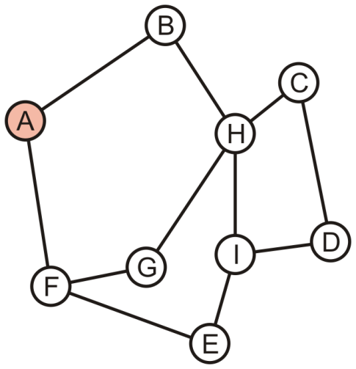
Bipartite Graphs
Push A onto the queue and colour it red
A

Slide 117
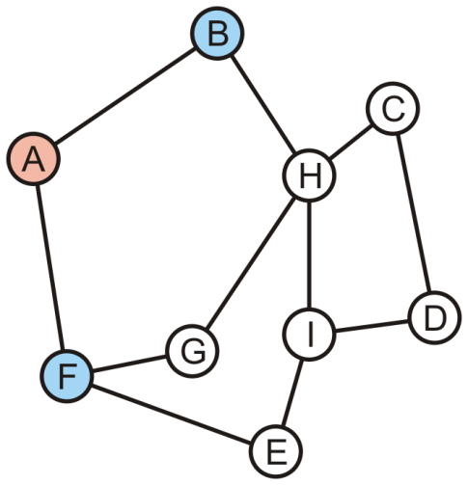
Bipartite Graphs
Pop A off the queue:
  Its neighbours are unmarked: colour them blue and push them onto the queue
B | F

Slide 118

Bipartite Graphs
Pop B off the queue:
  Its one neighbour, A, is red
  The other neighbour, H, is unmarked: colour it red and push it onto the queue
F | H

Slide 119

Bipartite Graphs
Pop F off the queue:
  Its one neighbour, A, is red
  The other neighbours, E and G, are unmarked: colour them red and push it onto the queue
H | E | G

Slide 120
Bipartite Graphs
Pop H off the queue—it is red:
  Its one neighbour, G, is already red
  The graph is not bipartite
E | G

Slide 121
Bipartite Graphs
Definition
  Cycles that contains either an even number or an odd number of vertices are said to be even cycles and odd cycles, respectively
Theorem
  A graph is bipartite if and only if it does not contain any odd cycles
Notes:
Reference: Kleinberg and Tardos

Slide 122
Sumary
This topic looked at identifying bipartite graphs
  Perform a breadth-first traversal
  Each vertex is given one of two identifiers (we used color)
  The first vertex is identified as one color and pushed onto the queue
  When a vertex is popped:
    Each unvisited neighbor is pushed onto the tree with the opposite color
    Each visited neighbor must be the opposite color
      If one is not, the graph is not bipartite

Slide 123
References
Wikipedia, http://en.wikipedia.org/wiki/Breadth-first_search#Testing_bipartiteness
http://en.wikipedia.org/wiki/Breadth-first_search
http://en.wikipedia.org/wiki/Bipartite_graph
[1] Jon Kleinberg and Éva Tardos, Algorithm Design, Addison Wesley, 2006, §§3.2-5, pp.78-99.
These slides are provided for the ECE 250 Algorithms and Data Structures course. The material in it reflects Douglas W. Harder’s best judgment in light of the information available to him at the time of preparation. Any reliance on these course slides by any party for any other purpose are the responsibility of such parties. Douglas W. Harder accepts no responsibility for damages, if any, suffered by any party as a result of decisions made or actions based on these course slides for any other purpose than that for which it was intended.

Slide 124
Outline
Graph traversal
  Breadth-first: use a queue
  Depth-first: use recursion or stack
Applications
  Connectedness
  Unweighted path length
  Identifying bipartite graphs
  Image segmentation via graph cut

Slide 125

Image Segmentation
Segmentation refers to the process of partitioning a digital image into multiple segments.
The goal of segmentation is to simplify and/or change the representation of an image into something that is more meaningful and easier to analyze.
Similarity (gray level difference), Proximity and continuity are important factors in segmentation.

Slide 126
Graph representation of Image
Set of points of the feature space represented as a weighted, undirected graph, G = (V, E).
The points of the feature space are the nodes of the graph.
Edge between every pair of nodes.

Slide 127

Graph representation of Image
Weight on each edge, w(i, j), is a function of the similarity between the vertices (every pixels in the image) i and j.
Partition the set of vertices into disjoint sets where similarity within the sets is high and across the sets is low.
  Similar pixels should be in the same segments.
  Dissimilar pixels should be in different segments.
Therefore, Segmentation is equivalent to Graph partition.

Slide 128
Graph representation of Image
Cut:
A cut in a graph is a set of edges whose removal disconnects the graph.
A minimum cut is a cut with a minimum number of edges. It is denoted by S. In the weighted graph,
cut(A,B) = ∑ w(u,v)
u E A,v E B
where A & B are two partitioned disjoint sets

Slide 129

Segmentation by Min Cut method
By Min Cut method, the graph is partitioned into clusters.
Each cluster is considered as an image segment.
Min Cut method uses the HCS (Highly Connected Subgraphs) Algorithm to find the clusters.

Slide 130
Segmentation by Min Cut method
Edge Connectivity is the minimum number of edges whose removal results in a disconnected graph. It is denoted by k(G).
For a graph with vertices n > 1 to be highly connected if its edge-connectivity k(G) > n/2.
A highly connected subgraph (HCS) is an induced subgraph H in G such that H is highly connected.

Slide 131
Segmentation by Min Cut method
Example:
No. of nodes = 5 Edge Connectivity = 1
A
B
Not HCS!
D
C
E

Slide 132
Segmentation by Min Cut method
Example continued:
No. of nodes = 4 Edge Connectivity = 3
A
B
HCS!
D
C

Slide 133
HCS Algorithm - Min Cut method
HCS(G(V,E))
begin
(H, H’,C) ← MINCUT(G)
if G is highly connected
then return (G)
else
HCS(H)
HCS(H’)
end if
end

Slide 134
HCS Algorithm - Min Cut method
The procedure MINCUT(G) returns H, H’ and C where C is the minimum cut which separates G into the subgraphs H and H’.
Procedure HCS returns a graph in case it identifies it as a cluster.
Single vertices are not considered clusters and are grouped into singletons set S.

Slide 135

HCS Algorithm - Min Cut method
Example

Slide 136

HCS Algorithm - Min Cut method
Example Continued

Slide 137

HCS Algorithm - Min Cut method
Example Continued
Cluster 2
Cluster 1
Cluster 3

Slide 138

HCS Algorithm - Min Cut method
The HCS Algorithm returns clusters which are nothing but image segments.
The problem with HCS Algorithm – Min Cut method is that there is a chance that many singletons may be separated.
To overcome this we use Graph-cut for image segmentation.
Min cut
Graph-cut

Slide 139

﻿Graph cuts segmentation
﻿Define graph for image segmentation
  Usually 4-connected or 8-connected
﻿
﻿Define two additional vertices for foreground and background
  Usually 4-connected or 8-connected
4-connected
8-connected

Slide 140

﻿Graph cuts segmentation
Background (label 0)
Foreground (label 1)

Slide 141

﻿Graph cuts segmentation
Background (label 0)
Foreground (label 1)

Slide 142

﻿Graph cuts segmentation
﻿Define graph
  Usually 4-connected or 8-connected
﻿Define group-wise similarity for each pixel $p$
  Color histogram or mixture of Gaussian, defined as $c(p)$ for background and foreground
  $Group_Similarity=−log\left(\frac{P\left(c\left(p\right); θ_{foreground}\right)}{P\left(c\left(p\right); θ_{background}\right)}\right)$
  Define pair-wise similarity between every pair of pixels $p$ and $q$
    $Pair_Similarity=exp\left(\frac{−{\left\|c\left(p\right)−c\left(q\right)\right\|}^{2}}{2σ^{2}}\right)$
    Apply min cut (no efficient algorithm), using max flow instead
    Return to 2, using current labels to compute fore ground, background models.

Slide 143
Max Flow - Min Cut Method
Theorem
In graph G, the maximum source-to-sink flow possible is equal to the capacity of the minimum cut in G.
(L. R. Foulds, Graph Theory Applications, 1992 Springer-Verlag New York Inc., 247-248)

Slide 144
Max Flow - Min Cut Method
Min Cut can be made by using Ford-Fulkerson Algorithm to find the max-flow in the graph.
In the graph temporarily add Source ‘s’ and Sink ‘t’ (the two labels 0/1).
Consider the weight associated with each each node as a flow capacity.
Starting from zero flow, increase the flow gradually by finding a path from s to t along which more flow can be sent, until a max-flow is achieved.

Slide 145
Max Flow - Min Cut Method
Min Cut can be made by using Ford-Fulkerson Algorithm to find the max-flow in the graph.
In the graph temporarily add Source ‘s’ and Sink ‘t’ (the two labels 0/1).
Consider the weight associated with each each node as a flow capacity.
Starting from zero flow, increase the flow gradually by finding a path from s to t along which more flow can be sent, until a max-flow is achieved.

Slide 146
Max Flow - Min Cut Method

Slide 147
Max Flow - Min Cut Method
After the max-flow is found, the minimum cut is by
S = {All vertices reachable from s}
T = G \ S

Slide 148





﻿Moderately straightforward examples

Slide 149

﻿Difficult Examples

