Slide 1
CS101 Algorithms and Data Structures
Insertion and Bubble Sort
Textbook Ch 2
Notes:
Adapted from the slides by Douglas Wilhelm Harder of U Waterloo (https://ece.uwaterloo.ca/~dwharder/aads/Lecture_materials/)
May also contain material from the slides at https://courses.cs.washington.edu/courses/cse326/03wi/326lecturesb.shtml (by Dan Suciu of U Washington)

Slide 2
Outline
Introduction
Inversions
Insertion sort
Bubble sort
Heap sort
Merge sort
Quicksort
Bucket sort
Radix sort

Slide 3
Definition
Sorting is the process of:
  Taking a list of objects which could be stored in a linear order
  (a₀, a₁, ..., a_{n – 1})
  e.g., numbers, and returning a reordering
  (a'₀, a'₁, ..., a'_{n – 1})
  such that
  a'₀ ≤ a'₁ ≤ · · · ≤ a'_{n – 1}
The conversion of an Abstract List into an Abstract Sorted List

Slide 4
Definition
Seldom will we sort isolated values
  Usually we will sort a number of records containing a number of fields based on a key:
19991532 | Stevenson | Monica | 3 Glendridge Ave.
19990253 | Redpath | Ruth | 53 Belton Blvd.
19985832 | Kilji | Islam | 37 Masterson Ave.
20003541 | Groskurth | Ken | 12 Marsdale Ave.
19981932 | Carol | Ann | 81 Oakridge Ave.
20003287 | Redpath | David | 5 Glendale Ave.
Numerically by ID Number
Lexicographically by surname, then given name
19981932 | Carol | Ann | 81 Oakridge Ave.
19985832 | Khilji | Islam | 37 Masterson Ave.
19990253 | Redpath | Ruth | 53 Belton Blvd.
19991532 | Stevenson | Monica | 3 Glendridge Ave.
20003287 | Redpath | David | 5 Glendale Ave.
20003541 | Groskurth | Ken | 12 Marsdale Ave.
19981932 | Carol | Ann | 81 Oakridge Ave.
20003541 | Groskurth | Ken | 12 Marsdale Ave.
19985832 | Kilji | Islam | 37 Masterson Ave.
20003287 | Redpath | David | 5 Glendale Ave.
19990253 | Redpath | Ruth | 53 Belton Blvd.
19991532 | Stevenson | Monica | 3 Glendridge Ave.

Slide 5
Definition
In these topics, we will assume that:
  We are sorting integers
    The algorithms can also be applied to other types of objects as long as we can compare any two objects
  Arrays are to be used for both input and output

Slide 6
In-place Sorting
Sorting algorithms may be performed in-place, that is, with the allocation of at most Θ(1) additional memory (e.g., fixed number of local variables)
  Some definitions of in place as using o(n) memory
Other sorting algorithms require the allocation of second array of equal size
  Requires Θ(n) additional memory
We will prefer in-place sorting algorithms

Slide 7
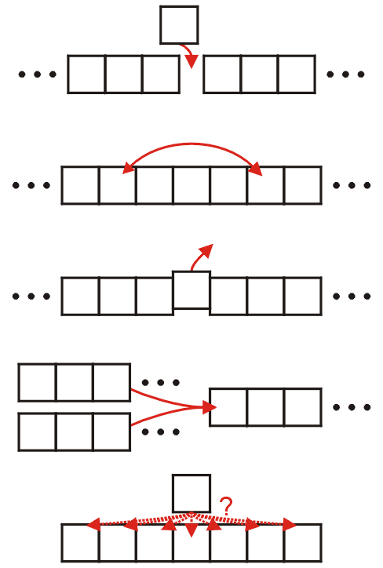
Classifications
The operations of a sorting algorithm are based on the actions performed:
  Insertion
  Exchanging
  Selection
  Merging
  Distribution

Slide 8
Run-time
The run time of the sorting algorithms we will look at fall into one of three categories:
Θ(n) Θ(n ln(n)) O(n²)
We will examine average- and worst-case scenarios for each algorithm
The run-time may change significantly based on the scenario

Slide 9
Run-time
We will review the more traditional O(n²) sorting algorithms:
  Insertion sort, Bubble sort
Some of the faster Θ(n ln(n)) sorting algorithms:
  Heap sort, Quicksort, and Merge sort
And linear-time sorting algorithms
  Bucket sort and Radix sort
  We must make assumptions about the data

Slide 10
Lower-bound Run-time
Any sorting algorithm must examine each entry in the array at least once
  Consequently, all sorting algorithms must be Ω(n)
We will not be able to achieve Θ(n) behaviour without additional assumptions

Slide 11
Lower-bound Run-time
The general worst-case run time is Ω(n lg(n))
The proof is based on the idea of a comparison tree

Slide 12
Lower-bound Run-time
The general worst-case run time is Ω(n lg(n))
The proof:
  Any comparison-based sorting algorithm can be represented by a comparison tree
  Worst-case running time cannot be less than the height of the tree
  How many leaves does the tree have?
    The number of permutations of n objects, which is n!
  What’s the shallowest tree with n! leaves?
    A complete tree, whose height is lg(n!)
    It can be shown that lg(n!) = Θ(n lg(n))
Notes:
Reference: Donald E. Knuth, The Art of Computer Programming, Volume 3: Sorting and Searching, 2nd Ed., Addison Wesley, 1998, §5.3.1, p.180.

Slide 13
Optimal Sorting Algorithms
We will cover some common sorting algorithms
  There is no optimal sorting algorithm which can be used in all places
  Under various circumstances, different sorting algorithms will deliver optimal run-time and memory-allocation requirements

Slide 14

Sub-optimal Sorting Algorithms
Before we look at other algorithms, we will consider the Bogosort algorithm:
  1. Randomly order the objects, and
  2. Check if they’re sorted, if not, go back to Step 1.
Run time analysis:
  best case: Θ(n)
  worst: unbounded
  average: Θ((n+1)!)

Slide 15
Sub-optimal Sorting Algorithms
There is also the Bozosort algorithm:
  1. Check if the entries are sorted,
  2. If they are not, randomly swap two entries and go to Step 1.
Run time analysis:
  More difficult than bogosort...
  O(n!) is the expected average case

Slide 16
Summary
Introduction to sorting, including:
  Assumptions
  In-place sorting (O(1) additional memory)
  Sorting techniques
    insertion, exchanging, selection, merging, distribution
  Run-time classification: O(n) O(n ln(n)) O(n²)
Overview of proof that a general sorting algorithm must be Ω(n ln(n)) in the worst-case.

Slide 17
Outline
Introduction
Inversions
Insertion sort
Bubble sort

Slide 18
Inversions
Consider the following three lists:
1 16 12 26 25 35 33 58 45 42 56 67 83 75 74 86 81 88 99 95
1 17 21 42 24 27 32 35 45 47 57 23 66 69 70 76 87 85 95 99
22 20 81 38 95 84 99 12 79 44 26 87 96 10 48 80 1 31 16 92
To what degree are these three lists unsorted?

Slide 19
Inversions
The first list requires only a few exchanges to make it sorted
1 16 12 26 25 35 33 58 45 42 56 67 83 75 74 86 81 88 99 95
1 12 16 25 26 33 35 42 45 56 58 67 74 75 81 83 86 88 95 99

Slide 20
Inversions
The second list has two entries significantly out of order
1 17 21 42 24 27 32 35 45 47 57 23 66 69 70 76 87 85 95 99
1 17 21 23 24 27 32 35 42 45 47 57 66 69 70 76 85 87 95 99
however, most entries (13) are in place

Slide 21
Inversions
The third list would, by any reasonable definition, be significantly unsorted
22 20 81 38 95 84 99 12 79 44 26 87 96 10 48 80 1 31 16 92
1 10 12 16 20 22 26 31 38 44 48 79 80 81 84 87 92 95 96 99

Slide 22
Inversions
Given any list of n numbers, there are
pairs of numbers
For example, the list (1, 3, 5, 4, 2, 6) contains the following 15 pairs:
  (1, 3) (1, 5) (1, 4) (1, 2) (1, 6)
  (3, 5) (3, 4) (3, 2) (3, 6)
  (5, 4) (5, 2) (5, 6)
  (4, 2) (4, 6)
  (2, 6)

Slide 23
Inversions
You may note that 11 of these pairs of numbers are in
order:
  (1, 3) (1, 5) (1, 4) (1, 2) (1, 6)
  (3, 5) (3, 4) (3, 2) (3, 6)
  (5, 4) (5, 2) (5, 6)
  (4, 2) (4, 6)
  (2, 6)

Slide 24
Inversions
The remaining four pairs are reversed, or inverted
(1, 3) (1, 5) (1, 4) (1, 2) (1, 6)
  (3, 5) (3, 4) (3, 2) (3, 6)
  (5, 4) (5, 2) (5, 6)
  (4, 2) (4, 6)
  (2, 6)

Slide 25
Inversions
Given a permutation of n elements
a₀, a₁, ..., a_{n – 1}
an inversion is defined as a pair of entries which are reversed
That is, (a_{j}, a_{k}) forms an inversion if
j < k but a_{j} > a_{k}
Notes:
Ref: Bruno Preiss, Data Structures and Algorithms

Slide 26
Inversions
Therefore, the permutation
1, 3, 5, 4, 2, 6
contains four inversions:
  (3, 2) (5, 4) (5, 2) (4, 2)

Slide 27
Inversions
Exchanging (or swapping) two adjacent entries either:
  removes an inversion, e.g.,
    1 3 5 4 2 6
    1 3 5 2 4 6
  removes the inversion (4, 2)
  or introduces a new inversion, e.g., (5, 3) with
    1 3 5 4 2 6
    1 5 3 4 2 6

Slide 28
Number of Inversions
There are pairs of numbers in any set of n objects
Consequently, each pair contributes to
  the set of ordered pairs, or
  the set of inversions
For a random ordering, we would expect approximately half of all pairs are inversions:

Slide 29
Number of Inversions
For example, the following unsorted list of 56 entries
61 548 3 923 195 973 289 237 57 299 594 928 515 55
507 351 262 797 788 442 97 798 227 127 474 825 7 182
929 852 504 485 45 98 538 476 175 374 523 800 19 901
349 947 613 265 844 811 636 859 81 270 697 563 976 539
has 655 inversions and 885 ordered pairs
The formula predicts inversions

Slide 30
Number of Inversions
Let us consider the number of inversions in our first three lists:
1 16 12 26 25 35 33 58 45 42 56 67 83 75 74 86 81 88 99 95
1 17 21 42 24 27 32 35 45 47 57 23 66 69 70 76 87 85 95 99
22 20 81 38 95 84 99 12 79 44 26 87 96 10 48 80 1 31 16 92
Each list has 20 entries, and therefore:
  There are pairs
  On average, 190/2 = 95 pairs would form inversions

Slide 31
Number of Inversions
The first list
1 16 12 26 25 35 33 58 45 42 56 67 83 75 74 86 81 88 99 95
has 13 inversions:
(16, 12) (26, 25) (35, 33) (58, 45) (58, 42) (58, 56) (45, 42)
(83, 75) (83, 74) (83, 81) (75, 74) (86, 81) (99, 95)
This is well below 95, the expected number of inversions
  Therefore, this is likely not to be a random list

Slide 32
Number of Inversions
The second list
1 17 21 42 24 27 32 35 45 47 57 23 66 69 70 76 87 85 95 99
also has 13 inversions:
(42, 24) (42, 27) (42, 32) (42, 35) (42, 23) (24, 23) (27, 23)
(32, 23) (35, 23) (45, 23) (47, 23) (57, 23) (87, 85)
This, too, is not a random list

Slide 33
Number of Inversions
The third list
22 20 81 38 95 84 99 12 79 44 26 87 96 10 48 80 1 31 16 92
has 100 inversions:
(22, 20) (22, 12) (22, 10) (22, 1) (22, 16) (20, 12) (20, 10) (20, 1) (20, 16) (81, 38)
(81, 12) (81, 79) (81, 44) (81, 26) (81, 10) (81, 48) (81, 80) (81, 1) (81, 16) (81, 31)
(38, 12) (38, 26) (38, 10) (38, 1) (38, 16) (38, 31) (95, 84) (95, 12) (95, 79) (95, 44)
(95, 26) (95, 87) (95, 10) (95, 48) (95, 80) (95, 1) (95, 16) (95, 31) (95, 92) (84, 12)
(84, 79) (84, 44) (84, 26) (84, 10) (84, 48) (84, 80) (84, 1) (84, 16) (84, 31) (99, 12)
(99, 79) (99, 44) (99, 26) (99, 87) (99, 96) (99, 10) (99, 48) (99, 80) (99, 1) (99, 16)
(99, 31) (99, 92) (12, 10) (12, 1) (79, 44) (79, 26) (79, 10) (79, 48) (79, 1) (79, 16)
(79, 31) (44, 26) (44, 10) (44, 1) (44, 16) (44, 31) (26, 10) (26, 1) (26, 16) (87, 10)
(87, 48) (87, 80) (87, 1) (87, 16) (87, 31) (96, 10) (96, 48) (96, 80) (96, 1) (96, 16)
(96, 31) (96, 92) (10, 1) (48, 1) (48, 16) (48, 31) (80, 1) (80, 16) (80, 31) (31, 16)

Slide 34
Outline
Introduction
Inversions
Insertion sort
Bubble sort

Slide 35
Outline
This topic discusses the insertion sort
We will discuss:
  the algorithm
  an example
  run-time analysis
    worst case
    average case
    best case

Slide 36
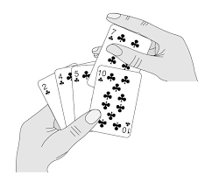
Background
Consider the following observations:
  A list with one element is sorted
  In general, if we have a sorted list of k items, we can insert a new item to create a sorted list of size k + 1
Notes:
插入排序算法是一个对少量元素进行排序的有效算法。按照算法导论的图例来说，工作原理和很多人打牌时, 整理手中牌时的做法类似。在开始摸牌时, 放置牌比如左手是空的, 牌面朝下放在桌上。接着, 一次从桌上摸一张牌, 并将它插入到左手那把牌中的正确位置上。为了找到这张牌的正确位置, 要将它与手中已有的每一张牌从左到右地进行比较，无论在什么时候，左手中的牌都是排好序的

Slide 37
Background
For example, consider this sorted array containing of eight sorted entries
Suppose we want to insert 14 into this array leaving the resulting array sorted
5 | 7 | 12 | 19 | 21 | 26 | 33 | 40 | 14 | 9 | 18 | 21 | 2

Slide 38
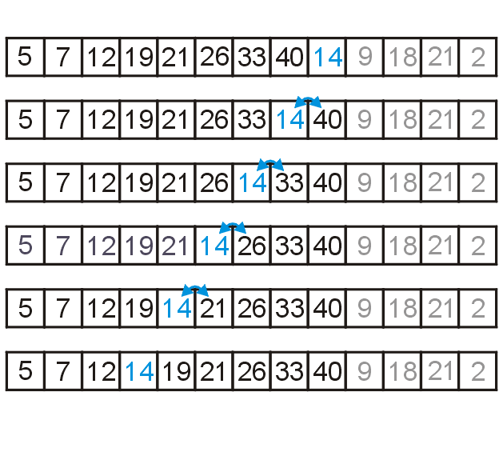
Background
Starting at the back, if the number is greater than 14, copy it to the right
  Once an entry less than 14 is found, insert 14 into the resulting vacancy

Slide 39
The Algorithm
For any unsorted list:
  Treat the first element as a sorted list of size 1
Then, given a sorted list of size k – 1
  Insert the k^{th} item into the sorted list
  The sorted list is now of size k

Slide 40
The Algorithm
Recall the five sorting techniques:
  Insertion
  Exchange
  Selection
  Merging
  Distribution
Clearly insertion falls into the first category

Slide 41
The Algorithm
Code for this would be:
      for ( int j = k; j > 0; --j ) {
      if ( array[j - 1] > array[j] ) {
      std::swap( array[j - 1], array[j] );
      } else {
      // As soon as we don't need to swap, the (k + 1)st
      // is in the correct location
      break;
      }
      }

Slide 42
Implementation and Analysis
This would be embedded in a function call such as
    template <typename Type>
    void insertion_sort( Type *const array, int const n ) {
    for ( int k = 1; k < n; ++k ) {
    for ( int j = k; j > 0; --j ) {
    if ( array[j - 1] > array[j] ) {
    std::swap( array[j - 1], array[j] );
    } else {
    // As soon as we don't need to swap, the (k + 1)st
    // is in the correct location
    break;
    }
    }
    }
    }

Slide 43
Implementation and Analysis
Let’s do a run-time analysis of this code
  the outer for-loop will be executed a total of n – 1 times
  In the worst case, the inner for-loop is executed k times
  Thus, the worst-case run time is O(n²)
    template <typename Type>
    void insertion_sort( Type *const array, int const n ) {
    for ( int k = 1; k < n; ++k ) {
    for ( int j = k; j > 0; --j ) {
    if ( array[j - 1] > array[j] ) {
    std::swap( array[j - 1], array[j] );
    } else {
    // As soon as we don't need to swap, the (k + 1)st
    // is in the correct location
    break;
    }
    }
    }
    }

Slide 44
Implementation and Analysis
Observation: we may break out of the inner loop…
    template <typename Type>
    void insertion_sort( Type *const array, int const n ) {
    for ( int k = 1; k < n; ++k ) {
    for ( int j = k; j > 0; --j ) {
    if ( array[j - 1] > array[j] ) {
    std::swap( array[j - 1], array[j] );
    } else {
    // As soon as we don't need to swap, the (k + 1)st
    // is in the correct location
    break;
    }
    }
    }
    }

Slide 45
Implementation and Analysis
Recall: each time we perform a swap, we remove an inversion
    template <typename Type>
    void insertion_sort( Type *const array, int const n ) {
    for ( int k = 1; k < n; ++k ) {
    for ( int j = k; j > 0; --j ) {
    if ( array[j - 1] > array[j] ) {
    std::swap( array[j - 1], array[j] );
    } else {
    // As soon as we don't need to swap, the (k + 1)st
    // is in the correct location
    break;
    }
    }
    }
    }

Slide 46
Implementation and Analysis
Thus, the body is run only as often as there are inversions
    template <typename Type>
    void insertion_sort( Type *const array, int const n ) {
    for ( int k = 1; k < n; ++k ) {
    for ( int j = k; j > 0; --j ) {
    if ( array[j - 1] > array[j] ) {
    std::swap( array[j - 1], array[j] );
    } else {
    // As soon as we don't need to swap, the (k + 1)st
    // is in the correct location
    break;
    }
    }
    }
    }
If the number of inversions is d, the run time is Θ(n + d)

Slide 47
Consequences of Our Analysis
The average random list has d = Θ(n²) inversions
Insertion sort, however, will run in Θ(n) time whenever d = O(n)
Other benefits:
  The algorithm is easy to implement
  Even in the worst case, the algorithm is fast for small problems
Size | Approximate Time (ns)
8 | 175
16 | 750
32 | 2700
64 | 8000

Slide 48
Consequences of Our Analysis
Unfortunately, it is not very useful in general:
  Sorting a random list of size 2²³ ≈ 8 000 000 would require approximately one day
  Doubling the size of the list quadruples the required run time
  An optimized quick sort requires less than 4s on a list of the above size

Slide 49
Consequences of Our Analysis
The following table summarizes the run-times of insertion sort
Case | Run Time | Comments
Worst | Θ(n²) | Reverse sorted
Average | O(d + n) | Slow if d = ω(n)
Best | Θ(n) | Very few inversions: d = O(n)

Slide 50
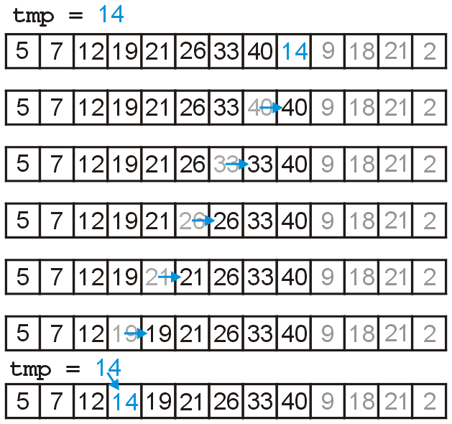
A small improvement
Swapping is expensive, so we could just temporarily assign the new entry
  this reduces assignments by a factor of 3

Slide 51
Implementation and Analysis
A reasonably good* implementation
    template <typename Type>
    void insertion( Type *const array, int const n ) {
    for ( int k = 1; k < n; ++k ) {
    Type tmp = array[k];
    for ( int j = k; j > 0; --j ) {
    if ( array[j - 1] > tmp ) {
    array[j] = array[j - 1];
    } else {
    array[j] = tmp;
    goto finished;
    }
    }
    array[0] = tmp; // only executed if tmp < array[0]
    finished; // empty statement
    }
    }
* we could do better with pointers

Slide 52
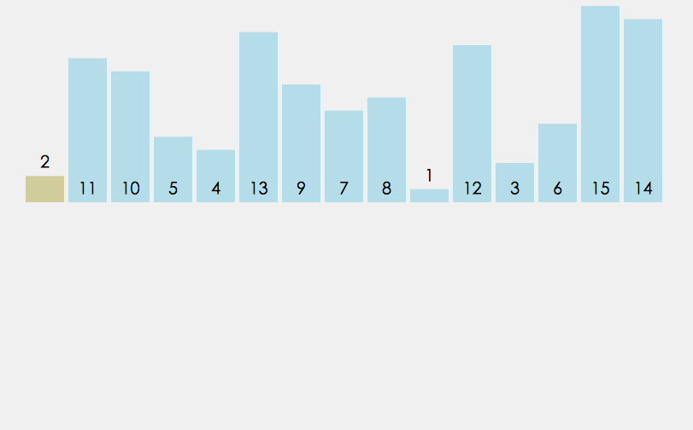
A small improvement

Slide 53
Summary
Insertion Sort:
  Insert new entries into growing sorted lists
  Run-time analysis
    Actual and average case run time: O(n²)
    Detailed analysis: Θ(n + d)
    Best case (O(n) inversions): Θ(n)
  Memory requirements: Θ(1)

Slide 54
Outline
Introduction
Inversions
Insertion sort
Bubble sort

Slide 55

Outline
The second sorting algorithm is the O(n²) bubble sort algorithm
  Uses an opposite strategy from insertion sort
We will examine:
  The algorithm and an example
  Run times
    best case
    worst case
    average case (introducing inversions)
  Summary and discussion

Slide 56
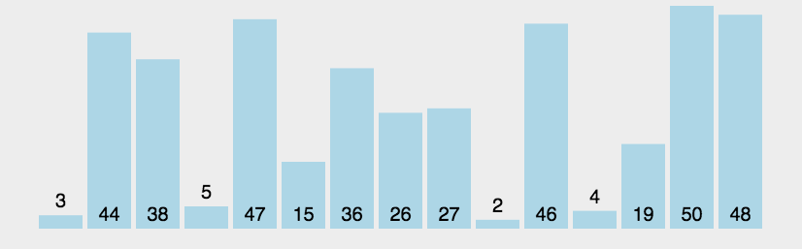
Description
Suppose we have an array of data which is unsorted:
  Starting at the front, traverse the array, find the largest item, and move (or bubble) it to the top
  With each subsequent iteration, find the next largest item and bubble it up towards the top of the array

Slide 57
Description
As well as looking at good algorithms, it is often useful to look at sub-optimal algorithms
  Bubble sort is a simple algorithm with:
    a memorable name, and
    a simple idea
  It is also significantly worse than insertion sort

Slide 58
The basic algorithm
Starting with the first item, assume that it is the largest
Compare it with the second item:
  If the first is larger, swap the two,
  Otherwise, assume that the second item is the largest
Continue up the array, either swapping or redefining the largest item

Slide 59
The basic algorithm
After one pass, the largest item must be the last in the list
Start at the front again:
  the second pass will bring the second largest element into the second last position
Repeat n – 1 times, after which, all entries will be in place

Slide 60
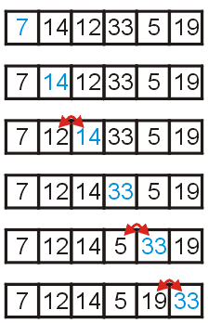
Example
Consider the unsorted array to the right
We start with the element in the first location, and move forward:
  if the current and next items are in order, continue with the next item, otherwise
  swap the two entries

Slide 61
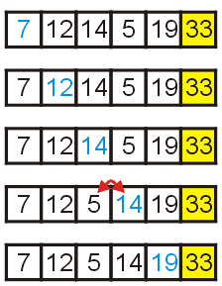
Example
After one loop, the largest element is in the last location
  Repeat the procedure

Slide 62
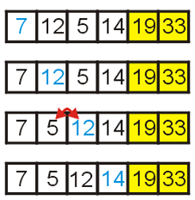
Example
Now the two largest elements are at the end
  Repeat again

Slide 63
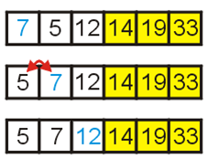
Example
With this loop, 5 and 7 are swapped

Slide 64
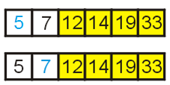
Example
Finally, we check the last two entries
  At this point, we have a sorted array

Slide 65
The basic algorithm
The default algorithm:
template <typename Type>
void bubble( Type *const array, int const n ) {
for ( int i = n - 1; i > 0; --i ) {
for ( int j = 0; j < i; ++j ) {
if ( array[j] > array[j + 1] ) {
std::swap( array[j], array[j + 1] );
}
}
}
}

Slide 66
Analysis
Here we have two nested loops, and therefore calculating the run time is straight-forward:

Slide 67
Implementations and Improvements
The next few slides show some implementations of bubble sort together with a few improvements:
  reduce the number of swaps,
  halting if the list is sorted,
  limiting the range on which we must bubble
  alternating between bubbling up and sinking down

Slide 68
First Improvement
We could avoid so many swaps...
template <typename Type>
void bubble( Type *const array, int const n ) {
for ( int i = n - 1; i > 0; --i ) {
Type max = array[0]; // assume a[0] is the max
for ( int j = 1; j <= i; ++j ) {
if ( array[j] < max ) {
array[j - 1] = array[j]; // move
} else {
array[j – 1] = max; // store the old max
max = array[j]; // get the new max
}
}
array[i] = max; // store the max
}
}

Slide 69
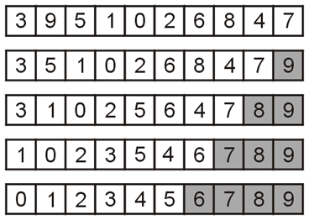
Flagged Bubble Sort
One useful modification would be to check if no swaps occur:
  If no swaps occur, the list is sorted
  In this example, no swaps occurred
  during the 5th pass
Use a Boolean flag to check if no
swaps occurred

Slide 70
Flagged Bubble Sort
Check if the list is sorted (no swaps)
template <typename Type>
void bubble( Type *const array, int const n ) {
for ( int i = n - 1; i > 0; --i ) {
Type max = array[0];
bool sorted = true;
for ( int j = 1; j <= i; ++j ) {
if ( array[j] < max ) {
array[j - 1] = array[j];
sorted = false;
} else {
array[j – 1] = max;
max = array[j];
}
}
array[i] = max;
if ( sorted ) {
break;
}
}
}

Slide 71
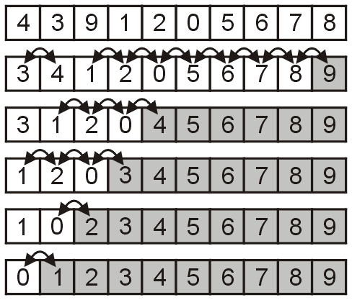
Range-limiting Bubble Sort
Intuitively, one may believe that limiting the loops based on the location of the last swap may significantly speed up the algorithm
  For example, after the second pass,
  we are certain all entries after 4 are
  sorted
The implementation is easier than that for using a Boolean flag
Unfortunately, in practice, this does little to affect the number of comparisons

Slide 72
Range-limiting Bubble Sort
Update i to at the place of the last swap
template <typename Type>
void bubble( Type *const array, int const n ) {
for ( int i = n - 1; i > 0; ) {
Type max = array[0];
int ii = 0;
for ( int j = 1; j <= i; ++j ) {
if ( array[j] < max ) {
array[j - 1] = array[j];
ii = j - 1;
} else {
array[j – 1] = max;
max = array[j];
}
}
array[i] = max;
i = ii;
}
}

Slide 73
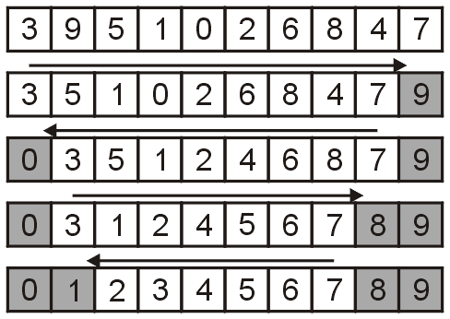
Alternating Bubble Sort
One operation which does significantly improve the run time is to alternate between
  bubbling the largest entry to the top, and
  sinking the smallest entry to the bottom

Slide 74
Alternating Bubble Sort
Alternating between bubbling and sinking:
template <typename Type>
void bubble( Type *const array, int n ) {
int lower = 0;
int upper = n - 1;
while ( true ) {
int new_upper = lower;
for ( int i = lower; i < upper; ++i ) {
if ( array[i] > array[i + 1] ) {
Type tmp = array[i];
array[i] = array[i + 1];
array[i + 1] = tmp;
new_upper = i;
}
}
upper = new_upper;
if ( lower == upper ) {
break;
}
int new_lower = upper;
for ( int i = upper; i > lower; --i ) {
if ( array[i - 1] > array[i] ) {
Type tmp = array[i];
array[i] = array[i - 1];
array[i - 1] = tmp;
new_lower = i;
}
}
lower = new_lower;
if ( lower == upper ) {
break;
}
}
}
Bubble up to the back
Sink down to the front

Slide 75
Run-time Analysis
Because the bubble sort simply swaps adjacent entries, it cannot be any better than insertion sort which does n + d comparisons where d is the number of inversions
Unfortunately, run-time analysis isn’t that easy:
  There are numerous unnecessary comparisons

Slide 76
Empirical Analysis
The next slide map the number of required comparisons necessary to sort 32768 arrays of size 1024 where the number of inversions range from 10000 to 523776
  Each point (d, c) is the number of inversions in an unsorted list d and the number of required comparisons c

Slide 77
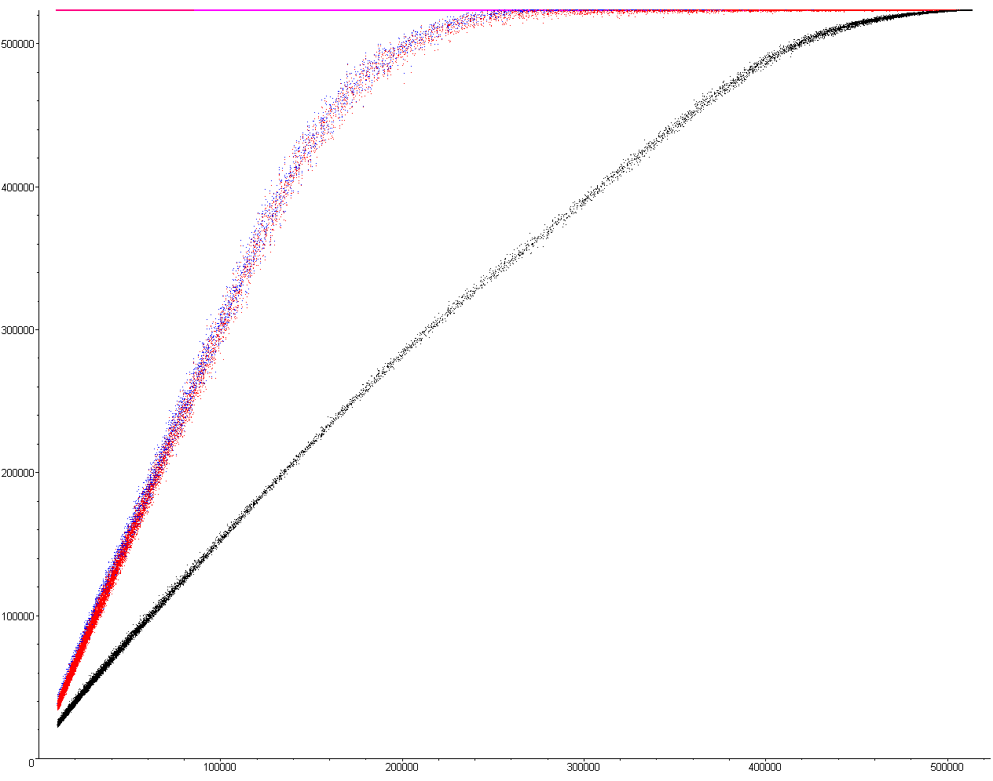
Empirical Analysis
The following for plots show the required number of comparisons required to sort an array of size 1024
Comparisons
Basic implementation ——
Flagged ——
Range limiting ——
Alternating ——
d

Slide 78
Empirical Analysis
The number of comparisons with the flagged/limiting sort
is initially n + 3d
For the alternating
variation, it is
initially n + 1.5d
Comparisons
Basic implementation ——
Flagged ——
Range limiting ——
Alternating ——
d

Slide 79
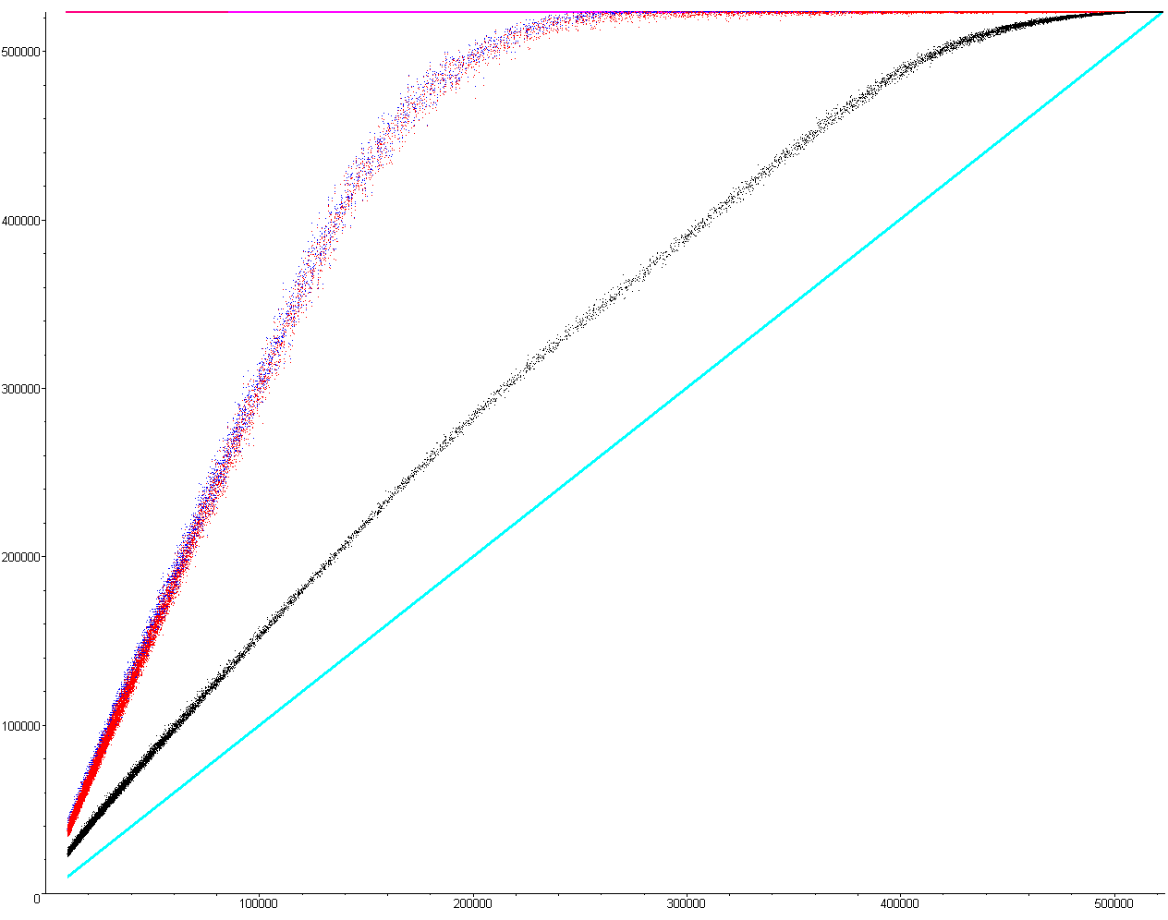
Empirical Analysis
Unfortunately, the comparisons for insertion sort is n + d which is better in all cases except when the list is
  Sorted, or
  Reverse sorted
Comparisons
Basic implementation ——
Flagged ——
Range limiting ——
Alternating ——
Insertion Sort ——
d

Slide 80

Run-Time
The following table summarizes the run-times of our modified bubble sorting algorithms; however, they are all worse than insertion sort in practice
Case | Run Time | Comments
Worst | Θ(n²) | Θ(n²) inversions
Average | Θ(n + d) | Slow if d = ω(n)
Best | Θ(n) | d = O(n) inversions

Slide 81
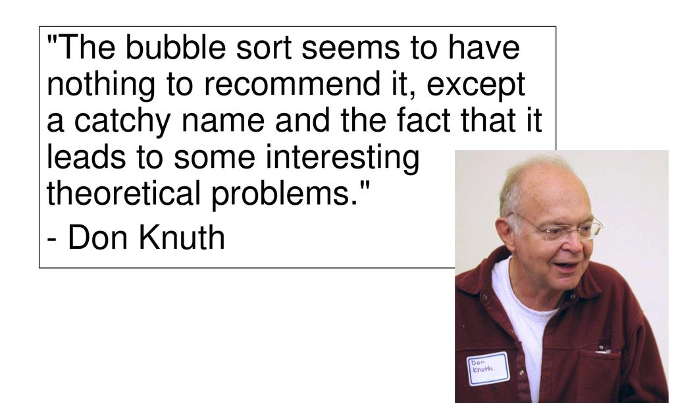
Summary
In this topic, we have looked at bubble sort
From the description, it sounds as if it is as good as insertion sort
  it has the same asymptotic behaviour
  in practice, however, it is significantly worse
  it is also much more difficult to code...

