Slide 1
CS101 Algorithms and Data Structures
Trees
Textbook Ch B.5, 10.4
Notes:
Adapted from the slides by Douglas Wilhelm Harder of U Waterloo (https://ece.uwaterloo.ca/~dwharder/aads/Lecture_materials/)
May also contain material from the slides at https://courses.cs.washington.edu/courses/cse326/03wi/326lecturesb.shtml (by Dan Suciu of U Washington)

Slide 2
Outline
Tree structure
Implementation
Tree traversal
Monte Carlo tree search
Forest

Slide 3
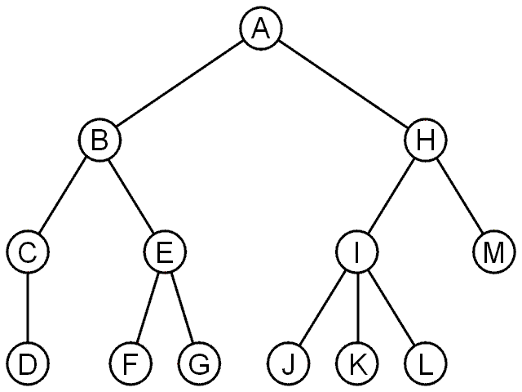
Trees
A rooted tree data structure stores information in nodes
  There is a first node, or root
  Each node has variable number of references to successors
  Each node, other than the root, has exactly one node pointing to it

Slide 4
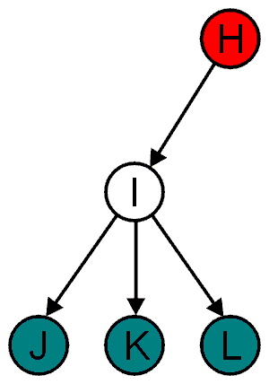
Terminology
All nodes will have zero or more child nodes or children
  I has three children: J, K and L
For all nodes other than the root node, there is one parent node
  H is the parent of I

Slide 5
Terminology
The degree of a node is defined as the number of its children: deg(I) = 3
Nodes with the same parent are siblings
  J, K, and L are siblings

Slide 6
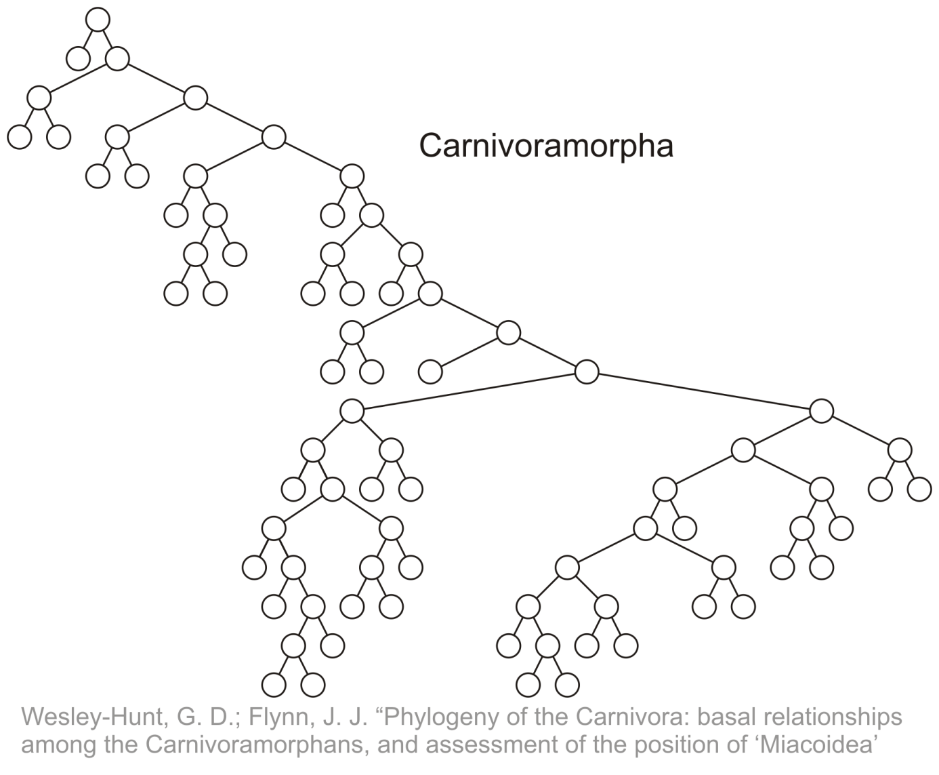
Terminology
Phylogenetic trees have nodes with degree 2 or 0:

Slide 7
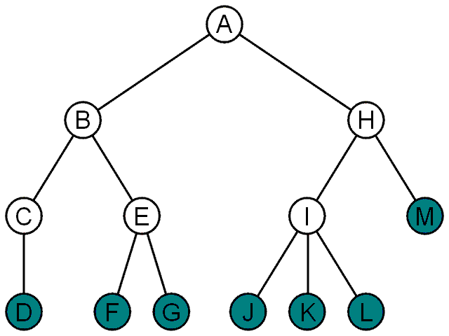
Terminology
Nodes with degree zero are also called leaf nodes
All other nodes are said to be internal nodes, that is, they are internal to the tree

Slide 8
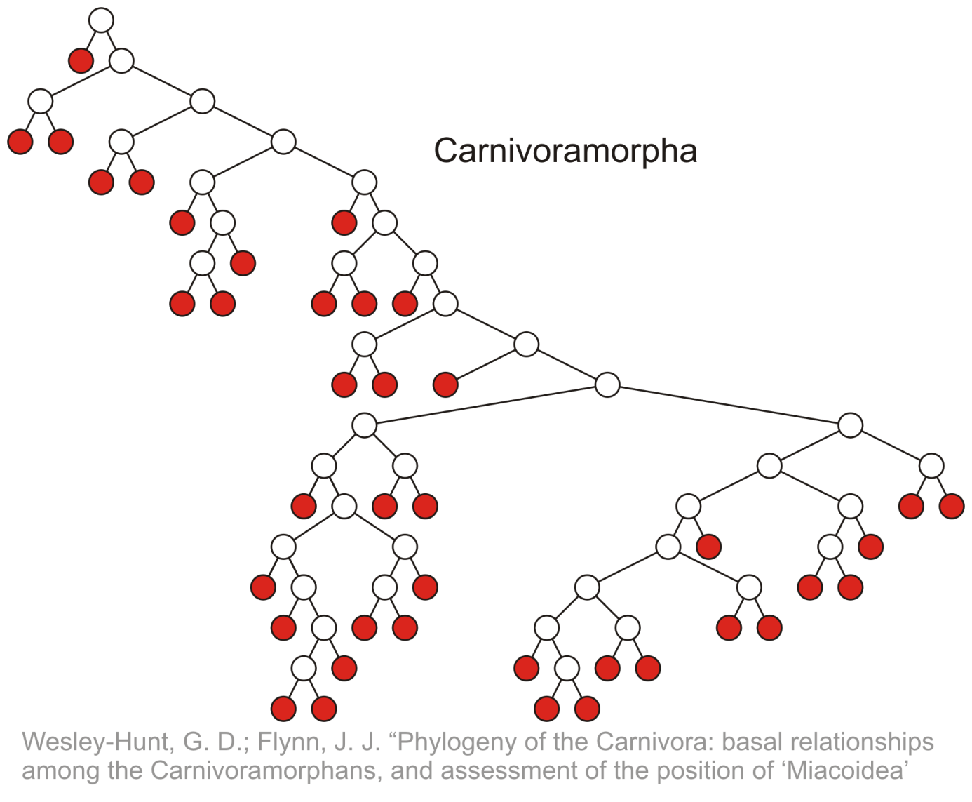
Terminology
Leaf nodes:

Slide 9
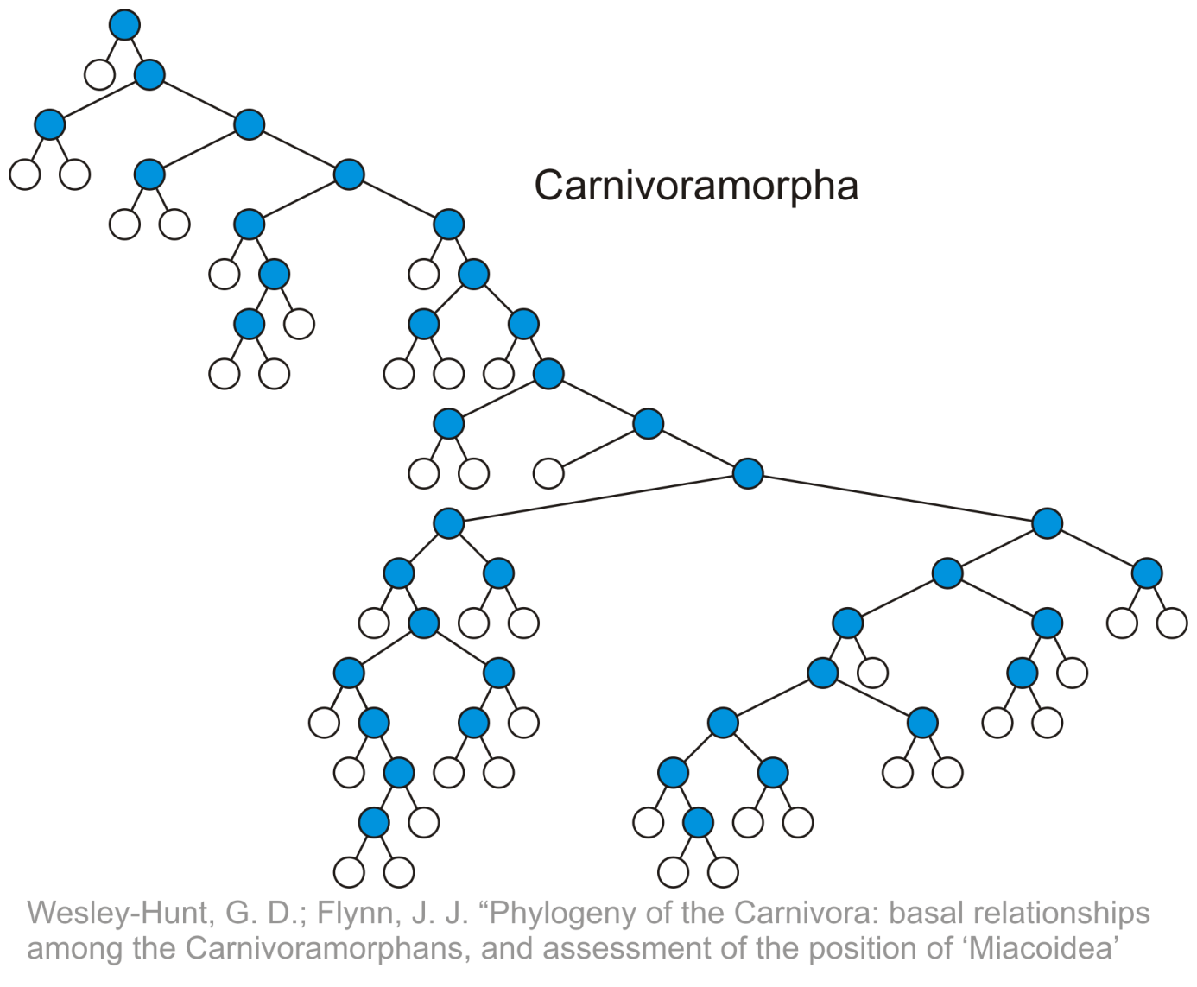
Terminology
Internal nodes:

Slide 10
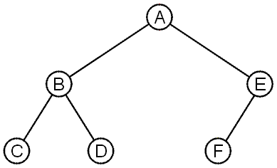
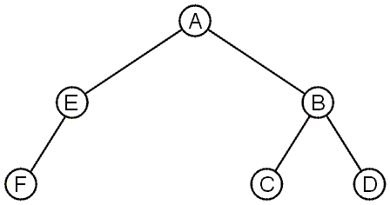
Terminology
These trees are equal if the order of the children is ignored (unordered trees)
They are different if order is relevant (ordered trees)
  We will usually examine ordered trees (linear orders)
Notes:
In a hierarchical ordering, order is not relevant

Slide 11
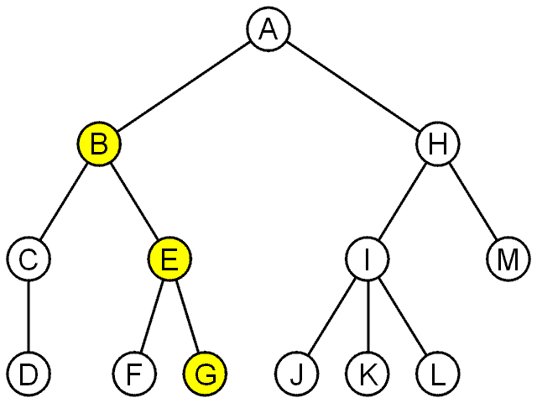
Terminology
A path is a sequence of edges between nodes.
The length of this path is number of edges in the path.
e.g., the path (B, E, G) has length 2

Slide 12
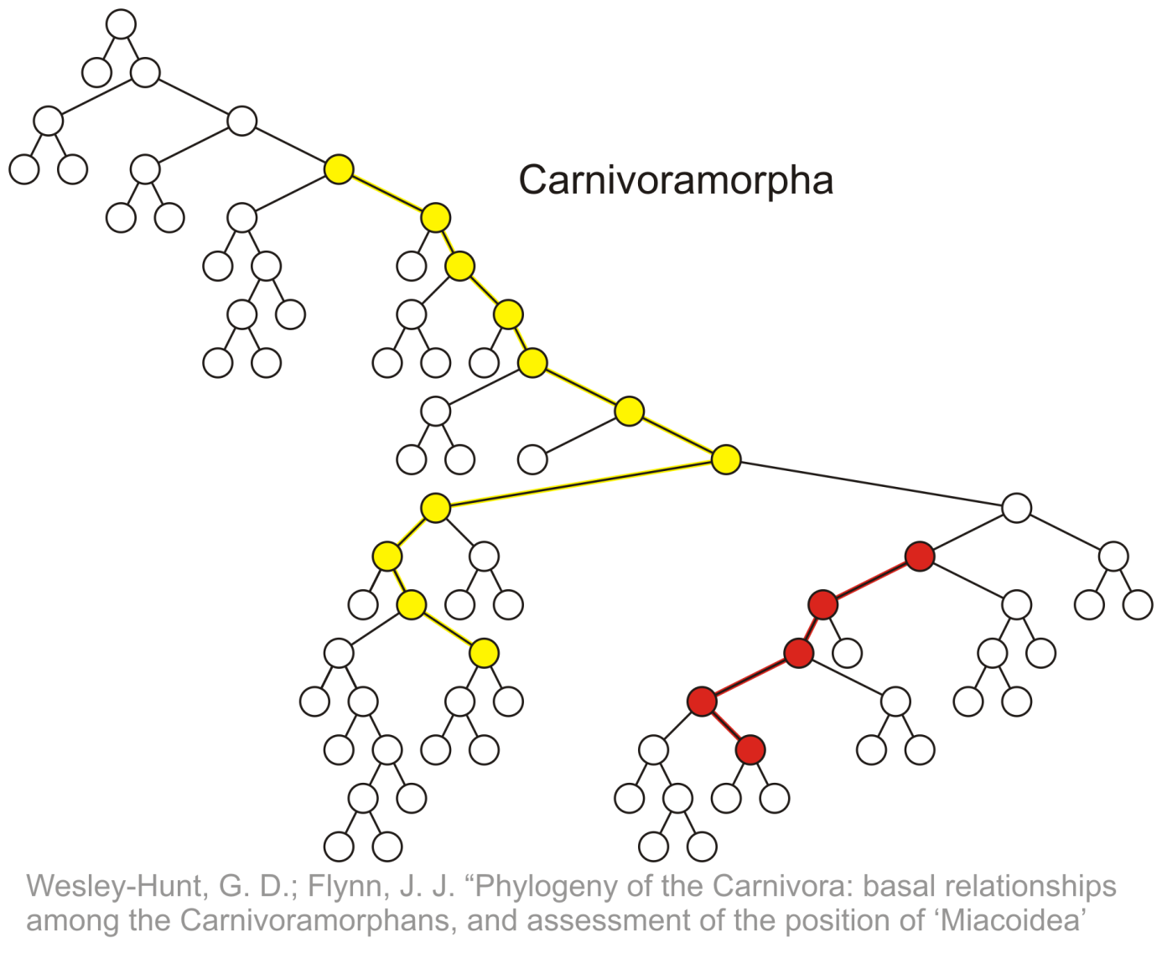
Terminology
Paths of length 10 (11 nodes) and 4 (5 nodes)
Start of these paths
End of these paths

Slide 13
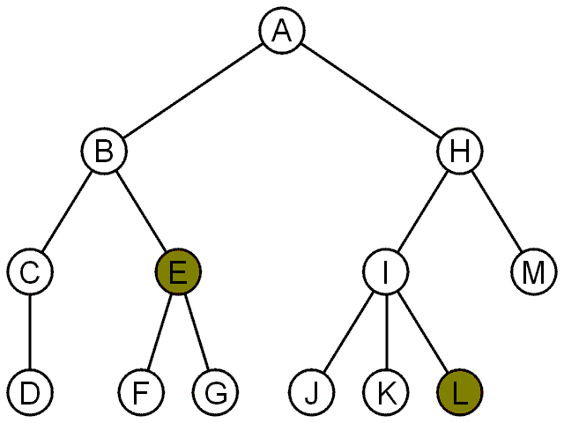
Terminology
For each node in a tree, there exists a unique path from the root node to that node
The length of this path is the depth of the node, e.g.,
  E has depth 2
  L has depth 3

Slide 14
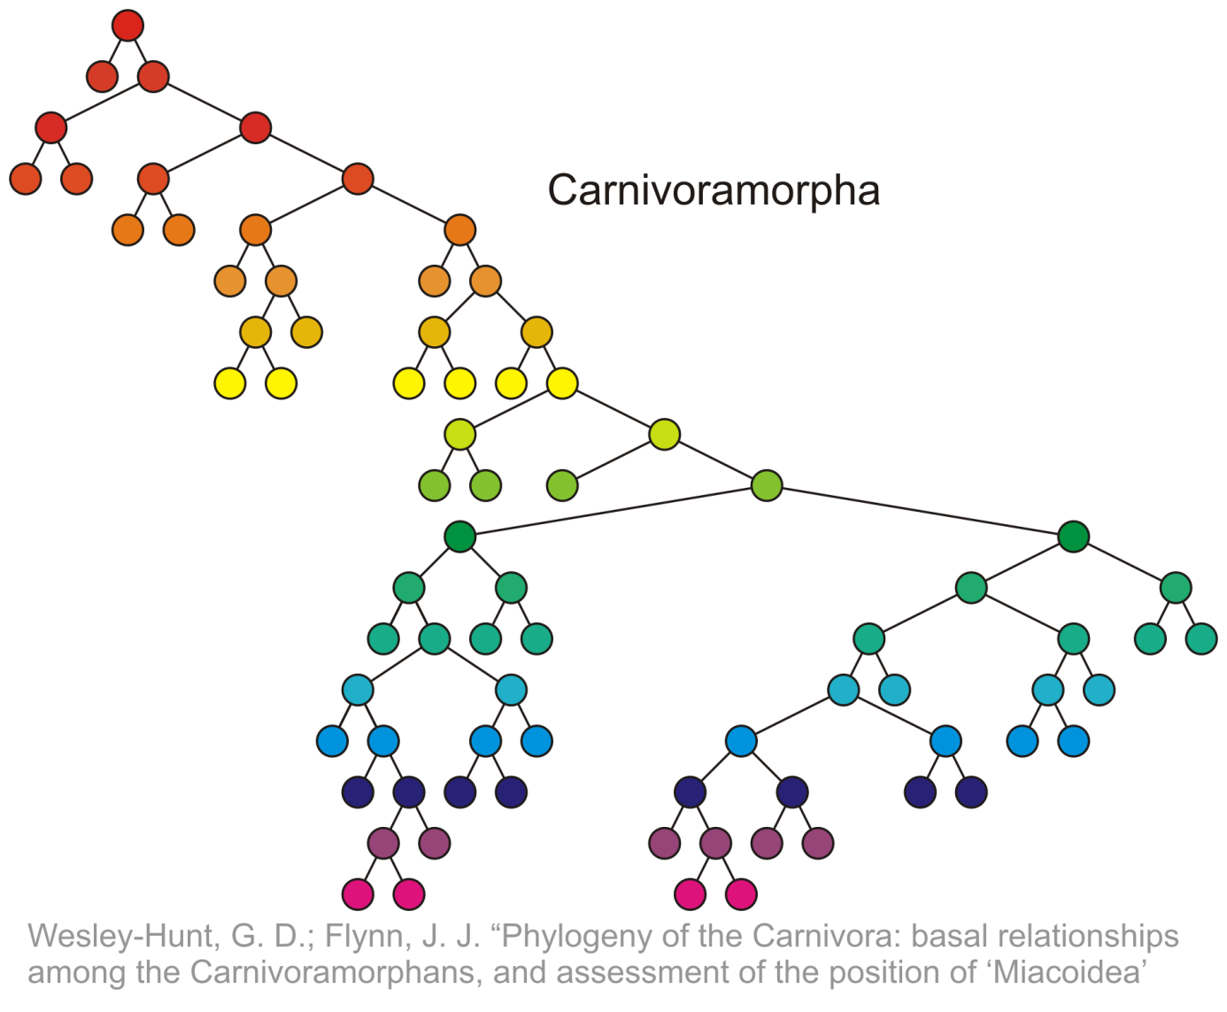
Terminology
Nodes of depth up to 17
0
4
9
14
17

Slide 15
Terminology
The height of a tree is defined as the maximum depth of any node within the tree
The height of a tree with one node is 0
  Just the root node
For convenience, we define the height of the empty tree to be –1

Slide 16
Terminology
The height of this tree is 17
17

Slide 17
Terminology
Ancestor of node n: any node y on the (unique) path from root r to node n is an ancestor of node n.
Descendent of node n: any node y for which n is an ancestor of y.
Thus, a node is both an ancestor and a descendant of itself
  We can add the adjective strict to exclude equality: a is a strict descendant of b if a is a descendant of b but a ≠ b
The root node is an ancestor of all nodes

Slide 18
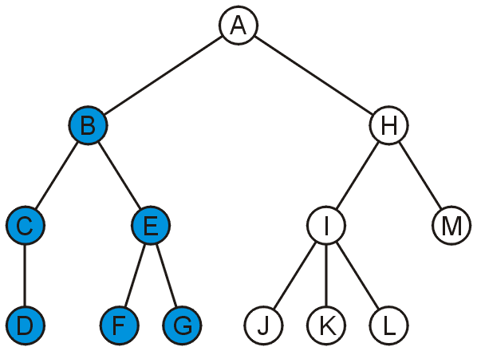
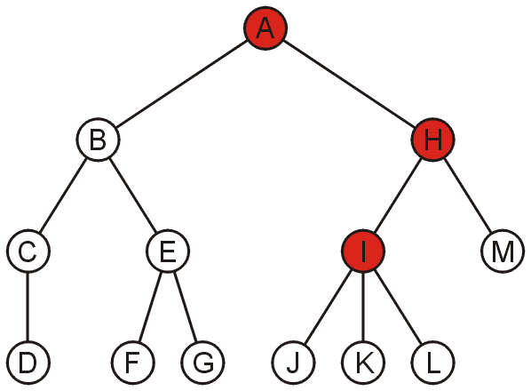
Terminology
The descendants of node B are B, C, D, E, F, and G:
The ancestors of node I are I, H, and A:

Slide 19
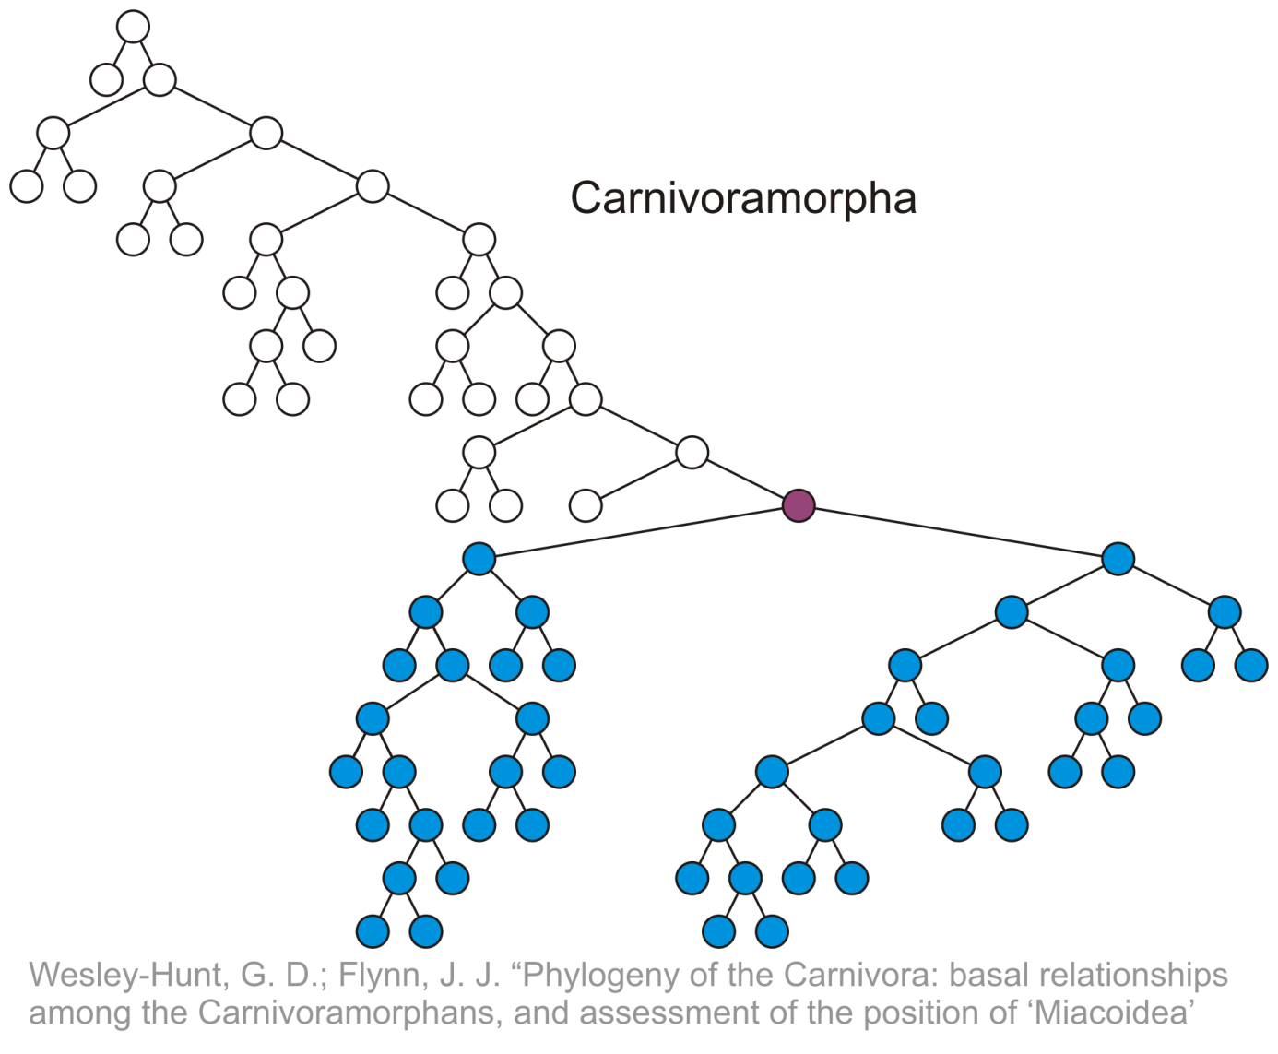
Terminology
All descendants (including itself) of the indicated node

Slide 20
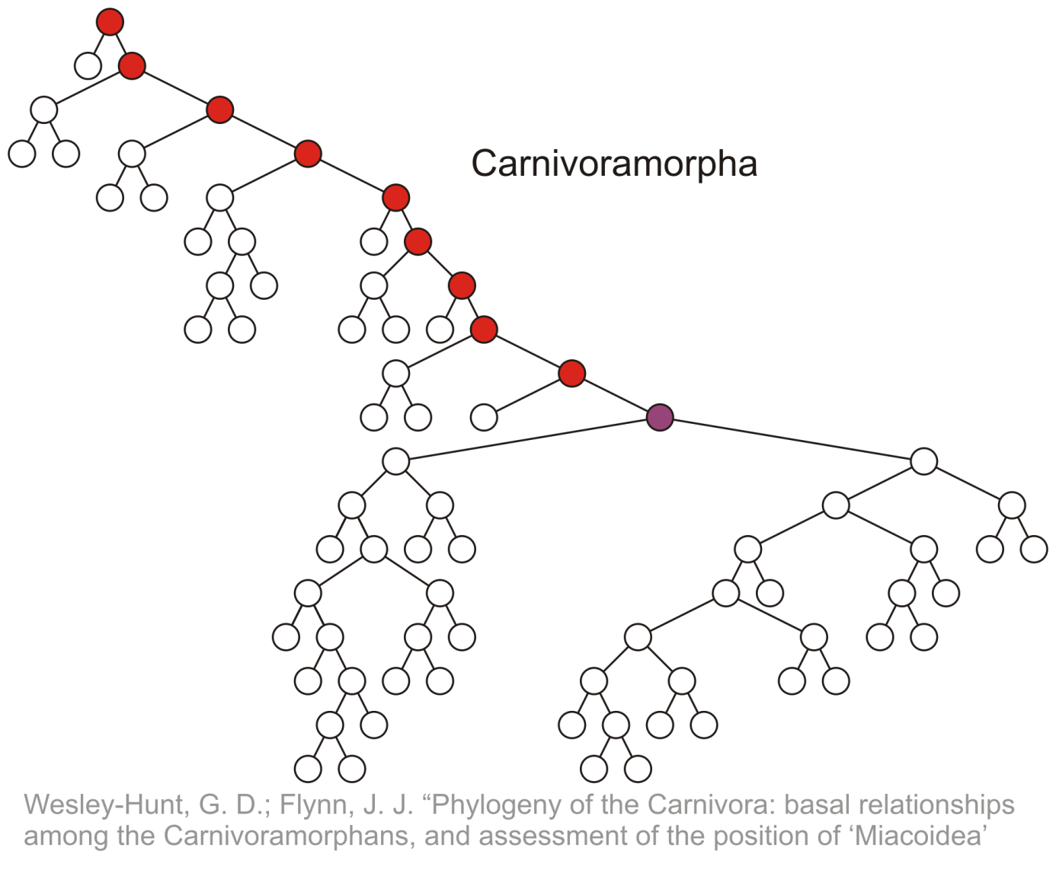
Terminology
All ancestors (including itself) of the indicated node

Slide 21
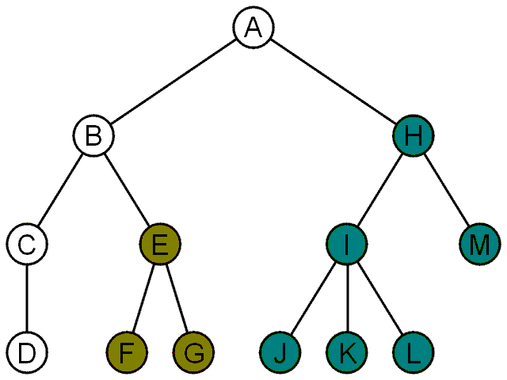
Terminology
A recursive definition of a tree:
  A degree-0 node is a tree
  A node with degree n is a tree if it has n children and all of its children are disjoint trees (i.e., with no intersecting nodes)
Given any node a within a tree,
the collection of a and all of its
descendants is said to be a
subtree of the tree with root a

Slide 22
Example: XHTML
The XML of XHTML has a tree structure
Consider the following XHTML document
<html>
<head>
<title>Hello World!</title>
</head>
<body>
<h1>This is a <u>Heading</u></h1>
<p>This is a paragraph with some
<u>underlined</u> text.</p>
</body>
</html>
title
heading
body of page
underlining
paragraph

Slide 23
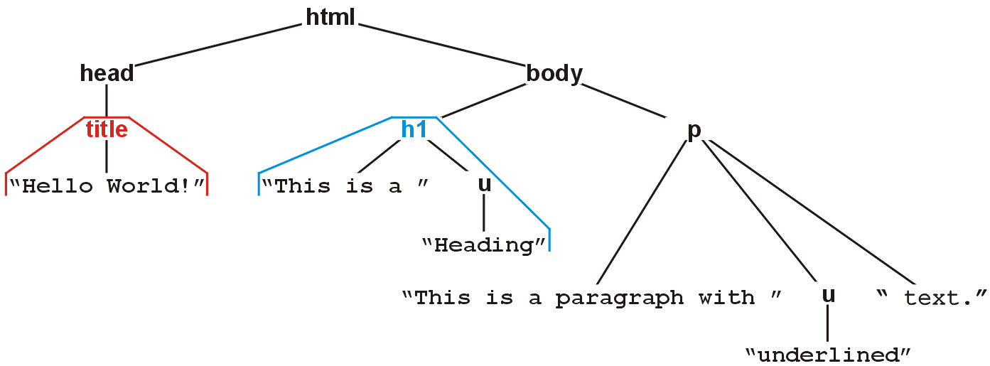
Example: XHTML
The nested tags define a tree rooted at the HTML tag
<html>
<head>
<title>Hello World!</title>
</head>
<body>
<h1>This is a <u>Heading</u></h1>
<p>This is a paragraph with some
<u>underlined</u> text.</p>
</body>
</html>

Slide 24
Example: XML
In general, any XML can be represented as a tree
  All XML tools make use of this feature
  Parsers convert XML into an internal tree structure
  XML transformation languages manipulate the tree structure
    E.g., XMLT

Slide 25
Outline
Tree structure
Implementation
Tree traversal
Monte Carlo tree search
Forest

Slide 26
General Trees
An abstract tree does not restrict the number of nodes
  In this tree, the degrees vary:
Degree | Nodes
0 | D, F, G, J, K, L, M
1 | C
2 | B, E, H
3 | I

Slide 27
Operations
Operations on a tree include:
  Accessing the root:
  Given an object in the container:
    Access the parent of the current object
    Find the degree of the current object
    Get a reference to a child,
    Attach a new sub-tree to the current object
    Detach this tree from its parent
Notes:
A hierarchical ordering of a finite number of objects may be stored in a tree data structure
27

Slide 28
Implementation
We can implement a general tree by using a class which:
  Stores an element
  Stores the children in a list

Slide 29
Implementation
    template <typename Type>
    class Simple_tree {
    private:
    Type element;
    Simple_tree *parent_node;
    Single_list<Simple_tree *> children;
    public:
    Simple_tree( Type const & = Type(), Simple_tree * = nullptr );
    Type retrieve() const;
    Simple_tree *parent() const;
    int degree() const;
    bool is_root() const;
    bool is_leaf() const;
    Simple_tree *child( int n ) const;
    int height() const;
    void insert( Type const & );
    void attach( Simple_tree * );
    void detach();
    };

Slide 30
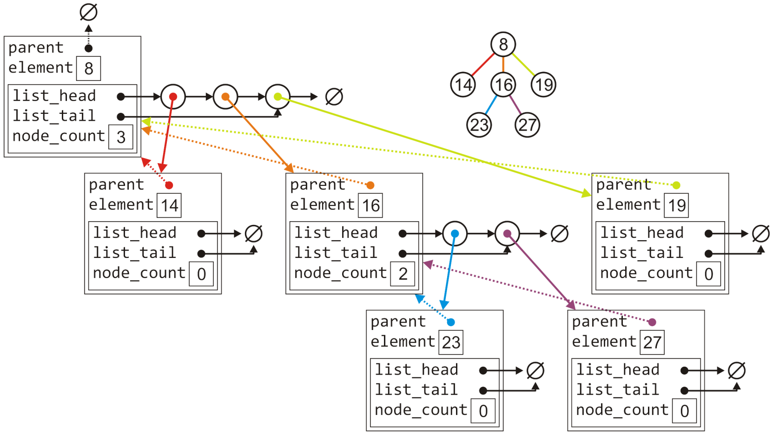
Implementation
The tree with six nodes would be stored as follows:

Slide 31
Implementation
Much of the functionality is similar to that of the Single_list class:
    template <typename Type>
    Simple_tree<Type>::Simple_tree( Type const &obj, Simple_tree *p ):
    element( obj ),
    parent_node( p ) {
    // Empty constructor
    }
    template <typename Type>
    Type Simple_tree<Type>::retrieve() const {
    return element;
    }
    template <typename Type>
    Simple_tree<Type> *Simple_tree<Type>::parent() const {
    return parent_node;
    }

Slide 32
Implementation
Much of the functionality is similar to that of the Single_list class:
    template <typename Type>
    bool Simple_tree<Type>::is_root() const {
    return ( parent() == nullptr );
    }
    template <typename Type>
    int Simple_tree<Type>::degree() const {
    return children.size();
    }
    template <typename Type>
    bool Simple_tree<Type>::is_leaf() const {
    return ( degree() == 0 );
    }

Slide 33
Implementation
Accessing the n^{th} child requires a for loop (Θ(n)):
template <typename Type>
Simple_tree<Type> *Simple_tree<Type>::child( int n ) const {
if ( n < 0 || n >= degree() ) {
return nullptr;
}
Single_node<Simple_tree *> *ptr = children.head();
for ( int i = 1; i < n; ++i ) {
ptr = ptr->next();
}
return ptr->retrieve();
}

Slide 34
Implementation
Attaching a new object to become a child is similar to a linked list:
    template <typename Type>
    void Simple_tree<Type>::attach( Type const &obj ) {
    children.push_back( new Simple_tree( obj, this ) );
    }

Slide 35
Implementation
To detach a tree from its parent:
  If it is already a root, do nothing
  Otherwise, erase this object from the parent’s list of children and set the parent pointer to NULL
    template <typename Type>
    void Simple_tree<Type>::detach() {
    if ( is_root() ) {
    return;
    }
    parent()->children.erase( this );
    parent_node = nullptr;
    }

Slide 36
Implementation
Attaching an entirely new tree as a sub-tree, however, first requires us to check if the tree is not already a sub-tree of another node:
  If so, we must detach it first and only then can we add it
    template <typename Type>
    void Simple_tree<Type>::attach( Simple_tree<Type> *tree ) {
    if ( !tree->is_root() ) {
    tree->detach();
    }
    tree->parent_node = this;
    children.push_back( tree );
    }

Slide 37
Implementation
Suppose we want to find the size of a tree:
  If there are no children, the size is 1
  Otherwise, the size is one plus the size of all the children
    template <typename Type>
    int Simple_tree<Type>::size() const {
    int s = 1;
    for (
    Single_node<Simple_tree *> *ptr = children.head();
    ptr != nullptr;
    ptr = ptr->next()
    ) {
    s += ptr->retrieve()->size();
    }
    return s;
    }

Slide 38
Implementation
Suppose we want to find the height of a tree:
  If there are no children, the height is 0
  Otherwise, the height is one plus the maximum height of any sub tree
    template <typename Type>
    int Simple_tree<Type>::height() const {
    int h = 0;
    for (
    Single_node<Simple_tree *> *ptr = children.head();
    ptr != nullptr;
    ptr = ptr->next()
    ) {
    h = std::max( h, 1 + ptr->retrieve()->height() );
    }
    return h;
    }

Slide 39
Implementation Using Array
Implementing a tree by storing the children in an array is similar.
    class Simple_tree {
    private:
    Type element;
    Simple_tree *parent_node;
    int child_count;
    int child_capacity;
    Single_tree *children; %any problem here?
    public:
    ...
    }

Slide 40
Alternative Implementation
Each node has a pointer to a list containing its children.
Each node has 2 pointers: one to its first child and one to next sibling
A
A
B
C
D
B
C
D
E
F
E
F

Slide 41
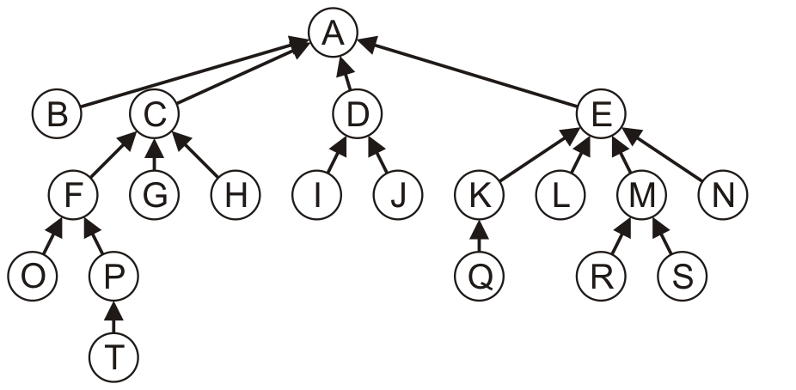
Parent Pointer Tree
A parent pointer tree is a tree where each node only keeps a reference to its parent node

Slide 42
Parent Pointer Tree
This requires significantly less memory than our general tree structure, as no data structure is required to track the children

Slide 43
Implementation
A naïve implementation may also be node based:
    template <typename Type>
    class Parental_tree {
    private:
    Type element;
    Parental_tree *parent;
    public:
    // ...
    };

Slide 44
Implementation
Generate an array of size n and associate each entry with a node in the tree
0 | 1 | 2 | 3 | 4 | 5 | 6 | 7 | 8 | 9 | 10 | 11 | 12 | 13 | 14 | 15 | 16 | 17 | 18 | 19
A | B | C | D | E | F | G | H | I | J | K | L | M | N | O | P | Q | R | S | T

Slide 45
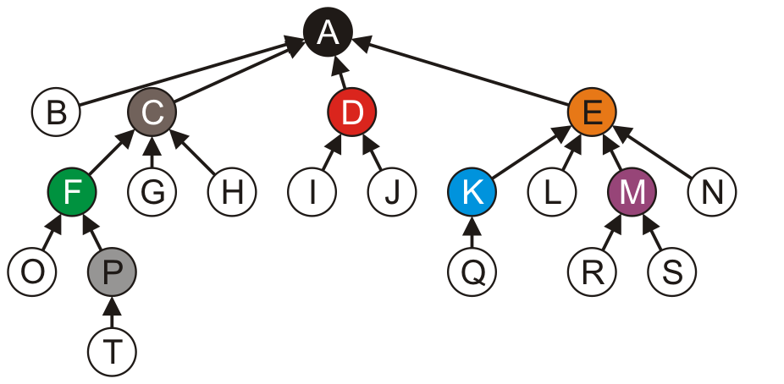
Implementation
Store the index of the parent in each node
  The root node, wherever it is, points to itself
0 | 1 | 2 | 3 | 4 | 5 | 6 | 7 | 8 | 9 | 10 | 11 | 12 | 13 | 14 | 15 | 16 | 17 | 18 | 19
0 | 0 | 0 | 0 | 0 | 2 | 2 | 2 | 3 | 3 | 4 | 4 | 4 | 4 | 5 | 5 | 10 | 12 | 12 | 15
A | B | C | D | E | F | G | H | I | J | K | L | M | N | O | P | Q | R | S | T

Slide 46
Outline
Tree structure
Implementation
Tree traversal
Monte Carlo tree search
Forest

Slide 47
Tree Traversals
Question: how can we iterate through all the objects in a tree in a predictable and efficient manner
  Requirements: Θ(n) run time and O(n) memory
Two types of traversals
  Breadth-first traversal
  Depth-first traversal
Notes:
47

Slide 48
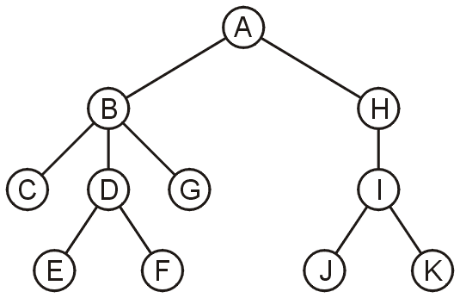
Breadth-First Traversal
Breadth-first traversals visit all nodes at a given depth before descending a level

Slide 49
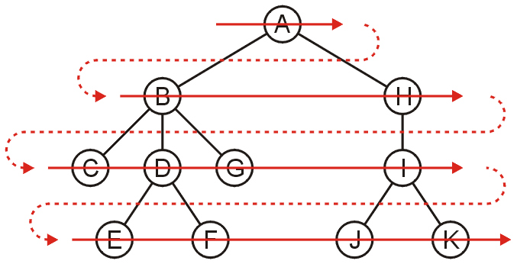
Breadth-First Traversal
Breadth-first traversals visit all nodes at a given depth before descending a level
  Order: A B H C D G I E F J K

Slide 50
Breadth-First Traversal
The easiest implementation is to use a queue:
  Place the root node into a queue
  While the queue is not empty:
    Pop the node at the front of the queue
    Push all of its children into the queue
The order in which the nodes come out of the queue will be in breadth-first order

Slide 51
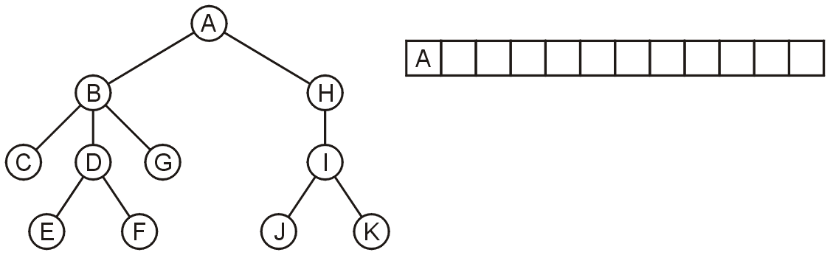
Breadth-First Traversal
Push the root directory A

Slide 52
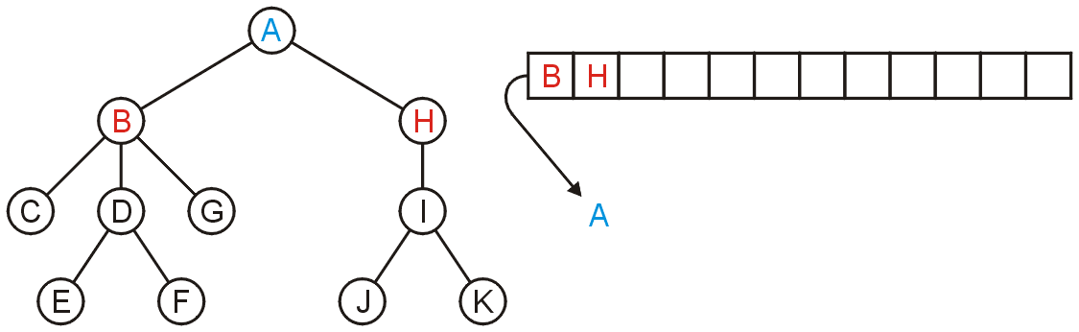
Breadth-First Traversal
Pop A and push its two sub-directories: B and H

Slide 53
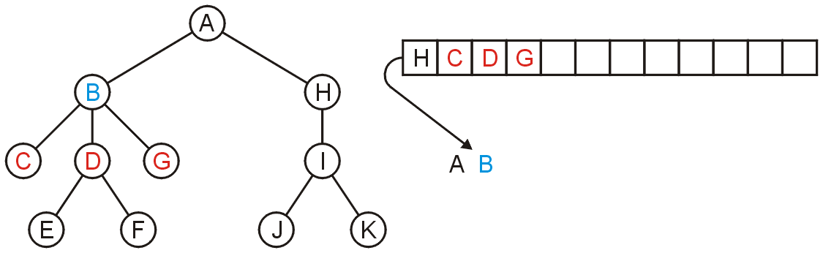
Breadth-First Traversal
Pop B and push C, D, and G

Slide 54
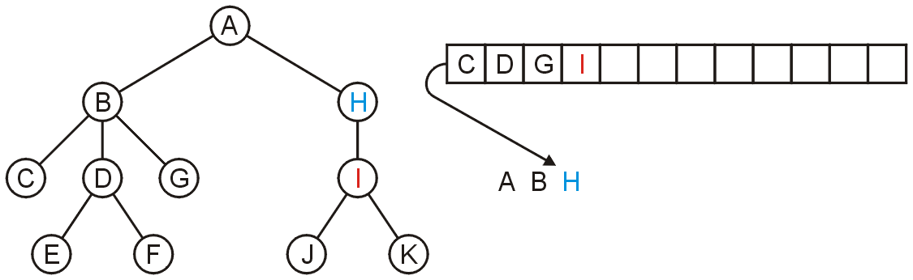
Breadth-First Traversal
Pop H and push its one sub-directory I

Slide 55
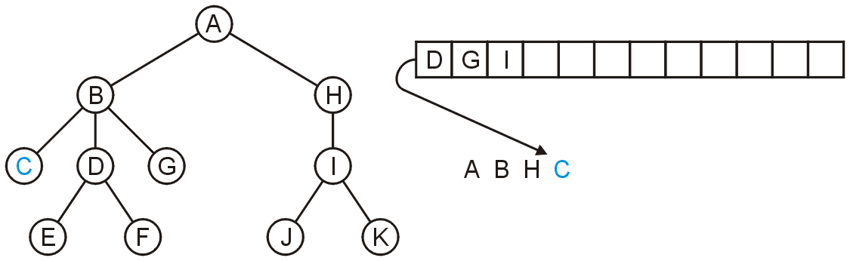
Breadth-First Traversal
Pop C: no sub-directories

Slide 56
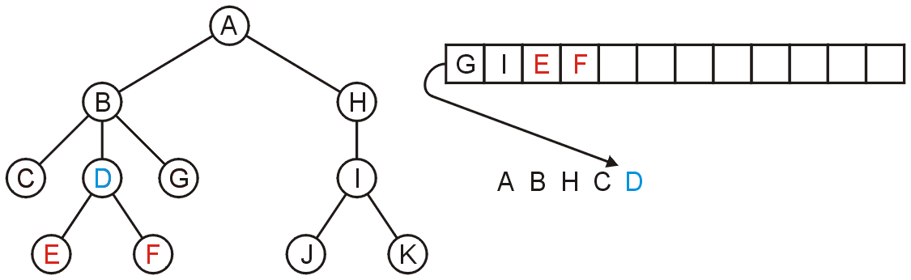
Breadth-First Traversal
Pop D and push E and F

Slide 57
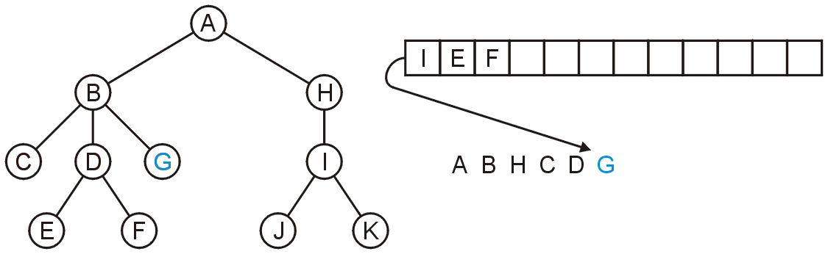
Breadth-First Traversal
Pop G

Slide 58
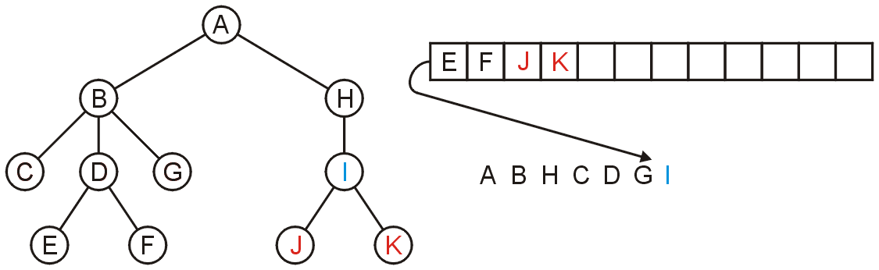
Breadth-First Traversal
Pop I and push J and K

Slide 59
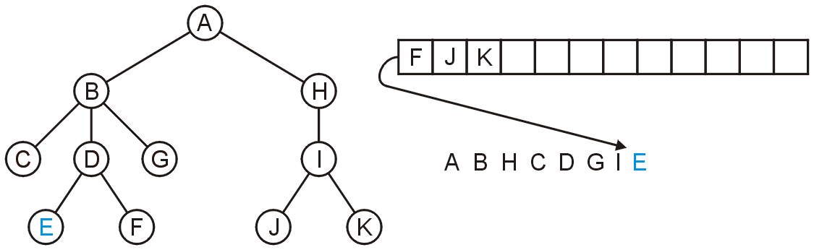
Breadth-First Traversal
Pop E

Slide 60
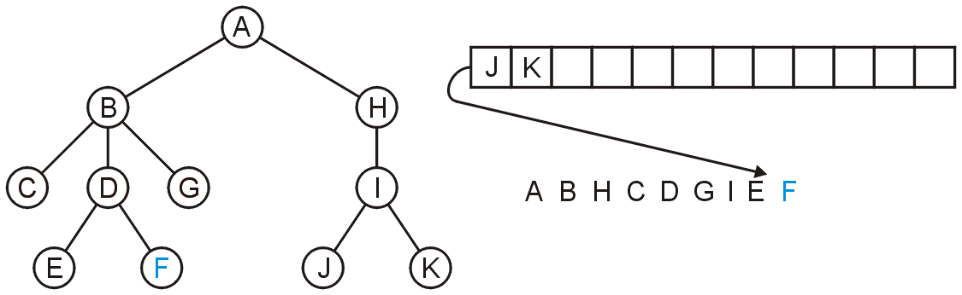
Breadth-First Traversal
Pop F

Slide 61
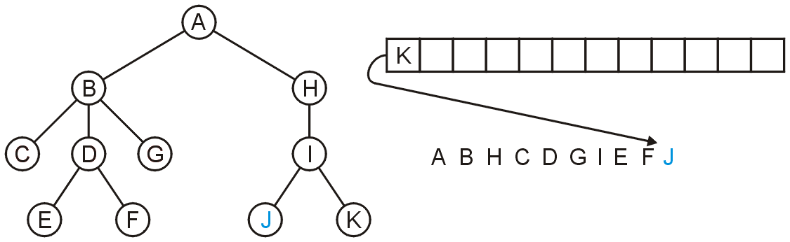
Breadth-First Traversal
Pop J

Slide 62
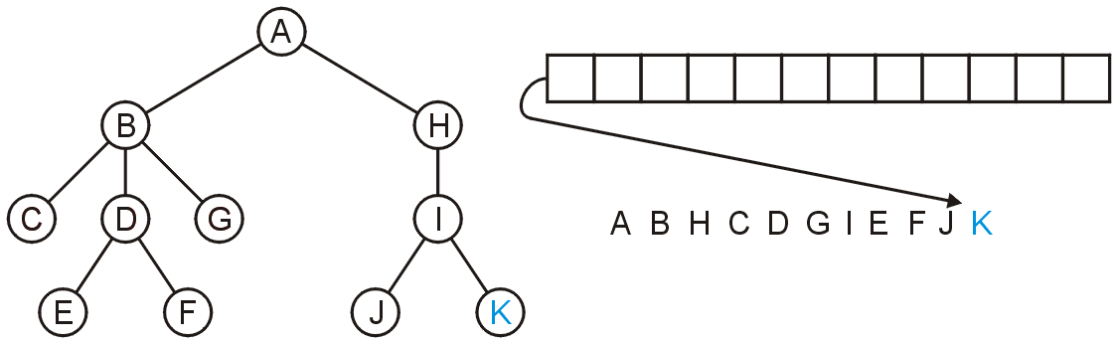
Breadth-First Traversal
Pop K and the queue is empty

Slide 63
Breadth-First Traversal
The resulting order
A B H C D G I E F J K
is in breadth-first order:

Slide 64
Breadth-First Traversal
Computational complexity
  Run time is Θ(n)
  Space: maximum nodes at a given depth, Ο(n)

Slide 65
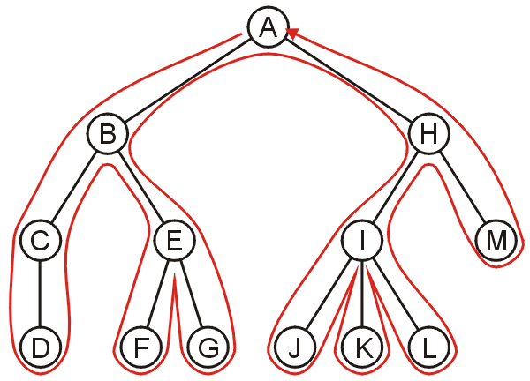
Depth-first Traversal
A backtracking algorithm for stepping through a tree:
  At any node, proceed to the first child that has not yet been visited
  If we have visited all the children (of which a leaf node is a special case), backtrack to the parent and repeat this process
We end once all the children of the root are visited

Slide 66
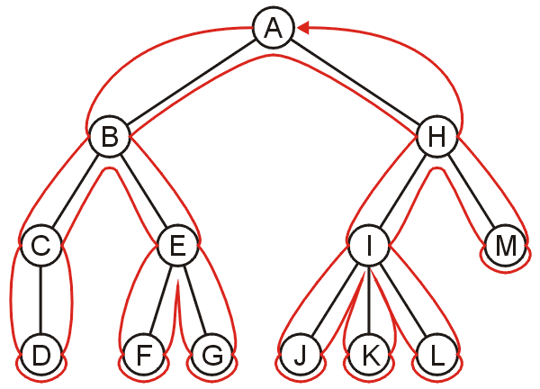
Depth-first Traversal
Each node is visited multiple times in such a scheme
  First time: before any children
  Last time: after all children, before backtracking

Slide 67
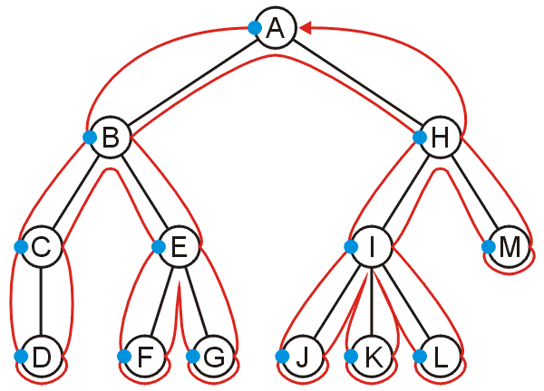
Pre-ordering
Ordering nodes by their first visits results in the sequence:
A, B, C, D, E, F, G, H, I, J, K, L, M

Slide 68
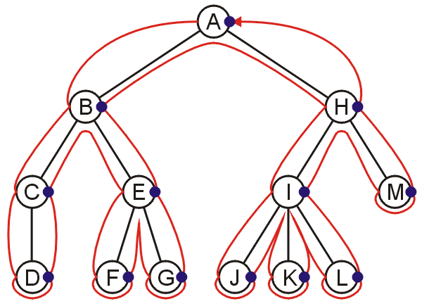
Post-ordering
Ordering nodes by their last visits results in the sequence:
D, C, F, G, E, B, J, K, L, I, M, H, A

Slide 69
Exercise
What is the pre-ordering and post-ordering of the following tree?
  Pre-ordering: A B C D E F G H I J K
  Post-ordering: C E F D G B J K I H A

Slide 70
Implementing Depth-First Traversals
Implementation with recursion:
  template <typename Type>
  void Simple_tree<Type>::depth_first_traversal() const {
  // Perform pre-visit operations on the element
  std::cout << element << ' ';
  // Perform a depth-first traversal on each of the children
  for (
  Single_node<Simple_tree *> *ptr = children.head();
  ptr != 0; ptr = ptr->next()
  ) {
  ptr->retrieve()->depth_first_traversal();
  }
  // Perform post-visit operations on the element
  std::cout << element << ' ';
  }

Slide 71
Implementing Depth-First Traversals
We can use a stack:
  Create a stack and push the root node onto the stack
  While the stack is not empty:
    Pop the top node
    Push all of the children of that node to the top of the stack in reverse order
Notes:
71

Slide 72
DFS using a Stack
A

Slide 73
DFS using a Stack
B
H

Slide 74
DFS using a Stack
C
E
H

Slide 75
DFS using a Stack
D
E
H

Slide 76
DFS using a Stack
E
H

Slide 77
DFS using a Stack
F
G
H

Slide 78
DFS using a Stack
G
H

Slide 79
DFS using a Stack
H

Slide 80
DFS using a Stack
I
M

Slide 81
DFS using a Stack
J
K
L
M

Slide 82
DFS using a Stack
K
L
M

Slide 83
DFS using a Stack
L
M

Slide 84
DFS using a Stack
M

Slide 85
DFS using a Stack
Notes:
深度优先要用堆栈实现。

Slide 86
Implementing Depth-First Traversals
Computational complexity of DFS using stack
  Run time is Θ(n)
  The objects on the stack are all unvisited siblings from the root to the current node
    If each node has a maximum of two children, the memory required is Θ(h): the height of the tree
Computational complexity of DFS using recursion?
  The same complexity? Recursion just hides the detail of stack.
Notes:
86

Slide 87
Guidelines
DFS is used when at each node we need information from:
  all its children or descendants, or
  all its ancestors
In designing a DFS, it is necessary to consider:
  Before the children are traversed, what initializations, operations and calculations must be performed?
  In recursively traversing the children:
    What information must be passed to the children during the recursive call?
    What information must the children pass back, and how must this information be collated?
  Once all children have been traversed, what operations and calculations depend on information collated during the recursive traversals?
  What information must be passed back to the parent?

Slide 88
Applications of DFS
Displaying information about directory structures and the files contained within
  Printing a hierarchical structure
  Determining memory usage

Slide 89
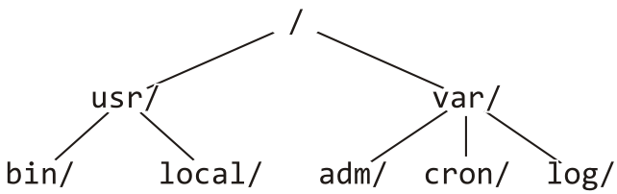
Printing a Hierarchy
Consider the directory structure presented on the left—how do we display this in the format on the right?
/
usr/
bin/
local/
var/
adm/
cron/
log/
What do we do at each step?

Slide 90
Printing a Hierarchy
For a directory, we initialize a tab level at the root to 0
We then do:
  Before the children are traversed, we must:
    Indent an appropriate number of tabs, and
    Print the name of the directory followed by a '/'
  In recursively traversing the children:
    A value of one plus the current tab level must be passed to the children, and
    No information must be passed back
  Once all children have been traversed, we are finished

Slide 91
Printing a Hierarchy
Assume the function void print_tabs( int n ) prints n tabs
  template <typename Type>
  void Simple_tree<Type>::print( int depth ) const {
  print_tabs( depth );
  std::cout << retrieve()->name() << '/' << std::endl;
  for (
  Single_node<Simple_tree *> *ptr = children.head();
  ptr != 0; ptr = ptr->next()
  ) {
  ptr->retrieve()->print( depth + 1 );
  }
  }

Slide 92
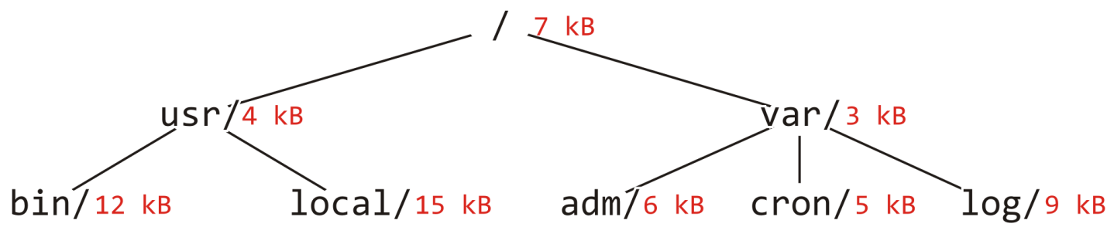
Determining Memory Usage
Printing the directory memory usage of this directory structure:
bin/ 12
local/ 15
usr/ 31
adm/ 6
cron/ 5
log/ 9
var/ 23
/ 61

Slide 93
Determining Memory Usage
For a directory, we initialize a tab level at the root to 0
We then do:
  Before the children are traversed, we must:
    Initialize the memory usage to that in the current directory.
  In recursively traversing the children:
    A value of one plus the current tab level must be passed to the children, and
    Each child will return the memory used within its directories and this must be added to the current memory usage.
  Once all children have been traversed, we must:
    Print the appropriate number of tabs,
    Print the name of the directory followed by a "/ ", and
    Print the memory used by this directory and its descendants
  Return the memory usage by this directory and its descendants

Slide 94
Printing a Hierarchy
  template <typename Type>
  int Simple_tree<Type>::du( int depth ) const {
  int usage = retrieve()->memory();
  for (
  Single_node<Simple_tree *> *ptr = children.head();
  ptr != 0; ptr = ptr->next()
  ) {
  usage += ptr->retrieve()->du( depth + 1 );
  }
  print_tabs( depth );
  std::cout << retrieve()->name() << "/ " << usage << std::endl;
  return usage;
  }

Slide 95
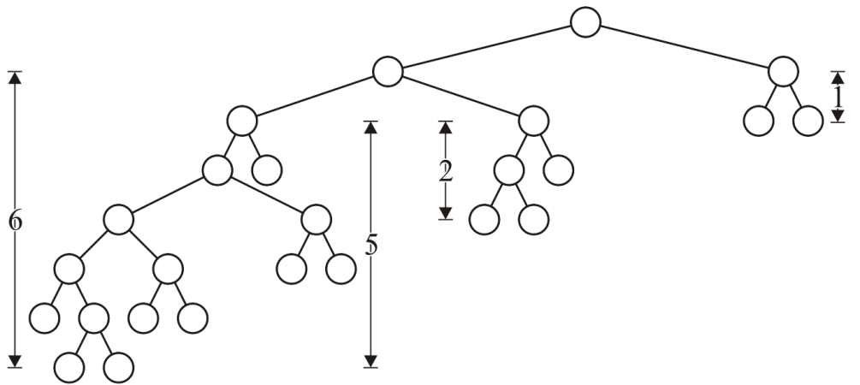
Height
The int height() const function is recursive in nature:
  Before the children are traversed, we assume that the node has no children and we set the height to zero: h_{current} = 0
  In recursively traversing the children, each child returns its height h and we update the height if 1 + h > h_{current}
  Once all children have been traversed, we return h_{current}
When the root returns a value, that is the height of the tree

Slide 96
Outline
Tree structure
Implementation
Tree traversal
Monte Carlo tree search
Forest

Slide 97

Game: Tic-Tac-Toe
Suppose Alice and Bob are playing tic-tac-toe. How can Alice or Bob find the best actions (for a game state)?

Slide 98
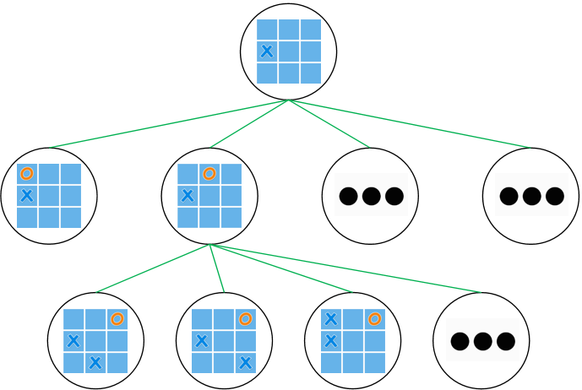
Game: Tic-Tac-Toe
Suppose Alice and Bob are playing tic-tac-toe. How can Alice or Bob find the best actions (for a game state)?
The structure of all possible situations is a game tree!
  Node is a state and link is an action
  DFS the tree and find the best actions

Slide 99
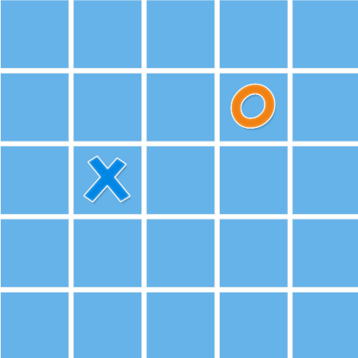
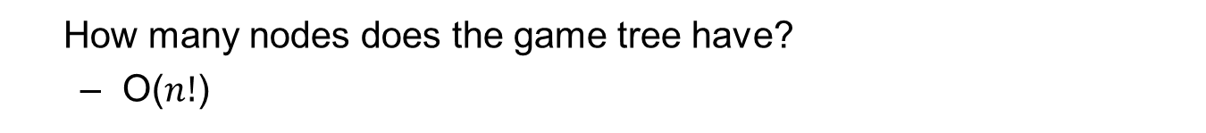
Game: Tic-Tac-Toe
How many nodes does the game tree have?
  O($n!$)
  Not so big when $n=9$, how about $n=25$?
DFS is infeasible to search all (leaf) nodes for the game tree in a limited time and computation budget.

Slide 100
Game: Tic-Tac-Toe
How many nodes does the game tree have?
  O($n!$)
  Not so big when $n=9$, how about $n=25$?
DFS is infeasible to search all (leaf) nodes for the game tree in a limited time and computation budget.
How to reduce the search space of the game tree (tree pruning)?
  Explore more often for possible good branches/actions
  Monte Carlo Tree Search (MCTS)!
  A randomized and principled tree search method

Slide 101
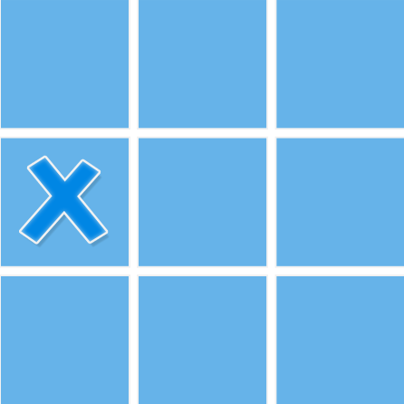
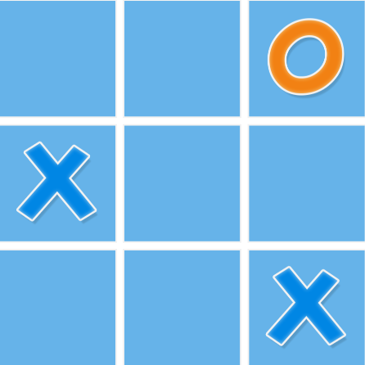



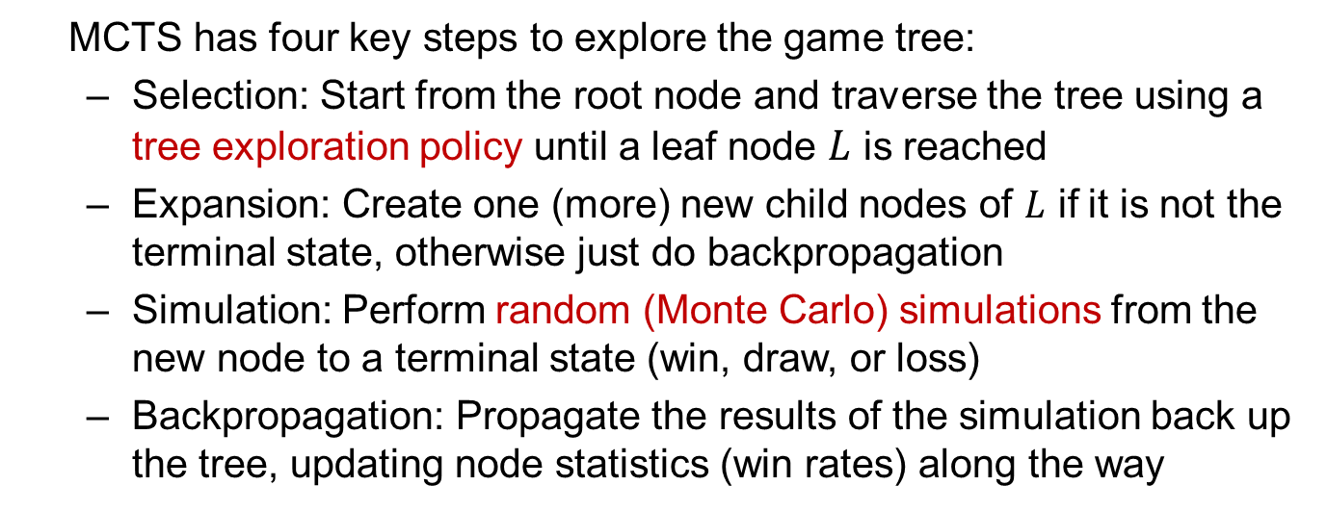
Monte Carlo Tree Search
MCTS has four key steps to explore the game tree:
  Selection: Start from the root node and traverse the tree using a tree exploration policy until a leaf node $L$ is reached
  Expansion: Create one (more) new child nodes of $L$ if it is not the terminal state, otherwise just do backpropagation
  Simulation: Perform random (Monte Carlo) simulations from the new node to a terminal state (win, draw, or loss)
  Backpropagation: Propagate the results of the simulation back up the tree, updating node statistics (win rates) along the way
Selection
Expansion
Simulation

Slide 102
Monte Carlo Tree Search
MCTS has four key steps to explore the game tree:
  Selection: Start from the root node and traverse the tree using a tree exploration policy until a leaf node $L$ is reached
  Expansion: Create one (more) new child nodes of $L$ if it is not the terminal state, otherwise just do backpropagation
  Simulation: Perform random (Monte Carlo) simulations from the new node to a terminal state (win, draw, or loss)
  Backpropagation: Propagate the results of the simulation back up the tree, updating node statistics (win rates) along the way
Selection
Expansion
Simulation
Win rate: 1/1
1/1
Backpropagation

Slide 103
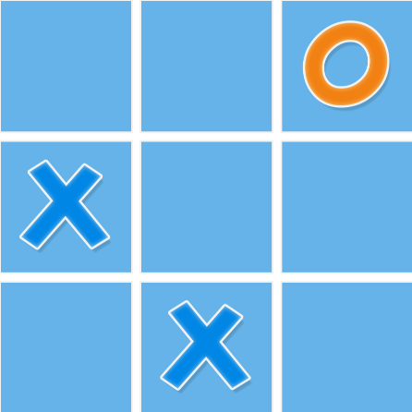
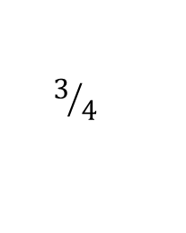



MCTS: Selection
What is a good tree exploration policy in Selection step?
$$4/8$$
$$0/2$$
$$3/4$$
$$1/2$$
What kind of actions can potentially be a good action?
  An action with high winning rate according to the history
  An action rarely searched

Slide 104
MCTS: Selection
What is a good tree exploration policy in Selection step?
$$4/8$$
$$0/2$$
$$3/4$$
$$1/2$$
What kind of actions can potentially be a good action?
  An action with high winning rate according to the history
  An action rarely searched
We need to balance Exploration and Exploitation! A well-known exploration policy is Upper Confidence Bound (UCB).

Slide 105








UCB: Balance Exploitation and Exploration
${UCB}_{i}=Emperical win rate +Bonus=\frac{W_{i}}{T_{i}}+\sqrt{\frac{\log{(T_{p})}}{T_{i}}}$
  $T_{i}$: number of visits on node $i$
  $W_{i}$: number of wins on node $i$
  $T_{p}$: numbers of visits on the parent of node $i$
$$4/8$$
$$0/2$$
$$3/4$$
$$1/2$$
Explore this action!
$${UCB}_{1}=0+\sqrt{\frac{\log{(8)}}{2}}$$
$${UCB}_{2}=0.75+\sqrt{\frac{\log{(8)}}{4}}$$
$${UCB}_{3}=0.5+\sqrt{\frac{\log{(8)}}{2}}$$

Slide 106









MCTS: Selection
Keep visiting child nodes with the largest UCB until the node
is a leaf node.
$$6/{19}$$
$$3/7$$
$$3/8$$
$$0/4$$
$$0/2$$
$$1/2$$
$$2/3$$
$$0/1$$
$$1/1$$

Slide 107

MCTS: Expansion
Create one (more) new child nodes of the leaf node and
expand the tree.
$$6/{19}$$
$$3/7$$
$$3/8$$
$$0/4$$
$$0/2$$
$$1/2$$
$$2/3$$
$$0/0$$
Expand a new node
$$0/1$$
$$1/1$$

Slide 108
MCTS: Simulation
Simulate random actions for both players until the game is end
(win, draw or loss). Note you might simulate multiple times.
$$6/{19}$$
$$3/7$$
$$3/8$$
$$0/4$$
$$0/2$$
$$1/2$$
$$2/3$$
$$0/0$$
$$0/1$$
$$1/1$$
Simulations
win, draw or loss

Slide 109




MCTS: Backpropagation
Backpropagate the result (win rate) from the leaf node to the
root node.
$$7/{20}$$
$$4/8$$
$$3/8$$
$$0/4$$
$$0/2$$
$$1/2$$
$$3/4$$
$$1/1$$
Backpropagation win!
$$0/1$$
$$1/1$$

Slide 110
Outline
Tree structure
Implementation
Tree traversal
Monte Carlo tree search
Forest

Slide 111
Hierarchical relation
Recall the properties of a hierarchical relation:
  It is never true that x ≺ x
  If x ≺ y then y ⊀ x
  If x ≺ y and y ≺ z, it follows that x ≺ z
  There is a root r such that r ≺ x for all x
  If is x ≺ z and y ≺ z, it follows that either x ≺ y, x = y or x ≻ y
If we remove the restriction that there is a unique root r, we allow for the possibility of a number of roots
  If a set S has such a relationship on it, we can define a tree rooted at a point x as the collection of all y such that x ≺ y
  For a finite set S, there is a set of points R such that for each r ∈ R, there are no points x ∈ S such that x ≺ r
    We call R the set of roots

Slide 112

Forest
A rooted forest is a data structure that is a collection of disjoint rooted trees

Slide 113
Forest
Note that:
  Any tree can be converted into a forest by removing the root node
  Any forest can be converted into a tree by adding a root node that has the roots of all the trees in the forest as children

Slide 114
Traversals
Traversals on forests can be achieved by treating the roots as children of a notional root
v_{k + 1}
e_{k}

Slide 115

Traversals
Traversals on forests can be achieved by treating the roots as children of a notional root
Pre-order traversal: A E B F O P U G H C I Q V W J D K R L M S T X Y Z N
Post-order traversal: E A O U P F G H B V W Q I J C R K L S X Y Z T M N D
Breadth-first traversal: A B C D E F G H I J K L M N O P Q R S T U V W X Y Z
v_{k + 1}
e_{k}

Slide 116

Application
In Windows, each drive forms the root of its own directory structure
  Each of the directories is hierarchical—that is, a rooted tree

Slide 117
Application
In C++, if you do not use multiple inheritance, the class inheritance structure is a forest
  In Java and C#, it is a rooted tree with Object being the root class
If you allow multiple inheritance in C++, you have a partial order
  A directed acyclic graph data structure allows you store such a relation

Slide 118
Summary
Tree structure
  Terminology
Implementation
  Children in a list
Tree traversal
  BFS, using queue
  DFS, using recursion or stack
  MCTS
Forest

