Slide 1
Lecture 16: Practical Aspects
Yujiao Shi
SIST, ShanghaiTech
Spring, 2025

Slide 2
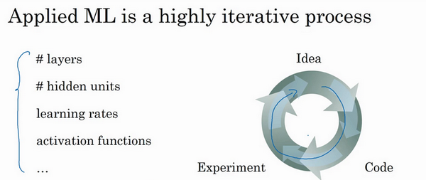

Slide 3
Train / Val / Test Sets
Val set -- for model selection
When the whole dataset is small:
When the whole dataset is large:
Train | Val | Test
60% | 20% | 20%
70% | 0% | 30%
Train | Val | Test
1million (98%) | 10 thousand (1%) | 10 thousand (1%)
4/10/2024
Notes:
测试集的主要目的是正确评估分类器的性能
所以，当数据集足够大的时候，我们不需要保证test images 永远占比20% 或 30%
In some scenarios, \eg, evaluate a single-class classifier, 1000 images should be enough.
验证集和测试集需要来自同一分布。理想情况下，train val test set需要都是来自同一分布的
就算没有测试集也不要紧，测试集的目的是对最终所选定的神经网络系统做出无偏估计，如果不需要无偏估计，也可以不设置测试集。所以如果只有验证集，没有测试集，我们要做的就是，在训练集上训练，尝试不同的模型框架，在验证集上评估这些模型，然后迭代并选出适用的模型。因为验证集中已经涵盖测试集数据，其不再提供无偏性能评估。当然，如果你不需要无偏估计，那就再好不过了。

Slide 4
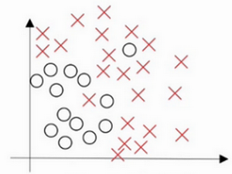
Bias / Variance
4/10/2024
Notes:
假设这就是数据集，如果给这个数据集拟合一条直线，可能得到一个逻辑回归拟合，但它并不能很好地拟合该数据，这是高偏差（high bias）的情况，我们称为“欠拟合”（underfitting）。

Slide 5
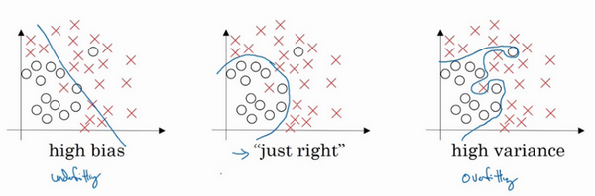
Bias / Variance
4/10/2024
Notes:
假设这就是数据集，如果给这个数据集拟合一条直线，可能得到一个逻辑回归拟合，但它并不能很好地拟合该数据，这是高偏差（high bias）的情况，我们称为“欠拟合”（underfitting）。
相反的如果我们拟合一个非常复杂的分类器，比如深度神经网络或含有隐藏单元的神经网络，可能就非常适用于这个数据集，但是这看起来也不是一种很好的拟合方式分类器方差较高（high variance），数据过度拟合（overfitting）。
在两者之间，可能还有一些像图中这样的，复杂程度适中，数据拟合适度的分类器，这个数据拟合看起来更加合理，我们称之为“适度拟合”（just right）是介于过度拟合和欠拟合中间的一类。

Slide 6
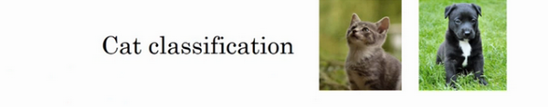
Bias / Variance
When feature dimension is high:
Two metrics:
  Train set error
  Test set error
4/10/2024

Slide 7
Bias / Variance
Train set error: | 1% | 15% | 15% | 0.5%
Test set error | 11% | 16% | 30% | 1%
 | High variance | High bias | High bias High variance | Low bias Low variance

Slide 8
Basic Recipe for Machine Learning
High Bias?
(Training set performance)
Bigger network
Train longer
Y
N
High Variance?
(Val set performance)
More data
Regularization
Y
N
Done
Notes:
Bigger network : more layers or neurons
Longer training time: not necessarily work, but it won’t hurt
Or more advanced optimiter, learning rate, other hyperparameter, etc.
A bigger network generally can fit better in the training data. If the image quality is low, algorithms may not be able to fit the traing dat
如果你以人的角度读看这个任务，认为误差应该不会那么高，那么通常情况下大一点儿的网络应该会work，至少可以拟合训练集
一旦偏差降到了一个可以接受的范围

Slide 9
Training overview
Two aspects of training networks
  Optimization
    How do we minimize the loss function effectively?
  Generalization
    How do we avoid overfitting?
CNN training pipeline
  Data processing
  Weight initialization
  Parameter updates
  Batch normalization
Avoid overfitting: Regularization

Slide 10
Training overview
Supervised learning paradigm
Mini-batch SGD
  Loop:
  Sample a (mini-)batch of data
  Forward propagation it through the network, compute loss
  Backpropagation to calculate the gradients
  Update the parameters using the gradient

Slide 11
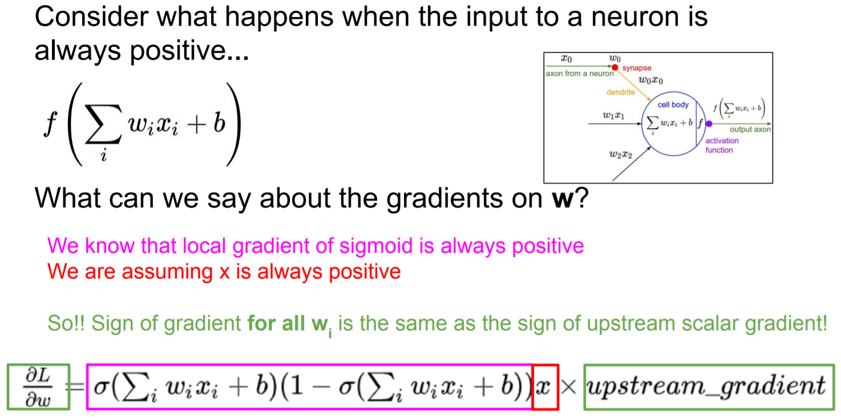
Data Preprocessing
Motivation

Slide 12
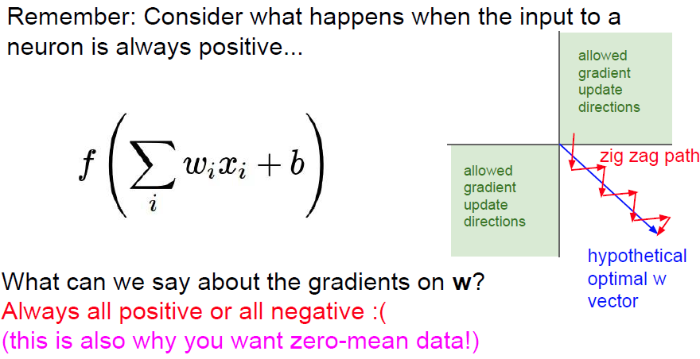
Data Preprocessing
Motivation

Slide 13
Data Preprocessing
Motivation
  Error surfaces with long, narrow ravines

Slide 14
Data Preprocessing
Motivation
  Example of linear regression
  Which direction of weights has a larger gradient updates?
  Which one do you want to receive a larger update?

Slide 15
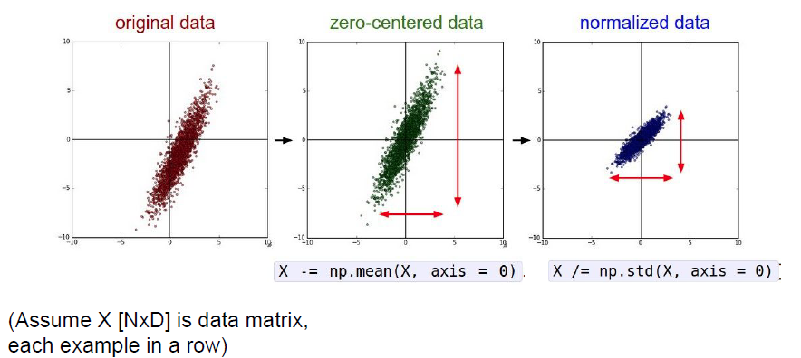
Data Preprocessing
Data normalization
  To avoid these problems, center your inputs to zero mean and unit variance

Slide 16
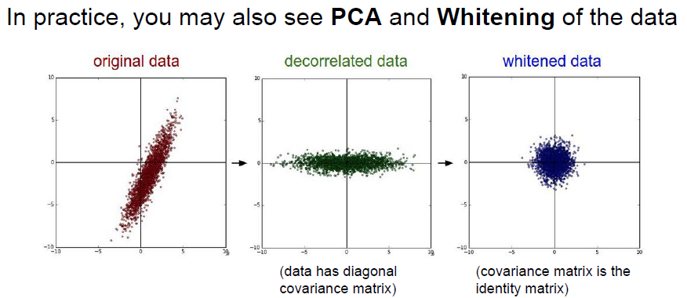
Data Preprocessing
More advanced methods

Slide 17
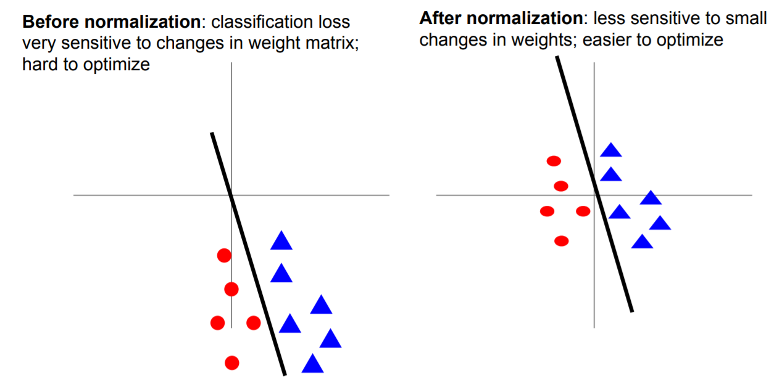
Data Preprocessing

Slide 18
Data Preprocessing
For visual recognition tasks
  In practice for images: centering only
  Not common to do PCA or whitening
For example, CIFAR-10
  Subtract the mean image (e.g. AlexNet)
  (mean image = [32,32,3] array)
  Subtract per-channel mean (e.g. VGGNet)
  (mean along each channel = 3 numbers)
  Subtract per-channel mean and Divide by per-channel std (e.g. ResNet)
  (mean along each channel = 3 numbers)

Slide 19
Outline
  Overview of CNN training
CNN training as optimization
  Data preprocessing
  Weight initialization
  Parameter update
  Batch normalization
Avoid overfitting: Regularization
  Acknowledgement: UofT, CMU & Feifei Li’s cs231n notes

Slide 20
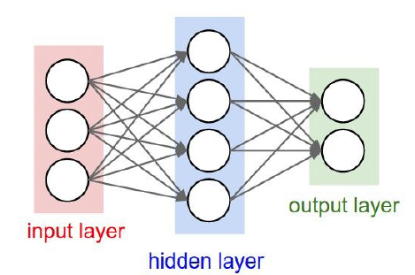
Weight Initialization
Non-convex objective functions
  Neural nets have a weight symmetry: permute all the hidden units in a given layer and obtain an equivalent solution.
  Q: What happens when W=0 initialization is used?
  A: All output are 0, all gradients are the same!
  No “symmetry breaking”

Slide 21
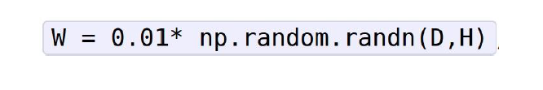
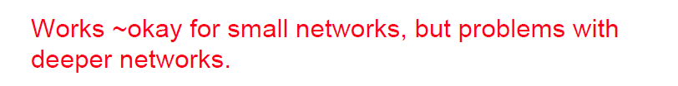
Weight Initialization
First idea: Small random numbers
  Gaussian with zero mean and 1e-2 std
  Simpler models to start
  Outputs are close to uniform for classification

Slide 22
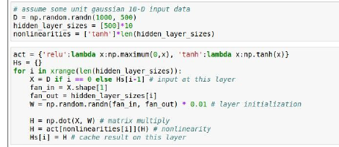
Weight Initialization
Motivating example
  Look at some activation statistics
  E.g., 10-layer net with 500 neurons on each layer using tanh non-linearities.

Slide 23
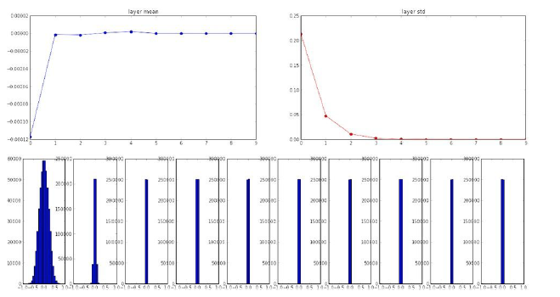
Weight Initialization
Motivating example

Slide 24
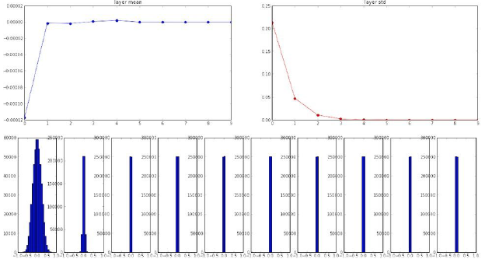
Weight Initialization
Motivating example
  All activations tend to zero for deeper network layers
  Q: What do the gradients dL/dW look like?

Slide 25
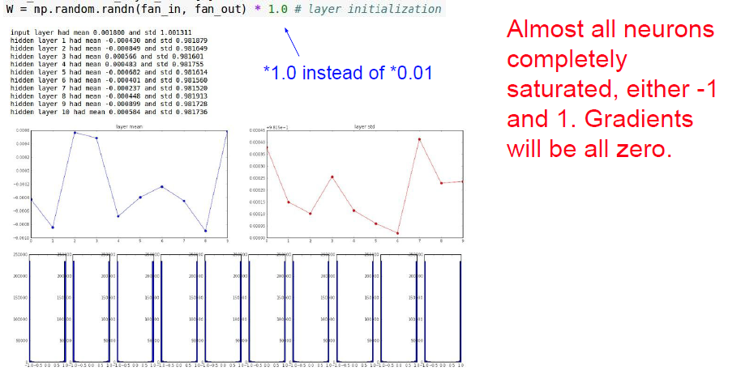
Weight Initialization
Motivating example

Slide 26
Weight Initialization
Motivating example
  All activations saturate
  Q: What do the gradients look like?
  A: Local gradients all zero

Slide 27
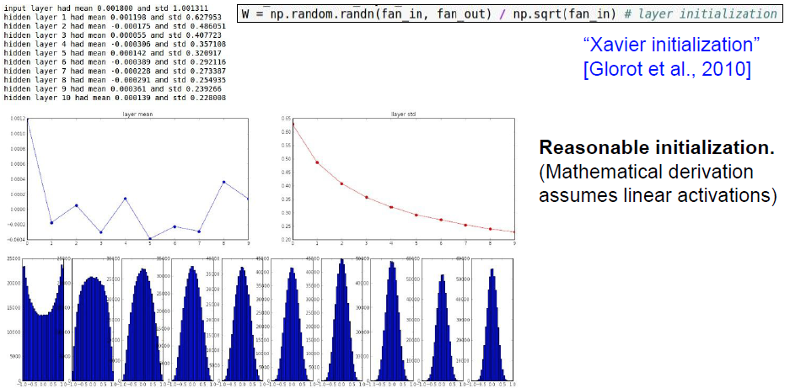
Weight Initialization
Xavier initialization [Glorot and Bengio, AISTAT 2010]
  std = 1/sqrt(fan_in): activations are nicely scaled for all layers

Slide 28
Weight Initialization
Xavier initialization [Glorot and Bengio, AISTAT 2010]
  For conv layers, fan_in is filter_size² * input_channels

Slide 29
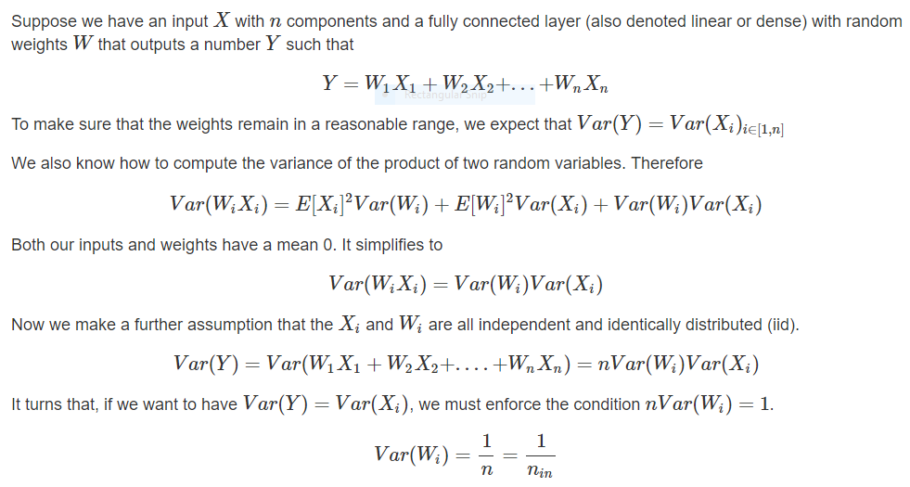
Weight Initialization
Theoretic analysis

Slide 30
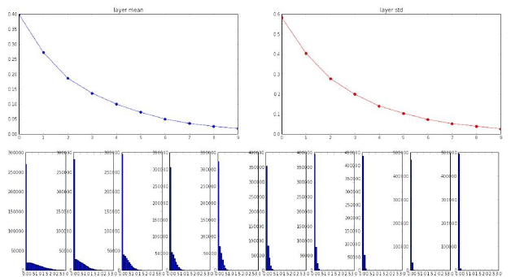
Weight Initialization
Problems with ReLU activation
  Xavier initialization assumes zero centered activation function, and hence breaks under ReLU

Slide 31
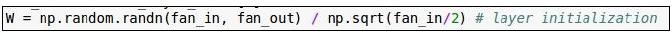
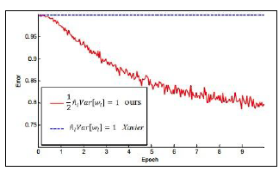
Weight Initialization
Initialization for CNNs with ReLU [He et al., 2015]
  MSRA Initialization: std = sqrt(2/fan_in)
ReLU correction: std = sqrt (2/Din)
  He et al, “Delving Deep into Rectifiers: Surpassing Human-level Performance on ImageNet Classification”, ICCV 2015

Slide 32
Weight Initialization
Weight initialization is an active area of research…
  Understanding the difficulty of training deep feedforward neural networks by Glorot and Bengio, 2010
  Exact solutions to the nonlinear dynamics of learning in deep linear neural networks by Saxe et al, 2013
  Random walk initialization for training very deep feedforward networks by Sussillo and Abbott, 2014
  Delving deep into rectifiers: Surpassing human-level performance on ImageNet classification by He et al., 2015
  Data-dependent Initializations of Convolutional Neural Networks by Krähenbühl et al., 2015
  All you need is a good init, Mishkin and Matas, 2015
  Fixup Initialization: Residual Learning Without Normalization, Zhang et al, 2019
  The Lottery Ticket Hypothesis: Finding Sparse, Trainable Neural Networks, Frankle and Carbin, 2019

Slide 33
Outline
  Overview of CNN training
CNN training as optimization
  Data preprocessing
  Weight initialization
  Parameter update
  Batch normalization
Avoid overfitting: Regularization
  Acknowledgement: UofT, CMU & Feifei Li’s cs231n notes

Slide 34
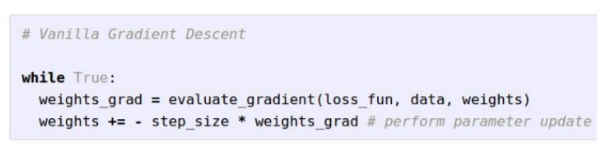
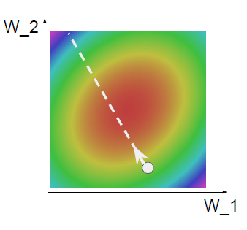
Optimization
Stochastic Gradient Descent

Slide 35
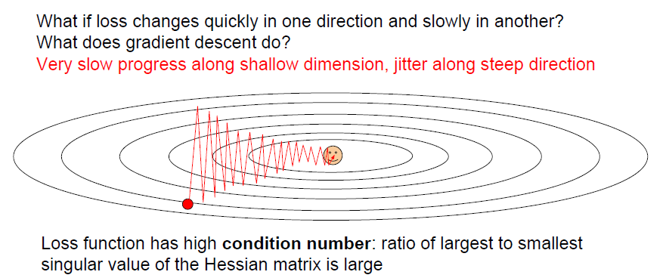
Optimization
Problems with SGD

Slide 36
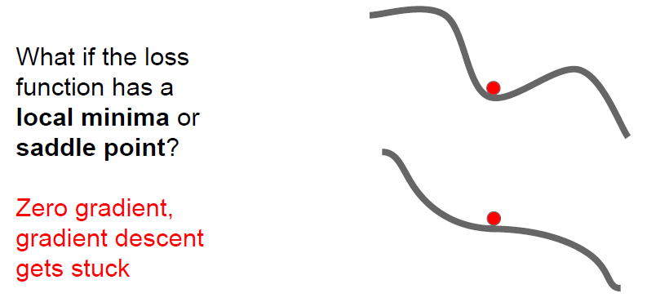
Optimization
Problems with SGD

Slide 37
Optimization
Problems with SGD
  Saddle points are more common in high-dim space

Slide 38
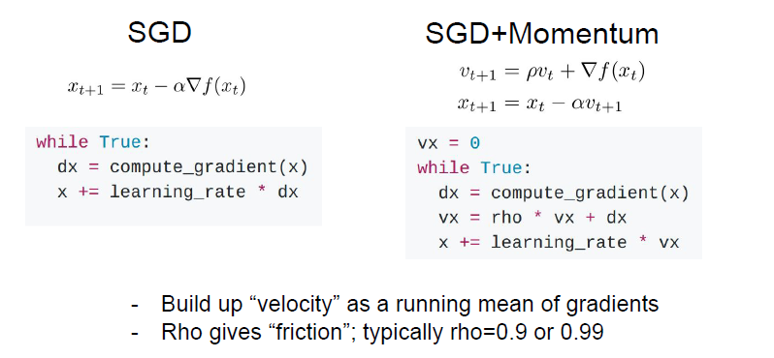
Optimization
SGD + Momentum
Sutskever et al, “On the importance of initialization and momentum in deep learning”, ICML 2013

Slide 39
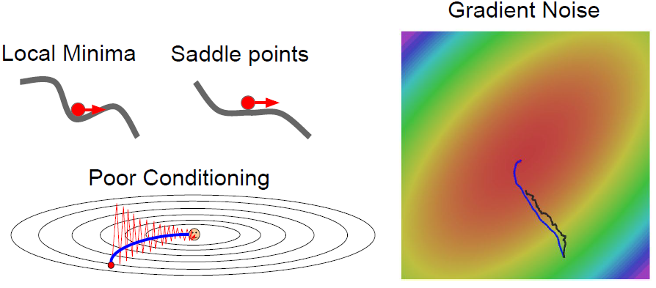
Optimization
SGD + Momentum
  Momentum sometimes helps a lot, and almost never hurts

Slide 40
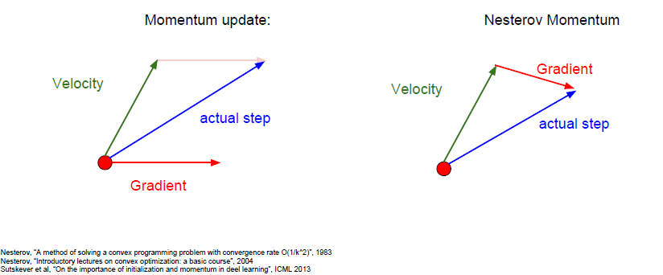
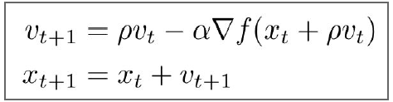
Optimization
Nesterov Momentum
  “Look ahead” to the point where updating using velocity would take us;
  Compute gradient there and mix it with velocity to get actual update direction

Slide 41
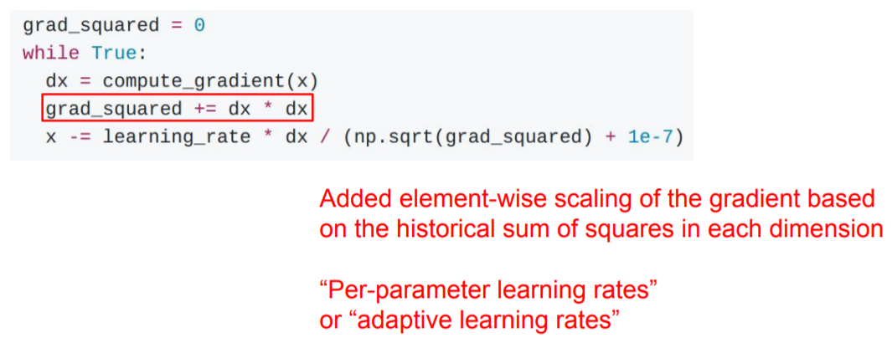
Optimization
AdaGrad
Duchi et al, “Adaptive subgradient methods for online learning and stochastic optimization”, JMLR 2011

Slide 42
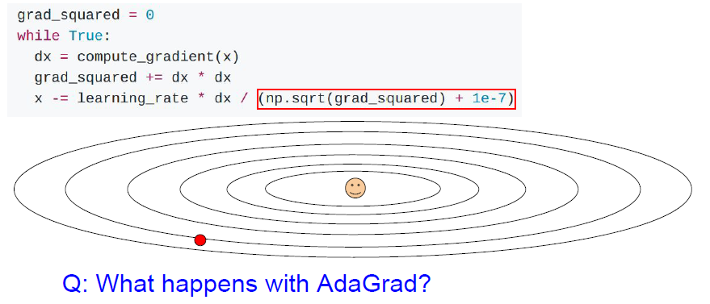
Optimization
AdaGrad
Progress along “steep” directions is damped; progress along “flat” directions is accelerated

Slide 43
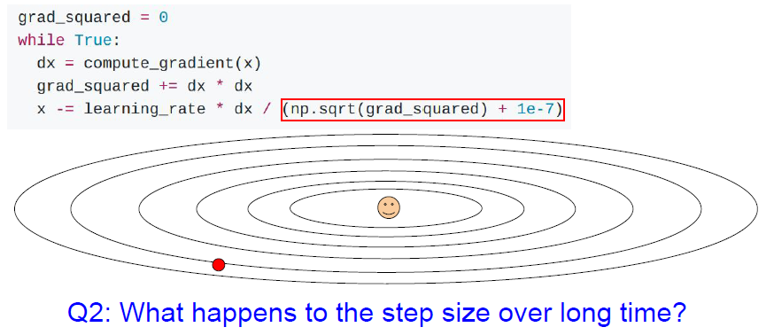
Optimization
AdaGrad
Decays to zero

Slide 44
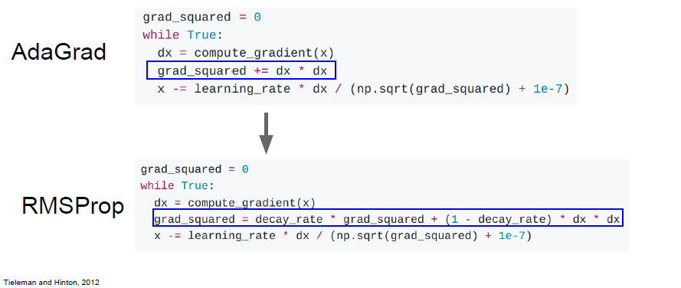
Optimization
RMSProp: smoothed version

Slide 45
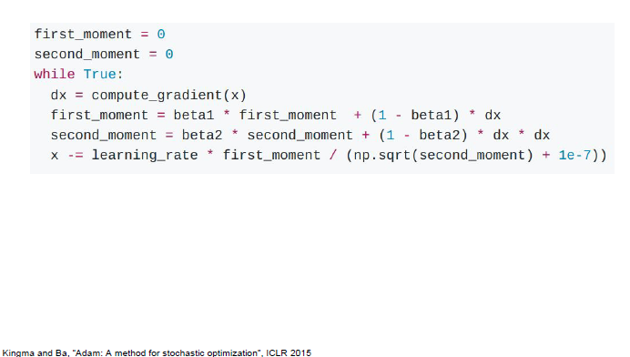
Optimization
Adam (almost): RMSProp + Momentum

Slide 46
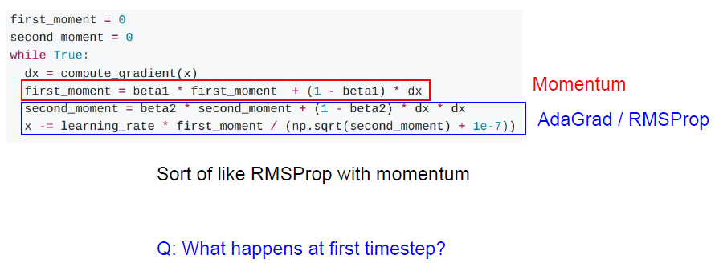
Optimization
Adam (almost)

Slide 47
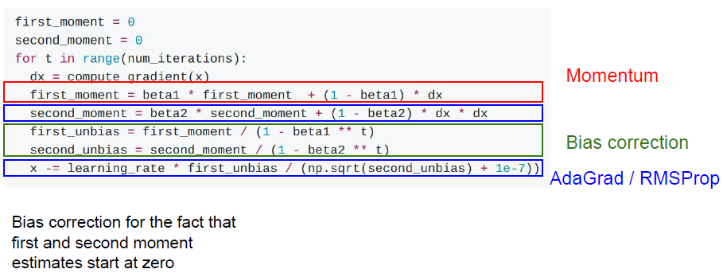
Optimization
Adam (full form)

Slide 48
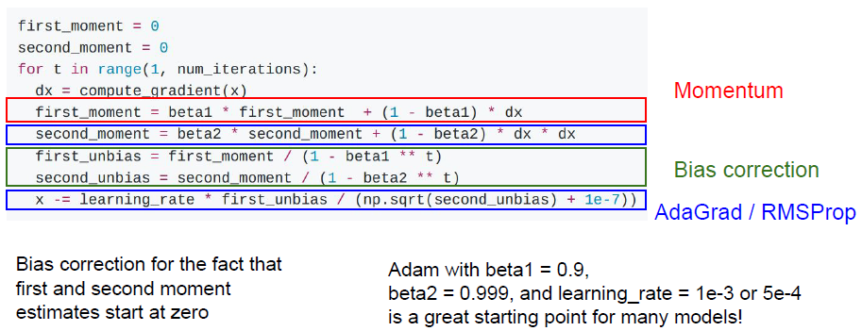
Optimization
Adam (full form)

Slide 49
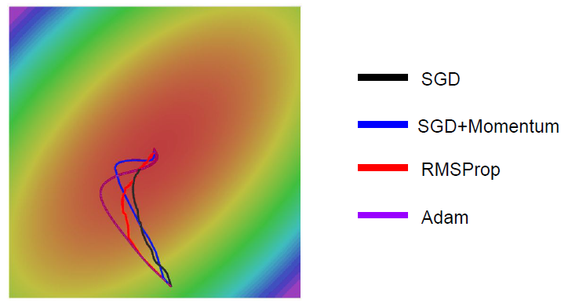
Optimization
Adam (full form)

Slide 50
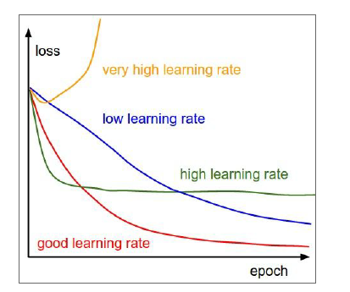
Learning rate
SGD, SGD+Momentum, Adagrad, RMSProp, Adam all have learning rate as a hyperparameter

Slide 51
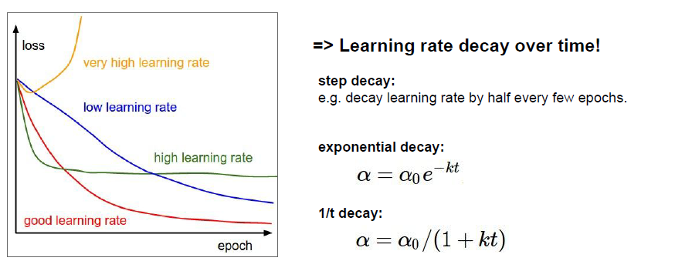
Learning rate
SGD, SGD+Momentum, Adagrad, RMSProp, Adam all have learning rate as a hyperparameter

Slide 52
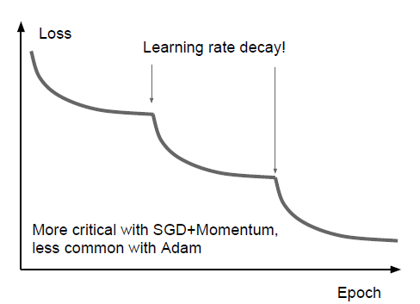
Learning rate decay
Step: reduce learning rate at a few fixed points.
  E.g. for ResNets, multiply LR by 0.1 after epochs 30, 60, and 90.

Slide 53

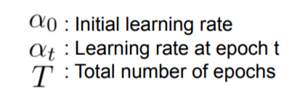


Learning rate decay
Cosine
Linear
Inverse sqrt
Loshchilov and Hutter, “SGDR: Stochastic Gradient Descent with Warm Restarts”, ICLR 2017
Radford et al, “Improving Language Understanding by Generative Pre-Training”, 2018
Feichtenhofer et al, “SlowFast Networks for Video Recognition”, arXiv 2018
Child at al, “Generating Long Sequences with Sparse Transformers”, arXiv 2019
Devlin et al, “BERT: Pre-training of Deep Bidirectional Transformers for Language Understanding”, 2018
Vaswani et al, “Attention is all you need”, NIPS 2017

Slide 54
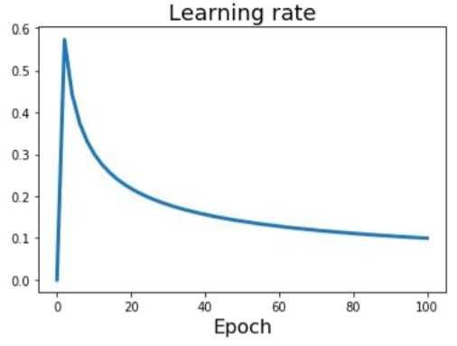
Learning rate decay
Linear warmup
High initial learning rates can make loss explode; linearly increasing learning rate from 0 over the first ~5000 iterations can prevent this
Empirical rule of thumb: If you increase the batch size by N, also scale the initial learning rate by N
Goyal et al, “Accurate, Large Minibatch SGD: Training ImageNet in 1 Hour”, arXiv 2017
Notes:
Increase the batch size by N, increase the initial learning rate by N

Slide 55
What can we find
Popular hypothesis
  In large networks, saddle points are far more common than local minima
  Gradient descent algorithms often get “stuck” in saddle points
  Most local minima are equivalent and close to global minimum

Slide 56
Outline
  Overview of CNN training
CNN training as optimization
  Data preprocessing
  Weight initialization
  Parameter update
  Batch normalization
Avoid overfitting: Regularization
  Acknowledgement: UofT, CMU & Feifei Li’s cs231n notes

Slide 57
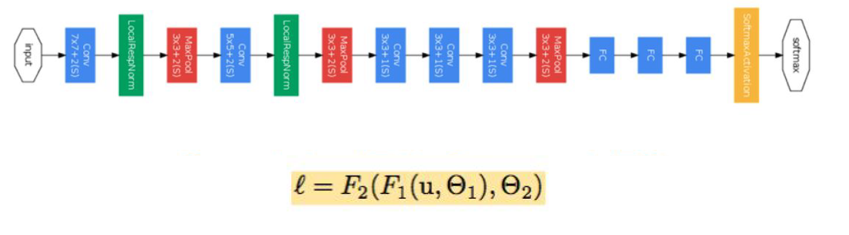
Batch Normalization
Problem in deep network learning
  Change of distribution in activation across layers

Slide 58
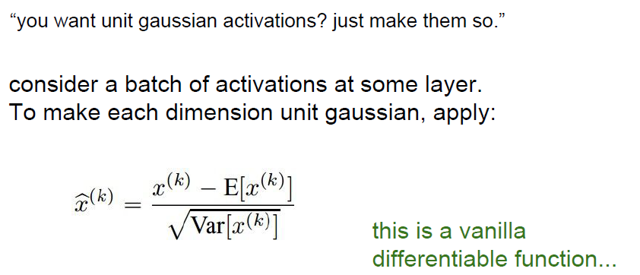
Batch Normalization
Normalize the inputs to a layer:
Notes:
Internal covariate shift → improve optimization

Slide 59
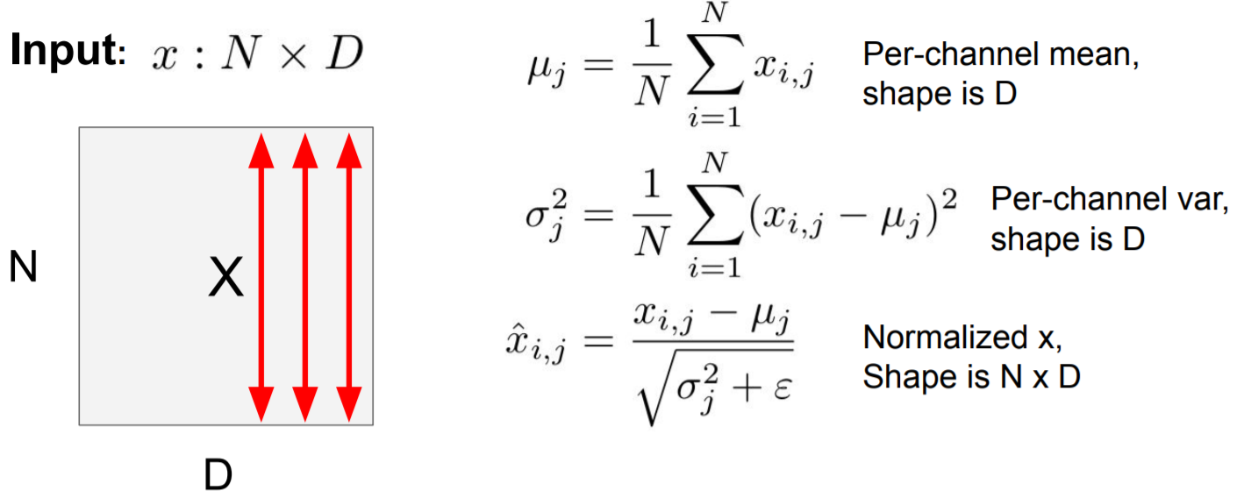
Batch Normalization
Layer details

Slide 60
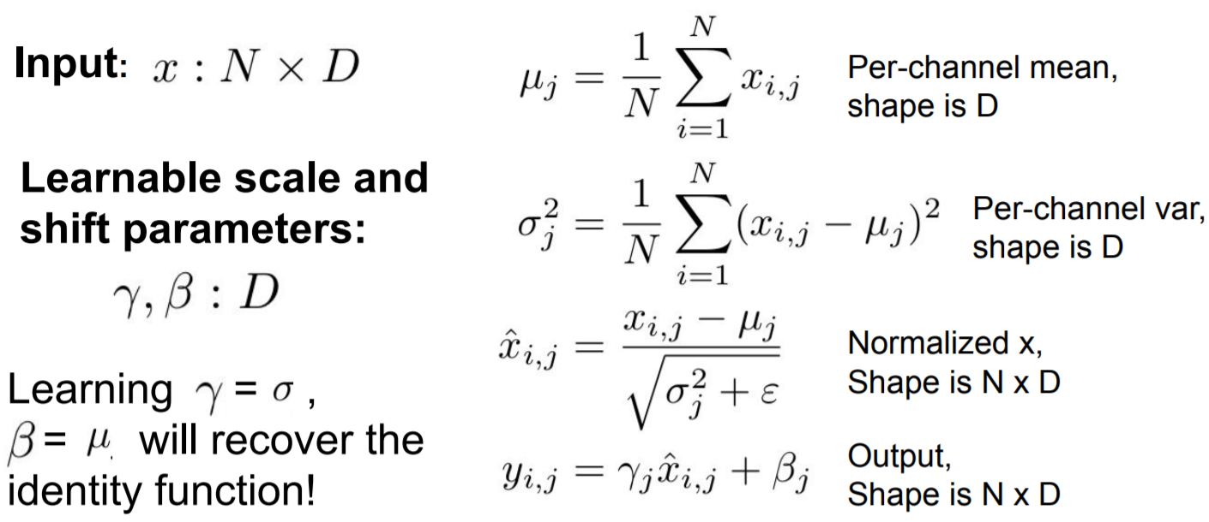
Batch Normalization
Extra capacity:
Notes:
Depends on minibatch, cannot do this at test-time

Slide 61
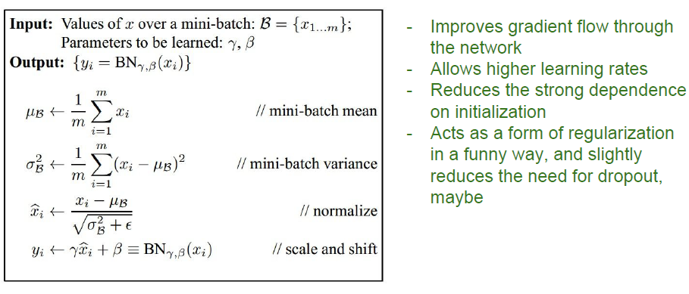
Batch Normalization
Algorithm

Slide 62
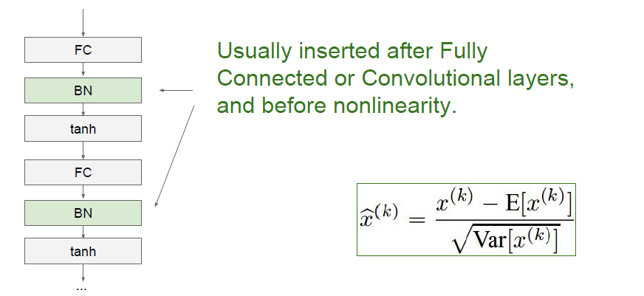
Batch Normalization
Layer details

Slide 63
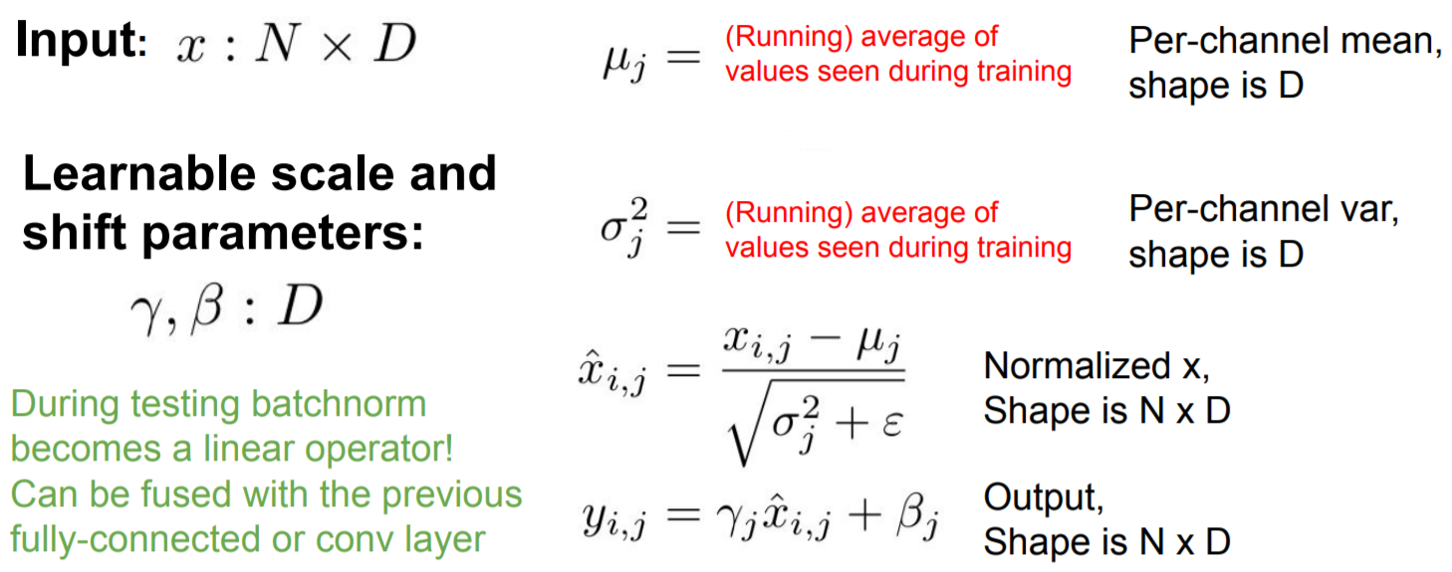
Batch Normalization
Test time

Slide 64

Batch Normalization
Benefits

Slide 65

Batch Normalization
ConvNets

Slide 66


Layer Normalization
Batch Normalization vs. Layer Normalization
Ba, Kiros, and Hinton, “Layer Normalization”, arXiv 2016

Slide 67

Instance Normalization
Ulyanov et al, Improved Texture Networks: Maximizing Quality and Diversity in Feed-forward Stylization and Texture Synthesis, CVPR 2017

Slide 68
Instance Normalization
Ulyanov et al, Improved Texture Networks: Maximizing Quality and Diversity in Feed-forward Stylization and Texture Synthesis, CVPR 2017

Slide 69

Batch-like Normalization
Layer normalization (Ba, Kiros, Hinton, 2016)
Instance normalization (Ulyanov, Vedaldi, Lempitsky, 2016)
Group normalization (Wu and He, 2018)

Slide 70
Outline
  Overview of CNN training
CNN training as optimization
  Data preprocessing
  Weight initialization
  Parameter update
  Batch normalization
Avoid overfitting: Regularization
  Acknowledgement: UofT, CMU & Feifei Li’s cs231n notes

Slide 71
Early Stopping
Early stopping: monitor performance on a validation set, stop training when the validation error starts going up.
  We don't always want to find a global (or even local) optimum of our cost function.
  Weights start out small, so it takes time for them to grow large. Therefore, it has a similar effect to weight decay.

Slide 72
Early Stopping
A slight catch: validation error fluctuates because of stochasticity in the updates.
  Determining when the validation error has actually leveled off can be tricky.
  May use temporal smoothing

Slide 73
Outline
Regularization in CNN training
  Data Augmentation
  Weight Regularization & Transfer Learning
  Stochastic Regularization
  Hyper-parameter optimization
  Acknowledgement: Feifei Li’s cs231n notes

Slide 74

Data Augmentation
Create more data for regularization

Slide 75


Data Augmentation
Create more data for regularization

Slide 76


Data Augmentation
Create more data for regularization

Slide 77
Data Augmentation
Create more data for regularization
Examples (for visual recognition)
  translation
  horizontal or vertical
  flip
  rotation
  smooth warping
  noise (e.g. flip random pixels)
The choice of transformations depends on the task.
  E.g. horizontal flip for object recognition, but not handwritten digit recognition.

Slide 78
Data Augmentation
AutoAugment (Cubuk et al, Arxiv 2018)
  An automatic way to design custom data augmentation policies for computer vision datasets,
  Selecting an optimal policy from a search space of 2.9 x 10³² image transformation possibilities.
    E.g., guiding the selection of basic image transformation operations, such as flipping an image horizontally/vertically, rotating an image, changing the color of an image, etc.
  Using reinforcement learning strategy
Results
  New state of the art: ImageNet: 83.54% top1 accuracy; SVHN: error rate 1.02%.
  AutoAugment policies are found to be transferable to other vision datasets.

Slide 79
Outline
Regularization in CNN training
  Data Augmentation
  Weight Regularization & Transfer Learning
  Stochastic Regularization
  Hyper-parameter optimization
  Acknowledgement: Feifei Li’s cs231n notes

Slide 80
Reducing # of Parameters
Reducing the number of layers or the number of parameters per layer.
Adding a linear bottleneck layer:
  The first network is strictly more expressive than the second (i.e. it can represent a strictly larger class of functions). (Why?)
  Remember how linear layers don't make a network more expressive? They might still improve generalization.

Slide 81
Weight Regularization
L₂ regularization / weight decay
  Encouraging the weights to be small in magnitude
  The gradient update can be interpreted as weight decay

Slide 82

Transfer Learning

Slide 83

Transfer Learning

Slide 84

Transfer Learning

Slide 85

Transfer Learning

Slide 86
Outline
Regularization in CNN training
  Data Augmentation
  Weight Regularization & Transfer Learning
  Stochastic Regularization
  Hyper-parameter optimization
Network Architectures
  Acknowledgement: Feifei Li’s cs231n notes

Slide 87

Stochastic Regularization
For a network to overfit, its computations need to be really precise. This suggests regularizing them by injecting noise into the computations, a strategy known as stochastic regularization.
Dropout is a stochastic regularizer which randomly deactivates a subset of the units

Slide 88

Dropout
Operations

Slide 89

Understanding Dropout

Slide 90
Understanding Dropout

Slide 91

Dropout
Dropout at test time

Slide 92

Dropout
Dropout at test time

Slide 93


Dropout
Dropout at test time

Slide 94

Dropout
Dropout at test time

Slide 95

Dropout
Implementation: Inverted dropout

Slide 96

Stochastic Regularization
Lots of other stochastic regularizers have been proposed:
  DropConnect drops connections instead of activations.
Training: Drop connections between neurons (set weights to 0)
Testing: Use all the connections
Wan et al, “Regularization of Neural Networks using DropConnect”, ICML 2013

Slide 97

Stochastic Regularization
Lots of other stochastic regularizers have been proposed:
  Fractional Pooling
Training: Use randomized pooling regions
Testing: Average predictions from several regions
Graham, “Fractional Max Pooling”, arXiv 2014

Slide 98

Stochastic Regularization
Lots of other stochastic regularizers have been proposed:
  Cutout
Training: Set random image regions to zero
Testing: Use full image predictions from several regions
DeVries and Taylor, “Improved Regularization of Convolutional Neural Networks with Cutout”, arXiv 2017

Slide 99

Stochastic Regularization
Lots of other stochastic regularizers have been proposed:
  Mixup
Training: Train on random blends of images
Testing: Use original images
Zhang et al, “mixup: Beyond Empirical Risk Minimization”, ICLR 2018

Slide 100
Stochastic Regularization
Lots of other stochastic regularizers have been proposed:
  Training: Add random noise
  Testing: Marginalize over the noise
In practice
  Consider dropout for large fully-connected layers
  Batch normalization and data augmentation almost always a good idea
  Try cutout and mixup especially for small classification datasets

Slide 101
Outline
Regularization in CNN training
  Data Augmentation
  Weight Regularization & Transfer Learning
  Stochastic Regularization
  Hyper-parameter optimization
  Acknowledgement: Feifei Li’s cs231n notes

Slide 102

Hyperparameter optimization
(Cross-)validation strategy

Slide 103

Hyperparameter optimization

Slide 104

Hyperparameter optimization

Slide 105

Hyperparameter optimization
Random search vs. Grid search
Random Search for Hyper-Parameter Optimization, Bergstra and Bengio, 2012

Slide 106

Hyperparameter optimization
Other hyperparameter optimization methods
  Shahriari, et al. "Taking the human out of the loop: A review of Bayesian optimization." Proceedings of the IEEE 104.1 (2016): 148-175.

