Slide 1

Best Cities &
Countries
for Startups
FINAL PRESENTATION
by: Jiayi Li
Yongchen Zhao

Slide 2
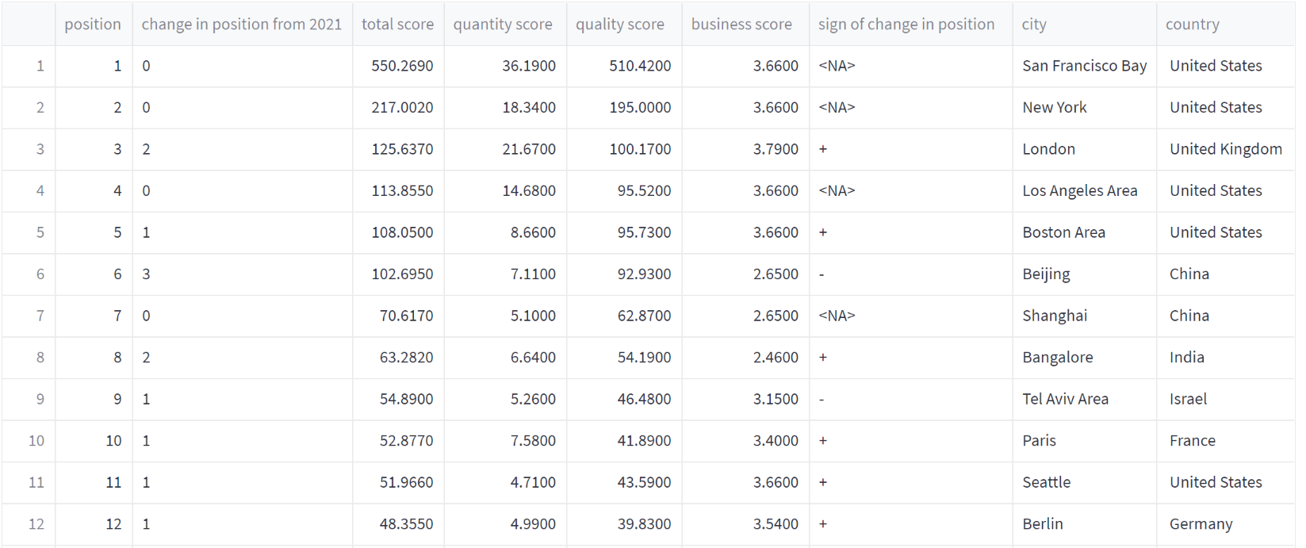
Description of dataset
Best Cities and Countries for Startups
The dataset contains about 1000 unique data values and 9 columns. Startups refer to new businesses that intend to grow large beyond the solo founder. The dataset provide us with information about to what extent can different factors influence startups and what element should people put much emphasis on if they want to achieve success when managing a startup.

Slide 3
Four Measurable Factors
Total score
Quality score
The total score of the rankings is a sum of the quantity, quality, and business environment
Qualitative results achieved by the ecosystem
Quantity score
Bussiness score
number of startups, number of coworking spaces
a mix of business and economic indicators at the national level

Slide 4
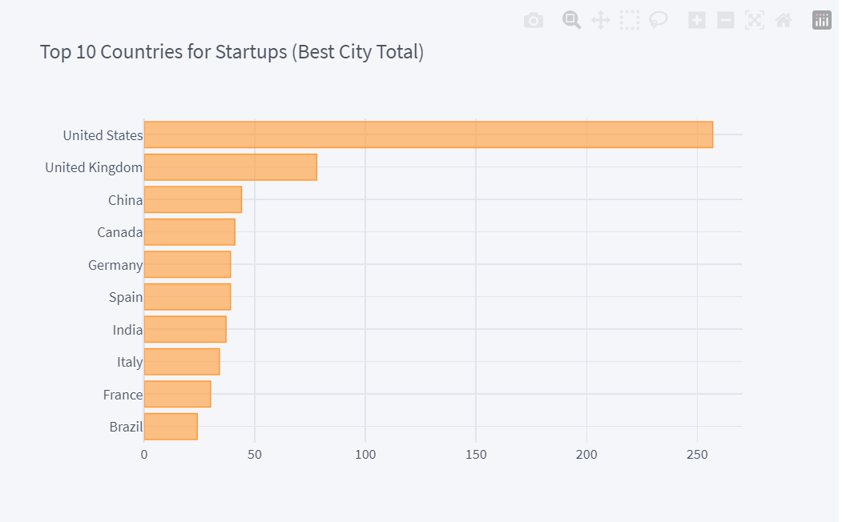
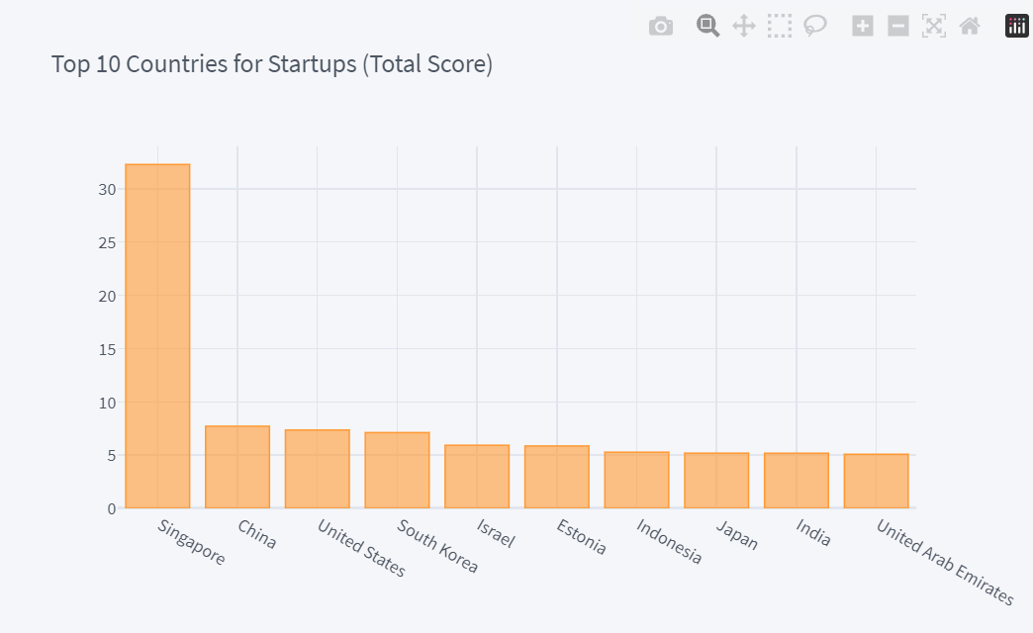
Best Countries for Startups
What is the best countries for startups?
Analyze by the number of best cities
Analyze by the average score of the cities
The United States has a significant quantitative advantage over the best cities.
Singapore has a high overall score advantage over other countries

Slide 5
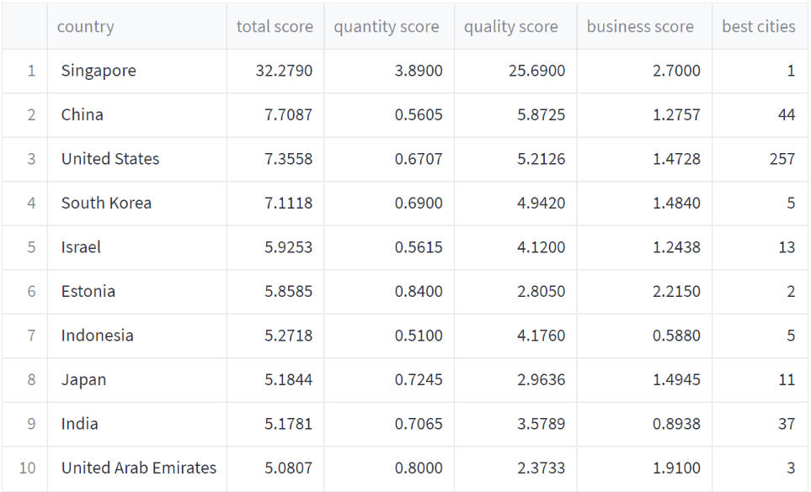
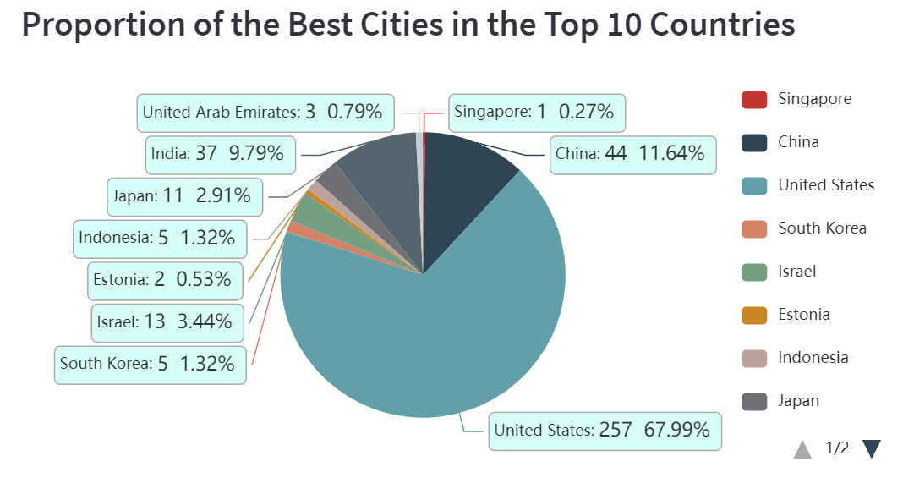
Proportion of Best Cities in the Top 10 Countries
What is the best countries for startups?
By using the pie chart for the top ten countries, we found that there are many cities with high scores in the United States, but because we averaged the 1000 best cities, this advantage was weakened by the number advantage of the United States
Based on this situation, we created an interactive table to see why this is the case.

Slide 6
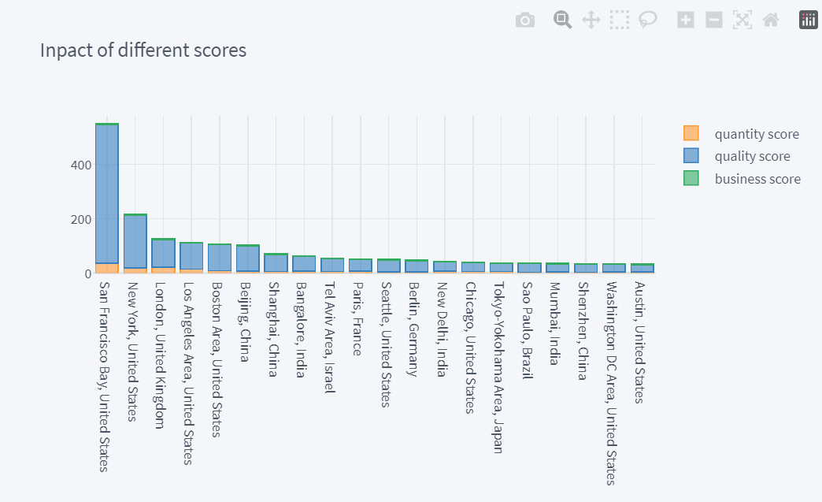
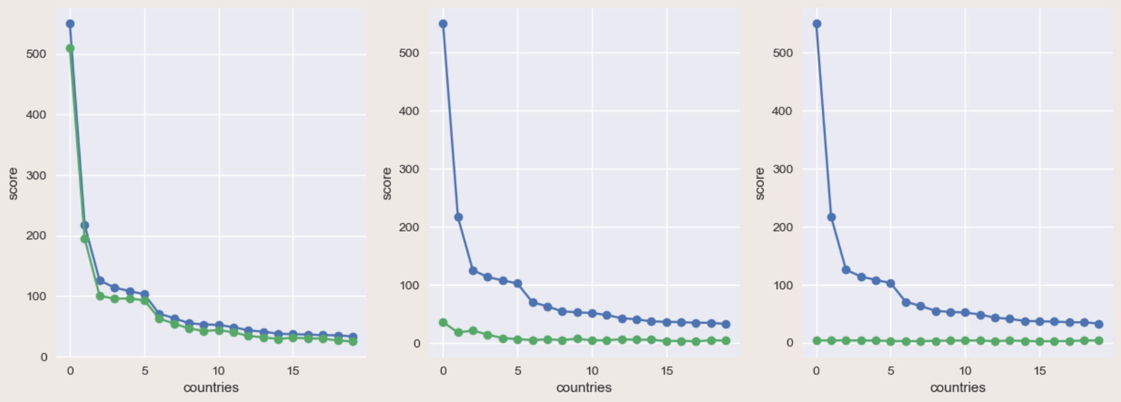
The Impact of Different Scores
What has greater impact on the best city score
Analyzed the top 20 cities using a stack chart
Analyze the relationship using the line chart
Obviously, the quality score, that is, the environmental score, plays a very important role.
Relationship between different scores and total scores

Slide 7
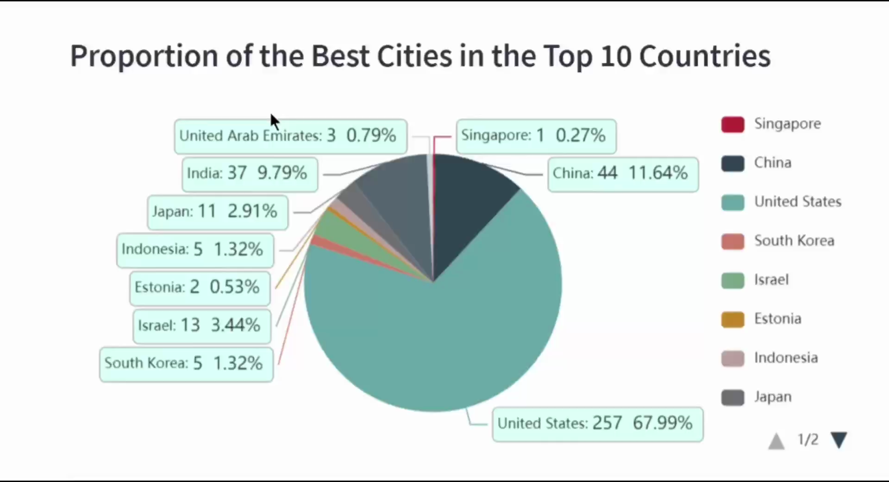
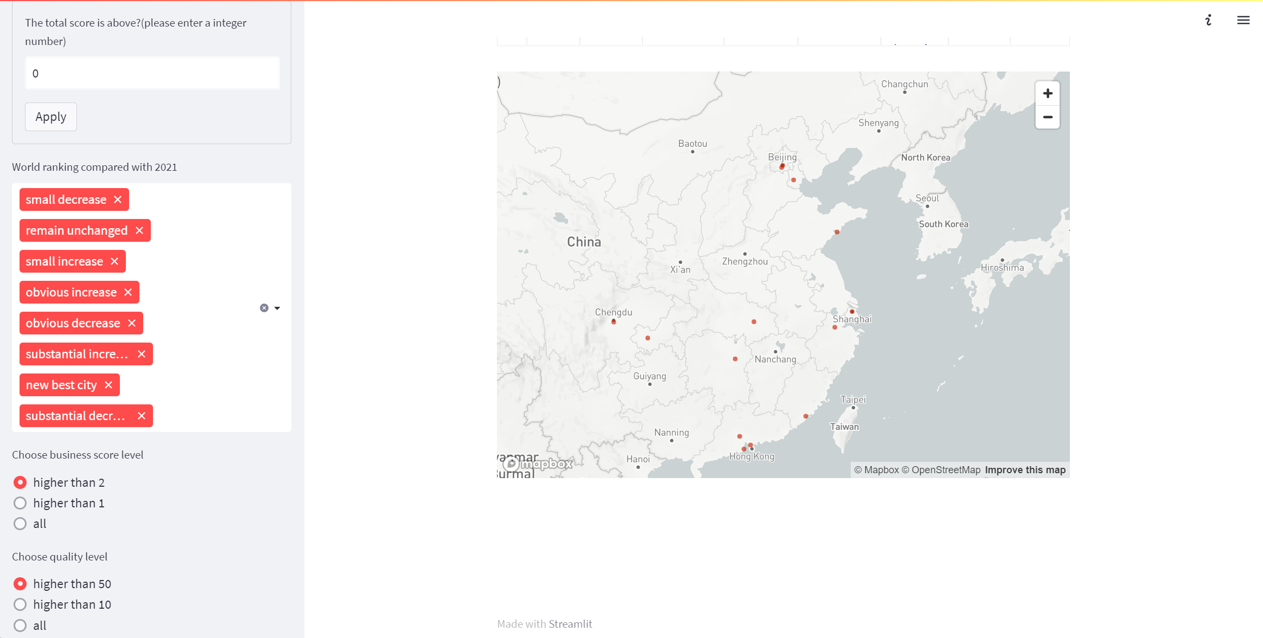
Data App Demo
some of our interactive part
the map of best cities in China

Slide 8
Thank you very much

