Slide 1
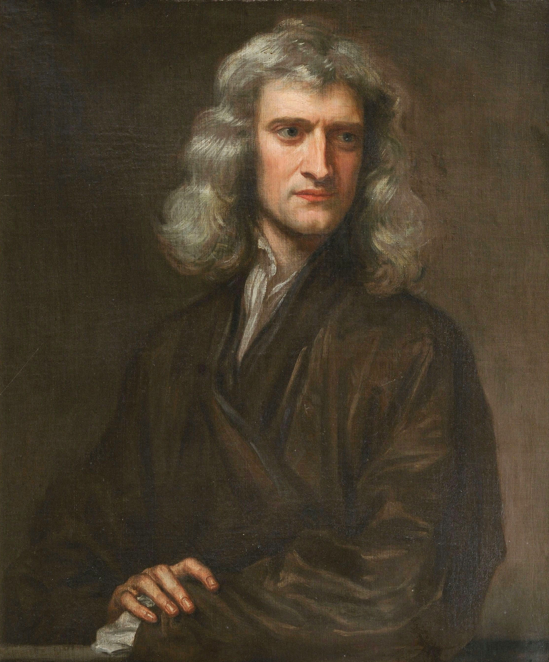
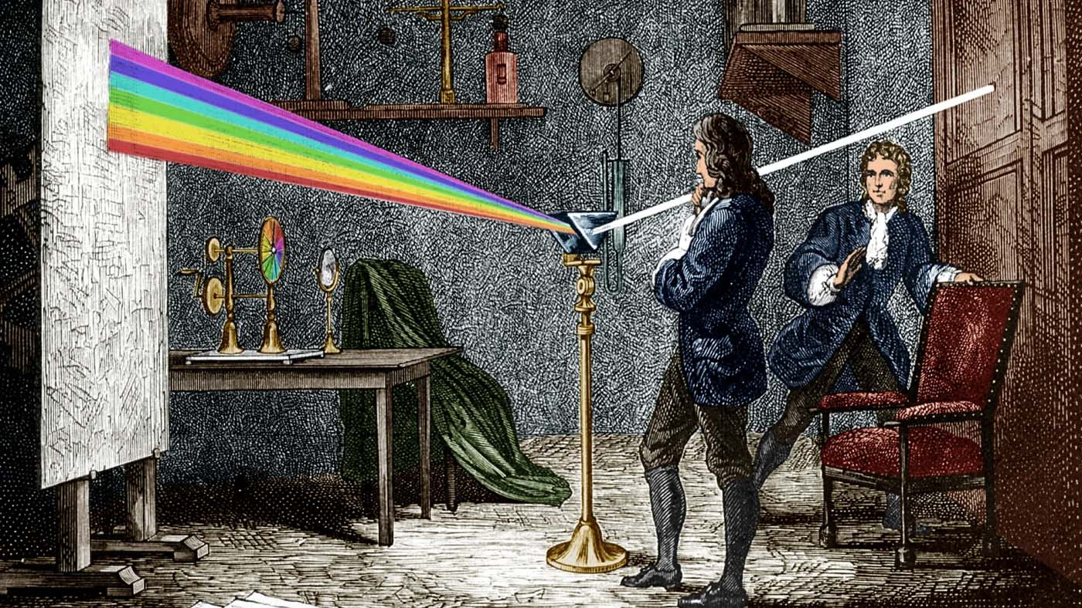
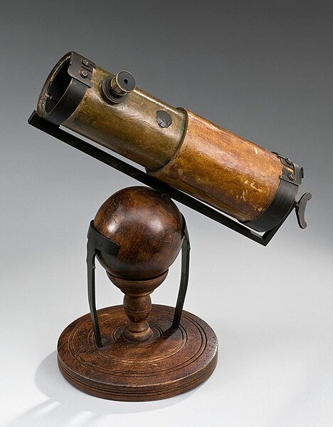
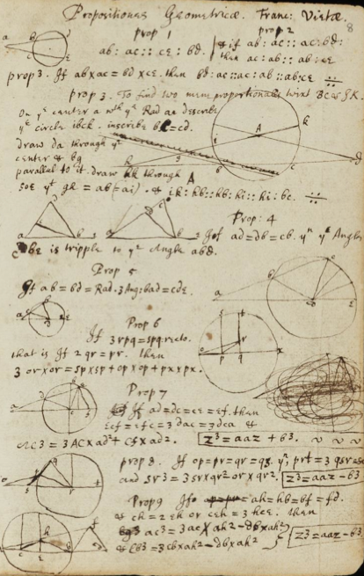
Isaac Newton
- Mechanik
- Optik
- Mathematik
- Alchemie

Slide 2
Isaac Newton
- Mechanik
- Optik
- Mathematik
- Alchemie
If I have seen further than any other it is by standing on the shoulders of Giants
Wenn ich weiter geblickt habe, so deshalb, weil ich auf den Schultern von Riesen stehe.

Slide 3
Isaac Newton
- Mechanik
- Optik
- Mathematik
- Alchemie
If I have seen further than any other it is by standing on the shoulders of Giants

