Slide 1
Python Final 과제
– Edit Distance
2015-20503 김성태
2015-20506 배성환

Slide 2

Input Data (editdistance.py 와 function.py 사용)
We should input 5 information to run the program
Original sequence
Comparing sequence
Gap penalty
Match score
Mistmatch score
Example with our program - Visualization

Slide 3
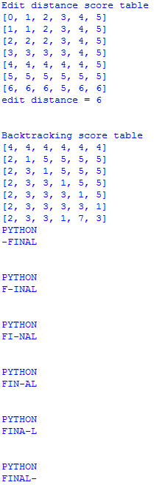
Result
1
2
3
What our program shows
Edit distance score table
Edit distance lowest score
Backtracking score table
Backtracking result with lowest score
(possible outcomes)
4

Slide 4
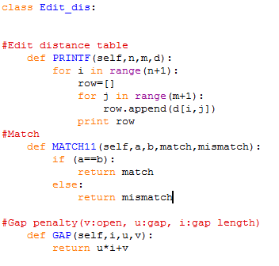
Python Codes
Edit distance table을 만드는 Code
Sequence Matching을 하는 Code
Gap penalty를 주는 Code

Slide 5
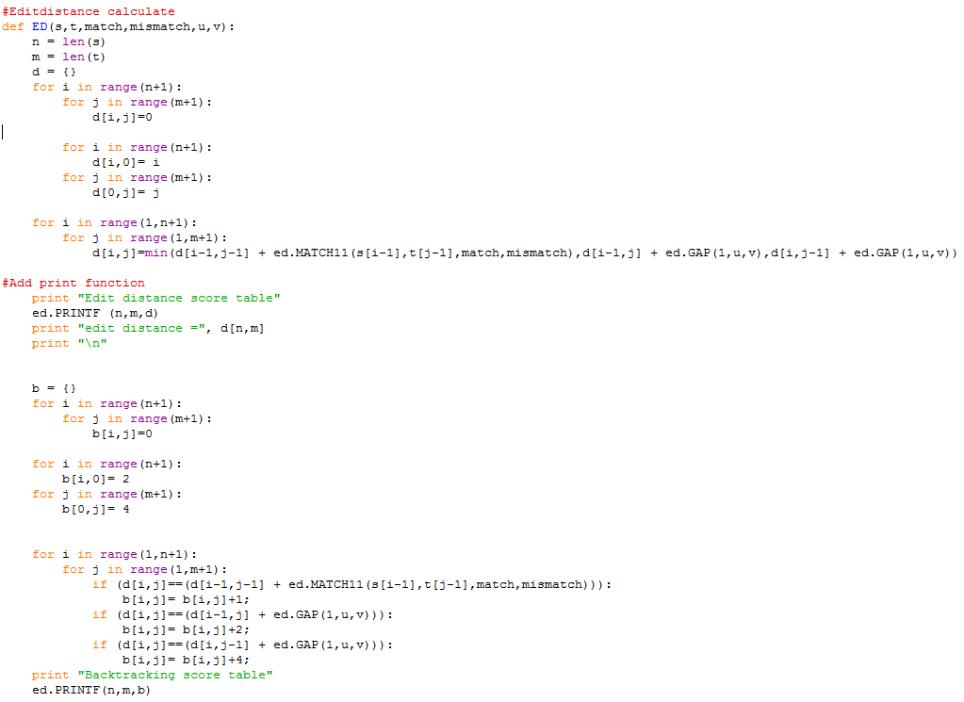
Python Codes
Edit distance를
계산하는 Code
Backtracking을
계산하는 Code

