Slide 1
Analysis of crime in san francisco 2010 through 2017
Beatriz Shetkar Ray Sheng
Abdullah Alfai Alex Leontiev Jan. 20, 2018

Slide 2
summary
Motivation
Investigate a relatable, relevant local topic
Work with up-to-date data sets
SF Open Data our starting point – sfdata.org
Questions of interest
What are general trends and makeup of types of crime in SF?
Are there temporal and geographic area correlations with criminal activity?
Are there any socioeconomic relationships?
Data sources
Primary source: SFPD Incident Report https://data.sfgov.org/Public-Safety/Police-Department-Incidents/tmnf-yvry
Census Bureau American Community Survey (ACS) reports https://www.census.gov/programs-surveys/acs/data.html

Slide 3
Challenges
Logistics and definitions
Large data set – SFPD Incident Report CSV 2.2M records
Focused on current decade – 2010 - 2017
Crime vs. police incident – 39 categories of incidents, not all criminal activity
Focused on select types of incidents – top ten list
No common definition of locales – SFPD district vs. city neighborhoods
Decided on zip code
Used http://ws.geonames.org for zip code lookup Metering issue mitigated by keeping track of locations
Data sharing & cleanup
Moving large CSV and loading them time consuming – zip to the rescue
Clean data – not many duplicates or missing fields
Used shape, columns, statistics, dtypes to examine data

Slide 4
Approach & follow-on work
Collaborative and iterative approach
All worked on data wrangling, then focused on individual questions
Code structure reflects the independent nature of questions
Started high level, drilled down into details, focused on relevant areas of interest
What new areas would we explore, given more time?
Apply geospatial techniques to identify hot spots
Use google API to relate hot spot info to landmarks – tourist attraction areas
Map incident coordinates to neighborhoods

Slide 5
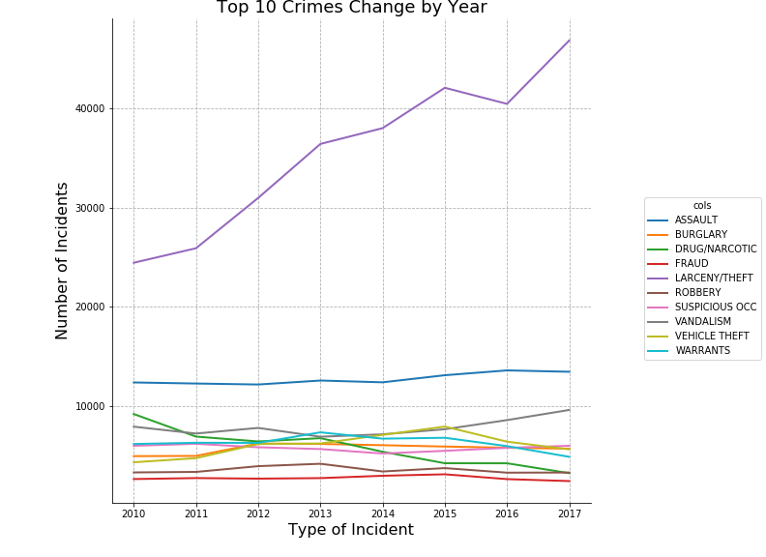

Slide 6
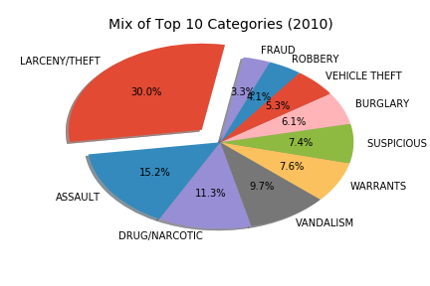
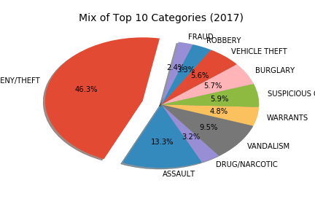
Top 10 Incident mix pattern over time

Slide 7
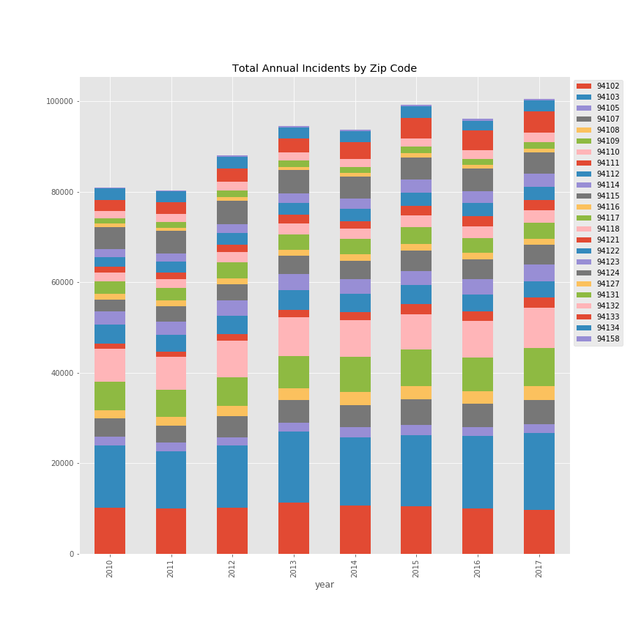
Annual pattern at zip code level

Slide 8
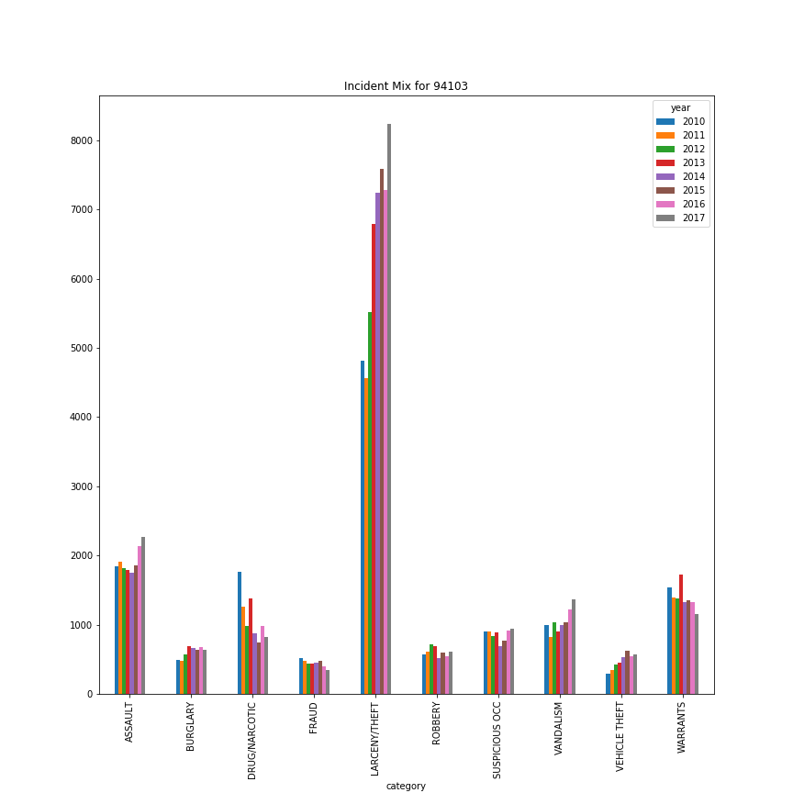
Incident mix pattern

Slide 9
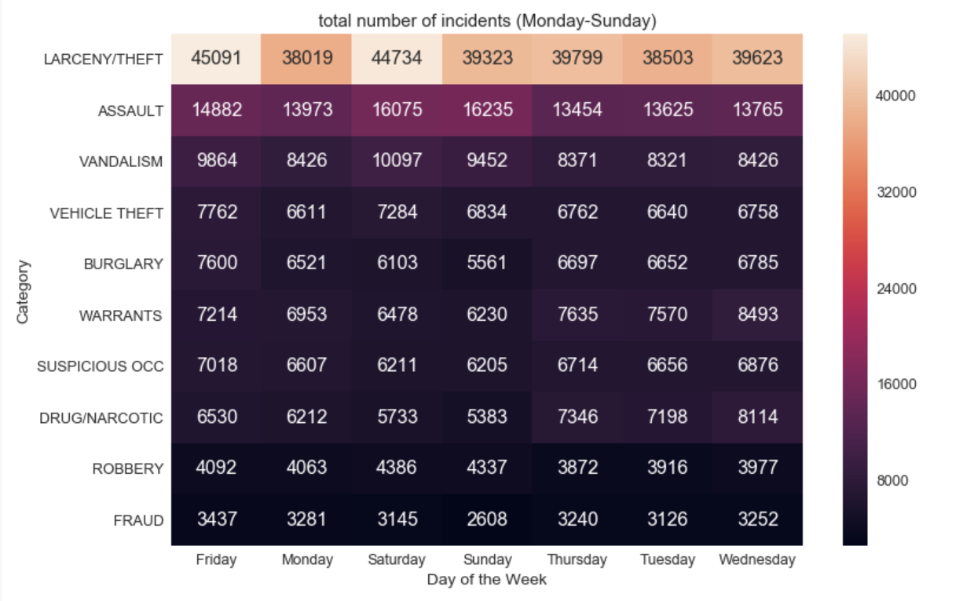
Day of week & crime incidents

Slide 10
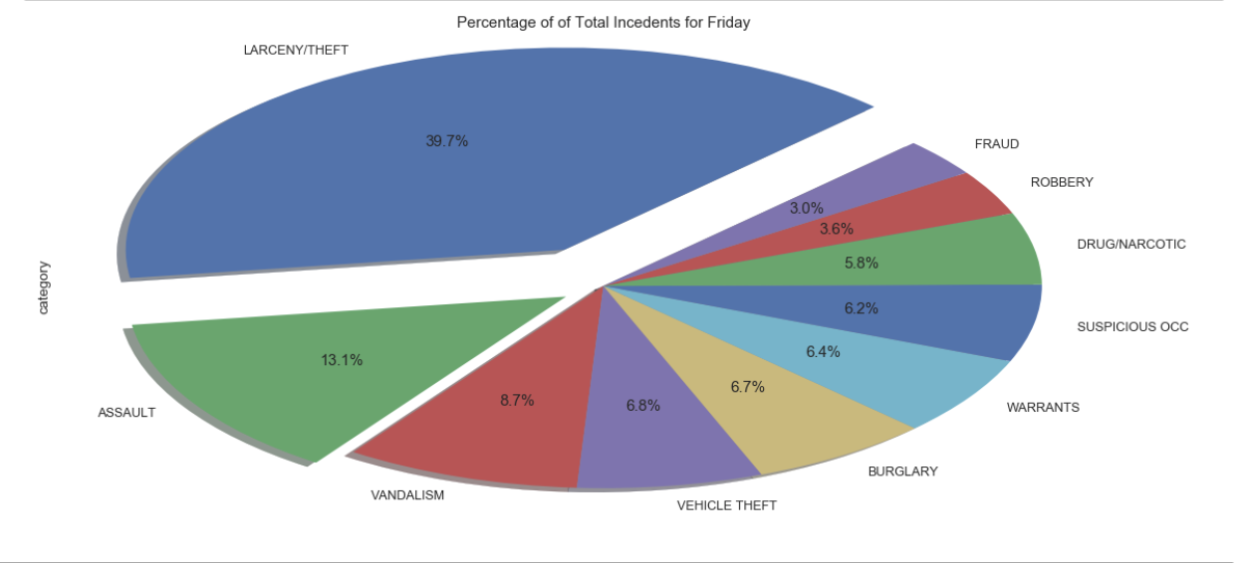
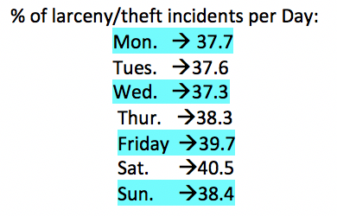
Incident mix on days of week

Slide 11
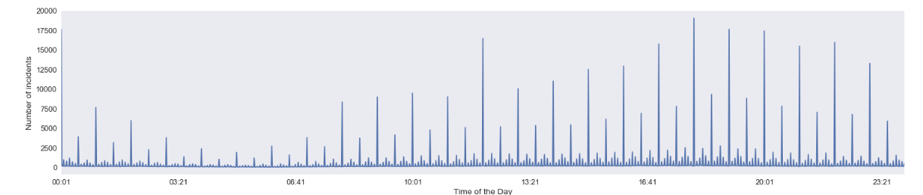
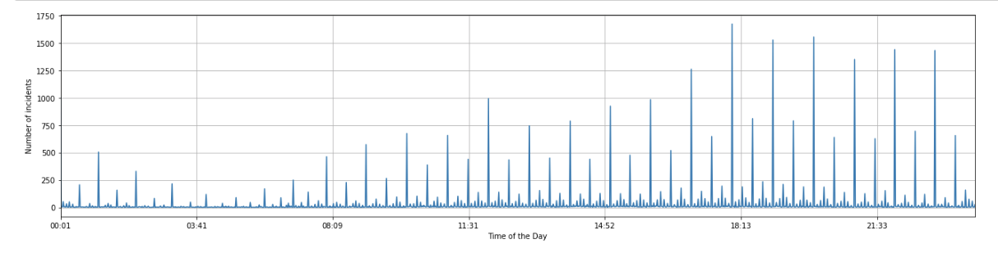
Time of day patterns
Other
Days
Sunday

Slide 12
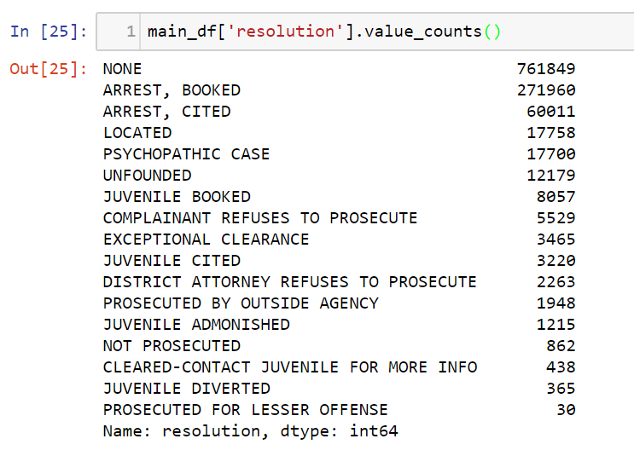
Resolution Rate Analysis
Resolution Rate:
Proportion of the incidents of the given category that does not have a resolution status of “NONE”
A non-NONE type resolution status implies that the police had followed up on the incident and given it some closure
All possible resolution types

Slide 13
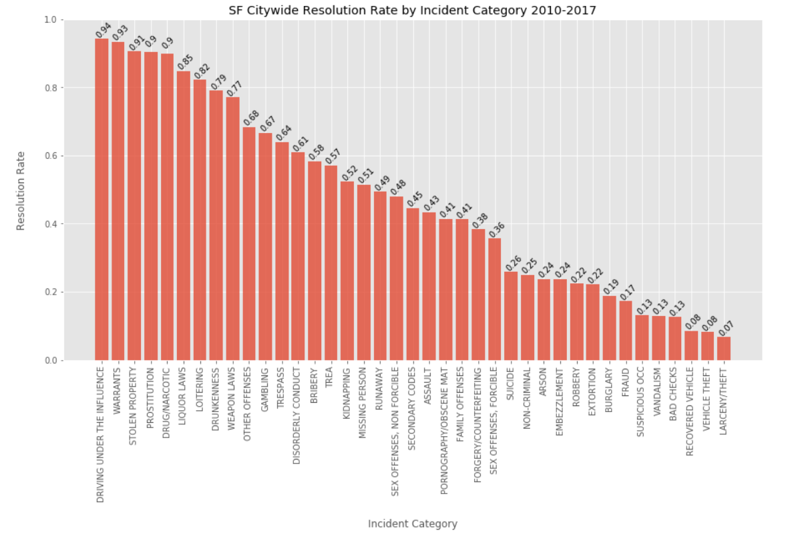

Slide 14
Does SFPD pay more attention to crimes committed in more affluent areas?
Mapped each incident’s coordinates to a zip code
Used ACS data from the Census Bureau to get the economic data for each zip code
Used 3 criteria for affluence level:
Poverty rate
Per capita income
Median household income
Incident types that showed correlation:
Burglary
Vehicle Theft
Trespassing
Assault
Fraud
Larceny/Theft

Slide 15
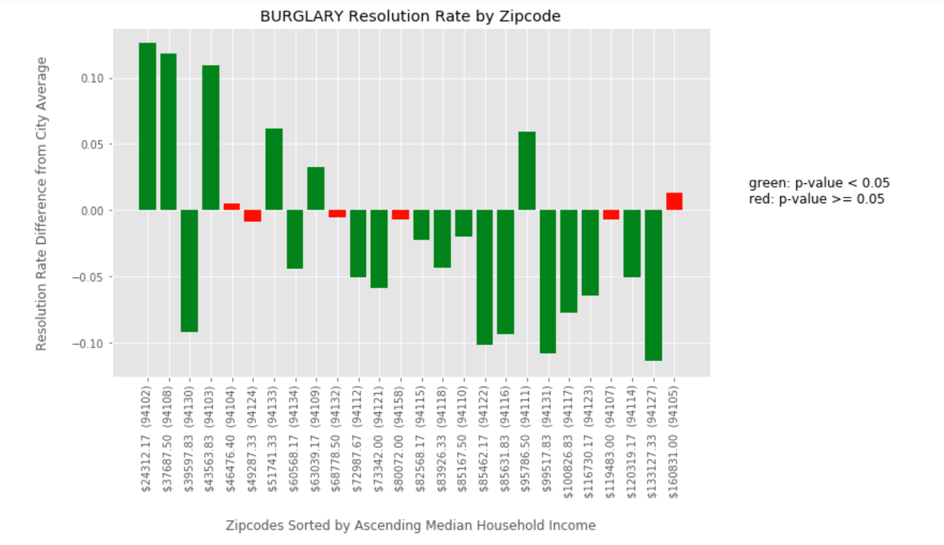

Slide 16
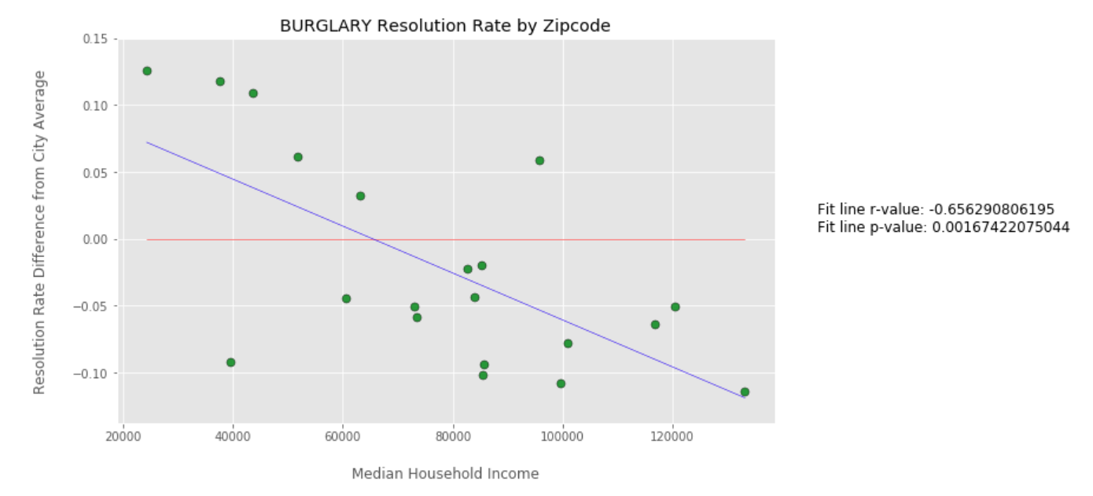

Slide 17
Q&A

Slide 18
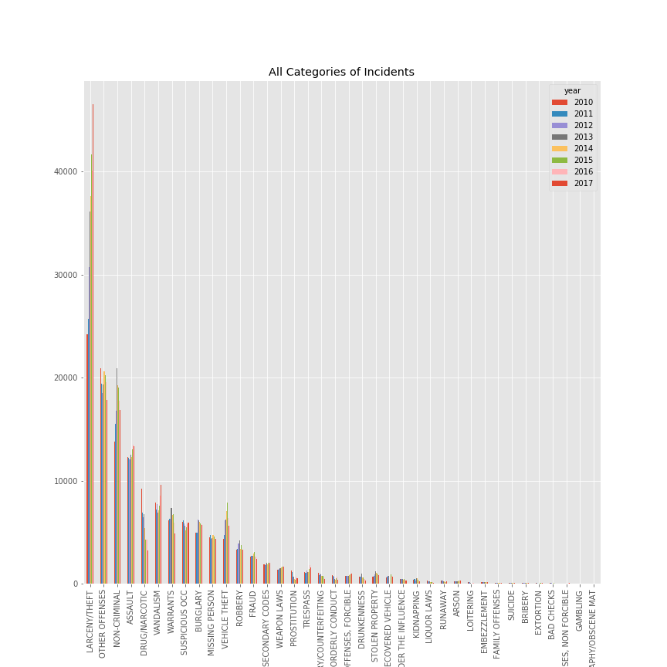
All categories of incidents by Count
BACK

Slide 19
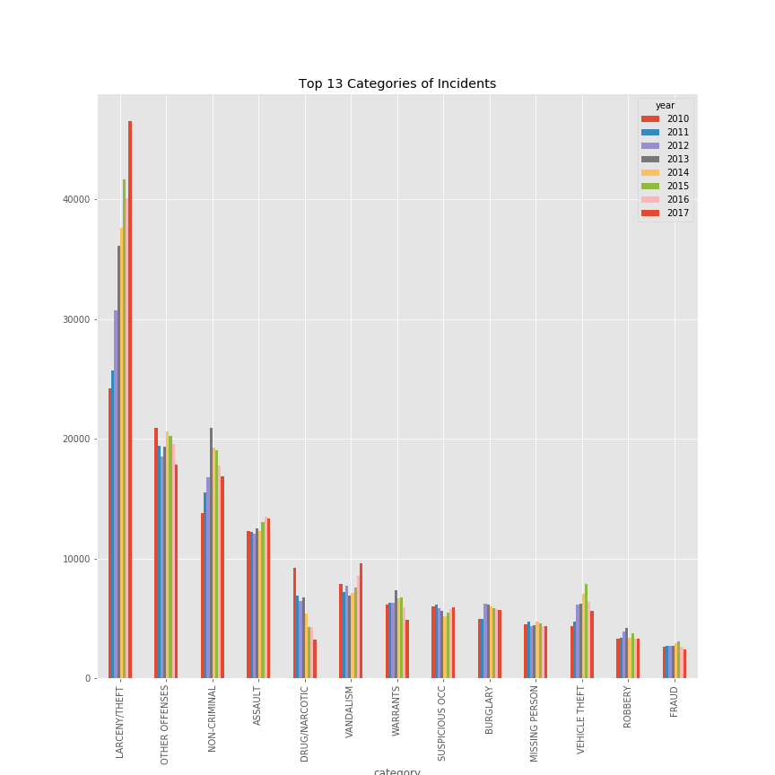
Top 13 categories of incidents by Count
BACK

