Slide 1


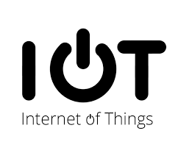
Branch: CSE
Presented by:
SOMITRA KUMAR DEY (20111065003)

Slide 2
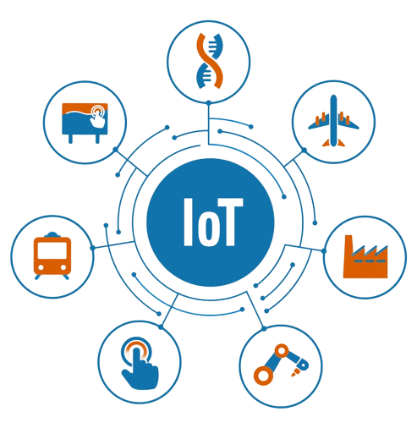
AGENDA OF THE DAY
Introduction
Components of IoT
Applications of IoT
Challenges and Solutions
Future of IoT
Case Studies
Conclusion

Slide 3
INTRODUCTION
IoT stands for Internet of Things. It refers to the interconnectedness of physical devices, such as appliances and vehicles, that are embedded with software, sensors, and connectivity which enables these objects to connect and exchange data..
Internet of Things (IoT) is the networking of physical objects that contain electronics embedded within their architecture in order to communicate and sense interactions amongst each other or with respect to the external environment.

Slide 4
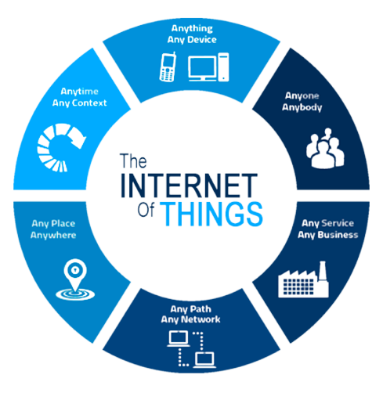
COMPONENTS OF IoT
Hardware components (sensors, devices, gateways)
Software components (operating systems, platforms, applications)
Connectivity technologies
(Wi-Fi, cellular, Bluetooth, Zigbee)
Cloud infrastructure and data analytics

Slide 5
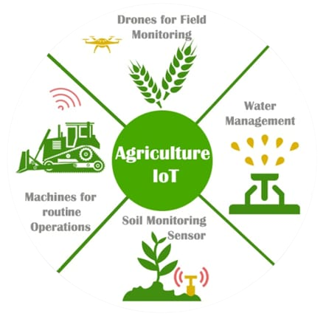
APPLICATIONS OF IoT
Smart homes and buildings
Industrial IoT (IIoT)
Healthcare IoT (HIoT)
Smart cities
Agriculture IoT (AIoT)

Slide 6
CHALLENGES AND SOLUTIONS
Security and privacy concerns
Interoperability and standards
Complexity of IoT systems
Data management and analytics
Energy consumption and sustainability
Solutions to address challenges

Slide 7
FUTURE OF IoT
Emerging trends and technologies (5G, edge computing, AI)
Opportunities and challenges in the future
Role of IoT in digital transformation

Slide 8
CASE STUDY
Smart Agriculture Using IoT
Smart agriculture, on the other hand, is mostly used to denote the application of IoT solutions in agriculture. So what is smart agriculture using IoT? By using IoT sensors to collect environmental and machine metrics, farmers can make informed decisions, and improve just about every aspect of their work – from livestock to crop farming.
For example, by using smart agriculture sensors to monitor the state of crops, farmers can define exactly how many pesticides and fertilizers they have to use to reach optimal efficiency. The same applies to the smart farming definition.

Slide 9
CONCULSION
The goal behind the Internet of things is to have devices that self report in real-time, improving efficiency and bringing important information to the surface more quickly than a system depending on human intervention.

Slide 10
THANK YOU

