Slide 1


SILLI POLYTECHNIC
(ESTD. BY GOVT. OF JHARKHAND &
RUN BY TECHNO INDIA UNDER PPP)
Approved by AICTE, Affiliated to JUT, Ranchi
An ISO 9001 :2015 Certified Institute
Hospital Appointment Website
Medlife
Presented by:
Somitra kumar Dey(20111065003)
Project Guide-

Slide 2

WELCOME

Slide 3
CONTENT
INTRODUCTION
OBJECTIVE
BLOCK DIAGRAM
METHODOLOGY
TOOL USED
TECHNOLOGY USED
ADVANTAGES
DISADVANTAGES
SCREENSHOTS
REFERENCE

Slide 4
INTRODUCTION
Medlife+ is a website designed to provide users with easy access to information about doctors and assist them in making appointments. The website aims to simplify the process of finding and booking appointments with healthcare professionals, making it easier for individuals to manage their health and wellness. By leveraging technology, Medlife+ hopes to bridge the gap between patients and doctors, providing a platform for users to connect with healthcare professionals in an efficient and convenient manner. With its user-friendly interface and comprehensive database of doctors, Medlife+ is poised to become a go-to destination for those seeking reliable healthcare services

Slide 5
OBJECTIVE
The primary objective of Medlife+ is to provide a user-friendly platform that allows individuals to easily find and connect with healthcare professionals. The website aims to streamline the process of booking appointments with doctors, reducing the time and effort required to access healthcare services. Additionally, Medlife+ seeks to provide users with valuable information about doctors, including their qualifications, specialties, and availability, helping individuals make informed decisions about their healthcare needs. Ultimately, the goal of Medlife+ is to improve access to healthcare services and make it easier for individuals to take control of their health and wellness.

Slide 6
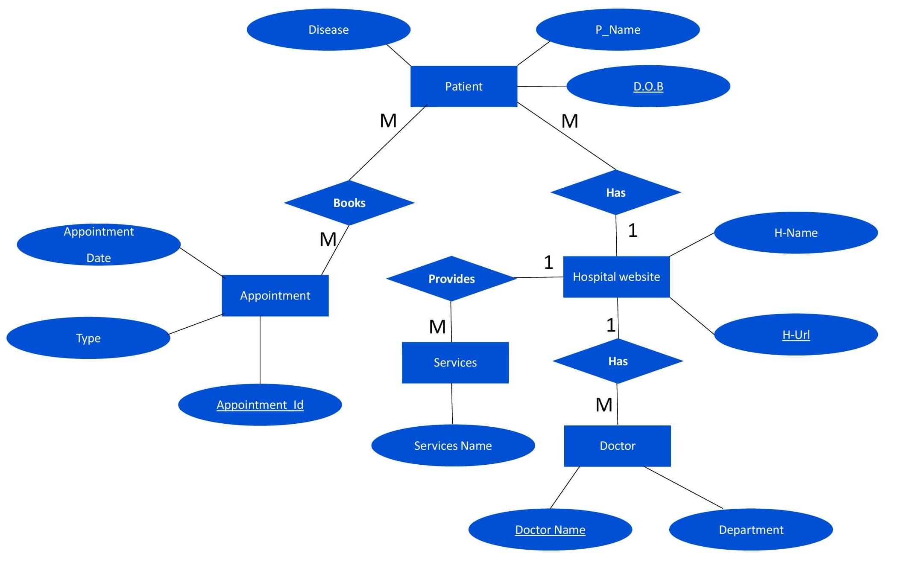
BLOCK DIAGRAM

Slide 7
METHODOLOGY
Requirement
System Design
Implementation
Testing
Deployment
Maintenance

Slide 8
TOOL USED
Hardware
Rayzen 5
8GB DDR4 RAM
1TB Hard Drive
AMD radeaon 2GB Graphic Driver
Software
Visual Studio 2023
Microsoft Windows 11

Slide 9






TECHNOLOGY USED
HTML
CSS
Java Script
PHP
FontAwsome
MySQL

Slide 10
ADVANTAGES
Provides a comprehensive database of doctors, making it easier for users to find the right healthcare professional for their needs
Enables users to easily book appointments with doctors, reducing the time and effort required to access healthcare services
Offers valuable information about doctors, including their qualifications, specialties, and availability, helping individuals make informed decisions about their healthcare needs
Leverages technology to bridge the gap between patients and doctors, providing a convenient platform for users to connect with healthcare professionals
Offers a user-friendly interface, making it easy for individuals of all ages and technical abilities to use the website
Improves access to healthcare services, helping to ensure that individuals can receive the care they need when they need it

Slide 11
DISADVANTAGES
The accuracy of the information provided on the website is dependent on the accuracy of the data sources used, and there is a possibility of outdated or inaccurate information being listed.
The website may be subject to technical issues, such as server downtime or website crashes, which could hinder users from accessing the platform or making appointments.
There may be some individuals who are not comfortable using technology to book appointments or prefer face-to-face interactions with healthcare professionals, limiting the target audience of the website.
The website may face competition from existing healthcare providers, making it challenging to attract users and build a loyal customer base.
Ensuring the privacy and security of users' personal and healthcare information is of utmost importance, and data breaches or security breaches could negatively impact the credibility and reputation of the website.

Slide 12
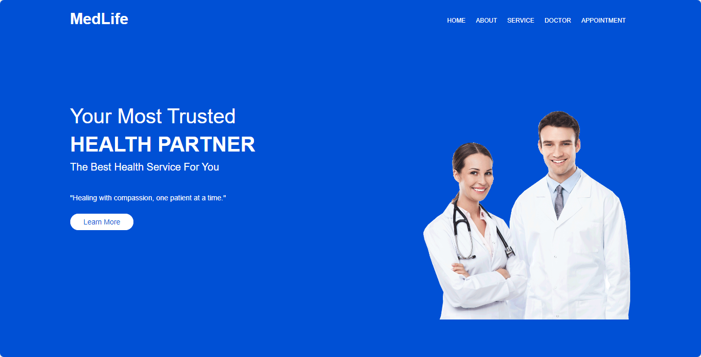
SCREENSHOTS
Home page

Slide 13
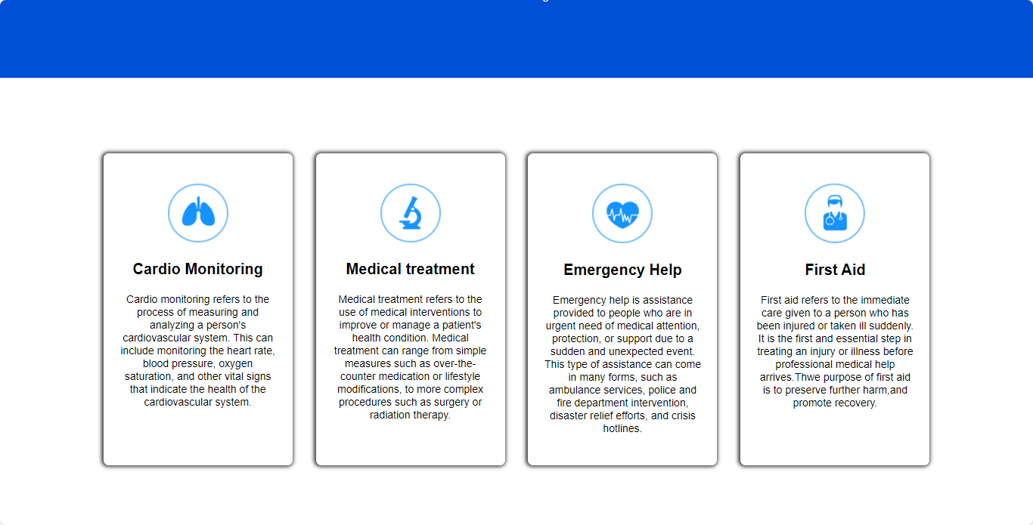
SCREENSHOTS
Services

Slide 14
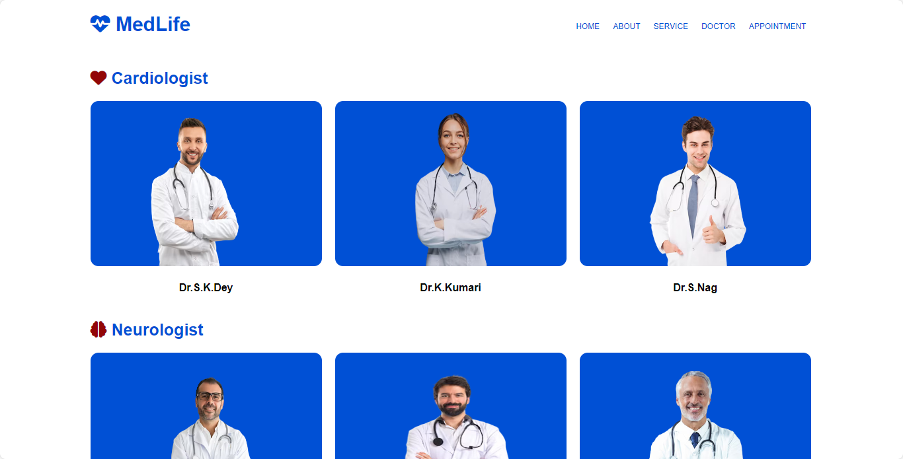
SCREENSHOTS
Doctor Detail

Slide 15
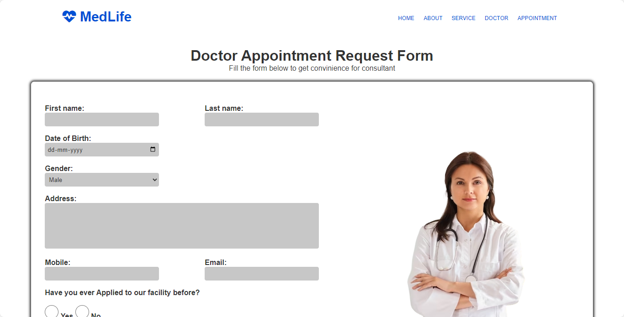
SCREENSHOTS
Appointment Form

Slide 16
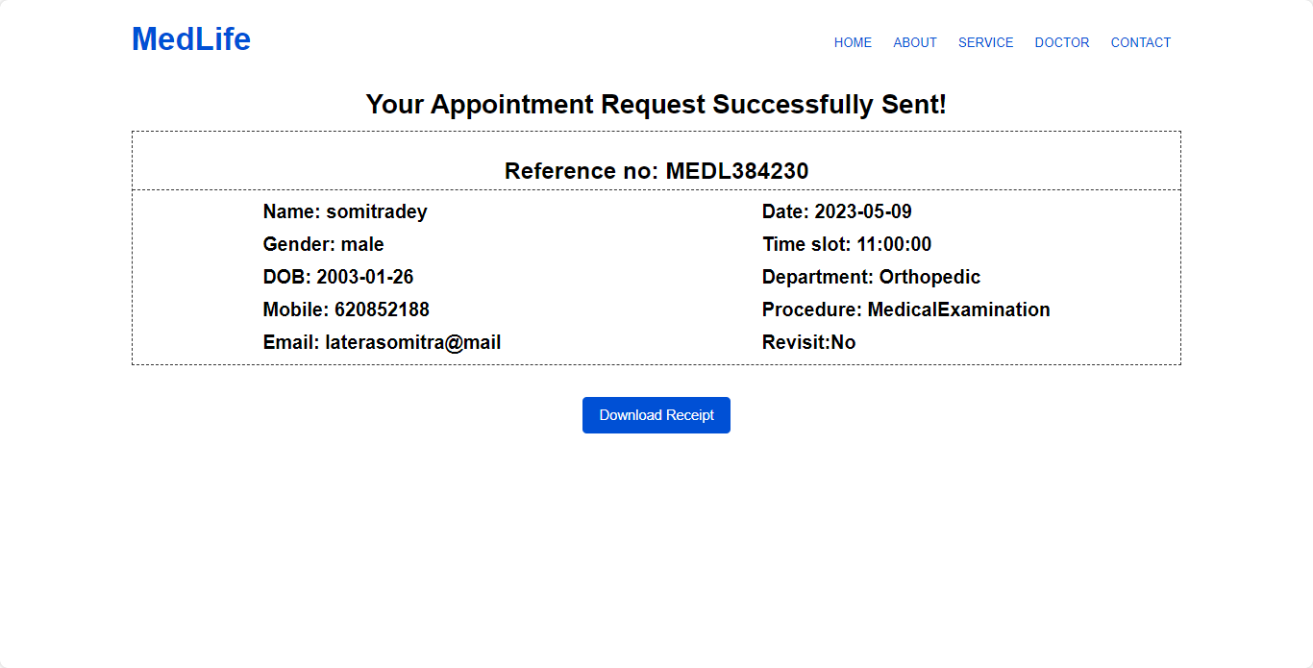
SCREENSHOTS
Appointment Reciept

Slide 17
REFERENCE
https://www.google.co.in/
https://www.geeksforgeeks.org/
https://www.youtube.com/

Slide 18
THANK YOU

