Slide 1
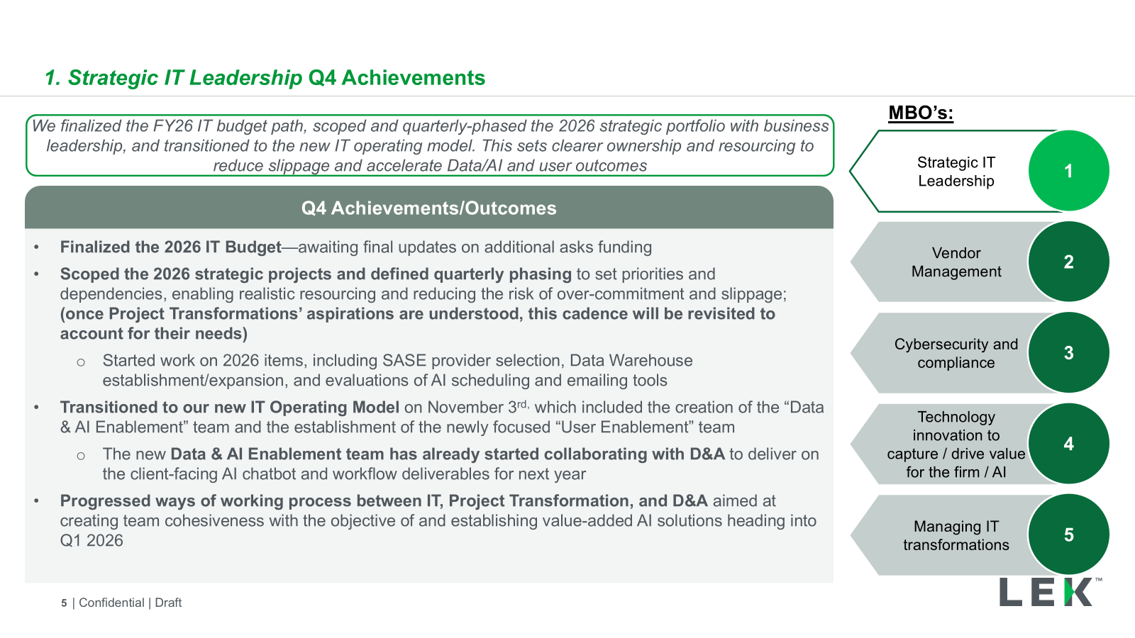
Challenge 1
Challenge: Create a deck that is able to convey the ‘true value’ of these delivered projects.
Background: This deck is provided to the Global Managing Partner (GMP) by the CIO on a quarterly basis to update him on project progress and the value delivered to the business.
So far, the GMP seems to like the work presented, but it is not conveyed in a way that truly tells of the value and importance these projects are providing.
The CIO wants to restructure this deck in a way that holds more meaning for the GMP
In the Appendix, you can see one slide that was an attempt to convey the ‘true value’ more effectively, but Kerri-Lynn said it still fell short.
Importance: This is a current issue that we aim to resolve for our next Q1 update with the GMP. If you can create something that impresses the CIO, it will demonstrate strong PPT skills
The challenge is to redesign the whole deck with a focus on these types of pages.
Obviously, we know you don’t have any more information so if there something you want to convey but don have the information just describe what information would fit in that box. The goal is to have a better structure & storytelling, rather than the information being presented right now.

Slide 2
IT is tracking against 5 high level MBO’s for 2025
Background info for what the MBO report tells leadership about
1
Strategic IT Leadership
Strategic IT Leadership | Driving L.E.K.’s business technology vision and strategy in alignment with business goals and building a high-performance IT team while cultivating a culture of innovation and learning
2
Vendor Management
Vendor Management | Driving value creation through strategic vendor and supplier relationships to meet evolving technology and staff needs
3
Cybersecurity and compliance
Cybersecurity & Compliance | Ensure effective management of IT systems, processes and resources to maintain competitive advantage
4
Technology innovation to capture / drive value for the firm
Technology innovation to capture / drive value for the firm | Enable digital transformation and AI initiatives to enhance client and employee experiences, and identify emerging technologies to maintain competitive advantage
5
Managing IT Transformations
Managing IT Transformations | Managing the delivery, performance and modernisation of IT systems and services, and driving operational efficiency through process optimisation and automation
Note: Blue text indicates a link to the Appendix items

Slide 3
1. Strategic IT Leadership | Q4 Achievements
Example of old slide to redesign
MBO’s:
We finalized the FY26 IT budget path, scoped and quarterly-phased the 2026 strategic portfolio with business leadership, and transitioned to the new IT operating model. This sets clearer ownership and resourcing to reduce slippage and accelerate Data/AI and user outcomes
Strategic IT Leadership
1
Q4 Achievements/Outcomes
Finalized the 2026 IT Budget—awaiting final updates on additional asks funding
Scoped the 2026 strategic projects and defined quarterly phasing to set priorities and dependencies, enabling realistic resourcing and reducing the risk of over-commitment and slippage; (once Project Transformations’ aspirations are understood, this cadence will be revisited to account for their needs)
Started work on 2026 items
Transitioned to our new IT Operating Model in November, which included the creation of the “Data & AI Enablement” team and the establishment of the newly focused “User Enablement” team
The new Data & AI Enablement team has already started collaborating with D&A to deliver on the client-facing tool to be delivered next year
Progressed ways of working process between IT, Project Transformation, and D&A aimed at creating team cohesiveness with the objective of establishing value-added AI solutions heading into Q1 2026
Vendor Management
2
Cybersecurity and compliance
3
Technology innovation to capture / drive value for the firm / AI
4
Managing IT transformations
5

Slide 4
Global IT delivered major upgrades to our internet, movement to the cloud, security upgrades, and D&A usage tracking upgrade
Example of a slide redesign
Internet upgrade
Gives us greater internet capacity, increasing from xx GB to xx GB
Automatic failover makes most circuit outages invisible to staff
Faster new-office setup and proactive monitoring via built-in analytics
Saves ~$xxK per year in connectivity cost
Upgraded the firm’s office internet and Wi-Fi backbone to a xxx service, so each office now has a faster, smarter, and more resilient connection
Move from on-premise to cloud
Moves us off an out-of-date, non-upgradeable version onto a patchable platform, reducing security risk
Avoids ~$xxk per year in VMware license costs
Reducing technical debt for out-of-date remaining on-premise items towards things on the cloud that will help with our overall transition
Security Upgrade
Replaces ~xxk hard-to-process and sort email alerts with focused dashboards so Tech Ops can improve reliability instead of triaging alert spam
Integrates with our hardware systems and gives us AI health scores and anomaly alerts for more proactive incident prevention
$x cost increase, materially better functionality
Upgraded a xx security platform that is able to ensure we have better security
D&A Tool Upgrade
Improves license management by showing who uses which tools and for how long
This enables accurate chargeback of D&A tool usage to client cases
Protects case margins
Upgraded a tool that will help us to track the usage of our data and analytics tools and tie that back to the case work that they were used on
Soft Value/nonmonetary
Hard Value/monetary

Slide 5
Challenge 2
Challenge: You will be given a prompt over the next few slides (in the comments), holding a description of what is needed for slides, and will create an outline with dummy information

Slide 6
Check Comments for Instructions
xx

Slide 7
Check Comments for Instructions
xx

Slide 8
Check Comments for Instructions
xx

