Slide 1
Ross 2017 Casebook
Edited and Assembled by Consulting Club @ Ross

Slide 2
Special Thanks to our Case Contributors
Case Writers:
Ashlyee Freeman
Pranav Gandhi
Sonia Joseph Griffin
Ben Lawson
Madeline Matthews
Victor Poon
Arthur Lilenbaum Valadares
Edward Xie
Edited and Assembled By: Chris Atkins
CC@R Education and all others who aided with content in this book!
‹#›

Slide 3
Ross 2017 Casebook – Table of Contents
Casebook Contents
Industry Overviews – In Development
Firm Specific Overviews – In Development
Reference Equations and Glossary – In Development (See Ross 2011)
Popular Peer Coaching Cases in Other Books – In Development
Cases
FLC Sports League
Libby’s Libation Lot
Auto Insurance Business Growth
Aircraft Hangar
Movie Studio Buyout
Rare Disease Business Growth
**Additional cases are currently being developed to supplement 2018 Recruitment
High Speed Train
Timeshare Exchange Co.
Pulp Friction
Data Aggregator
Consumer Products Strategy
‹#›

Slide 4
Popular Peer Coaching Cases in Other Books
Ross 2005
Argentinean Bank – E
Tissue Paper – M
Ross 2010
Gas Station – M
Pizzanomics – E
Vitamin Co – M
Wayne Rooney – M
Ross 2011
Baby Dinosaur – M
Lonestar Oil – M
Marie’s Café – M
Ross 2012
Bolsen Pharma – H
PD Gas Buyout – H
Seaworthly Floating Hotel - M
Ross 2015
African Call Center – M
Apache Helicopters – H
Dr. Rossmans Magic Drops – E
Lawn Co – H
Midwest Hospital – H
Ross 2016
Airport Parking - E
Diesel Transportation Co – M
Fertilizer Innovation – M
German Luxury Car – M
Spare Parts – E
Darden 2014
Ski Resort – H
Fuqua 2009
Lizettes Luxury Properties – M
Kellogg 2011
A+ Airline – M
Bell Computers – H
GoNet ISP – H
Health Coaches – H
Hospitality Co – M
Maine Apples – M
Rock Energy – M
Syzygy Supercomputers – H
Winter Olympics Bidding – M
Wharton 2010
Caskets – M
Debeer’s Retail Venture – M
Jamaican Land Investment – E
Organic Pizza Crust – E
Copper Ore Mining Investment – M
Whisky Brand Turnaround – M
‹#›

Slide 5
FLC Sports League
Case Prompt
Your client is a major sports league called FLC. They organize a national championship and several other smaller competitions. Serving as the only men’s soccer league in the country, FLC currently has 10 teams. FLC is involved in general league management which includes setting rules of gameplay, organizing the US National Championship, drafts, matches, referees and deals with sponsors etc. Currently FLC only receives revenues from royalties payed by the teams within the league and the company is interested in increasing its net income by expanding its operations.
Case Info
Interviewer Guidance
Difficulty: Hard
Case Format: Profitability / Market entry
Concepts Being Tested: Market Share or Sizing, Net Income Margin
In this case, the candidate should NOT focus on FLC’s current existing costs. The main focus is to evaluate different options to expand FLC’s operations to meet the target NI growth.
This is an interviewee led case. It should conclude with a concrete recommendation from the interviewee
‹#›

Slide 6
FLC Sports League
Clarifying Information
Guide to Handouts
This year, FLC’s revenue was ~$100M with 10% Net Income
FLC wants to increase its NI by 20% in the next year, with a ROI (NI / Investment) hurdle rate of 15%
For the purpose of this case, consider that FLC current operations and revenue management are fully optimized (no organic growth possible)
FLC is responsible for large upfront commercial, operational and marketing costs when a new team enters the league
FLC does not own any teams in the league
Candidate should assume that are teams interested to join the league in any option chosen.
Provide Exhibit #1 when candidate requests information regarding potential revenues/ market size
Provide Exhibit #2 when candidate requests information on existing geographies, or suggests evaluating geographic expansion
Provide Exhibit #3 when candidate requests information on costs involved to accept new teams
Candidate should clarify that FLC is a soccer league and that FLC’s only revenue stream is royalties from teams in the league
‹#›

Slide 7
FLC Sports League
Possible Framework
Market entry – same business
New sport – hockey, baseball, football
New geography – recruit new teams in US cities
New leagues – women, youth
Market entry – different business
Acquiring a team – good idea, but if it is a soccer team, conflict of interests. If other sports, very risky, because FLC doesn’t have the know how.
Current business
Increase royalties – Not possible, revenue management fully optimized
For each of the options, candidates should come with a method to evaluate revenues and costs to FLC
Revenue drivers: Royalties paid to the league (Soccer fans, Avg spent with sports, team avg revenues)
Cost drivers: Marketing, Labor, SG&A
Give bonus points for candidates that come with those different options and can point out different drivers / risks.
‹#›

Slide 8
FLC Sports League
Exhibit 1: Average royalties paid for league MGMT
# Teams
10
8
10
10
Avg revenue per team ($M)
40
50
100
60
‹#›

Slide 9
FLC Sports League
Exhibit 2: Sports fans in cities where FLC isn’t present
New club projected revenue per sports fan (year)
$30
$50
$25
$40
‹#›

Slide 10
FLC Sports League
Exhibit 3: FLC’s total cost to foster a new team
City | Sport | Cost ($M)
San Diego | Hockey | 1
San Diego | Baseball | 2
San Diego | Football | 3
San Diego | Soccer | 5
Atlanta | Hockey | 9
Atlanta | Baseball | 10
Atlanta | Football | 12.5
Atlanta | Soccer | 7.5
City | Sport | Cost ($M)
Detroit | Hockey | 4
Detroit | Baseball | 1.5
Detroit | Football | 2.5
Detroit | Soccer | 2
Houston | Hockey | 1
Houston | Baseball | 4
Houston | Football | 8
Houston | Soccer | 4.5
‹#›

Slide 11
FLC Sports League
Exhibit 1 Takeaways
Exhibit 2 Takeaways
Exhibit 3 Takeaways
A good candidate will exclude Hockey and Baseball from further analysis after calculations, but a great candidate will exclude these two sports just looking at the graph and not doing any math.
Calculations:
Hockey – 10 x $40M x 2% = $8M
Baseball – 8 x $50M x 5% = $20M
Football – 10 x $100M x 10% = $100M
Soccer – 10 x $60M x 15% = $90M
Takeaway
Move on with Soccer and Football
A great candidate will start with Atlanta and will remember to multiply the final revenue of each team by the royalties % and NI margin
Calculations:
Atlanta Football – (4M – 2.5M) x $50 = $125M rev. x 10% royalties paid to FLC = $12.5M in new rev. x 10% NI margin = $1.25M
Atlanta Soccer – (6M – 4M) x $50 = $100M x 15% royalties = $15M x 10% = $1.5M
Houston Football – (4M – 2M) x $40 = $80M x 10% royalties = $8M x 10% = $0.8M
Houston Soccer – (5.5M – 4M) x$40 = $60M x 15% royalties = $9M x 10% = $0.9M
Takeaway
Atlanta and Houston good options
A good candidate will get here with Atlanta soccer and football recommendation. A great candidate will point out possible risks of moving to another sport.
Calculations:
Atlanta Football - $1.25M NI / $12.5 cost = 10% ROI
Atlanta Soccer - $1.5M NI / $7.5M = 20% ROI
Houston Football - $0.8M / $8M = 10% ROI
Houston Soccer - $0.9M / $4.5M = 20% ROI
Takeaway
Football’s ROI is lower than FLC’s hurdle rate, so FLC should move on with soccer in Atlanta and Houston
‹#›

Slide 12
FLC Sports League
Recommendation
Risks
FLC should invest in an Atlanta ($1.5M) and a Houston ($.09M) team in order to achieve the $2.4M (24%) increase in net income and respect the ROI hurdle rate of 15% in both investments (Atlanta and Houston – 20%)
Customer preference can change from soccer to other sports
Average spent can be lower than expected
As FLC grows, costs can increase more than expected
Next Steps
Excellent Answers
Start negotiating with the proponents
Set up initial marketing and communication plan for the launch
Client should consider other cities to keep expanding in the following years.
Candidates come with two or more opportunities to expand (other sports, other cities, other leagues)
Candidates that quickly realize that Hockey and Baseball are not interesting to FLC
Candidates that identify risks involved in opening a Football League (lack of know how, competitiors)
Candidates with perfect math calculations / organization
‹#›

Slide 13
Libby’s Libation Lot
Case Prompt
Your client, Libby, owns a local lawn & garden store is looking at opportunities to generate additional revenue. She is exploring the possibility of opening an outdoor bar in the parking lot of her store. She has asked for your help in assessing the opportunity
Case Info
Interview guidance
Difficulty: medium
Case format: profitability / market entry
Concepts being tested:
Interviewee led case
Candidate should focus on profitability; discussion of market / competition / customer impact should be brief but should be noted at some point by the candidate
‹#›

Slide 14
Libby’s Libation Lot
Clarifying information
Geography: Client is located in Ann Arbor, MI
Goal: Client is looking to payback the investment in 3 years or less
Competition: there are a number of restaurants nearby selling local beer and local wine, local breweries nearby, and a beer garden across the street.
Experience: client has no experience in selling beer or wine, they do not have a liquor license, they only sell gardening tools, plants, etc.
Current business: lawn and garden store is open from 10am – 5pm everyday. Typical customer is middle-aged, full-time resident of Ann Arbor.
‹#›

Slide 15
Libby’s Libation Lot
Possible Framework
Revenue Profit
Volume
Product mix -- beer, wine, soda, snacks
# customers
# drinks / customer
Price
Happy hour pricing
Pricing to competition
Volume pricing -- pitchers, bottles of wine
Cost
Investment
Repaving lot / bar area
Tables / Chairs / Lighting / Music / glasses
Fixed Cost
Electricity / Equipment depr. / replacement
Variable cost
Beer, wine, snacks
Staff
Bartenders, bouncer, bussers, maintenance
Market
Company
- Alignment w/ strategy / mission
Customers
- Impact to current customer base? (how they view the company)
- Potential to generate more knowledge about the lawn / garden store through beer garden
Competition
- Nearby restaurants, bars, breweries
- Is there room in the market for another
Other
- Liquor license
- City regulations
‹#›

Slide 16
Libby’s Libation Lot
Information provided when specifically asked
Notes for interviewer
Investment: $250k
(includes repaving, bar area, tables, chairs, glasses, etc.)
Fixed costs: $8k / year
($4k electricity, $4k depreciation)
Variable costs:
$4 / beer
$8 / wine
$10 / hour / employee
7 employees (3 bartenders, 2 bussers, 1 bouncer, 1 maintenance)
Revenue (market sizing): Capacity of space: 100 seated, 20 standing (120 total)
Hours of operation: 6 – 10pm, 150 days per year
Assume: 50% capacity, each person spends $12 (2 beers or 1 wine)
Wine: $12
Beer: $6
Guide candidate to think of revenue in terms of capacity and utilization of the space vs. total bar market in Ann Arbor
‹#›

Slide 17
Libby’s Libation Lot
Math solution
Revenue
# of customers per year: 120 people * 50% capacity * 4 hours per day * 150 days per year = 36,000 customers
Revenue: 36,000 customers * $12 per person = $432,000
Variable costs
$8 of beer or wine per person * 36,000 = $288,000
7 employees * $10 per hour * 4 hours * 150 days = 42,000
Fixed costs
$8,000 per year
Annual profit
$432,000 - $288,000 - $42,000 - $8,000 = $94,000
Can we get payback in 3 years
Assume 0% discount rate
3 years: $282,000 in profit
Cover $250,000 investment
‹#›

Slide 18
Libby’s Libation Lot
Additional areas of discussion
Bonus points
Strength of competition
Impact to customers of lawn and garden store
Ask about a discount rate
Ask if there are other ways to use this investment money?
Recommendation
Yes, they should move forward because we can payback the investment in less than 3 years
Risks / Mitigation (next step):
R: capacity assumptions may be too high; M: analysis of market share potential
R: negative impact to lawn and garden brand; M: interview / survey current customers
R: client has no expertise in bar business; M: consulting team can provide additional guidance on approach / ongoing management
‹#›

Slide 19
Auto Insurance Business Growth
Problem Statement
In 2006, a top 5 auto insurance company in Singapore is looking to grow its revenues from new customer premiums by 3 times the market growth rate over the next 5 years
The CEO is asking BCG to help find out:
Is it feasible
If feasible, how do we achieve it
Type of Case
Interview Guidance
Industry: Insurance
Format: Revenue Growth
Difficulty: Medium
Concept Tested: Revenue Model, Organizational Problem Analysis
This is a interviewee lead case
It is critical for the candidate to break down revenue by sales channels
After the candidate identifies online channels as the best growth engine, ask candidate to brainstorm reasons that would cause our client to lag behind competition with online customer premium growth
‹#›

Slide 20
Auto Insurance Business Growth – Framework
Existing Revenue
New Revenue
Channels
Agent Channel
Market Size
Market Growth
Competitor Growth
Call Center Channel
Market Size
Market Growth
Competitor Growth
Online Channel
Market Size
Market Growth
Competitor Growth
Avg. Customer Spending $
Competitor performance
Customer #
Compliment Service
New Products
Acquisition
‹#›

Slide 21
Auto Insurance Business Growth
Clarifying Information
New customer definition
BCG is brought in to work on the revenue growth problem and profitability is not in the scope
Revenue growth rate from new customers (3x market growth rate) is the only goal pursued by our client
Candidate needs to answer the first question on feasibility and then look into how it can be achieved
In the auto insurance business, a customer’s insurance contract is renewed every year. A new customer is one who did not buy insurance from us during the year prior.
Additional Information to Provide upon request
Market will grow 20% over next 5 years
The client’s company generated $500M of revenue over the past year
Auto insurance is the only product the company sells and It is hard to build business on other insurance products within 5 years due to various constraints such as regulation control and strong competition
Consumers purchase auto insurance through 3 channels: sales agent, call center and online with sales agents accounting for most historical sales
Competitors have a much higher growth rate than us, but no particular figure is available
Merger or acquisition is not an option due to tight cash flow and large cost to conduct M&A
‹#›

Slide 22
Auto Insurance Business Growth – Exhibit 1
Market Growth by Channel
Channel | Market Size Now | Market Size in 5 years
Agent | 8 billion | 7 billion
Call Center | 7 billion | 7 billion
Online | 5 billion | 10 billion
Total | 20 billion | 24 billion
‹#›

Slide 23
Auto Insurance Business Growth
Sample Calculations
Guidance: To evaluate the feasibility of obtaining premium revenue growth at 3X market growth rate, candidate needs to look into the overall market growth and understand the take-up % needed to achieve that. An excellent candidate will look into this path. Otherwise guide candidate to this path
If we focus our growth efforts specifically on the online channel, while maintaining growth rates from sales agents and call centers, how much percent of the online market growth we need to capture? Is it feasible in your opinion?
Current Revenue: $500M
Market Growth: 20%, Target Growth: 20% *3 = 60%
Absolute Growth Value: $500M * 60% = $300M
Online Chanel Growth: $10B – $5B = $5B
Market growth portion to be captured: $300M / $5B = 6%
6% is a relatively small portion of overall market growth, thus it is feasible
Good Insight: There is likely low fragmentation in a highly consolidated insurance industry (general characteristics), thus capturing 6% of market growth is very feasible
‹#›

Slide 24
Auto Insurance Business Growth
Key to achieve the ambitious growth rate – Brainstorm & Potential Answer
Guidance: After determining the growth target is feasible, the candidate should look into the 2nd question on how to achieve it. Benchmarking against competition is the way to find out that client's online channel is lagging behind. Excellent candidate can drive to ask the competition benchmark. Otherwise guide candidate to this path
Currently, our online channel revenue growth is far behind our competitor, what do you think can be the reason?
Lacking talent to work on online product for great user acquisition
Lacking capability of digital marketing to bring more traffic and better customer conversion
Price disadvantage to attract customers
Misalignment of goals and incentives to promote online channel growth from structure dominated by sales agents.
Ex: Proper incentives could promote “hybrid model” where sales agents support the online interface
Note: Drive candidate to discover point 4, which will differentiate an excellent candidate from good candidate
‹#›

Slide 25
Auto Insurance Business Growth
Answer to feasibility
Answer to how
Risk and Follow-up
Yes, we can achieve 60% growth given
1. Fast growth of online channel
2. We only need to capture 6% of the online channel market
We can achieve this target by
1. Re-design organization structure to allow more resource allocation to online channel
2. Improve online channel user experience
3. Improve digital marketing to draw traffic to online channel
Risk:
Organizational change is challenging
Follow-up:
1. Explore options to resolve the organizational issue, e.g. spin out the business unit to run independently
2. Change management performance matrix to allow more resource allocated to online channel
‹#›

Slide 26
Aircraft Hangar
Problem Statement
Our client, an independent aircraft hangar, has found that revenues have been very unpredictable and they have not been able to meet their earnings targets. They have engaged your firm to understand why and to turn it around.
Type of case
Interviewer Guidance
Type: Operations
Difficulty: Very Hard
Concepts tested: General industry knowledge, heavy quantitative, operations
This case is very quant heavy which requires a bit of reasoning to understand how to put the equations together.
Interviewer guidance may be necessary to help piece together the equations. However, a superior candidate will not need such guidance.
‹#›

Slide 27
Aircraft Hangar
Clarifying Information
Calculating assumptions
Demand for the hangar is ample so it is occupied year-round.
The management team bought the hangar from its previous owners who were unable to turn a reasonable profit from it. The current management has been running it for two years.
An aircraft hangar generates revenue by selling maintenance services to commercial clients (American Airlines) and freight clients (FedEx).
Assume that only regular maintenance is done – no special, customized, or non-routine work is completed in this hangar.
Boeing 737, 757, and 767 can be serviced by the client. Profitability within each of these models is consistent.
300 work days in a year
The same maintenance work is done on every aircraft of the same model which comes in
‹#›

Slide 28
Aircraft Hangar – Recommended Solution
Margin per aircraft
Per aircraft, in $ millions | 737 | 757 | 767
Revenues generated | $0.60 | $1.00 | $1.10
Labor costs | $0.32 | $0.50 | $0.64
Materials costs | $0.08 | $0.05 | $0.06
Contribution margin | $0.20 | $0.45 | $0.40
Days to process | 4 | 5 | 8
CM per day | $0.05 | $0.09 | $0.05
Desirable aircraft mix | 757
Contribution margin per aircraft | $0.45
Number of aircraft processed | 300 / 4 days * 3 hangars
Contribution margin | $101.25 million
Net income | $81.25 million
‹#›
Notes:
123,750

Slide 29
Aircraft Hangar – Exhibit A
Exhibit A: 2016 ERP output
 | Hangar bay 1 | Hangar bay 2 | Hangar bay 3
Aircraft processed | 65 | 48 | 37
737 | 55
757 |  | 28
767 | 10 | 20 | 37
Revenues generated | $44 million | $50 million | $40.7 million
‹#›

Slide 30
Aircraft Hangar – Exhibit B
Exhibit B: 2016 Head mechanic notes
 | Processing time | Movement time¹
737 | 3 days | 1 day
757 | 4 days | 1 day
767 | 7 days | 1 day
 | Daily labor cost per aircraft | Flat materials cost per aircraft | Total annual fixed costs
737 | $80,000 | $80,000 | $20 million
757 | $100,000 | $50,000
767 | $80,000 | $60,000
¹ Processing time is the time it takes for maintenance work to be completed on a plane from the time it begins to the time it is complete. Movement time is the time it takes to move an aircraft out of the hangar after work is finished plus the time it takes to move a new aircraft into the hangar before work can begin.
‹#›

Slide 31
Aircraft Hangar
Insights – Exhibit A
Insights – Exhibit B
Different aircraft have different revenue figures
First move is to calculate the revenues generated per aircraft processed
Recommended method
Start with calculating 767 revenues, then isolate for 757, and then 737
$1.1m for each 767
$1.0m for each 757
$0.6m for each 737
When the interviewee sees this exhibit, he/she should come to understand that we want to find out revenues / day for each type of aircraft in the hangar.
Therefore, the goal with this exhibit is to understand how much it costs to process each aircraft. This can be done on a “per day” basis or a “per aircraft” basis, before aggregating to a full year basis.
Movement time can be added to the beginning or end of each aircraft job. Therefore processing time and movement time should be added together
Recommended method
Total hangar time
4 days for 737
5 days for 757
8 days for 767
Total labor cost
$320,000 for 737
$500,000 for 757
$640,000 for 767
‹#›

Slide 32
Aircraft Hangar – Recommended Solution
Conclusion
Risks (could name several)
Aircraft Hangar should attempt to sell 757 work, as it is most profitable. It would be able to reliably earn $81.25 million.
Popularity of aircraft? Is demand there?
Are the mechanics knowledgeable and trained in the 757?
Is there a reason the 757 was not in as much before? Maybe strong competition?
Next steps
Secure maintenance contracts with airlines which use the 757
Assess pricing of competitors to align daily contribution margin to be “indifferent” between the different aircrafts
‹#›

Slide 33
Movie Studio Buyout
Case Prompt
Our client, Trust Studios, is looking to purchase a movie studio and has hired our firm for advice. Trust Studios was founded this year by Ethan Trust, a self-made billionaire, after attending this years Academy Awards.
Case Info
Interviewer Guidance
Difficulty: Hard
Case Format: Interviewee Led / Profitability
Concepts Being Tested: Valuation, Chart Interpretation, Trend Analysis
- This case is designed to test a candidate’s ability to analyze charts and prepare them for a written case.
- Allow the candidate to lead the case through the framework then give them a data dump with all the exhibits. This will force the candidate to stay structured and properly synthesize a lot of information at once. Also recommend giving a time limit to discuss the exhibits.
- The candidate should focus on buying a studio that can break even and that is likely to win an Oscar.
‹#›

Slide 34
Movie Studio Buyout
Clarifying Information
Guide to Handouts
Trust Studios has not produced any movies and only has 3 employees
Ethan Trust made his billions building next generation luxury green campers/recreational vehicles
Mr. Trust was overwhelmed by the glitz and glam of the Academy Awards Ceremony and wants to win an Oscar
Even Mr. Trust’s philanthropic endeavors have been cash flow positive and he at least wants to break even over 5 years
Trust Studios was initially targeting LionsGate (LG) because they have won a number of Oscars and are a top ten movie studio
Recommend giving the candidate all the handouts at once after they walk through their framework. This will force the candidate to 1. stay structured and refer back to their framework, and 2. analyze, prioritize, and synthesize a large amount of data. A technique to make this transition is after they walk through the framework, say something such as, “I think that framework makes sense; I am excited to see your recommendation at the end. We have done a little research into the movie studio industry and have come up with this raw data but are not sure how to interpret it. Hopefully some of it fits in to your framework and can go toward your recommendation. Our Mr. Trust is visiting us in 15 minutes for initial recommendations, what are your thoughts?”
The case presents itself initially to be about profits, but little calculation is needed to present good recommendations.
If the candidate does not ask, recommend telling them the initial target of LionsGate (LG).
‹#›

Slide 35
Movie Studio Buyout – Potential Framework
Should Trust Studios purchase LG
LG profitability
Oscar chances
Gross revenue
Costs
Number of tickets sold per movie
Number of movies produced
LG is producing movie types that win awards
Mix of movie genres (action vs drama & small budget vs large)
Marketing (national, cobranding)
LG has won awards in the past
Ticket price (national or by location)
Actors (A-lists vs B-lists)
Number of movies produced
Logistical (set design, on-location)
Ancillary (action figures, video games, cartoons, etc.)
Crew (director, others)
CGI (action vs others)
‹#›

Slide 36
Movie Studio Buyout – Chart Takeaways
Exhibit 1: Gross Sales
Exhibit 2: Movies and Market Share
-The top 4 movie producers make up ~75% of the market, up from ~50% in 2012.
-The movie market has been fairly stable over the last 5 years with an average market size of just under $9 billion.
-LG sales dropped from ~$1 billion in 2012 to ~$500 million in 2016.
-The top 4 producers have been gaining market share over the last 5 years while not increasing the number of movies produced.
-Most of the top movie producers make ~20 movies a year.
-LG has lost 50% of its market share and is producing more movies
Exhibit 3: Top 5 Movies
Exhibit 4: Gross Sales Total
-Top 5 movies account for ~25% of the market
-Most top 5 movies’ genres are either series, action, or kids.
-Top 5 movies do not win many awards.
-Top 5 movies are highly rated. (not relevant)
-LG produced the “Starving Kids Fight” series in 2012-2014 and this made up ~50% of their revenue.
-~75% of the movie market is action, series, or kids films.
-Other production firms make up a disproportionately large percentage of sales for “other” type movies.
-LG made a large percentage of its revenue from action and series movies (see Starving Kids Fight, Exhibit 3)
‹#›

Slide 37
Movie Studio Buyout – Chart Takeaways
Exhibit 5: Studio Awards (2012 – 2016)
Exhibit 6: Oscar Best Picture Winners
-LG has won an average of 1.8 Oscars a year.
-Revenue does not correlate with awards.
-On average a studio needs ~5 nominations to win an award. (not relevant)
-Best picture winners win multiple awards.
-Best picture winners are rarely action, series, or kids.
-Best picture winners are usually not grossing enough to be in the Top 5 pictures.
Exhibit 7: Movie Ratings
Exhibit 8: Movie Production Expenses
- This graph is extraneous information (movies that are ranked higher in general have higher sales).
-High budget films cost 10X more than low budget films.
‹#›

Slide 38
Movie Studio Buyout
Sample Calculations
*With how open-ended this case is, a very successful answer may not use any of the calculations below and the numbers are not expected to be exact since they come off graphs.
With 25 movies a year (Exhibit 2) at $25 million (Exhibit 8, assuming least expensive case using low budget films), LG has costs = $625 million
LG’s 2016 profit is $500 million (Exhibit 1) - $625 million = -$125 million
Top 5 movies from 2012-2016 generated ~$10.5 billion (Exhibit 3) while all movies generated $44 billion (Exhibit 1, 4)
$10.5 / $44 = ~25% of all movie revenue is from the top 5 movies
‹#›

Slide 39
Movie Studio Buyout
Solution and Recommendations
LG does not look attractive because of its declining sales
LG has lost 50% market share in the last 5 years
Net loss of $125 million a year
LG does look attritive because of its Oscar wins
Ethan Trust initially wanted to buy a studio to win an Oscar
LG has won 8 awards over the last 5 years
There is no right answer, a candidate may recommend to go ahead recommending LG with caution (a potential next step could be to identify movies in the production pipeline that could turn a profit and others that could win Oscars). If a candidate does not recommend buying Lions Gate, they should give at least briefly talk about another option.
Excellent Case Insights
Top grossing movies are likely to be action, series, and kids movies but those genres are not likely to win awards
1 movie series made up nearly half of LG’s revenue during 2012-2014 resulting in a large drop in revenue in 2015-2016
‹#›

Slide 40
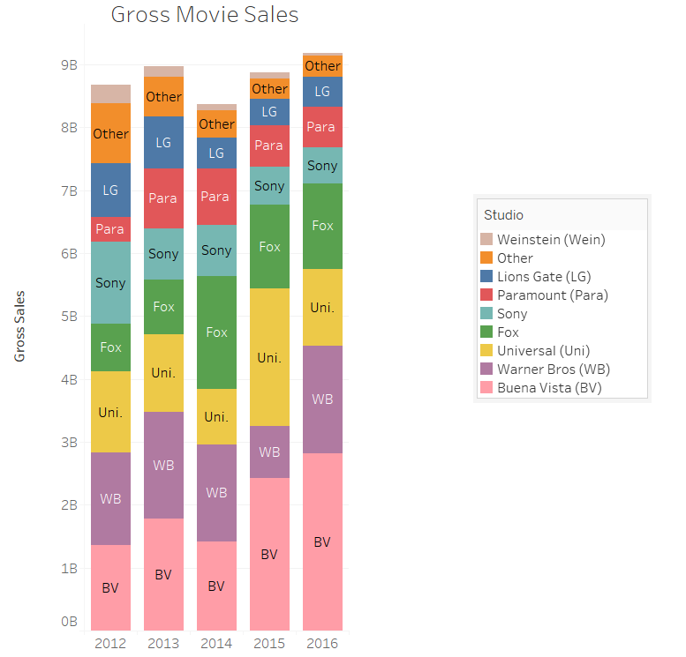
Exhibit 1: Gross Sales
‹#›

Slide 41
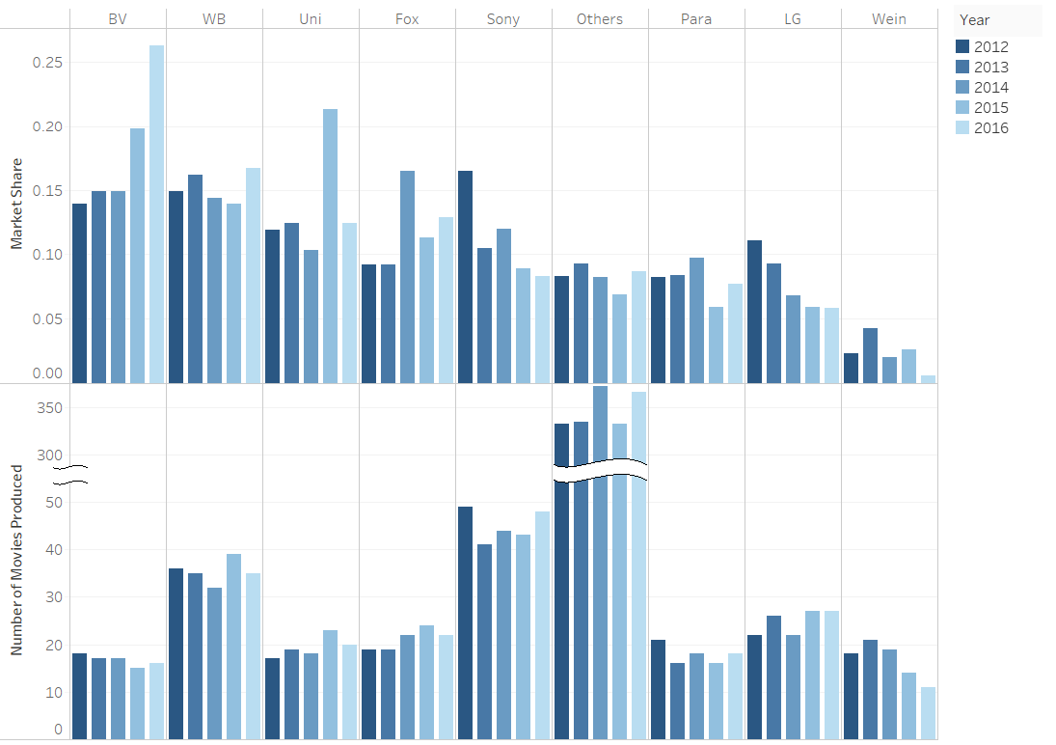
Exhibit 2: Movies and Market Share
‹#›

Slide 42
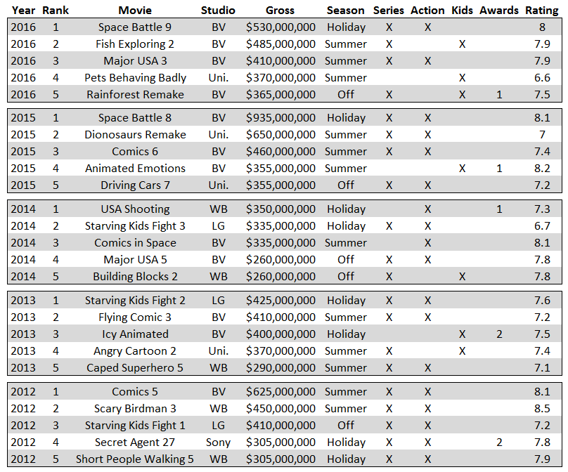
Exhibit 3: Top 5 Movies
‹#›

Slide 43
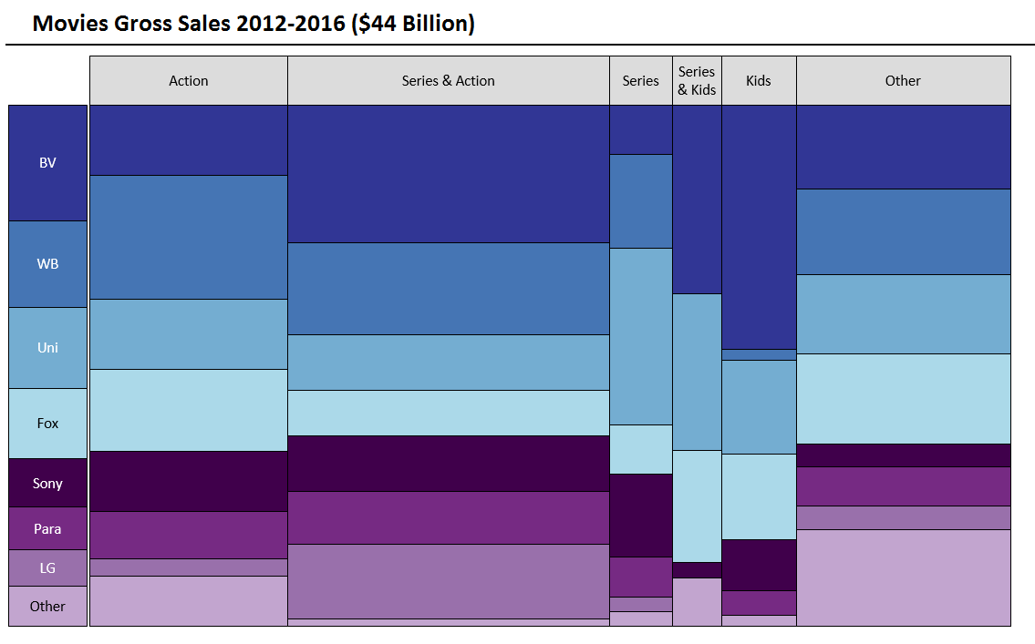
Exhibit 4: Gross Sales Total
‹#›

Slide 44
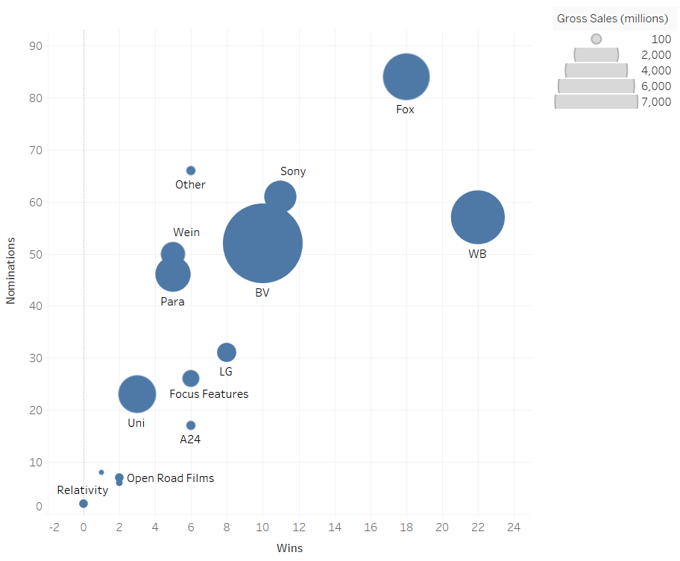
Exhibit 5: Studio Awards (2012 – 2016)
‹#›

Slide 45
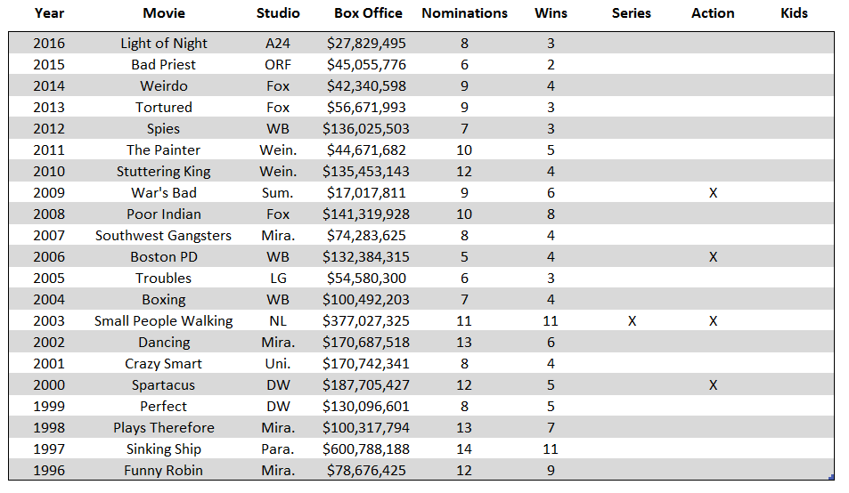
Exhibit 6: Oscar Best Picture Winners
‹#›

Slide 46
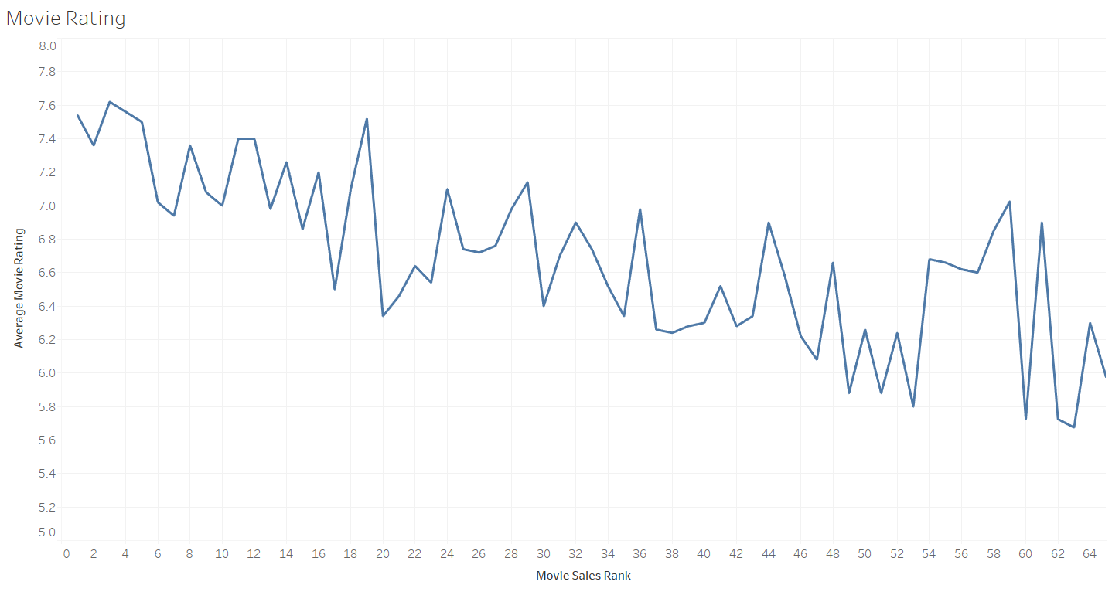
Exhibit 7: Movie Ratings (2012 – 2017)
‹#›

Slide 47
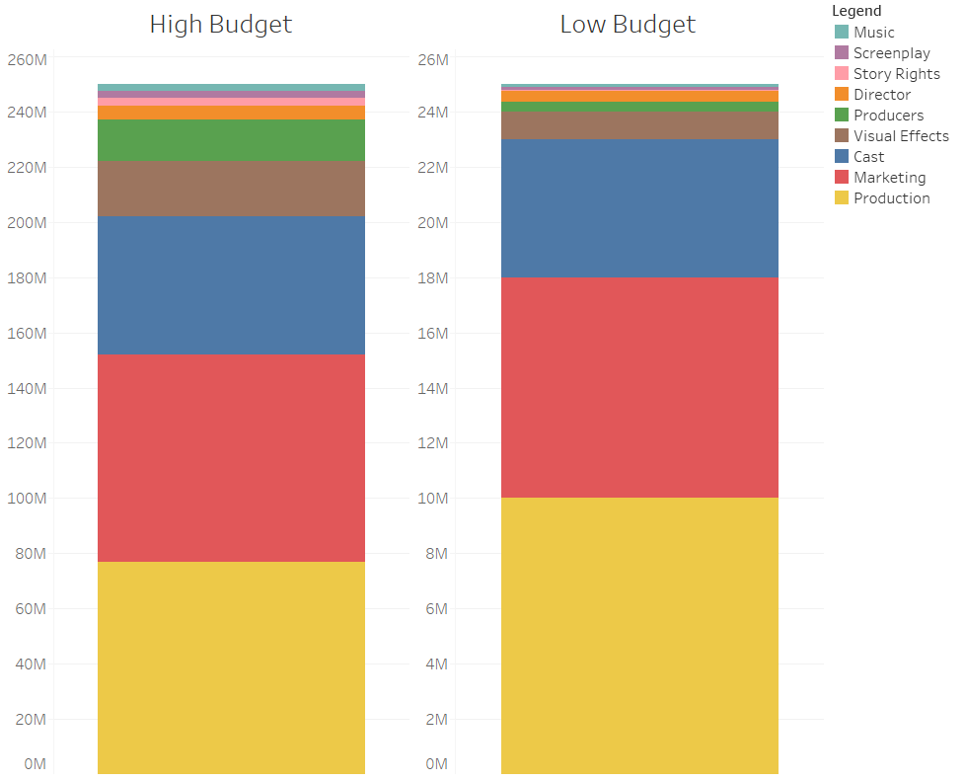
Exhibit 8: Movie Production Expenses
‹#›

Slide 48
Rare Disease Business Growth
Case Prompt
Our client is a large pharmaceutical company with a strong business in “Rare Disease” (rare diseases are conditions that affect fewer than 200,000 people in the US)
Historically pharmaceutical companies have not invested significantly in Rare Disease because it has not been cost effective to conduct research for such small populations. Due to the fall off in the number of pharmaceutical blockbusters and improved regulation to make R&D cheaper for Rare Disease, pharmaceutical companies have begun to invest more in Rare Disease R&D over the last few years.
Our Client has hired you because it would like to grow its Rare Disease business, specifically they would like to double their Rare Disease business in 5 years
Clarifying Information to Provide Upon Request
Our Client is an Industry leader with a track record of success. Its existing business is $2.5B, expected to grow
at 5% per year
The Rare Disease market is $30B and is as profitable as “Big Pharma”
While research is relatively expensive, the government provides tax credits for drugs designated to treat rare diseases
Additionally, prices tend to be higher to make up for the upfront research investment. It’s also growing faster than Big Pharma
There are many small bio-techs that are attractive targets and there are also other big pharmaceutical companies that have rare disease divisions / assets
‹#›

Slide 49
Rare Disease Business Growth
Questions for the Candidate
Use these questions to guide the case if the candidate is struggling to lead. A strong candidate will take initiative to lead the case
How would you approach our client’s question on growing its Rare Disease business?
Where would you like to start?
[When the candidate asks about the existing business, share Exhibit 1] Based on the data,
how large will the client's rare disease business be in 2016? [If necessary,] what is the
shortfall to its goal of doubling its business?
What does the client need to do to double the Rare Disease revenues by 2016? [If candidates discuss acquisitions] Who to acquire? How many assets will we need to buy?
‹#›

Slide 50
Rare Disease Business Growth
Recommendation
Internal growth will not be sufficient to achieve your goals of doubling your business. You will need to acquire ~3 “peak revenue” assets to close the gap between your goal of $2.5B and the $1.1B your portfolio will generate organically
Risks and Next Steps
Risks
Changing political landscape could drastically impact profitability of acquired assets (presidential term is <5 years)
Investigate potential for geographical expansion and associated hurdles with entering new countries (legal, regulatory, political, competitive landscape)
‹#›

Slide 51
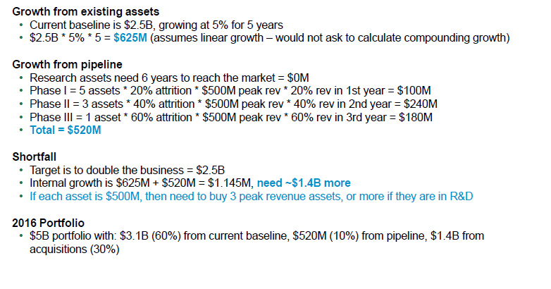
Rare Disease Business Growth
Quantitative Analysis and Solution
‹#›

Slide 52
Rare Disease Business Growth – Exhibit 1
Assets in research and development
Phase | # Assets | Time to Market (years) | Attrition (% expected to be approved to reach the market) | Peak Revenue ($M)
Research | 20 | 6 | 10% | 500
Phase I | 5 | 4 | 20% | 500
Phase II | 3 | 3 | 40% | 500
Phase III | 1 | 2 | 60% | 500
Revenue by years on market
Year on the Market | Revenue (% of Peak Revenue)
1st | 20%
2nd | 40%
3rd | 60%
4th | 80%
5th | 100%
‹#›

Slide 53
High Speed Train
Case Prompt
Blue Group Industries (BGI) has hired our consulting firm to analyze it’s potential high speed train project with the goal of having commuters travel at average speeds of 150 mph. BGI is a large multinational conglomerate with business units in most major sectors including energy, manufacturing, transportation, finance, and technology. BGI believes that high speed rail is the future of transportation in the US and is determining where to build its first line. The initial options are between option 1) Washington DC and New York City, option 2) New York City and Boston, and option 3) Los Angeles and San Francisco. BGI would like to know your thoughts on the project.
Case Info
Interviewer Guidance
Difficulty: Medium
Case Format: Interviewee Led / Profitability
Concepts Being Tested: Valuation, NPV, Profitability, Math with large numbers
This case has a simple framework but requires the candidate to discount cash flows at the appropriate time and account for all costs and revenues appropriately
‹#›

Slide 54
High Speed Train
Clarifying Information
Guide to Handouts
BGI’s goal is to maximize profit over the lifetime of the railroad. The railroad and trains will take 7 years to build and will be operational for 50 years. (For ease of calculations later, we will assume a salvage value of zero)
BGI will have to build the new rails from the ground up. They will have to purchase the land, install the tracks and stations, and then operate the trains once complete
The discount rate is 10%
BGI has been in close conversation with several investment banks and is confident they can secure financing needed to fund the project (The discount rate of 10% has financing expenses built in)
150mph average speed is the target average speed over the duration of travel for all 3 routes
As the case progresses, you should give the candidate handouts and information as they bring them up:
Comparison of the cities (Exhibit 1)
Initial investment costs (Exhibit 2)
Variable costs (Exhibit 3)
Number of seats on a train (Exhibit 4)
Train average speed is 150mph
While the candidate can calculate travel time, the interviewer should tell them it takes 30 minutes to load and unload a train (some variable costs are not paid while loading unloading)
The candidate should be able to estimate the number of trips made per day, if they are struggling, you can give them 15 for DC & NYC, 20 for NYC & Boston, and 30 for LA & SF
The candidate should be able to estimate a price per ticket for both coach and first class, if they are struggling, you can give them $100 for East Coast and $150 for West Coast with First Class being 4X more
‹#›

Slide 55
High Speed Train
Which location to build railroad
Profitability
Other considerations
Gross revenue
Costs
Number of train tickets sold
Initial investment
Government grants/assistance
City populations, wealth, travel habits, alternatives
Train, rail, land, infrastructure, stations
Population/wealth considerations in 7-57 years
Ticket price
Operational Costs
Environmental issues
Business vs coach passenger, East vs West Coast
Wages, power, maintenance
Ancillary (food, drinks, other)
‹#›

Slide 56
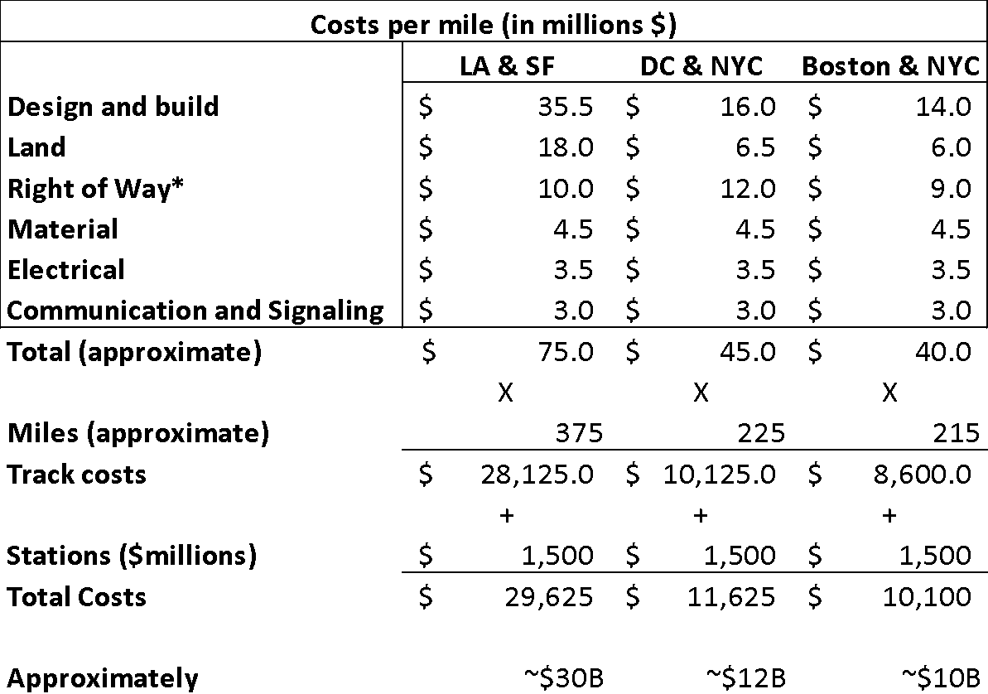
High Speed Train
Sample Calculations
‹#›

Slide 57
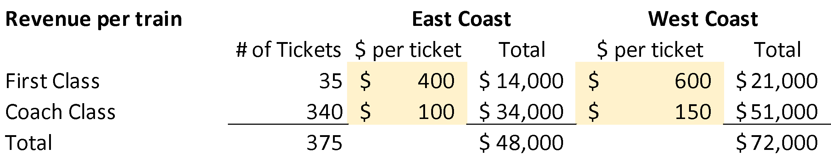
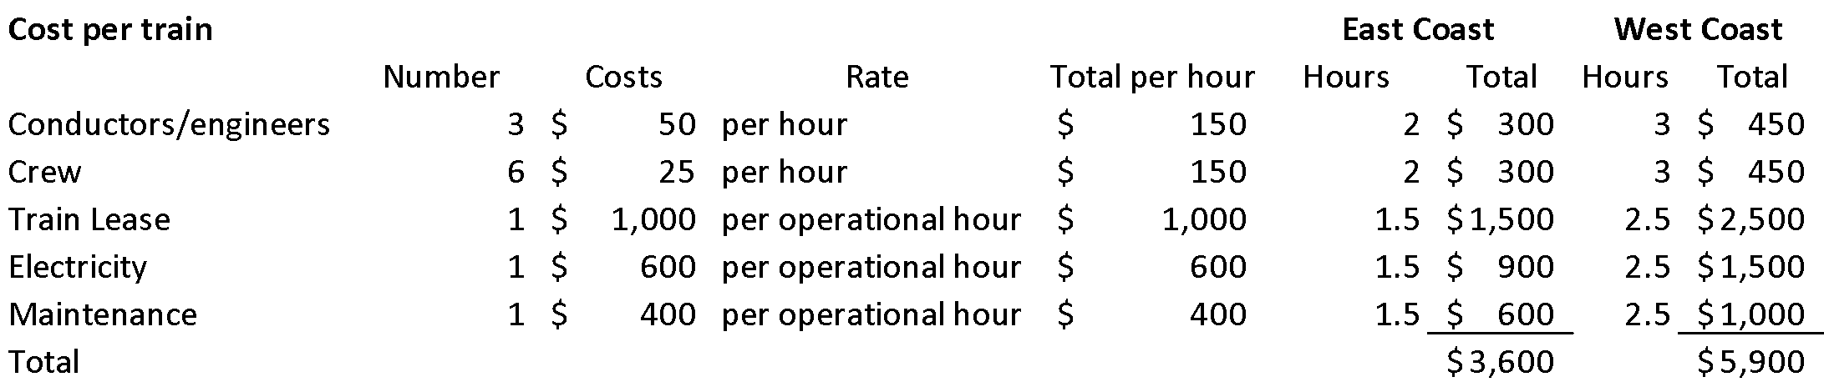
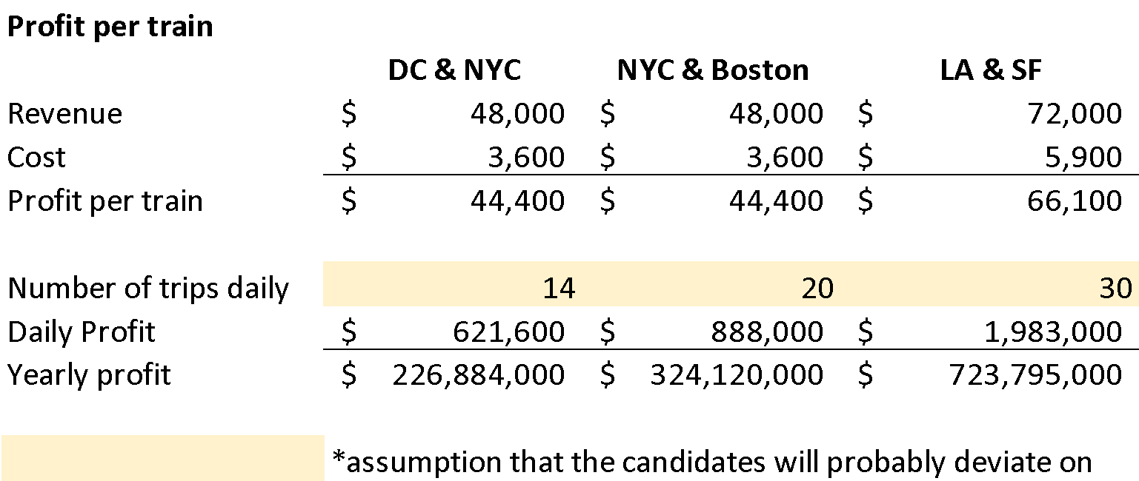
High Speed Train
Sample Calculations – candidates do not need to calculate these exact numbers
‹#›

Slide 58
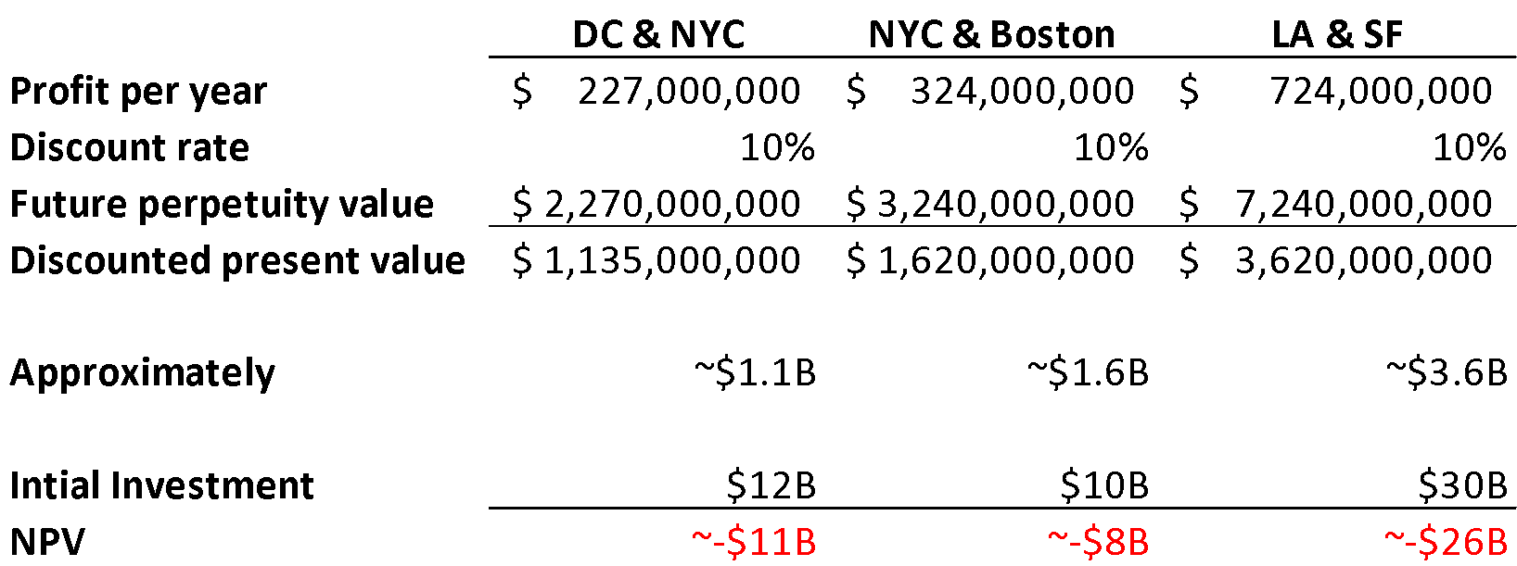
High Speed Train
Sample Calculations
NYC & Boston
Time = 0 8 9 10... …57
$10B $324M $324M $324M $324M
Because there are 50 cash flows, we can treat the 50 years of profit like a perpetuity (yearly payment/discount rate) and discount that back to the current year(rule of 72 implies money doubles in ~7 years at 10%, and going from future cash flows to present value, we take half of the future value)
‹#›

Slide 59
High Speed Train
Solution and Recommendations
BGI should not invest in high speed rail
The initial set up costs far outweigh the discounted revenue
Unless they can figure out how to significantly bring down costs and raise additional revenue, they should look elsewhere to invest
Candidates will vary slightly on which route is the best, but all should have negative NPV unless the revenue estimates were very aggressive
Excellent Case Insights
Depending on the candidates assumptions about ticket prices and number of trains per day, a great candidate will say which line is the closest to profitability and talk through ways to reduce the initial investment such as partnering with local and federal government for grants that would reduce the discount rate or subsidies for environmentally friendly transportation
We assumed a salvage value of $0, that is not realistic; would all the value of the initial investment be lost?
‹#›

Slide 60
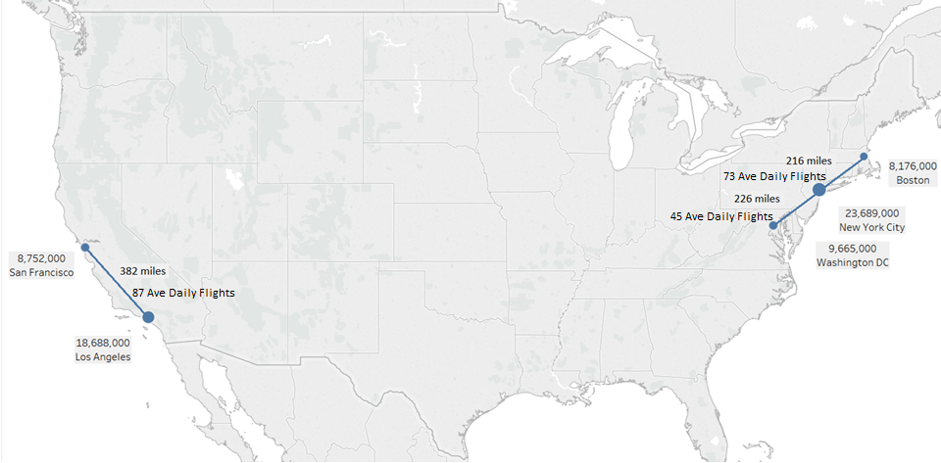
High Speed Train - Exhibit 1: Map
City combined statistical populations, distances, and number of airline flights
‹#›

Slide 61
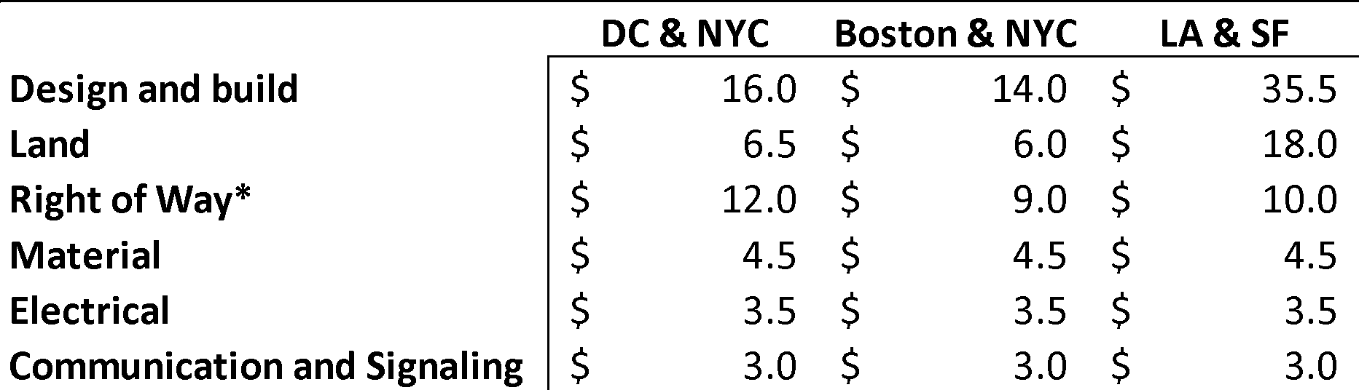
High Speed Train - Exhibit 2
Initial Investment Cost: Costs per Mile (Million $USD)
Stations cost $1,500M per line
*Right of Way is the legal right, established by usage or grant, to pass along a specific route through grounds or property belonging to another
‹#›

Slide 62
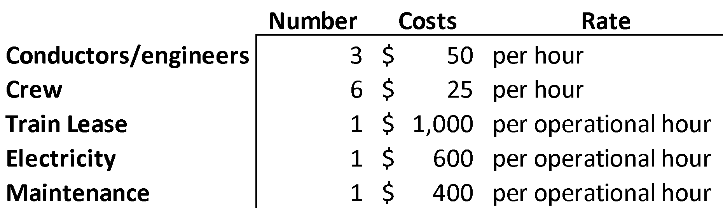
High Speed Train - Exhibit 3
Operational Cost Estimates: Cost per train
‹#›

Slide 63
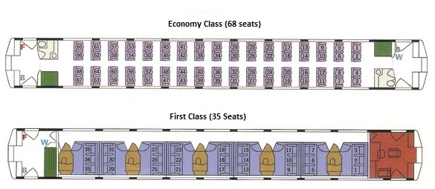
High Speed Train - Exhibit 4: Train diagram
A standard train has 1 First Class car and 5 Economy Class cars
‹#›

Slide 64
Timeshare Exchange Co.
Case Prompt
Your client is a provider of timeshare exchanges. Timeshares are an arrangement between multiples parties for joint ownership of a piece of property. Each party or owner has the right to use the property for a specific period of time during a specific period of the year. These owners can trade their ownership rights with others through exchanges.
The number of exchanges conducted through your client's exchange has been decreasing. You client wants to know:
1. What is causing this decrease in exchange quantity and
2. What they can do to increase topline revenue?
Case Intro
Interview Guidance
Difficulty: Medium
Case Format: Growth
Concepts Being Tested: New industry (Travel & Tourism), Profitability/Revenue Growth, Problem diagnosis
This case is testing 2 skills: can candidates digest information to identify trends and diagnose potential root causes of a problem; can candidates think outside the box to develop solutions for a nebulous problem. The former involves some quantitative analysis. The latter problem is largely a brainstorming exercise.
If prompted, share the detail on how a timeshare works within the clarifying information
‹#›

Slide 65
Timeshare Exchange Co.
Clarifying Information
Guide to Handouts
Detail on how exchanges work: Say you own 2 weeks in early March at a Disney Resort in Orlando. You can go 'deposit' your ownership right for 1 year into an exchange. Our client, the exchange company, will assign a value to your offering based on the popularity of the property & timeframe of ownership. You can then exchange your rights for someone else's right of equal or lesser value, say 2 weeks in November in Marriott Resort in Hawaii. The client will charge a fee to each owner for each exchange. However, if the owner wants to exchange from a Disney property in Orlando to a Disney property in Los Angeles (so inside the Disney network), they don’t have to go through the client and therefore don't have to pay an exchange fee.
How clients generate revenue: Yearly membership fee and exchange fees. Our client does not own/sell actual timeshares or real estate - they only manage exchanges.
Customers: Individual timeshare owners are the customers, however they often have affiliations to “clubs” or timeshare providers (generally large hotel chains or resorts) which also allow for exchanges within their internal club network.
Goals: Diagnose & propose solutions.
Relevant buckets include:
Diagnose through exploration of:
Current revenue generation patterns (Exhibit 1), provide upon request
Industry trends or shifts - AirBnB etc. making need for timeshares obsolete
Customer segments/spending patterns
Growth options:
- Organic options:
Inorganic options:
JV or acquisition of competitor
‹#›

Slide 66
Timeshare Exchange Co. – Exhibit 1
Year | Number of members (K) | Number of exchanges (K)
2012 | 700 | 630
2013 | 770 | 655
2014 | 847 | 678
2015 | 932 | 699
2016 | 1025 | 717
Average yearly membership fee | $100
Average price of exchange (per owner) | $250
‹#›

Slide 67
Timeshare Exchange Co.
Problem 1
Problem 2
Problem 3
Guide to candidate to calculate revenue in 2016
Solution
* Remember - 2 parties involved in each exchange
- Some members have multiple properties
- Some members may split 2 weeks of timeshares into 2 and week long exchanges (price per exchange = $125)
Guide candidate to calculate rate of change or % change in # of members and exchanges
Solution
What do trends identified in Problem 2 indicate?
Solution
While the total number of members and exchanges are increasing, the total number of exchanges by total number of customers is decreasing. This is indicating that each member is no longer conducting as many exchanges. What might be causing this?
Change in exchange price? Price has been consistent
Change in customer mix? Exhibit 2
Average yearly membership fee | $100
Average price of exchange (per owner) | $250
Average revenue per exchange* (2 owners/) | $500
Number of members, 2016 | 1,024,870
Number of exchanges, 2016 | 717,409
Total Revenue | $461,191,500
Year | % increase in # of members | Total exchanges / Total members
2012 |  | 90%
2013 | 10% | 85%
2014 | 10% | 80%
2015 | 10% | 75%
2016 | 10% | 70%
‹#›

Slide 68
Timeshare Exchange Co. – Exhibit 2
Large Clubs (Hilton, Mariott etc.)
Medium Clubs (Disney, Hawaii Hotel Company etc.)
Small Clubs (Individual homeowner groups)
‹#›

Slide 69
Timeshare Exchange Co.
Key Insights from Exhibit 2
Customer mix has changed drastically. Potential reasons for change and impact on customer mix:
The number of timeshares has increased, However, as clubs get larger, they now are capable of providing a strong range of timeshares within their network.
Members don’t need the exchange as much. Industry is shifting towards members buying timeshare not for exchange purposes, but because of resorts they like to visit yearly (ie. Disney) because of their unique selling proposition.
If travelers want to try different locations, vacation rental sites like AirBnB is preferred.
Strategy to Mitigate Industry Trends
Ask candidate to brainstorm options, discuss procs & cons and select a strong option.
Organic options:
Focus on their current business model – reduce costs, try to attract more customers, change pricing structure (tiered pricing, different servicing)
Explore alternative options that capitalize on their strengths as an exchange platform – Exchange cars, exchange homestays
Other business models within industry – timeshare rental (put up timeshare in AirBnb etc.), timeshare resale
Inorganic options:
JV or acquisition of competitor – gain pricing power and larger range of timeshare “products”
‹#›

Slide 70
Timeshare Exchange Co.
Solution and Recommendations
Industry is shifting (summarize shifts within customer mix, spending on exchange patterns) so client needs to invest resources to meet head on. Select any of the brainstormed options with strong support of pros & cons.
Risks:
Stagnating growth, declining industry so need to act
Cons for recommendations are risks
Excellent Case Insights
Excellent case will demonstrate strong creative ability in brainstorming exercise capturing many of the listed suggestions with strong, logical pros and cons.
‹#›

Slide 71
Pulp Friction
Case Prompt
Our client, Pulp Friction, Inc. is a French pulp manufacturer that sells pulp to multinational CPG firms. These firms use the pulp to make toilet paper. Toilet paper is made from recycled pulp or virgin pulp, using a combination of softwood and hardwood trees. Softwood trees such as Southern pines and Douglas firs have long fibers that give paper strength¹. Over the last three years, Pulp Friction has seen profits decline at an increasing rate. The leadership team has engaged you to help them find out why.
Case Info
Difficulty: Hard
Case Format: Profitability
Concepts Being Tested: Supply chain optimization, sourcing,
This is an interview led case. After the candidate provides a framework, guide the candidate through the 3 prompts
‹#›

Slide 72
Pulp Friction
Clarifying Information
Interviewer Guide to Case and Exhibits
Virgin paper is an industry term for paper made from new pulp (no recycled feedstock)
Financial goal: increase profit
Customers: global CPG companies such as P&G, Kimberly-Clark, and Unilever
Client sells the bulk of its pulp to the European market
Value chain: Trees are grown, cut, chipped and made into a slurry before being sent to our client. Our client uses this raw slurry to create pulp. They may also use recycled slurry. The pulp is sent to their customers who manufacture paper products like toilet paper etc.
After interviewee prepares and explains framework, interviewer should move forward with Exhibit 1, which covers the competitive cost structure
Follow the prompts to guide the interviewee through the case
After the interviewee has answered the math question in Exhibit 1, the interviewer will prompt for a recommendation
‹#›

Slide 73
Pulp Friction – Prompt #1
Prompt
Hand over Exhibit #1. Ask “What trends can you identify?”
Solution
There is an inverse relationship between % of recycled materials used and COGS - implies that recycled material might be cheaper
France’s use of recycled material is considerably lower than its European counterparts
China’s higher freight makes sense because it is much further than the other countries
Europeans counterparts have a higher cost position compared to Brazil & China due potentially to higher labor costs etc.
European countries with stronger recycle/environmental activist culture already use a high proportion of recycled materials
‹#›

Slide 74
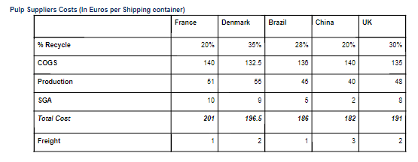
Pulp Friction – Exhibit 1: Pulp Supplier Costs
‹#›

Slide 75
Pulp Friction – Prompt #2
Prompt
How can we improve profitability based on the information in this graph? What factors are you considering?
Solution
Reduce SGA costs: Try to match industry average or UK value by assessing expenditure on unnecessary staff,
Reduce production costs: Increase automation,
Change country to purchase or production
Reduce COGS: Change mix of recycle vs. virgin raw feed; find cheaper raw feed; enter tree production process
‹#›

Slide 76
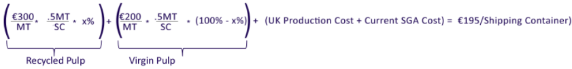
Pulp Friction – Prompt #3
Prompt
The client is considering structuring their cost position, and they believe they can match UK's production cost. What percentage of recycled pulp feed would the client need to reduce its cost position to €195/shipping container?
Additional Cost Information: Virgin Pulp: €300 per metric ton; Recycled Pulp: €200 per metric ton; There are 5 metric tons in a truck and 10 shipping containers fit in one truck.
Solution
Disregard Freight costs. Candidate should try to lay out the following equation and solve for x.
MT = Metric ton
SC = Shipping Container
x = 25% for % recycled (increased from 20%)
‹#›

Slide 77
Pulp Friction
Solution and Recommendations
Client does not have a competitive cost structure. To bring their costs down, client must:
Increase amount of recycled raw feed used to 25% from 20% (assuming production costs are reduced to UK level)
Decrease other costs to around industry average
Consider outsourcing production to low cost countries
Risks include:
Can costs actually be matched
Fluctuations in prices and corresponding impact
Amount of recycle pulp available
Damaging relationship with virgin slurry supplier
Excellent Case Insights
Use increased recycle raw feed used as promotional material to customers to incentivize purchases.
Are low recycle material prices real (based on production process) or perhaps subsidized by governments to incentivize recycling?
‹#›

Slide 78
Data Aggregator
Case Prompt
Our client is a large data aggregating firm that collects & stores personnel data used for background checks, credit monitoring, etc. The client recently acquired a competitor in the same industry. The acquired firm has a business unit that develops software to automate document processing for the insurance industry. The client has asked you to help understand what they should do with this BU.
Case Intro
Interview Guidance
Difficulty: Medium
Case Format: M&A
Concepts Being Tested: Post-merger integration, synergy assessment
This case is focused on assessing the various options related to post-merger integrations. The candidate should focus on what to do with the BU i.e. (1) Keep as-is (2) Integrate completely (3) Divest. This is not a quant heavy case, and focuses on how the candidate thinks through an M&A transaction
‹#›

Slide 79
Data Aggregator
Clarifying Information
Guide to Handouts
Client – The client’s business model can be considered identical to that of Equifax, Experian, etc. They serve a variety of clients including financial services and the insurance industry
Acquired Firm – Same business model as client
Software BU – They develop s/w to automate document processing. For example, the renewal notices that you get from your insurance providers are automatically generated through this software and sent to a 3rd party for printing and mailing
Goals – No specific target.
Exhibit 1 – Financials for the client and the software BU
Tax rates are different for the Client and the software BU – if candidates brings this up, ask the question back to candidate – Reason is that the S/W BU got R&D tax credits reducing the effective tax rate
No major insights from this exhibit – Will provide candidate additional reference material to make the final decision
Exhibit 2 – Multiples based valuations for recent sales of similar software companies
Three different comps are provided and all will lead to a valuation of ~$300M
‹#›

Slide 80
Data Aggregator
Question 1
How would you think about approaching this problem?
For interviewer: After going through the framework, the candidate should analyze each option. Information for each is provided in the following slides
Recommended Framework
The candidate should think of the following options that the client has and provide more context for each:
Keep As-Is / Do Nothing
Growth of the industry
Understand financials of the S/W BU and growth over the years
% of total net income generated by this BU
Management capabilities – does the client’s management team have experience in this space? (Key insight – candidates may not think about this upfront)
Integrate
Synergy assessment (Revenue and Cost)
Divest
Who to sell to?
Valuation
‹#›

Slide 81
Data Aggregator - Options
Option 1 – Do Nothing
Option 2 - Integrate
Option 3 - Divest
When asked for financials, provide Ex. 1
Industry growth trends – No more information, but assume stable industry (growth @ GDP)
S/W BU growth trends – Don’t have more details but assume growth at industry rates
Competitors – There are competitors but we don’t have details about them
Management – Client’s management team does not have experience in the S/W space
See next slide
Ask candidate about divestiture considerations – Valuation is the critical driver here
Ask how they would estimate the value – Multiples based valuation and DCF
Candidate should ask for comparables for multiple based valuation – Provide Ex. 2
Based on Ex. 2, client can sell the BU for ~$300M
‹#›

Slide 82
Data Aggregator - Options
Option 2 - Integrate
To make the case for integration, candidate should talk about revenue and cost synergies
Revenue Synergies
Ask candidate how the client could find revenue synergies
Cross selling credit check data to S/W insurance customers
Cross selling insurance S/W to existing credit check customers in the insurance industry
Evaluate feasibility of these options - ask following questions
Who in the organization would purchase these services? IT group for S/W and Risk group for data so customers are different
How often are vendors changed? IT - very rarely given the implementation costs; Credit data –more frequently, but all vendors provide very similar services so no incentive to switch
Conclusion – No real revenue synergies
Cost Synergies
Using Ex. 1 ask candidate where they see cost synergies? Est. these numbers
SG&A for S/W BU may see a ~10% cut
Conclusion – No real cost synergies
‹#›

Slide 83
Data Aggregator
Recommendation – Option 1 or Option 3
There is no clear “answer” to this case – Candidate should recognize that “Option 2 – Integrate” generates no incremental value and should choose either Option 1 or Option 3 as the recommendation and highlight the rationale / risks
Option 1 – Do Nothing / Keep As-Is
Rationale:
No synergies by integrating, plus client will face potential integration costs
Divesting does not make sense given the current market valuations – The S/W BU will generate enough Net Income to cover the gains of divesting in 2 – 3 years
Keep business as is and potentially divest in the future when multiples are higher
Risks:
S/W BU does not align with core competencies of the client
Management may face a huge burden trying to manage this BU due to lack of experience
Option 2 – Integrate
Risks: No synergy gains from this strategy and high potential costs of integration
Option 3 – Divest
Rationale: BU does not align with the client’s competencies and management does not have experience in this space
Risks: Multiples are low & this may not be the best time to sell
‹#›

Slide 84
Data Aggregator - Exhibit 1: Financials
 | Client | S/W Business Unit
Revenue | $3,100 | $250
COGS | $930 | $38
SG&A | $465 | $63
Sales & Mktg | $372 | $30
Operating Income | $1,333 | $120
Taxes | $400 | $24
Net Income | $933 | $96
‹#›

Slide 85
Data Aggregator - Exhibit 2: Valuation
Competitor | Multiple
Company A | 3.1x Net Income
Company B | 1.2x Revenue
Company C | 2.4x EBIT
‹#›

Slide 86
Consumer Products Strategy
Case Prompt
Our client is a large, multinational consumer products company with business in over 200 countries. Today we are going to focus on its US business.
Our client has been following US demographic trends and has found that low income households have been growing two times as quickly as other consumer segments. Low income is defined as families with income at the poverty level or below
Our client has always had a premium product strategy. It sells its products in grocery stores, convenience stores, mass retailers, etc. But its products are always priced at the high-end of their respective categories. It has never targeted the low income segment before and doesn’t have a low income strategy, but given the growth of this segment, our client is considering entering the low income segment.
Questions for Candidate
Information to Provide Upon Request
Our Client has 3 questions for you
Should it have a low income strategy?
If it should have a low income strategy, what are some tactics it should deploy?
What are some of the risks that the client may face?
- Low income consumers purchase largely in smaller, local shops
Low income consumers can’t afford salons, but will indulge on shampoos
Low income consumers are willing to spend more on baby food to protect their children
There are valid generics that compete with our client’s cold medicine
‹#›

Slide 87
Consumer Products Strategy
Questions to for the Candidate
Use these questions to guide the case if the candidate is struggling to lead. A strong candidate will take initiative to lead the case
What would you like to know to help the client answer its questions?
[When the candidate asks about products share Exhibit 1] The client has shared some data for its key products, what do you make of this information?
What else would you like to know about diapers and cold medicine to assess the opportunity
Ok. The client is not interested in cold medicine, but is has done customer research that suggests low income consumers are interested in buying diapers [share Exhibit 2]. What do you see that could help us figure out why low income consumers aren’t buying our client’s diapers?
What else should our client think about as it develops a low income strategy? What are the risks?
‹#›

Slide 88
Consumer Products Strategy
Recommendation
The client should pursue a low income strategy, focusing on diapers, which could generate an additional $25M in revenue.
To pursue low income consumers, our client should reduce its package size. Today, our client’s package size is significantly larger than its competitors. Our client could keep the price/diaper the same, but if it dropped the package size from 40 diapers to 20 diapers, it would cut the absolute price of the box to $10, even lower than its competitors
Risks
There will be some risks involved with adopting a low income strategy, including cannibalizing business from existing products and brand risk
Maintaining the same price per diaper will enable the brand to sustain its value with minimal impacts to brand image (cannibalization of higher end customers)
‹#›

Slide 89
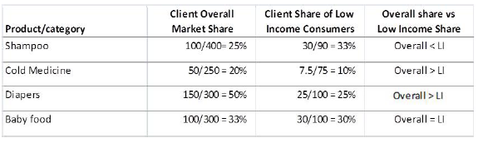
Consumer Products Strategy
Quantitative Analysis and Solution
Calculate the overall share and share of low income consumers by product/category
Calculate incremental revenue for cold medicine and diapers
- Cold medicine = (20% - 10%) * $75M = $7.5M
- Diapers = (50% - 25%) * $100M = $25M
Total Incremental Revenue = $7.5M + $25M = 32.5M
‹#›

Slide 90
Consumer Products Strategy - Exhibit 1
Product /Category | Total Category Sales (US$M) | Client Category Sales (US$M) | Total LI Consumer Spend on Category (US$M) | LI Consumer Spend on Client (US$M)
Shampoo | 400 | 100 | 90 | 30
Cold Medicine | 250 | 50 | 75 | 7.5
Diapers | 300 | 150 | 100 | 25
Baby Food | 300 | 100 | 100 | 30
‹#›

Slide 91
Consumer Products Strategy - Exhibit 2
Product /Category | Client Package Size | Average Package Size of Competitors | Client Price | Average Price of top 5 Competitors
Shampoo | 10 oz bottle | 12 oz bottle | $4 | $3
Cold Medicine | 6 oz bottle | 6.5 oz bottle | $6 | $3
Diapers | 40-pack | 32-pack | $20 | $16
Baby Food | 6 oz jar | 6 oz jar | $2 | $1.50
‹#›

