Slide 1

Case Workshop
Michigan Marketing Club Education Session 5
September 30, 2022

Slide 2
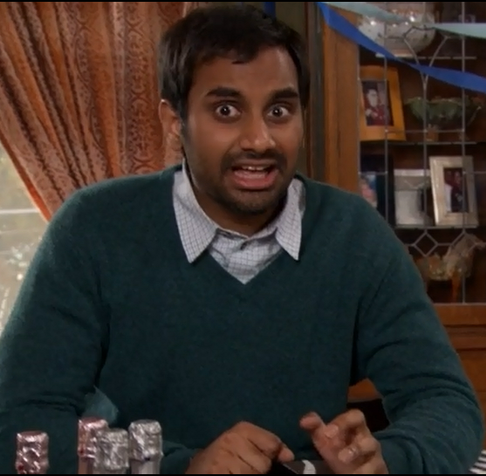

Week 5 down and we’re almost done with Fall A!
How excited are you to learn casing today?

Slide 3
Welcome to Marketing Club Week 5!
Today’s Agenda
Trek Updates and FB&A event
Overview of Marketing Case Questions
Deep dive on the 5 C’s
How to Prepare for Case Questions
Resources and Homework

Slide 4
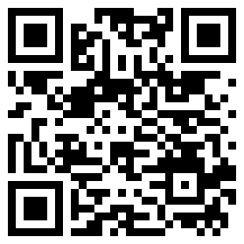





MMC Chicago Trek
MMC is hosting a Chicago trek on October 19th & 20th
This is a great opportunity to:
network with company representatives in person
get a feel for the office and culture
learn what the internship looks like
Itineraries are being finalized but select events include:
Beer tasting with Molson Coors
Happy Hour hosted by PepsiCo
Please sign up on Campus Groups by 10/5
Reach out to jmregan@umich or mtphan@umich.edu with any questions!
Participating Companies

Slide 5
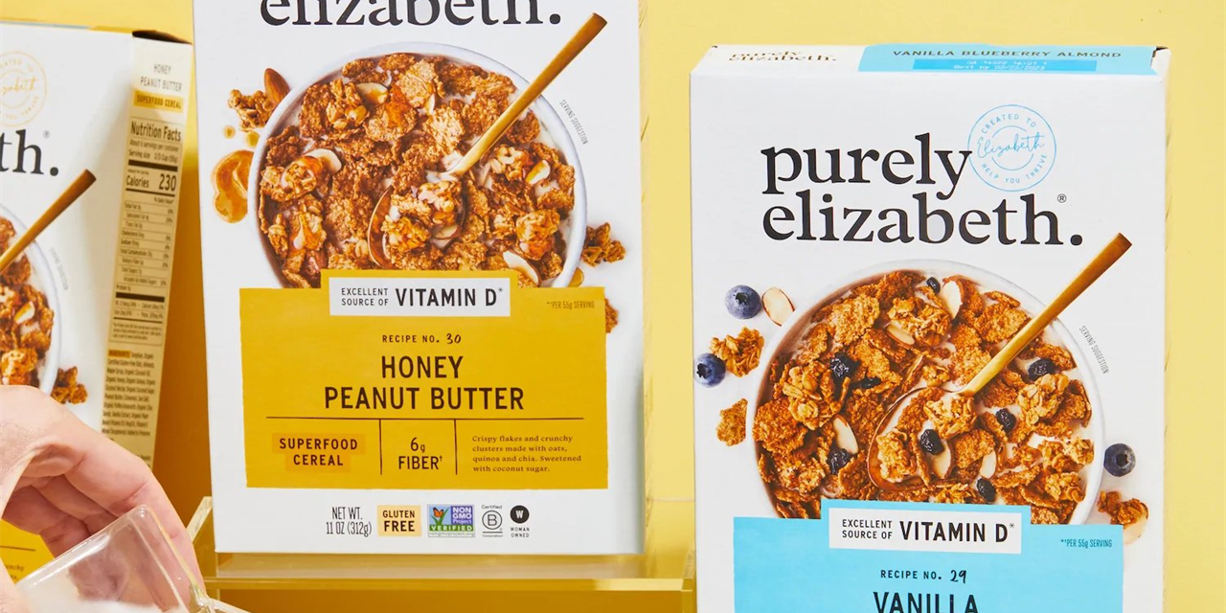
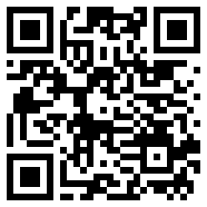
FB&A: Purely Elizabeth Fireside Chat
On October 5th (next Wednesday), F&BA is hosting members of Purely Elizabeth’s sustainability and R&D teams for a virtual Q&A
Purely Elizabeth has been a leader in the natural foods category with its nutritious, non-GMO and organic ancient grain products.
Purely Elizabeth is redefining the standards of packaged foods with its current line of certified gluten-free and vegan products consisting of granola, cereal, oatmeal, and pancake & waffle mix.

Slide 6
Before we get into case questions!
Does anybody have questions about…
Recruiting timelines
Researching companies
Networking with alums / companies
Fit questions
Behavioral questions
Symposium
Our favorite colors…?

Slide 7
Context for (Marketing) Case Interviews

Slide 8
Last few weeks we focused on fit and behavioral Qs
Fit
Behavioral
Case
Assesses how well you fit with the company and role
Can be aspirational (“Why do you want to work here?”) OR knowledge-based (“What’s our best performing brand?”)
Fairly common
Can be similar to behavioral
Demonstrates past behavior on the job
Used to predict your success in the role
Most common questions
Not unique to marketing
Often used interchangeably with “fit”
Each industry and role has a different form of “case” question
Several types used in marketing:
New Product Launch
Performance Analysis
New Entrant
Market Sizing
Marketing Analysis

Slide 9
Today we will focus on case questions
Fit
Behavioral
Case
Assesses how well you fit with the company and role
Can be aspirational (“Why do you want to work here?”) OR knowledge-based (“What’s our best performing brand?”)
Fairly common
Can be similar to behavioral
Demonstrates past behavior on the job
Used to predict your success in the role
Most common questions
Not unique to marketing
Often used interchangeably with “fit”
Each industry and role has a different form of “case” question
Several types used in marketing:
New Product Launch
Performance Analysis
New Entrant
Market Sizing
Marketing Analysis

Slide 10
What is a case question?
Case questions require you to evaluate a business problem: specific situations, products, or advertising campaigns
They are used by companies to see if you understand basic marketing acumen and if you can think like a marketer
Unlike consulting cases, marketing cases require you to bring all knowledge of consumer/product trends, specific brands, and any company insights that you want to use to apply to situations
There are 4 major types of case questions and frameworks that can be applied (we will review these in depth on the following slides)
The most important thing to know about case questions: the more you practice, the better you will be and the more confident you will feel!

Slide 11
There are four types of marketing case questions you need to master to succeed in interviews
5 C’s
4 P’s
TOESS
Market Sizing
Used to evaluate a situation or the market
Focus is big picture, strategic
Used to evaluate a specific brand situation or execute a marketing plan for a new product
Focus is in-depth, execution
Used to evaluate advertising efficacy
Reactive to a specific piece of creative or campaign
Evaluate the potential size of an opportunity
Focus is on demonstration of analytical ability

Slide 12
There are four types of marketing case questions you need to master to succeed in interviews
Case Q Type | 5C’s | 4P’s | TOESS | Mkt Sizing
Prevalence* | 70% | 80% | 20% | 10%
Purpose | Evaluate a situation or the market | Evaluate a specific brand situation or execute a marketing plan for a new product | Evaluate advertising effectiveness | Evaluate the potential size of an opportunity
Focus | “Big Picture” strategic decisions | “In the weeds” execution decisions | Ability to critique an ad critically, and have an opinion about its effectiveness | Ability to break down a complex number using logic in a rational manner
Cues | Should we… bring X product to Y market? | How should we… | How would you evaluate this… | How many/big is…
Sample | How would you think about a decision to bring X product to Y market? | How should we market X product to Y consumers? | How would you evaluate this video ad? | How many screens are in all of Ann Arbor?

Slide 13
If you only remember one thing today…
All marketing case interviews should start with you demonstrating a fundamental understanding of the Consumer (of the product or brand that’s being asked about)
Consumer is one of the 5 “C”s -- and also needs to be brought in for 4Ps questions
What are the consumers demographics, psychographics (pain points, lifestyles, behaviors, wants/needs… etc.)
Once you’ve defined the consumer, the rest of the case gets much easier!
This is why reading about the latest trends (ie through Mintel) is important, because you need to bring relevant knowledge about consumers into the interview

Slide 14
The 5 C’s

Slide 15
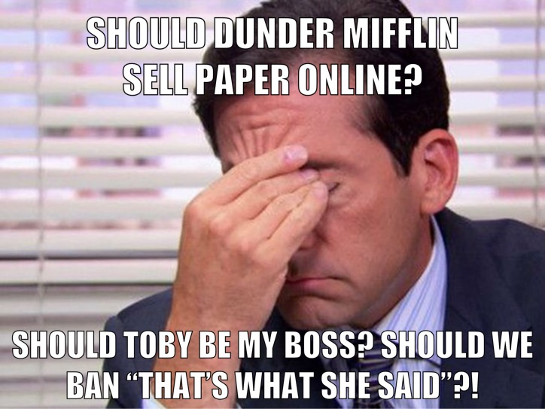
5 C’s Overview
Used to evaluate a situation and make strategic recommendations, e.g.,
Whether to enter new categories and/or have line extensions
New product launches
How serious the threat of a new entrant is
Focus is big picture, strategic
Questions may include some upfront context
Sample questions sound like:
Should we ___?
What would you consider doing if a competitor did _____?

Slide 16
Should Danone launch a plant-based whipped topping?
MMC Example
“
”
Notes:
This is one that is done together as a group

Slide 17

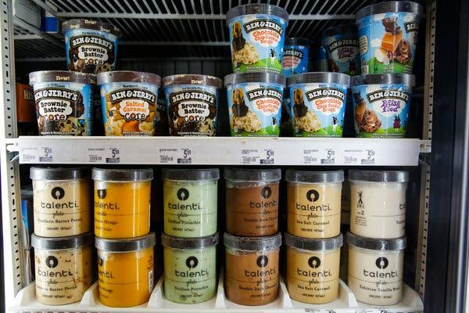
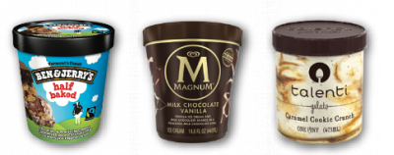


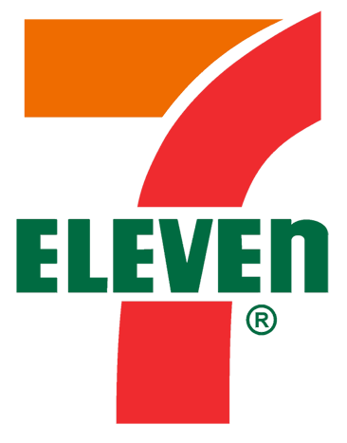
The 5 C’s Defined
Consumer
This is the end consumer – the person actually purchasing the product
Category
The market of comparable products or services that your product belongs to
Competitors
The companies, products, or product substitutes that also address the need state of your consumer target
Company
The organization whose product, strategy, or market opportunity you are evaluating
Customers/
Channel
The distribution channels you plan to use to distribute your product for sale to consumers

Slide 18
How to Apply the 5 C’s
Consumer
Always start with a description of the consumer and relevant insights
Establish a baseline for preferences, needs, tastes, budgets, demographics, etc.
Category
Focus on category growth or decline, newly emerging substitutes, or tech disruption
Think about trends that could impact the product or opportunity being considered
Competitors
Discuss competitors (internal or external) and what they have been up to
Consider recent competitor innovations, new entrants, changes in product features, potential reactions to the new product or opportunity
Company
Discuss whether this is a core competency for your organization
Consider the need for new capabilities/relationships and impact to firm’s strategy
Think about the impact on existing products (e.g. if there is a risk of cannibalization)
Customers/
Channel
Discuss impact on existing customer relationships and potential for new customers
Think about relevant customer trends/constraints
Consider the need for an omni channel or eCommerce strategy

Slide 19
Answer: No. Products already exist and category growth is declining.
Should Danone launch a plant-based whipped topping?
Consumer
Likely someone that is concerned about health and well-being
Interested in other plant-based products and consumes a low amount of dairy or has moved away from dairy entirely, e.g. someone who drinks almond/coconut/soy/oat milk or creamer with their coffee instead of dairy milk or creamer
Also needs to be someone that while they see health as a priority, they value the chance to indulge every once in awhile. Otherwise, they would not be interested in a whipped topping that would go with desserts or on their coffee (like a frappuccino)
Category
Plant-based/non-dairy alternatives have been very popular in recent years. There has been huge growth in this area and we have seen many new brands focused on providing consumers with these options. However, we might be at the point where growth is declining
For whipped toppings, I can imagine that they have likely been on decline - with health and wellness being at the forefront of the minds of many consumers, including our own, I could see this being something that they are not buying as much
Competitors
Though there are many brands that have put out non-dairy milks and creamers, there are fewer non-dairy whipped topping brands. Even with the saturation of the market and a decline in whipped toppings, a non-dairy whipped topping may be an interesting opportunity, especially when thinking back to our consumer and what they value - health but also indulgence
I would definitely want to look at brands like Reddi-wip, Cool Whip, and private label brands. I know that Reddi-Wip already has almond and coconut options. I believe Cool Whip only has low-fat. Private labels may have a mix of options (both non-dairy and low fat)
Company
Danone has a few brands where a plant-based whipped topping may make sense - International Delight, So Delicious, and Silk
International Delight and So Delicious already do make plant-based whipped toppings, so this would not be a new capability that Danone would need to figure out. However, with existing products there is a risk of cannibalization
Note: here might be a good opportunity to engage with Danone. If the question is general - is this for a specific brand? They have several where it might make sense. If they have existing products - is this a line extension? Show your critical thinking (if applicable)
Customers/
Channel
Danone has existing relationships with a number of customers, including Kroger, Costco, Walmart, Target, Amazon, Whole Foods
There is going to be limited shelf space for a new product, so will need to make the case for why this is different from existing products (whether competitor or our own)
For health conscious consumers, we want to make sure that we launch at customers that make sense, maybe Whole Foods

Slide 20
Additional Tips for 5 C’s
Always bring your responses back to the consumer. Connect your insights to the consumer profile you established at the beginning of the question
If this is a new product for a specific brand, think about if this product would be targeted at the existing consumer base or a new consumer base, and mention that insight
Make sure logic for each of the 5 C’s directionally moves to your answer
When talking about trends or competitors, be specific.
This is how you flex!
Say more than “I would want to look at if this category is growing or declining” or “I would want to evaluate competitors”
As a former CDO advisor said, “Act like you have been to the grocery store!”
Don’t forget about private label brands when thinking about competitors - they are huge!
At the end, always summarize your insights and respond to the question at the end with a definitive “Yes” or “No”
Would you like us to demonstrate another example?

Slide 21
How do I prepare for
case questions?

Slide 22
The Do’s and Don’ts of Case Questions
DO
DO NOT
Always bring your response back to the consumer
Be coherent, thoughtful, and as specific as you can
Ask questions if anything is unclear
Remember: case questions are a thought exercise. The interviewer wants to see that you are a critical thinker
State your assumptions as you go through. You don’t need to be an expert on everything but you can make logical guesses
If unsure, see if your interviewer validates
Do your research and have knowledge about the biggest products and categories of the company you are interviewing with
Create a story with the C’s and P’s. This should be fun and a good way to show your creativity!
Forget one of the 5 C’s or 4 P’s. Take time to write them out before you respond to make sure you hit all of them
Respond as if you are listing them out (e.g. the consumer is X, the category is Y, etc.)
Leave out specifics. Don’t just say “we need to look at competitors in this space.” Mention who they are
Ask a question that you should already know (e.g. “Does Danone sell this type of product?)
Get in your head. Take a deep breath before you respond and stay calm - you got this!
Notes:
Case questions are many times based on real-life. If you ask more specific questions, they may be able to provide you with a bit more detail to guide your response

Slide 23
PRACTICE TIME!
Let’s answer these questions as a group

Slide 24
How to Apply the 5 C’s
Consumer
Always start with a description of the consumer and relevant insights
Establish a baseline for preferences, needs, tastes, budgets, demographics, etc.
Category
Focus on category growth or decline, newly emerging substitutes, or tech disruption
Think about trends that could impact the product or opportunity being considered
Competitors
Discuss competitors (internal or external) and what they have been up to
Consider recent competitor innovations, new entrants, changes in product features, potential reactions to the new product or opportunity
Company
Discuss whether this is a core competency for your organization
Consider the need for new capabilities/relationships and impact to business strategy
Think about the impact on existing products (e.g. if there is a risk of cannibalization)
Customers/
Channel
Discuss impact on existing customer relationships and potential for new customers
Think about relevant customer trends/constraints
Consider the need for an omni channel or eCommerce strategy

Slide 25
Impossible Meats is considering launching a “beef” jerky product. Should they do it?
MMC Example
“
”
Notes:
One person from MMC Ed will give an example of how to answer this type of question

Slide 26
Dell is considering entering the phone market. Should they do it?
MMC Example
“
”
Notes:
One person from MMC Ed will give an example of how to answer this type of question

Slide 27
Dell’s premium laptop is losing share to the Apple MacBook. What should we do over the next year?
MMC Example
“
”
Tricked you, this is a 4P questions!
Notice it asked “what should we do”, NOT “whether we should” or “should we…”
Notes:
One person from MMC Ed will give an example of how to answer this type of question

Slide 28
How to Apply the 4 P’s
Consumer
Always start with a description of the consumer and relevant insights
Establish a baseline for preferences, needs, tastes, budgets, demographics, etc.
Product & Packaging
Focus on the attributes that define the product (sizes, flavors, ingredients, etc.)
Think about how the product is packaged (blister pack, freestanding, etc.) and any imagery, claims, or call outs on the packaging
Price
Discuss the set price of the product and how it reflects the product’s positioning (premium, parity, or value vs. competitors)
Consider consumer willingness to pay and how to maximize profits
Promotion
Discuss how awareness about the product is generated and through which mediums (social, television, billboards, in-store and point-of-sale displays)
Consider ways to increase trial of the product (e.g. coupons, sampling, demos)
Placement
Think about where the product is located within the store (think both aisle and placement on shelf)
Consider customers and channels (grocery, mass, convenience, club, online, etc.)

Slide 29
PRACTICE TIME!
Find a partner & practice answering
the following case questions…

Slide 30
Imagine you are the Brand Manager for Cheerios and you have the choice to launch a new peanut butter or caramel flavor. Which would you choose and why?
If you don’t have the “facts”, just practice applying the framework and you can sound believable later :)
MMC Example
“
”

Slide 31
Imagine you are the Brand Manager for Tropicana and someone has the idea of making a strawberry flavored juice. Talk me through your thought process on whether you’d decide to do it.
MMC Example
“
”

Slide 32
Now that you’re sufficiently overwhelmed…
What can you do?
Add Blue Page Breaker: eCommerce

Slide 33
Ways to research in advance of interviews
Store walks
eCommerce stalking
Mintel report reviews
Company websites
Newsletters, Google alerts, etc.
Networking / informational interviews

Slide 34
Today, we’ll focus on Mintel because it’s most broadly applicable!
Store walks
eCommerce stalking
Mintel report reviews
Company websites
Newsletters, Google alerts, etc.
Networking / informational interviews

Slide 35
Mintel 101
What is Mintel?
Mintel is a market research database that you can access through the Kresge library.
Contains industry reports, covering consumer behavior and relevant industry trends
How can Mintel help me?
Reading Mintel reports will help educate you on trends and the industry to better inform your casing!
What sections of a Mintel report are most relevant?
Executive Summary
The Consumer
Key Takeaways from other sections
“ctrl + f” company / competitors names
Somebody please suggest a topic that we can look into!

Slide 36
Resources and Homework

Slide 37
Homework
Practice, practice, practice: Find a buddy (or group of peers) to practice responses
Schedule weekly touchpoints: Identify a weekly meeting time with your buddy (or group) to practice interview responses
Review existing case questions: Brainstorm potential responses and apply relevant marketing tactics/levers for each type of question
Beware of “studying for the test”; getting used to hearing a tough question for the first time is a muscle worth developing!
Keep booking appointments with peer coaches: Book time with your FACT group leader or CDO peer coaches to practice case questions (allowed 2 meetings/week)
Your responses DO NOT need to be perfect before you meet with a FACT group leader or peer coach. This is the time to start getting comfortable with case questions and gain feedback and insights from peer coaches on different ways you can answer them

Slide 38
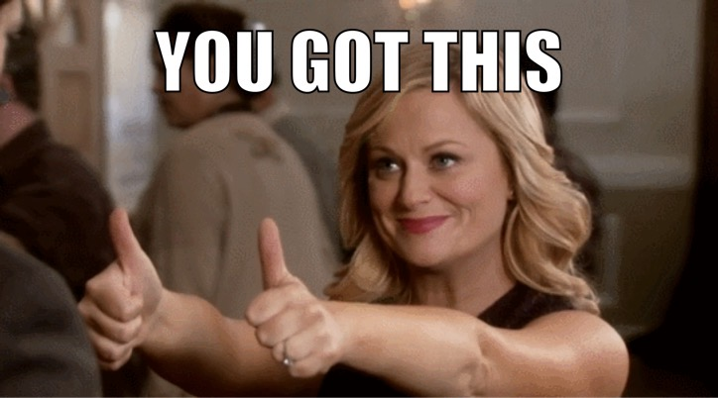
Resources
CDO Interview Prep Microsite
CDO Guide to Interview Prep
Phone + Video Conference Interview Guide
CDO Guide to Sample Networking & Interview Questions
CDO Interview History Bank
CDO Kraft Marketing Interview Guide
Lewis Lin’s books: Rise Above the Noise and The Marketing Interview
Columbia Market Sizing Overview
Mintel Database through Kresge
MMC Casing Guide
MMC MBA1 Interview Question Bank
Note: Viewing this PowerPoint in presentation mode or as a PDF will allow you to click on the embedded links above

Slide 39
Upcoming Friday Sessions
October 7th: Casing Workshop (4Ps) & store-walks
Sign up on CampusGroups!
October 14th: NONE! Study for finals!
October 21st: NONE! Enjoy fall break!
October 28th: TOESS & Market Sizing & additional research
Let’s discuss!
November 5th: Symposium introduction
November 12th: Preparing for Symposium
November 16th-18th: Marketing Symposium

Slide 40
What questions do you have?

Slide 41
Appendix

Slide 42
Popular Case Themes
New Product Launch
How should J&J market organic baby powder?
How would you market a deodorant for pets under the Old Spice brand?
Performance Analysis
You’re the brand manager of Hefty trash bags. Your sales have been flat the last three quarters, but your market share has dropped 5%. What do you do?
New Entrant
As the brand manager of Häagen-Dazs ice cream, should you be worried when P&G launches a frozen, alcoholic sorbet?
Market Sizing
How large is the US shampoo market?
Marketing Analysis
What’s your favorite brand?
What’s a great marketing campaign on TV right now?

Slide 43
Application of the frameworks can vary
New Product Launch
C’s: understand the opportunity
P’s: develop a marketing plan
Performance Analysis
Clarify the prompt
Breakdown the problem into data points
Identify root cause
P’s: develop a response
New Entrant
C’s: assess the threat
If a threat, use P’s to plan response
If not a threat, C’s to identify data to monitor
Market Sizing
Breakdown the problem into data points
Make assumptions and validate with interviewer
Round numbers and do math
Gut-check, adjust as necessary
Marketing Analysis
C’s: why brand is marketed well
P’s: demonstrate successful campaign
TOESS: evaluate ad campaign

