Slide 1
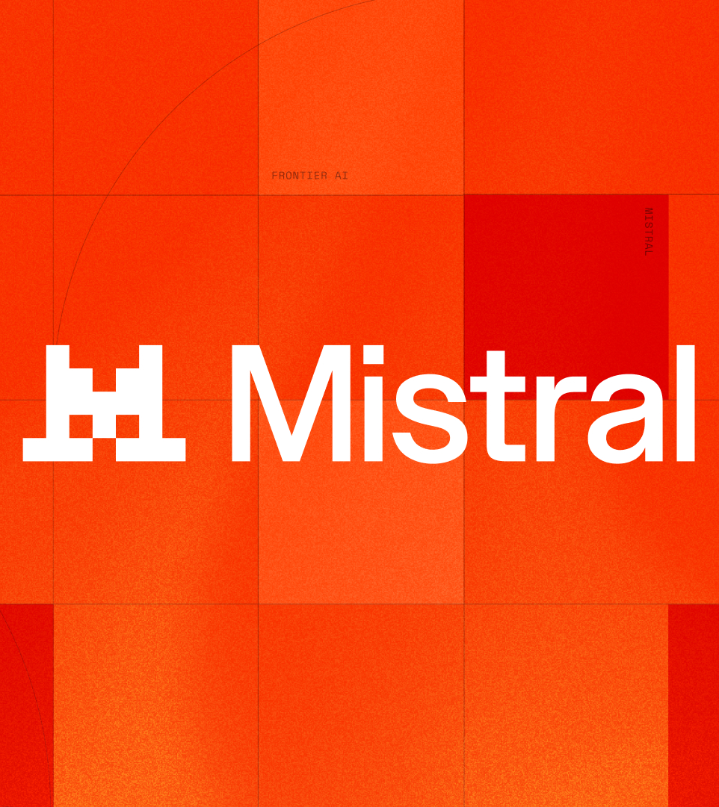
MISTRAL STUDIO
Launch &
commercialization plan
The plan to price, sell, contract, bill, deploy and support Studio at launch.
Commercial and operational scope only; market, audience, positioning, messaging and proof sit in the PMM deck.
2026-08-16
01

Slide 2

LAUNCH CHARTER • COMMERCIAL SCOPE • DECISION RIGHTS
What this launch must deliver — and what must be ready
The concise deck now keeps the original operating charter, commercial scope, scorecard and executive decision rights together.
LAUNCH CHARTER
Six decisions, one DRI each
OBJECTIVE
Make Studio buyable on every route, deployable in production within 30 days of contract, and operable at launch-day scale.
DECISION
DRI
DUE
STATUS
Budget + headcount
CFO
T−6
In review
SCOPE
Revenue + commit targets
CRO
T−5
Open
Pricing, packaging, offer architecture, routes to market, commercial motion, billing, legal, support, marketplace readiness and docs.
Launch tier + GA date
VP Product
T−8
Approved
SUCCESS CRITERIA
Pricing + packaging
CFO + CRO
T−6
In review
Trial-to-paid at plan; ten production workloads live; committed spend across Serverless, Dedicated and Self-hosted.
SLA + support model
VP Engineering
T−5
Open
COMMERCIALIZABLE CAPABILITY BASE
Contract + marketplace terms
GC
T−4
Open
DEPLOY / METER / PROVISION / GOVERN / SUPPORT
Deploy: serverless, dedicated, self-hosted • Meter: usage per model call
Provision: workspaces + API keys • Govern: RBAC, SSO, audit logs
Support: SLA tiers + escalation
Decision standard
Every launch-critical decision has an owner, due date and current status before the critical path begins.
SCORECARD
CONVERSION
REVENUE
VELOCITY
MIX
PRODUCTION
Trial-to-paid
POV-to-contract
ACV
Committed spend
Expansion
Time to contract
Time to production
Tier mix
Marketplace contribution
Production workloads
Paying teams
THE ASK Clear every decision by T−4; anything still amber escalates to the launch steering group.
Mistral Studio • Launch & commercialization plan
02

Slide 3
A. ROUTES TO MARKET • COMMERCIAL MOTION
Four routes, one commercial spine
Buying vehicle determines entry; every route advances through gated handoffs from qualification to expansion.
ENTRY ROUTES AND ROUTE OF RECORD
ROUTE
WHO ENTERS THERE
HOW IT IS RUN
ROUTE RULE
Self-serve
Developers and small teams; card or PAYG, no sales contact
Product-led; Growth owns funnel, Sales engages above threshold
Default below enterprise spend threshold
Direct enterprise
Enterprise platform teams; committed capacity, custom terms
Sales-led; AE + SE own POV to contract; Finance approves terms
Default above enterprise threshold
Cloud marketplace
Cloud-committed buyers; private offers retire cloud spend
Co-sell; Alliances own listings and private offers
Use when cloud commitment applies
Partners / SIs
Regulated and delivery-led accounts; co-sell and implementation
Co-sell; partners deliver deployment with SE support
Use when delivery capacity decides
COMMON COMMERCIAL SPINE
Qualify
Workspace active + first workflow run; use case, budget and deployment need confirmed.
Product • Growth • Sales
POV
Signed POV scope with success criteria, data access and dated exit decision.
Sales • SE • Product
Contract
POV criteria met; pricing and terms approved; security review cleared.
Sales • Finance • Legal
Deploy
Production workload live on agreed SLA and deployment path.
CS • SE • Product
Expand
Second use case and commit uplift tied to production proof.
CS • SE • Finance
QUALIFY
POV
CONTRACT
DEPLOY
EXPAND
GATE RULE No POV without a signed scope; no contract without met POV criteria; no expansion without a production workload running.
Mistral Studio • Launch & commercialization plan
03

Slide 4
B. PRICING • PACKAGING • COMMERCIAL TERMS
Three tiers, one meter, one commercial rulebook
Entry is free or metered; commitment and deployment control define the paid tiers and contract mechanics.
ENTRY + USAGE RATES
MISTRAL MEDIUM 3.5
MISTRAL SMALL 4
FREE TIER + TRIAL
$1.50 in • $7.50 out per 1M tokens
From $0.15 in • $0.60 out per 1M tokens
Workspace credits; 30-day POV credits for qualified enterprise
PACKAGING TIERS AND SKU MECHANICS
SERVERLESS
Pay as you go
Self-serve workspace and API; no commitment; card or invoice.
Serverless usage SKU
Metered tokens and pages; no minimum; monthly invoice.
Upgrade when committed spend justifies dedicated capacity.
DEDICATED
Committed capacity
Reserved throughput; in-region inference; annual commitment with drawdown.
Dedicated capacity SKU
Reserved throughput units; 12–36 month committed spend; overage at list.
Discounts tiered by commitment and term; beyond band needs Finance + CRO.
SELF-HOSTED
Enterprise Suite
Customer VPC or on-prem; licensed per environment; private offer via marketplaces.
Self-hosted suite SKU
Per-environment license plus support subscription.
Private offers retire AWS, Azure or GCP cloud commitment.
ADD-ONS AND COMMERCIAL APPROVAL POINTS
ADD-ON SKUS
CONTROL PRINCIPLE
ASSURANCE
Premium support • Document AI volume • extended retention
Tiers change deployment location and commitment, not core features.
Identity, residency and audit evidence must be ready for security review.
COMMERCIAL RULEBOOK One usage meter across all tiers and routes; launch pricing, free-tier limits, discount bands and marketplace dates require final approval.
Mistral Studio • Launch & commercialization plan
04

Slide 5
C. LAUNCH READINESS • CRITICAL PATH • GATES
One operational timeline, one gate checklist
The concise deck now carries both the original readiness timeline and the full launch gate standard.
INTEGRATED READINESS TIMELINE
T−8 → T−5
Build + prove
Feature freeze and GA criteria set; scale and SLA testing; metering and billing build; legal terms drafted.
Product • Engineering • Finance • Legal
T−4 → T−1
Operate + approve
Provisioning and invoicing tested end to end; security review closed; marketplace listings submitted; docs staged.
Billing Ops • Security • Alliances • Docs
Launch week
Go live
GA build shipped; pricing live; marketplace offers published; support rota and escalation paths active.
Product • Support • Alliances
T+1 → T+8
Scale + prove
POVs converted to contracts; first workloads into production; billing accuracy and support load monitored.
Sales • CS • Finance • Engineering
LAUNCH GATE CHECKLIST
PRODUCT
COMMERCIAL
BILLING
LEGAL
GA criteria met and signed off
Pricing and packaging approved
Metering, provisioning and invoicing live
Terms, DPA and security approved
MARKETPLACE
SUPPORT
DOCS
SALES + CS
Offers live and transactable
Response targets, escalation and rota staffed
Quickstart, API reference and deployment guides published
Quoting, approval paths and onboarding runbooks live
CRITICAL PATH
BILLING + PROVISIONING
LEGAL + SECURITY
GATE RULE
Marketplace offers cannot list without metering; contracts cannot sign without provisioning and invoicing tested end to end.
Terms, DPA and security review must be approved before contracts or private offers go live.
Every gate has a named owner and green / amber / red status; any red at T−1 moves the date.
OPERATING RULE Launch only after billing, provisioning, legal terms, marketplace readiness, support rota, sales/CS runbooks and docs are all green.
Mistral Studio • Launch & commercialization plan
05

