Slide 1
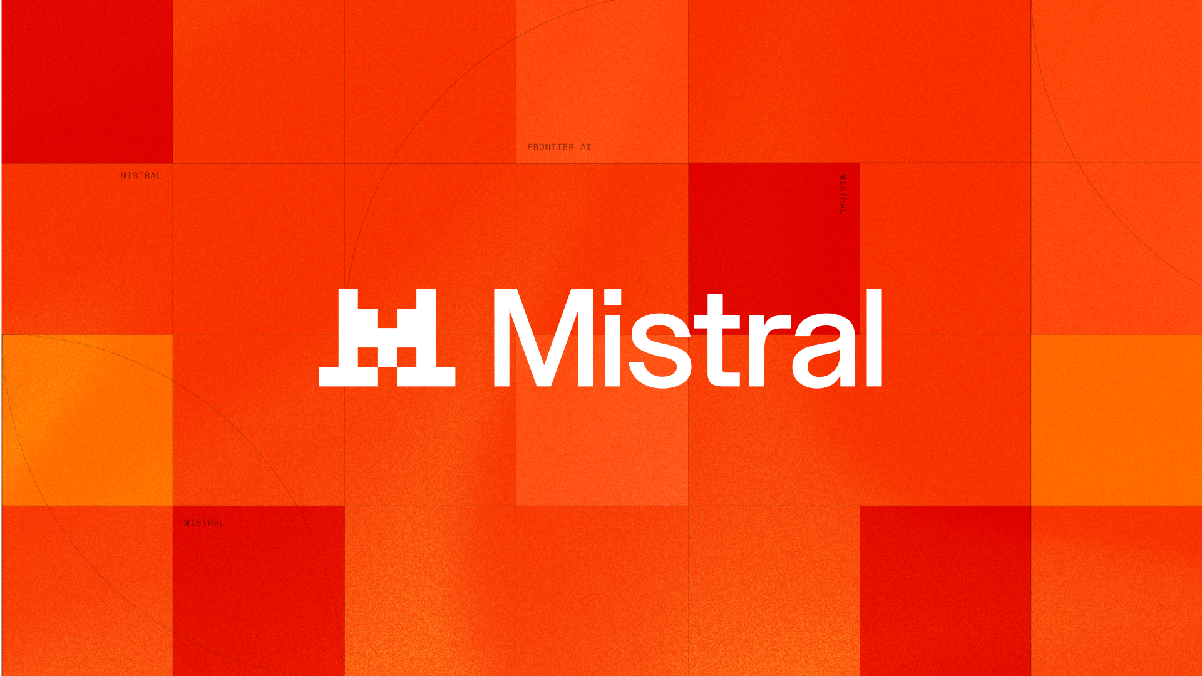
COMPETITIVE LANDSCAPE & DIFFERENTIATION
The buyer is choosing an operating model—not a model
Model quality is table stakes. Buyers are deciding who controls deployment, data, and production.
04 Competitive Landscape & Differentiation Framework
01
Notes:
[Sources] - https://mistral.ai/products/studio/ - https://mistral.ai/news/ai-studio/ - https://docs.mistral.ai/studio-api/overview - https://mistral.ai/customers/ - https://openai.com/index/new-tools-for-building-agents/ - https://docs.mistral.ai/studio-api/workflows/getting-started/overview - https://docs.mistral.ai/studio-api/workflows/building-workflows/connectors - https://mistral.ai/customers/cisco/

Slide 2
16 CRITERIA · 7 STUDIO WEDGES · DIRECTIONAL SCORES 1–5
Scores converge; operating control breaks the tie
PURCHASE CRITERIA
DIRECTIONAL AVERAGE
Technical / platform
Commercial / enterprise
Control breaks the capability tie
Frontier model access
Open / portable model posture ▲
Durable agent runtime ▲
Workflow orchestration ▲
Evals / judges ▲
Tracing / observability ▲
Registry / versioning ▲
Enterprise connectors / identity
Guardrails / moderation
Hybrid / self-host / on-prem ▲
Data residency / control
Developer UX / docs
Governance gates
Cloud / ecosystem breadth
Commercial maturity
Sovereignty positioning
Qualify three issues: deployment control, production governance, and architectural portability.
04 Competitive Landscape & Differentiation Framework
02
Notes:
[Sources] - https://mistral.ai/products/studio/ - https://openai.com/index/new-tools-for-building-agents/ - https://docs.anthropic.com/en/docs/agents-and-tools/tool-use/tool-runner-sdk - https://docs.cloud.google.com/vertex-ai/generative-ai/docs/agent-engine/evaluate - https://azure.microsoft.com/en-us/products/ai-foundry - https://aws.amazon.com/about-aws/whats-new/2026/05/bedrock-agentcore-launch-aws-govcloud-us/ - https://www.langchain.com/langsmith-platform - https://docs.llamaindex.ai/en/v0.10.33/understanding/loading/llamahub/ - https://langchain-ai.github.io/langgraph/concepts/persistence/ - https://mistral.ai/news/ai-studio/

Slide 3
10 ALTERNATIVES · RANKED BY AVERAGE SCORE · N/R = NOT SCORED
Shortlists converge; production trade-offs decide the winner
BROAD PLATFORMS
SCORE
BUILDER / SPECIALIST ROUTES
SCORE
1 · Microsoft Azure AI Foundry / Copilot Studio
4.4
3 · LangSmith / LangGraph
4.3
Acknowledge M365 fit; test model choice, exit cost, and sovereign deployment.
Acknowledge flexibility; test who owns production operations.
2 · Amazon Bedrock AgentCore
4.4
6 · Internal enterprise AI platform
3.4
Acknowledge AWS-native runtime; test workflow depth and hybrid deployment.
Acknowledge internal control; test build-versus-buy economics for the production layer.
4 · Google Vertex AI / Gemini Enterprise
4.1
7 · LlamaIndex / LlamaCloud
3.4
Acknowledge Workspace reach; test data residency and deployment beyond Google Cloud.
Acknowledge RAG depth; test guardrails and governance.
5 · OpenAI Responses + Agents SDK
3.5
— · DIY open-source stack
n/r
Acknowledge model quality; test portability, self-hosting, and switching cost.
Acknowledge maximum control; test the cost of building registry, guardrails, and governance.
— · Anthropic Claude Platform
n/r
— · Point observability / eval tools
n/r
Acknowledge MCP depth; test registry, versioning, and regulated deployment.
Acknowledge specialist depth; test the cost of stitching the lifecycle together.
Win by exposing the production trade-off: ownership, governance, and portability.
04 Competitive Landscape & Differentiation Framework
Leaders 4.1+
Mid 3.4–4.0
Not scored
03
Notes:
[Sources] - https://openai.com/index/new-tools-for-building-agents/ - https://docs.anthropic.com/en/docs/agents-and-tools/tool-use/tool-runner-sdk - https://docs.cloud.google.com/vertex-ai/generative-ai/docs/agent-engine/evaluate - https://azure.microsoft.com/en-us/products/ai-foundry - https://aws.amazon.com/about-aws/whats-new/2026/05/bedrock-agentcore-launch-aws-govcloud-us/

Slide 4
TURN THE POSITIONING INTO FOUR FIELD MOVES
Win by turning requirements into architecture proof
1
BUYER PRIORITY
2
PRODUCTION RISK
3
STUDIO PROOF
FOUR FIELD MOVES
Scale pilots
Pilots stall without runtime, evals, and governance
One governed lifecycle from build to production
1
Lead with operating requirements.
Recover failures
Multi-step agents need state, retry, and resume
Durable workflows with observability
2
Acknowledge the best-fit alternative; expose its production gap.
Secure enterprise data
Identity and data access block production
Connectors, workspaces, and deployment controls
3
Prove one flagship workflow in an architecture session.
Behavior varies by prompt and model
Continuous evals, judges, and feedback loops
4
Prove quality
Validate pricing and maturity before external use.
Retain architecture control
Regulated buyers need deployment and data choice
Hybrid deployment and data ownership
10
16
7
alternatives
criteria
wedges
04 Competitive Landscape & Differentiation Framework
04
Notes:
[Sources] - https://mistral.ai/products/studio/ - https://docs.mistral.ai/studio-api/workflows/building-workflows/workflows - https://docs.mistral.ai/studio-api/workflows/getting-started/overview - https://mistral.ai/news/ai-studio/ - https://docs.mistral.ai/studio-api/workflows/building-workflows/durable_agents - https://docs.mistral.ai/studio-api/workflows/building-workflows/connectors - https://docs.mistral.ai/studio-api/agents/agents-api - https://docs.mistral.ai/studio-api/overview - https://docs.mistral.ai/studio-api/workflows/observability - https://docs.mistral.ai/studio-api/safety-moderation

