Slide 1


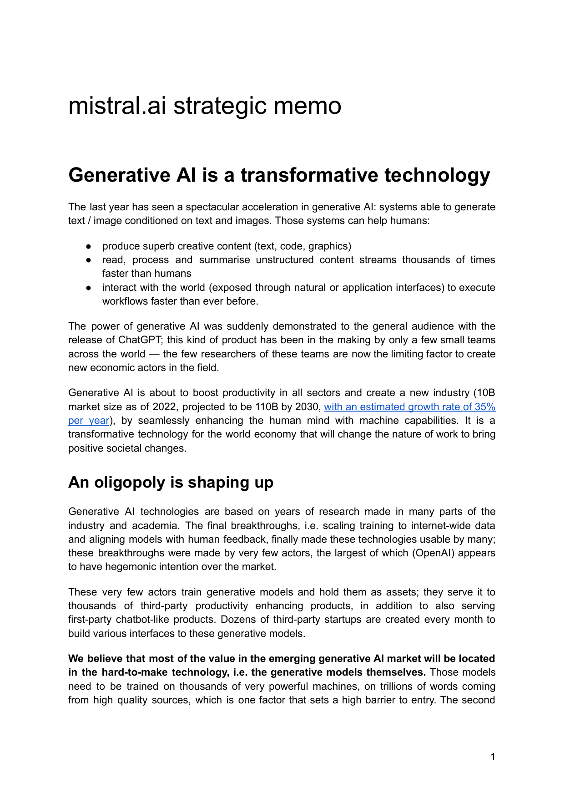


01
REFACTORED NARRATIVE
Mistral AI:
From model wedge to European AI stack
Company thesis meets policy architecture.
A concise synthesis of the 2023 strategic memo and European AI playbook.
Memo: win the model layer
Playbook: make it durable
Mistral AI narrative synthesis
1/7
Notes:
[Sources] - mistral-230622095835-813027ae.pdf p.1: 2023 strategic memo frames generative AI as transformative and a new productivity industry. - whitepaper.pdf p.1-p.3: European AI playbook frames Europe as having the assets to become a self-reliant AI powerhouse. - Visuals use crops from the uploaded Mistral memo and European AI playbook PDFs.

Slide 2
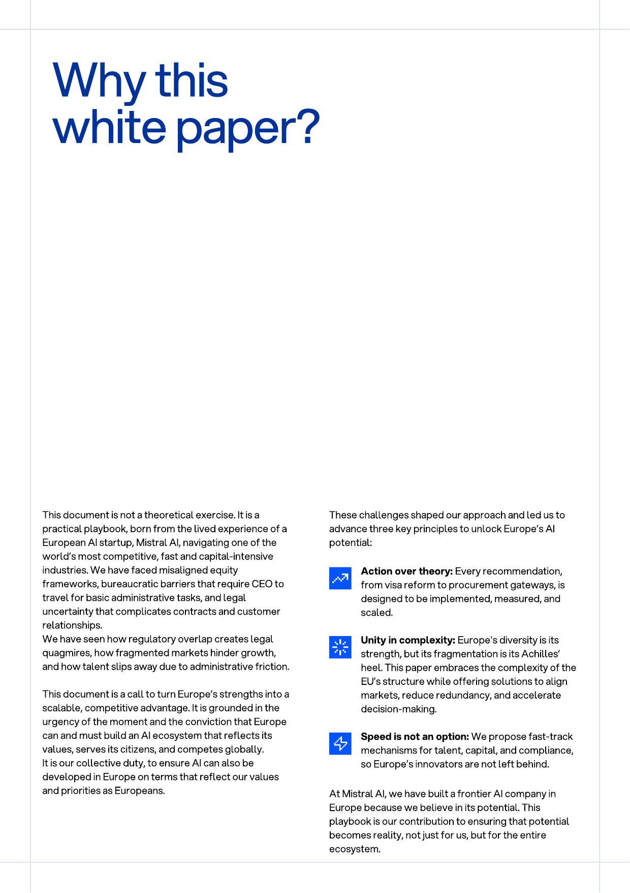
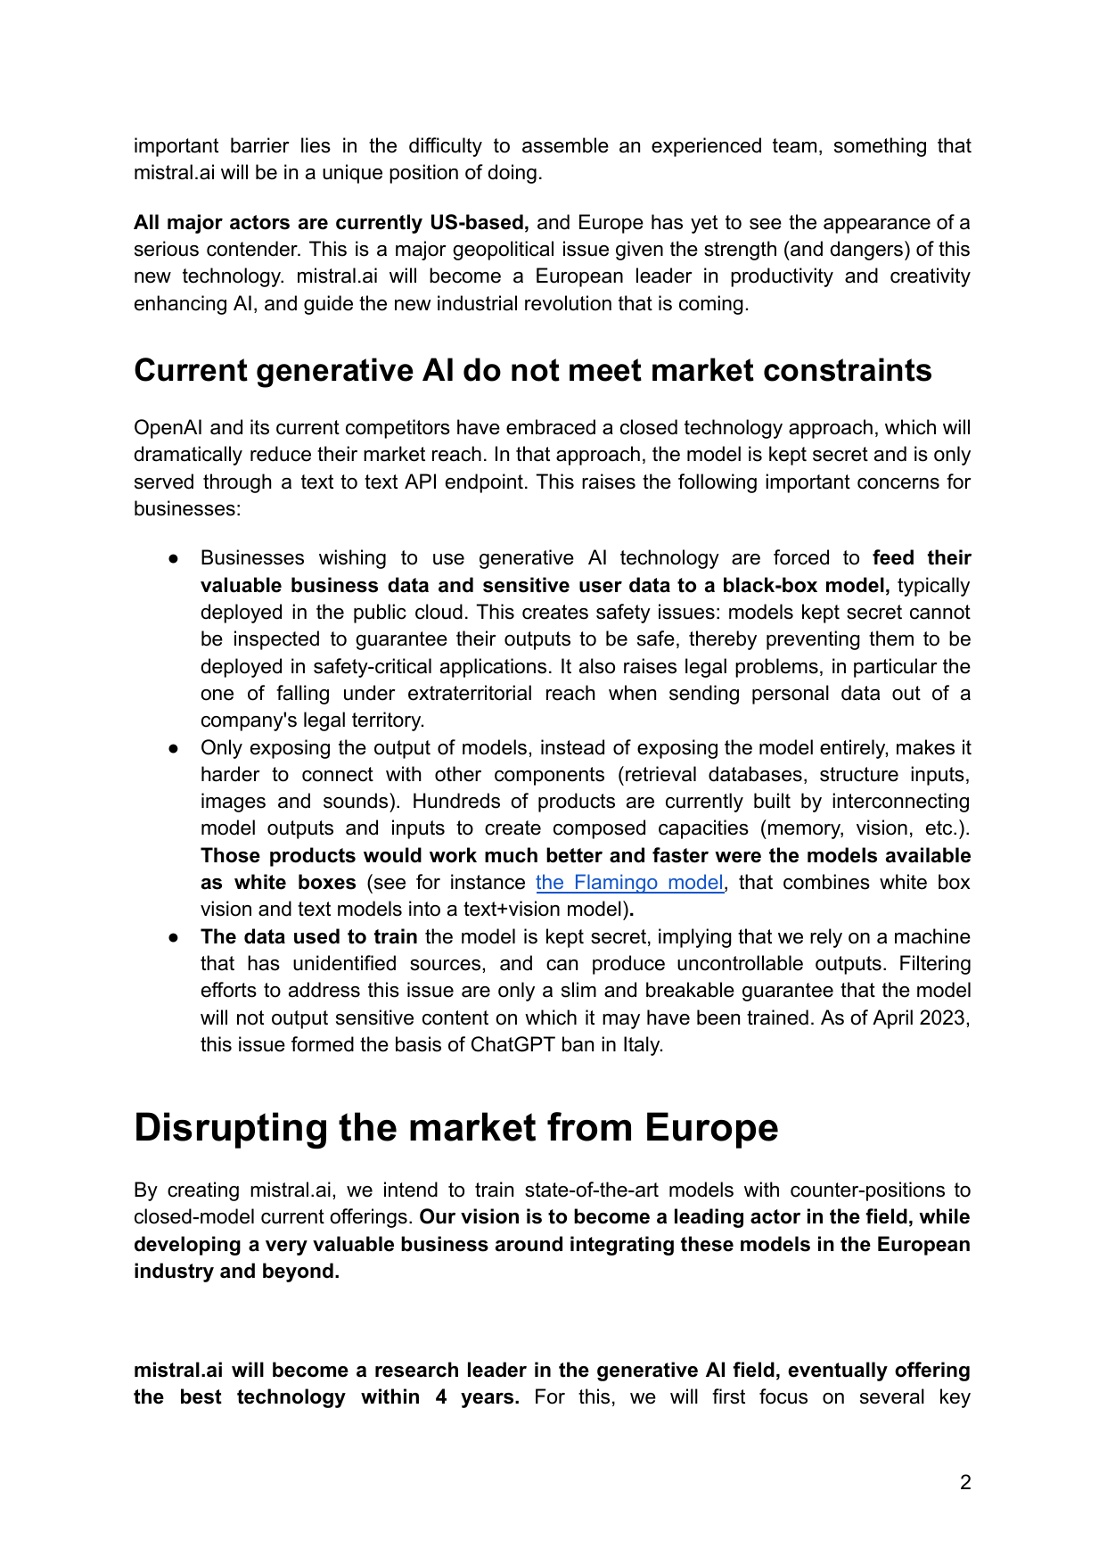
02
NARRATIVE SPINE
THE SINGLE STORY
One thesis, two layers
The memo explains why Mistral can win. The playbook explains how Europe makes that win compounding.
1
Company wedge
2
Industrial loop
3
European stack
open, inspectable, deployable models
adoption creates data and usage feedback
talent, compute, demand, capital
Refactor: collapse the deck around one arc - model control becomes market architecture.
Mistral AI narrative synthesis
2/7
Notes:
[Sources] - mistral-230622095835-813027ae.pdf p.2-p.3: Mistral counter-positions against closed models with open models, accessible internals, and private deployment. - whitepaper.pdf p.3-p.4: Playbook presents an actionable framework to make Europe a cohesive, self-reliant AI powerhouse.

Slide 3
03
STRATEGIC PROBLEM
WHY THE WEDGE MATTERS
The model layer is the choke point
$110B
Value, trust, and autonomy shift to the layer that is hardest to replicate: models trained with scarce compute, data, and talent.
projected 2030 GenAI market
35%
Closed APIs limit inspection and enterprise data control.
estimated annual growth
Integration is constrained when only text outputs are exposed.
450M+
Foreign AI stacks create strategic and legal dependency.
EU single-market population
memo p.1 / playbook p.3
Mistral AI narrative synthesis
3/7
Notes:
[Sources] - mistral-230622095835-813027ae.pdf p.1: Generative AI market projected at $110B by 2030 with estimated 35% annual growth. - mistral-230622095835-813027ae.pdf p.2: Closed API models raise safety, legal, and integration concerns for businesses. - whitepaper.pdf p.3: Europe has a single market of +450 million people.

Slide 4
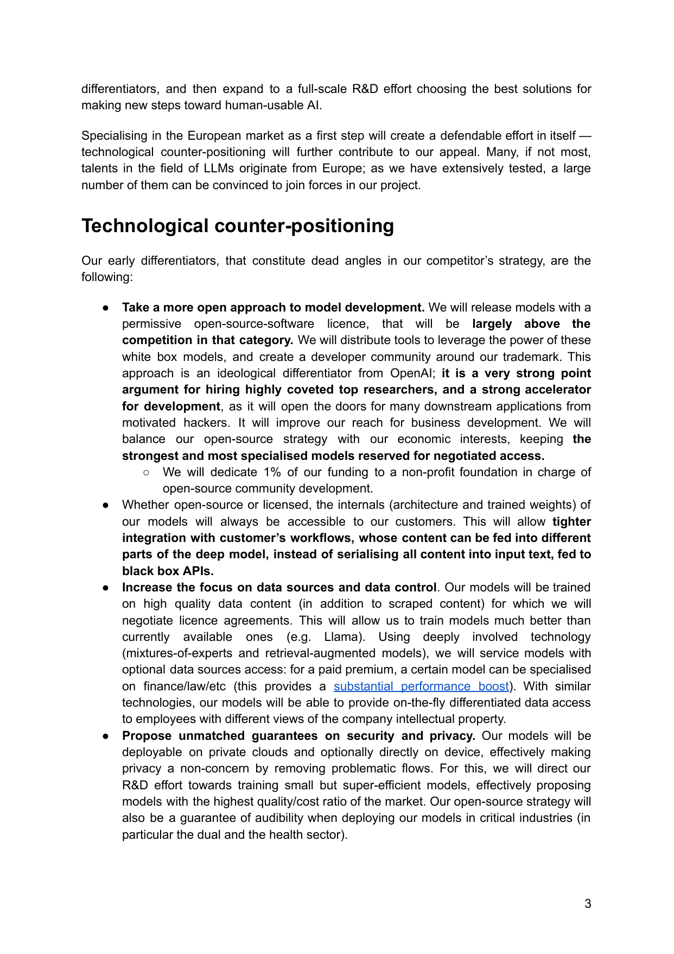
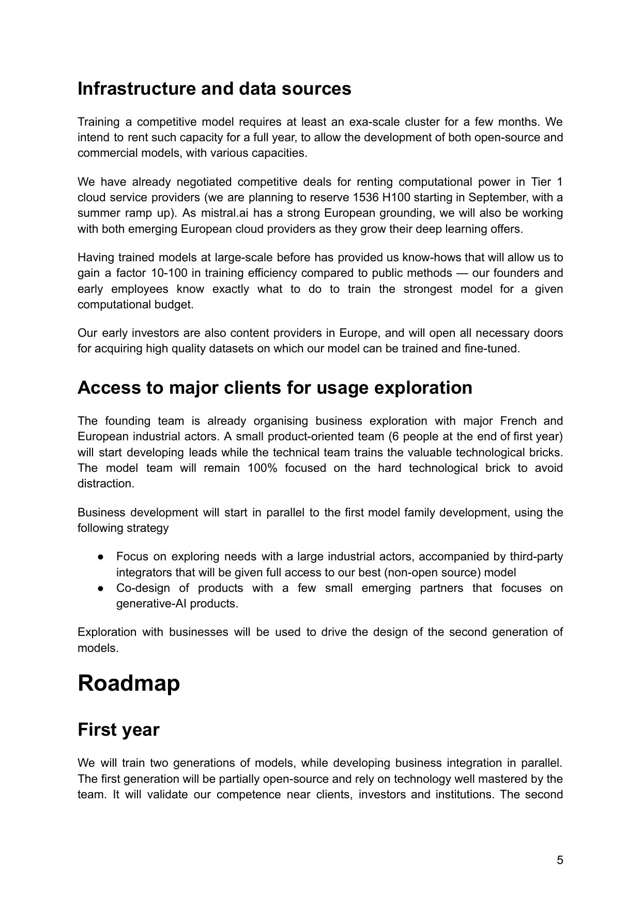
04
MISTRAL WEDGE
THE MOVE
Open for trust.
Controlled for value.
Mistral turns openness into an enterprise wedge: inspectable, composable, privately deployable models.
Open models
developer reach + hiring edge
White-box access
inspectable internals
Private deployment
customer data control
The wedge is not open vs. closed. It is open where trust compounds and controlled where customers need value capture.
Mistral AI narrative synthesis
4/7
Notes:
[Sources] - mistral-230622095835-813027ae.pdf p.3: Mistral proposed permissive open models, accessible model internals, high-quality data, and private/on-device deployment. - mistral-230622095835-813027ae.pdf p.5-p.6: Memo describes infrastructure, model training, business exploration, and model roadmap.

Slide 5
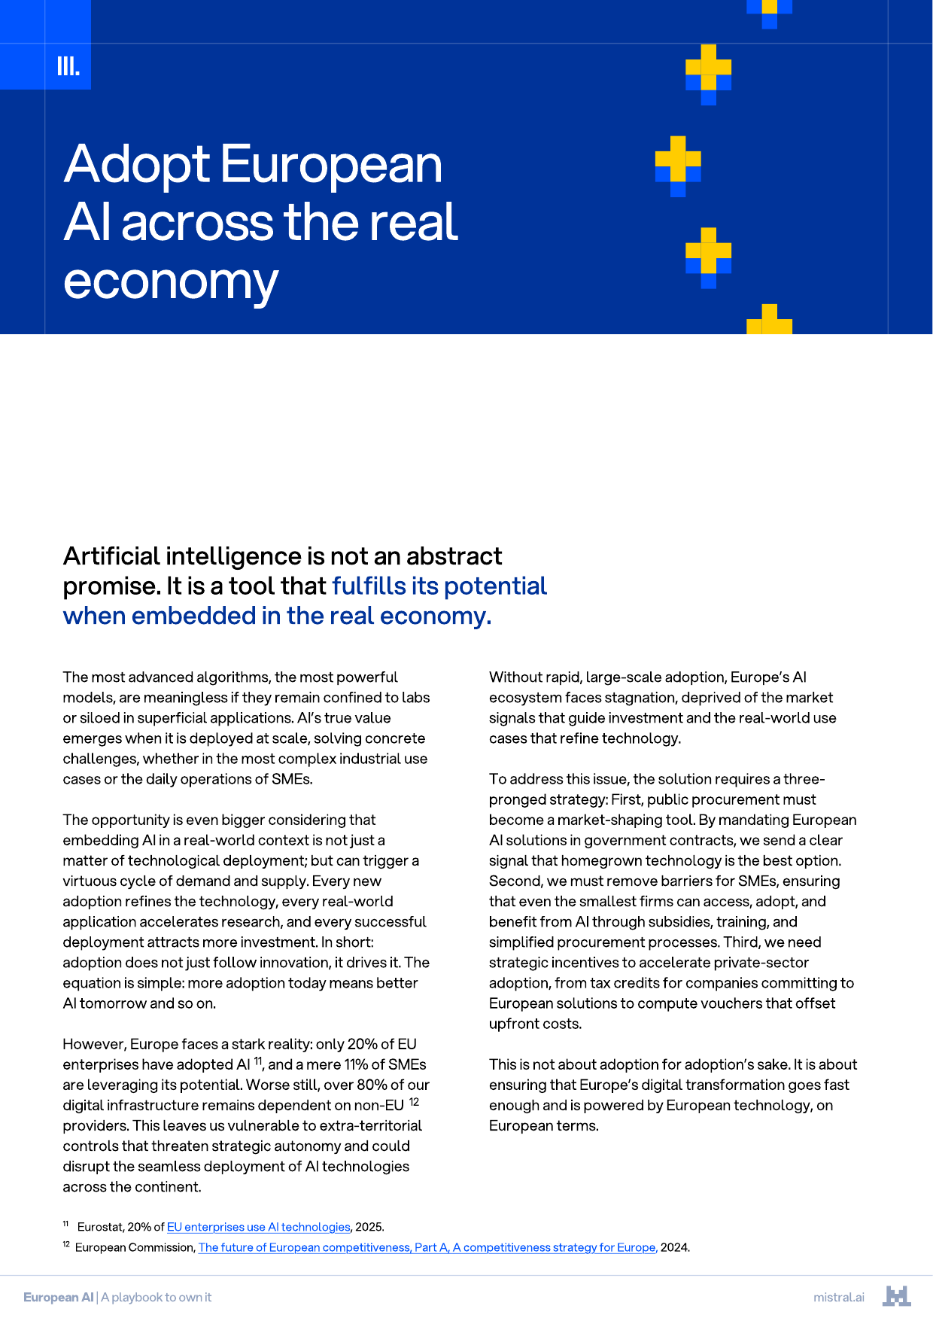
05
OPERATING MODEL
COMPOUNDING LOOP
The sharper story is a flywheel
Company execution proves the wedge; policy compresses cycle time around it.
Talent
Compute
Models
Adoption
Feedback
rare AI team
capacity + efficiency
open + controlled
public + enterprise
data + usage
The policy job: remove friction at every turn of the loop.
Mistral AI narrative synthesis
5/7
Notes:
[Sources] - mistral-230622095835-813027ae.pdf p.4-p.6: Memo connects rare team, infrastructure, business development, model training, and roadmap. - whitepaper.pdf p.5-p.8: talent policies; p.14-p.17: adoption policies; p.18-p.22: compute, infrastructure, and data policies.

Slide 6
06
POLICY ARCHITECTURE
MAKE IT DURABLE
Four levers turn the wedge into a stack
The playbook is not a policy appendix. It is go-to-market infrastructure for European AI.
Talent
Market
Demand
Stack
AI visa
PhD fund
mobility
single market
capital access
ESOP alignment
procurement
SME adoption
public sector lead
compute
data commons
AI infrastructure
DURABLE EUROPEAN AI STACK
playbook levers: talent, scale, adoption, infrastructure
Mistral AI narrative synthesis
6/7
Notes:
[Sources] - whitepaper.pdf p.5-p.8: attract and retain talent measures including EU AI talent visa, PhD fund, mobility, and student compute. - whitepaper.pdf p.9-p.13: scale measures covering regulatory simplification, single market operations, corporate banking, ESOP, capital, and prudential frameworks. - whitepaper.pdf p.14-p.17: real-economy adoption measures including EU institutions, procurement gateway, European preference, and sustainability criteria. - whitepaper.pdf p.18-p.22: infrastructure, compute, legal certainty for training, data commons, and AI-ready archive.

Slide 7
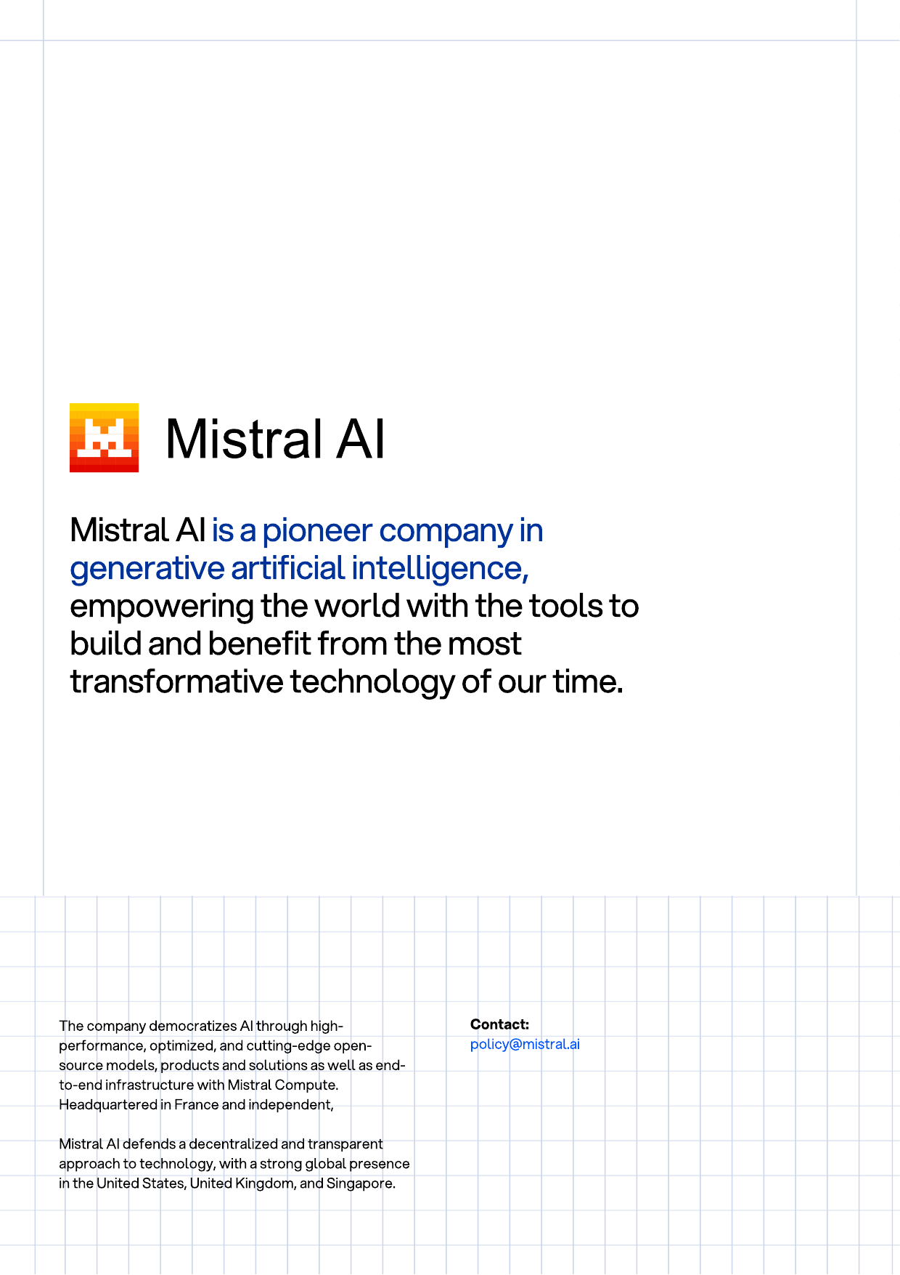
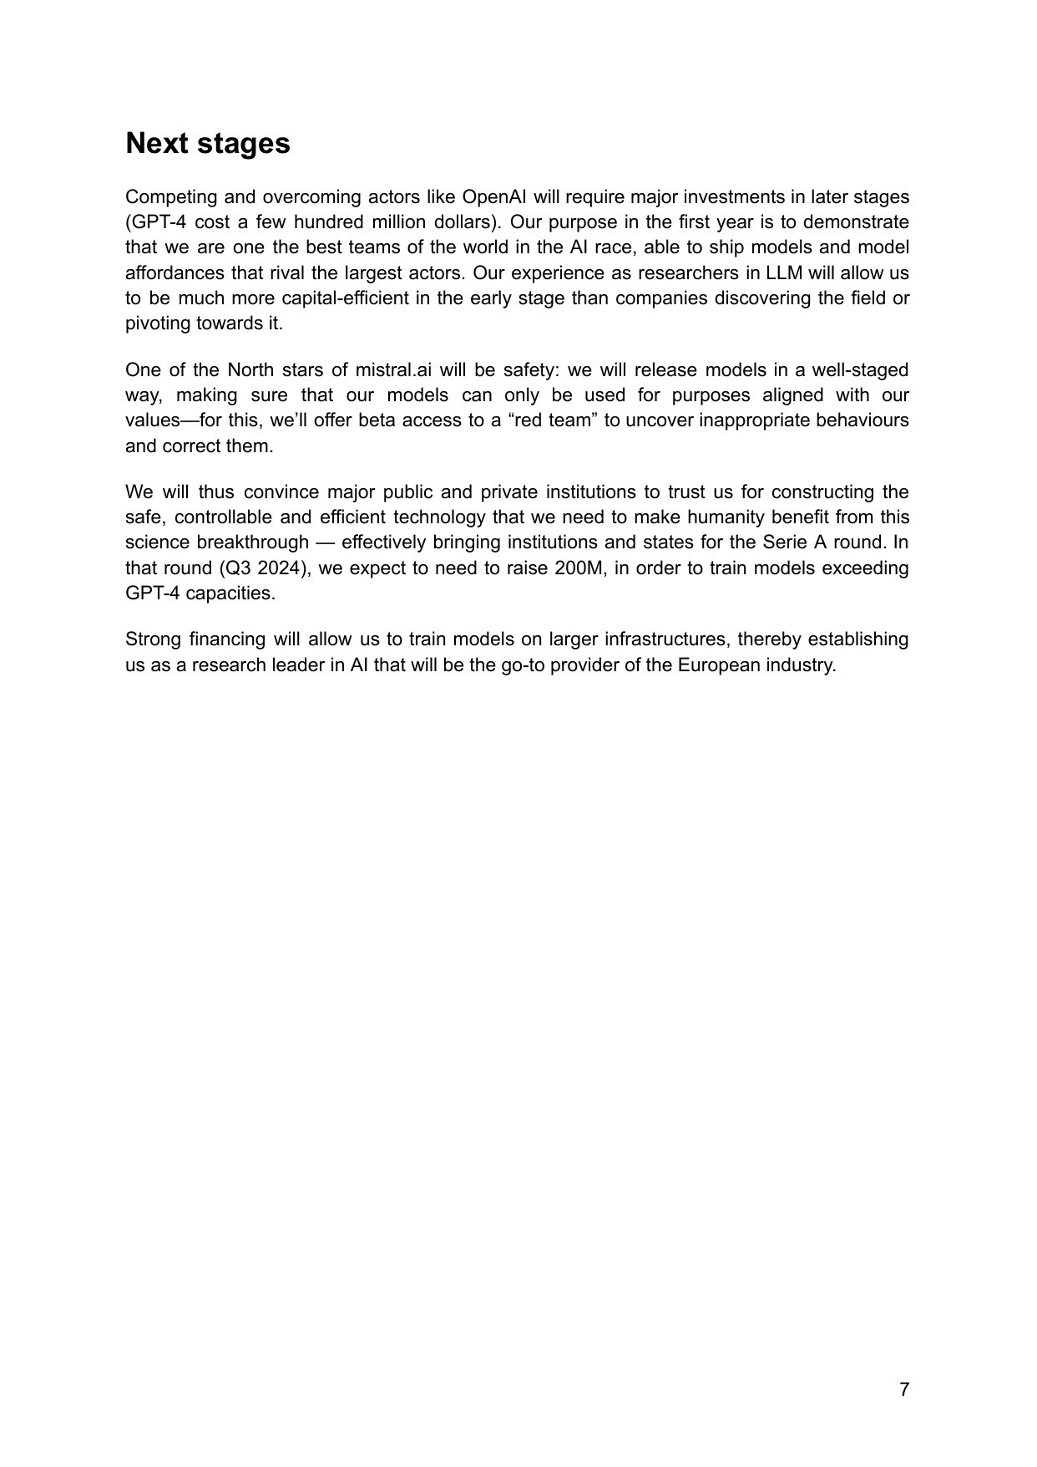
07
CARRY-FORWARD MESSAGE
FINAL LINE
Mistral is the product proof
for a European AI stack.
Company thesis
open, controllable frontier models
Policy thesis
talent, demand, compute, data, and capital under European control
One sentence to carry forward:
The memo says why Mistral can win. The playbook says how Europe turns that win into an enduring category advantage.
memo close / playbook close
Mistral AI narrative synthesis
7/7
Notes:
[Sources] - mistral-230622095835-813027ae.pdf p.7: Memo frames safety, institutional trust, and later financing as steps toward European AI leadership. - whitepaper.pdf p.23: Mistral describes itself as a generative AI pioneer democratizing AI through open-source models, products, solutions, and end-to-end infrastructure.

