Slide 1

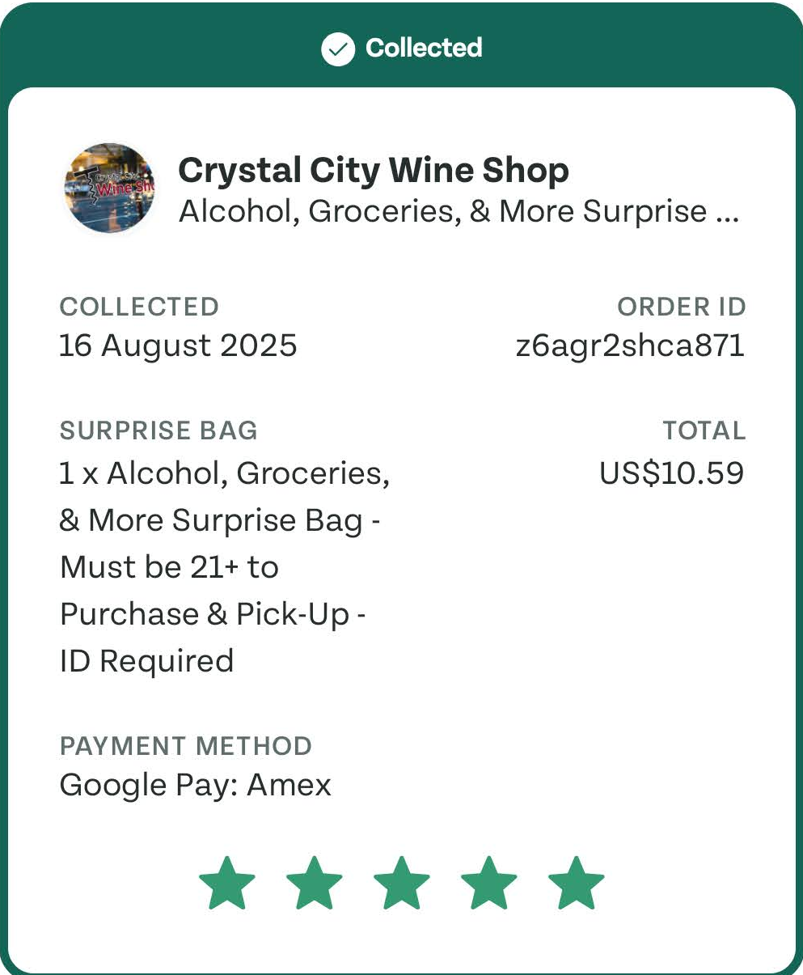
PAID DEMAND STRATEGY
01
AUTHOR: SHIVAM SINGH | AUG 2026
Allocate paid demand
where it rescues
more food.
01
MORE FOOD COLLECTED
More incremental collected bags.
THESIS: PAID SOCIAL AS A DEMAND-BALANCING TOOL
02
HEALTHIER MARKETS
Demand follows at-risk supply.
03
MORE EFFICIENT SPEND
Every euro earns its next euro.

Slide 2
THE CASE FOR CHANGE
02
One in five installs ends in a collected bag
Install cost hides the only outcome that matters.
WHERE VOLUME IS LOST, INSTALL TO COLLECTION
19%
MOBILE-FIRST, FULL-FUNNEL
Awareness — 100 installs (baseline)
Reach and mission storytelling
INSTALL-TO-COLLECTION RATE
Consideration — 38% drop-off
Local supply discovery and social proof
Conversion — 61% drop-off
PRIMARY OUTCOME
Install and first reservation
Incremental 90-day collected bags per euro
Quality — 21% drop-off
First bag collected and repeat rate
Only 19 of every 100 installs become a collected bag within 90 days.
A low CPI with weak retention isn’t growth — it’s cheap traffic.
Judge spend on collected bags, not installs.
Note: The 90-day window begins at install.

Slide 3
MARKET PRIORITISATION
03
Berlin earns more budget than Munich
Equal install cost hides a 12× supply gap; one city score sets the state.
MARKET RESCUE
OPPORTUNITY SCORE
AT-RISK SUPPLY
Enough nearby supply
×
PAID RESPONSE
Causal lift, not correlation
×
USER QUALITY
90-day collections
=
Incremental
bags per €
<50
50–79
80+
REDUCE
MAINTAIN
INCREASE
Supply is weak or causal lift is low
Signals are positive; monitor saturation
Increase 15–25% while marginal cost remains below the limit
MUNICH · REDUCE
PARIS · MAINTAIN
BERLIN · INCREASE
Note: The score combines supply gap, 90-day repeat value and causal lift.

Slide 4
BUDGET ALLOCATION
04
Scaling stops when marginal cost hits the cap
Every additional euro goes to the strongest marginal return.
MARKET
AT-RISK SUPPLY (BAGS/WEEK)
iCPB (€ PER BAG)
ACTION
Berlin A
2,400
€7
Increase 20%
Munich B
200
€21
Reduce
Paris C
1,100
€9
Maintain
Copenhagen D
750
Event constraint
Pause
MARGINAL COST PER COLLECTED BAG, BY WEEKLY SPEND
€12
SCALING CAP PER COLLECTED BAG
Fund the first three €5k increments; send the next euro to a stronger market.
Note: iCPB is incremental cost per collected bag; €12 is the scaling cap.

Slide 5
CHANNEL MIX
05
Meta scales, TikTok creates, Pinterest tests
Concentrate spend to learn; each platform's role shifts with market conditions.
PLANNED FIRST-YEAR BUDGET SHARE
60%
30%
10%
Meta
TikTok
Pinterest
SCALE ACQUISITION
CREATE DEMAND
TEST INTENT DISCOVERY
Broad acquisition optimised to the collection event.
Creator-led reveals; scale only themes that add quality users.
A contained test on high-intent discovery moments.
Earns more budget while marginal cost stays under the cap.
Grows where creative lifts reservations, not just views.
Keeps its budget only if it adds quality collectors.
The mix is a starting point: rebalanced quarterly on lift-adjusted cost per collected bag.
Source: Planned first-year mix. Note: Reviewed quarterly on lift-adjusted iCPB.

Slide 6
CREATIVE & OPERATING MODEL
06
Four creative themes, one weekly operating rhythm
What we test in market, and how budget moves to the cells that collect more bags.
WHAT WE TEST · FOUR CREATIVE THEMES
HOW WE RUN IT · WEEKLY OPERATING MODEL
VALUE
SURPRISE
01
STRUCTURE THE CELLS
“I paid €4.99 for this.”
“I had no idea what would be inside.”
City cluster × supply state × funnel stage; supply-rich and supply-constrained markets stay separate.
Cost per first collection
Attention to reservation
02
OPTIMISE TO QUALITY
Bid to the collection event; increase, maintain or reduce by lift-adjusted iCPB against the cap.
DISCOVERY
MISSION
“Three places near you tonight.”
“This bakery had food left at closing.”
03
LEARN, THEN REALLOCATE
Activation in supply-rich cities
90-day repeat collections
Weekly creative tests and daily pacing checks; monthly review of incrementality and saturation.
WEEKLY DECISION RULE
The next euro goes to the city × channel × creative cell with the strongest incremental collected bags per euro.
Stop or reduce when supply is constrained, lift is weak, or marginal iCPB crosses the cap.
Note: Themes are hypotheses, not results; thresholds should be calibrated with internal channel, supply and product data.

Slide 7
MEASUREMENT
07
Incrementality, not attribution, guides the budget
Only holdouts show what paid media caused; attribution can overstate it by 2.5×.
LIFT FACTOR
Incremental ÷ attributed bags
Meta
60%
TikTok
85%
Pinterest
40%
Allocate on lift-adjusted iCPB, not platform-reported cost per bag.
Note: Lift = incremental ÷ attributed bags; €6 iCPB needs 50% lift and €8 needs 67% at the €12 cap.

Slide 8
TEAM & OPERATING MODEL
08
Four charters, one weekly decision
Each owner holds a channel or capability; the reallocation decision stays in one room, once a week.
01
02
03
04
META OWNER
TIKTOK & CREATIVE
MEASUREMENT & OPS
MARKET PARTNER
Scale acquisition
Create demand
Prove and industrialise
Match demand to supply
Campaign structure and bidding
Audience and exclusion logic
Holdout design with Data
Creator and UGC pipeline
Theme testing across four jobs
Localised variants per market
Geo-Lift and split-test setup
Meta/TikTok API reporting
Anomaly alerts and QA
City opportunity scoring
Local supply and event signals
Global standards vs local calls
Lift-adjusted iCPB
Attention to reservation
Measured lift
Bags rescued per city
OPERATING RHYTHM
WEEKLY
BI-WEEKLY
MONTHLY
QUARTERLY
Marginal iCPB by city — reallocate the next €5k
Experiment readout — scale, iterate or stop
Channel mix, creative saturation, capability gaps
Rebalance the 60/30/10 on measured lift
WHAT I OWN
Strategy and budget envelope · talent development and hiring · the cost cap per collected bag · cross-functional alignment with Data, Brand and local markets. Charters make the calls inside their remit; I own the trade-offs between them.
Note: Charter split assumes a four-person team; two-person start merges 03 into 01.

Slide 9
90-DAY ROADMAP
09
In 90 days, budget follows rescue economics
Align measurement, prove two levers, then standardise spend.
01
02
03
0–30 DAYS
31–60 DAYS
61–90 DAYS
ALIGN MEASUREMENT
VALIDATE TWO LEVERS
STANDARDISE SPEND
Use one baseline for collected bags
Link spend to collections, not installs
Use measured lift in reporting
Assign one primary metric and owner
Move budget toward the largest supply gaps
Give every city an opportunity score
Rank every city by rescue opportunity
Set a cost limit per collected bag and market
Make weekly reallocation routine
12-MONTH
OPERATING MODEL
01
02
03
04
Marginal economics guides spend
Measured lift calibrates reporting
Creative learning adapts by market
Human review governs automation
Note: Timings assume measurement baseline agreed in month one.

Slide 10


ABOUT THE AUTHOR/CANDIDATE
SHIVAM SINGH | AUG 2026
10
Connecting channel spend to incrementality, retention and unit economics
Analytical growth leader who scales that through strong teams, experimentation and automation.
01
02
03
WHY TOO GOOD TO GO
PAID SOCIAL EXPERIENCE
INCREMENTALITY EXPERIENCE
Tangible mission: better acquisition means more food saved and less waste
Demand must follow uneven local supply, not cheap installs
Scope I want: channel ownership, experimentation, people leadership
Active user for a year; EU work rights, no sponsorship delay
Meta, Instagram, TikTok, YouTube, Google and LinkedIn across social, search and app
Hands-on targeting, campaign structure, testing and analysis
Full cycle: objective, measurement, launch, budget reallocation
Pinterest is the one platform I have not run directly
Attribution assigns credit; incrementality proves causation
User-level holdouts when randomisation is possible, Geo-Lift when it is not
MMM for longer-horizon cross-channel allocation
Example: Geo-Lift plus cohort economics to find real incremental growth
04
05
LEADERSHIP EXPERIENCE
DATA AND TOOLS
Led cross-functional teams and programs throughout my career
Clear outcomes and decision rights first, then flex how hands-on I am
Example: 15-plus-person global team, hiring and promotion calibration
Player-coach: clear standards, frequent feedback, real ownership
SQL and BigQuery daily for cohort and lift analysis
Looker, Tableau, Power BI and QlikSense across BI environments
First-party customer data alongside advertising-platform data
Engineering background: build the pipeline when none exists

